Slide 1
Muthuraj M
Final Project
3/21/2024 Annual Review

Slide 2
SMS SPAM COLLECTION
3/21/2024 Annual Review

Slide 3


AGENDA
PROBLEM STATEMENT
PROJECT OVERVIEW
WHO ARE THE END USERS?
YOUR SOLUTION AND ITS VALUE PROPOSITION
THE WOW IN YOUR SOLUTION
MODELLING
RESULTS
3/21/2024 Annual Review

Slide 4

PROBLEM STATEMENT
You are working on a text classification task using the SMS Spam Collection Dataset. The problem involves classifying text messages as either spam or not spam.
3/21/2024 Annual Review

Slide 5

PROJECT OVERVIEW
The project involves building a machine learning model to automatically classify SMS messages as spam or not spam. This model will be trained on a dataset containing labeled examples of SMS messages.
3/21/2024 Annual Review

Slide 6

WHO ARE THE END USERS?
The end users of this project could be anyone who wants to filter out spam messages from their SMS inbox, such as smartphone users, businesses, or service providers.
3/21/2024 Annual Review

Slide 7

YOUR SOLUTION AND ITS VALUE PROPOSITION
Your solution involves developing a machine learning model that can accurately and efficiently classify SMS messages as spam or not spam. The value proposition lies in providing users with a tool that helps them manage their SMS inbox more effectively by automatically filtering out unwanted spam messages.
3/21/2024 Annual Review

Slide 8

THE WOW IN YOUR SOLUTION
The "wow" factor in your solution could be its accuracy, efficiency, ease of use, or any unique features or techniques employed in the model development process. For example, if your model achieves state-of-the-art performance on the dataset or if you incorporate advanced natural language processing techniques for better text representation, these could be considered as "wow" factors.
3/21/2024 Annual Review

Slide 9
MODELLING
You will utilize LSTM (Long Short-Term Memory) neural networks for text classification. LSTMs are a type of recurrent neural network (RNN) that are well-suited for sequence data like text. They can effectively capture dependencies and patterns in sequential data.
3/21/2024 Annual Review

Slide 10
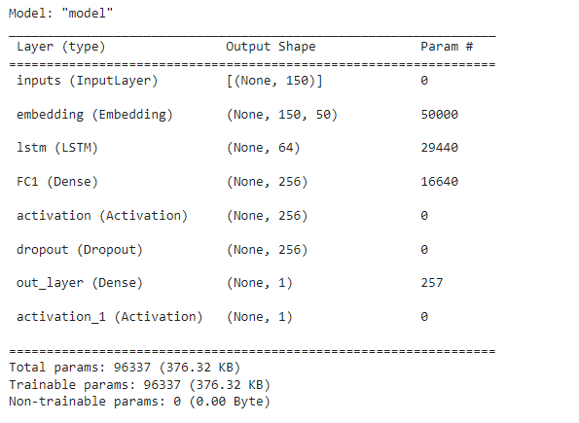
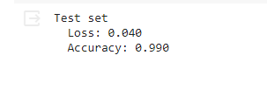
RESULTS
Demo Link
https://colab.research.google.com/drive/1je28ZwqVsukZnwBAM_Am6gXg8ONrpnZl?usp=sharing

