Slide 1


air quality prediction using machine learning algorithm
DEPARTMENT OF ARTIFICIAL INTELLIGENCE
GUIDE BY
A.JEYASHRI

Slide 2
TEAM MEMBERS
927622BAL019 - KANNAN R
927622BAL029 - MUTHURAM S
927622BAL039 - SARVESHWARAN S
927622BAL049 - TAMIL SELVAN V

Slide 3
INTRODUCTION
Air quality prediction involves modeling the intricate compositions of air mixtures, including various pollutants and gases that impact environmental health.
Leveraging decision tree algorithms allows us to analyze complex datasets, identify patterns, and predict the amounts or concentrations of different air constituents accurately.
By employing decision tree models, we gain actionable insights into the factors influencing air mixture compositions, enabling targeted interventions and pollution control strategies.

Slide 4
objectives
Optimize Pollution Control: Develop decision tree models to accurately predict the concentrations of air pollutants, aiding in optimizing pollution control strategies and reducing environmental impact.
Enhance Environmental Monitoring: Utilize machine learning algorithms to enhance environmental monitoring systems, providing real-time insights into air quality variations and potential pollution hotspots.

Slide 5
ALGORITHM USED
Decision tree
Decision Tree is a Supervised learning technique that can be used for both classification and Regression problems, but mostly it is preferred for solving Classification problems. It is a tree-structured classifier, where internal nodes represent the features of a dataset, branches represent the decision rules and each leaf node represents the outcome.
Decision nodes are used to make any decision and have multiple branches, whereas Leaf nodes are the output of those decisions and do not contain any further branches.

Slide 6
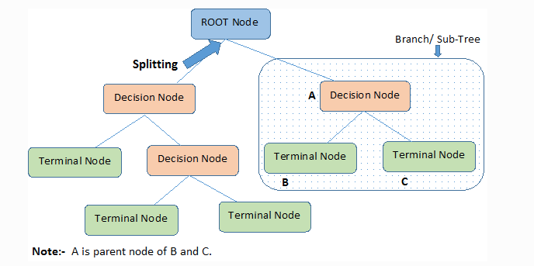
Decision Tree Terminologies
Root Node: Root node is from where the decision tree starts. It represents the entire dataset, which further gets divided into two or more homogeneous sets.
Leaf Node: Leaf nodes are the final output node, and the tree cannot be segregated further after getting a leaf node.
Splitting: Splitting is the process of dividing the decision node/root node into sub-nodes according to the given conditions.
Branch/Sub Tree: A tree formed by splitting the tree.
Pruning: Pruning is the process of removing the unwanted branches from the tree.
Parent/Child node: The root node of the tree is called the parent node, and other nodes are called the child nodes.

Slide 7
advantages
Interpretability: Decision trees provide a clear and understandable representation of how air quality predictions are made based on input features, making it easier for stakeholders to grasp the factors influencing air quality.
Feature Importance: Decision trees automatically rank features based on their importance in predicting air quality, helping identify critical factors that significantly impact air quality.
Robustness: Decision trees are robust to noisy data and outliers, as they make decisions based on local information at each node rather than global patterns, improving the model's performance and generalization ability.

Slide 8

disadvantages
Overfitting: Decision trees can get too detailed and fit the training data too closely, making them less accurate when predicting new, unseen data.
Sensitivity to Small Changes: Small changes in the input data or the way the tree is built can lead to big changes in the predictions, which can make the model less reliable.
Handling Continuous Data: While decision trees are good with categories, they might not work as well with continuous data (like temperature readings) without extra steps to prepare the data first..

Slide 9
applications
Pollution Monitoring: Predicting pollutant levels like PM2.5, NOx, and CO based on weather and environmental factors.
Health Risk Assessment: Identifying health risks from air pollution for different population groups.
Urban Planning: Guiding city development to reduce pollution in high-risk areas.
Environmental Impact Studies: Assessing how new projects may affect air quality before implementation.
.

Slide 10
conclusion
Decision tree algorithms offer clear and understandable decision paths, aiding in comprehending the key factors affecting air quality predictions.
These algorithms can handle various types of data, including categorical and numerical, making them adaptable to different aspects of air quality analysis.
By using decision trees, we can gain deeper insights into the dynamics of air pollution, leading to enhanced prediction accuracy and informed decision-making.

Slide 11

THANK YOU

