Slide 1
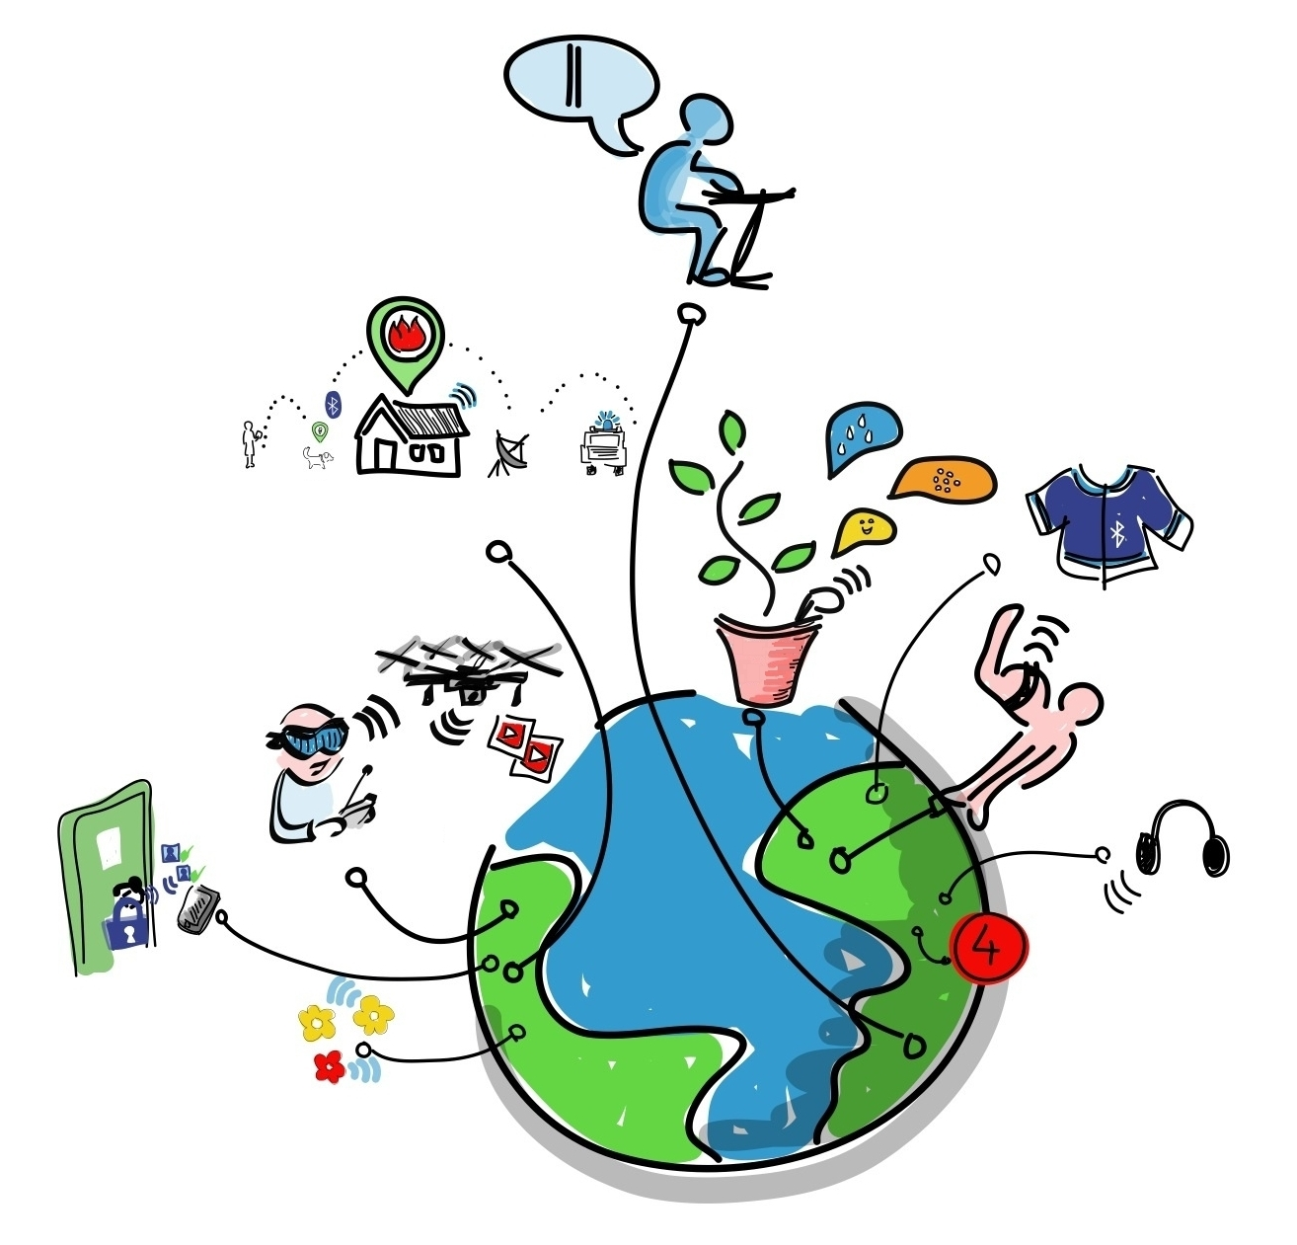

Slide 2

IDP - Interdisciplinary Project
Presentation - WoT-CI: Web of Things System Continuous Integration
Presenter:
Muthuraman Chidambaram
Chair of Embedded Systems and Internet of Things | Muthuraman Chidambaram | IDP
Notes:
‹#›

Slide 3
Agenda
IoT Interoperability
WoT Interoperability
Continuous Integration (CI)
CI ⇒ WoT-CI
Architecture & Approach
Conclusion
Learnings
History
Thanks
Chair of Embedded Systems and Internet of Things | Muthuraman Chidambaram | IDP

Slide 4
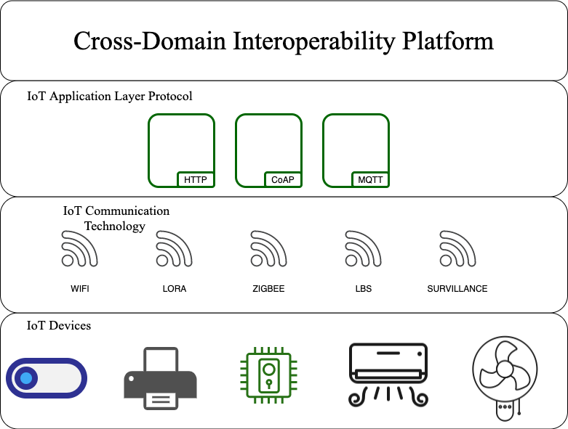
IoT Interoperability
Chair of Embedded Systems and Internet of Things | Muthuraman Chidambaram | IDP

Slide 5
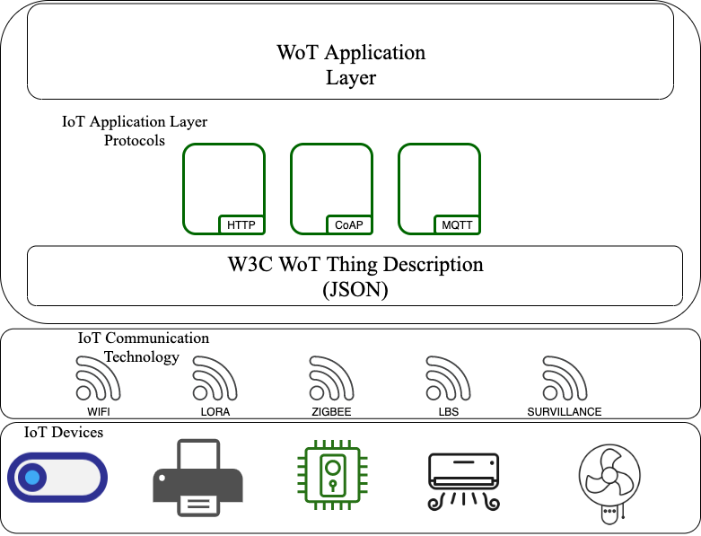
WoT Interoperability
Chair of Embedded Systems and Internet of Things | Muthuraman Chidambaram | IDP

Slide 6
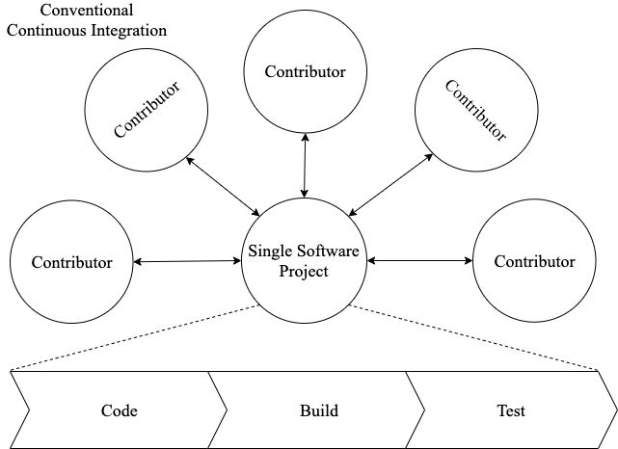
Continuous Integration(CI):
Chair of Embedded Systems and Internet of Things | Muthuraman Chidambaram | IDP

Slide 7
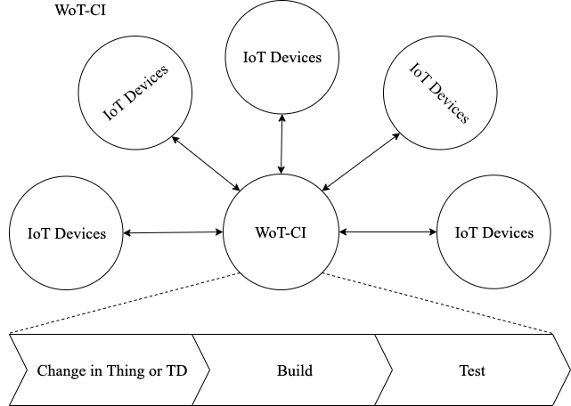
CI ⇒ WoT-CI
Chair of Embedded Systems and Internet of Things | Muthuraman Chidambaram | IDP

Slide 8
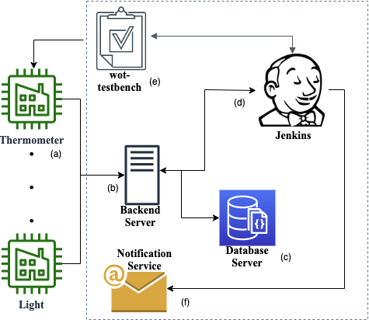
Architecture & Approach
Chair of Embedded Systems and Internet of Things | Muthuraman Chidambaram | IDP

Slide 9
Conclusion
The presented architecture is supposed to be used for blackbox system testing for W3C WoT ecosystem.
In this paper we introduce WoT-CI, a method that uses the principles of Continuous Integration (CI) in the context of WoT, by considering the WoT devices as contributors and WoT system as a single software project.
We show that this system can reduce system integration effort while requiring no manual input from the developer, thereby, assuring that the WoT devices are functioning as per the requirement after any change to the hardware, software or network.
Chair of Embedded Systems and Internet of Things | Muthuraman Chidambaram | IDP

Slide 10
Questions
Chair of Embedded Systems and Internet of Things | Muthuraman Chidambaram | IDP

Slide 11
Learnings
Markdown
Fork and Pull request in Git
Node.js
JSON
World Wide Web Consortium Web of Things: Thing Description
Postman
Not to develop a application in 64 bit OS when you know you are going to deploy it in Raspberry Pi (Until 2019)
Cron job can be used for starting applications on restart.
Continuous Integration: Tools like Travis CI and Jenkins
How to write a paper? (Yet to learn a lot, would be happy to do peer review)
How to create images for paper?
LaTeX
Chair of Embedded Systems and Internet of Things | Muthuraman Chidambaram | IDP

Slide 12
History
Chair of Embedded Systems and Internet of Things | Muthuraman Chidambaram | IDP

Slide 13
Thanks
Thanks to Prof. Sebastian Steinhorst, for allowing me to work with the chair.
Thanks to Ege Korkan, for his continuous and tireless support.
Thanks to the Team, for helping and sharing their time and knowledge whenever I’m at their desk.
Chair of Embedded Systems and Internet of Things | Muthuraman Chidambaram | IDP

