Slide 1
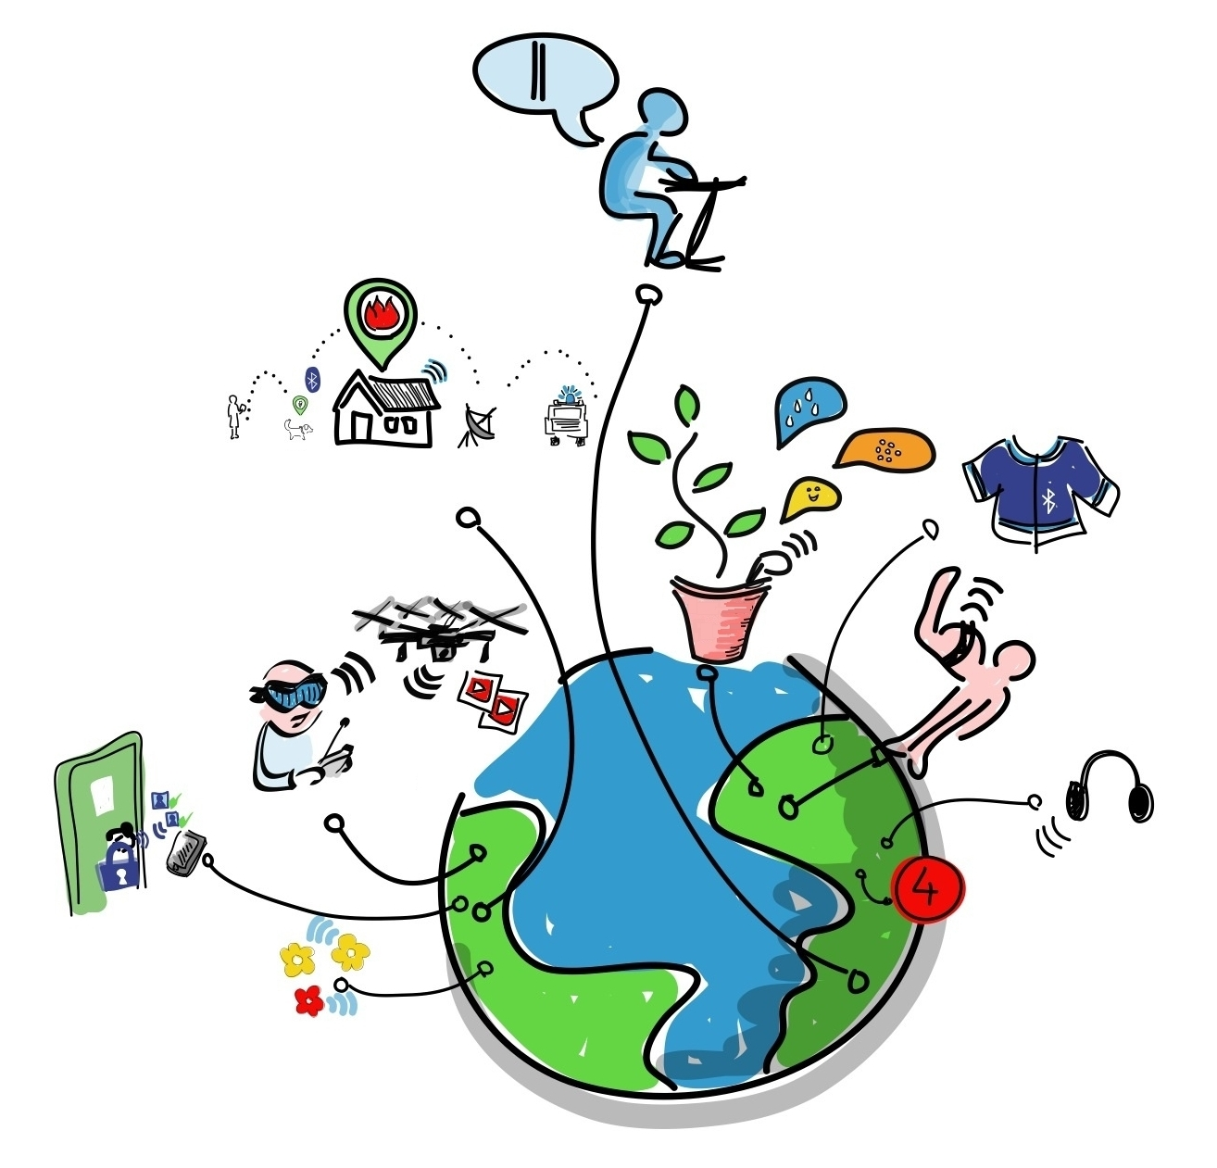

Slide 2

IDP - Interdisciplinary Project
Presentation - WoT-CI: Web of Things System Continuous Integration
Presenter:
Muthuraman Chidambaram
Supervisor:
Ege Korkan
Advisor:
Sebastian Steinhorst
Embedded Systems and Internet of Things | Muthuraman Chidambaram | IDP
Notes:
‹#›

Slide 3
Agenda
IoT Interoperability
WoT Interoperability
Continuous Integration (CI)
CI ⇒ WoT-CI
Architecture & Approach
Conclusion
Learnings
History
Thanks
Embedded Systems and Internet of Things | Muthuraman Chidambaram | IDP

Slide 4
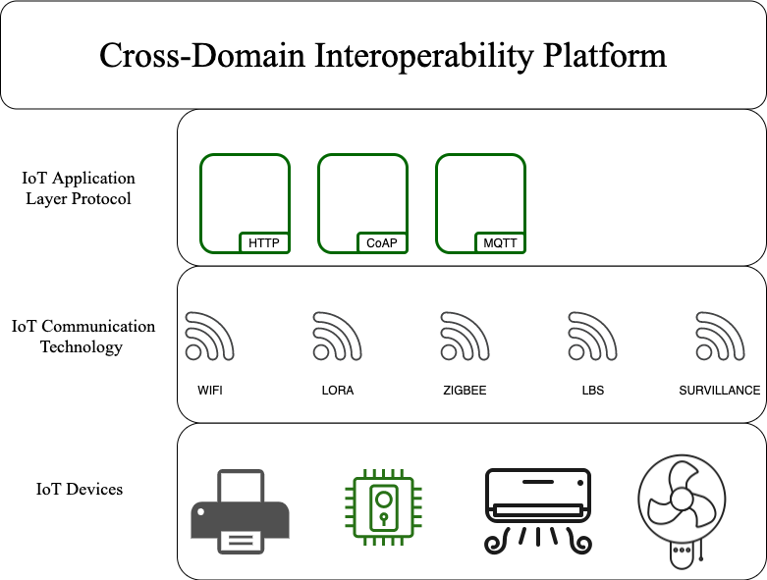
IoT Interoperability
Embedded Systems and Internet of Things | Muthuraman Chidambaram | IDP

Slide 5
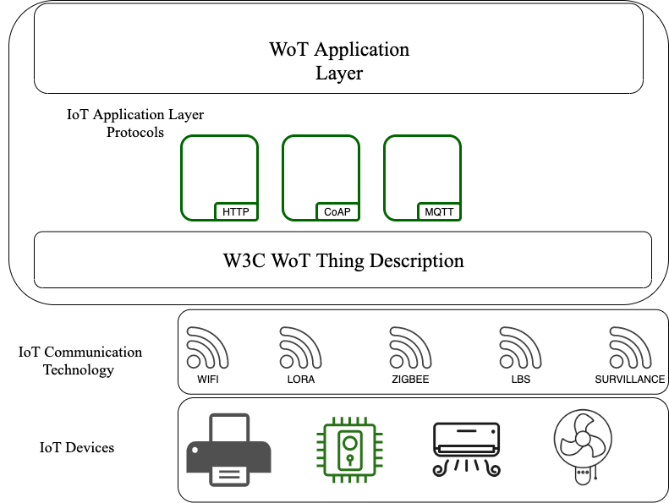
WoT Interoperability
Embedded Systems and Internet of Things | Muthuraman Chidambaram | IDP

Slide 6
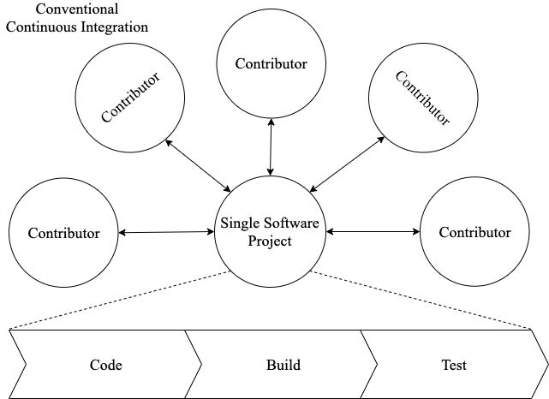
Continuous Integration(CI):
Embedded Systems and Internet of Things | Muthuraman Chidambaram | IDP

Slide 7
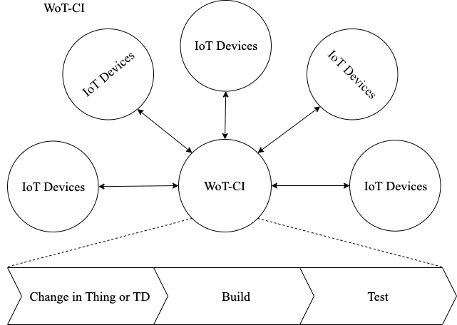
CI ⇒ WoT-CI
Embedded Systems and Internet of Things | Muthuraman Chidambaram | IDP

Slide 8
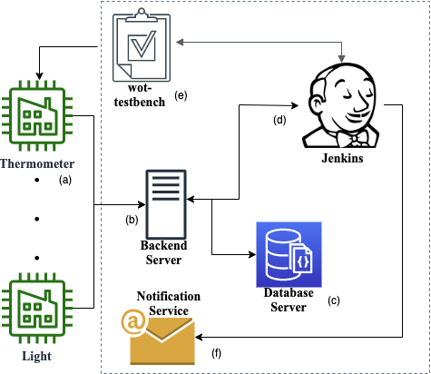
Architecture & Approach
Embedded Systems and Internet of Things | Muthuraman Chidambaram | IDP

Slide 9
Conclusion
The presented architecture is supposed to be used for blackbox system testing for W3C WoT ecosystem.
WoT-CI - a method that uses the principles of Continuous Integration (CI) in the context of WoT, by considering the WoT devices as contributors and WoT system as a single software project.
This system can reduce system integration effort while requiring
no manual input from the developer
Also makes sure that the WoT devices are functioning as per the requirement after any change to the hardware, software or network.
Embedded Systems and Internet of Things | Muthuraman Chidambaram | IDP

Slide 10
Questions
Embedded Systems and Internet of Things | Muthuraman Chidambaram | IDP

Slide 11
Learnings
Learnt to contribute to an existing git project to which I don’t have a push access
Node.js & JSON schema
W3C Web of Things: Thing Description standard
Postman API development environment
Continuous Integration: Tools like Travis CI and Jenkins
When & How to write a paper? (Yet to learn a lot, would be happy to do peer review)
How to create images for paper?
LaTeX
Consider deployment constraint while developing a software
Embedded Systems and Internet of Things | Muthuraman Chidambaram | IDP

Slide 12
Thank you !!!
Embedded Systems and Internet of Things | Muthuraman Chidambaram | IDP

