Slide 1
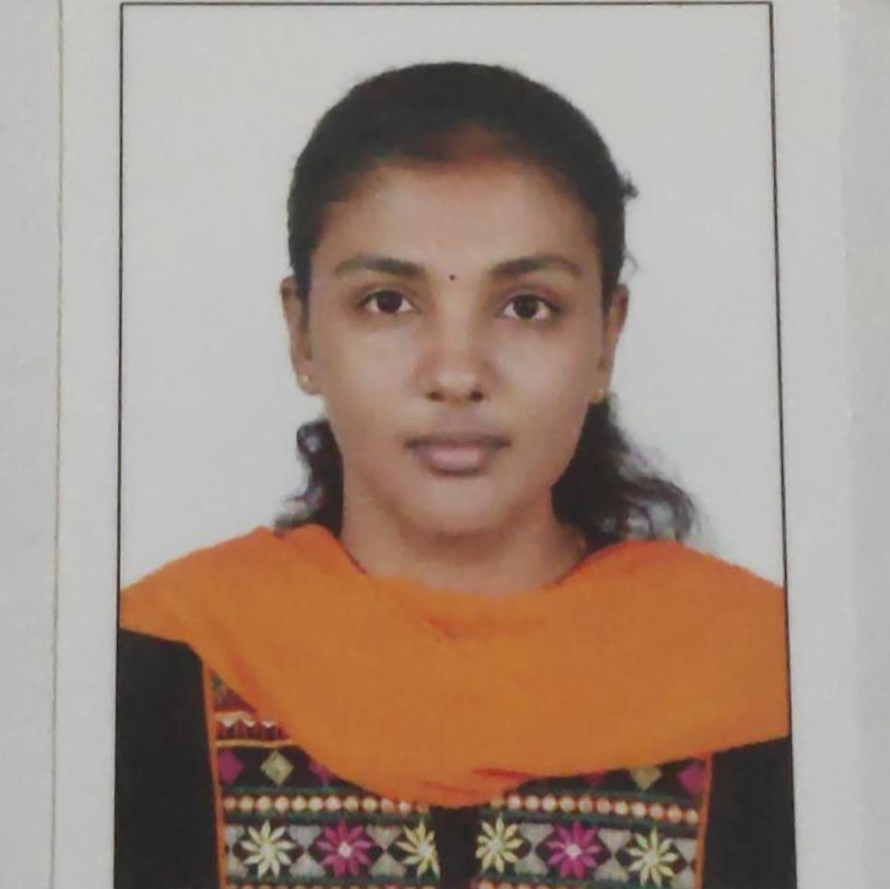
Muthu risha
Analyst/Software Engineer
Bachelor of Science in Computer Science
2016-2019
Master of Computer Applications
2019-2021
Skills Dot Net
C#
ADO. Net
ASP. Net Core MVC
Database:
MS SQL Server 2014
AddOns
Github
Postman
Additional Details:
Leadership
Quick Learner
Team management
Chennai
muthurisha.muthurisha@capgemini.com
9566875122
A4
A self-driven learner eager to work in a team of
dedicated people and serve a key role in the
enhancement and development of the project..
Ready to learn new technologies and implement them to further improve my knowledge.
Eager to work in a team of dedicated people and serve a key role in the enhancement and development of the project.
Proficient in C# and OOPs concepts.
Hands on experience in developing web pages
using HTML5,Asp.net, Object Oriented
Programming.
City bus management system:
Completed end to end case study of City bus Management Application along with JWT authentication, Swagger and postman testing using ASP.NET Core Web API
Trained on Dot Net, SQL Server, Ado.net, Core Mvc, Core Web API, Entity Framework.
Microsoft Azure Fundamentals Certificate : Completed Azure certification with 91.4%.

