Slide 1
Welcome To Python Basics !!!

Slide 2
Agenda
Introduction
Discovery , Version
Python Flavour,
Buzz Words About Python
Python setup
Python Data Type
Control Flow
Operator Example
Command Line Argument
User Input in Python
Notes:
Key Message(s): NA
Additional Information: NA
Application Delivery Fundamentals (ADF) 2.0: Testing
Module 02: Introduction to Software Development Life Cycle (SDLC)

Slide 3
Python Introduction
It is a general purpose High Level Language.
High-level languages used by software developers , Software programs and scripts are written in high-level languages, like C#, Swift, and PHP.
Low-level code is often cryptic and not human-readable. low-level programming languages are assembly language and machine language.
2. It is Object Oriented Language.
It is Functional Programming Language
We can write python Program without any class also where in java we must have to write one class.

Slide 4
Python Introduction
5. It is a Scripting language.
All scripting languages are programming languages. The theoretical difference between the two is that scripting languages do not require the compilation step and are rather interpreted.
No ; at the end of the line.
6. Today we can use python in all the areas like IOT , AI , ML , RPA etc.

Slide 5
Python Introduction
7. We have to write less number of code in Python.
print("Hello")
class Hello{
public static void main(String args[]){
System.out.println("Welcome") ;
}
}
8. python 2.x 140000
python 3.x 40000 +
9. Open source

Slide 6
Python Introduction - Discovery
It was created in the year 1980 by Guido van Rossum at Centrum Wiskunde & Informatica (CWI) in the Netherlands.
Its implementation was started in December 1989.
Most of the syntax of Python came from a official language called ABC.

Slide 7
A bit of History
Created by Guido Van Rossum
In early 1990’s
@ National Research Institute for Mathematics and Computer Science in
Netherlands.
Named after the BBC show “Monty Python’s Flying Circus”
Python is copyrighted. Like Perl, Python source code is now available under the GNU General Public License (GPL).

Slide 8
Python Introduction-Version
Implementation started – 1989
Python 0.9.0 ---------------- 1991
Python 1.0 ----------------- 1994
Python 2.0 --------------- 2000
Python 3.0 ---------------- 2008
Python 3.7 ---------------- 2018

Slide 9
Web and Internet Development
Frameworks such as Django and Pyramid.
Micro-frameworks such as Flask and Bottle.
Advanced content management systems such as Plone and django CMS
Flask is a web application framework written in Python

Slide 10
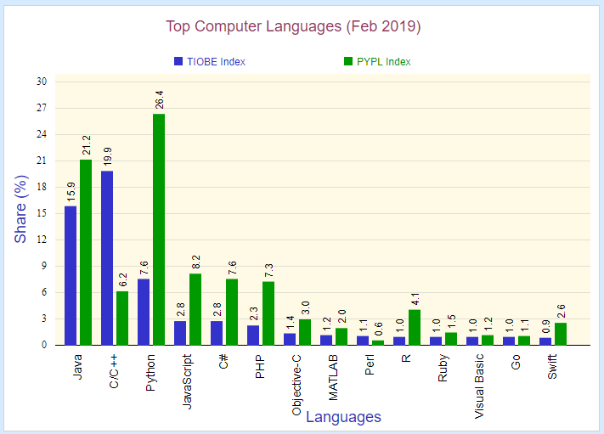
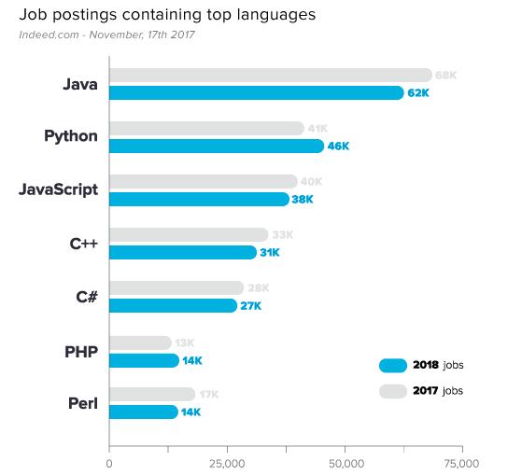
Python Share

Slide 11
Scientific and Numeric
Python is widely used in scientific and numeric computing:
SciPy is a collection of packages for mathematics, science, and engineering.
Numpy and Pandas is a data analysis and modelling library.
Python is perfect for Complex data Analysis and Visualization , Machine Learning and AI Applications.

Slide 12
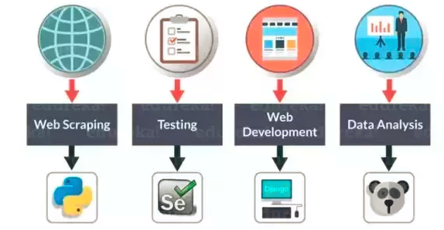
Python finds application in a lot of domains..

Slide 13
Python finds application in a lot of domains..
1.Data Analysis
Data analysis is one of the hottest topic in IT industry and probably the highest paying also. It can be done effectively with Python.
Python modules used in Data Analysis are:
-Pandas
-NumPy and Matplotlib.
2.Web development
Python can be used to build server-side web applications. Though not used in Web Browser(JavaScript still dominates)
Python code first converts into .js code to run on webBrowsers.
Django is the most popular module used for web development with Python. Though there are many other modules which are doing the same. Flask, Web2py, Pylons, Zope2, Giotto, CubicWeb are used for web development with python.

Slide 14
Python finds application in a lot of domains..
3.Data Science
Similar to Data Analysis, Python is now widely used for machine learning and artificial neural network. Using some of the knowledge from Data science and Stats. you can easily build your own algorithm for machine learning.
Sklearn is the module used for machine learning.
4.Networking
Python has same socket module as that in java but with more power and more ease of use. Protocols like HTTP,SMTP can be easily implemented in Python.
5.Robotics
You can code raspberry pi in python as well as it can be used to implement logics in Robot Technology.

Slide 15
Python Flavour
Flavors of Python simply refers to the different Python compilers.
These flavors are useful to integrate various programming languages into Python.
CPython
Jython
PyPy
Iron Python
RubyPython
Pythonxy
StacklessPython
Anaconda Python

Slide 16
Buzz Words About Python
Simple To Use
Object Oriented Programming Language
Dynamically Typed Language
Platform Independent
Distributed
Scripting Language
Readability
Community

Slide 17
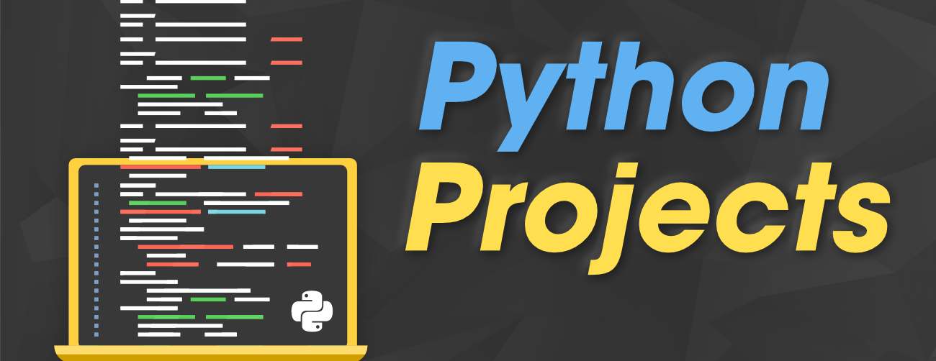
Simple To Use

Slide 18
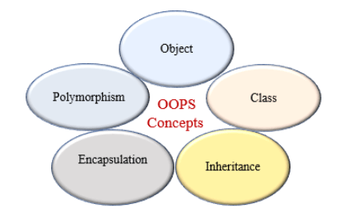
Object Oriented Programming Language

Slide 19
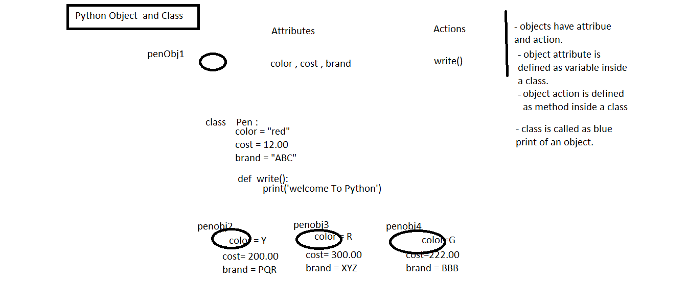
Python Class and Object

Slide 20
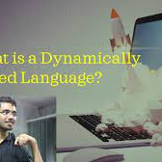
Dynamically Typed Language
We don't have to declare the type of variable while assigning a value to a variable in Python.

Slide 21
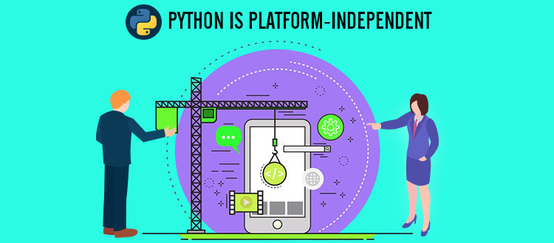
Platform Independent

Slide 22
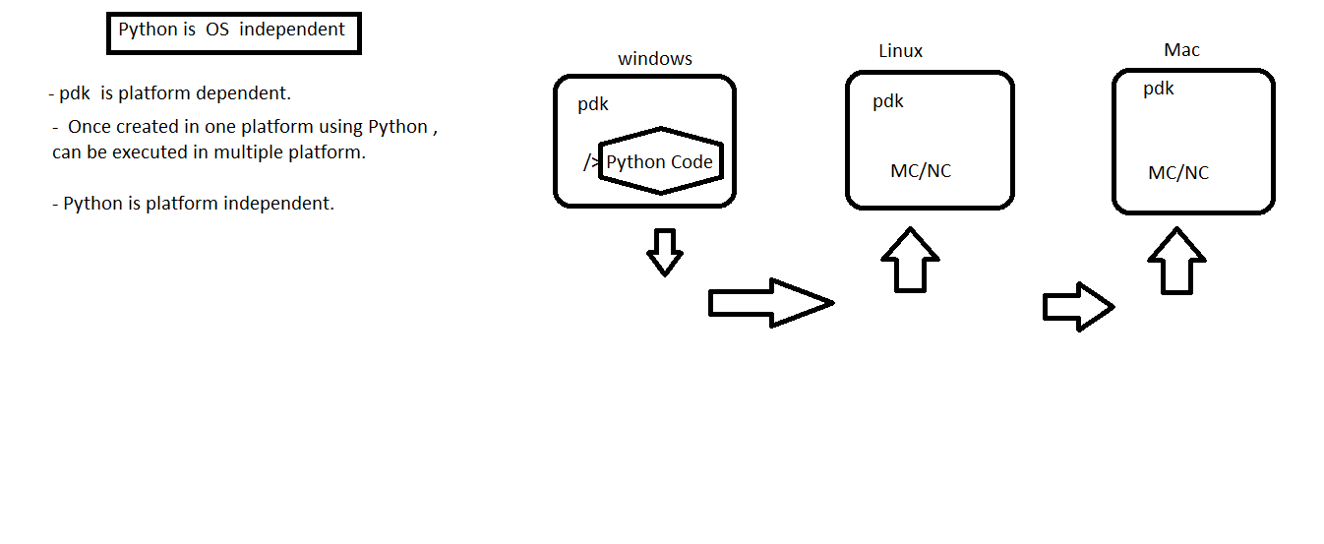
Python is Platform independent

Slide 23
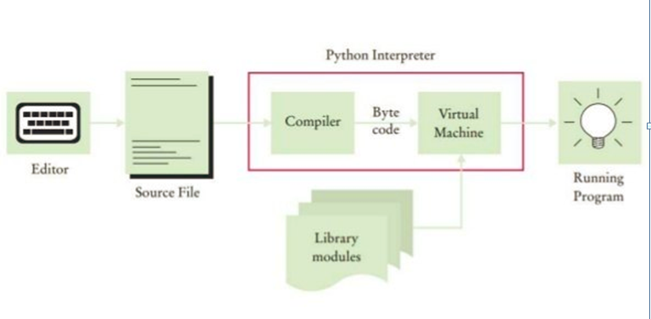
How Python Interpreter Works

Slide 24
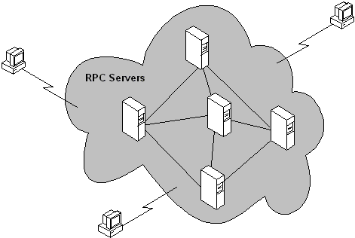
Distributed

Slide 25
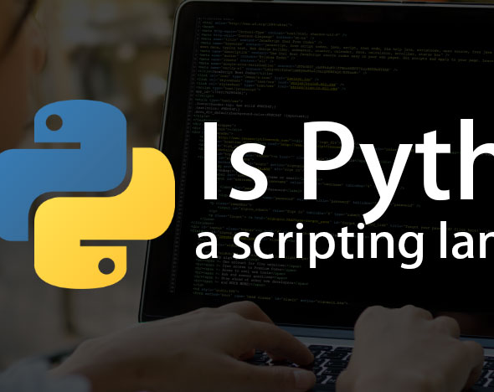
Scripting Language
Python is an interpreted language. Python uses an interpreter to translate and run its code. Hence Python is a scripting language.

Slide 26
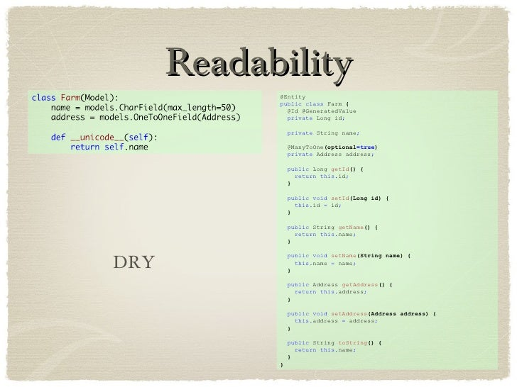
Readability

Slide 27

Community

Slide 28








Who is using Python?

Slide 29

Python setup
1st Method: - installation required
1. python-3.7.3-amd64.exe
2. PATH: Command Prompt
set path= C:\Users\AppData\Local\Programs\Python\Python37\Scripts
set path= C:\Users\AppData\Local\Programs\Python\Python37
3. /> python --version
4. /> python Hello.py
2nd Method: IDLE - installation required
3rd Method: IDE - installation required
4th Method : Google Colab - no installation required

Slide 30

Python Data Type
Python has the following data types built-in.
Text Type: str
Numeric Types: int, float, complex
Sequence Types: list, tuple, range
Mapping Type: dict
Set Types: set, frozenset
Boolean Type: bool
Binary Types: bytes, byte array, memory view

Slide 31
Python Data Type
python 2.x - long present python 3.x - long does not exist
class DataTypeDemo:
def method1(self):
str1 = "Good Book"
int1 = 10
bool1 = True
long1 = 999999999999999999999999
print(str1 +"/"+ int1 +"/"+ bool1 +"/"+long1)
obj = DataTypeDemo()
obj.method1()

Slide 32

Identifiers
A Python identifier is a name used to identify a variable, function, class, module, or any other object.
Naming Rules
Variable length can be of anything.
Identifier names should start with an alphabet or underscore(_) followed by zero or more letters, underscores and digits
No other special characters are allowed.
Identifier names are case sensitive.

Slide 33
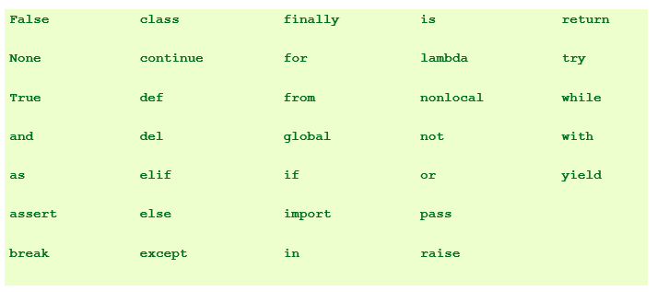
Reserved Words

Slide 34
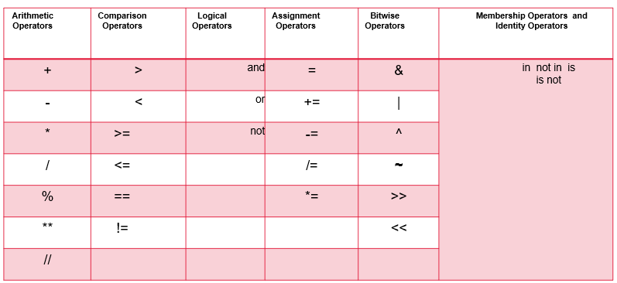
Operators

Slide 35

Control Flow Using Python
A program's control flow is the order in which the program's code executes.
Selection Statement
(if else switch)
2. Iterative statement
(for , while , do while)

Slide 36
Agenda
OOPs-Python -Class and Object
Constructor , self , cls
Types Of Variable
Types Of Method
Inner class
Bean
HandsOn
Notes:
Key Message(s): NA
Additional Information: NA
Application Delivery Fundamentals (ADF) 2.0: Testing
Module 02: Introduction to Software Development Life Cycle (SDLC)

Slide 37
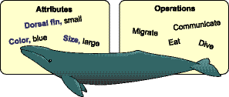
OOPs-Python -Class and Object
Any thing that we find in the real life can be defined as object.
Any thing that have attribute and action is defined as Object.
Tangible and non-tangible

Slide 38

OOPs-Python -Class and Objects-Python -Class and Object
CLASS
class is defined as Blue Print of an object.
object attribute is defined as variable inside a class.
object action is defined as Method inside a class.

Slide 39

OOPs-Python -Class and Object
class Pen:
'''this is pen class'''
def __init__(self,color,cost):
self.color=color #instance variable
self.cost=cost
def write(self):
print("color value",self.color)
print("cost value",self.cost)

Slide 40
OOPs-Python -Class and Object
pobj1=Pen('red',23.00)
pobj1.write()
pobj2=Pen('yel',43.00)
pobj2.write()
print(Pen.__doc__)
help(Pen)

Slide 41

Constructor
It is used to initialize object attribute.
__init__() is the default constructor.
Constructor name is __init__ always.
When we create an object , constructor is called automatically.
Any variable we create inside constructor using self is called instance variable
Two types of constructor
default - no arg
parameterized - more than one arg
If we don’t provide any constructor then python PVM will provide the constructor inside the class.
If we have multiple constructor inside the class , then only the recent one is applicable.

Slide 42
Self
Self is used to point current object
It is an implicit variable inside the constructor.
It is the first argument inside the constructor and instance method
By using self we can declare instance variable
We use self within the class only
Instead of self we can use other word also but it is recommended to use self.
At the time of passing value to constructor we don’t have to pass the value of self. PVM will pass the value.

Slide 43
Method and Constructor
Method can be used for any name but the constructor name is predefined as __init__()
When we create object , constructor is called automatically
Inside constructor we call instance variable
Function inside the class is called method
Function outside the class is called function

Slide 44
Types Of Variable
Three types of variable in Python class
instance variable
Any variable declared inside the constructor using self
B. local variable
Any variable declared inside the method without using self.
Its scope is inside the method only.
C. static variable
Any variable created inside the class , outside constructor or method is called a static or class variable.
We can access static var using class name.
static variable can be shared by multiple object

Slide 45
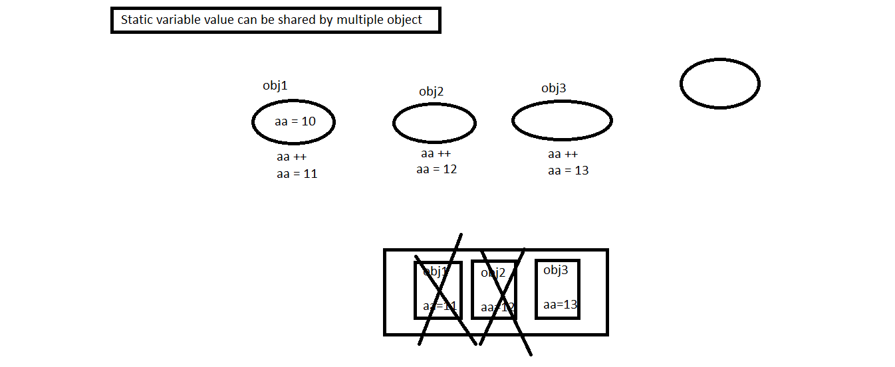
Static Variable In Python

Slide 46
Types Of Method
Three Types of Method
A. instance method - Any method where we are using instance variable.
- Always deal with object related data.
B. class method - for any class we create in python , PVM will create an class object.
- This class object will contain class level variable.
- PVM will use ref variable callled cls to point current class level object.
- We can use @classmethod annotation to identify a class.
- Use of @classmethod is optional.
C. static method
- Any method that will not deal with class level var or object level data ie utility method
- We can use @staticmethod annotation to identify a class.
- Use of @staticmethod is optional.

Slide 47
Inner class
Any class that is defined inside another class.
class OuterClass:
message="This is a outer class var"
def __init__(self):
self.innnerinstance = self.InnerClass()
class InnerClass:
def printMessage(self):
return OuterClass.message
outerinstance = OuterClass()
print(outerinstance.innerinstance.printMessage()

Slide 48
Bean Class
Bean Class - It is used to initialize object attribute.
- Any class that have instance var and its getters and setters is called a bean class.
class Learner:
def __init__(self):
print("default const")
def setName(self,name):
self.name=name
def getName(self):
return self.name;
obj = Learner()
obj.setName("maX") # name = max
print(obj.getName())

Slide 49
Agenda
OOPs - Data Hiding
OOPs-OBJECT RELATIONSHIP
Python-Inheritance
MRO
super()
Hands On
Notes:
Key Message(s): NA
Additional Information: NA
Application Delivery Fundamentals (ADF) 2.0: Testing
Module 02: Introduction to Software Development Life Cycle (SDLC)

Slide 50
OOPs - Data Hiding
Hiding object attribute value or method inside an object.
Using private access specifier, we implement data hiding.
Data hiding, we implement into 2 level
A. data member __color > private variable
private data members are not available outside the class
B. method __m1(self):

Slide 51
Object Relationship
Association : Association is a relationship between two objects.
The association between objects could be
– one-to-one , – one-to-many , – many-to-one , – many-to-many
Types of Association
– Aggregation
– Composition
Example: A Student and a Faculty are having an association.

Slide 52
Aggregation
Aggregation is a special case of association.
A directional association between objects
When an object ‘has-a’ another object, then you have got an aggregation between them
Aggregation is also called a “Has-a” relationship.
Example: College has a Student Object.

Slide 53
Composition
Composition is a special case of aggregation
When an object contains the other object, if the contained object cannot exist without the existence of container object, then it is called composition.
Example: A class contains students. A student cannot exist without a class. There exists composition between class and students.
Example: Order have Order Item

Slide 54
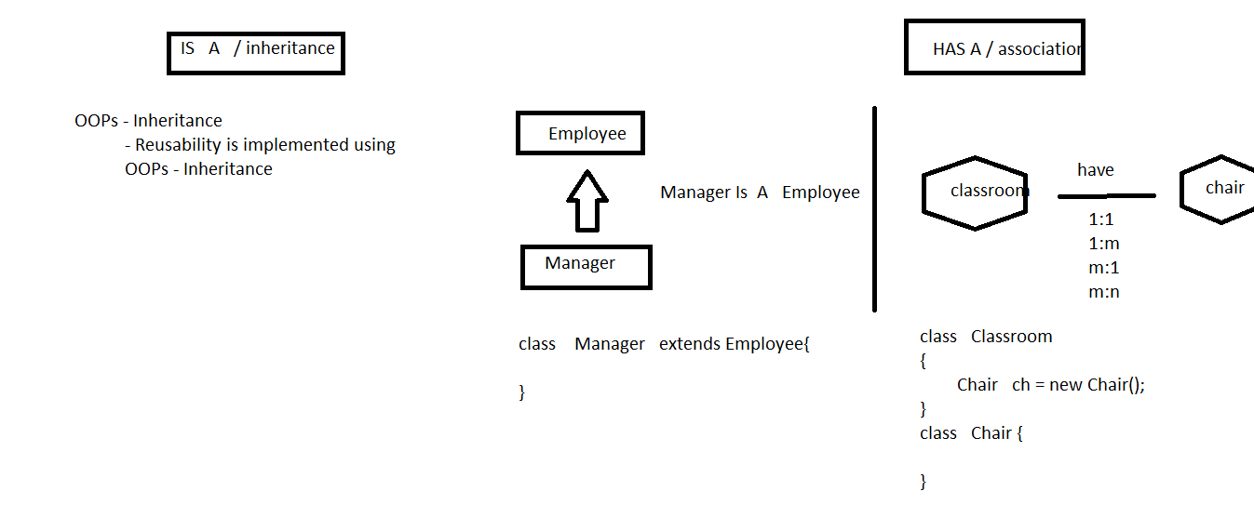
Object Relationship

Slide 55
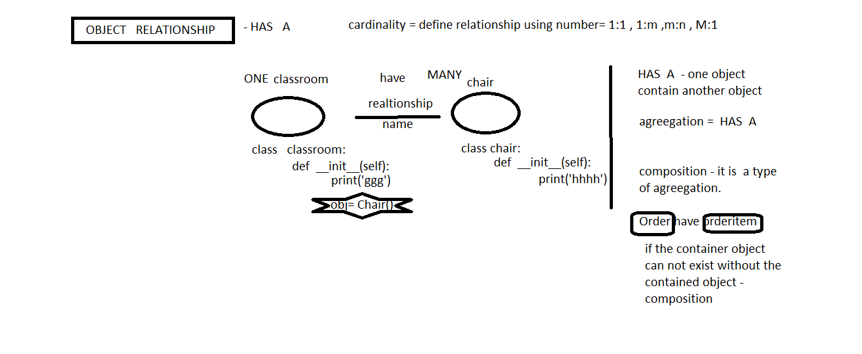
Object Relationship – HAS A

Slide 56
Object Relationship
HAS-A relationship is expressed with containership
Containership simply means using instance variables that refer to other objects.
House HAS-A Kitchen.
IS-A relationship: Manager IS-A Employee
Inheritance :
Inheritance is one of the cornerstones of OOP because it allows for the creation of hierarchical classifications
Using inheritance, you can create a general class at the top
This class may then be inherited by other, more specific classes
Each of these classes will add only those attributes and behaviors that are unique to it.

Slide 57
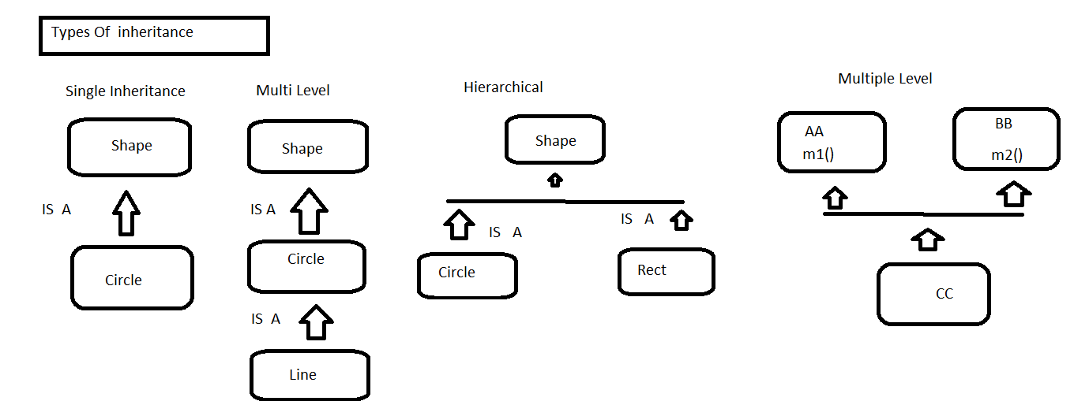
Type Of Inheritance

Slide 58
Single Inheritance
class Shape:
def area(self):
print("This is area method")
class Circle(Shape):
def area1(self):
print("This is area of circle")
obj = Circle()
obj.area()
obj.area1()

Slide 59
Multilevel Inheritance
class Shape:
def area(self):
print("This is area method")
class Circle(Shape):
def area1(self):
print("This is area of circle")
class QLine(Circle):
def area2(self):
print("This is area of QLine")
obj = QLine()
obj.area()
obj.area1()
obj.area2()

Slide 60
Hierarchical Inheritance
class Shape:
def area(self):
print("This is area method")
class Circle(Shape):
def area1(self):
print("This is area of circle")
class Rect(Shape):
def area2(self):
print("This is area of rect")
obj = Circle()
obj.area()
obj.area1()
obj1 = Rect()
obj1.area()
obj1.area2()

Slide 61
Multiple Inheritance
More than one base class
Java does not support multiple inheritance
Python support multiple inheritance
class AA:
def m1(self):
print("This is m1() method of class AA")
class BB:
def m1(self):
print("This is m2() method of class BB")
class CC(AA,BB):
def m3(self):
print("This is m3() method of class CC")

Slide 62
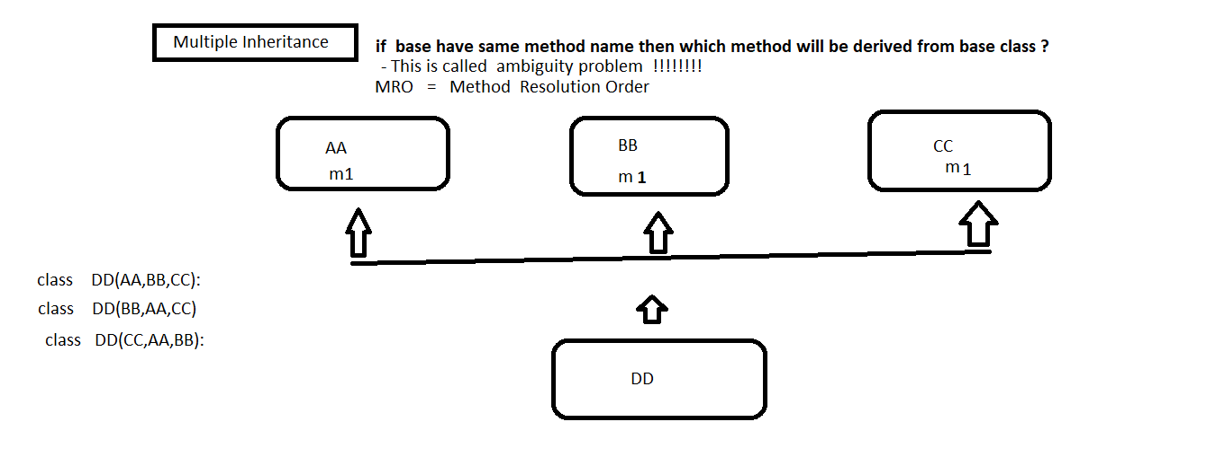
Method Resolution Order
Any specified attribute or method is searched first in the current class . If not available, then the search will continue into parent class in left to right .

Slide 63

Super()
super() is used to call base class constructor
Reusability
super() is used to call base class method

Slide 64
Agenda
Python String
String Manipulation Function
Python Data Structure:
List
Tuple
Dictionary
Set
Frozen Set
Notes:
Key Message(s): NA
Additional Information: NA
Application Delivery Fundamentals (ADF) 2.0: Testing
Module 02: Introduction to Software Development Life Cycle (SDLC)

Slide 65

Python String
String is defined as collection of character.
' ' or " " both is used to define string in python.
To concatenate any datatype to string, we need to first explicitly convert that data type to string.
python string is object.
== operator is used to compare the content of the string.
is operator is used to compare the address of two string.
String is immutable in nature.

Slide 66
String Manipulation Function
A. Character Extraction
B. String Comparison
C. Searching String
D. Replace String
E. Changing the case of character
F. Joining String
G. Reverse String

Slide 67

Python Data Structure
Organizing, managing and storing data is important as it enables easier access and efficient modifications.
Data Structures allows you to organize your data in such a way that enables you to store collections of data, relate them and perform operations on them accordingly.

Slide 68
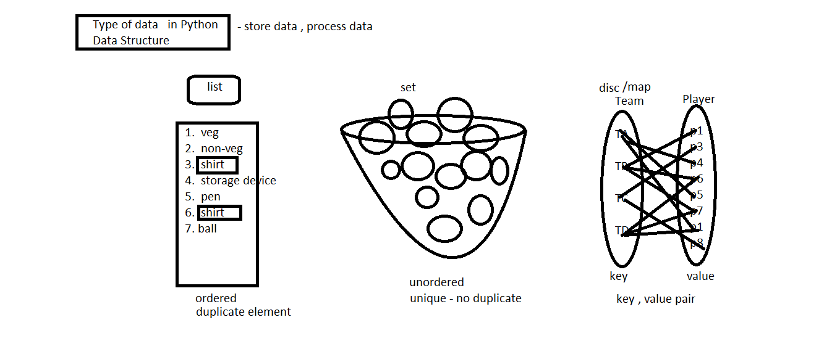
Python Data Structure

Slide 69
Python Data Structure - List
Objects are ordered and non unique
It is mutable , we can change the existing object
It will increase and decrease in size dynamically.
a = [] # empty list
a.append(111)
a.append(222)
a.append(333) #adding objects
a.append(444) #adding objects
print(a)

Slide 70
Python Data Structure - Tuple
It is a immutable object means once created can not be changed.
Tuple is collection of elements of fixed size
Tuple is faster than list
Tuple protect your data from being changed
#tuple
tp = (7,9,4,2)
print(tp)
#check if tuple is immutable
tp1 = (20,30,40,50)
tp1[0] = 9999 # error

Slide 71
Python Data Structure - Dictionary
Dictionary is a mutable object
It is used to store the object as key and value pair
key should be unique and value can be duplicated
If we have a duplicate key then the last assignment overrides all the previous assignments.
dict = {
100 : "srini",
200 : "max",
300 : "paro”
300 : “sonai”
}

Slide 72
Python Data Structure - Set
Set is unordered and It can not have duplicate element
It a mutable object
If we have duplicate element inside set then all duplicate will be removed, leaving only one for each value.
#set
#st = { 12 , 13 , 14 , 14 , 14}
#print(st)

Slide 73
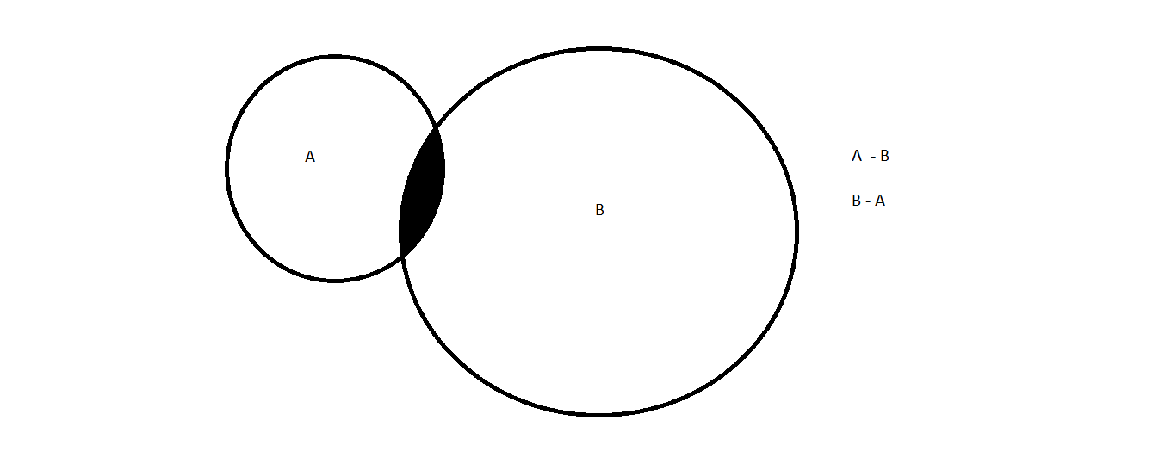
Python Data Structure - Set

Slide 74
Python Data Structure - Frozen Set
It is Immutable object means once created can not be changed.
we can not change the elements inside the frozen set.
#frozen set from tuple
v = ('a','e','i','o','u')
fs = frozenset(v)
print(fs)

