Slide 1

ENVIRONMENTAL MONITORING

Slide 2



COMPONENTS
ESP 32 cam
camera
GPS
Gas sensor
ESP 32
Display
webapp
@alert
Node
ESPnow
Node
@Flow chart for fire detection and monitoring

Slide 3
IOT DEVICES
ESP32
It is a series of low-cost, low-power system on a chip microcontrollers with integrated Wi-Fi and dual-mode Bluetooth. The ESP32 series employs either a Tensilica Xtensa LX6 microprocessor in both dual-core and single-core variations, Xtensa LX7 dual-core microprocessor or a single-core RISC-V microprocessor and includes built-in antenna switches, RF balun, power amplifier, low-noise receive amplifier, filters, and power-management modules.

Slide 4

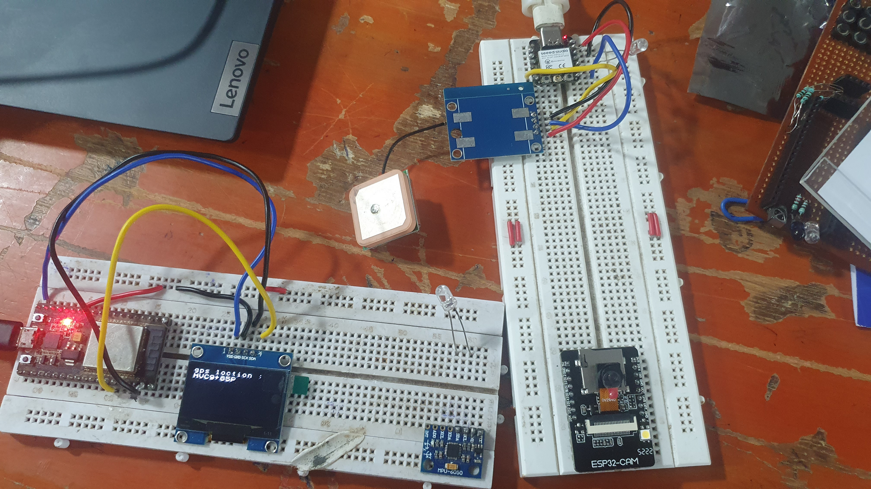
PROCESS
ESP32-CAM detects and transfers the data.
Using the gas sensor, the smoke are also detected any time.
GPS is used to give the location data.
Data’s are received by the nodeMCU.
Using espnow protocol the data is transferred.
These data’s are collected at the gateway(GSM or wifi).
Through the gateway data’s are sent to the webapp.
Data’s from the NASA’s are collected and displayed.
These data’s are now opensource and always available for our people.
It also detect the activities in the forestry areas.

Slide 5
Python script
#include <esp_now.h>
#include <WiFi.h>
#include <DFRobot_DHT11.h>
DFRobot_DHT11 DHT;
#define DHT11_PIN 3
const int ledPin = 10; // the pin that the LED is attached to
int incomingByte; // a variable to read incoming serial data into
// REPLACE WITH YOUR RECEIVER MAC Address
uint8_t broadcastAddress[] = {0x24, 0x62, 0xAB, 0xFF, 0x4B, 0x6C};//24:62:AB:FF:4B:6C
// Structure example to send data

Slide 6
// Must match the receiver structure
typedef struct struct_message {
char a[32];
int b;
char c;
//bool d;
} struct_message;
typedef struct struct_message1 {
char a[32];
int b;
char c;
//bool d;
} struct_message1;
// Create a struct_message called myData
struct_message myData;
struct_message1 myData1;
esp_now_peer_info_t peerInfo;
// callback when data is sent
void OnDataSent(const uint8_t *mac_addr, esp_now_send_status_t status) {
Serial.print("\r\nLast Packet Send Status:\t");
Serial.println(status == ESP_NOW_SEND_SUCCESS ? "Delivery Success" : "Delivery Fail");
}

