Slide 1

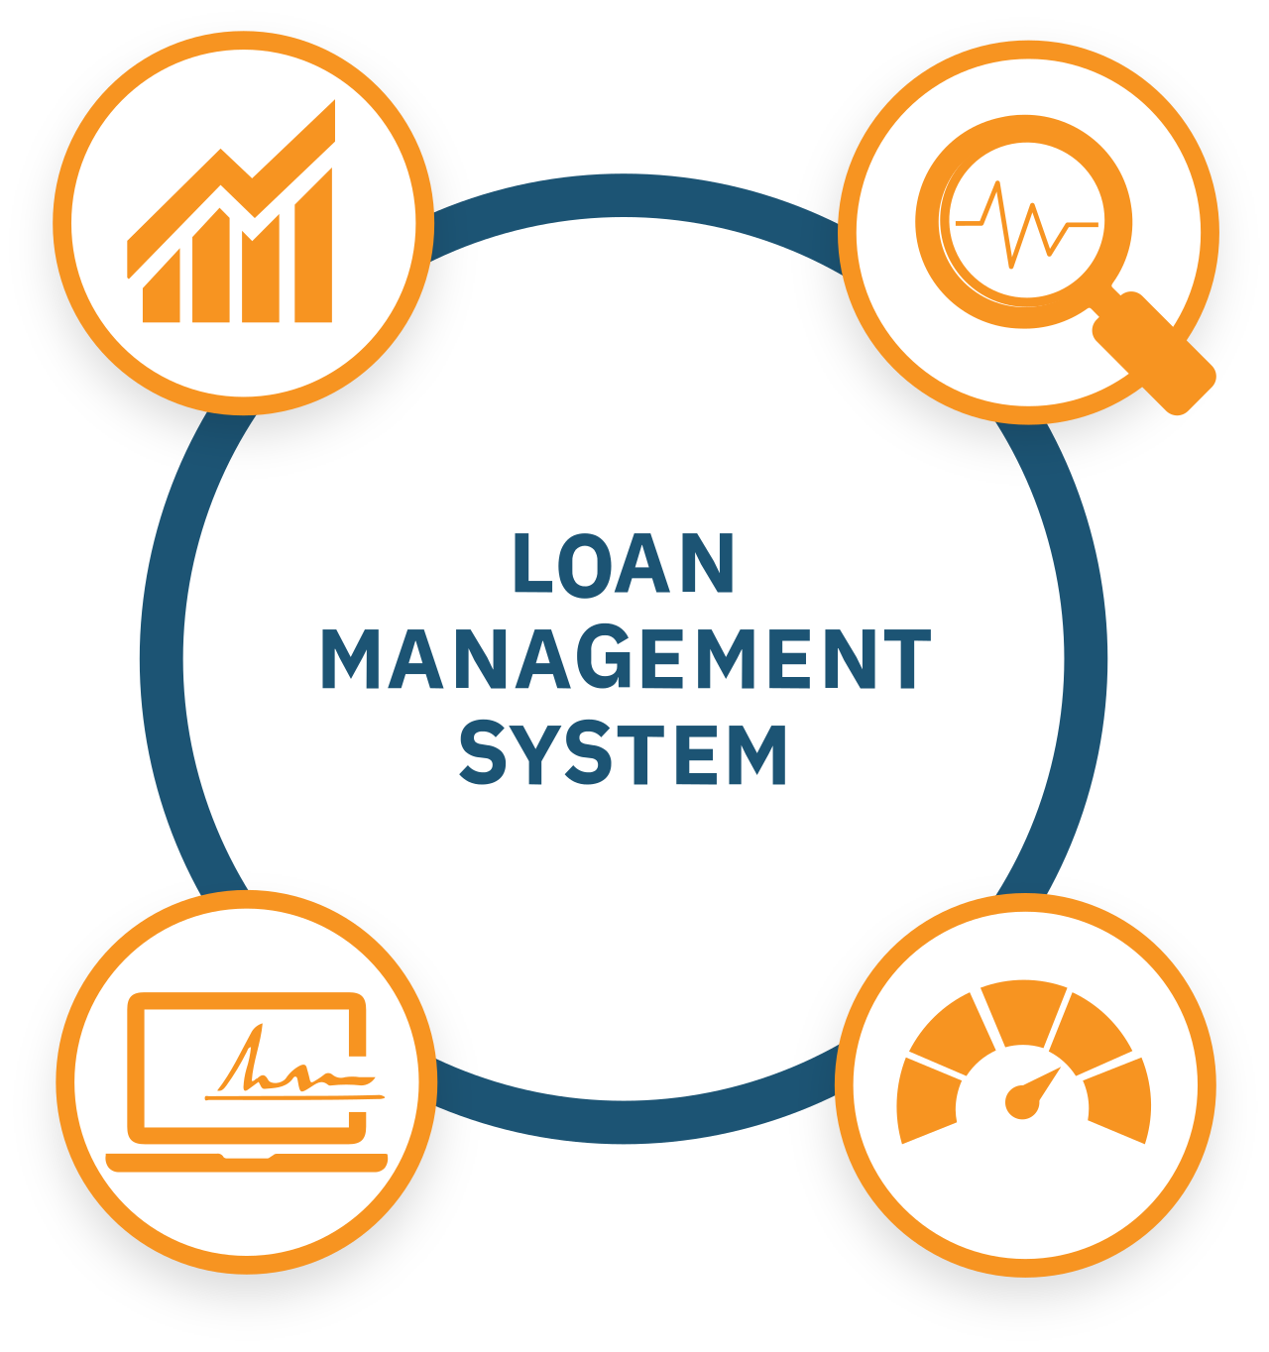
Loan Management System (LMS)
Presented by:
Muthyapwar Sai Prasad

Slide 2


INTRODUCTION
The Loan Management System is a digital platform designed to simplify and automate the handling of various types of loans such as property, education, gold, and vehicle loans. The Loan Management System (LMS) is a backend software solution built with Python, FastAPI and MongoDB that automates the complete loan lifecycle — from loan application with EMI scheduling to approval, disbursement, and repayment. It is designed for financial institutions, NBFCs, and banks to streamline operations, reduce manual errors, and provide transparency in loan processing.
Loan Management System – Project Presentation

Slide 3

OBJECTIVES
Automate loan processes from application to repayment
Enable role-based access (Admin & Borrower)
Secure authentication using JWT
Real-time loan tracking and transaction history
Increase efficiency, transparency, and scalability
Loan Management System – Project Presentation

Slide 4
Key Features
User Management – Registration and login for Admin & Borrower, role-based permissions and security.
Loan Management – Borrower applies for loans (property, education, vehicle, gold, etc…). Admin reviews and approves/disburses loans or reject loan. Borrower makes repayments in installments.
Secure Authentication – JWT-based login ensures safe and secure access.
Transaction Tracking – Loan balance & repayment history
API-driven System – REST APIs for integration
Loan Management System – Project Presentation
Loan Management System – Project Presentation

Slide 5
Technology Stack
Backend: FastAPI (Python)
Database: MongoDB
Authentication: JWT (JSON Web Tokens)
Testing: Postman (for API testing)
Deployment: Cloud-ready (AWS/Azure/Local)
Loan Management System – Project Presentation

Slide 6
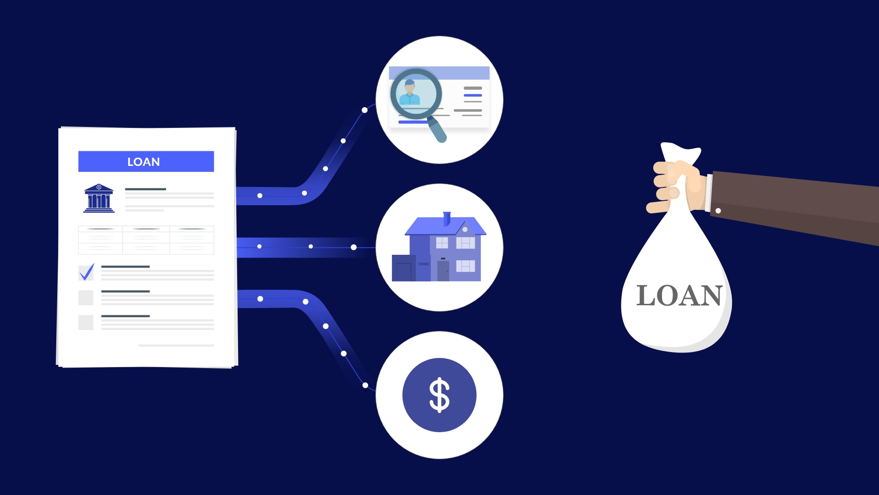
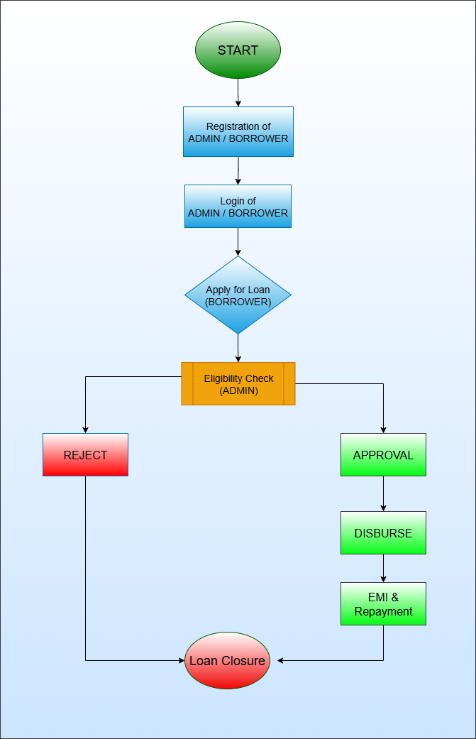
WORKFLOW DIAGRAM
Loan Management System – Project Presentation

Slide 7
WORKFLOW
Admin registers and manages system
Borrower registers and logs in.
Borrower applies for a loan.
Admin reviews the application → Approve or Reject.
If approved, Admin disburses loans
Borrower repays loan in installments
System updates loan status & history
Loan Management System – Project Presentation

Slide 8
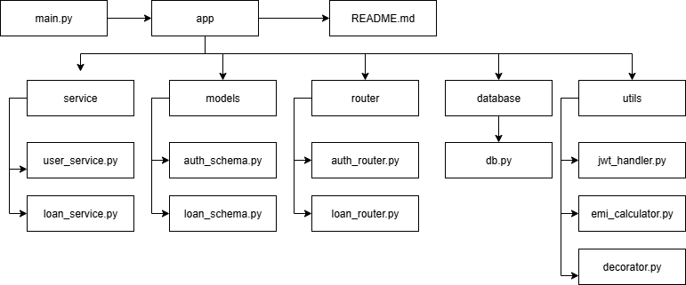
Project Structure
Loan Management System – Project Presentation

Slide 9
API ENDPOINTS
Authentication API’s : POST /auth/register → Register user (Admin/Borrower)
POST /auth/login → Login user (Admin/Borrower) and receive JWT token GET /auth/me → Get details of logged-in user GET /auth/users → List all users (Admin or Borrower )
Loan API’s : POST /loans/apply → Borrower applies for a loan POST /loans/{loan_id}/approve → Admin approves loan POST /loans/{loan_id}/disburse → Admin disburses loan POST /loans/{loan_id}/repay → Borrower repays loan
POST /loans/{loan_id}/reject → Admin reject loan
Loan Management System – Project Presentation

Slide 10
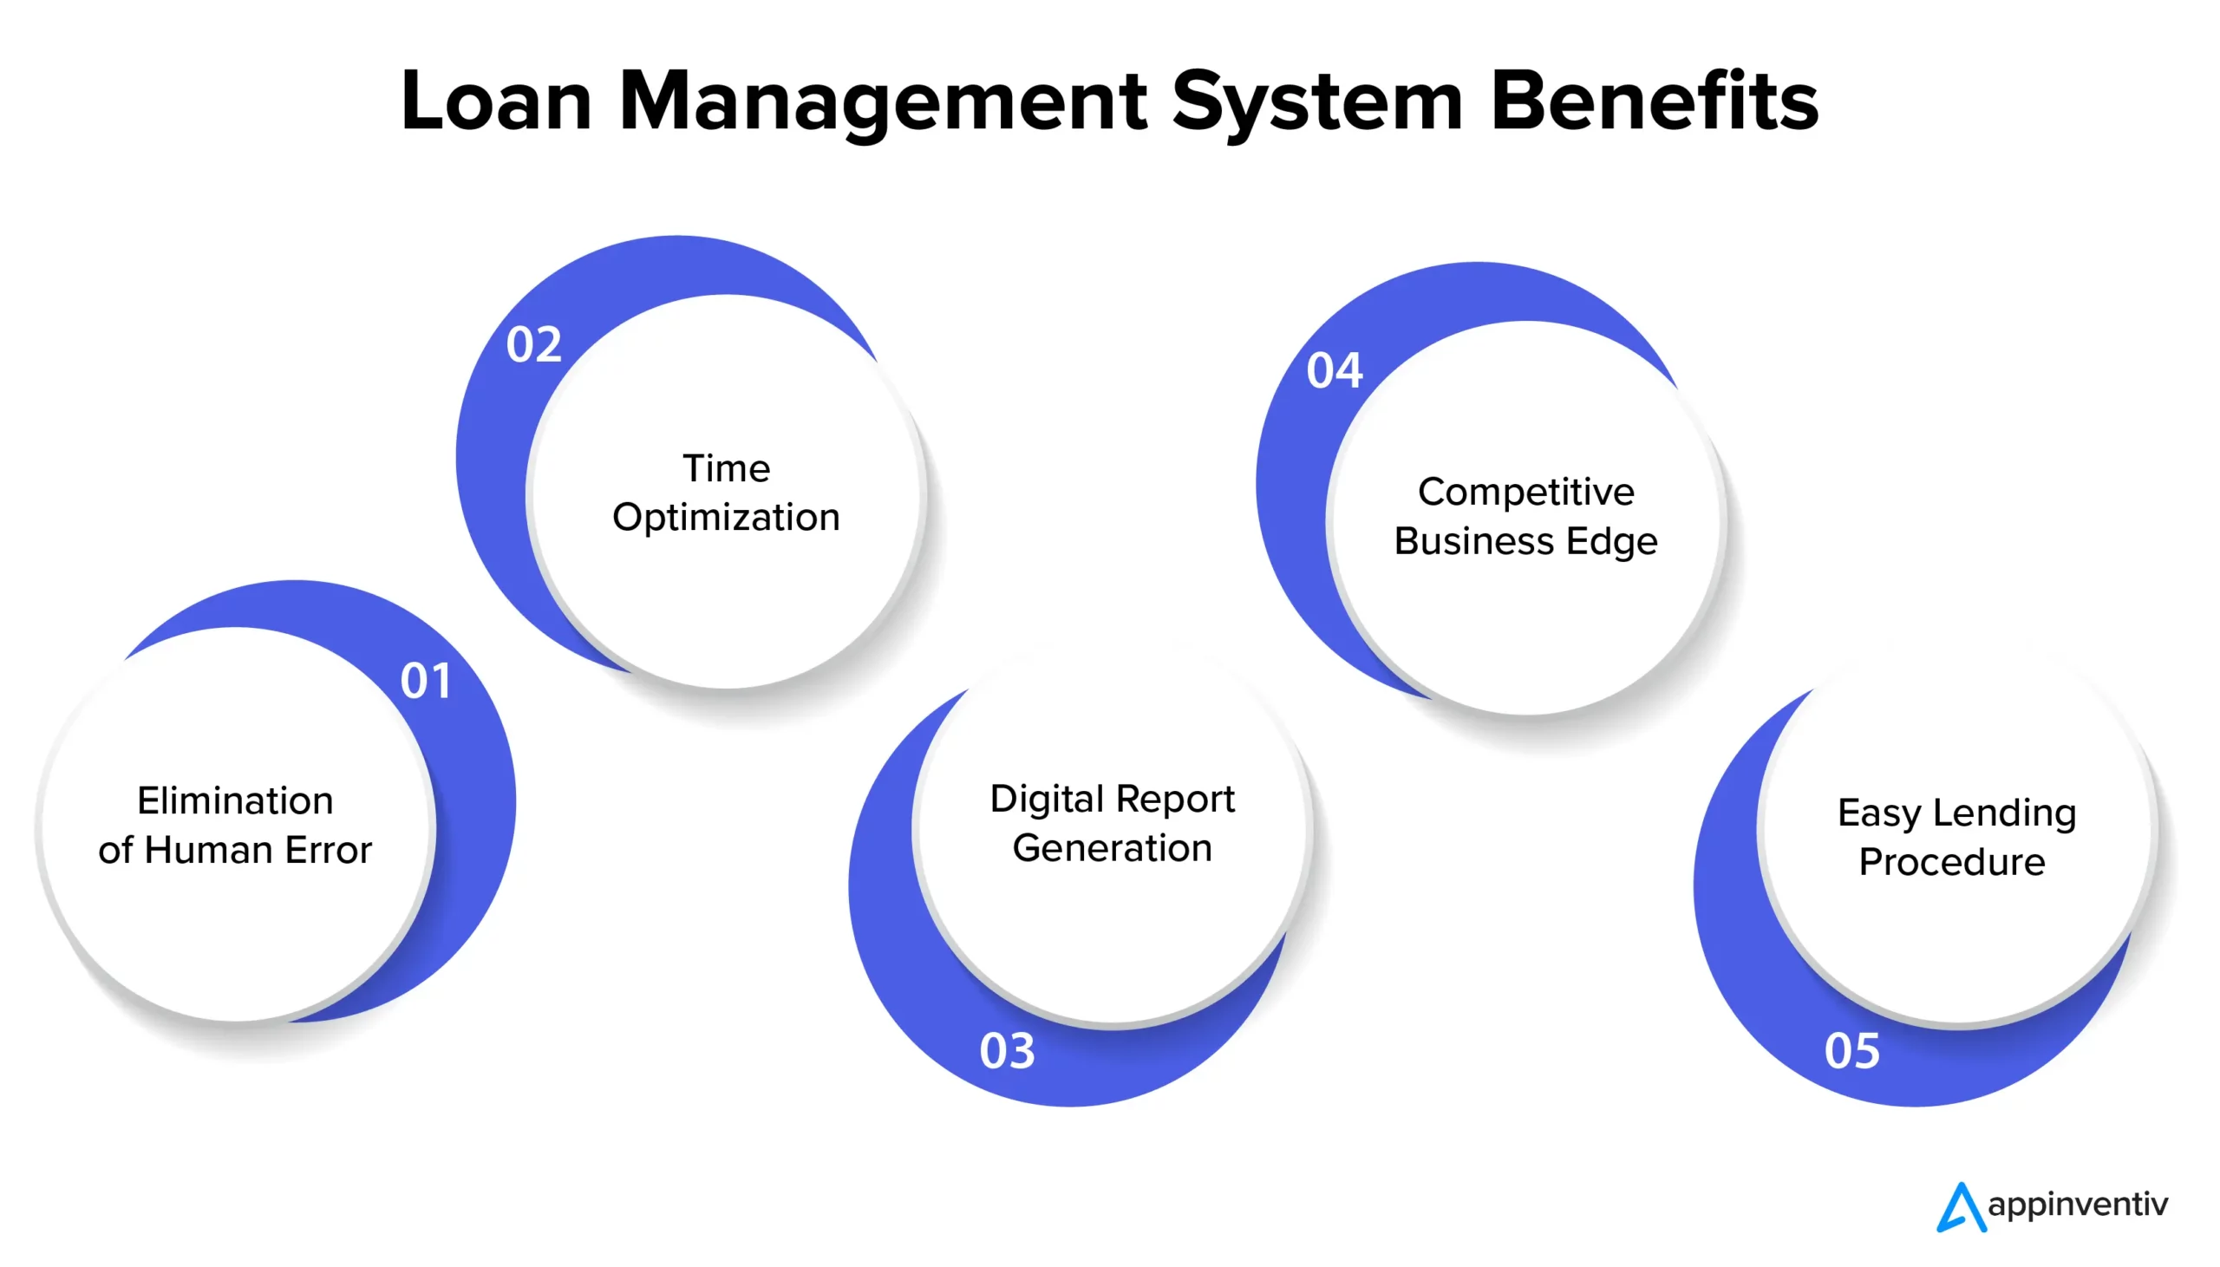
BUSINESS BENEFITS
Efficiency: Reduces paperwork and delays
Transparency: Real-time tracking for borrowers
Security: Encrypted authentication & role-based access
Scalability: Supports multiple loans and users
Integration Ready: Extendable for apps/banking systems
Loan Management System – Project Presentation

Slide 11
CONCLUSION
The Loan Management System (LMS) provides an end-to-end solution for managing loans in a secure, automated, and efficient manner. By automating loan approval, EMI scheduling, repayment tracking, and reporting, it significantly reduces manual effort while ensuring accuracy and transparency. With its robust architecture, secure design, and scalability, it can serve as a reliable solution for banking or financial ecosystem. With its modular API design helping organizations save time, reduce risks, and improve customer satisfaction.
Loan Management System – Project Presentation

Slide 12
Thank You

