Slide 1
hello.

Slide 2
digest quest.io
fitbit for your stomach

Slide 3
864 kCal

Slide 4


Slide 5
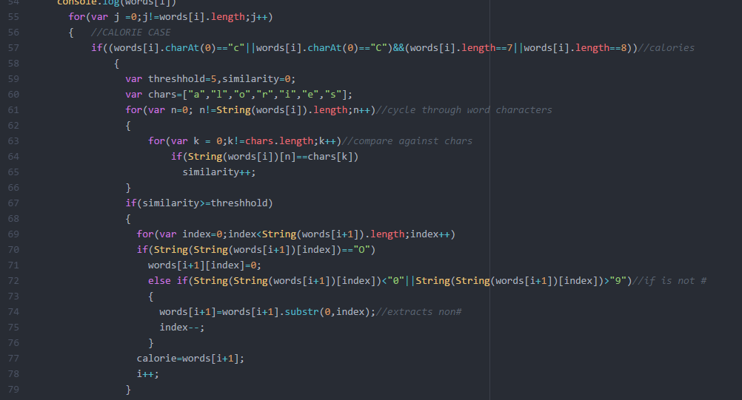
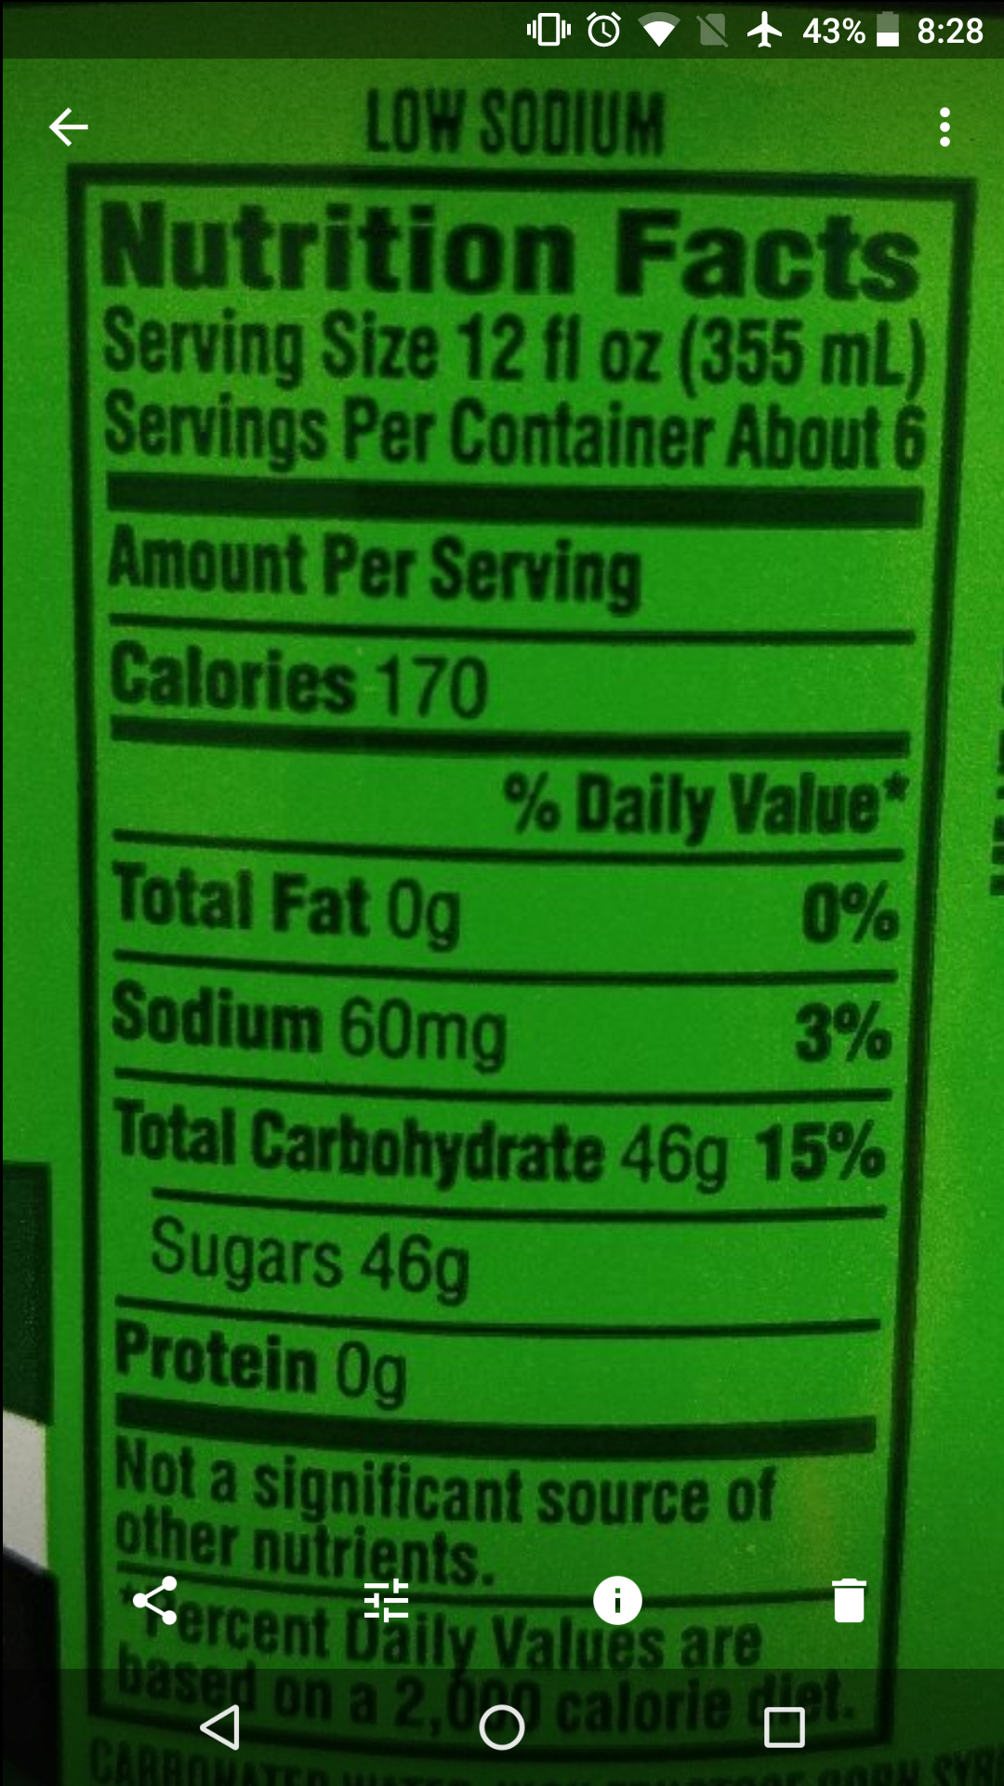
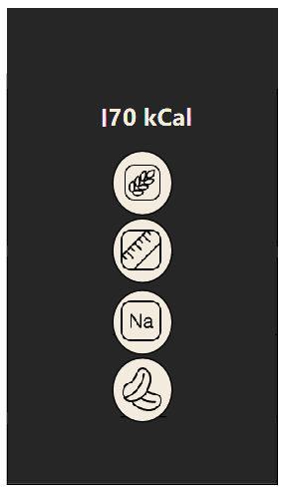
Low SODIUM Nutrition Facts Sewing Size 12 ﬂ oz (355 ml) Servings Per Container About 6 — Amount Per Sewing “ ‘ Calories 170 ‘1 “- % Daily Value‘ 5 TotalFatOg 0% ' M Sodium 60mg 3% V Total Carbohydrate 46g 15% \— SUQars 46g ‘— Prntein Og * N0! I - - f :9; 3002000 ° an: 1 I 0000205302000.“ “IRMA!" ..."..- .__.. _-....“
Low SODIUM Nutrition Facts Sewing Size 12 oz 355 ml Servings Per Container About 6 Amount Per Sewing Calories 170 Daily Value 5 Total Fat Og 0 M Sodium 60mg V Total Carbohydrate 15 SUQars 46g Prntein Og N0 I f9 3002000 an 1 I 0000205302000 IRMA nlllll Ml
visualize(data);

Slide 6
technically speaking
heuristic image processing (optical character recognition)
portable to any device via responsive web app
user database to allow logging of one’s diet across multiple devices

Slide 7
data has never been healthier

