Slide 1

Khulna University of Engineering & Technology
Department of Computer Science and Engineering
Project Report
ResearchHub – Thesis Management Platform
Name : Mutiur Rahman
Roll : 220797
Year : Third
Term : First
Course No : CSE 3100
Course Name : Web Programming Laboratory
Date of Submission : 20/07/2026

Slide 2
Abstract
Universities typically manage the thesis lifecycle through fragmented channels - email threads, shared drives, and messaging apps - resulting in lost documents, unclear deadlines, overwritten files, and no shared record of decisions between students and supervisors. ResearchHub is a centralized web application that addresses this by unifying the entire thesis workflow inside a single system: structured proposal submission and supervisor approval, automatic creation of a thesis workspace on approval, milestone and task tracking with dependency chains, versioned document uploads with SHA-256 checksums, meeting scheduling with optional Google Calendar/Meet integration, and threaded discussion with private supervisor notes.
The system is built on Laravel using server-rendered Blade views with Livewire for SPA-style navigation, and ships with a relational schema of thirteen application tables plus Laravel’s standard authentication infrastructure, running on MySQL in development. Three roles are supported - Student, Supervisor, and Admin - each with a distinct dashboard and permission set enforced through role middleware and explicit ownership checks.
This report documents the system’s architecture, database schema, and object model using Entity-Relationship and UML diagrams (class, use-case, sequence, and state diagrams), walks through its major functional modules, and presents annotated screenshots captured from a live, seeded instance of the running application.
Introduction
Supervising a thesis is a long, multi-stage collaboration between a student and a supervisor. In the absence of dedicated tooling, this collaboration fragments across email (proposal drafts and feedback), cloud drives (document versions, often with ad-hoc filenames such as "thesis_v3_final_FINAL.docx"), and messaging apps (meeting scheduling, quick questions). This causes three recurring problems: documents get overwritten or lost because there is no enforced version history; deadlines and milestones are tracked inconsistently or not at all; and there is no single, queryable record of what was agreed, when, and by whom.
ResearchHub was built to give a university department a single web application that every participant in the thesis lifecycle logs into, where the state of every proposal, thesis, milestone, document, and meeting is authoritative, timestamped, and access-controlled.

Slide 3
Objectives
Provide a structured proposal submission and review workflow with explicit approve / reject / request-revision decisions.
Automatically instantiate an active thesis workspace the moment a proposal is approved, eliminating manual project setup.
Track progress via milestones and tasks, including dependency ordering and automatically computed completion percentages.
Provide document management with immutable version history and integrity checksums, so no file is ever silently overwritten.
Support meeting scheduling, including optional one-click Google Calendar / Google Meet link generation.
Support threaded, role-aware discussion on each thesis, including supervisor-only private notes.
Enforce role-appropriate access (Student / Supervisor / Admin) throughout, with a seeded demo dataset for evaluation.
Requirement Analysis
User Roles
The system defines exactly three roles via a PHP backed enum (UserRole: Student, Supervisor, Admin). Students and Supervisors may self-register; the first Admin is bootstrapped through a one-time /setup email-code flow, and additional admins are created only by promoting an existing Student or Supervisor from the admin user-management screen.
Permission Matrix
Capability | Student | Supervisor | Admin
Self-register | Yes | Yes | No (promoted only)
Create / edit / submit proposal | Yes | No | No
Review & decide proposal | No | Yes | No
View own / supervised thesis | Own only | Supervised only | All (admin panel)
Submit final thesis | Yes | No | No
Create / edit / delete milestones & tasks | No | Yes (while open) | No
Complete milestone / update own task status | Yes | No | No
Schedule / edit / delete meetings | No | Yes | No
Post public comment | Yes | Yes | No
Post private (supervisor-only) note | No | Yes | No
Upload documents / new versions | Yes | Yes | No
Download documents | Own thesis | Supervised thesis | No admin route
Override thesis status | No | No | Yes
Manage users (role/department/active) | No | No | Yes
Manage departments (CRUD) | No | No | Yes
Connect Google Calendar | No | Yes | No

Slide 4
Functional Requirements
FR1 - Allow a Student to create, edit (while Draft/Revision-Requested), and submit a research proposal to a chosen active Supervisor.
FR2 - Allow a Supervisor to review a submitted proposal and record Approve / Reject / Request-Revision, with mandatory notes for the latter two.
FR3 - On approval, automatically create a Thesis linked 1:1 to the approved proposal, copying student, supervisor, and department.
FR4 - Allow a Supervisor to define Milestones (due dates, optional dependency) and Tasks under each milestone, assigned to the student.
FR5 - Automatically recompute a milestone’s progress percentage from its tasks, and block completion unless all tasks are done and any dependency is itself complete.
FR6 - Support thesis document uploads under categories (Proposal, Chapter, Appendix, Final, Other) as immutable, SHA-256-checksummed versions.
FR7 - Allow a Supervisor to schedule a Meeting and auto-provision a Google Calendar event with a Meet link when Google is connected and the meeting is Online.
FR8 - Support threaded comments (one level of replies), @mention parsing scoped to the thesis’s two participants, and supervisor-only private notes.
FR9 - Gate final thesis submission on the presence of an uploaded Final-category document.
FR10 - Provide role-specific dashboards with live counts (pending reviews, active theses, overdue milestones, totals).
FR11 - Provide an Admin interface for department CRUD and user role/status management, including confirmed promotion to Admin.
System Design
System Architecture

Slide 5
Schema Diagram

Slide 6
Use Case Diagrams

Slide 7
Use Case Diagrams

Slide 8
Sequence Diagrams - Proposal
Sequence Diagrams - Meeting

Slide 9
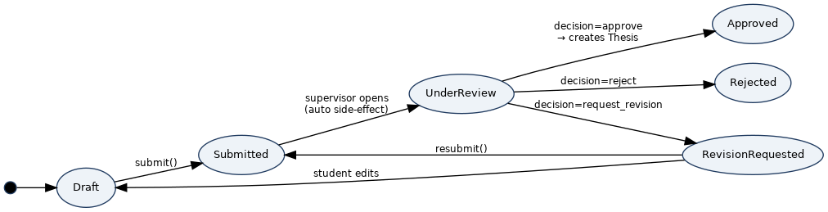
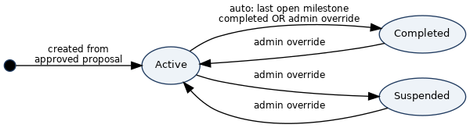
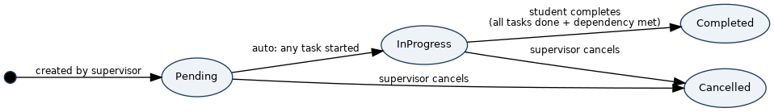
State Diagrams
Tech Stack
Package / Tool | Role
laravel/framework | Core application framework
php | Language runtime
livewire/livewire | wire:navigate SPA-style page transitions only
guzzlehttp/guzzle | HTTP client used by the Composio integration service
vite | Frontend build tool
tailwindcss / @tailwindcss/vite | Utility-first CSS framework
laravel-vite-plugin | Laravel ↔ Vite bridge

Slide 10
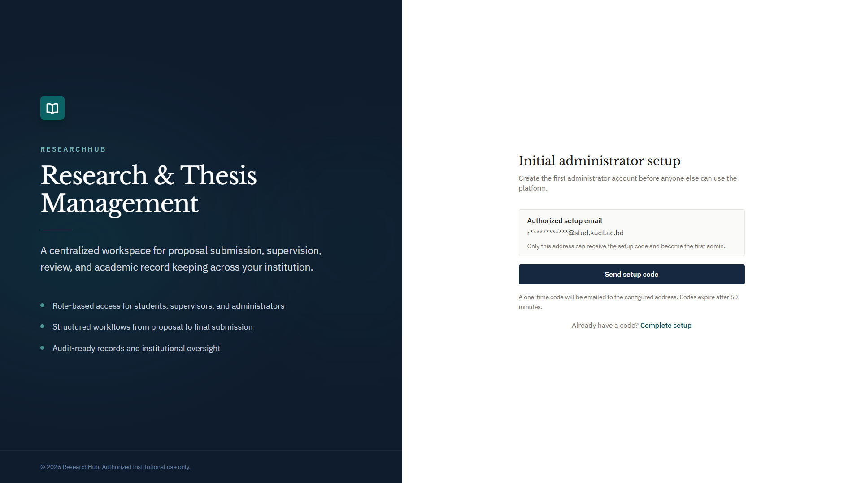
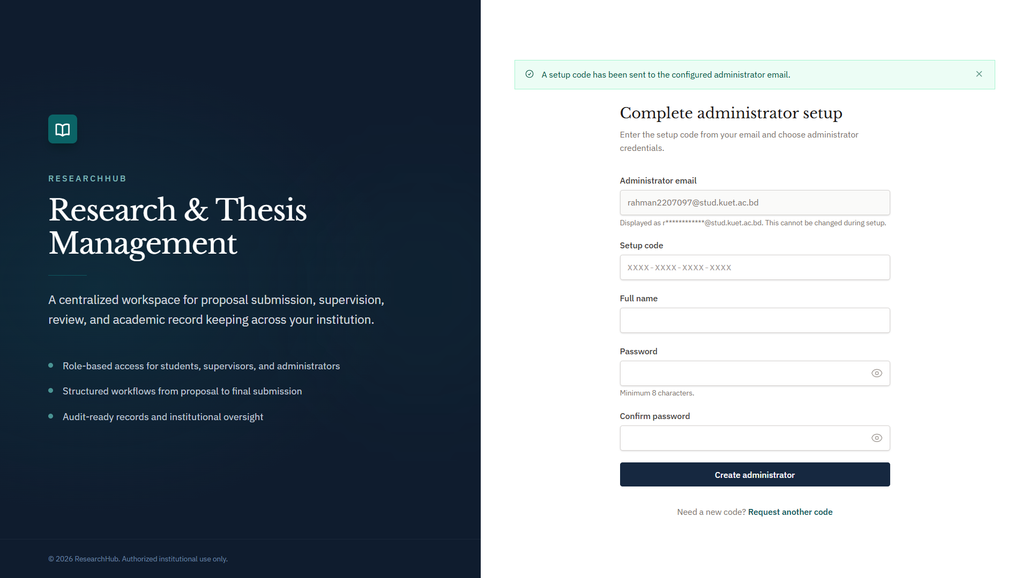
Live Application Walkthrough - Admin Profile
Setup
Setup Code Sent

Slide 11
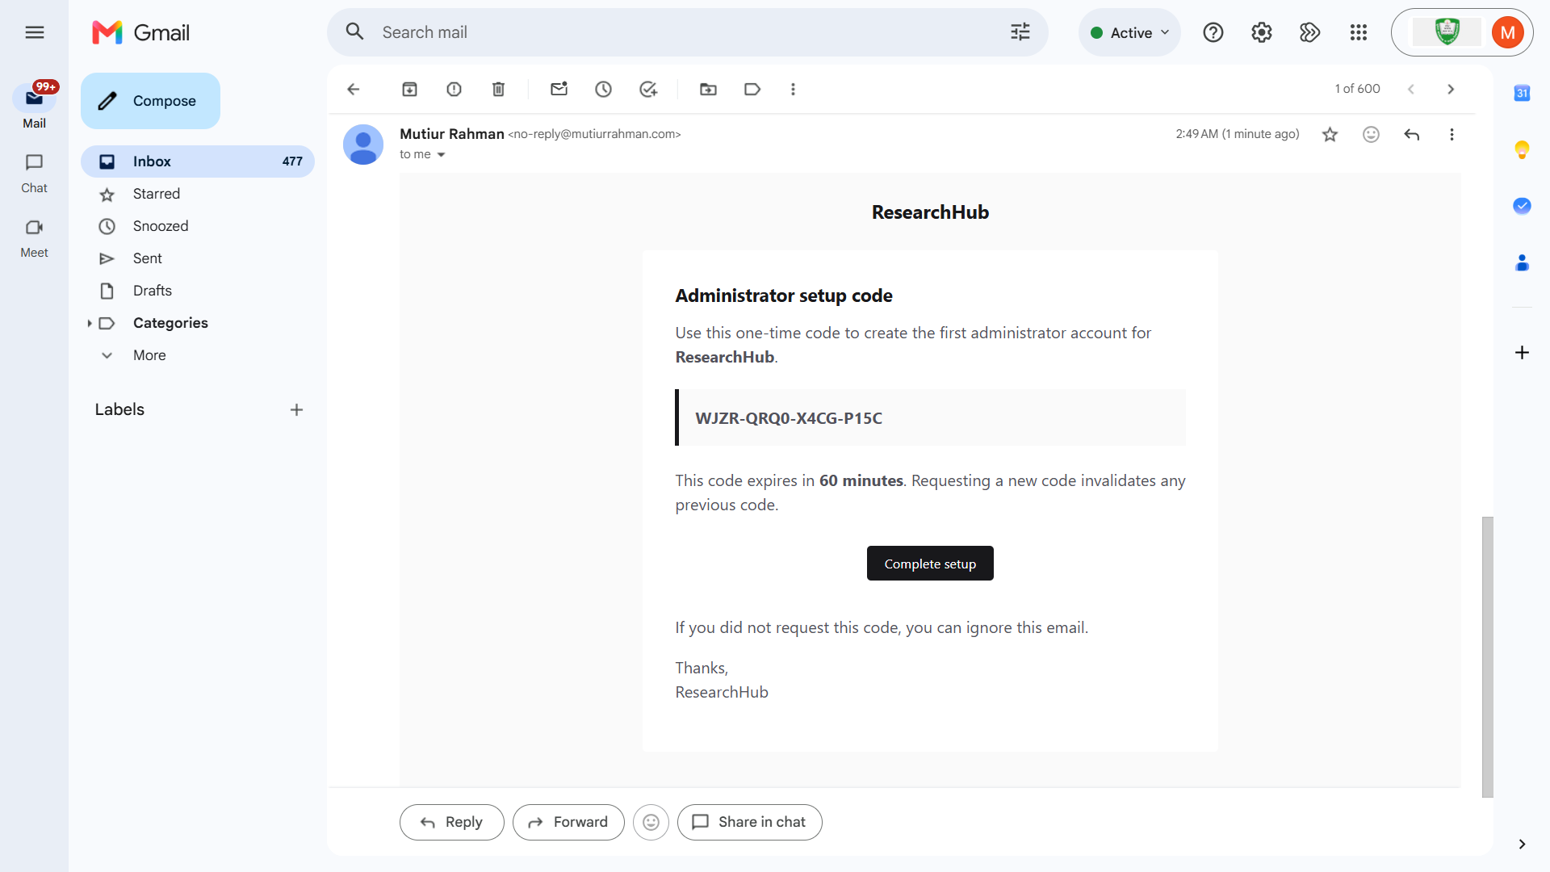
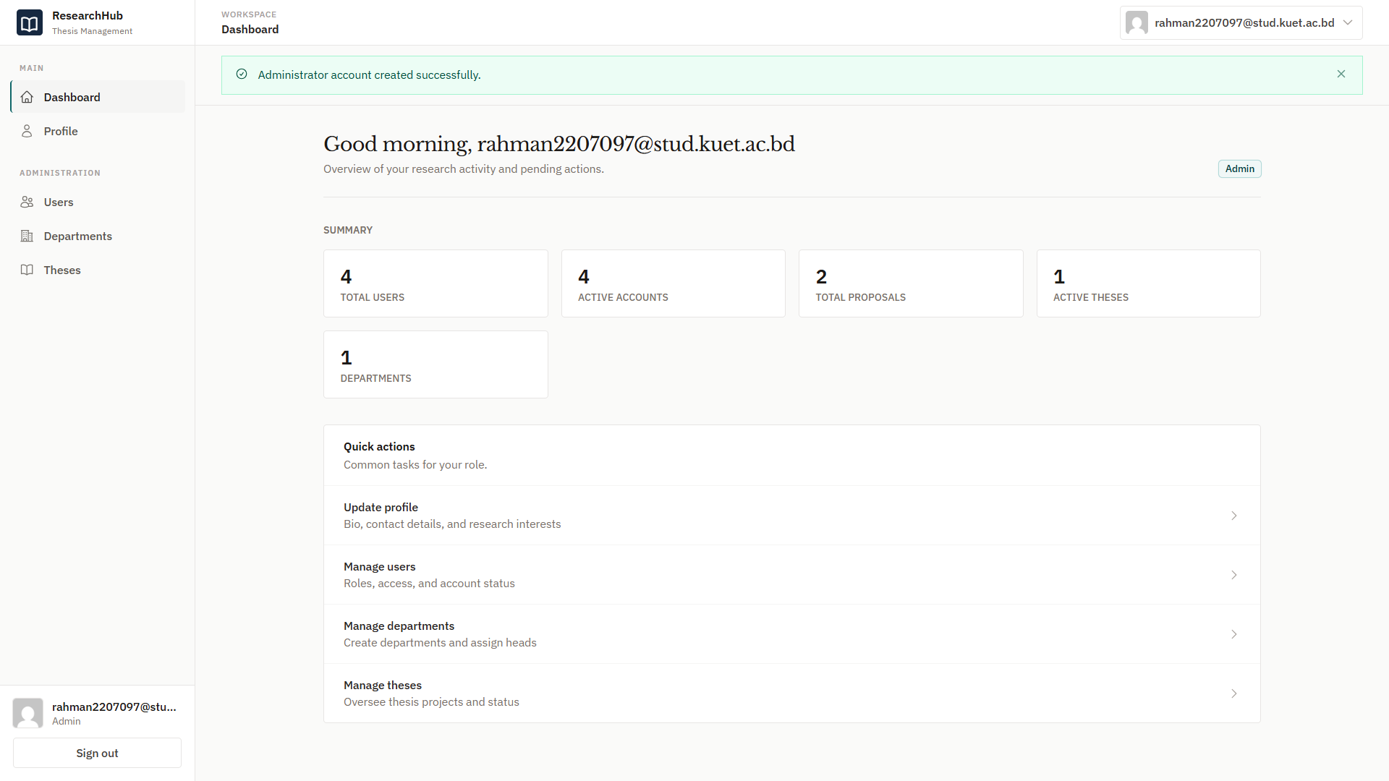
Email Received
Admin Created

Slide 12
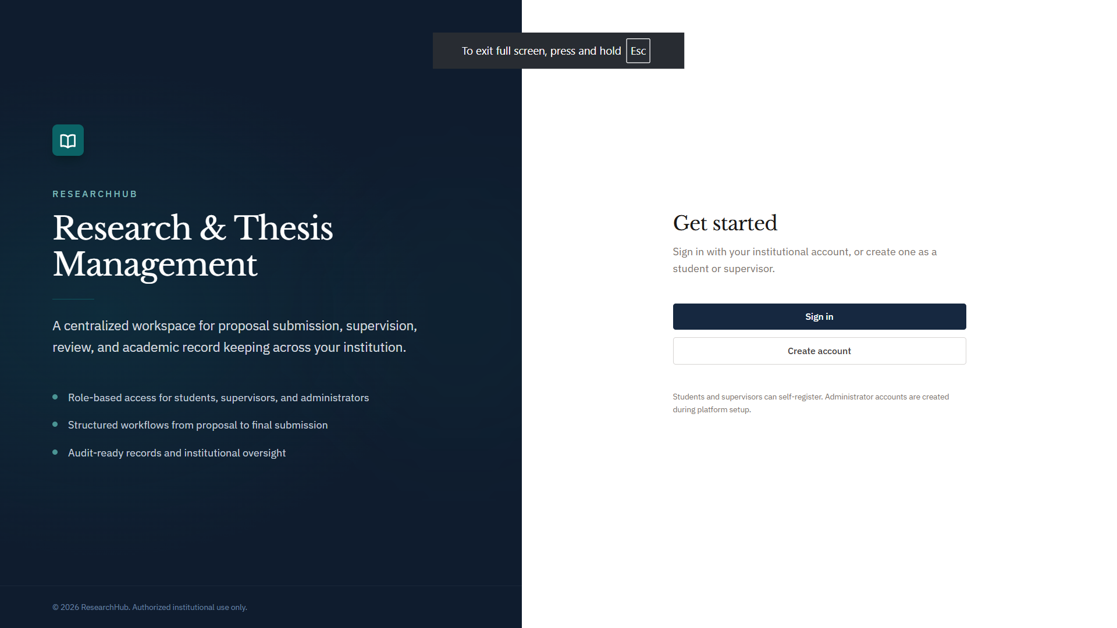
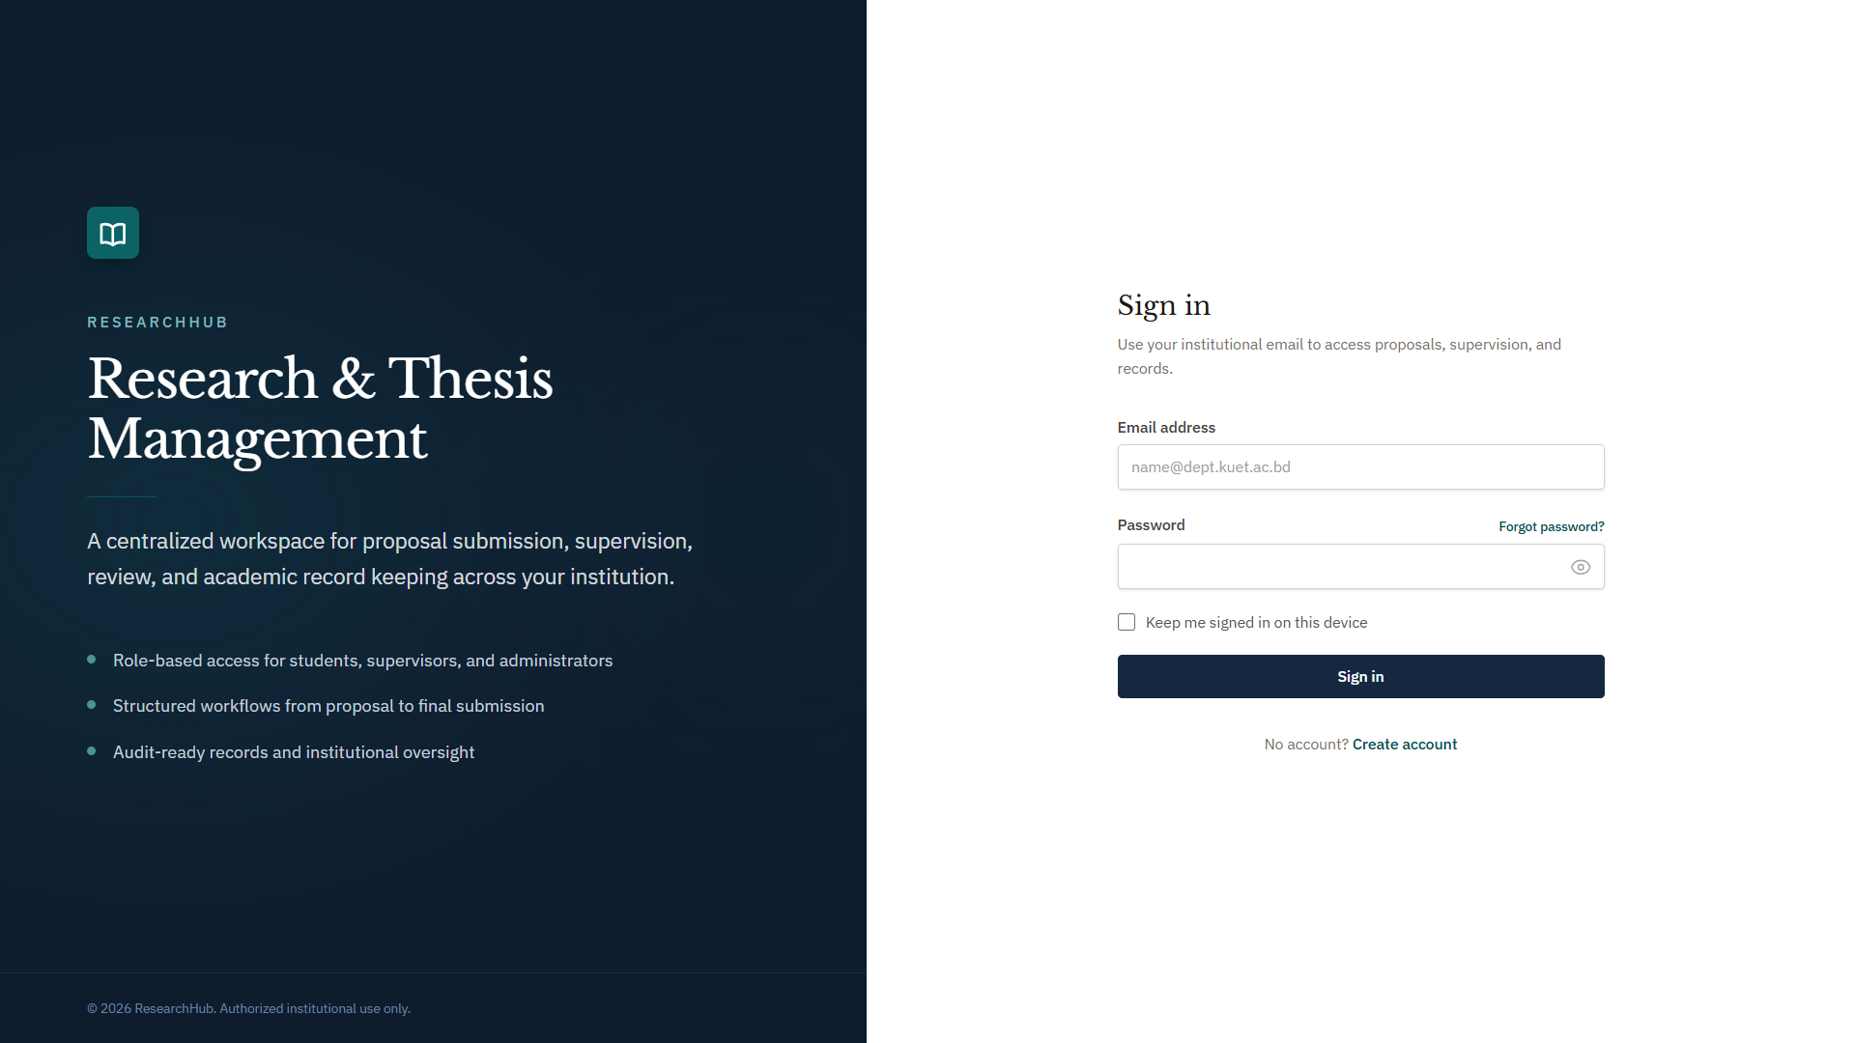
Live Application Walkthrough - Student Profile
Home Page
Login Page

Slide 13
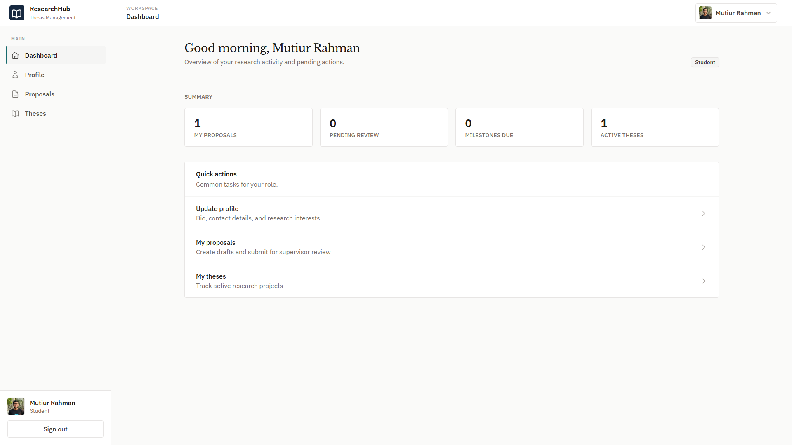
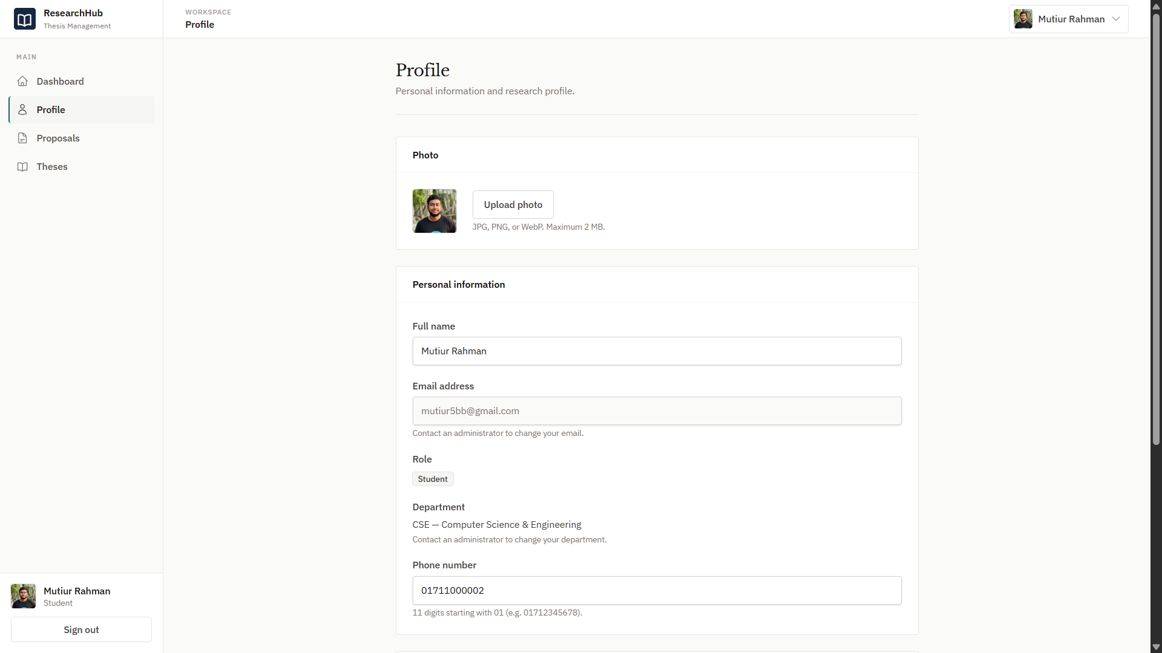
Student Dashboard
Student Profile

Slide 14
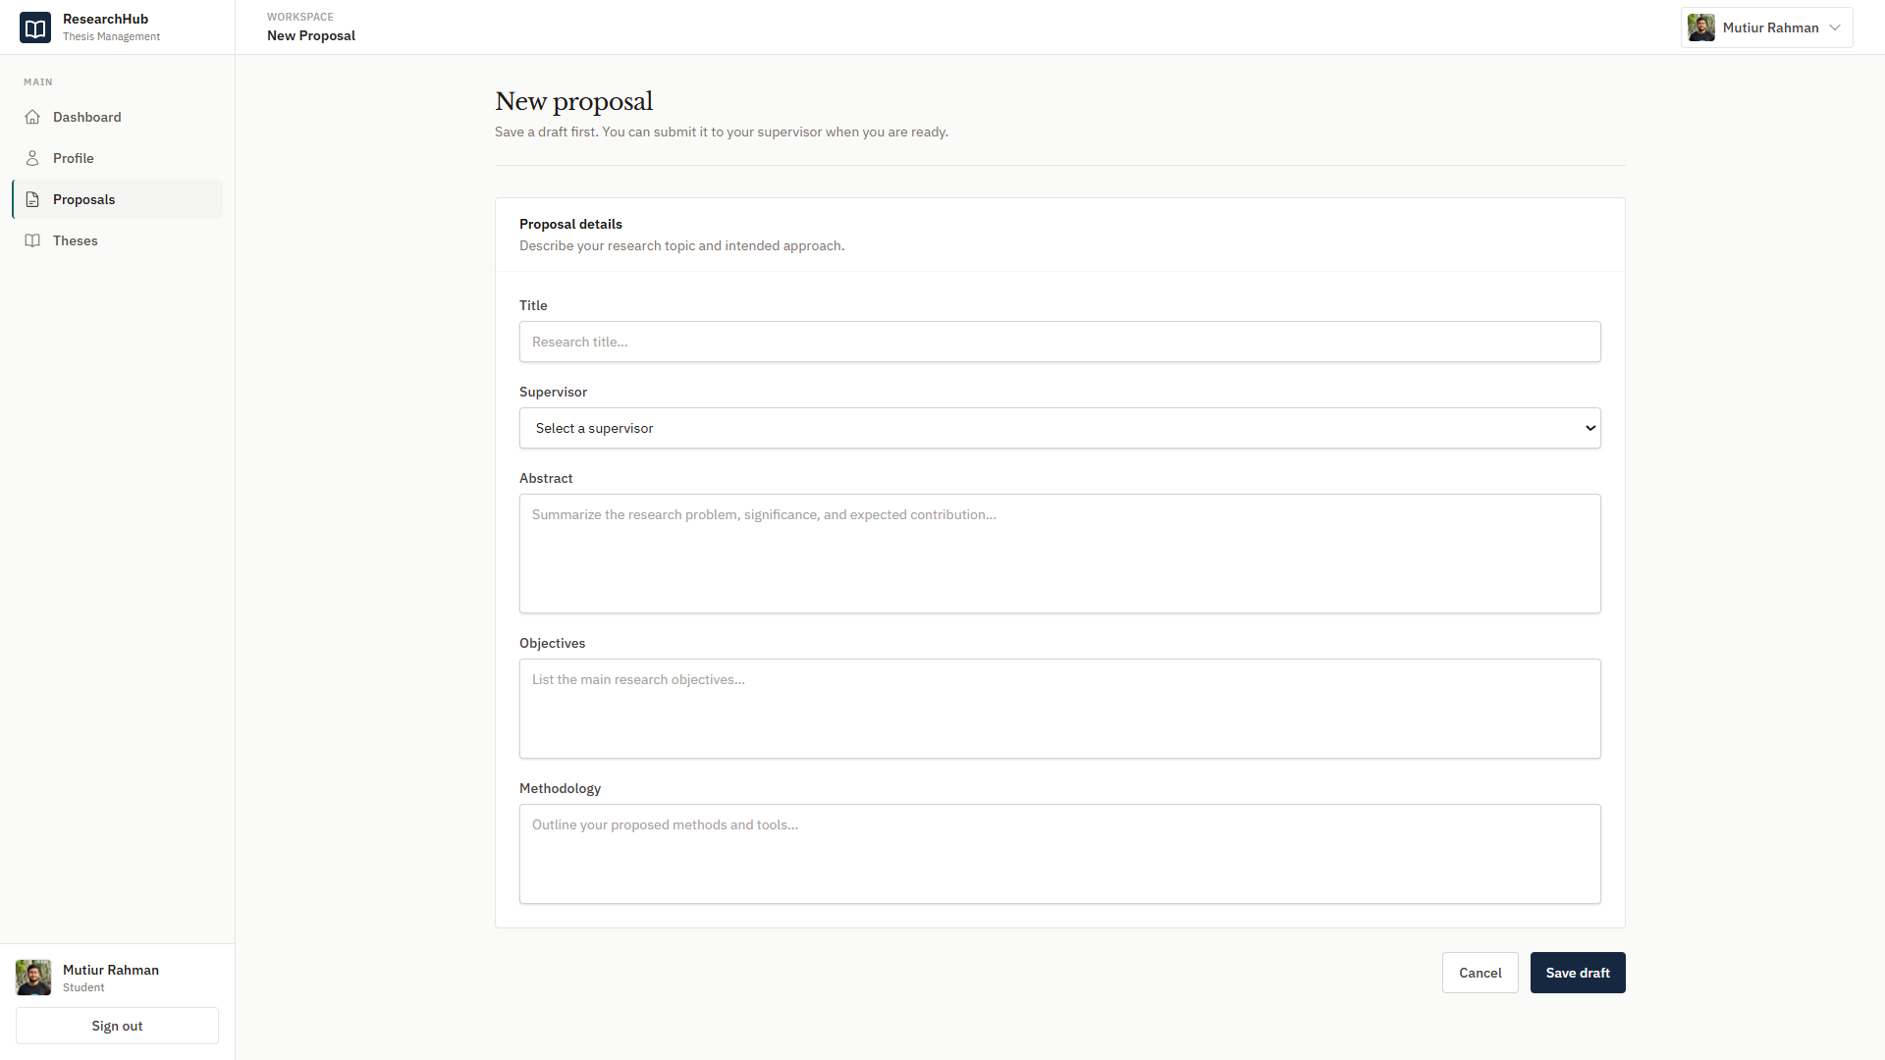
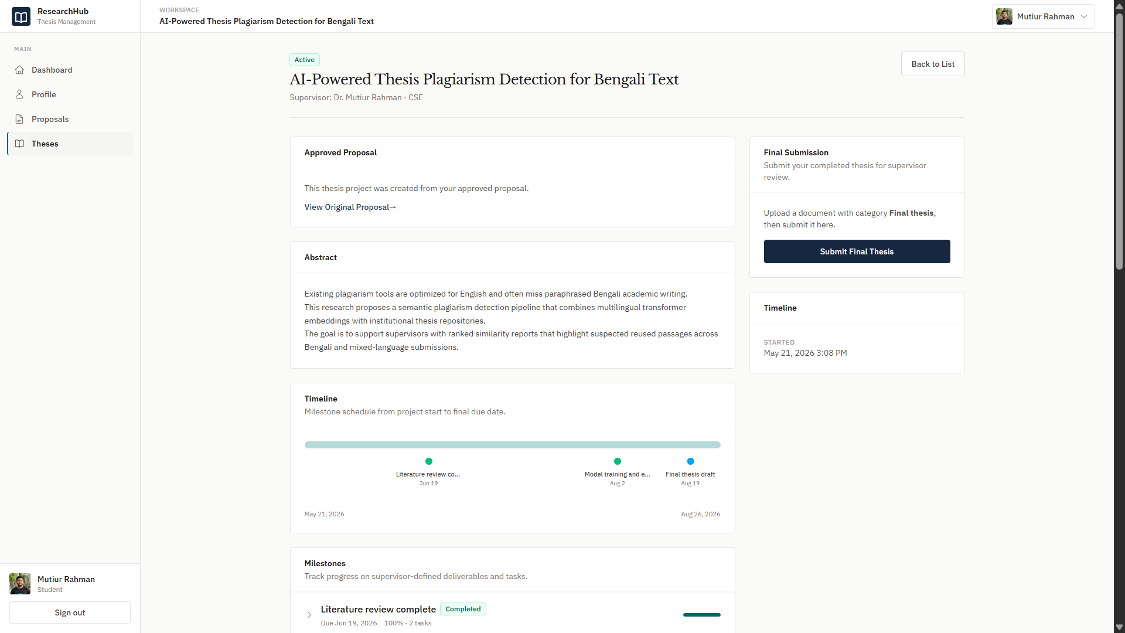
Proposal Page
Thesis Page -1

Slide 15
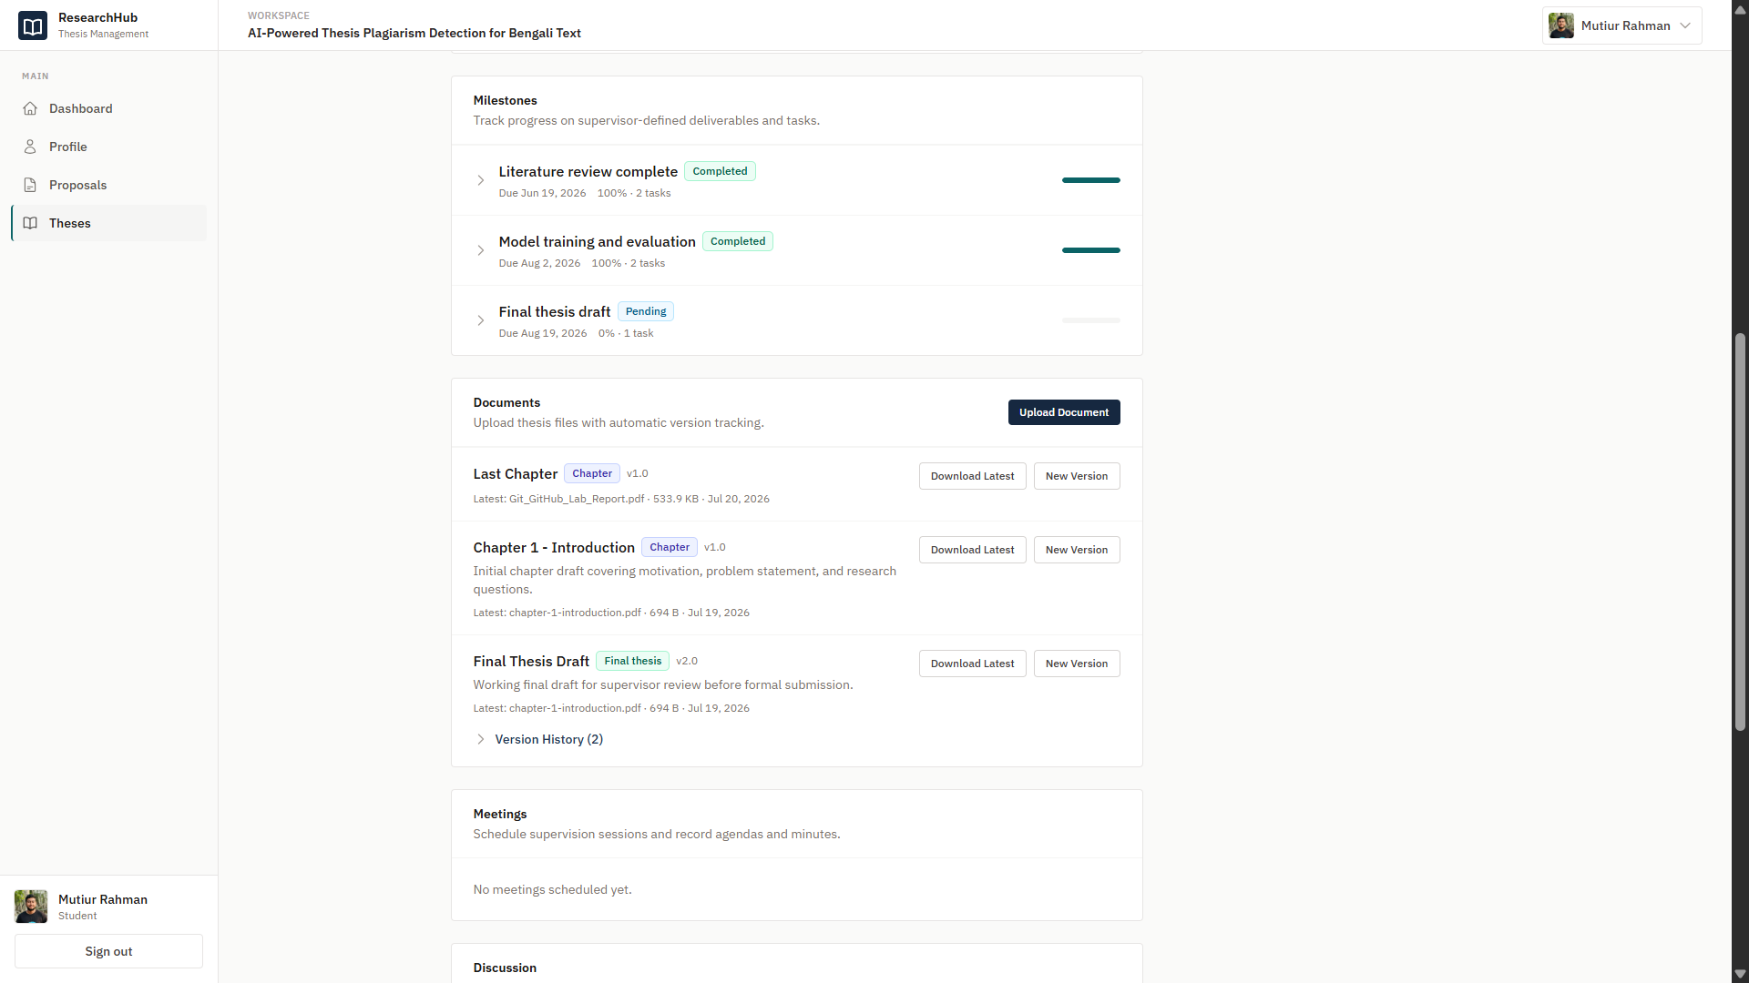
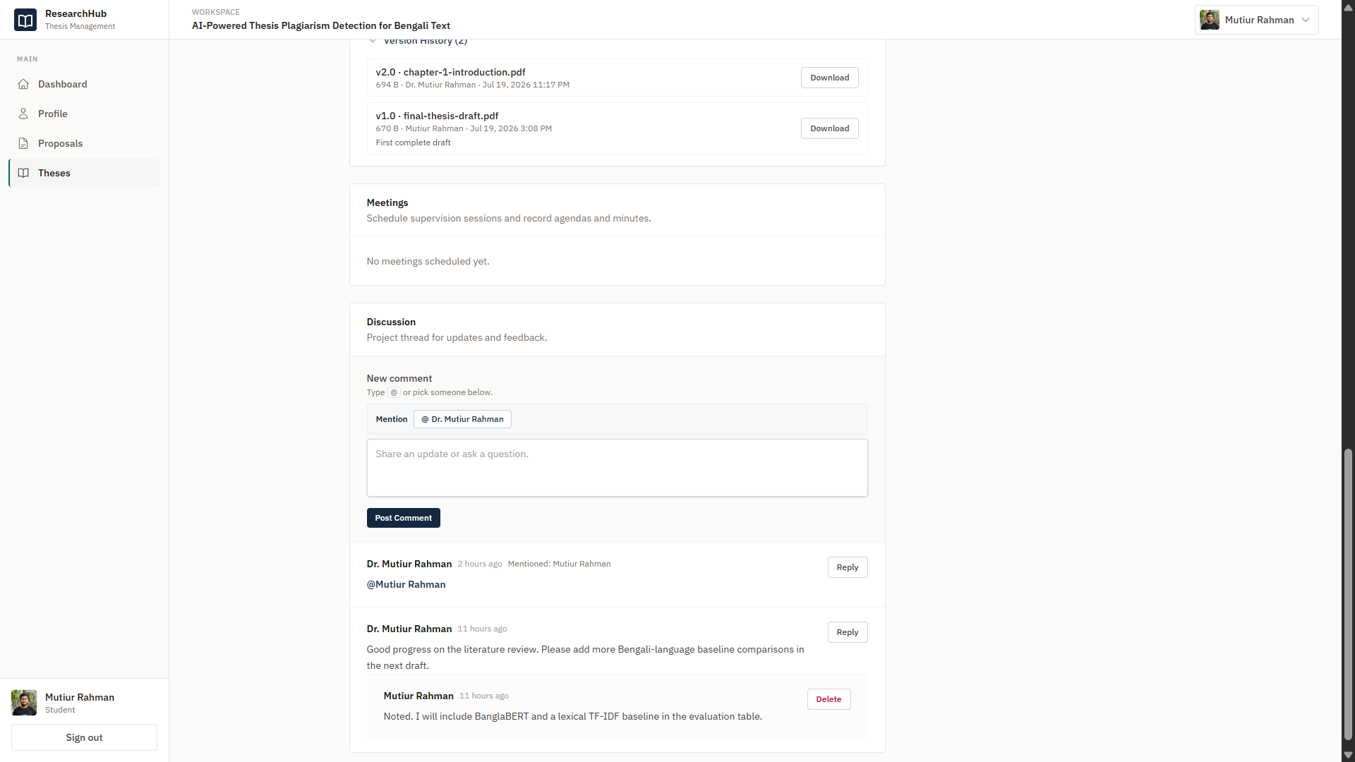
Thesis Page -2
Thesis Page -3

Slide 16
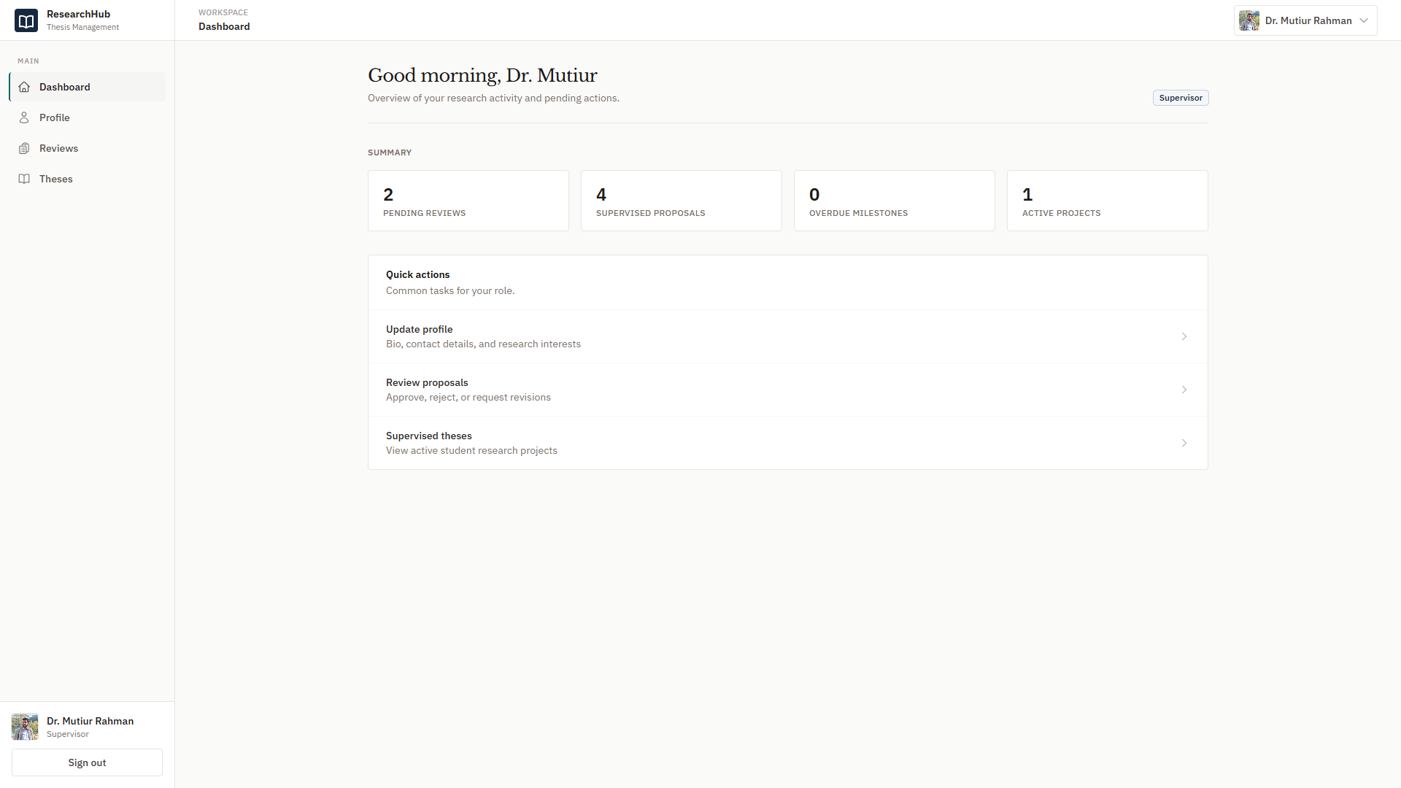
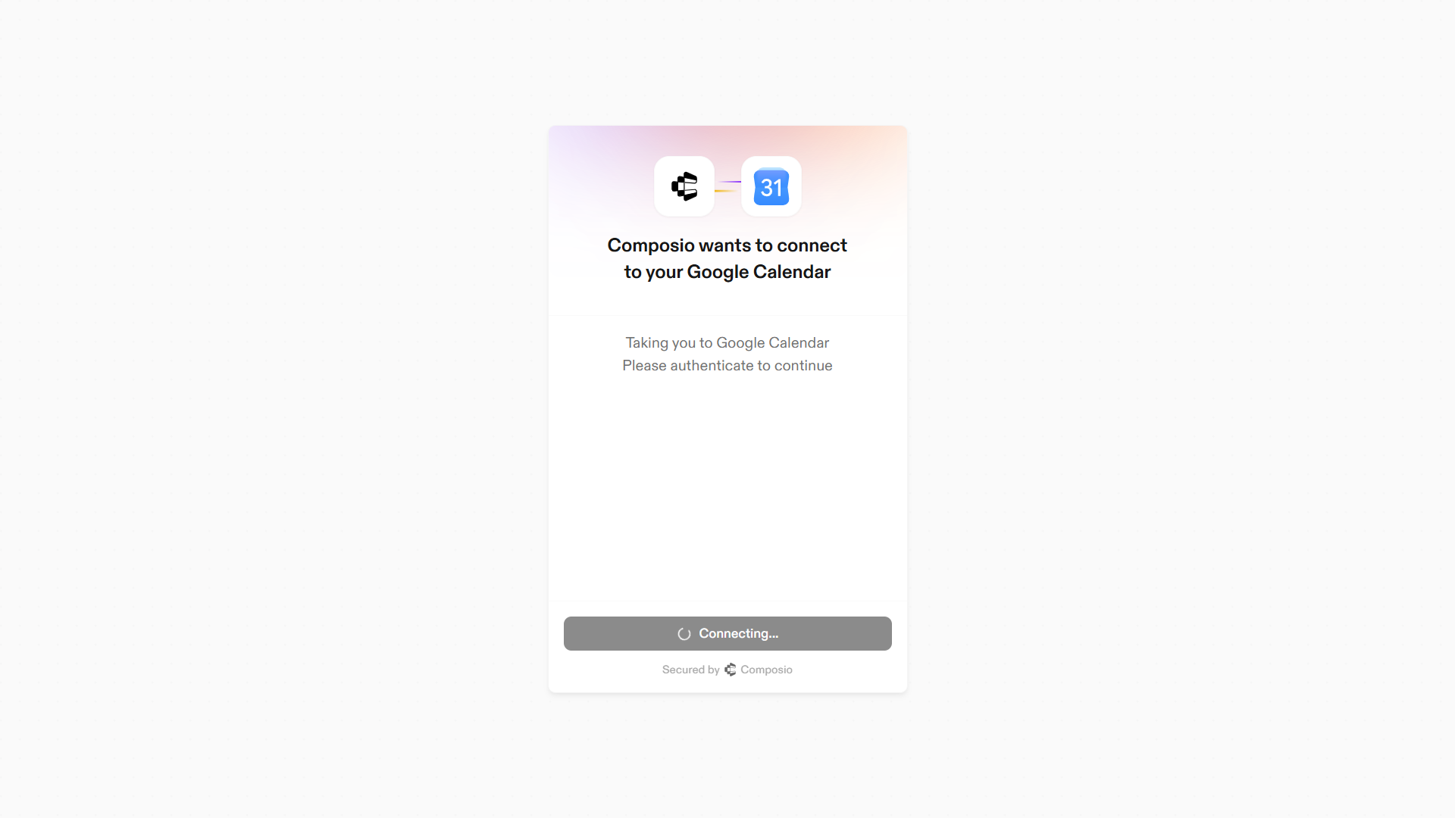
Live Application Walkthrough - Supervisor Profile
Dashboard
Composio Connection for Meeting

Slide 17
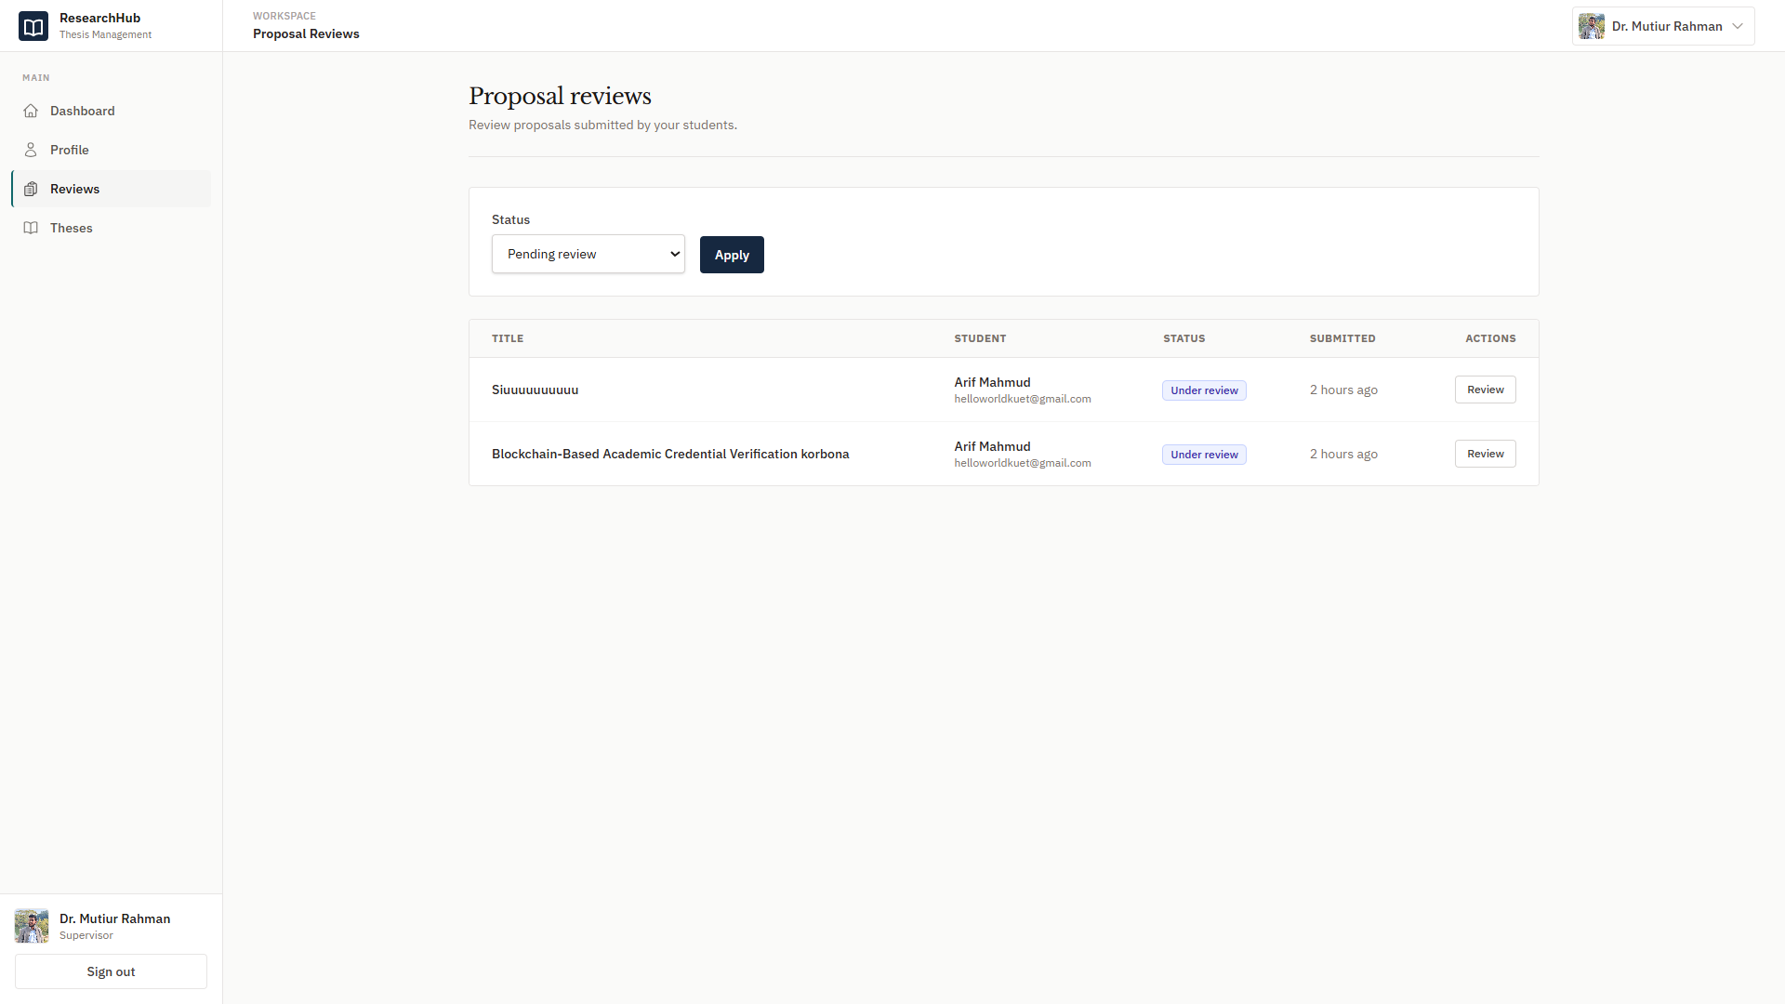
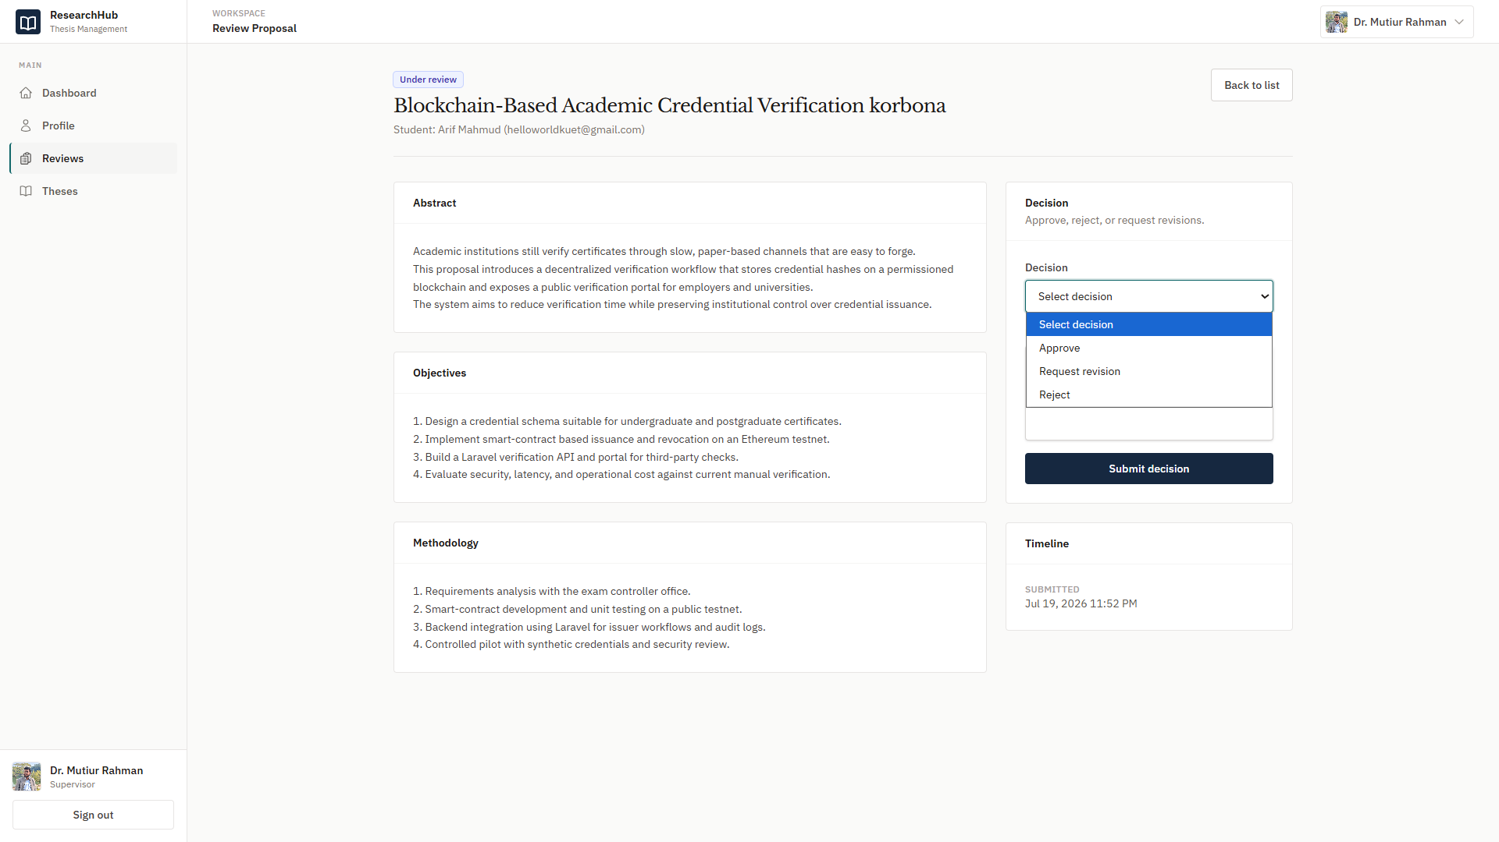
Proposal Review Page
Proposal Response Page

Slide 18
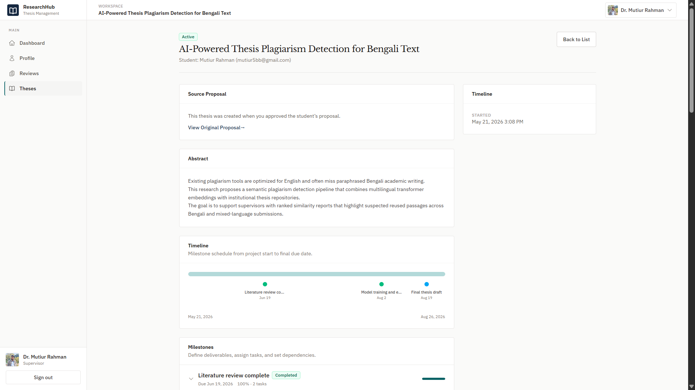
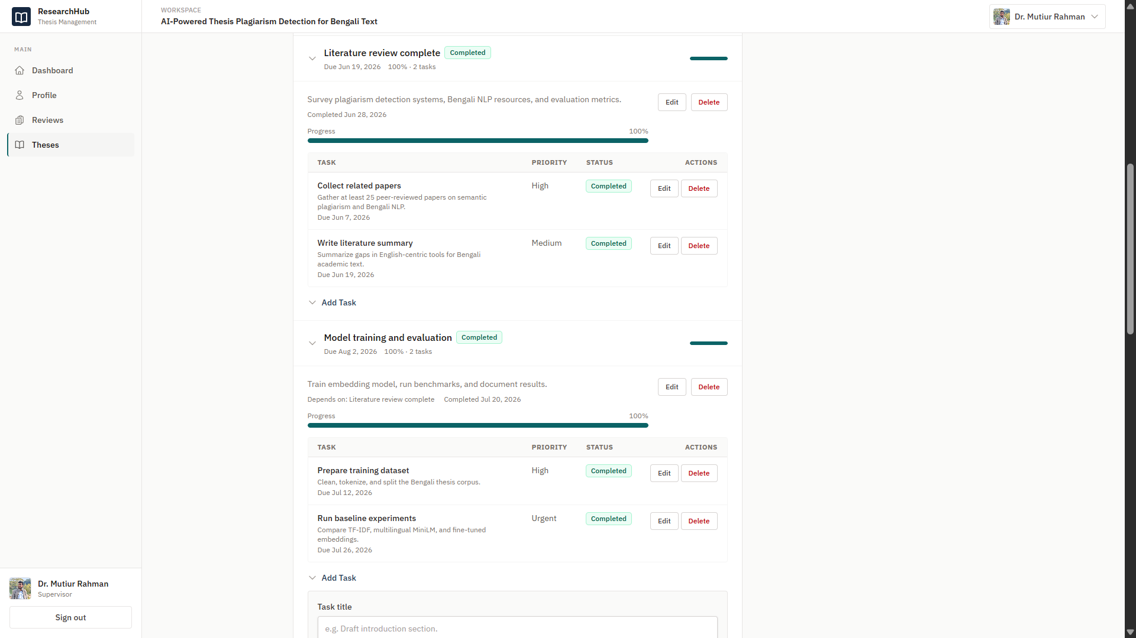
Thesis Supervise Page -1
Thesis Supervise Page -2

Slide 19
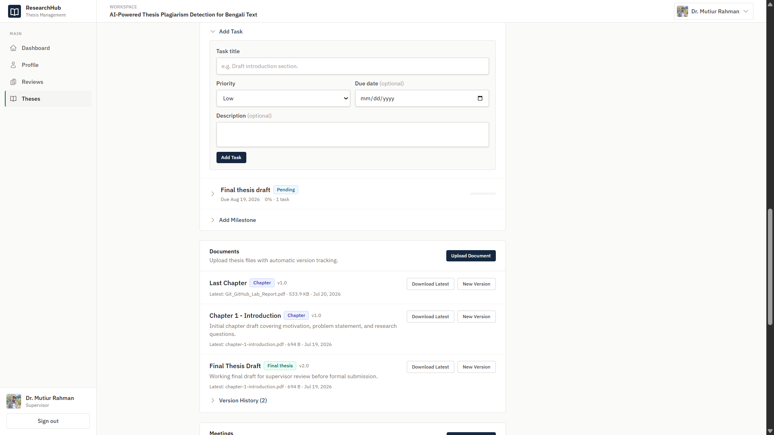
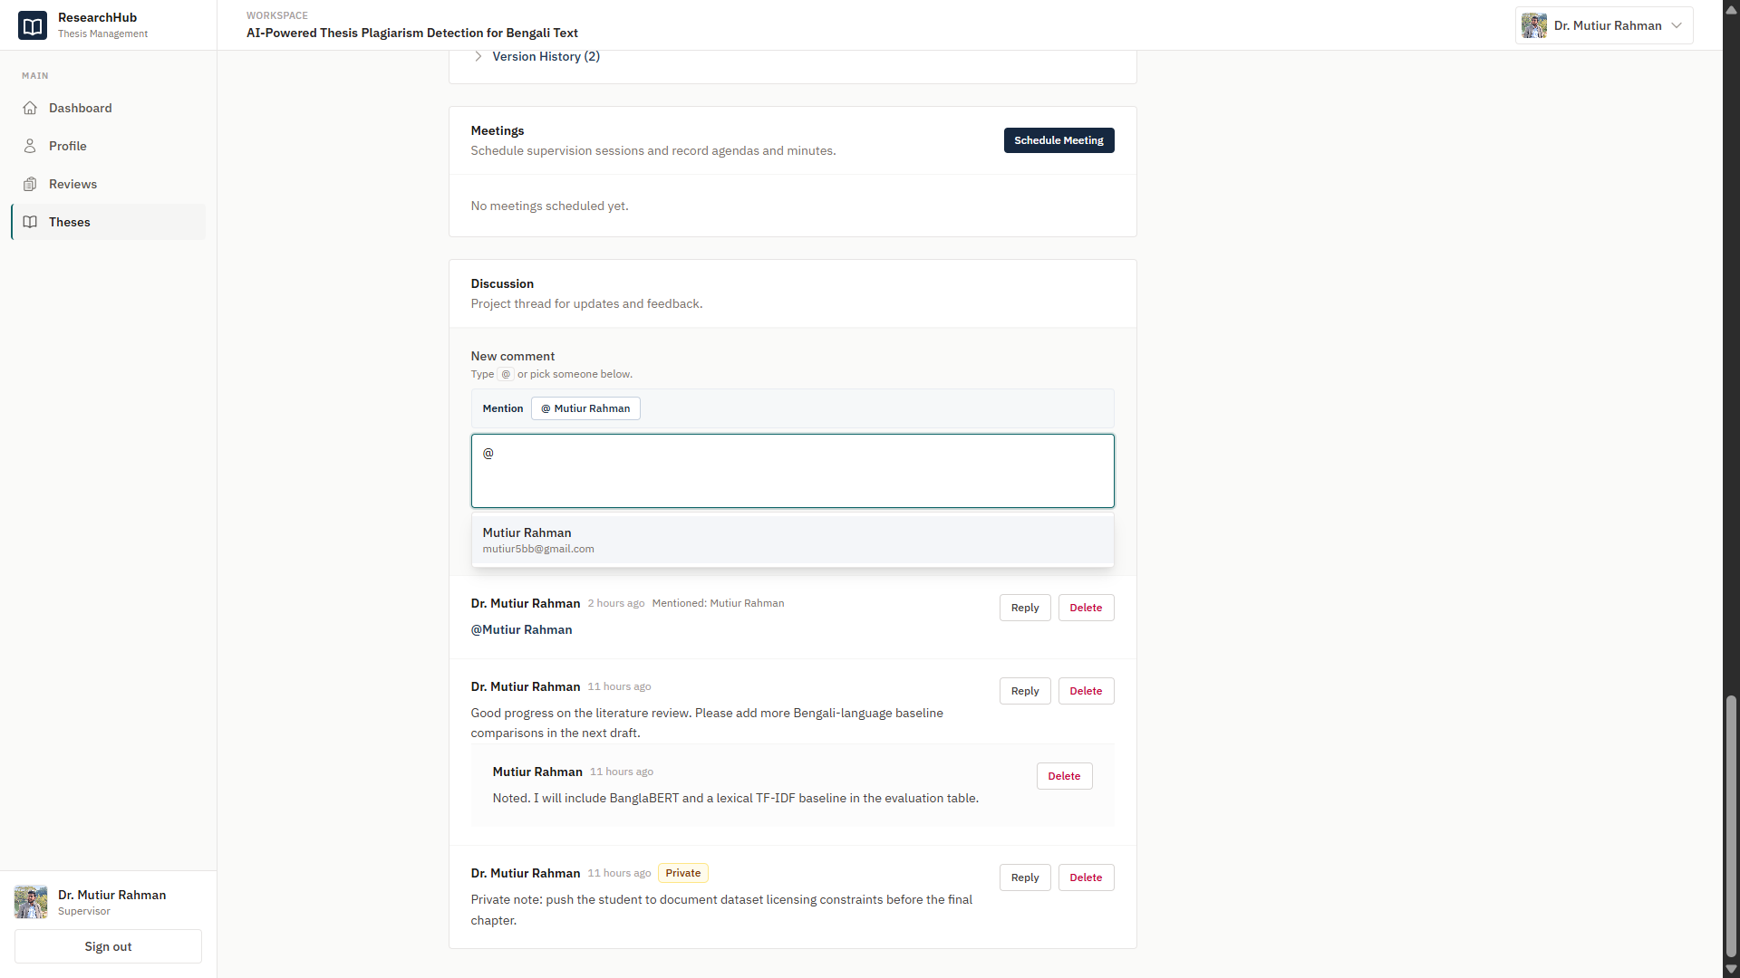
Thesis Supervise Page -3
Thesis Supervise Page -4

Slide 20
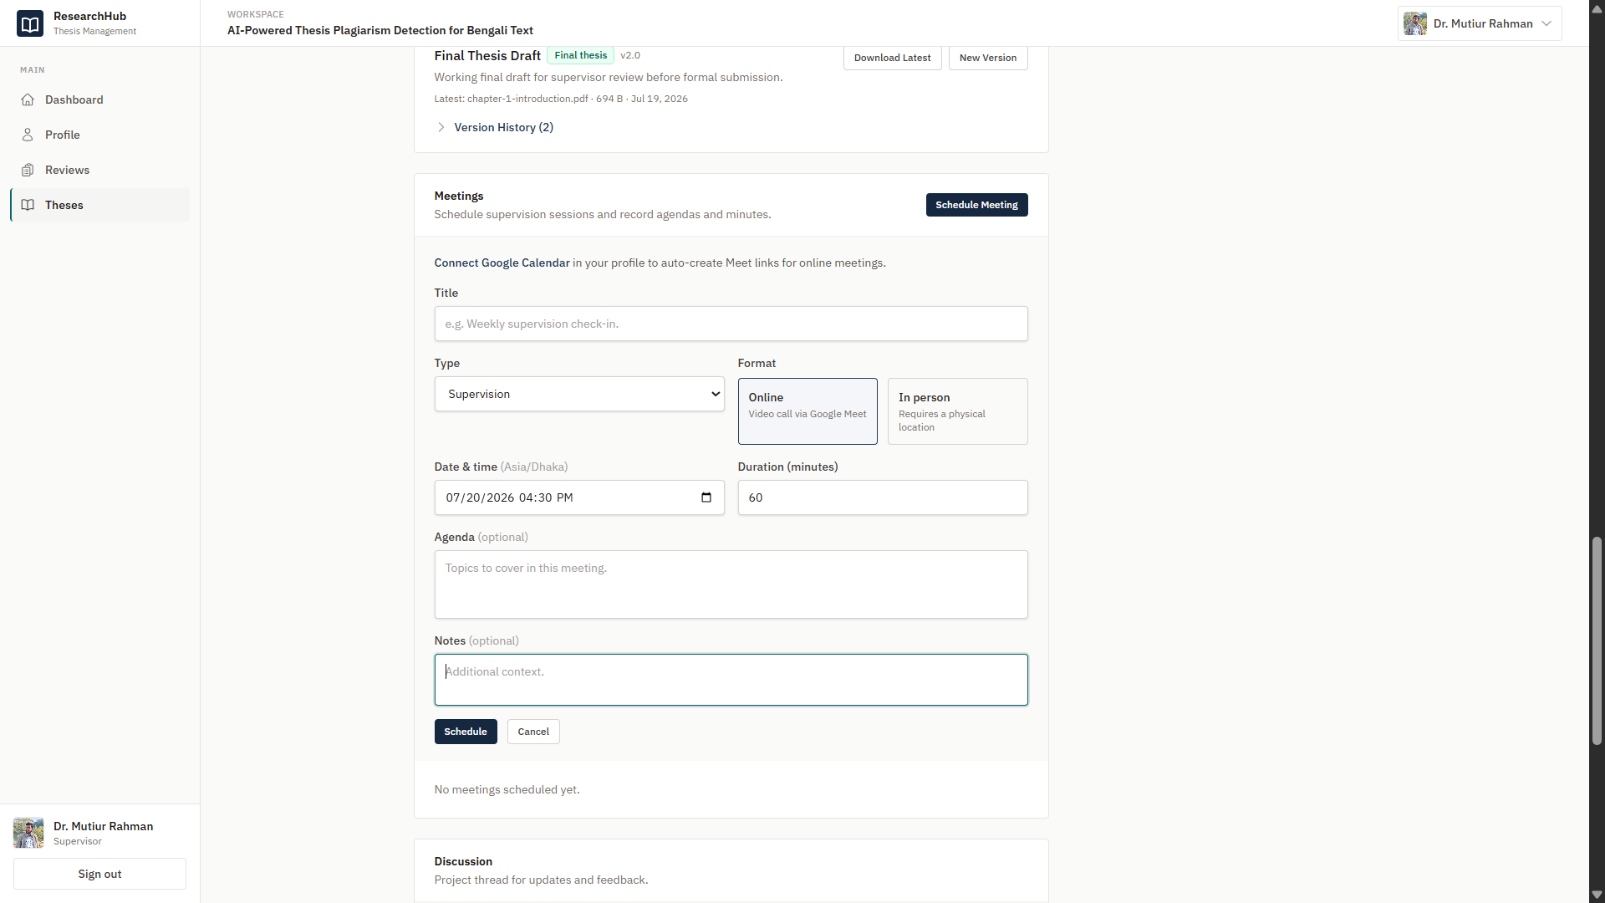
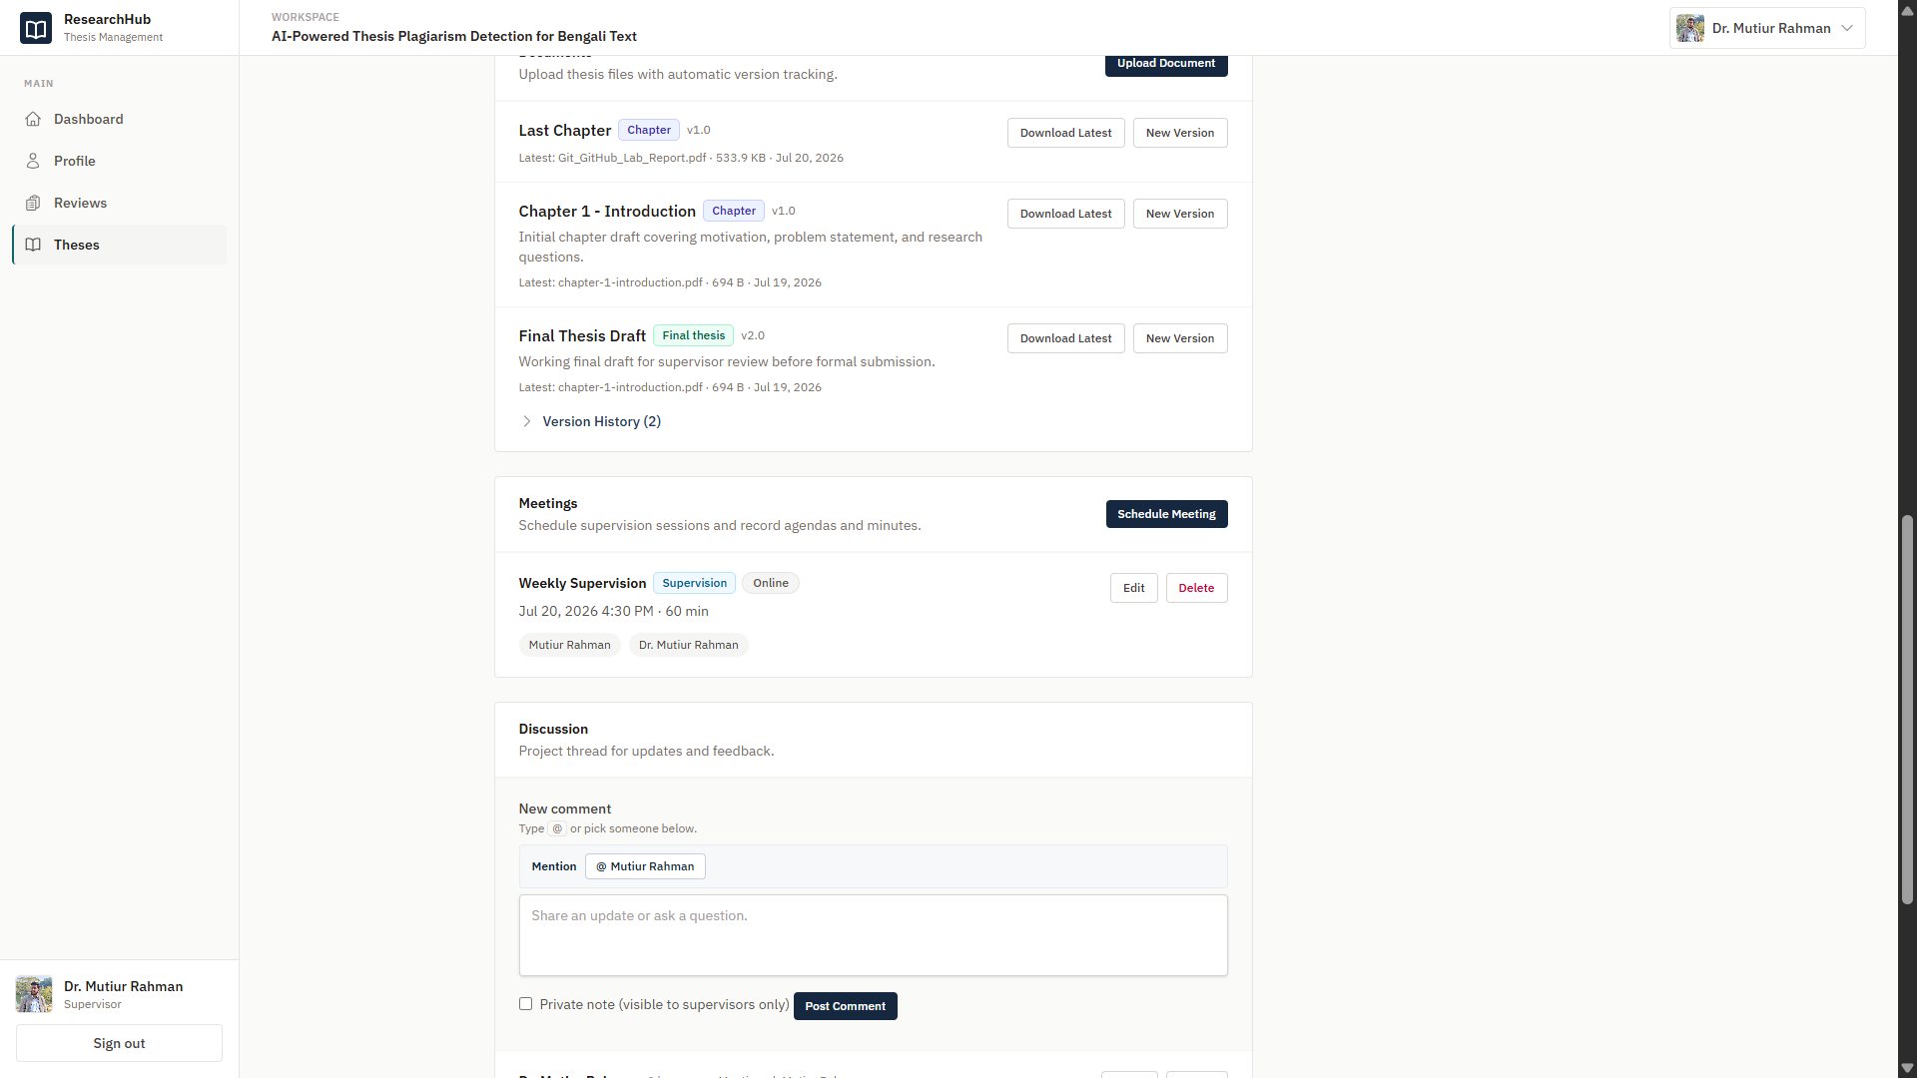
Meeting Manage - 1
Meeting Manage - 2

Slide 21
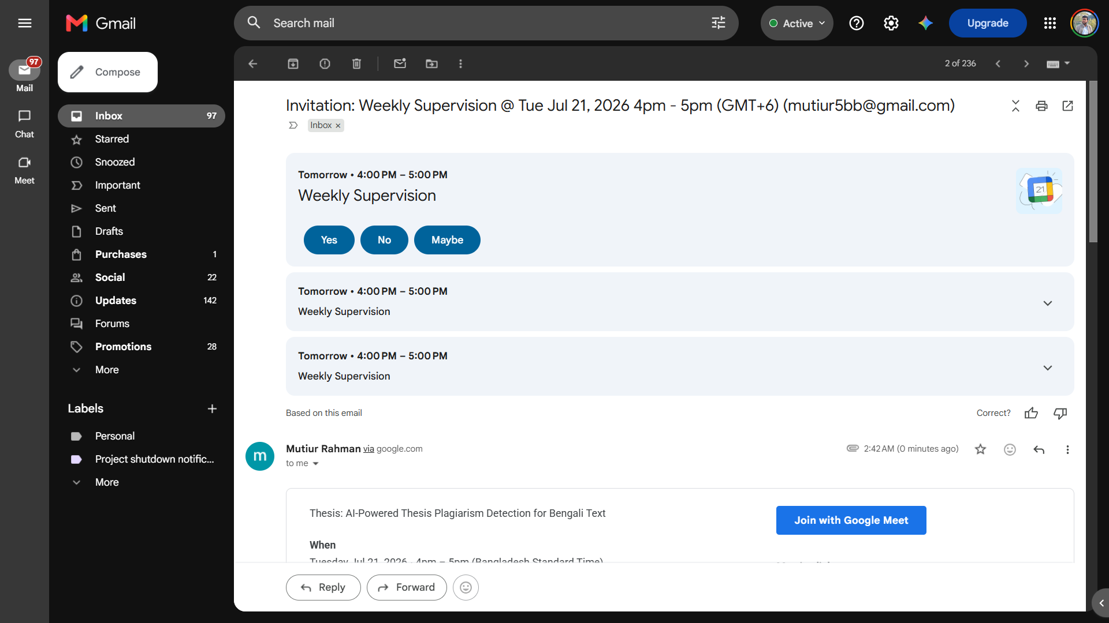
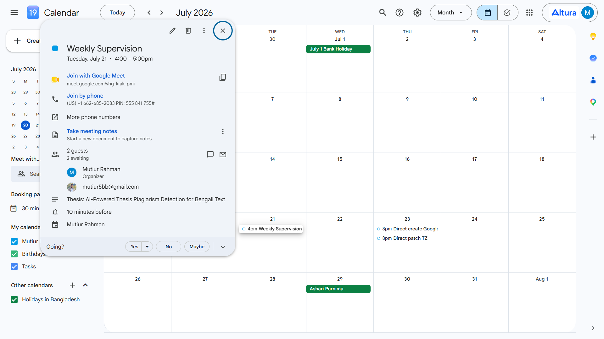
Meeting Manage - 3
Meeting Manage - 4

Slide 22
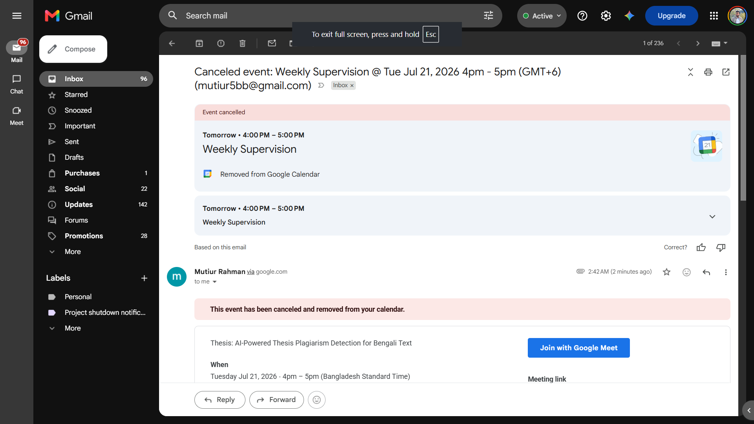
Meeting Manage - 5

