Slide 1
DATABASE SYSTEMS LABORATORY • CSE3110
ScrumLab
A Scrum-Style Project Management System
Built on Laravel + Oracle Database & PL/SQL
Presented by Mutiur Rahman (2207097)

Slide 2
OVERVIEW
What We'll Cover
01
02
03
The Problem
Product Overview
Architecture
Why teams need structured issue & sprint tracking
What ScrumLab is and who it's for
Laravel application layer + Oracle database layer
04
05
06
App Walkthrough
PL/SQL Engine
Advanced SQL
Feature-by-feature tour with screenshots
Functions, procedures, triggers & views
Set operators, window functions & HAVING beyond PL/SQL
07
Demo & Wrap-up
Sample queries, testing approach, and conclusion
02

Slide 3
MOTIVATION
The Problem: Work Gets Lost Without Structure
1
Software teams juggle dozens of small tasks, bugs, and stories at once
Jira solves this for industry —
2
Spreadsheets and chat threads don't track ownership, status, or history
ScrumLab solves it for learning.
A self-built Scrum tracker gives us full control over the schema, the workflow rules, and the database logic underneath — instead of treating it as a black box.
3
Sprint progress and team workload are invisible without a shared system
Status changes need to be trustworthy - not just "whatever the last message said"
4
03

Slide 4
PRODUCT
What Is ScrumLab?
ScrumLab is a web-based Scrum and issue-tracking system — inspired by Jira — where teams plan projects, run sprints, and manage the full lifecycle of an issue from idea to done.
1
2
3
4
Projects
Sprints
Issues
Boards
Workspaces with a name, key, owner & members
Time-boxed cycles that pull work off the backlog
Epics, Stories, Tasks & Bugs with full workflow
Kanban-style columns driven by issue status
04

Slide 5
FEATURE SET
Core Capabilities
1
Auth
2
Projects
3
Members
4
Teams
Registration & login with credentials stored in the database
Project workspace, key, description, ownership
Per-project membership with an assigned role
Team membership scoped to a project
5
Roles
6
Issues
7
Sprints
8
Boards
Admin, Project Owner, Scrum Master, Developer, Viewer
Epic → Story/Task/Bug hierarchy with parent linking
Planning, active, and completed sprint states
Columns generated from live issue status
9
Comments
10
Activity Log
11
Notifications
12
Reports
Threaded discussion attached to each issue
Every change recorded automatically
Assignment, comment, status & sprint alerts
Leaderboards, rollups & team insights via SQL
05

Slide 6
TECHNOLOGY
Tech Stack
Backend
Laravel (PHP 8.2)
Routing, controllers, Eloquent models, auth
Frontend
Blade + Livewire + Vite
Server-rendered views, reactive board & forms
Database
Oracle Database 21c XE
yajra/laravel-oci8 driver — Oracle only, no MySQL/SQLite in prod
DB Logic
PL/SQL
Functions, procedures, triggers & views run inside the database
Testing
PHPUnit
Feature + unit tests against a separate Oracle test schema
06

Slide 7
SYSTEM DESIGN
Architecture: Where the Database Does the Work
Laravel App
Oracle Database
• Controllers validate & route requests
Tables 9 core tables + constraints
Browser
Functions count_open_issues, fn_sprint_velocity, fn_project_health…
• Eloquent models map to Oracle tables
Blade + Livewire UI
(Board, Backlog, Issue detail)
Procedures update_issue_status, rollup_parent_issue_status
• SqlDialect helper calls PL/SQL directly
Triggers status rollup, audit log, role validation
• Livewire components drive the live board
Views v_issue_full, v_project_stats
Design principle: critical rules (status rollups, audits, role checks) live in the database itself — so they hold even if a change bypasses the app.
07

Slide 8
Database Schema

Slide 9
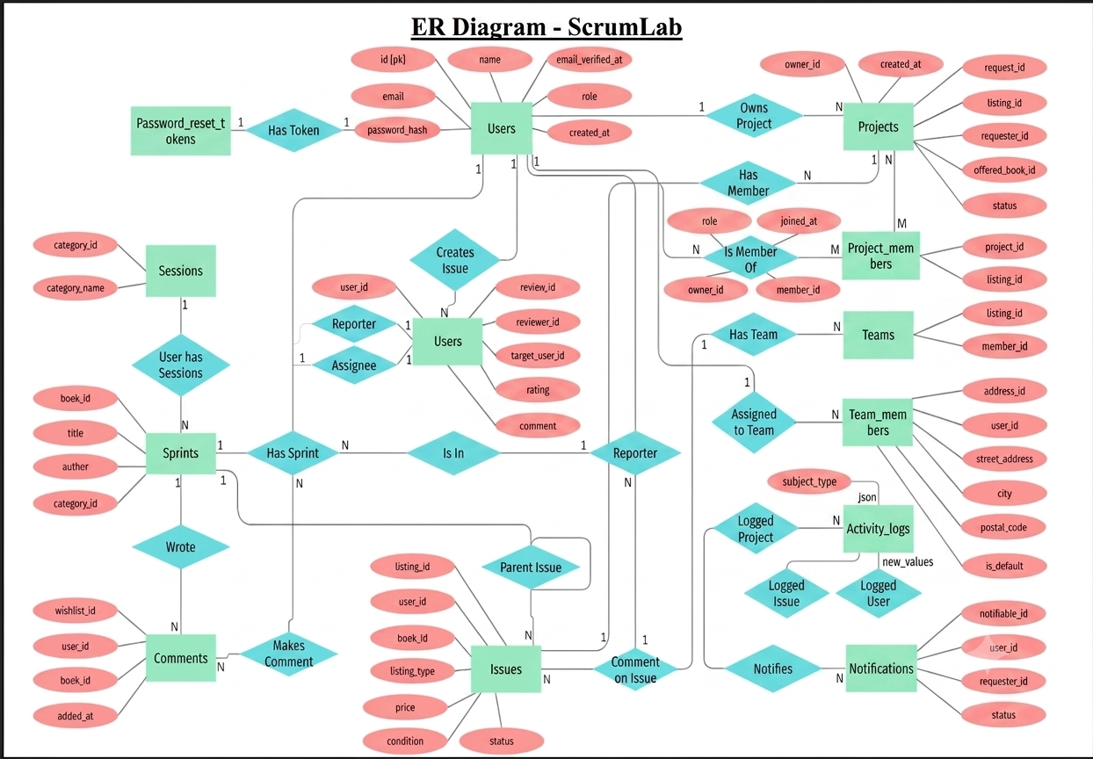
ER Diagram

Slide 10
DATA MODEL
Database Schema — Identity & Ownership
Table
Key Columns & Constraints
users
id PK · name · email UNIQUE · password · avatar · job_title
projects
id PK · owner_id FK → users · name · key UNIQUE · status
project_members
id PK · project_id FK → projects · user_id FK → users · role · UNIQUE(project_id, user_id)
teams
id PK · project_id FK → projects · name · UNIQUE(project_id, name)
team_members
id PK · team_id FK → teams · user_id FK → users · role · UNIQUE(team_id, user_id)
08

Slide 11
DATA MODEL
Database Schema — Work Tracking
Table
Key Columns & Constraints
sprints
id PK · project_id FK → projects · name · start_date · end_date · status
issues
id PK · key UNIQUE · project_id, team_id(null), sprint_id(null), reporter_id, assignee_id(null), parent_issue_id(self, null) FK
comments
id PK · issue_id FK → issues · user_id FK → users · body
activity_logs
id PK · project_id(null), issue_id(null), user_id(null) FK · action, old_values, new_values
notifications
id PK · notifiable_type + notifiable_id (polymorphic) · type · data · read_at
09

Slide 12
REQUEST LIFECYCLE
Data Flow — How a Request Reaches the Database
1
Browser
A user acts in the Blade/Livewire UI — e.g. dragging a card on the Scrum board
2
Route + Controller
Laravel matches the route (web.php) and the controller validates input & authorization
3
Query Layer
Eloquent models or a raw DB::select/DB::unprepared call build the SQL that is sent to Oracle
4
Oracle Database
Constraints guard the tables; PL/SQL procedures/functions run the business rule (e.g. update_issue_status)
5
Triggers Fire
trg_issues_status_rollup and trg_issues_audit react automatically — rollups & audit trail, no extra app code
6
Response
Laravel returns the fresh state; Livewire re-renders only the affected part of the page
Because rollups, audits and role checks are enforced by triggers inside Oracle, the same guarantees hold whether the request comes from the web UI, a script, or SQL Developer.
10

Slide 13
WORKFLOW
Issue Lifecycle & the Scrum Board
Backlog
Selected for Sprint
In Progress
Review
Done
Board columns are generated live from each issue's status field — moving a card calls update_issue_status(), the same procedure the app and SQL Developer both use.
When a child issue's status changes, trg_issues_status_rollup automatically recomputes its parent Epic/Story status — the database keeps the hierarchy consistent without app-level polling.
11

Slide 14
ACCESS CONTROL
Roles & Permissions
1
2
3
4
5
Admin
Project Owner
Scrum Master
Developer
Viewer
Full system access across all projects
Manages members, settings & project lifecycle
Runs sprint planning and board ceremonies
Creates, updates and moves issues
Read-only access to boards and reports
Roles are stored per-membership (project_members.role, team_members.role) — the same person can be a Scrum Master on one project and a Developer on another.
trg_project_members_role_chk validates that only allowed role values can be inserted — enforced at the database layer, not just in a form dropdown.
12

Slide 15
Application Walkthrough
13

Slide 16
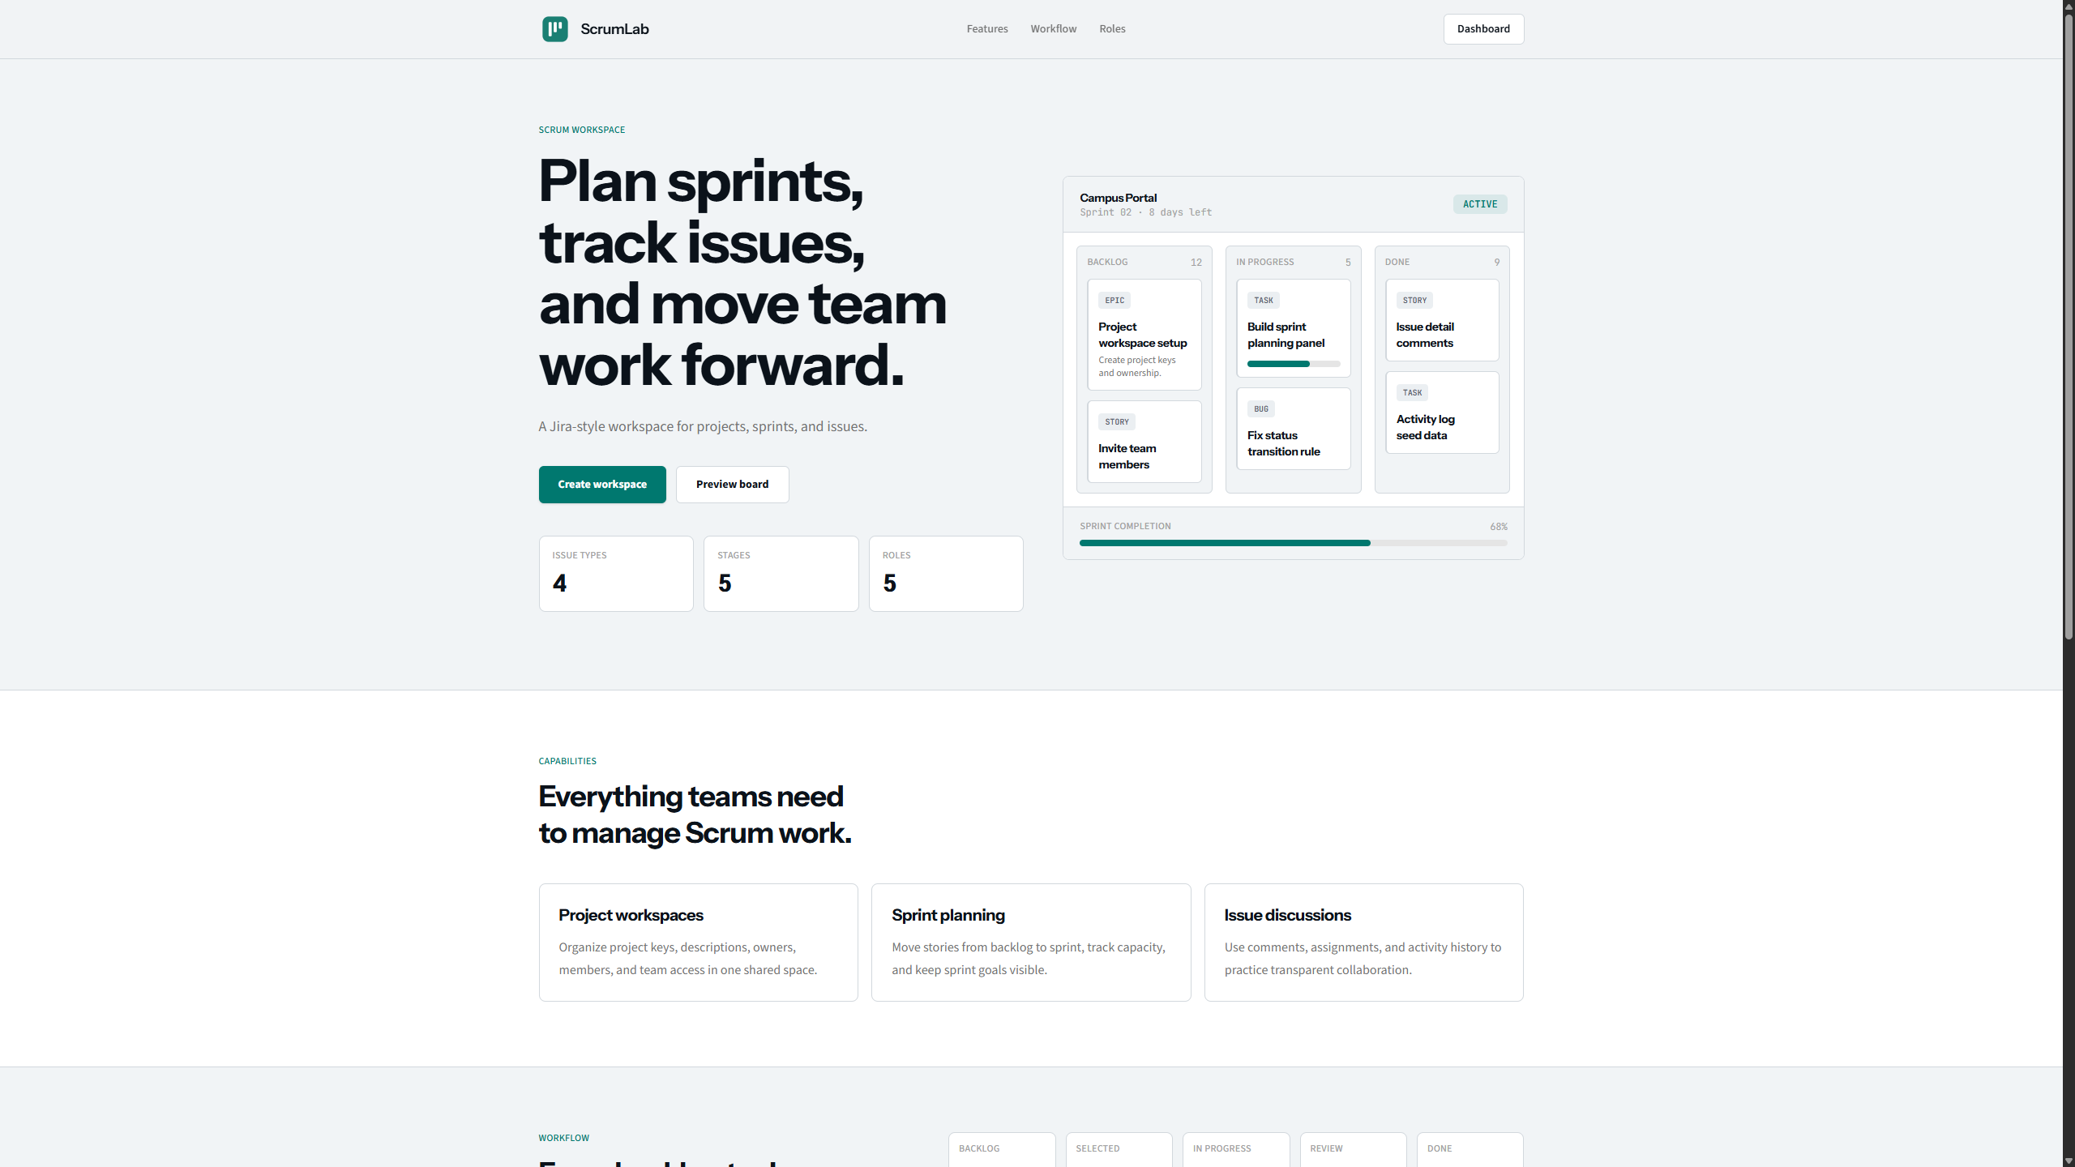

Slide 17
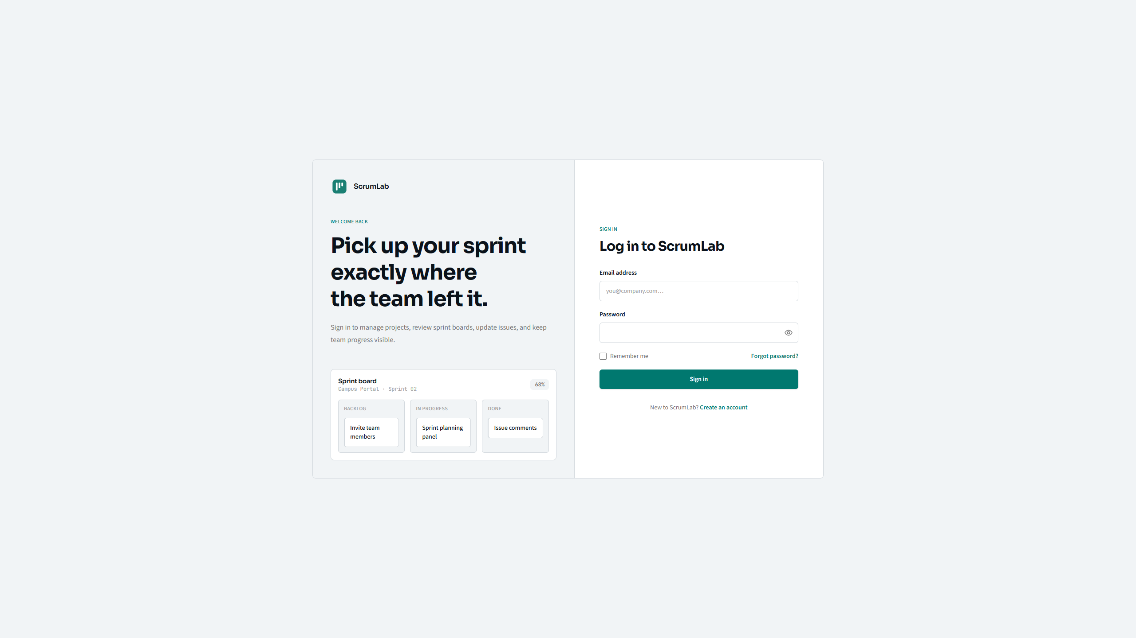

Slide 18
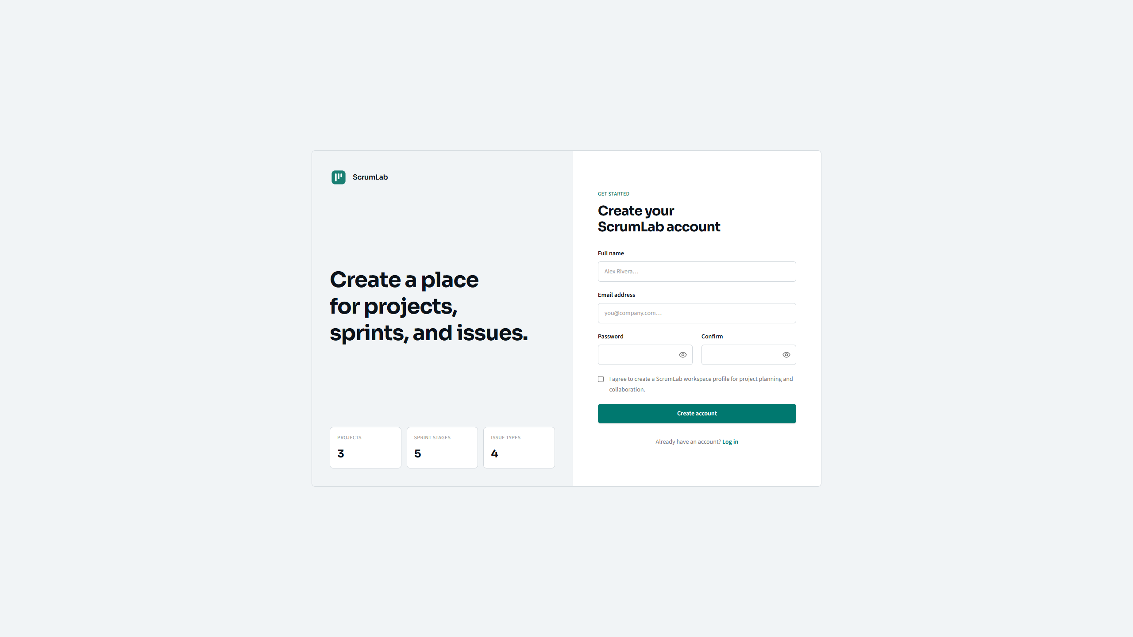

Slide 19
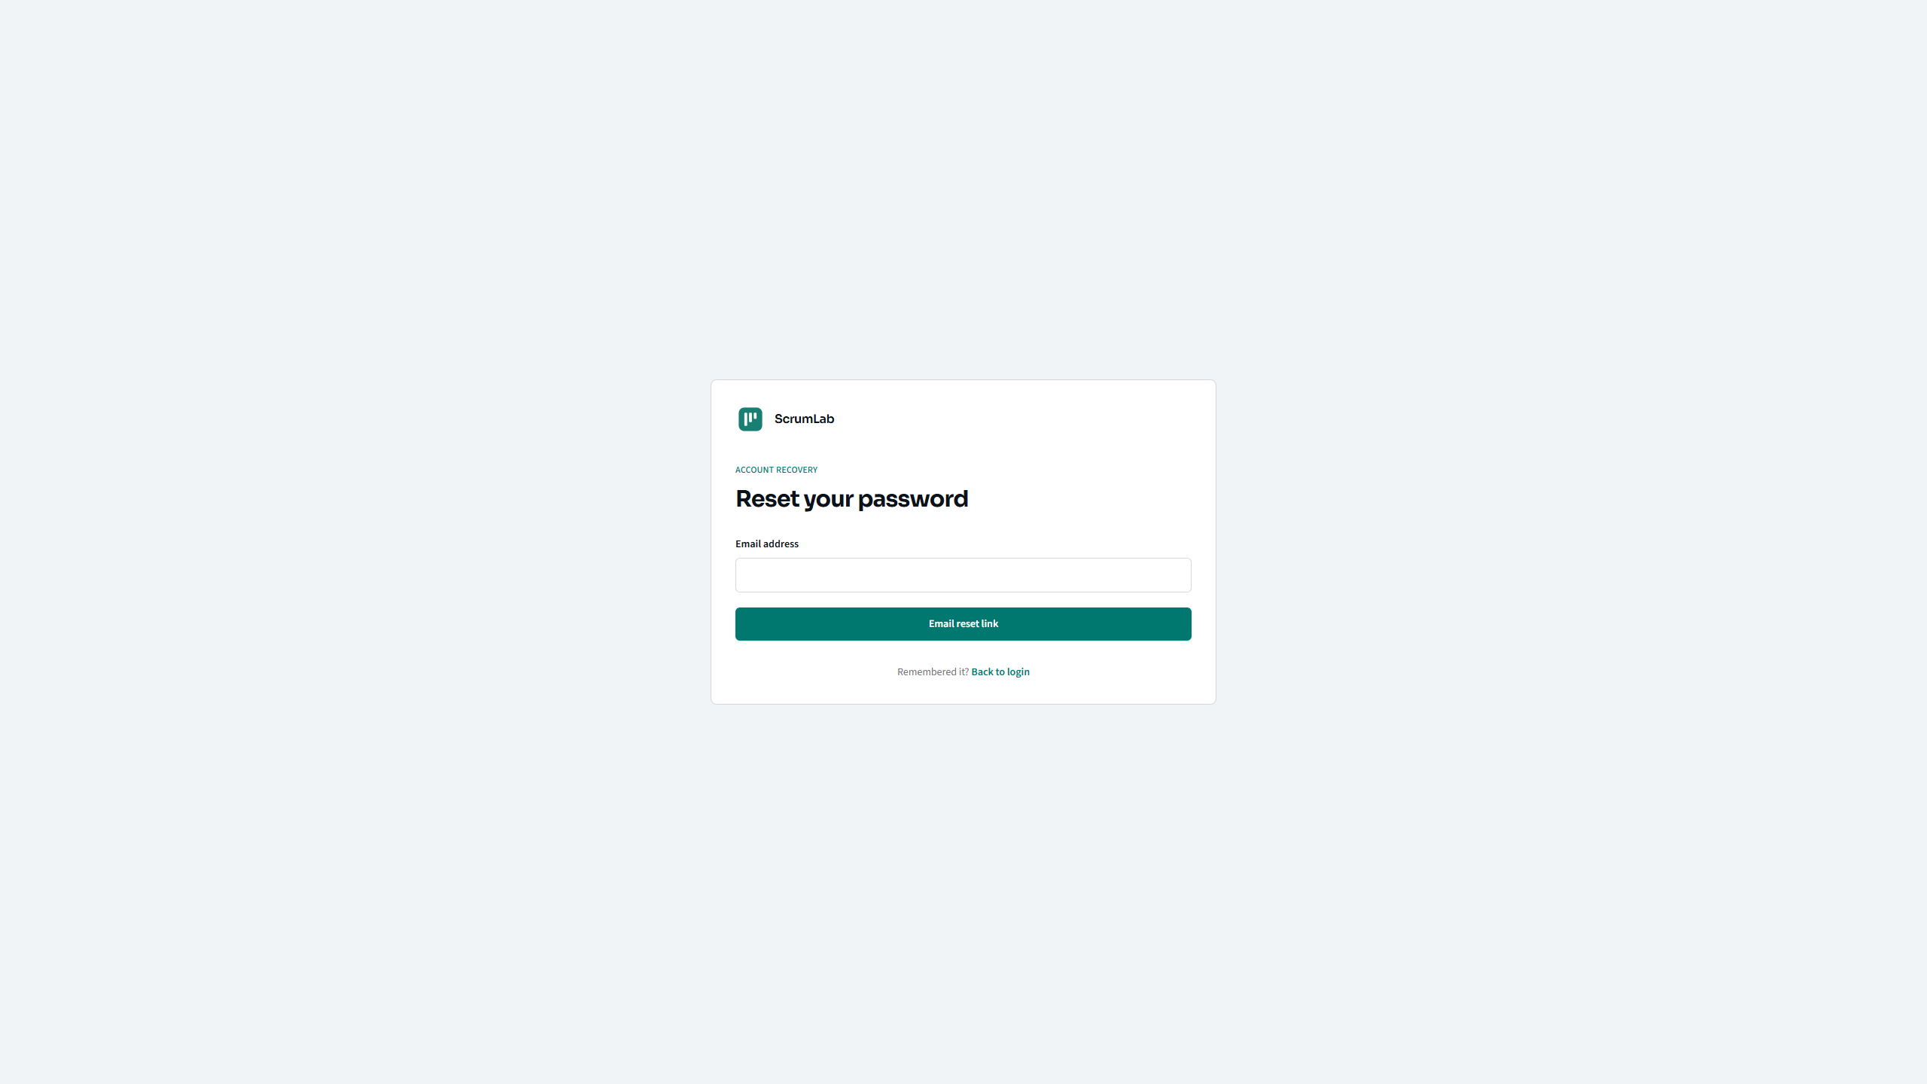

Slide 20
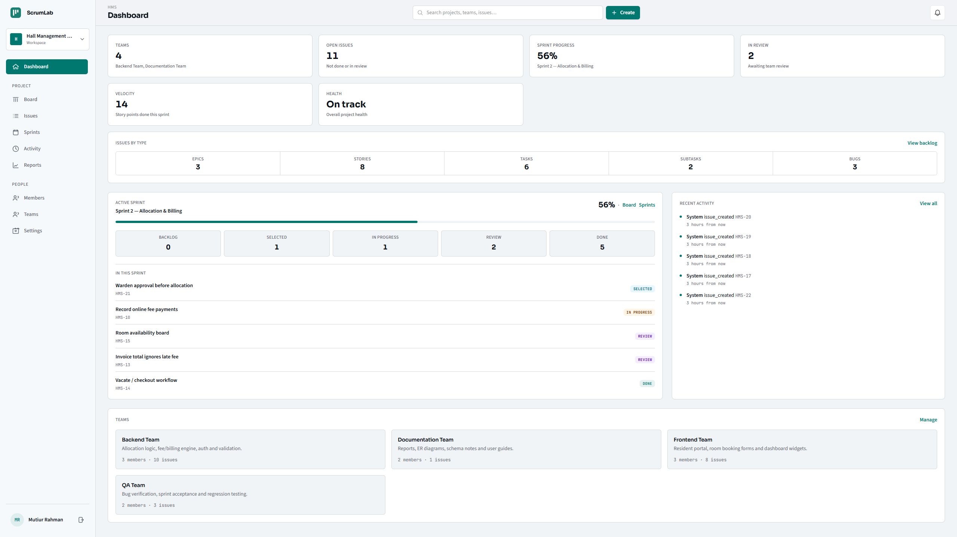

Slide 21
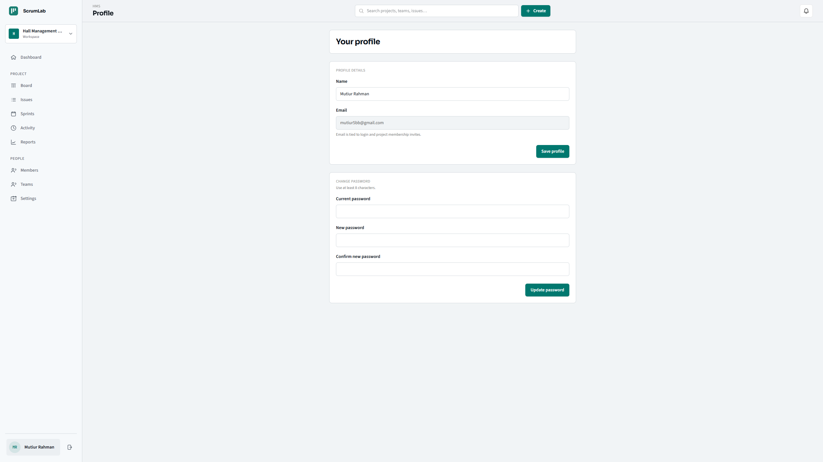

Slide 22
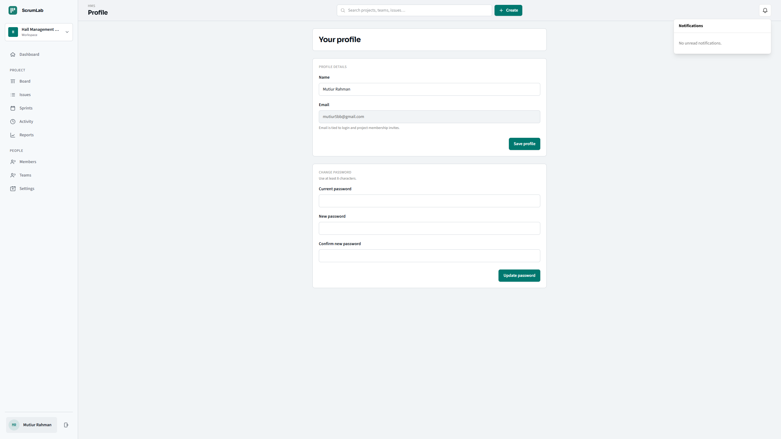

Slide 23
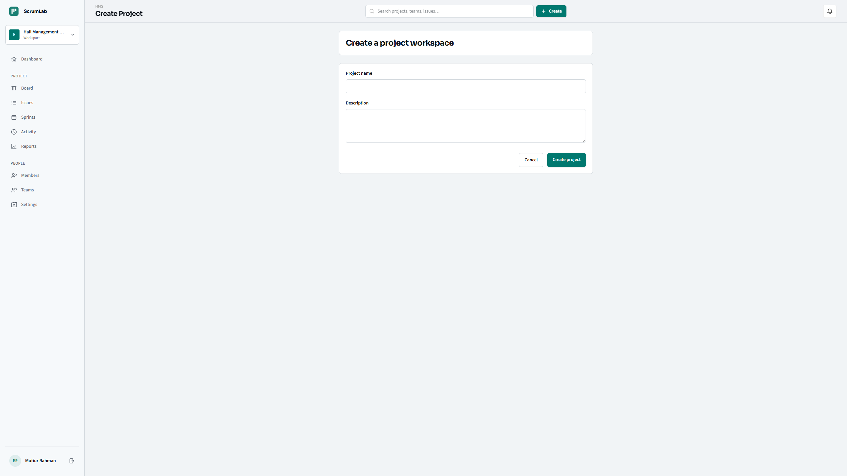

Slide 24


Slide 25
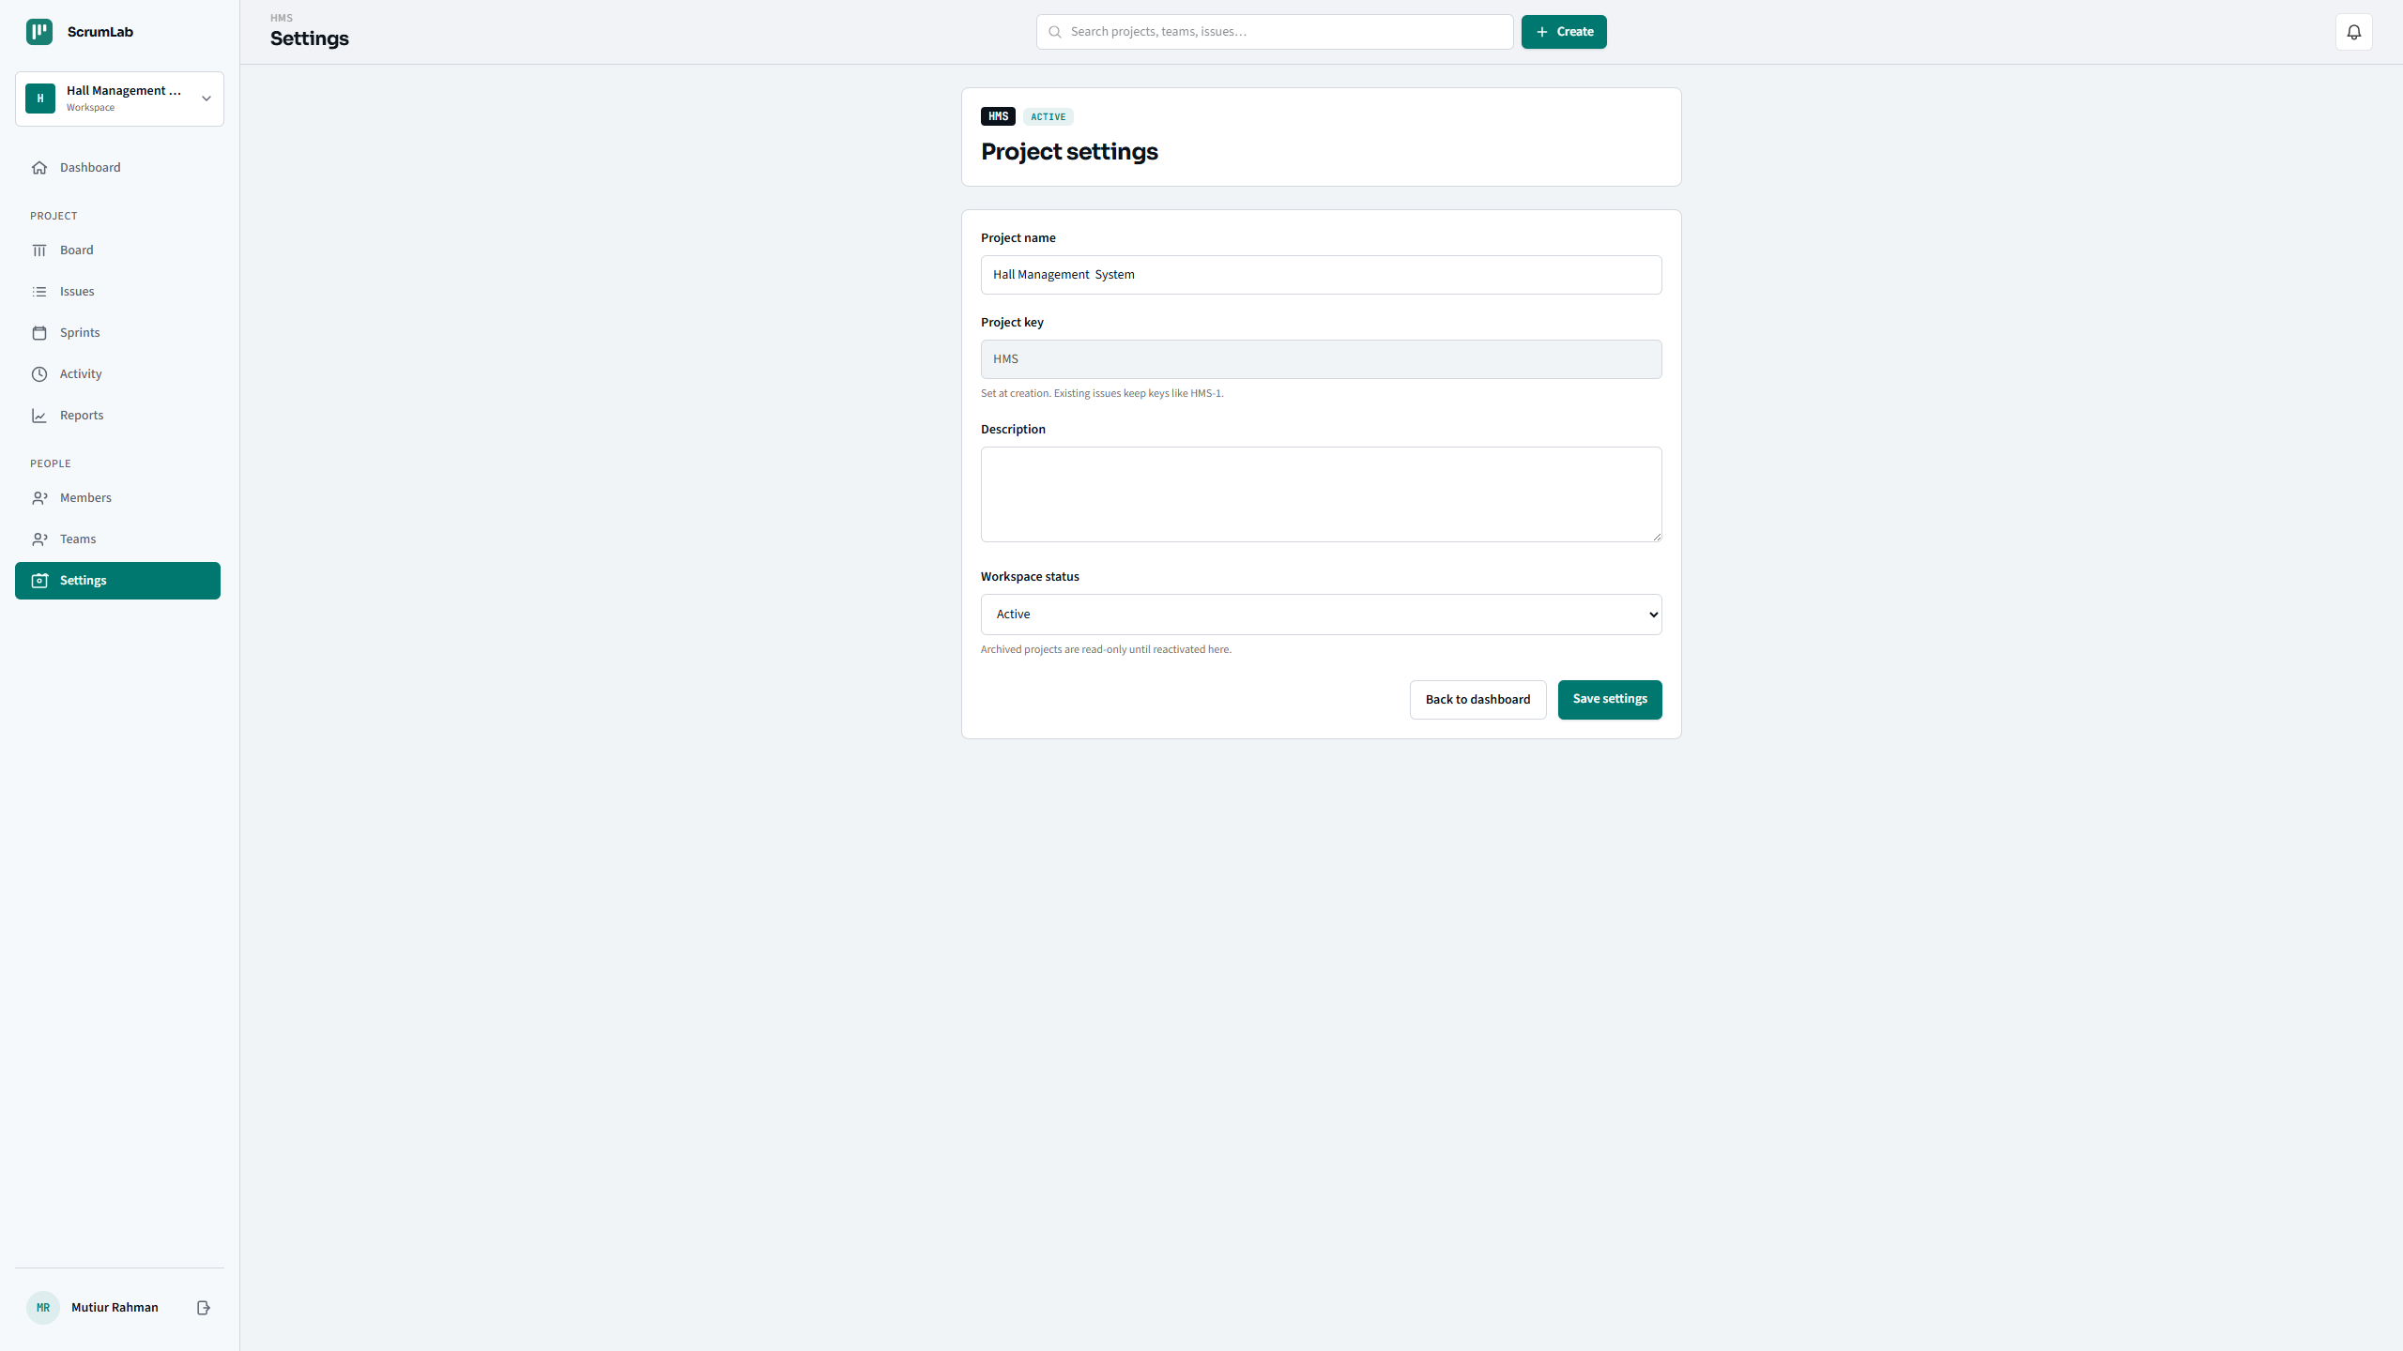

Slide 26
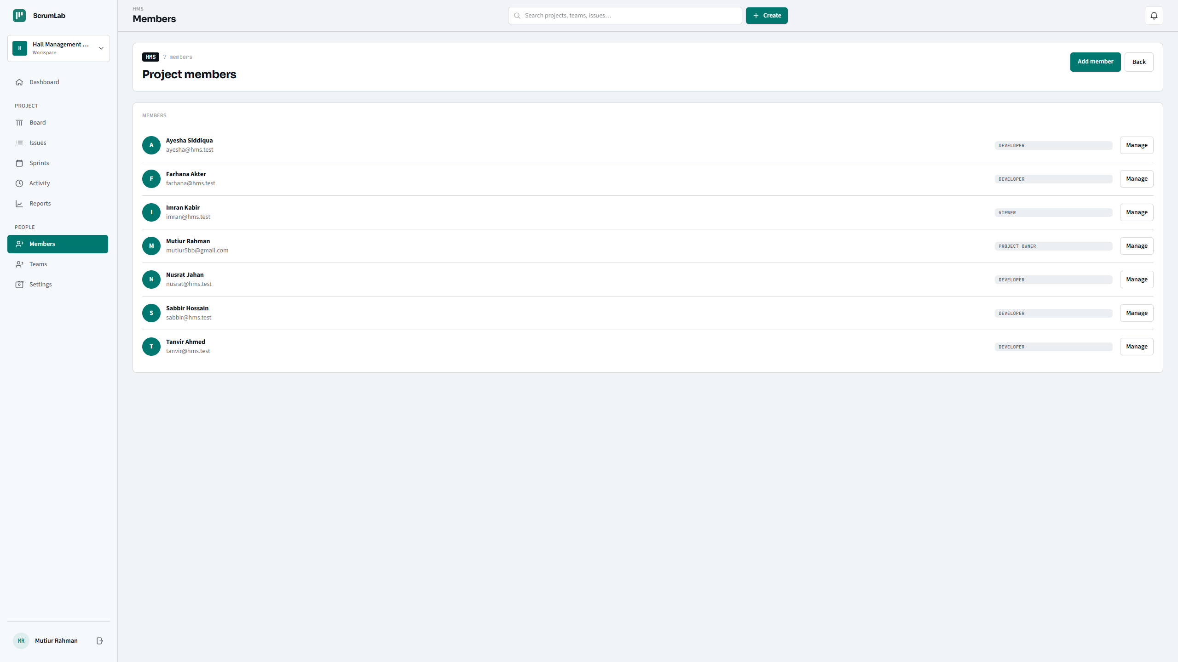

Slide 27
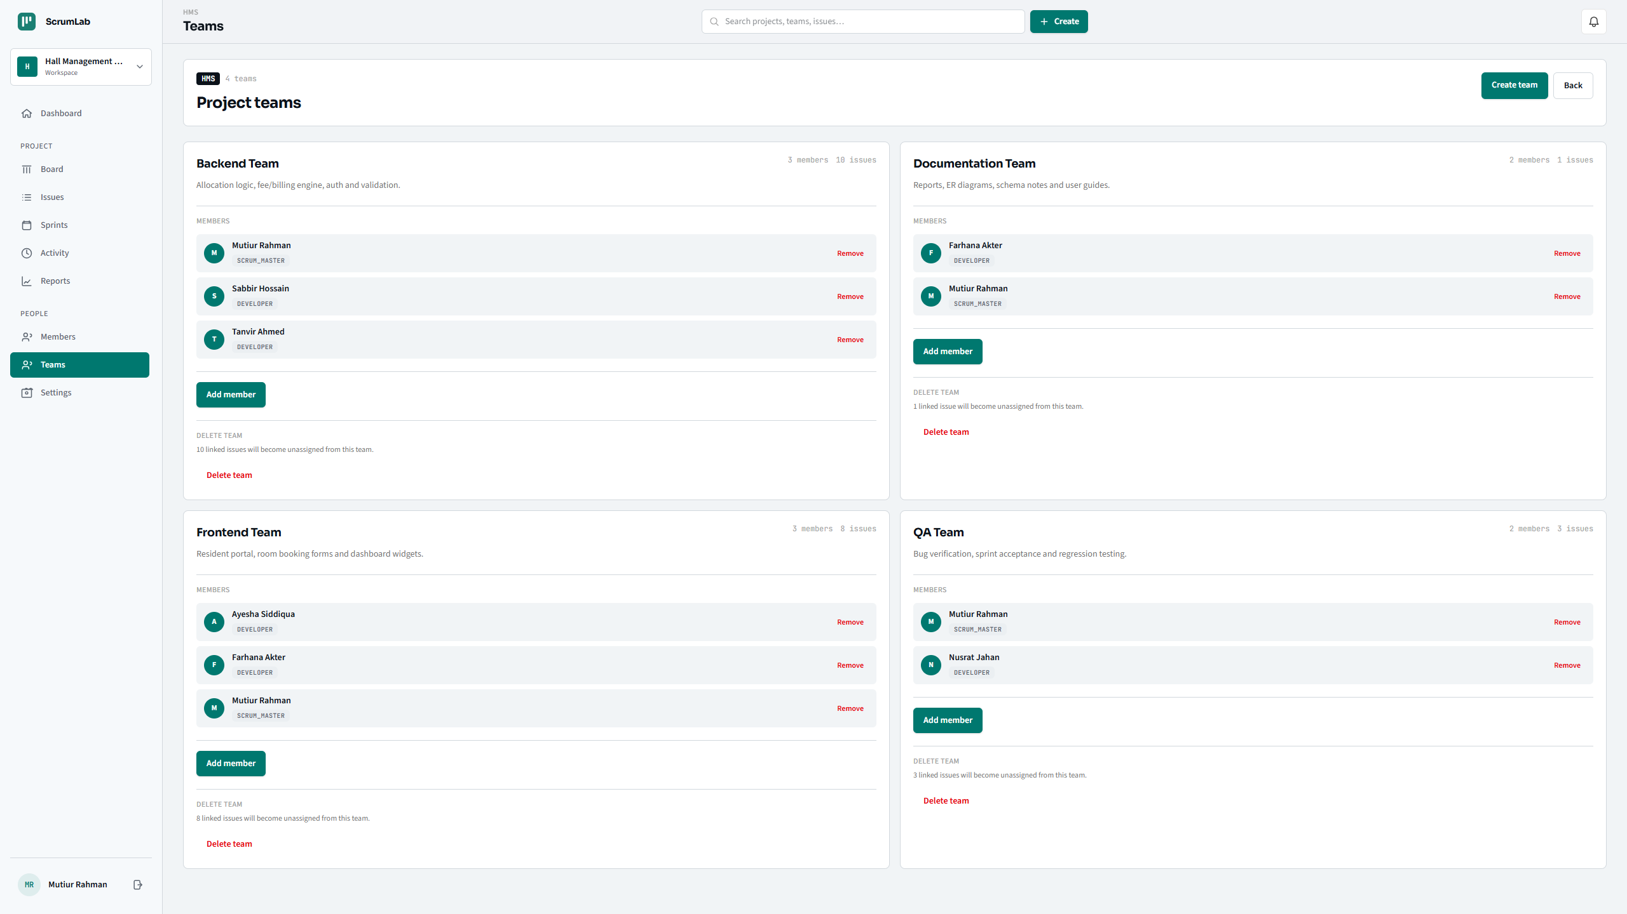

Slide 28
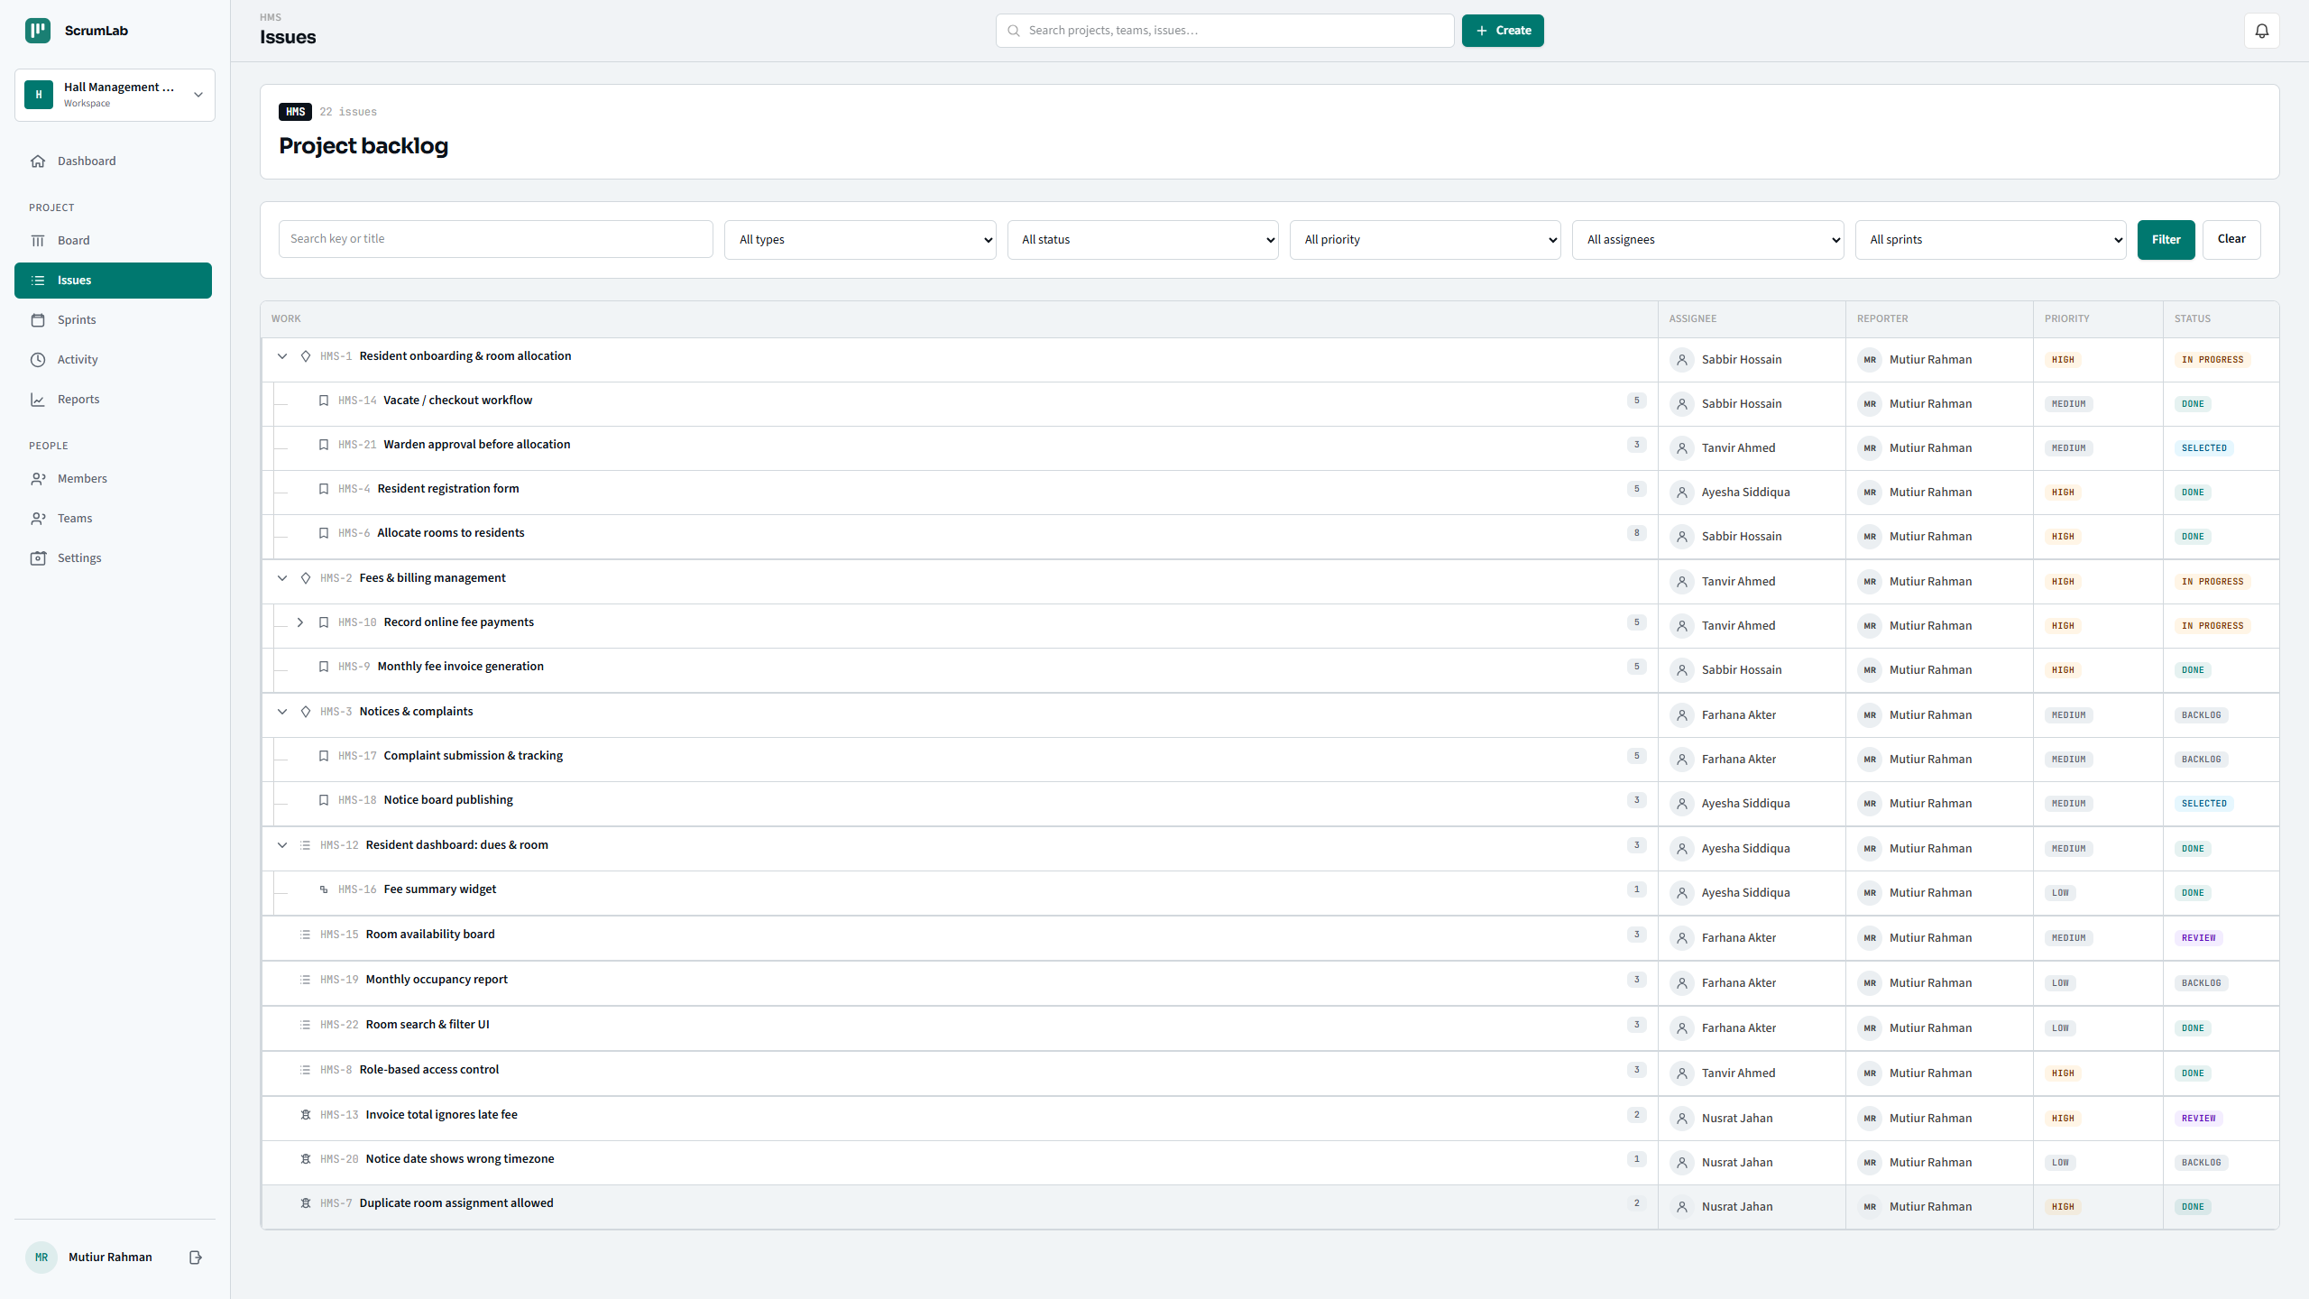

Slide 29
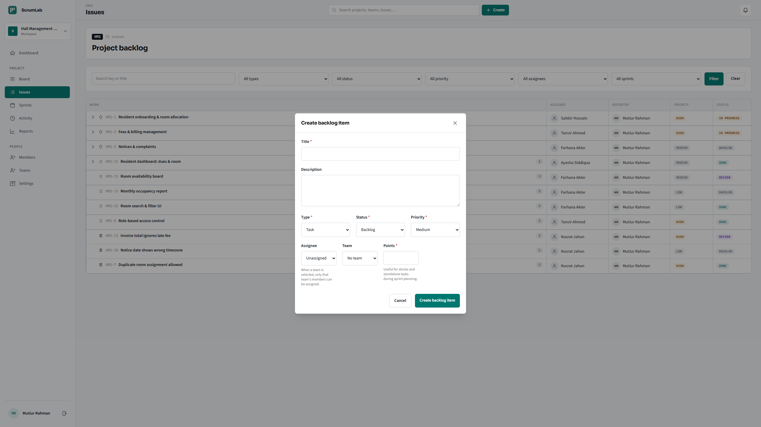

Slide 30
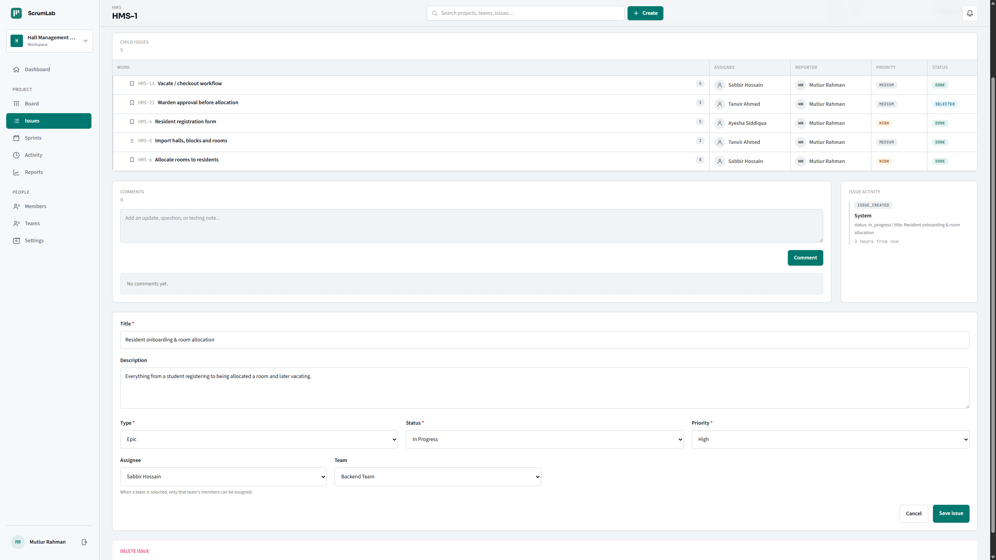

Slide 31
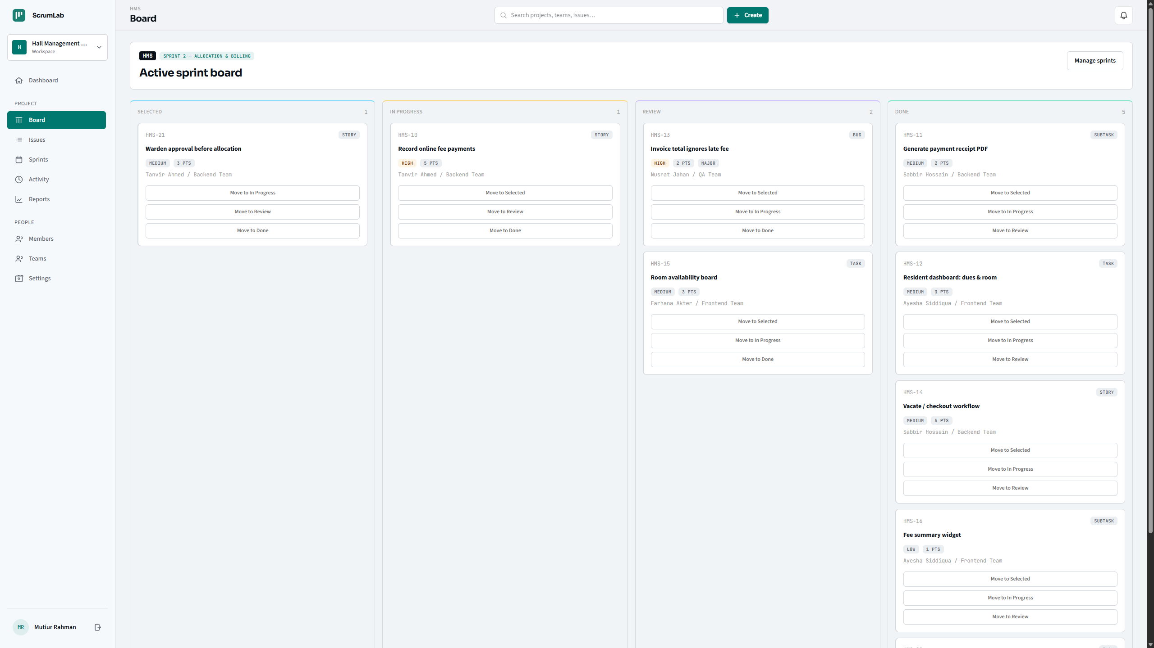

Slide 32
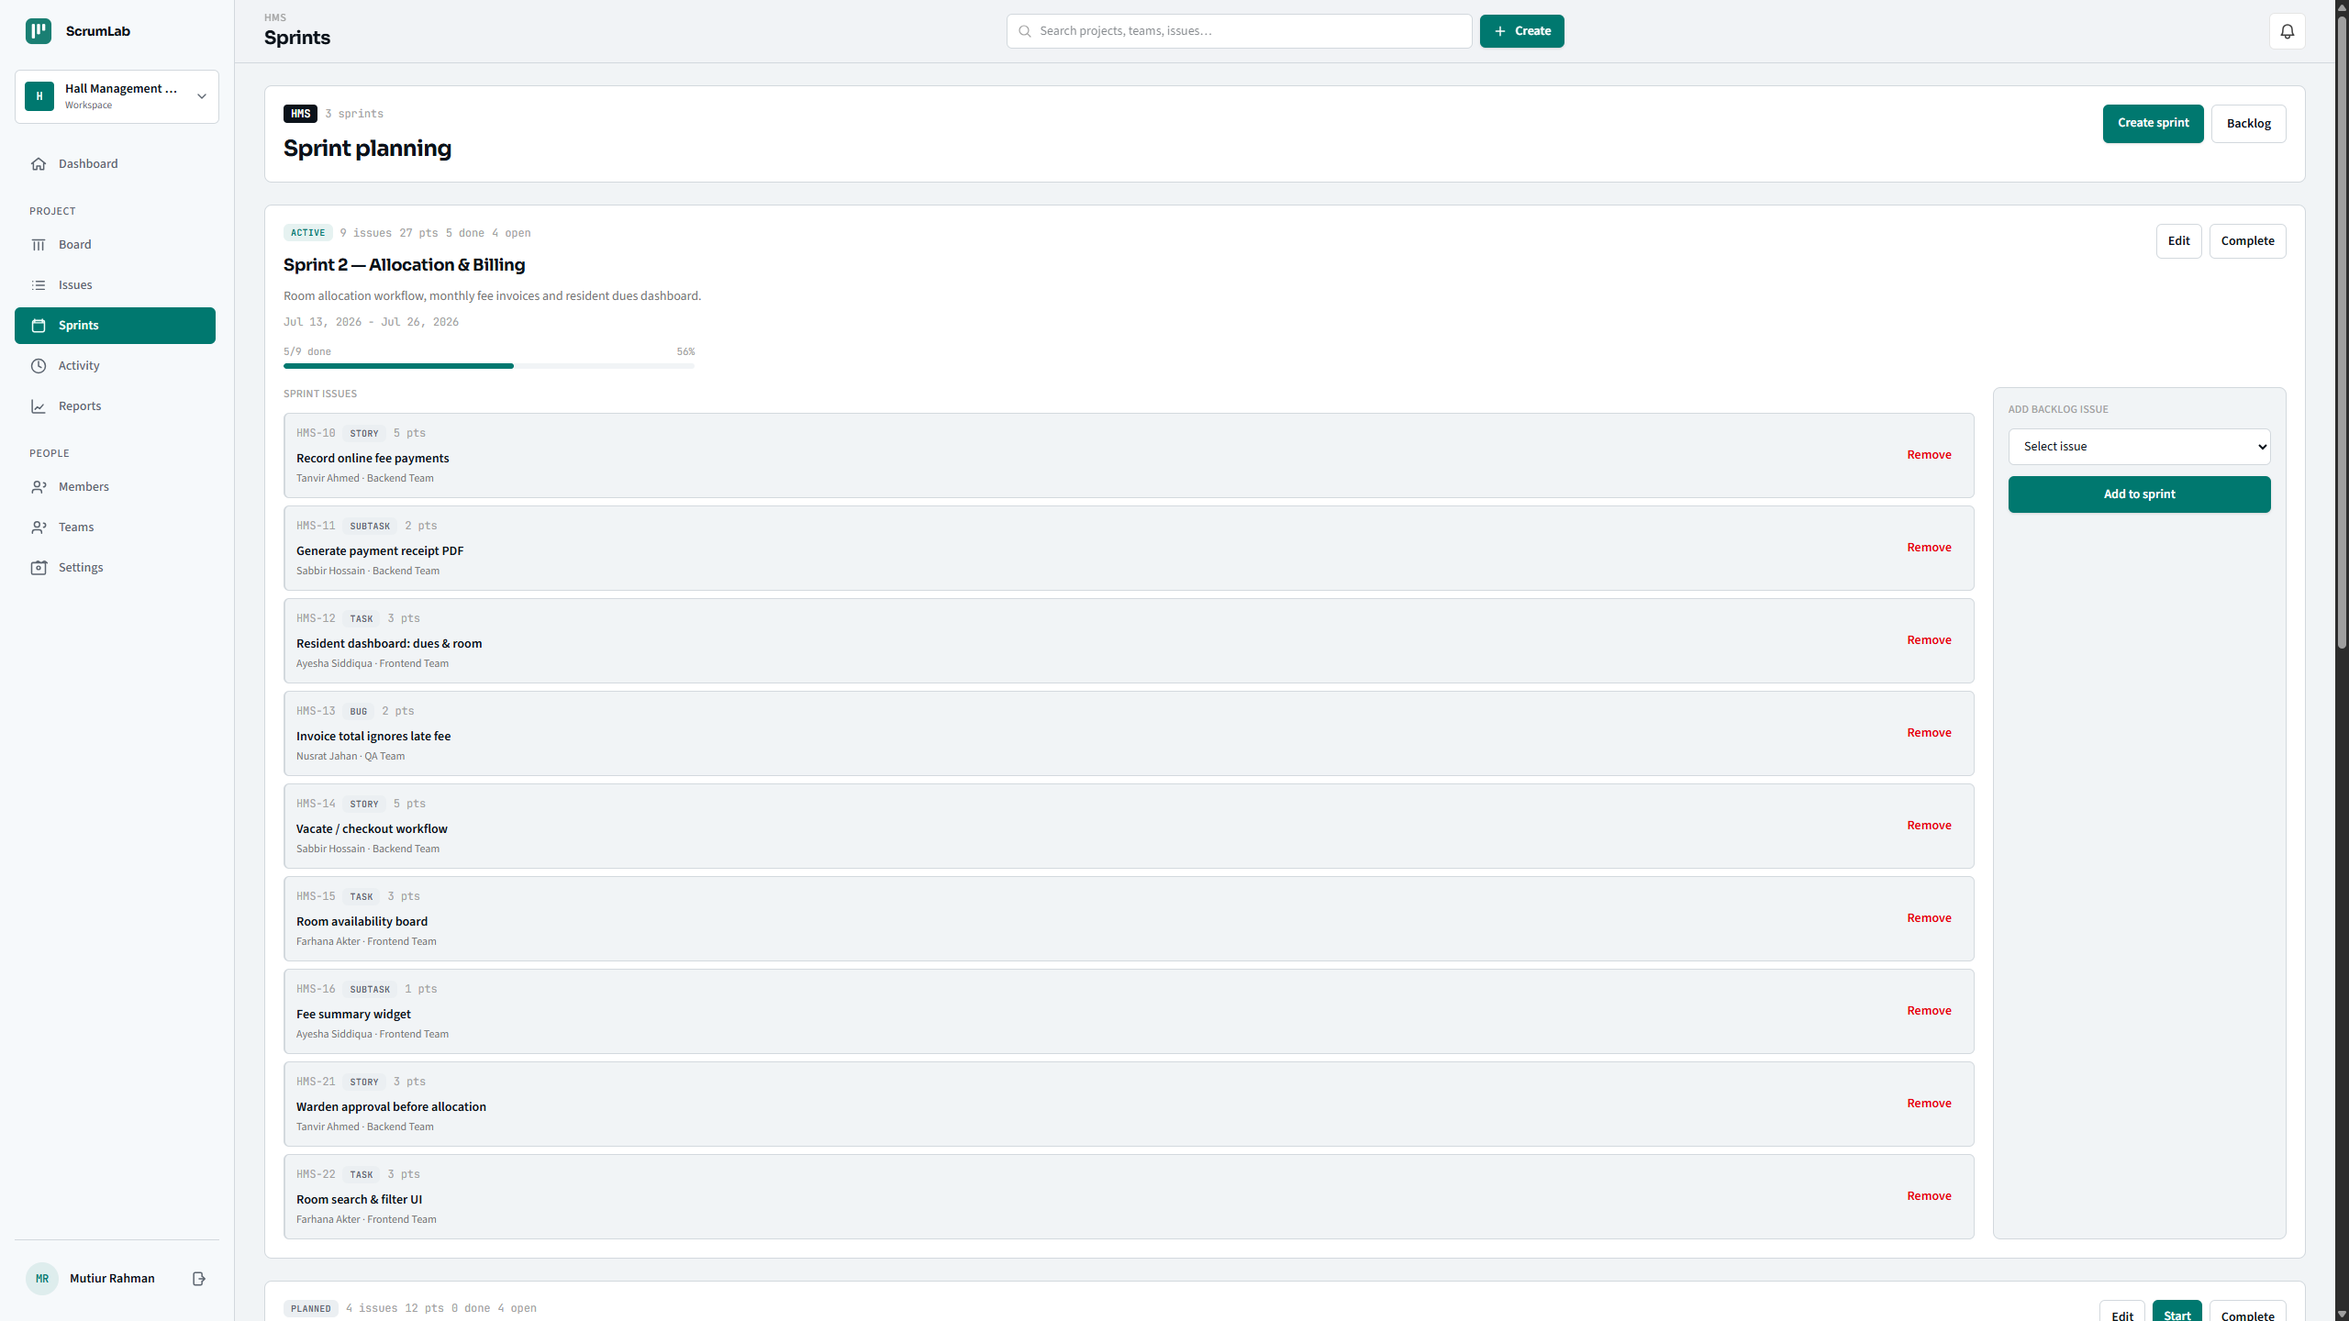

Slide 33
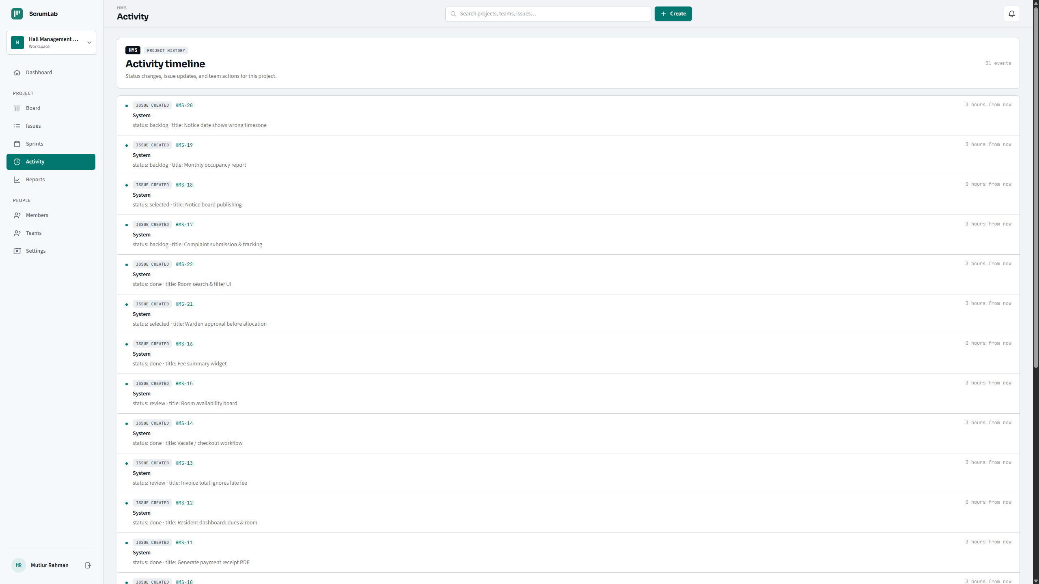

Slide 34
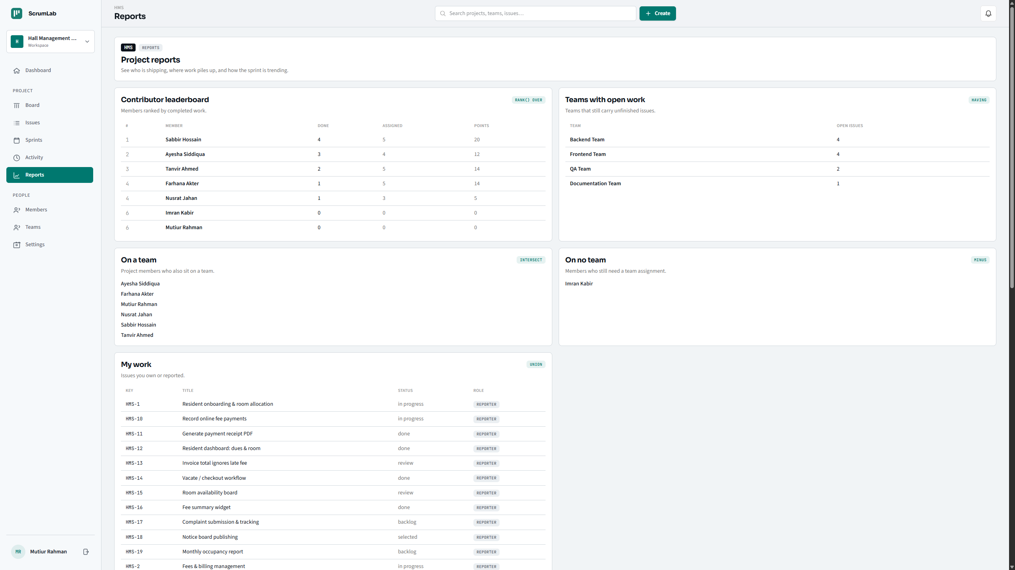

Slide 35
DATABASE ENGINE
Pushing Logic Into the Database
Beyond tables, ScrumLab uses four categories of PL/SQL objects so that business rules are enforced no matter what touches the data — the Laravel app, a raw SQL script, or SQL Developer.
6
3
3
2
Functions
Procedures
Triggers
Views
Reusable calculations callable from SQL: open-issue counts, sprint velocity, cycle time, project health
Multi-step operations: status changes, parent status rollup, centralized error logging
Automatic reactions: status rollups, full audit trail, role validation
Denormalized read models: v_issue_full, v_project_stats
33

Slide 36
PL/SQL
Functions — Callable Metrics
Function
Purpose
count_open_issues(project_id)
Counts issues not yet 'done' for a project — powers the dashboard
fn_sprint_velocity(sprint_id)
Sums story points of 'done' issues in a sprint
fn_issue_cycle_time(issue_id)
Days from creation to completion; NULL if not done yet
fn_project_progress_pct(project_id)
Percent of a project's issues marked done, rounded
fn_project_health(project_id)
Coarse health label derived from progress % and overdue work
fn_new_uuid()
Generates a UUID for new primary keys inside PL/SQL
34

Slide 37
PL/SQL — FUNCTIONS
Code: Open-Issue Count & Sprint Velocity
count_open_issues.sql
fn_sprint_velocity.sql
-- FUNCTION
FUNCTION count_open_issues(
p_project_id VARCHAR2
) RETURN NUMBER IS
v_count NUMBER;
BEGIN
SELECT COUNT(*) INTO v_count
FROM issues
WHERE project_id = p_project_id
AND status != 'done';
RETURN v_count;
END;
-- FUNCTION
FUNCTION fn_sprint_velocity(
p_sprint_id VARCHAR2
) RETURN NUMBER IS
v_points NUMBER;
BEGIN
SELECT NVL(SUM(story_points), 0)
INTO v_points
FROM issues
WHERE sprint_id = p_sprint_id
AND status = 'done';
RETURN v_points;
END;
35

Slide 38
PL/SQL — FUNCTIONS
Code: Cycle Time & Progress Percentage
fn_issue_cycle_time.sql
fn_project_progress_pct.sql
-- FUNCTION
FUNCTION fn_issue_cycle_time(
p_issue_id VARCHAR2
) RETURN NUMBER IS
v_status issues.status%TYPE;
v_created issues.created_at%TYPE;
v_updated issues.updated_at%TYPE;
BEGIN
SELECT status, created_at, updated_at
INTO v_status, v_created, v_updated
FROM issues WHERE id = p_issue_id;
IF v_status != 'done' OR v_created IS NULL
OR v_updated IS NULL THEN
RETURN NULL;
END IF;
RETURN CAST(v_updated AS DATE)
- CAST(v_created AS DATE);
EXCEPTION
WHEN NO_DATA_FOUND THEN RETURN NULL;
END;
-- FUNCTION
FUNCTION fn_project_progress_pct(
p_project_id VARCHAR2
) RETURN NUMBER IS
v_total NUMBER; v_done NUMBER;
BEGIN
SELECT COUNT(*),
NVL(SUM(CASE WHEN status='done'
THEN 1 ELSE 0 END), 0)
INTO v_total, v_done
FROM issues
WHERE project_id = p_project_id;
IF v_total = 0 THEN
RETURN 0;
END IF;
RETURN ROUND((v_done / v_total) * 100);
END;
36

Slide 39
PL/SQL — FUNCTIONS
Code: Project Health Label
fn_project_health.sql
-- FUNCTION — combines progress % with overdue sprint work
FUNCTION fn_project_health(p_project_id VARCHAR2) RETURN VARCHAR2 IS
v_total NUMBER; v_done NUMBER; v_overdue NUMBER;
BEGIN
SELECT COUNT(*), NVL(SUM(CASE WHEN status='done' THEN 1 ELSE 0 END), 0)
INTO v_total, v_done FROM issues WHERE project_id = p_project_id;
IF v_total = 0 THEN RETURN 'empty'; END IF;
-- Unfinished issues sitting in a sprint whose end date has passed.
SELECT COUNT(*) INTO v_overdue FROM issues i JOIN sprints s ON s.id = i.sprint_id
WHERE i.project_id = p_project_id AND i.status != 'done' AND s.end_date < TRUNC(SYSDATE);
IF v_done = v_total THEN RETURN 'complete';
ELSIF v_overdue > 0 THEN RETURN 'at_risk';
ELSIF (v_done / v_total) >= 0.5 THEN RETURN 'on_track';
ELSE RETURN 'behind';
END IF;
END;
37

Slide 40
PL/SQL
Procedures — Multi-Step Operations
Procedure
Purpose
update_issue_status(issue_id, status)
Validates and applies a status change; hardened with input checks and centralized error logging
rollup_parent_issue_status(issue_id)
Recomputes a parent Epic/Story's status from the state of its children
proc_log_error(code, message, context)
Writes structured error details for any failed operation, shared across procedures
38

Slide 41
PL/SQL — PROCEDURES
Code: update_issue_status (Hardened)
update_issue_status.sql
-- PROCEDURE — validates input at the DB layer, defense-in-depth vs. app bugs
PROCEDURE update_issue_status(
p_issue_id VARCHAR2, p_status VARCHAR2
) IS
v_exists NUMBER;
BEGIN
IF p_status NOT IN ('backlog','selected','in_progress','review','done') THEN
RAISE_APPLICATION_ERROR(-20010, 'Invalid issue status: ' || p_status);
END IF;
SELECT COUNT(*) INTO v_exists FROM issues WHERE id = p_issue_id;
IF v_exists = 0 THEN
RAISE_APPLICATION_ERROR(-20014, 'Issue not found: ' || p_issue_id);
END IF;
UPDATE issues SET status = p_status, updated_at = SYSTIMESTAMP
WHERE id = p_issue_id;
END;
39

Slide 42
PL/SQL — PROCEDURES
Code: rollup_parent_issue_status
rollup_parent_issue_status.sql
-- PROCEDURE — recomputes a parent's status from all its children
PROCEDURE rollup_parent_issue_status(p_issue_id VARCHAR2, p_new_status VARCHAR2) IS
v_parent_id VARCHAR2(36); v_parent_status VARCHAR2(255);
v_child_total, v_child_done, v_child_active, v_child_selected NUMBER;
v_new_status VARCHAR2(255);
BEGIN
SELECT parent_issue_id INTO v_parent_id FROM issues WHERE id = p_issue_id;
IF v_parent_id IS NULL THEN RETURN; END IF;
SELECT status INTO v_parent_status FROM issues WHERE id = v_parent_id;
-- Count children by effective status (treats p_issue_id's NEW status as already applied)
SELECT COUNT(*),
NVL(SUM(CASE WHEN eff_status='done' THEN 1 ELSE 0 END), 0),
NVL(SUM(CASE WHEN eff_status IN ('in_progress','review') THEN 1 ELSE 0 END), 0),
NVL(SUM(CASE WHEN eff_status='selected' THEN 1 ELSE 0 END), 0)
INTO v_child_total, v_child_done, v_child_active, v_child_selected
FROM (SELECT CASE WHEN id=p_issue_id THEN p_new_status ELSE status END eff_status
FROM issues WHERE parent_issue_id = v_parent_id);
IF v_child_total = 0 THEN RETURN; END IF;
IF v_child_done = v_child_total THEN v_new_status := 'done';
ELSIF v_child_active > 0 THEN v_new_status := 'in_progress';
ELSIF v_child_selected > 0 THEN v_new_status := 'selected';
ELSE v_new_status := 'backlog'; END IF;
IF v_new_status != v_parent_status THEN
UPDATE issues SET status=v_new_status, updated_at=SYSTIMESTAMP WHERE id=v_parent_id;
END IF;
END;
40

Slide 43
PL/SQL
Triggers — Automatic Enforcement
Trigger
Purpose
trg_project_members_role_chk
Fires BEFORE INSERT/UPDATE on membership rows; rejects invalid role values
trg_issues_status_rollup
Fires AFTER an issue's status changes; calls rollup_parent_issue_status so parents stay in sync
trg_issues_audit
Fires on every INSERT/UPDATE/DELETE of an issue; writes an activity_logs row in the same transaction — a change and its audit record can never drift apart
41

Slide 44
PL/SQL — TRIGGERS
Code: trg_project_members_role_chk
trg_project_members_role_chk.sql
-- TRIGGER — BEFORE INSERT OR UPDATE OF role ON project_members
TRIGGER trg_project_members_role_chk
BEFORE INSERT OR UPDATE OF role ON project_members
FOR EACH ROW
BEGIN
IF :NEW.role NOT IN (
'admin', 'project_owner', 'scrum_master', 'developer', 'viewer'
) THEN
RAISE_APPLICATION_ERROR(-20001, 'Invalid project member role: ' || :NEW.role);
END IF;
END;
42

Slide 45
PL/SQL — TRIGGERS
Code: trg_issues_status_rollup
trg_issues_status_rollup.sql
-- TRIGGER — compound trigger, batches changed rows then rolls up once per statement
TRIGGER trg_issues_status_rollup
FOR UPDATE OF status ON issues
COMPOUND TRIGGER
TYPE t_issue_change IS RECORD (issue_id issues.id%TYPE, new_status issues.status%TYPE);
TYPE t_issue_changes IS TABLE OF t_issue_change INDEX BY PLS_INTEGER;
g_changes t_issue_changes;
AFTER EACH ROW IS
BEGIN
IF :OLD.status != :NEW.status THEN
g_changes(g_changes.COUNT + 1).issue_id := :NEW.id;
g_changes(g_changes.COUNT).new_status := :NEW.status;
END IF;
END AFTER EACH ROW;
AFTER STATEMENT IS
BEGIN
FOR i IN 1 .. g_changes.COUNT LOOP
rollup_parent_issue_status(g_changes(i).issue_id, g_changes(i).new_status);
END LOOP;
g_changes.DELETE;
END AFTER STATEMENT;
END trg_issues_status_rollup;
43

Slide 46
PL/SQL — TRIGGERS
Code: trg_issues_audit
trg_issues_audit.sql
-- TRIGGER — AFTER INSERT OR UPDATE OR DELETE ON issues, writes activity_logs in the same transaction
TRIGGER trg_issues_audit AFTER INSERT OR UPDATE OR DELETE ON issues FOR EACH ROW
DECLARE
v_action VARCHAR2(255); v_old VARCHAR2(4000); v_new VARCHAR2(4000);
v_project_id VARCHAR2(36); v_issue_id VARCHAR2(36);
BEGIN
IF INSERTING THEN
v_action := 'issue_created'; v_project_id := :NEW.project_id; v_issue_id := :NEW.id;
v_new := '{status:'||:NEW.status||', title:'||SUBSTR(:NEW.title,1,200)||'}';
ELSIF DELETING THEN
v_action := 'issue_deleted'; v_project_id := :OLD.project_id; v_issue_id := :OLD.id;
v_old := '{status:'||:OLD.status||', title:'||SUBSTR(:OLD.title,1,200)||'}';
ELSE
IF NVL(:OLD.status,'~')=NVL(:NEW.status,'~') AND NVL(:OLD.assignee_id,'~')=NVL(:NEW.assignee_id,'~')
AND NVL(:OLD.priority,'~')=NVL(:NEW.priority,'~') AND NVL(:OLD.sprint_id,'~')=NVL(:NEW.sprint_id,'~')
THEN RETURN; END IF;
v_action := CASE WHEN NVL(:OLD.status,'~')!=NVL(:NEW.status,'~')
THEN 'status_changed' ELSE 'issue_updated' END;
v_old := '{...OLD status/assignee/priority/sprint...}';
v_new := '{...NEW status/assignee/priority/sprint...}';
END IF;
INSERT INTO activity_logs (id, project_id, issue_id, action, subject_type,
subject_id, old_values, new_values, created_at, updated_at)
VALUES (fn_new_uuid, v_project_id, v_issue_id, v_action, 'issue', v_issue_id,
v_old, v_new, SYSTIMESTAMP, SYSTIMESTAMP);
END;
44

Slide 47
PL/SQL
Views & Shared Utility Functions
Views
Error & UUID utilities
v_issue_full
Joins issues with project, sprint, team, assignee & reporter names, plus fn_issue_cycle_time() — controllers stop re-writing the same 5-table join.
Two standalone PL/SQL objects — fn_new_uuid and proc_log_error — shared by procedures like update_issue_status and rollup_parent_issue_status. No package wraps them; they're called directly.
• Consistent error codes & messages across all procedures
v_project_stats
One live row per project: issue_count, open_count, progress_pct, health, team_count, member_count — built directly on the metric functions.
• proc_log_error persists failures via an autonomous transaction
• Avoids duplicating exception blocks in every object
• Makes failures traceable in SQL Developer, not just app logs
45

Slide 48
PL/SQL — VIEWS
Code: v_issue_full
v_issue_full.sql
-- VIEW — denormalized issue read model used across controllers
VIEW v_issue_full AS
SELECT
i.*,
p.key AS project_key, p.name AS project_name,
s.name AS sprint_name, s.status AS sprint_status,
tm.name AS team_name,
ua.name AS assignee_name, ua.avatar AS assignee_avatar,
ur.name AS reporter_name,
fn_issue_cycle_time(i.id) AS cycle_time_days
FROM issues i
JOIN projects p ON p.id = i.project_id
LEFT JOIN sprints s ON s.id = i.sprint_id
LEFT JOIN teams tm ON tm.id = i.team_id
LEFT JOIN users ua ON ua.id = i.assignee_id
JOIN users ur ON ur.id = i.reporter_id
46

Slide 49
PL/SQL — VIEWS
Code: v_project_stats
v_project_stats.sql
-- VIEW — one live row per project, built on the metric functions
VIEW v_project_stats AS
SELECT
p.id AS project_id, p.name AS project_name, p.key AS project_key,
(SELECT COUNT(*) FROM issues i WHERE i.project_id = p.id) AS issue_count,
count_open_issues(p.id) AS open_count,
fn_project_progress_pct(p.id) AS progress_pct,
fn_project_health(p.id) AS health,
(SELECT COUNT(*) FROM teams t WHERE t.project_id = p.id) AS team_count,
(SELECT COUNT(*) FROM project_members m
WHERE m.project_id = p.id) AS member_count
FROM projects p
47

Slide 50
PL/SQL — UTILITY LAYER
Code: fn_new_uuid & proc_log_error
fn_new_uuid.sql
proc_log_error.sql
-- FUNCTION — UUID matching the app's VARCHAR2(36) keys
FUNCTION fn_new_uuid RETURN VARCHAR2 IS
v_hex VARCHAR2(32);
BEGIN
v_hex := LOWER(RAWTOHEX(SYS_GUID()));
RETURN SUBSTR(v_hex,1,8)||'-'||
SUBSTR(v_hex,9,4)||'-'||
SUBSTR(v_hex,13,4)||'-'||
SUBSTR(v_hex,17,4)||'-'||
SUBSTR(v_hex,21,12);
END;
-- PROCEDURE — autonomous transaction, survives a rollback
PROCEDURE proc_log_error(
p_context VARCHAR2, p_message VARCHAR2
) IS
PRAGMA AUTONOMOUS_TRANSACTION;
BEGIN
INSERT INTO activity_logs (
id, action, subject_type,
new_values, created_at, updated_at
) VALUES (
fn_new_uuid, 'error',
SUBSTR(p_context,1,255),
SUBSTR(p_message,1,4000),
SYSTIMESTAMP, SYSTIMESTAMP
);
COMMIT;
END;
48

Slide 51
ADVANCED SQL
Beyond PL/SQL: The Reports Engine
app/Http/Controllers/ReportController.php is a dedicated showcase of core SQL features the rest of the app doesn't otherwise use — each report method demonstrates one technique.
Set Operators
Window Functions
Grouping & Filtering
• UNION — my work (assignee ∪ reporter)
• RANK() OVER — leaderboard by issues done
• GROUP BY — aggregate counts per team
• UNION ALL — merged activity timeline
• DENSE_RANK() OVER — leaderboard by points
• HAVING — teams with open issues
• INTERSECT — members onboarded to a team
• SUM() OVER — cumulative sprint velocity
• MINUS — members on no team
49

Slide 52
ADVANCED SQL — SET OPERATORS
Code: UNION & UNION ALL
mywork.sql
unifiedtimeline.sql
-- UNION — issues where the user is assignee OR reporter, de-duplicated
SELECT key, title, status, 'Assignee' AS role
FROM issues
WHERE project_id = ? AND assignee_id = ?
UNION
SELECT key, title, status, 'Reporter' AS role
FROM issues
WHERE project_id = ? AND reporter_id = ?
ORDER BY key
-- UNION ALL — comments + activity merged, newest first (no dedupe needed)
SELECT 'comment' kind, c.created_at ts,
u.name actor, i.key issue_key,
SUBSTR(c.body,1,120) detail
FROM comments c
JOIN issues i ON i.id = c.issue_id
LEFT JOIN users u ON u.id = c.user_id
WHERE i.project_id = ?
UNION ALL
SELECT 'activity', al.created_at,
u.name, i.key, al.action
FROM activity_logs al
LEFT JOIN issues i ON i.id = al.issue_id
LEFT JOIN users u ON u.id = al.user_id
WHERE al.project_id = ?
50

Slide 53
ADVANCED SQL — SET OPERATORS
Code: INTERSECT & MINUS
onboardedmembers.sql
membersonnoteam.sql
-- INTERSECT — members who are both project members AND on a team
SELECT u.name FROM users u JOIN (
SELECT user_id
FROM project_members
WHERE project_id = ?
INTERSECT
SELECT tm.user_id
FROM team_members tm
JOIN teams t ON t.id = tm.team_id
WHERE t.project_id = ?
) x ON x.user_id = u.id
ORDER BY u.name
-- MINUS — project members that belong to no team
SELECT u.name FROM users u JOIN (
SELECT user_id
FROM project_members
WHERE project_id = ?
MINUS
SELECT tm.user_id
FROM team_members tm
JOIN teams t ON t.id = tm.team_id
WHERE t.project_id = ?
) x ON x.user_id = u.id
ORDER BY u.name
51

Slide 54
ADVANCED SQL — WINDOW FUNCTIONS
Code: RANK() & DENSE_RANK()
leaderboard.sql
-- One query, two ranking styles — RANK() leaves gaps after ties, DENSE_RANK() doesn't
SELECT u.name,
COUNT(i.id) AS assigned,
NVL(SUM(CASE WHEN i.status='done' THEN 1 ELSE 0 END), 0) AS done,
NVL(SUM(i.story_points), 0) AS points,
RANK() OVER (
ORDER BY NVL(SUM(CASE WHEN i.status='done' THEN 1 ELSE 0 END), 0) DESC
) AS rnk,
DENSE_RANK() OVER (
ORDER BY NVL(SUM(i.story_points), 0) DESC
) AS points_rnk
FROM project_members pm
JOIN users u ON u.id = pm.user_id
LEFT JOIN issues i ON i.assignee_id = u.id AND i.project_id = pm.project_id
WHERE pm.project_id = ?
GROUP BY u.id, u.name
ORDER BY rnk, u.name
52

Slide 55
ADVANCED SQL — WINDOW FUNCTIONS
Code: SUM() OVER & HAVING
cumulativevelocity.sql
busyteams.sql
-- SUM() OVER — a running total across sprints, ordered by start date
SELECT s.name,
NVL(SUM(CASE WHEN i.status='done'
THEN i.story_points END), 0) AS points,
SUM(NVL(SUM(CASE WHEN i.status='done'
THEN i.story_points END), 0))
OVER (ORDER BY s.start_date, s.id)
AS cumulative
FROM sprints s
LEFT JOIN issues i ON i.sprint_id = s.id
WHERE s.project_id = ?
GROUP BY s.id, s.name, s.start_date
ORDER BY s.start_date, s.id
-- HAVING — filters on the aggregate itself, after grouping
SELECT t.name,
COUNT(i.id) AS open_issues
FROM teams t
LEFT JOIN issues i
ON i.team_id = t.id
AND i.status != 'done'
WHERE t.project_id = ?
GROUP BY t.id, t.name
HAVING COUNT(i.id) > 0
ORDER BY open_issues DESC
53

Slide 56
QUALITY
Testing & Data Integrity
1
2
3
4
Feature tests
Isolated test schema
Seeders
DB-enforced rules
PHPUnit covers login, project creation, issue creation, status updates & sprint planning against a real Oracle schema.
.env.testing points to a separate Oracle user, so php artisan test never touches development data — an auto-provisioner creates the schema if missing.
Realistic sample data — projects, members, sprints, issues, comments — makes every demo and test reproducible.
Because rollups, audits & role checks live in triggers, they're covered automatically the moment any test writes to the tables — not just when a specific endpoint is hit.
54

Slide 57
REFLECTION
Challenges & Learnings
Oracle-only tooling
OCI8 setup (Instant Client, php.ini) is finicky per machine — solved with a one-time composer run setup-oracle script.
Raw SQL migrations
Laravel's schema builder doesn't express PL/SQL, so table DDL and database objects are written as versioned DB::unprepared() SQL instead.
Self-referencing hierarchy
Epics → Stories/Tasks → Subtasks required careful FK design and a recursive-feeling rollup procedure.
55

Slide 58
Thank You
GitHub Repository

