Slide 1




PROJECT PRESENTATION
(CSE 2200)
Presented by
Mutiur Rahman
2207097

Slide 2
PROBLEM I HAVE SOLVED
Sometimes when we book any appointment to any doctor then don’t know any update of when it’s our turn. For that we had to call to clinic and take update. Now it’s time to solve this problem

Slide 3
PROJECT OVERVIEW
QSync is a cross-platform system where user can book doctor’s appointment and track updates in real time.

Slide 4
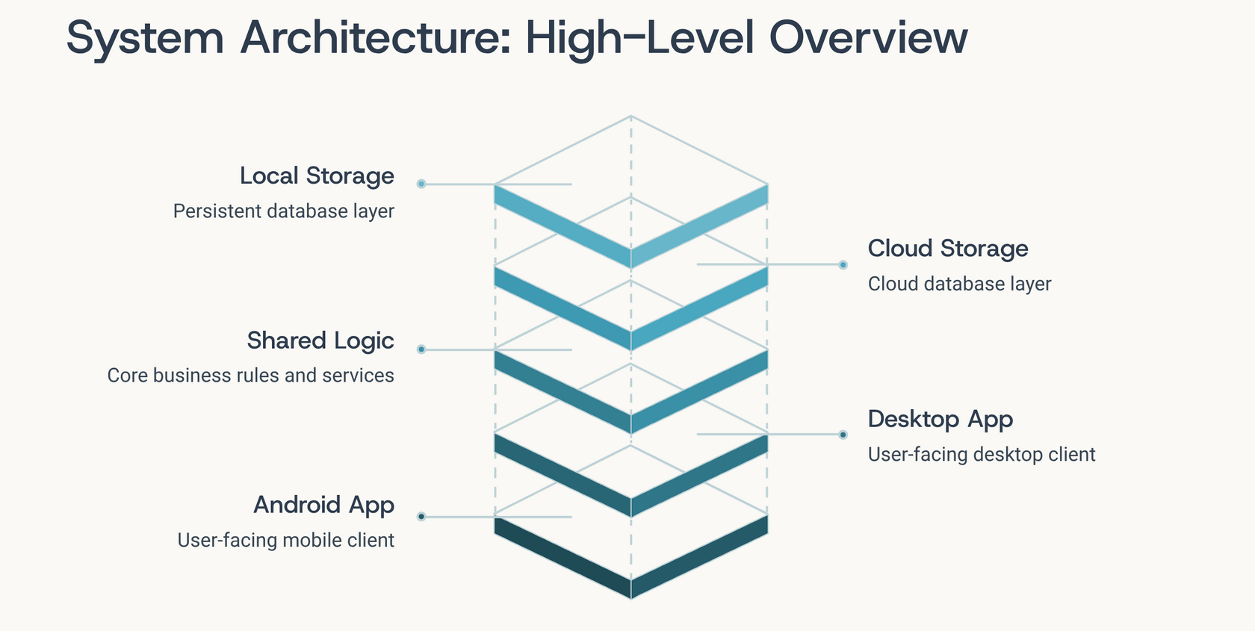
SYSTEM ARCHITECTURE

Slide 5
TECH STACK
ANDROID APPLICATION
DESKTOP APPLICATION
Java (Android SDK)
Java
XML (Design)
JavaFX (Design)
Gradle (Build)
Maven (Build)
Firebase (Database)
SQLite (Database)
FireAuth (Auth)

Slide 6
FEATURES
RBAC (Role Bases Access Control).
Saved states for Authorized User.
Profile management and Customization.
Relationship among tables using Join (One to many or many to many).
Appointment booking with checking the actual waiting time.
Real time waiting update.

Slide 7
FEATURES
Notification when it’s your turn.
Cancel booking with undo.
Appointment history.
CRUD on Departments and Doctors.
Password Update.
Status update from admin panel and instant notification to user dashboard.

Slide 8
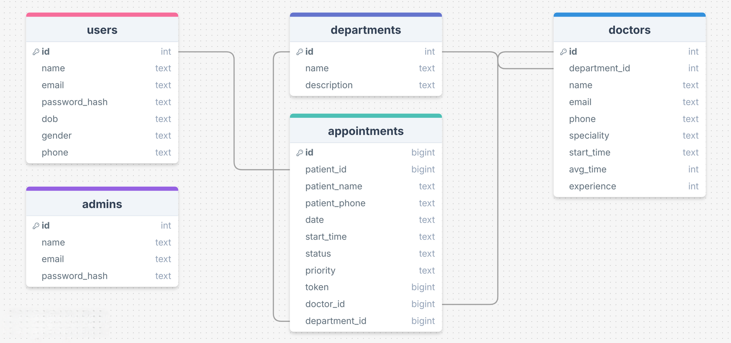
DATABASE SCHEMA

Slide 9
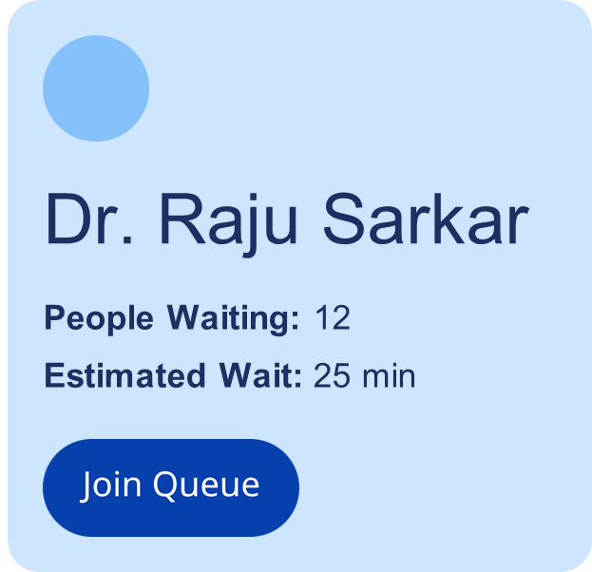
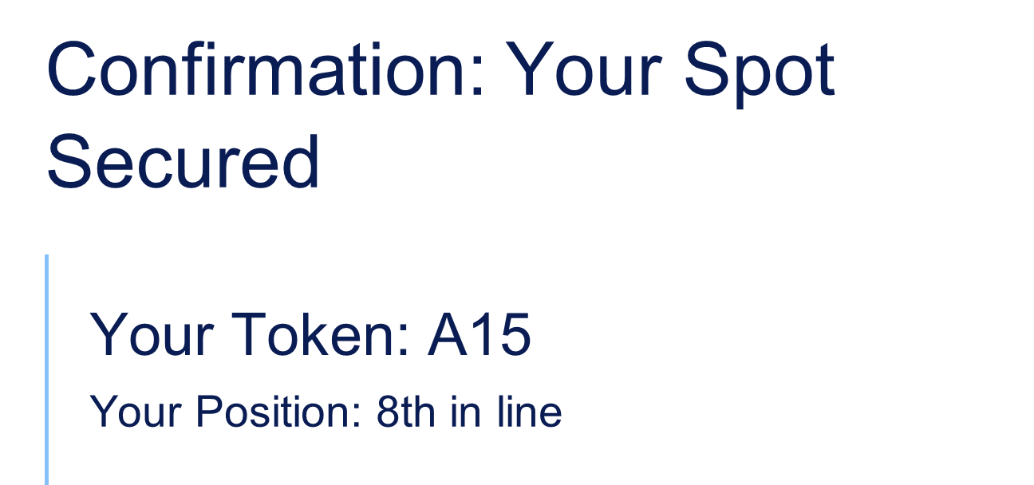
ANDROID APPLICATION
FEATURES AND UI

Slide 10
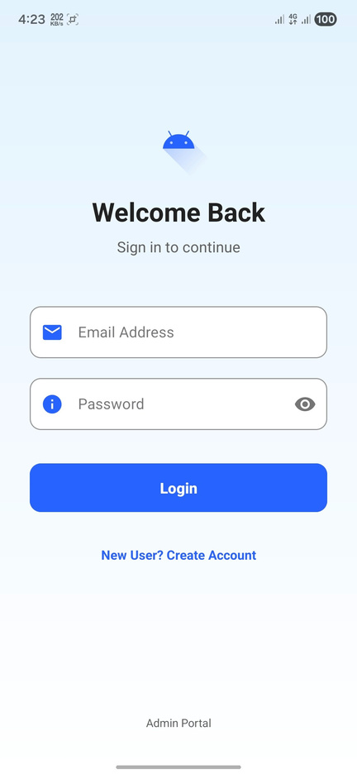
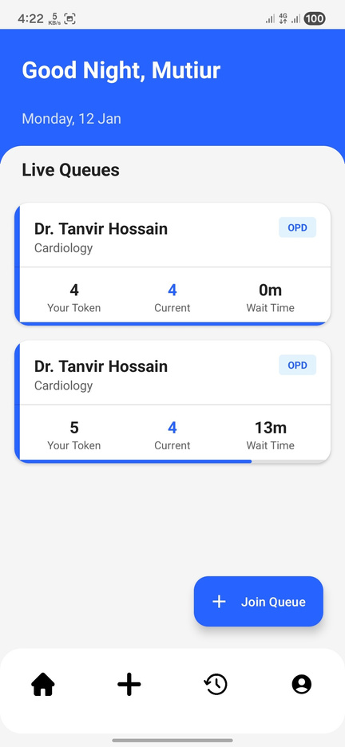
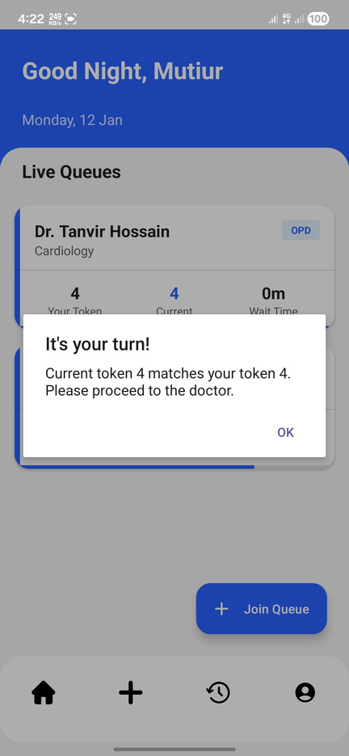
ANDROID APPLICATION

Slide 11
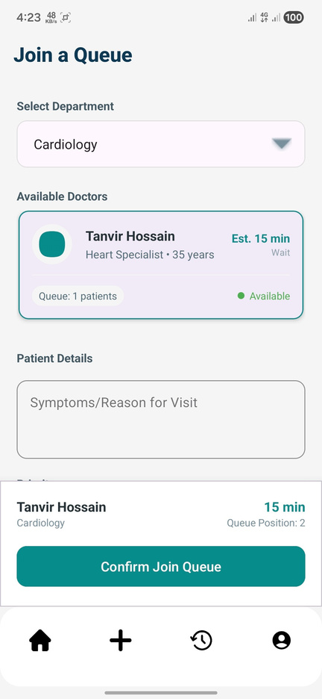
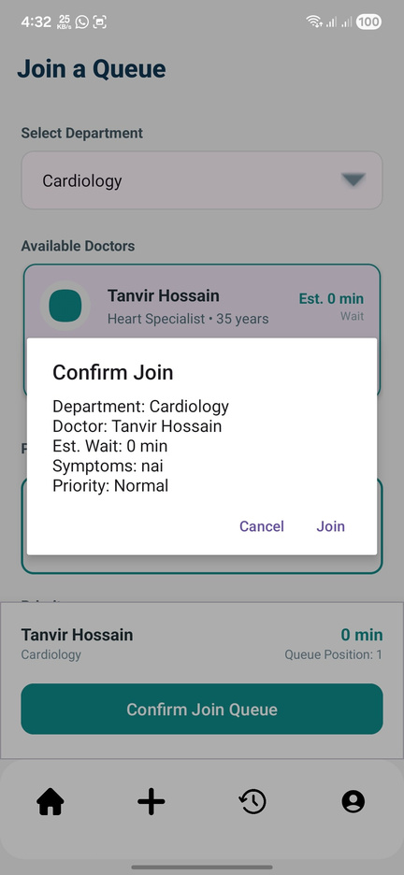
ANDROID APPLICATION

Slide 12
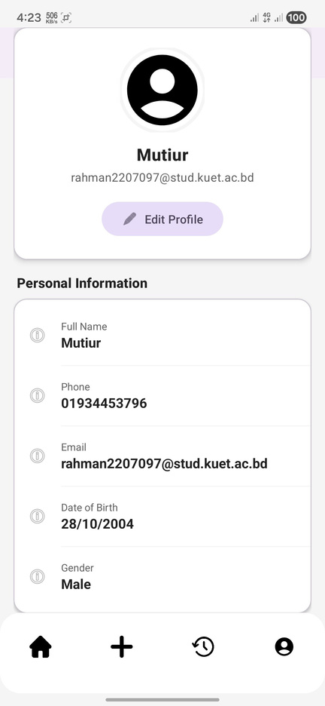
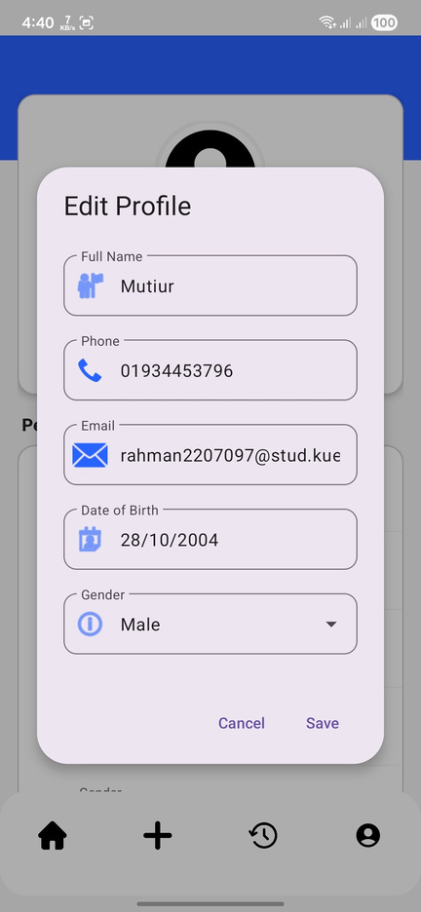
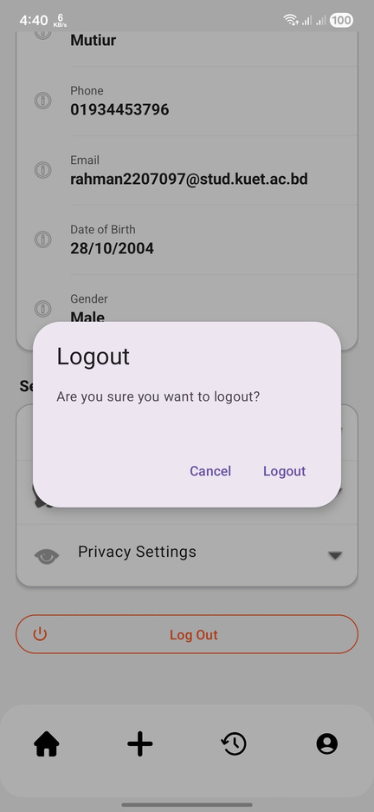
ANDROID APPLICATION

Slide 13
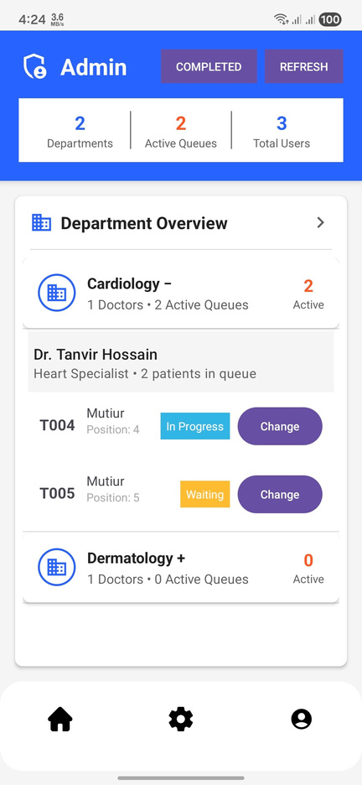
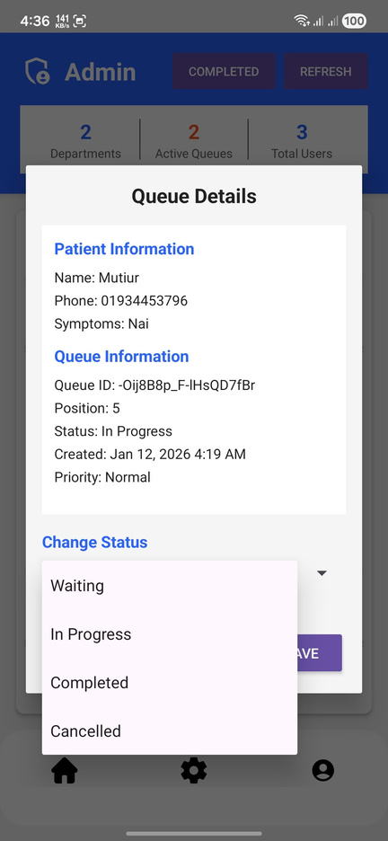
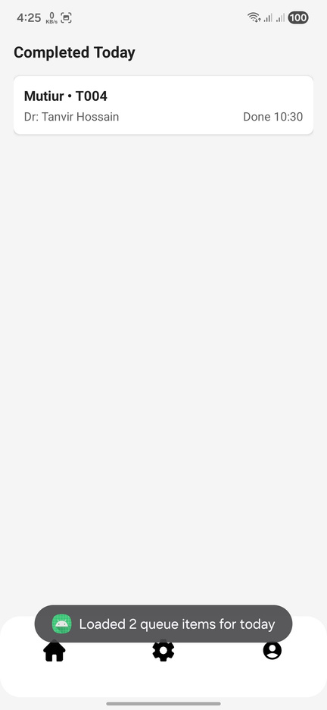
ANDROID APPLICATION

Slide 14
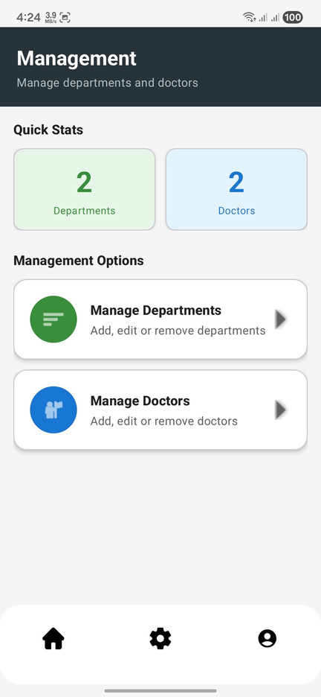
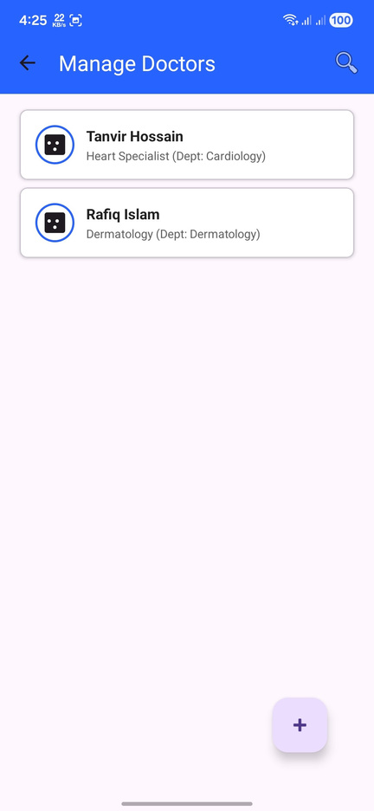
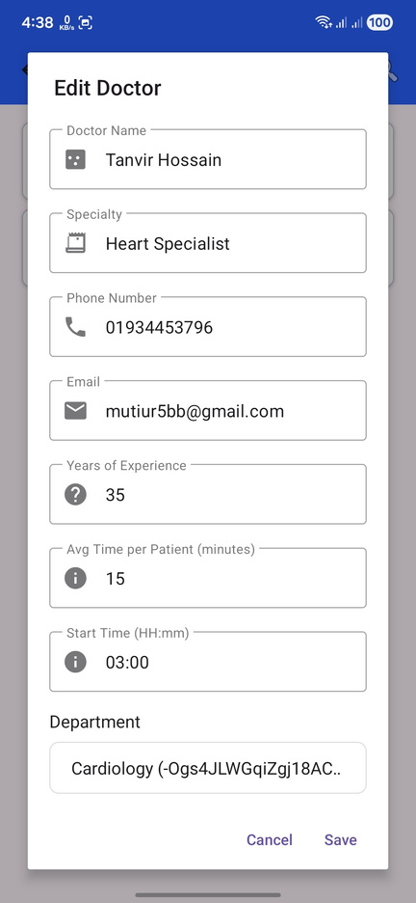
ANDROID APPLICATION

Slide 15
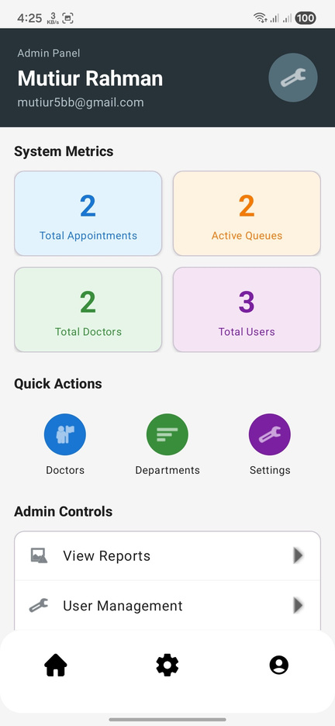
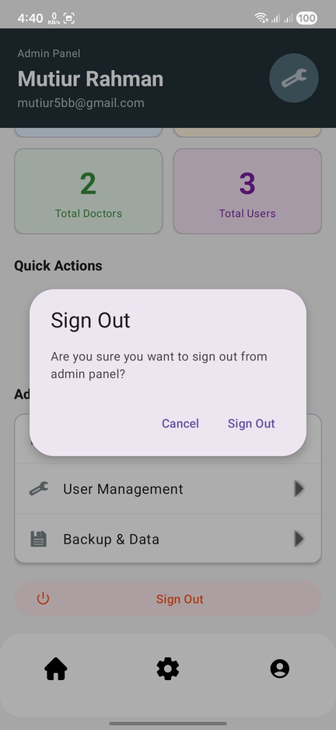
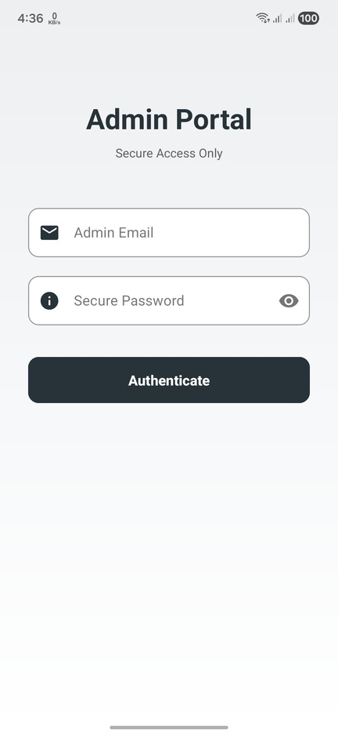
ANDROID APPLICATION

Slide 16
DESKTOP APPLICATION
FEATURES AND UI

Slide 17
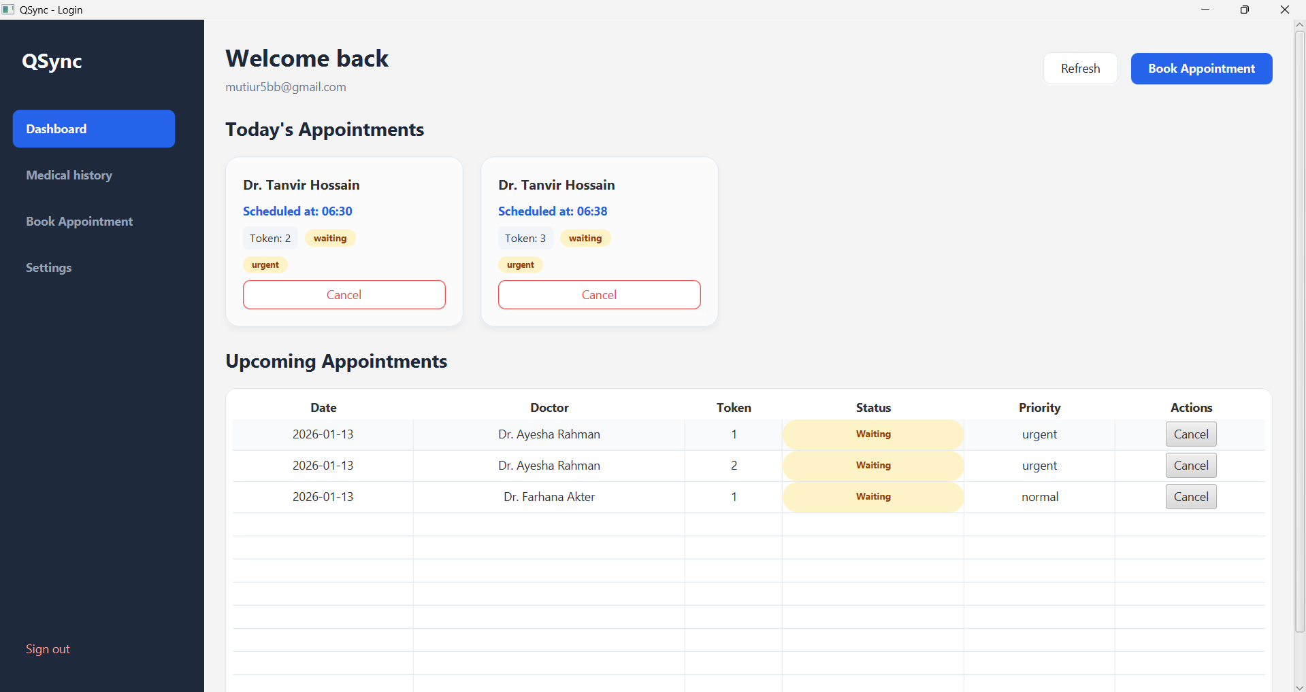
USER DASHBOARD

Slide 18
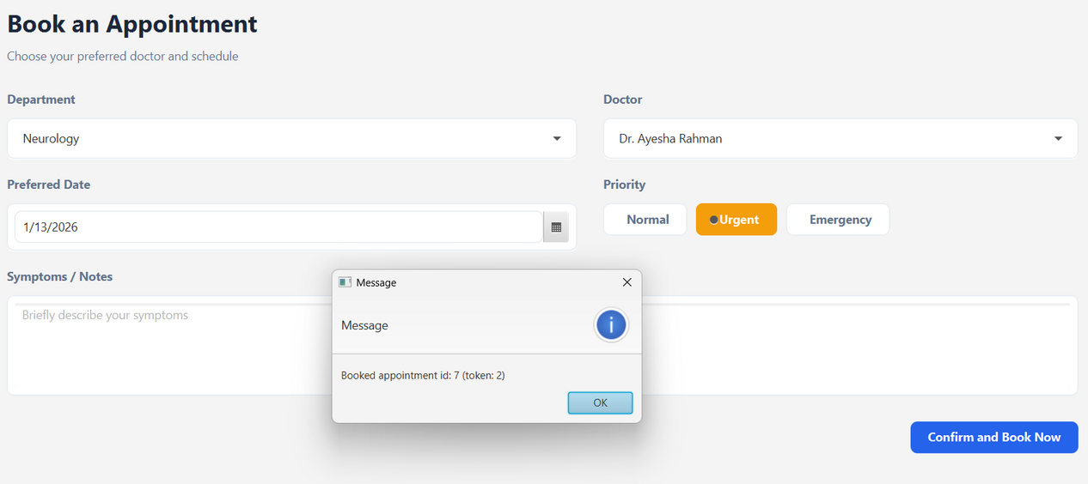

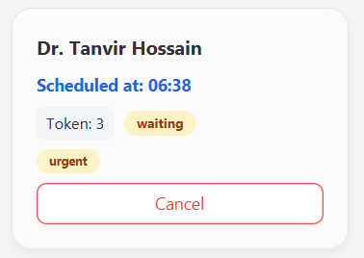
QUEUE JOINING

Slide 19
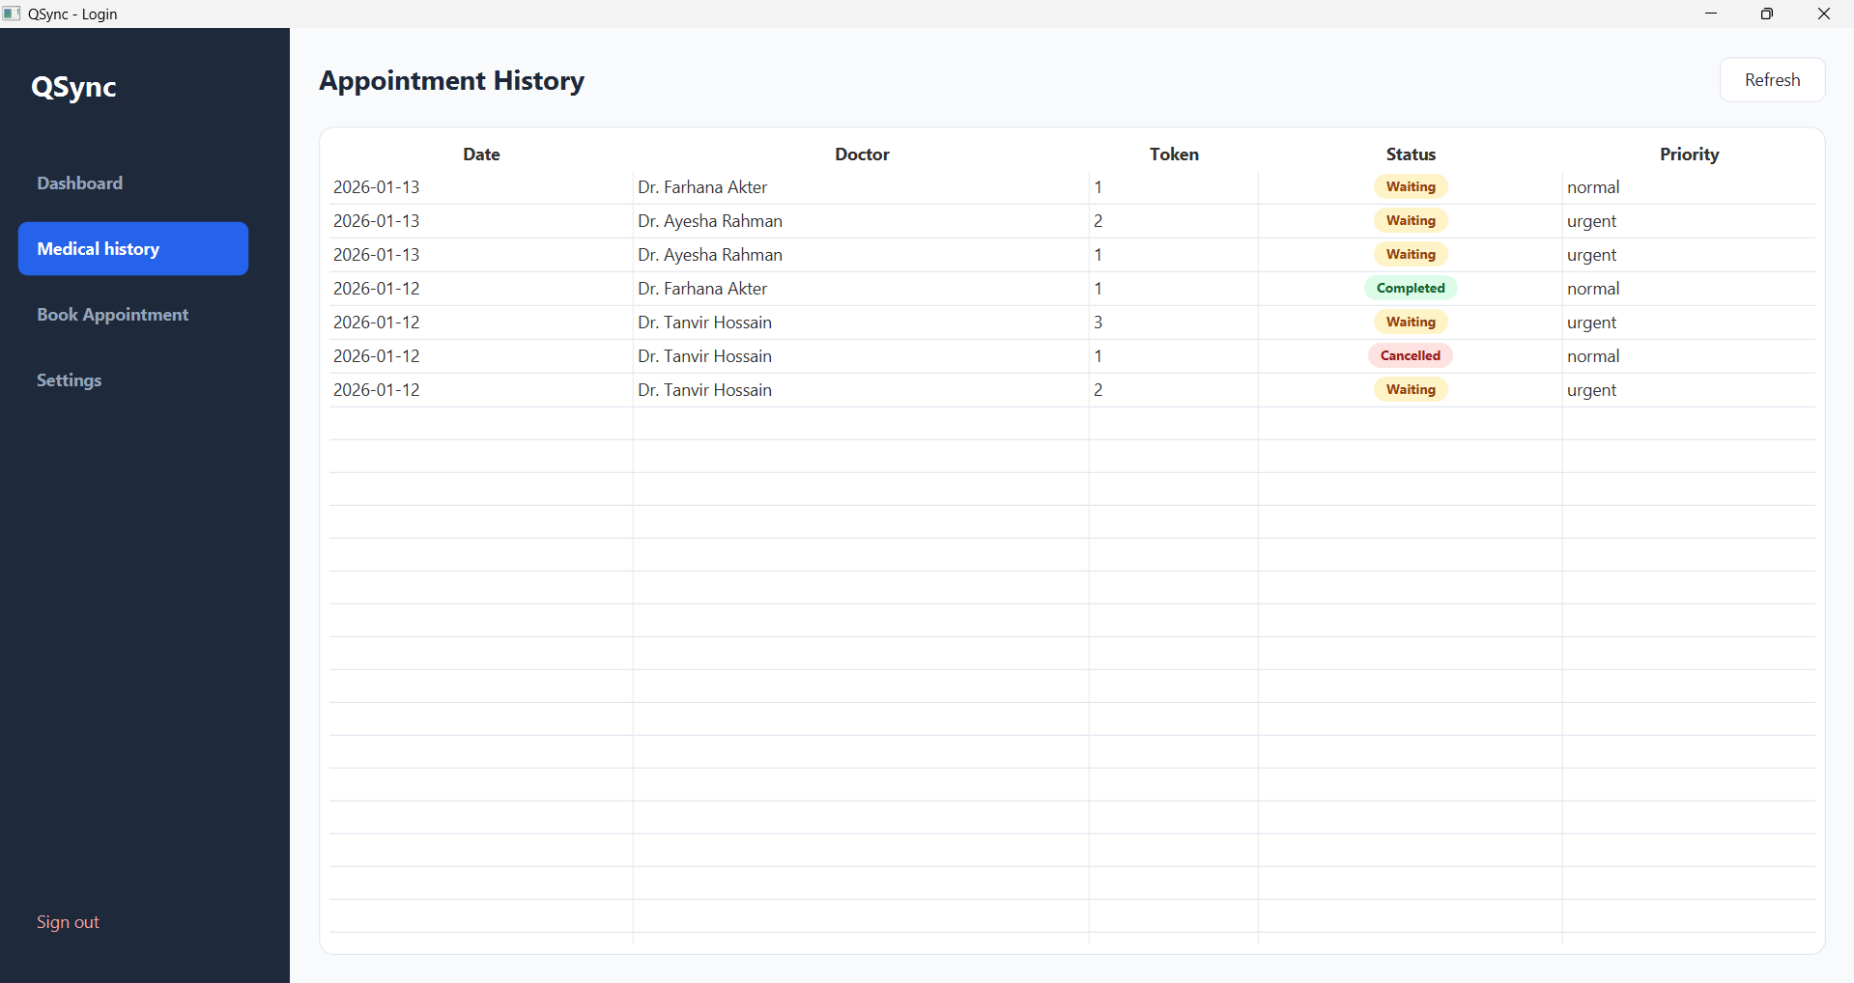
USER HISTORY

Slide 20
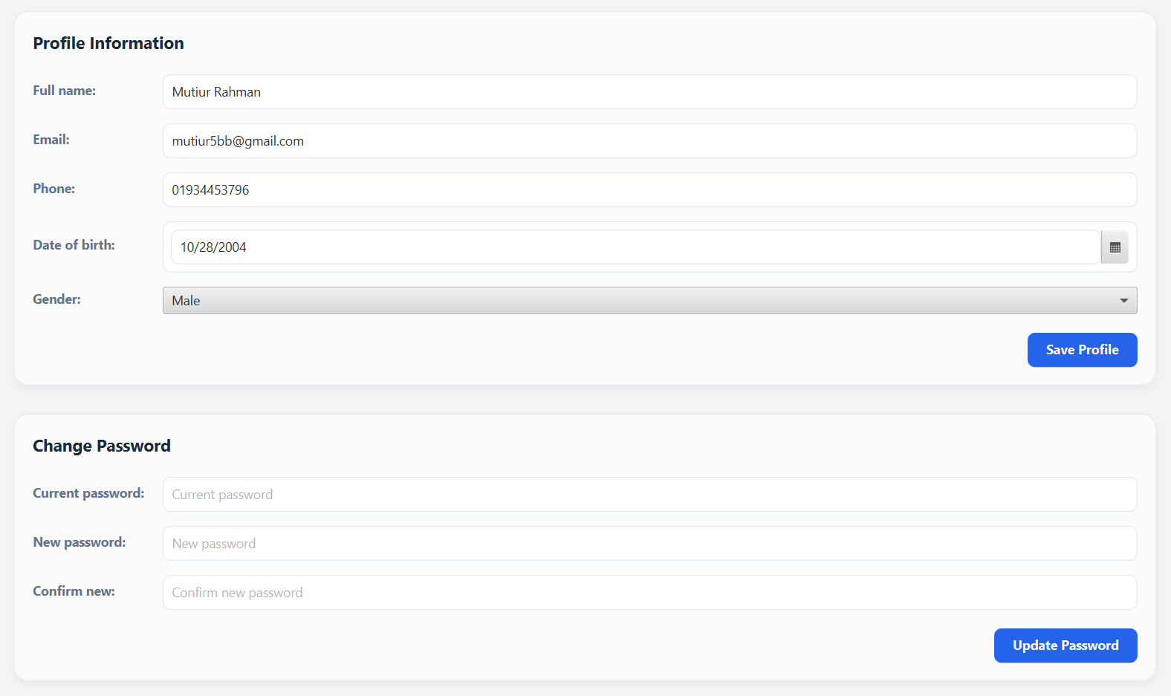
USER SETTINGS

Slide 21
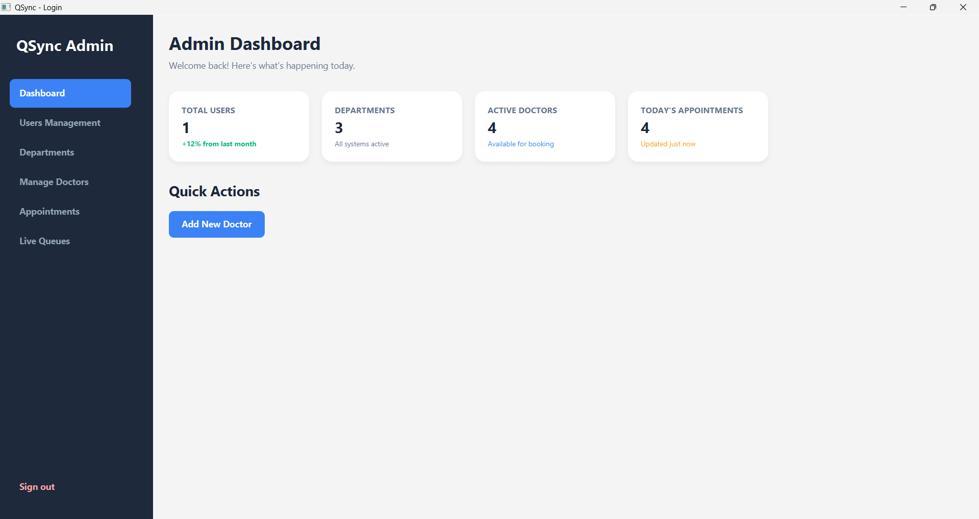
ADMIN DASHBOARD

Slide 22
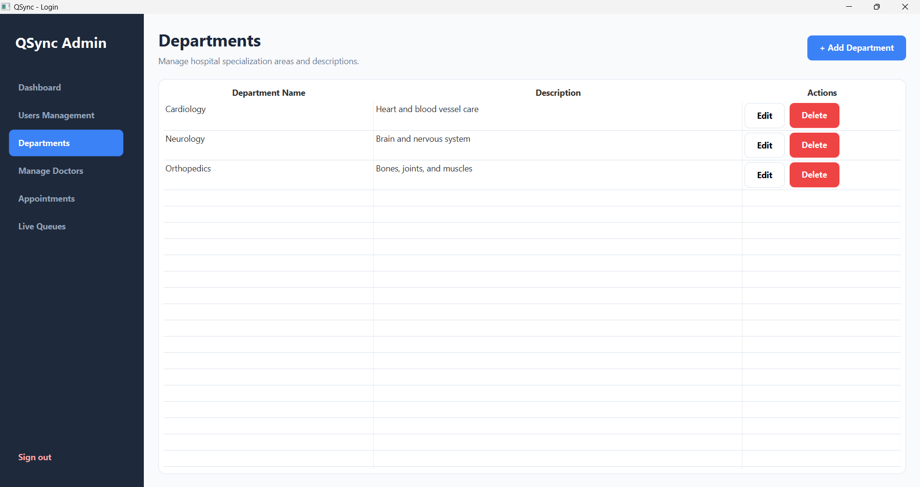
DEPARTMENT MANAGEMENT

Slide 23
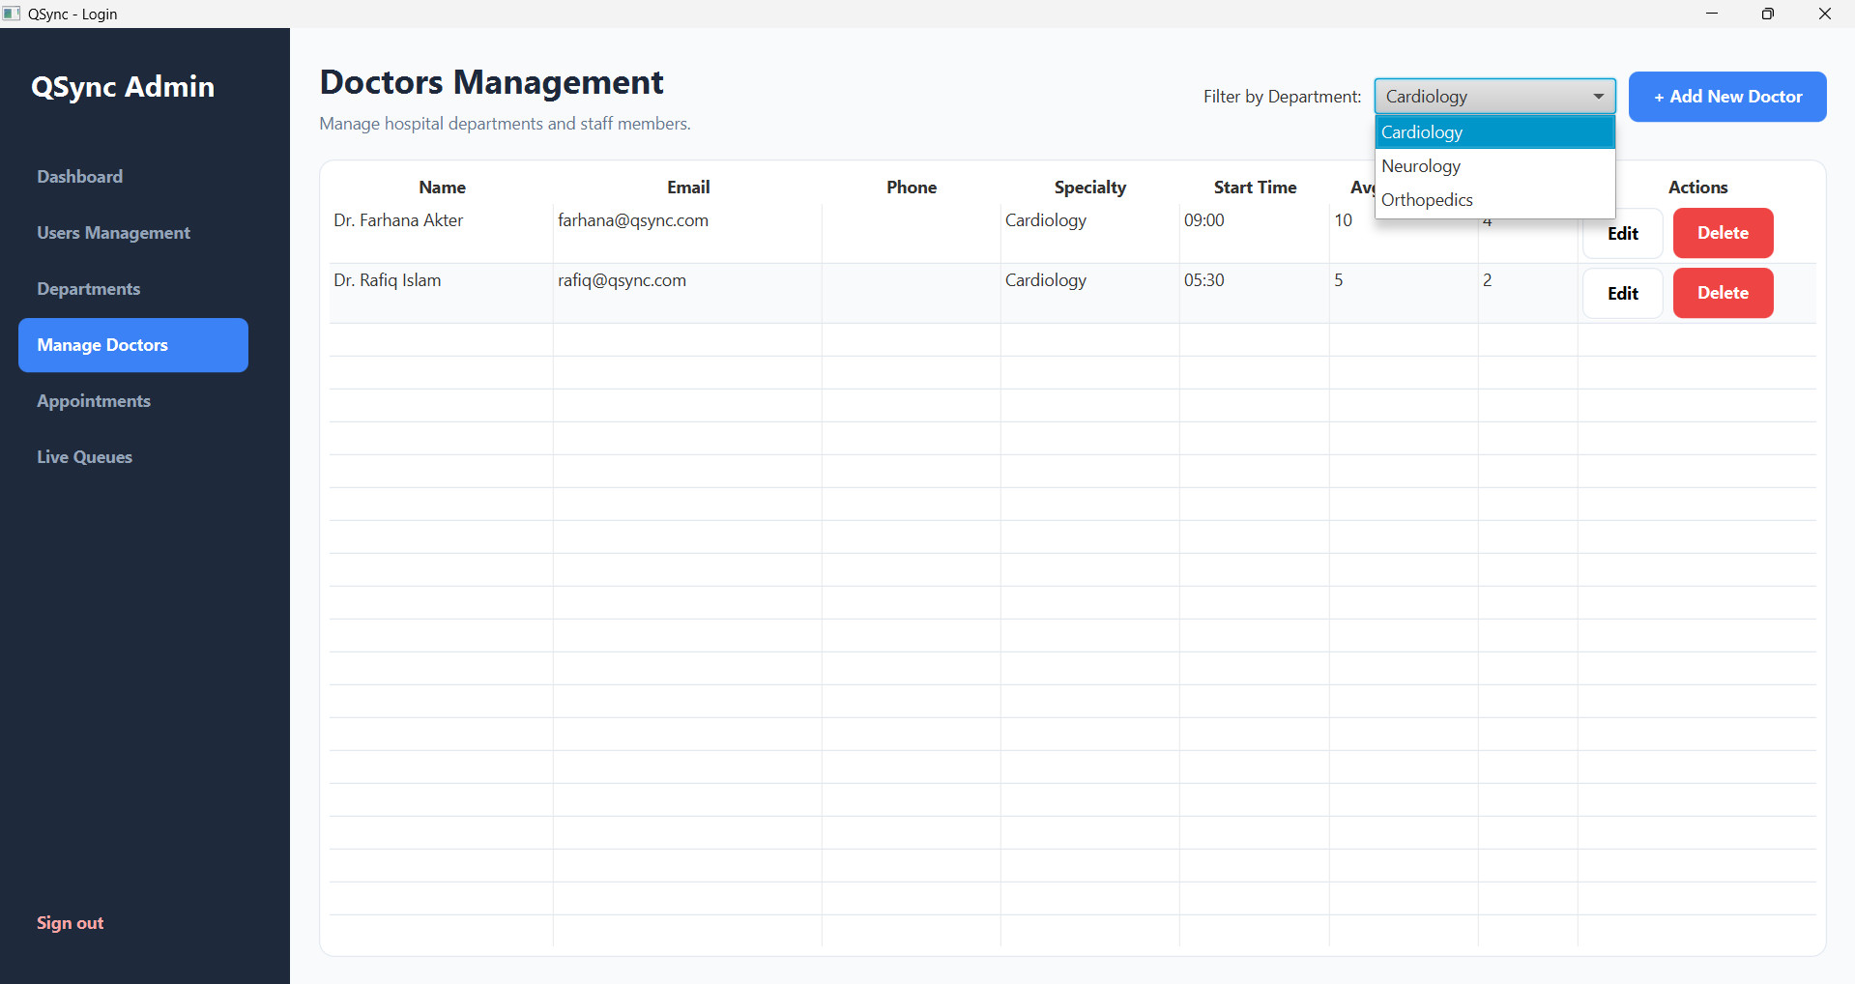
DOCTOR MANAGEMENT

Slide 24
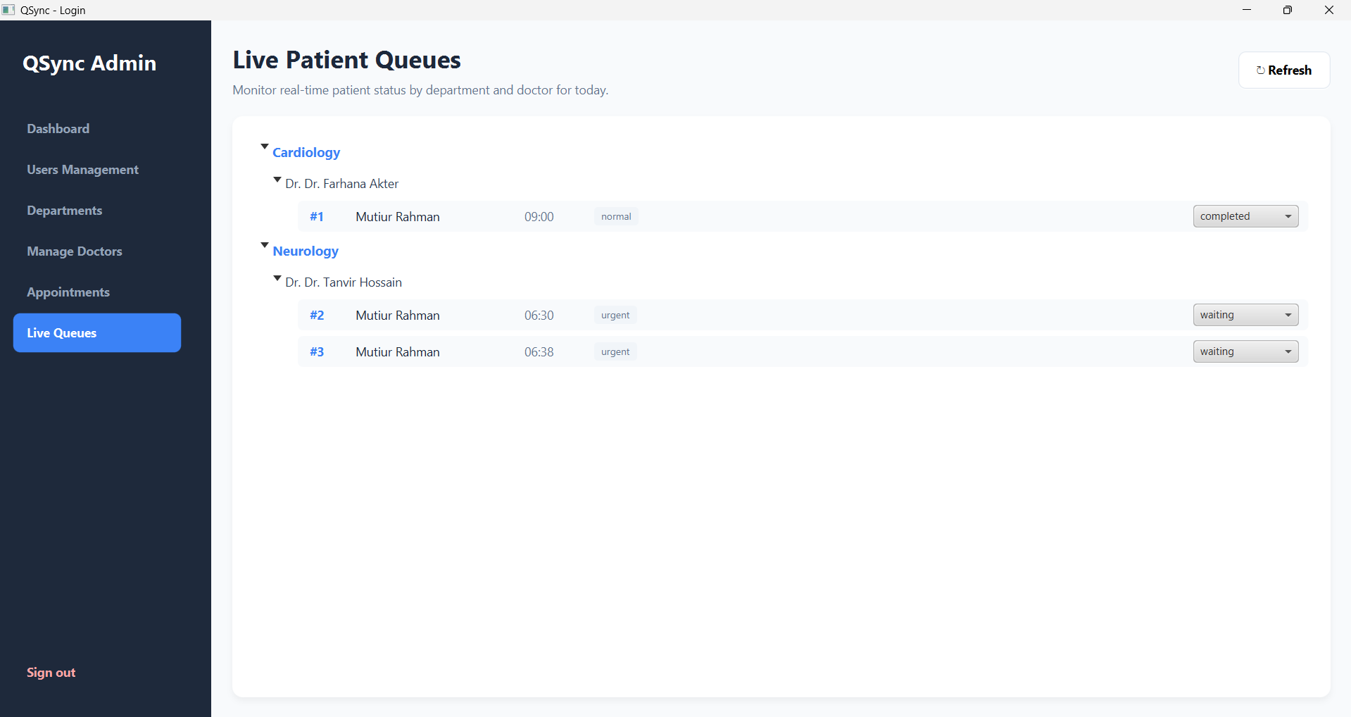
LIVE QUEUES
WHERE ADMIN WILL UPDATE STATUS OF QUEUES

Slide 25
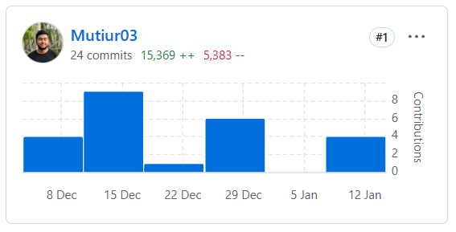
GIT CONTRIBUTION
ANDROID

Slide 26
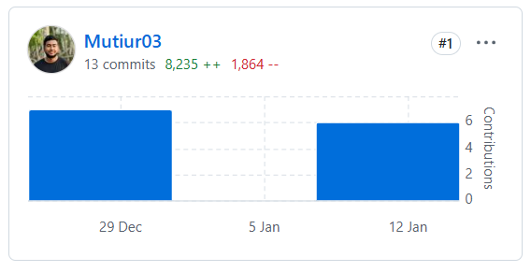
GIT CONTRIBUTION
DESKTOP

Slide 27
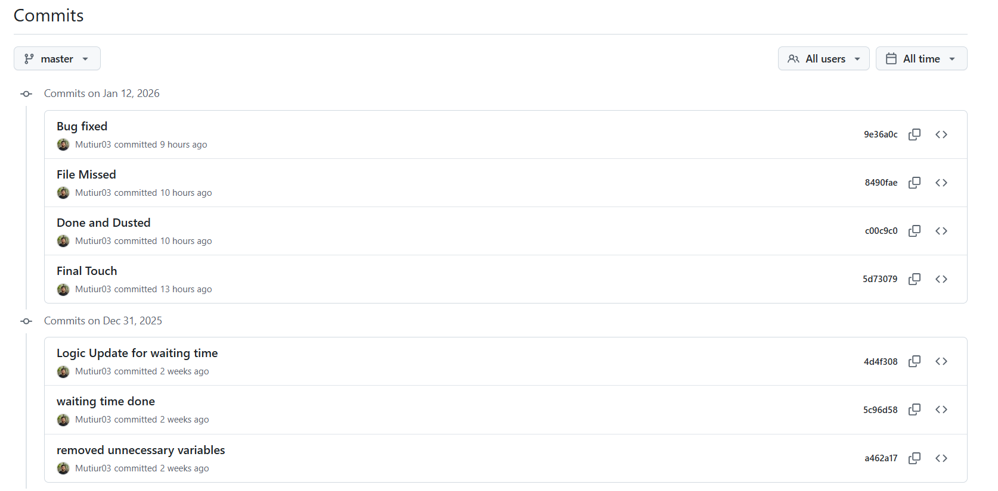
GIT HISTORY
ANDROID

Slide 28
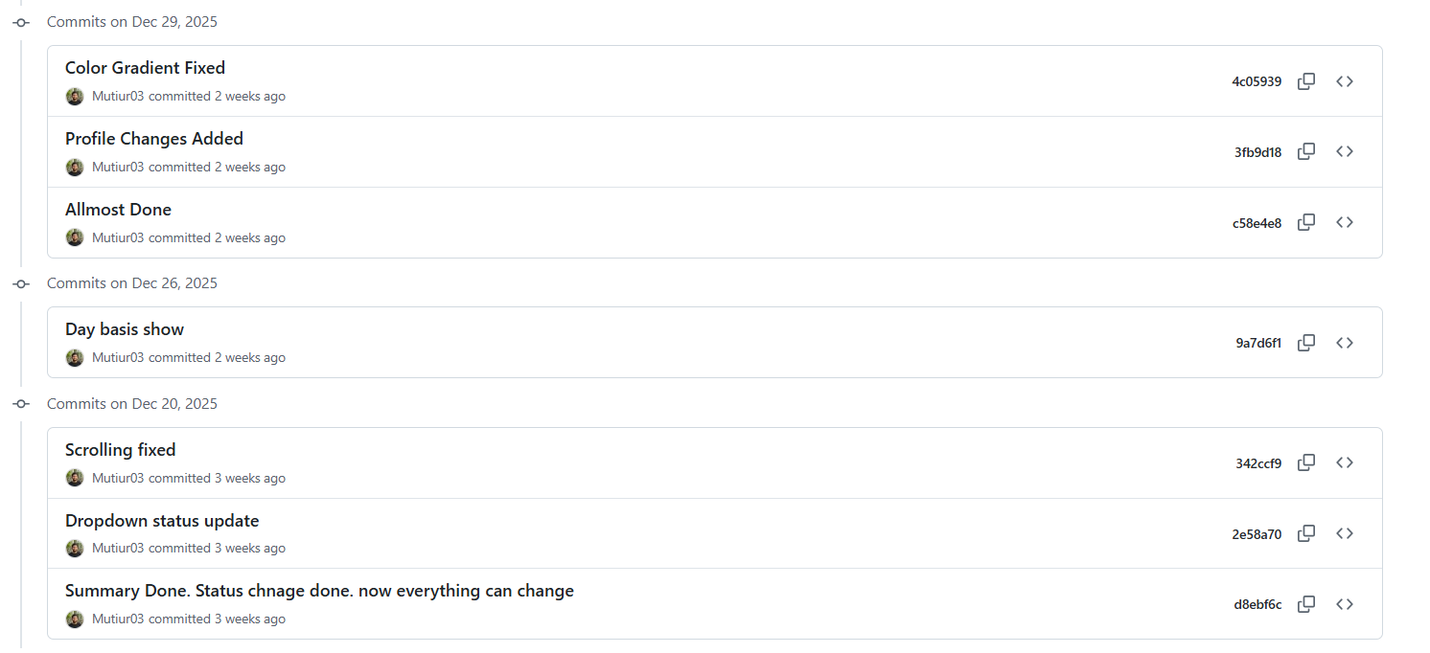
GIT HISTORY
ANDROID

Slide 29
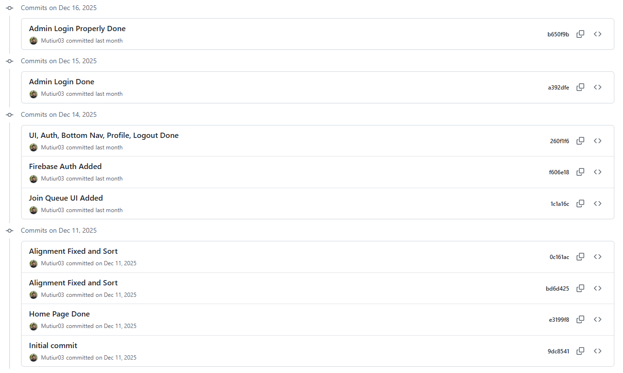
GIT HISTORY
ANDROID

Slide 30
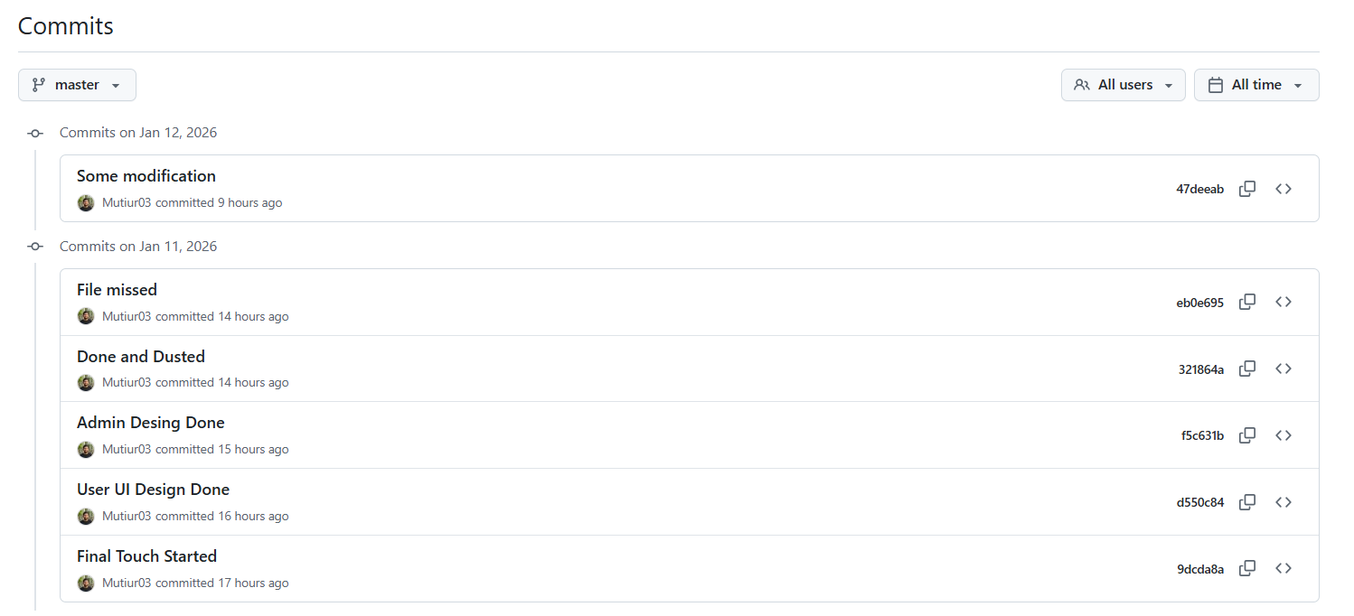
GIT HISTORY
DESKTOP

Slide 31
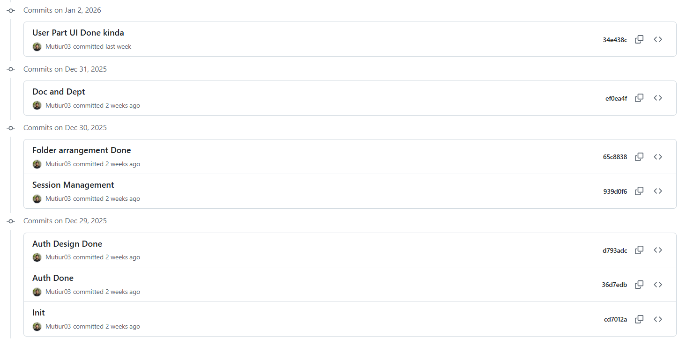
GIT HISTORY
DESKTOP

Slide 32
THANK YOU
ANDROID GITHUB REPO
DESKTOP GITHUB REPO

