Slide 1
Memento
CTRL+Z
CTRL+Y

Slide 2
Introduction
Undo|Redo
Works by saving states

Slide 3
Description
Also know as Token
Motivation behind using it
Fix mistakes
Go back to previous Iterations

Slide 4
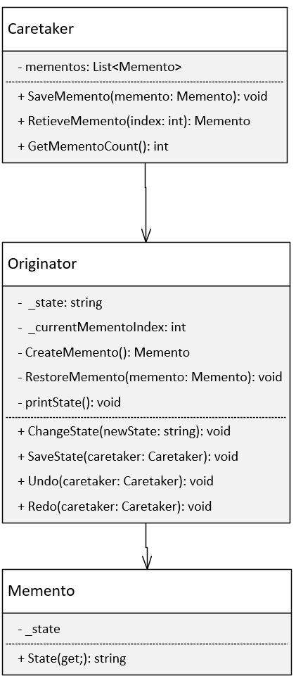
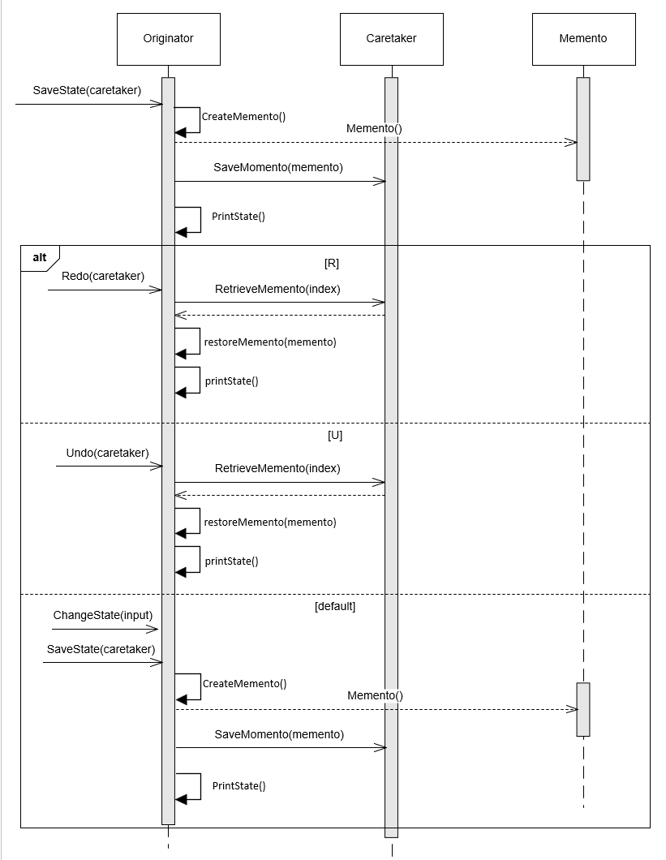
Structure
Memento
State
Originator
State
Editor
Caretaker
Handles List
Handles Redo/Undo commands
Consequenses

Slide 5
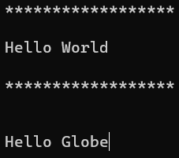
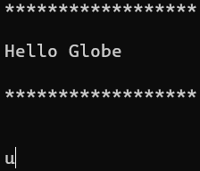
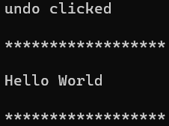
Code Example

Slide 6

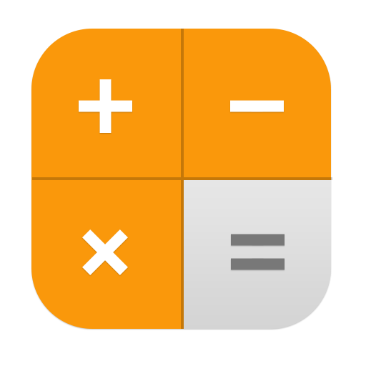
Perspectivation
Word
Calculator
Related patterns
Command
Iterator

Slide 7
Conclusion
States getting saved
Be wary how much you save
Applications can vary in use of Memento
Word: Redo/Undo
Calculator: History of calculations

