Slide 1
CIS612: Half-Semester Project
Created by
Muttaki I. Bismoy
G02518887
Delivered to
Byron DeVries
Associate Professor, School of Computing
Padnos College of Engineering and Computing
Grand Valley State University

Slide 2
Functional and Non-Functional Requirements
Functional Requirements | Non-Functional Requirements
allow users to input their date of birth through a date picker interface. | provide an intuitive and user-friendly interface accessible to users of all ages.
allow users to input a 'To Date' to calculate age from birthdate until the given 'To Date'. | accessible on both mobile and desktop platforms via a web browser if deployed.
calculate the user's age in years, months, weeks, and days from the provided birthdate to the current date, or 'To Date'. | display results within 2 seconds of receiving user input.
correctly account for leap years in age calculations. | handle at least 1000 concurrent users without performance degradation if deployed.
determine the user's zodiac sign based on their birthdate. | have an uptime of 99.9% outside of scheduled maintenance.
provide horoscope information for the user's zodiac sign. | scale to accommodate an increasing number of users.
calculate the user's life path number based on numerology from their birthdate. | be easy to maintain with well-documented code and a clear structure.
provide compatibility scores or insights based on the user's zodiac sign with other signs. | be compatible with major browsers, including Chrome, Firefox, Safari, and Edge.

Slide 3
System Boundary
System | System Context | Irrelevant Environment
Date input fields | User's birthdate input | User's clothing preference
Calculate button | Current date or a second input date | Political climate
Zodiac sign determination logic | User interaction with the UI | Stock market performance
Age calculation logic | Web server processing the calculations | User's physical location
Horoscope retrieval logic | Database of zodiac sign dates and attributes | Time of day
Life path number calculation | User's device and browser | News events of the day
Zodiac compatibility logic |  | Weather conditions

Slide 4
Software Process Model
Waterfall Model
Simplicity
Linear approach
Works best with well-defined requirements
One-time design and implementation

Slide 5
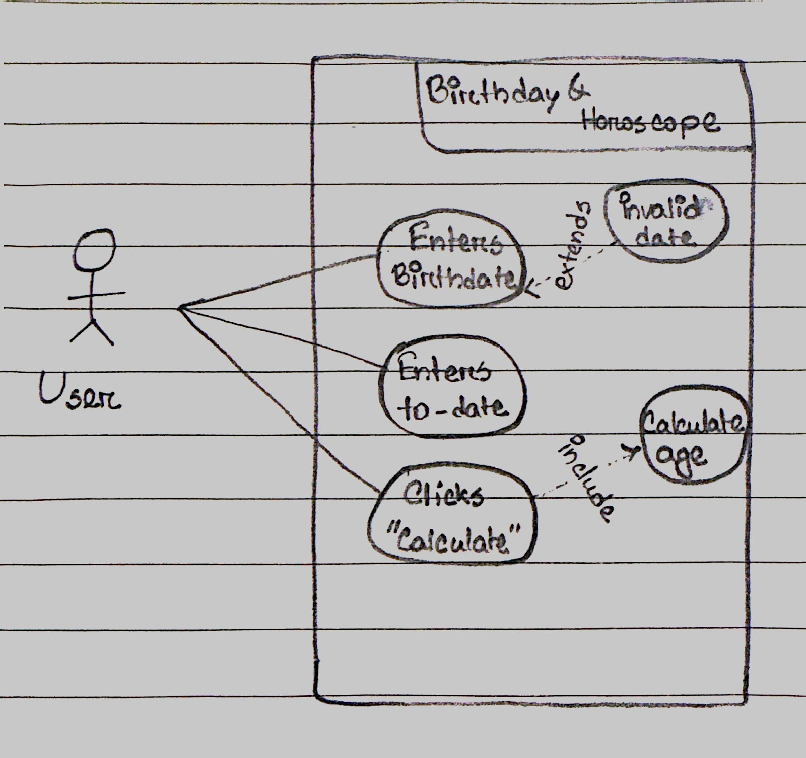
Use-Case Diagram

Slide 6
Natural Language Requirements
Requirement 1: The web application shall allow the user to input their birth date and a target date to calculate the age.
Requirement 2: The web application shall calculate the age in years, months, weeks, and days from the birth date to the target date.
Requirement 3: The web application shall determine and display the user's zodiac sign based on their birth date.
Requirement 4: The web application shall provide horoscope information based on the user's zodiac sign.
Requirement 5: The web application shall calculate and display the user's life path number based on numerology.
Requirement 6: The web application shall provide compatibility information based on the user's zodiac sign.
Requirement 7: The web application shall display a list of significant leap years within the user's age.
Requirement 8: The web application shall provide a link to more information about the user's zodiac sign.
Traceability Matrix
Requirement | Age Calculation | Zodiac Sign | Horoscope | Life Path Number | Compatability | Leap Year | Learn More
1 | X
2 | X |  |  |  |  | X
3 |  | X
4 |  | X | X
5 |  |  |  | X
6 |  | X |  |  | X
7 | X |  |  |  |  | X
8 |  | X |  |  |  |  | X

Slide 7
Decision Table
Pre-Conditions:
- User enters a valid date of birth (DOBValid = True).
- User clicks on the 'Calculate' button (CalculateClicked = True).
Post-Conditions:
- The correct zodiac sign is displayed (ZodiacDisplayed = True).
- The correct life path number is calculated and displayed (LifePathDisplayed = True).
Rules | R1 | R2
DOBValid | F | T
CalculateClicked | - | T
ZodiacDisplayed | - | X
LifePathDisplayed | - | X

Slide 8
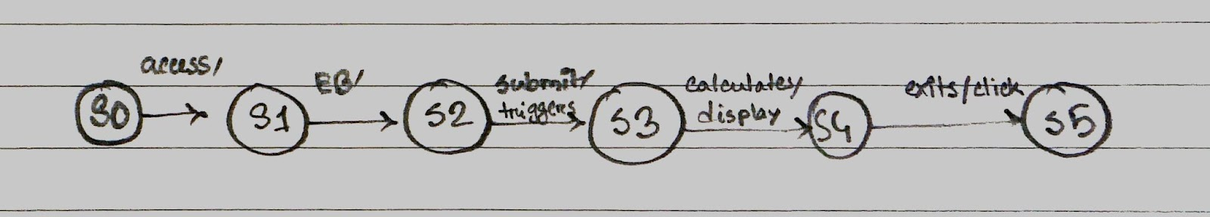
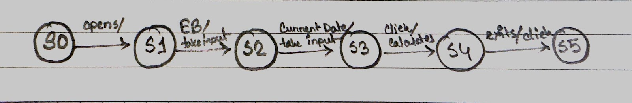
Finite State Machine & Statecharts
FSM & Statechart for zodiac sign and horoscope calculation:
1. Start (S0): Initial state when the user accesses the web application.
2. Enter Birthday (S1): The user inputs their birth date.
3. Submit Date (S2): The user submits the date, triggering the calculation process.
4. Calculate Sign (S3): The system calculates the zodiac sign based on the submitted date.
5. Display Results (S4): The zodiac sign and horoscope are displayed to the user.
6. End (S5): The user exits or closes the web application.
FSM & Statechart for age calculation:
1. Start (S0): The user opens the age calculation page.
2. Input Birth Date (S1): The user inputs their birth date into the system.
3. Input Current Date (S2): Either the user enters the current date or the system automatically fills it in.
4. Calculate Age (S3): The system calculates the age when the user clicks "Calculate".
5. Display Age (S4): The calculated age is displayed to the user.
6. End (S5): The process ends, either by the user closing the application or initiating a new calculation.

Slide 9
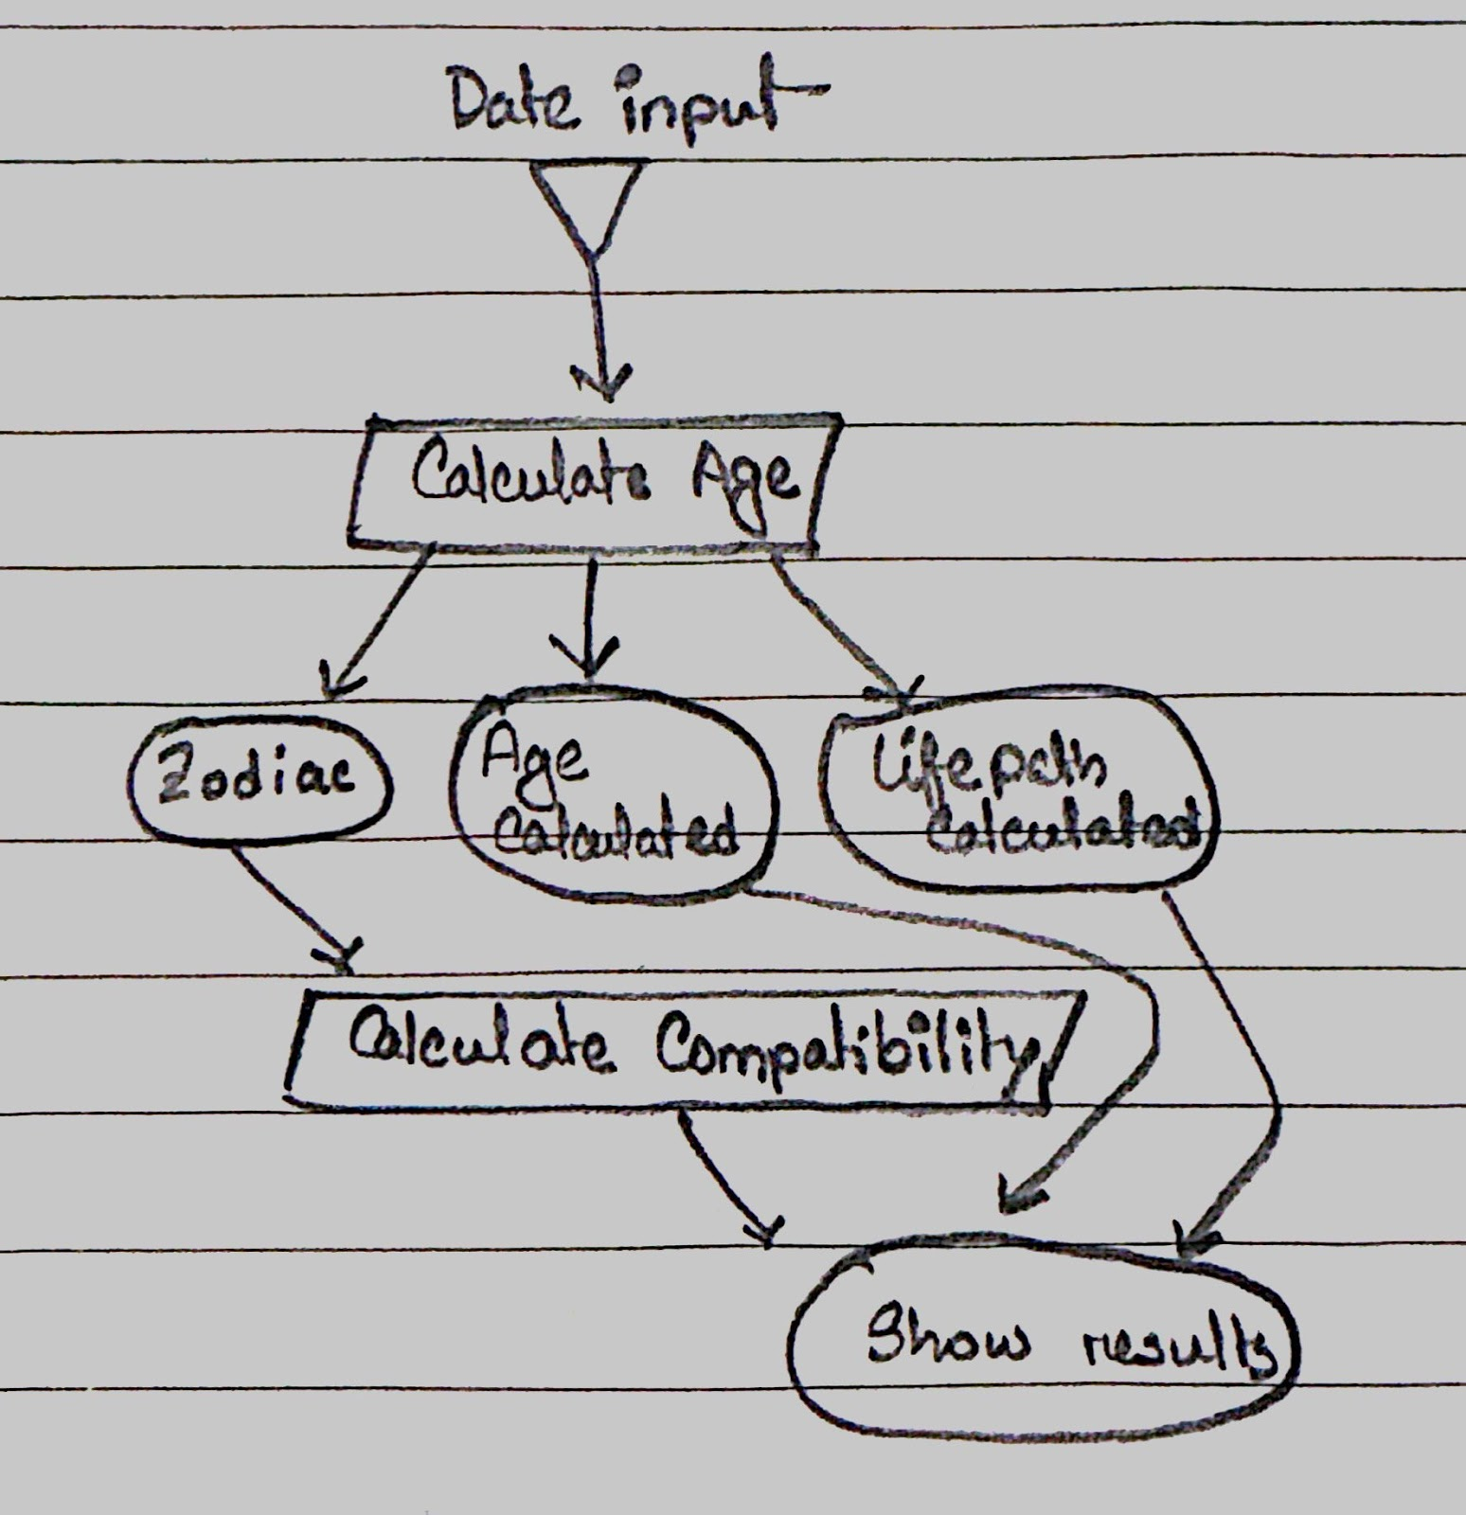
Petri Nets

