Slide 1
A Study On the Determination of Heart Disease Using Machine Learning Algorithm
Muttesir OKUDUCU
A0228521@live.tees.ac.uk

Slide 2
Introduction and background
Heart disease rates have dramatically risen to become the leading cause of death
World Health Organization(who) reported that 17,9 million people die each year from heart disease, which correlates with 31% of all deaths worldwide (WHO, 2017)
The number of deaths from heart disease decreases in high-income countries, death occurs in many low- and middle-income countries
Early detection of the disease and appropriate treatment play an important role in preventing deaths and reducing the risk of heart diseases.
Artificial intelligence applications and different classification methods are increasing in detecting heart diseases.

Slide 3
This project aims to calculate the accuracy score using the three different machine-learning approaches on the heart disease dataset. It will be calculated to conclude which one is best among them.
Logistic Regression (LR),
K Nearest Neighbour algorithm (KNN)
Support Vector Machine (SVM).

Slide 4
Related work
Researchers | Method | Accuracy and recommendation
Palaniappan and Awang (2008) | Decision Trees, Naïve Bayes, Neural Network. | %80.4 %86.12 85.68
Das and Sengur (2009) | Statistical Analysis System (SAS) | 89.01% classification accuracy 80.95% specificity 95.91% sensitivity values
Shao et al. (2014) | hybrid intelligent modelling scheme logistic regression (LR), multivariable adaptive regression splines (MARS), Artificial Neural Network (ANN) and Rough Cluster (RS) techniques. | recommended hybrid schemes efficiently classify heart disease and outperform the typical, single-stage ANN method.

Slide 5
Researchers | Method | Accuracy and recommendation
Singh et al. (2016) | Aprior, FP-Growth, Naive Bayes, ZeroR, OneR, J48 and k-NN | K-NN method gives better results than the other
Priyanka and Kumar (2017) | Naïve Bayes Decision Tree | (%82.35,%82.14,%70) (%98.03,%98.21,%90)
Kohali et al. (2018) (Heart, Breast cancer, Diabetes) | AdaBoost classifier for Breast Cancer detection, Logistic Regression using heart disease detection. Support Vector Machine using Diabetes prediction | 98.57% 87.1% 3. 85.71%

Slide 6
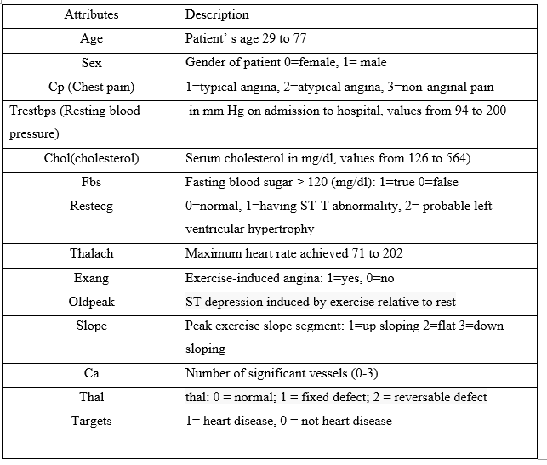
Pre-processing stages to prepare the dataset
Explain the selected dataset and state the reason of selecting this dataset.
The medical industry contains huge amount of data large and very difficult to predict a disease in traditional methods.
The 'Public Health Dataset' data set of the Kaggle database, an open-source internet site, was used in the study to detect heart disease. The data set used consists of 1025 data, 499 of which are not heart disease patients, and 526 are heart disease patients. There are 14 attributes in the received data set. The "target" field points to the presence of heart disease in the patient. It is number valued 0 = no disease and 1 = disease.

Slide 7
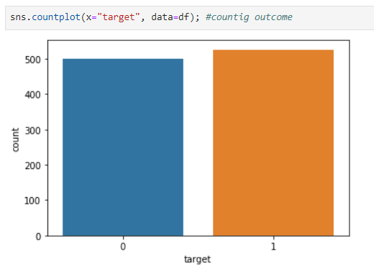
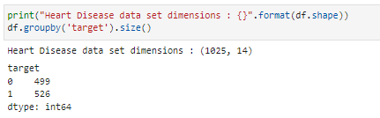
As seen in this dataset balancing graph, it can seem that both the target classes are nearly equal.

Slide 8
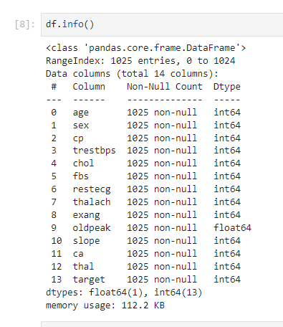
It has been inspected, and there are not any null values. Also, it has been checked data type; there are 13 integers and one float number.

Slide 9
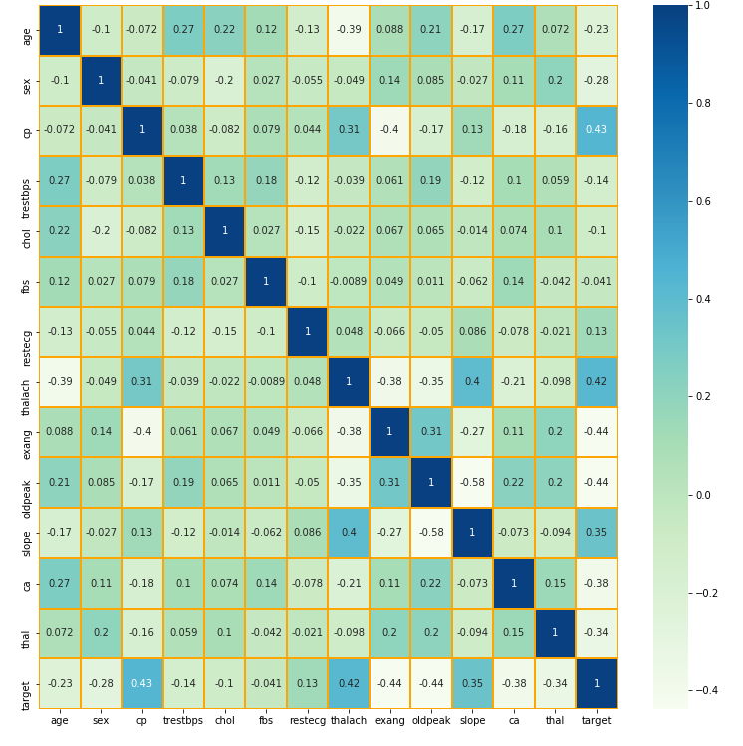
helps cross-examine multivariate data by placing variables in rows and columns and colouring cells in the table
show variance among multiple variables, reveal any design, show whether any variable is like each other, and detect any correlation between them.

Slide 10
Machine Learning
Allows software applications to become more accurate at predicting outcomes without being explicitly programmed to do so. Machine learning algorithms use historical data as input to predict new output values
1
There are three types of machine learning algorithms;
2
Supervised learning: Generates a function that maps inputs to target outputs. In this type of learning, algorithm.
3
Unsupervised learning: Models a set of inputs. It provides inferences about the data by using the distances of the data samples from each other and the neighbourhood relation
4
Reinforcement learning is a type of machine learning that aims to train the agent (robot, vehicle) with the reactions it receives from the environment without training data.
5

Slide 11
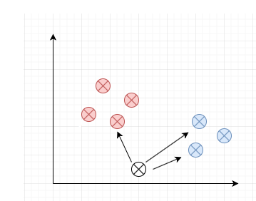
Machine learning algorithms, divided into training and testing, provide feedback in connection with the accuracy of the predictions. In this project, the data will into training and testing; it will set into a ratio of 70% training data and 30% testing data
K-Nearest Neighbor: The k-nearest neighbor (KNN) algorithm is a supervised learning algorithm that is easy to implement. Although it is used in solving both classification and regression problems, it is mainly used in solving classification problems in industry.

Slide 12
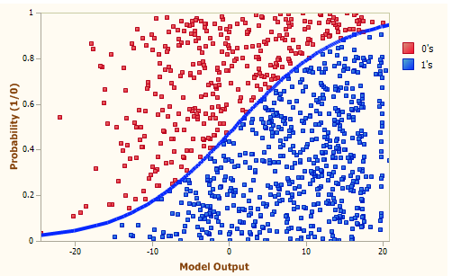
Logistic Regression: Logistic Regression (LR) is a regression method for classification. It is used to classify categorical or numerical data. It works when the dependent variable can only take two different values.

Slide 13
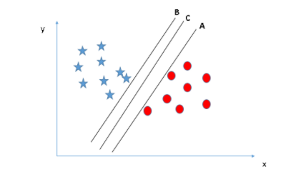
Support Vector Machines (SVM): Support Vector Machine is one of the supervised learning methods generally used in classification problems. In this algorithm, each data item is plotted as a point in the n-dimensional space (where n is the number of features your data has), with the value of each feature being the value of a particular coordinate.

Slide 14
Result and Analysis
firstly, it will show the test accuracy score made by default parameters of machine learning algorithms.
Secondly, it will show the tuned best accuracy score with GridsearchCV.
Finally, it is going to deliver a confusion matrix ;

Slide 15
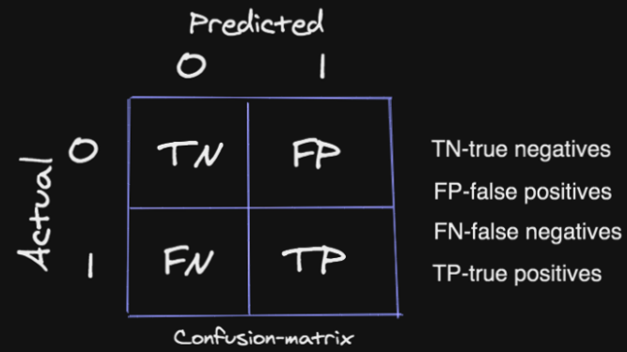
A confusion matrix is a table often used to describe the performance of a classification model on a set of test data for which the actual values are known
True Positives (TP): These are instances where true value is 1, and the predicted value is 1.
True Negatives (TN): These are instances where true value is 0, and the predicted value is 0.
False Positives (FP): These are instances where true value is 0, but the predicted value is 1.
False Negatives (FN): These are instances where true value is 1, but our predicted value is 0.

Slide 16
THANKS FOR LISTINNIG

Slide 17
References
Palaniappan, S. & Awang, . R., 2008. Intelligent heart disease prediction system using data mining. In 2008 IEEE/ACS international conference on computer systems and applications, March, pp. 108-115.
Benjamin, E. J. & Muntner, P., 2019. Heart disease and stroke statistics—2019 update: a report from the American Heart Association. Circulation, 139(10), pp. e56-e528.
Bonaccorso, G., 2017. Machine learning algorithms. s.l.:Packt Publishing Ltd..
Das, R., Turkoglu, . I. & Sengur, A., 2009. Effective diagnosis of heart disease through neural networks ensembles. Expert systems with applications, 36(4), pp. 7675-7680.
Engebretsen, M. and Kennedy, H., 2020. Data visualization in society (p. 441).
García, S., Luengo, J. & Herrera, F., 2015. Data preprocessing in data mining. Cham, Switzerland: Springer International Publishing..
Kishor, A. & Chinmay , C., 2021. Artificial intelligence and internet of things based healthcare 4.0 monitoring system. Wireless Personal Communications, pp. 1-17.
Kohli, P. S. & Arora, S., 2018. December. Application of machine learning in disease prediction. In 2018 4th International conference on computing communication and automation (ICCCA), pp. 1-4.
Organization, W. H., 2017. Cardiovascular diseases (CVDs): World Health Organization, Geneva, Switzerland: s.n.
Priyanka, N. & Kumar, . P. R., 2017. Usage of data mining techniques in predicting the heart diseases—Naïve Bayes & decision tree. In 2017 International Conference on Circuit, Power and Computing Technologies (ICCPCT), April, pp. 1-7.
Shao, Y. E., Hou, C. D. & Chiu, C. C., 2014. Hybrid intelligent modeling schemes for heart disease classification. Applied Soft Computing, Volume 14, pp. 47-52.
Singh, J., Kamra, A. & Singh, H., 2016. October. Prediction of heart diseases using associative classification. s.l., International conference on wireless networks and embedded systems (WECON).
Surden, H., 2014. Machine learning and law. Wash, p. 87.
Wang, C. et al., 2021. Wang, C., Sun, Y., Jiang, D., Wang, C. and Liu, S., 2021. Risk‐Attributable Burden of Ischemic Heart Disease in 137 Low‐and Middle‐Income Countries From 2000 to 2019.. ournal of the American Heart Association, 10(19), p. p.e021024.

