Slide 1
Agenda
Machine Learning: Introduction
Machine Learning: Concepts

Slide 2
Machine Learning: Introduction
Machine learning as a set of methods that can automatically detect patterns in data, and then use the uncovered patterns to predict future data, or to perform other kinds of decision making under uncertainty
There are various kinds of patterns in the data that can be learnt:
Supervised Learning
Unsupervised Learning

Slide 3
Supervised Learning: Introduction
Supervised Learning: There are two main tasks that are accomplished using supervised learning.
Regression: This involves predicting a continuous variable of interest on the basis of other variables. Eg, a typical example could be predicting the bounding box in object detection.
Classification: This involves predicting a categorical variable of interest on the basis of other variables. Eg, Classifying images

Slide 4
Supervised Learning: Introduction, Regression
Lets take an example: Regression
IDV
Age | # of Visits | Geographical Region
……. | ……. | …….
……. | ……. | …….
……. | ……. | …….
DV
Predict? | …….. | …….
Predict? | …….. | …….
DV | Continuous
IDV | Continuous/Categorical

Slide 5
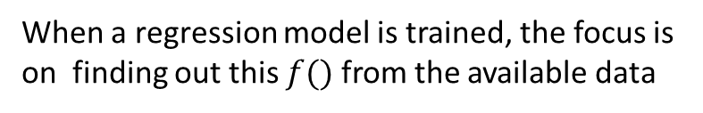
Supervised Learning: Introduction, Regression
Lets take an example: Regression
IDV
Age | # of Visits | Geographical Region
……. | ……. | …….
……. | ……. | …….
……. | ……. | …….
DV
Predict? | …….. | …….
Predict? | …….. | …….
It is possible to have regression models without any specific functional form, but the ones with a functional/parametrised form are more popular
$$Age=f(\# of Visits,Geographical Region)$$
When a regression model is trained, the focus is on finding out this $f()$ from the available data

Slide 6
Supervised Learning: Introduction, Regression
Linear Regression: A linear function of predictors is estimated, this estimated function is used to make predictions.
Eg:
#BlogsShared=f(predictors)
#BlogsShared=b0+b1NumberOfWords+b2Topic_Politics+b3Weekday
#BlogsShared=0.007+3*NumberOfWords+1.2*Topic_Politics-0.67*Weekday

Slide 7
Supervised Learning: Introduction, Classification
Lets take an example: Classification
IDV
Default | Monthly Income | City
……. | ……. | …….
……. | ……. | …….
……. | ……. | …….
DV
Predict? | …….. | …….
Predict? | …….. | …….
DV | Discreet (Yes, No), Could be more than 2 categories
IDV | Continuous/Categorical

Slide 8
Supervised Learning : Introduction, Classification
Logistic Regression: A linear function of predictors is used to estimate the log-odds of an event.
log(p/1-p)=b0+b1X1+b2X2+..+bnXn
log(p/1-p)=b0+b1*TimeSpent+b2*NumberOfPageVisited+b3*ProductsAddedInCart
log(p/1-p)=0.01+4.2*TimeSpent+3.1*NumberOfPageVisited+2.6*ProductsAddedInCart

Slide 9
Recap
Notion of Learning
Supervised vs Unsupervised Learning
DV and IDV
Linear and Logistic Regression

Slide 10
Supervised Learning: Regression
Agenda:
Regression: Introduction
Linear Regression: OLS estimation
Linear Regression: Gradient Descent

Slide 11
Supervised Learning: Regression
We will discuss linear regression and its variants in this section
Regression problems can be solved by other algorithms also, linear regression is just one of many regression algorithms
Sales | Advt Exp TV | Advt Exp Radio | Advt Exp Newspaper
….. | ….. | ….. | …..
….. | ….. | ….. | …..
….. | ….. | ….. | …..
….. | …… | …… | …..

Slide 12

Supervised Learning: Linear Regression
Some Notation
Sales (Y) | Advt Exp TV (X1) | Advt Exp Radio (X2) | Advt Exp Newspaper (X3)
….. | ….. | ….. | …..
….. | ….. | ….. | …..
….. | ….. | ….. | …..
….. | …… | …… | …..
We want to predict Y (Sales) from X1,X2,X3, think of Y,X1,X2,X3 as vectors
$$Sales=f(X1,X2,X3)$$
Since we are doing Linear Regression, $f()$ should be a linear function
Hence, $Sales= β0+β1X1+β2X2+β3X3+ε$

Slide 13
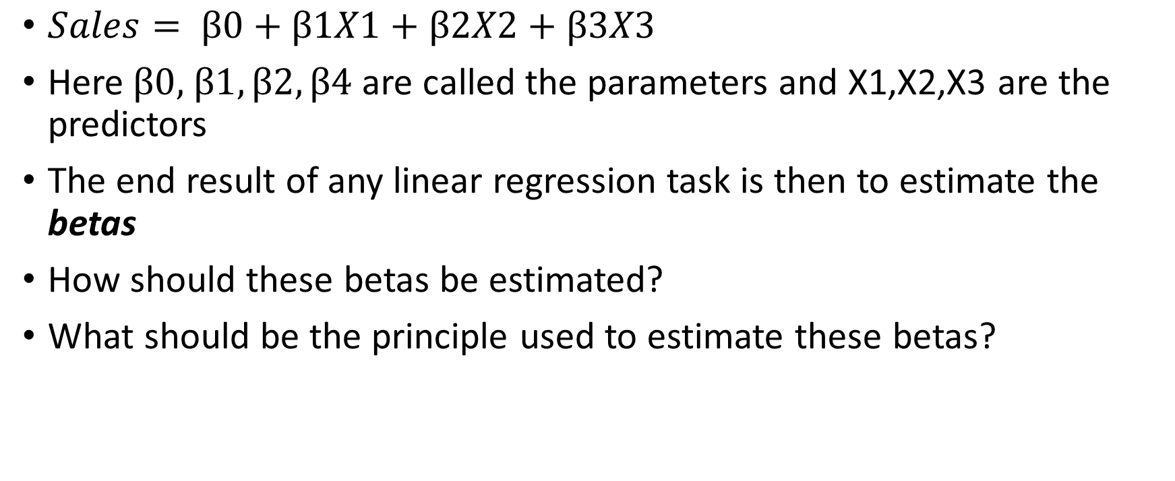
Supervised Learning: Linear Regression
$Sales= β0+β1X1+β2X2+β3X3$
Here$β0,$ $β1,β2,β4$ are called the parameters and X1,X2,X3 are the predictors
The end result of any linear regression task is then to estimate the betas
How should these betas be estimated?
What should be the principle used to estimate these betas?

Slide 14
Supervised Learning: Linear Regression
Sales (Y) | Advt Exp TV (X1) | Advt Exp Radio (X2) | Advt Exp Newspaper (X3)
….. | ….. | ….. | …..
….. | ….. | ….. | …..
….. | ….. | ….. | …..
….. | …… | …… | …..
X’
Y

Slide 15
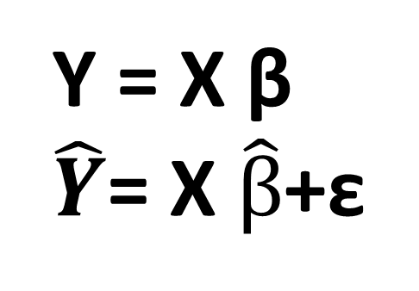
Supervised Learning: Linear Regression
Y1
Y2
….
Yn
β0
β1
….
βn
1 | X11 | X12 | X13
1 | X21 | X22 | X23
…. | … | …. | ….
1 | Xn1 | Xn2 | Xn3
Y, Sales=
β=
X=
Y = X β
$\hat{Y}$= X $\hat{β}$+ε

Slide 16
Supervised Learning: Linear Regression
Define error as RSS (Residual Sum of Squares)
RSS = (y-Xβ)^{T}(y-Xβ)
RSS(β)=(y-Xβ)^{T}(y-Xβ)
For learning beta vector, we can keep on changing beta until the RSS is minimized, this method is termed as method of least squares or OLS

Slide 17
Supervised Learning: Linear Regression
The minimum RSS(β) can be found out by differentiating RSS(β) wrt β
β_{est}= (X^{T}X)⁻¹X^{T}Y
OLS is not the only procedure to minimise RSS(β), there are numerical optimization techniques also, such as gradient descent and stochastic gradient descent.
Code demo….

Slide 18
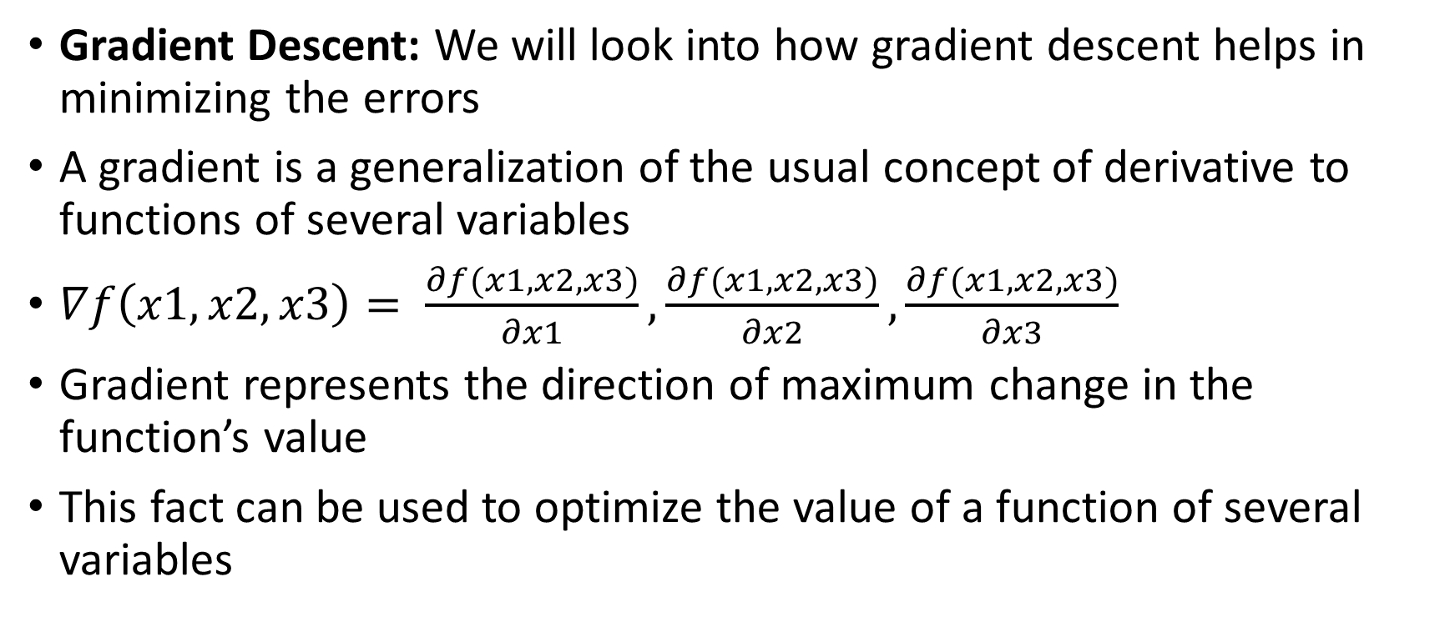
Supervised Learning: Linear Regression
Gradient Descent: We will look into how gradient descent helps in minimizing the errors
A gradient is a generalization of the usual concept of derivative to functions of several variables
$∇f\left(x1,x2,x3\right)= \frac{∂f(x1,x2,x3)}{∂x1},\frac{∂f(x1,x2,x3)}{∂x2},\frac{∂f(x1,x2,x3)}{∂x3}$
Gradient represents the direction of maximum change in the function’s value
This fact can be used to optimize the value of a function of several variables
T

Slide 19

Supervised Learning: Linear Regression
$$Y= βX1$$
RSS will change if we change values of β1, so, RSS(β)
β’+δ1
β’-δ1
How to compute the δ?
RSS
β’+δ2
β’-δ2
β*
β

Slide 20





Supervised Learning: Linear Regression
$$Y= βX1$$
RSS will change if we change values of β1, so, RSS(β)
β’+ $(−η\frac{dRSS}{d\text{β}})$
β’+ $(−η\frac{dRSS}{d\text{β}})$
How to compute the δ?
RSS
β’+ $(−η\frac{dRSS}{d\text{β}})$
β’+ $(−η\frac{dRSS}{d\text{β}})$
$\frac{dRSS}{d\text{β}}$=0
β*
β

Slide 21
GRADIENT DESCENT VARIANTS

Slide 22
AGENDA
Stochastic Gradient Descent
Adagrad
Rmsprop
Adam

Slide 23
Stochastic Gradient Descent
Let’s revisit the classic implementation
The update rule is:
$w^{new}=w^{old}−η\frac{∂RSS}{∂w_{w=w^{old}}}$
Also, the $\frac{∂RSS}{∂W}=−2X^{T}(Y−XW^{T})$

Slide 24
Stochastic Gradient Descent
Let’s revisit the classic implementation
The update rule is:
$w^{new}=w^{old}−η\frac{∂RSS}{∂w_{w=w^{old}}}$
Also, the $\frac{∂RSS}{∂W}=−2X^{T}(Y−XW^{T})$
Do you see any issues?

Slide 25
Stochastic Gradient Descent
Let’s revisit the classic implementation
The update rule is:
$w^{new}=w^{old}−η\frac{∂RSS}{∂w_{w=w^{old}}}$
Also, the $\frac{∂RSS}{∂W}=−2X^{T}(Y−XW^{T})$
Do you see any issues?
Now?

Slide 26
Stochastic Gradient Descent
Let’s revisit the classic implementation
The update rule is:
$w^{new}=w^{old}−η\frac{∂RSS}{∂w_{w=w^{old}}}$
Also, the $\frac{∂RSS}{∂W}=−2X^{T}(Y−XW^{T})$
Do you see any issues?
Now?
$$\left[\begin{matrix}1 & ⋯ & x_{1k} \\ ⋮ & ⋱ & ⋮ \\ 1 & ⋯ & x_{300k}\end{matrix}\right]$$

Slide 27
Stochastic Gradient Descent
Let’s revisit the classic implementation
The update rule is:
$w^{new}=w^{old}−η\frac{∂RSS}{∂w_{w=w^{old}}}$
Also, the $\frac{∂RSS}{∂W}=−2X^{T}(Y−XW^{T})$
Do you see any issues?
Now?
$$\left[\begin{matrix}1 & ⋯ & x_{1k} \\ ⋮ & ⋱ & ⋮ \\ 1 & ⋯ & x_{300k}\end{matrix}\right]$$
$$\left[\begin{matrix}1 & ⋯ & x_{1k} \\ ⋮ & ⋱ & ⋮ \\ 1 & ⋯ & x_{10000k}\end{matrix}\right]$$

Slide 28
Stochastic Gradient Descent
Let’s revisit the classic implementation
The update rule is:
$w^{new}=w^{old}−η\frac{∂RSS}{∂w_{w=w^{old}}}$
Also, the $\frac{∂RSS}{∂W}=−2X^{T}(Y−XW^{T})$
Do you see any issues?
Now?
Now?
$$\left[\begin{matrix}1 & ⋯ & x_{1k} \\ ⋮ & ⋱ & ⋮ \\ 1 & ⋯ & x_{300k}\end{matrix}\right]$$
$$\left[\begin{matrix}1 & ⋯ & x_{1k} \\ ⋮ & ⋱ & ⋮ \\ 1 & ⋯ & x_{10000k}\end{matrix}\right]$$

Slide 29
Stochastic Gradient Descent
One way to tackle this problem is to use only a sample of data
So the new update rule becomes:
$w^{new}=w^{old}−η\frac{∂RSS}{∂w_{w=w^{old}}}$
Also, the $\frac{∂RSS}{∂W}=−2X_{sample}^{T}(Y−X_{sample}W^{T})$
This is usually very commonly done when training a neural network
How large a sample is, controlled by batch size

Slide 30
Stochastic Gradient Descent
Often, in most implementations of SGD, the learning rate is also varied
So if update in iteration 1 is
$w^{new}=w^{old}−η_{1}\frac{∂RSS}{∂w_{w=w^{old}}}$
Update in Iteration 2 becomes
$w^{new}=w^{old}−η_{2}\frac{∂RSS}{∂w_{w=w^{old}}}$
Update in Iteration nth becomes
$w^{new}=w^{old}−η_{n}\frac{∂RSS}{∂w_{w=w^{old}}}$

Slide 31
Stochastic Gradient Descent
Often, in most implementations of SGD, the learning rate is also varied
So if update in iteration 1 is
$w^{new}=w^{old}−η_{1}\frac{∂RSS}{∂w_{w=w^{old}}}$ $w^{new}=w^{old}−η\frac{∂RSS}{∂w_{w=w^{old}}}$
Update in Iteration 2 becomes
$w^{new}=w^{old}−η_{2}\frac{∂RSS}{∂w_{w=w^{old}}}$
Update in Iteration nth becomes
$w^{new}=w^{old}−η_{n}\frac{∂RSS}{∂w_{w=w^{old}}}$
RSS
Parameters, X

Slide 32
Stochastic Gradient Descent
Often, in most implementations of SGD, the learning rate is also varied
So if update in iteration 1 is
$w^{new}=w^{old}−η_{1}\frac{∂RSS}{∂w_{w=w^{old}}}$ $w^{new}=w^{old}−η\frac{∂RSS}{∂w_{w=w^{old}}}$
Update in Iteration 2 becomes
$w^{new}=w^{old}−η_{2}\frac{∂RSS}{∂w_{w=w^{old}}}$
Update in Iteration nth becomes
$w^{new}=w^{old}−η_{n}\frac{∂RSS}{∂w_{w=w^{old}}}$
RSS
If $η$ is constant
Parameters, X

Slide 33
Stochastic Gradient Descent
Often, in most implementations of SGD, the learning rate is also varied
So if update in iteration 1 is
$w^{new}=w^{old}−η_{1}\frac{∂RSS}{∂w_{w=w^{old}}}$ $w^{new}=w^{old}−η\frac{∂RSS}{∂w_{w=w^{old}}}$
Update in Iteration 2 becomes
$w^{new}=w^{old}−η_{2}\frac{∂RSS}{∂w_{w=w^{old}}}$
Update in Iteration nth becomes
$w^{new}=w^{old}−η_{n}\frac{∂RSS}{∂w_{w=w^{old}}}$
RSS
If $η$ is constant
Parameters, X

Slide 34
Stochastic Gradient Descent
Often, in most implementations of SGD, the learning rate is also varied
So if update in iteration 1 is
$w^{new}=w^{old}−η_{1}\frac{∂RSS}{∂w_{w=w^{old}}}$ $w^{new}=w^{old}−η\frac{∂RSS}{∂w_{w=w^{old}}}$
Update in Iteration 2 becomes
$w^{new}=w^{old}−η_{2}\frac{∂RSS}{∂w_{w=w^{old}}}$
Update in Iteration nth becomes
$w^{new}=w^{old}−η_{n}\frac{∂RSS}{∂w_{w=w^{old}}}$
RSS
If $η$ is reduced successively
Parameters, X

Slide 35
Stochastic Gradient Descent
Often, in most implementations of SGD, the learning rate is also varied
So if update in iteration 1 is
$w^{new}=w^{old}−η_{1}\frac{∂RSS}{∂w_{w=w^{old}}}$ $w^{new}=w^{old}−η\frac{∂RSS}{∂w_{w=w^{old}}}$
Update in Iteration 2 becomes
$w^{new}=w^{old}−η_{2}\frac{∂RSS}{∂w_{w=w^{old}}}$
Update in Iteration nth becomes
$w^{new}=w^{old}−η_{n}\frac{∂RSS}{∂w_{w=w^{old}}}$
RSS
If $η$ is reduced successively
Parameters, X

Slide 36
Stochastic Gradient Descent
Often, in most implementations of SGD, the learning rate is also varied
So if update in iteration 1 is
$w^{new}=w^{old}−η_{1}\frac{∂RSS}{∂w_{w=w^{old}}}$ $w^{new}=w^{old}−η\frac{∂RSS}{∂w_{w=w^{old}}}$
Update in Iteration 2 becomes
$w^{new}=w^{old}−η_{2}\frac{∂RSS}{∂w_{w=w^{old}}}$
Update in Iteration nth becomes
$w^{new}=w^{old}−η_{n}\frac{∂RSS}{∂w_{w=w^{old}}}$
RSS
If $η$ is reduced successively
Parameters, X

Slide 37
Stochastic Gradient Descent
Often, in most implementations of SGD, the learning rate is also varied
So if update in iteration 1 is
$w^{new}=w^{old}−η_{1}\frac{∂RSS}{∂w_{w=w^{old}}}$ $w^{new}=w^{old}−η\frac{∂RSS}{∂w_{w=w^{old}}}$
Update in Iteration 2 becomes
$w^{new}=w^{old}−η_{2}\frac{∂RSS}{∂w_{w=w^{old}}}$
Update in Iteration nth becomes
$w^{new}=w^{old}−η_{n}\frac{∂RSS}{∂w_{w=w^{old}}}$
RSS
If $η$ is reduced successively
Parameters, X

Slide 38
Stochastic Gradient Descent
Often, in most implementations of SGD, the learning rate is also varied
So if update in iteration 1 is
$w^{new}=w^{old}−η_{1}\frac{∂RSS}{∂w_{w=w^{old}}}$
Update in Iteration 2 becomes
$w^{new}=w^{old}−η_{2}\frac{∂RSS}{∂w_{w=w^{old}}}$
Update in Iteration nth becomes
$w^{new}=w^{old}−η_{n}\frac{∂RSS}{∂w_{w=w^{old}}}$
The updates in $η$ are controlled by ”decay” factor:
$$η_{i+1}=η_{i}×\frac{1}{1+decay∗i}$$

Slide 39
Stochastic Gradient Descent: Momentum
In some implementations of gradient descent, the notion of momentum is also used
$w^{new}=w^{old}−η\frac{∂RSS}{∂w_{w=w^{old}}}$
This generally helps if there are regions of local minima

Slide 40
Stochastic Gradient Descent: Momentum
In some implementations of gradient descent, the notion of momentum is also used
$w^{new}=w^{old}−η\frac{∂RSS}{∂w_{w=w^{old}}}$
This generally helps if there are regions of local minima
RSS
Parameters, X

Slide 41
Stochastic Gradient Descent: Momentum
In some implementations of gradient descent, the notion of momentum is also used
$w^{new}=w^{old}−η\frac{∂RSS}{∂w_{w=w^{old}}}$
This generally helps if there are regions of local minima
RSS
Parameters, X

Slide 42
Stochastic Gradient Descent: Momentum
In some implementations of gradient descent, the notion of momentum is also used
$w^{new}=w^{old}−η\frac{∂RSS}{∂w_{w=w^{old}}}$
This generally helps if there are regions of local minima
RSS
Parameters, X

Slide 43
Stochastic Gradient Descent: Momentum
In some implementations of gradient descent, the notion of momentum is also used
$w^{new}=w^{old}−η\frac{∂RSS}{∂w_{w=w^{old}}}$
This generally helps if there are regions of local minima
RSS
Parameters, X

Slide 44
Stochastic Gradient Descent: Momentum
In some implementations of gradient descent, the notion of momentum is also used
$w^{new}=w^{old}−η\frac{∂RSS}{∂w_{w=w^{old}}}$
This generally helps if there are regions of local minima
$$w^{new}=w^{old}−η\frac{∂RSS}{∂w_{w=w^{old}}}+momentum×δw^{old}$$
RSS
Parameters, X

Slide 45
Stochastic Gradient Descent: Momentum
In some implementations of gradient descent, the notion of momentum is also used
$w^{new}=w^{old}−η\frac{∂RSS}{∂w_{w=w^{old}}}$
This generally helps if there are regions of local minima
$$w^{new}=w^{old}−η\frac{∂RSS}{∂w_{w=w^{old}}}+momentum×δw^{old}$$
RSS
Parameters, X

Slide 46
Stochastic Gradient Descent: Momentum
In some implementations of gradient descent, the notion of momentum is also used
$w^{new}=w^{old}−η\frac{∂RSS}{∂w_{w=w^{old}}}$
This generally helps if there are regions of local minima
$$w^{new}=w^{old}−η\frac{∂RSS}{∂w_{w=w^{old}}}+momentum×δw^{old}$$
RSS
Parameters, X

Slide 47
Stochastic Gradient Descent: Momentum
In some implementations of gradient descent, the notion of momentum is also used
$w^{new}=w^{old}−η\frac{∂RSS}{∂w_{w=w^{old}}}$
This generally helps if there are regions of local minima
$$w^{new}=w^{old}−η\frac{∂RSS}{∂w_{w=w^{old}}}+momentum×δw^{old}$$
RSS
Parameters, X

Slide 48
Adagrad
Adagrad is a variation of SGD, here, the change in the weights is governed by how important a predictor is
The updates are larger for important predictors and smaller for less important ones
This means that the effective learning rate for each parameter is different
Makes sense to use when data is sparse (Text data, Images)

Slide 49
Adagrad
The general update rule is $w_{i}^{new}=w_{i}^{new}−\frac{η}{{√G}_{it}}\frac{∂RSS}{∂w_{i}}$
Here $G_{i}$ is a measure of the importance of variable
For a model of the form $\hat{y}=w_{o}+w_{1}x_{1}+w_{2}x_{2}$
The update rules will look something like:
$w_{0}^{new}=w_{0}^{old}−\frac{η}{√G_{0t}}\frac{∂RSS}{∂w_{0}}$
$w_{1}^{new}=w_{1}^{old}−\frac{η}{√G_{1t}}\frac{∂RSS}{∂w_{1}}$
$w_{2}^{new}=w_{2}^{old}−\frac{η}{√G_{2t}}\frac{∂RSS}{∂w_{2}}$
Here, $G_{it}={\frac{∂RSS}{∂w_{i1}}}^{2}+{\frac{∂RSS}{∂w_{i2}}}^{2}+..+{\frac{∂RSS}{∂w_{it}}}^{2}$

Slide 50
RMSPROP
RMSPROP is very similar to Adagrad, the only way it differs from adagrad is how it computes the per-parameter update
Instead of accumulating squares of gradients, a moving average is used.
The update rule is: $w_{i}^{new}=w_{i}^{old}−\frac{η}{\sqrt{g_{it−m_{it}^{2}}}}\frac{∂RSS}{∂w_{i}}+momentum×δw_{i}$
Here $g_{it}=ρg_{t−1 }+\left(1−ρ\right){\frac{∂RSS}{∂w_{i}}}^{2}$
$m_{it}=ρm_{t−1 }+\left(1−ρ\right)\frac{∂RSS}{∂w_{i}}$

Slide 51
Adam
Adam is also similar to Rmsprop and Adagrad, again the difference arises out of how weight updates happen.
The update rule is $w_{i}^{new}=w_{i}^{old}−η\frac{\hat{m_{t}}}{√\hat{g_{t}}}$
Here $g_{it}=β_{1}g_{t−1 }+\left(1−β_{1}\right){\frac{∂RSS}{∂w_{i}}}^{2}$
$m_{it}=β_{2}m_{t−1 }+\left(1−β_{2}\right)\frac{∂RSS}{∂w_{i}}$
${\hat{g}}_{it}=\frac{g_{it}}{1−β_{1}^{t}}$ and ${\hat{m}}_{it}=\frac{m_{it}}{1−β_{2}^{t}}$

Slide 52
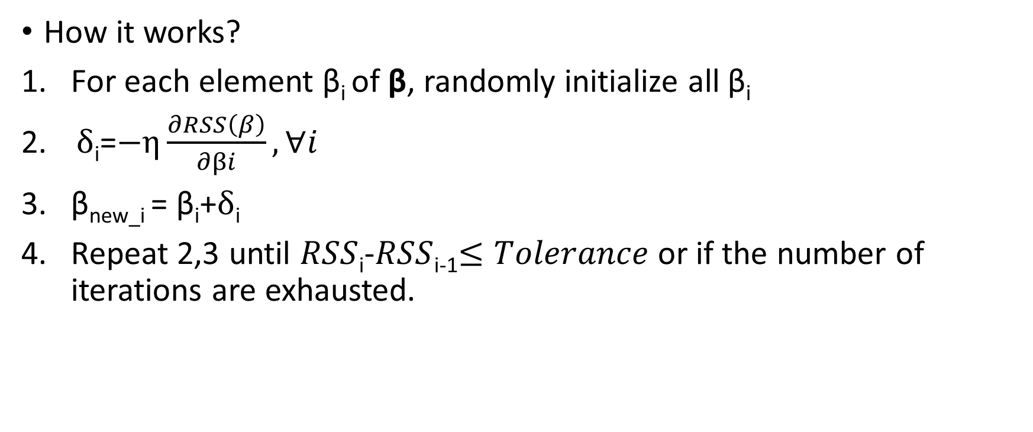
Supervised Learning: Linear Regression
How it works?
For each element β_{i} of β, randomly initialize all β_{i}
$δ$_{i}=$−η\frac{∂RSS\left(β\right)}{∂βi}, ∀i$
β_{new_i} = β_{i}+$δ$_{i}
Repeat 2,3 until $RSS$_{i}-$RSS$_{i-1}$≤Tolerance$ or if the number of iterations are exhausted.

Slide 53
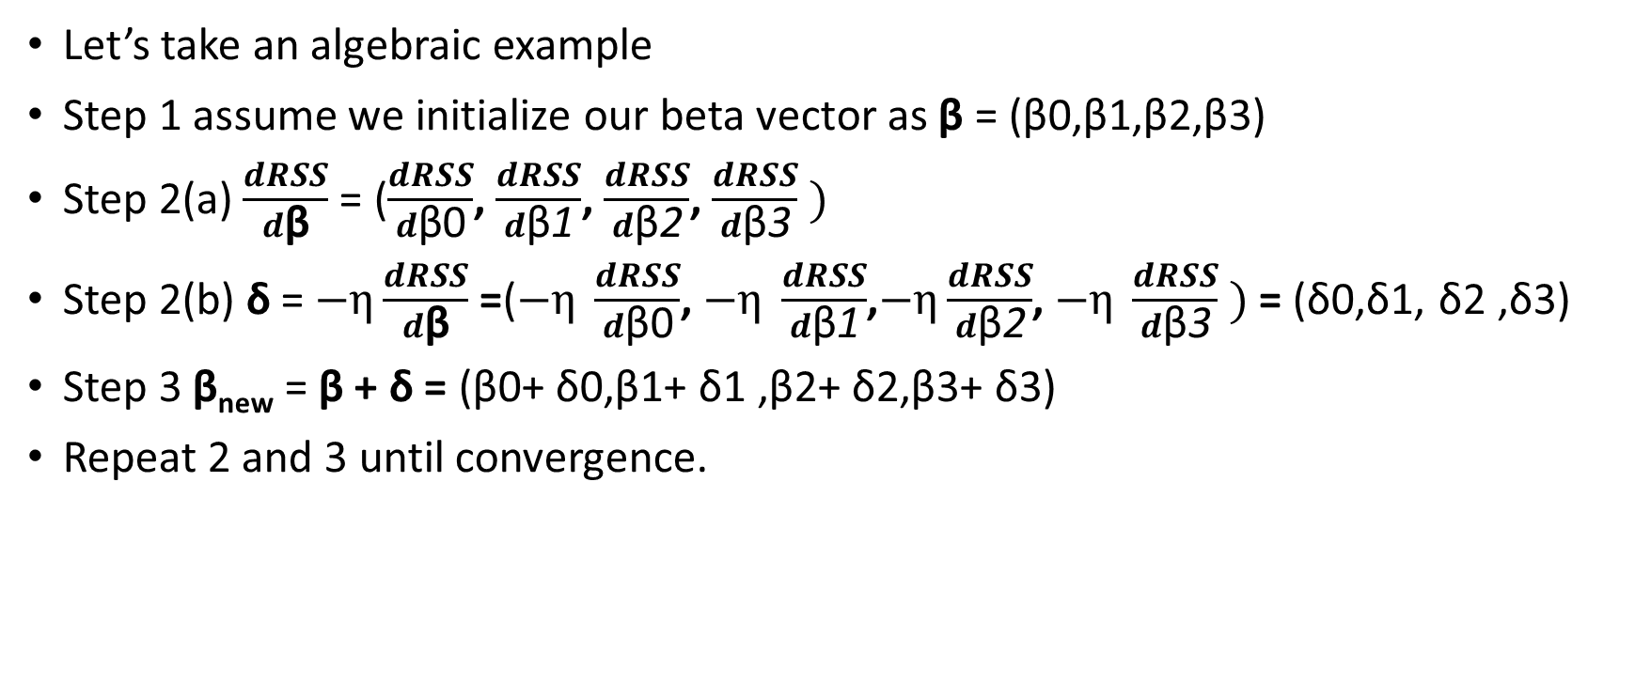
Supervised Learning: Linear Regression
Let’s take an algebraic example
Step 1 assume we initialize our beta vector as β = (β0,β1,β2,β3)
Step 2(a) $\frac{dRSS}{d\text{β}}$ = ($\frac{dRSS}{d\text{β}\text{0}}$, $\frac{dRSS}{d\text{β}\text{1}}$, $\frac{dRSS}{d\text{β}\text{2}}$, $\frac{dRSS}{d\text{β}\text{3}} )$
Step 2(b) δ = $−η\frac{dRSS}{d\text{β}}$ =($−η \frac{dRSS}{d\text{β}\text{0}}$, $−η \frac{dRSS}{d\text{β}\text{1}}$,$−η\frac{dRSS}{d\text{β}\text{2}}$, $−η \frac{dRSS}{d\text{β}\text{3}} )$= (δ0,δ1, δ2 ,δ3)
Step 3 β_{new} = β + δ = (β0+ δ0,β1+ δ1 ,β2+ δ2,β3+ δ3)
Repeat 2 and 3 until convergence.

Slide 54

Supervised Learning: Linear Regression
Computations for gradient descent can be easily written using Linear Algebra
$\frac{dRSS}{d\text{β}}$ = 2X^{T}(Xβ-y)
Code demo…..

Slide 55
Recap
Regression problem
Linear form of Regression Problem
OLS
Gradient

Slide 56
Supervised Learning: Classifying using a linear model
Classification: Fitting lines
Logistic function
Logistic regression: Cost function
Regularization: L1 and L2
Classifying multiple classes
Cross Entropy Loss

Slide 57
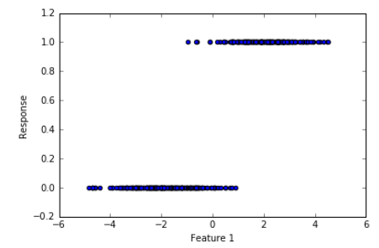
Supervised Learning: Fitting lines
Feature 1 (Age_Normalized) | Feature 2 (Income_Normalized) | Response (Good/Bad)
….. | …… | Good = 1
….. | …… | Bad = 0
….. | …… | ……
…... | ….. | ……
Fit a model of the form, Response=b0+b1Feature1

Slide 58
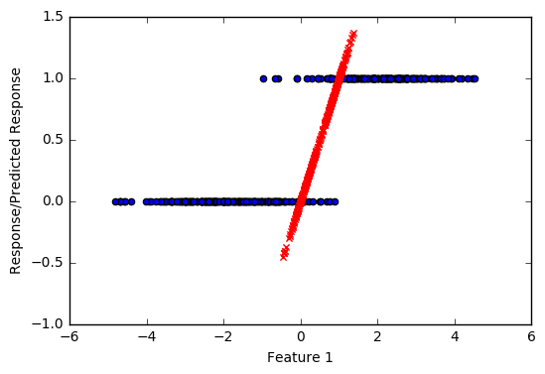
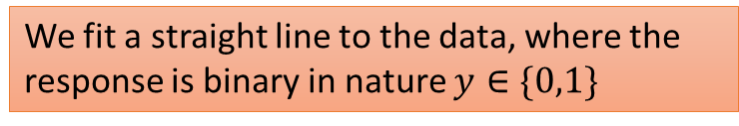
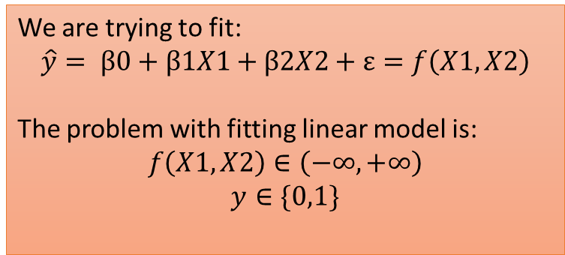
Supervised Learning: Fitting line
We fit a straight line to the data, where the response is binary in nature $y∈\{0,1\}$
Notice the predictions in red colour
Predictions < 0 or Predictions > 1
0<Predictions<1
We are trying to fit:
$$\hat{y}= β0+β1X1+β2X2+ε=f\left(X1,X2\right)$$
The problem with fitting linear model is:
$$f\left(X1,X2\right)∈\left(−∞,+∞\right)$$
$$y∈\{0,1\}$$

Slide 59
Supervised Learning: Fitting line
Age | Target
20 | 1
20 | 0
21 | 1
21 | 0
Age | Proportion (1)
20 | 0.50
21 | 0.50

Slide 60
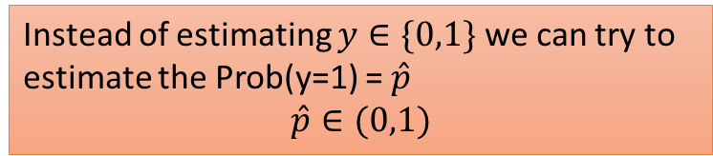
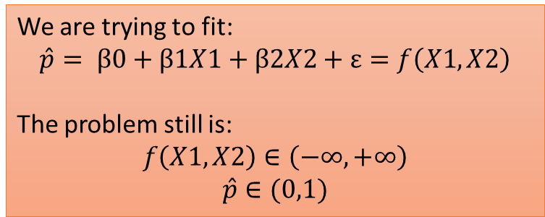
Supervised Learning: Fitting a line
Instead of estimating $y∈\{0,1\}$ we can try to estimate the Prob(y=1) = $\hat{p}$
$$\hat{p}∈(0,1)$$
These estimates make sense now
We are trying to fit:
$$\hat{p}= β0+β1X1+β2X2+ε=f\left(X1,X2\right)$$
The problem still is:
$$f\left(X1,X2\right)∈\left(−∞,+∞\right)$$
$$\hat{p}∈(0,1)$$

Slide 61
Supervised Learning: Fitting a line
Age | Target
20 | 1
20 | 1
20 | 1
20 | 0
21 | 1
21 | 0
Age | Pr (1) | Pr/1-Pr
20 | 0.75 | 3
21 | 0.50 | 0.5
Maximum and Minimum value Pr/(1-Pr) ?
Minimum value of Pr(1) ?
Pr(1) = 0
Maximum value of Pr(1) ?
Pr(1) = 1
Min Pr(1) = 0, Pr/(1-Pr) = ?
Pr/(1-Pr) =0
Max Pr(1) = 1, Pr/(1-Pr) = ?
Pr/(1-Pr) =Infinity
0<=Pr/(1-Pr)<=Infinity

Slide 62
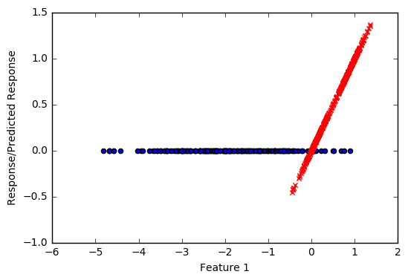
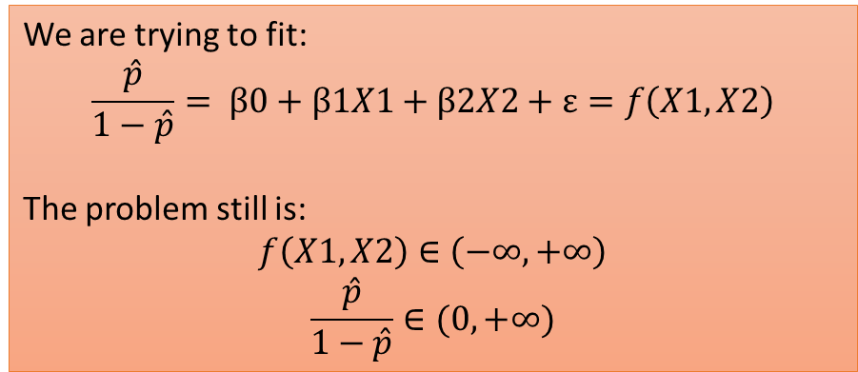
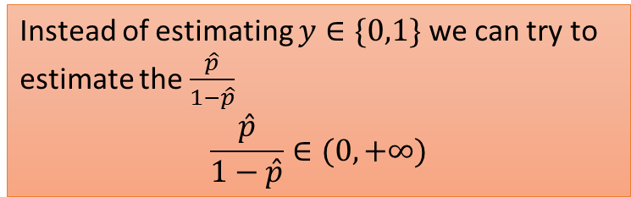
Supervised Learning: Fitting a line
Instead of estimating $y∈\{0,1\}$ we can try to estimate the $\frac{\hat{p}}{1−\hat{p}}$
$$\frac{\hat{p}}{1−\hat{p}}∈(0,+∞)$$
These estimates make sense now
We are trying to fit:
$$\frac{\hat{p}}{1−\hat{p}}= β0+β1X1+β2X2+ε=f\left(X1,X2\right)$$
The problem still is:
$$f\left(X1,X2\right)∈\left(−∞,+∞\right)$$
$$\frac{\hat{p}}{1−\hat{p}}∈(0,+∞)$$

Slide 63
Supervised Learning: Fitting a line
Age | Target
20 | 1
20 | 1
20 | 1
20 | 0
21 | 1
21 | 0
Age | Pr (1) | Pr/1-Pr | log(Pr/(1-Pr))
20 | 0.75 | 3 | 1.09
21 | 0.50 | 0.5 | -0.70
0<=Pr/(1-Pr)<=Infinity
-Infinity<=log(Pr/(1-Pr))<=Infinity

Slide 64
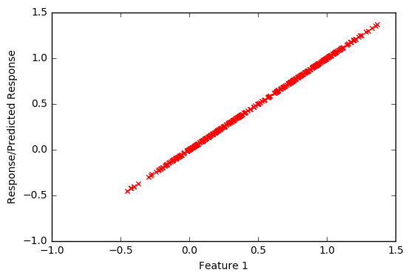
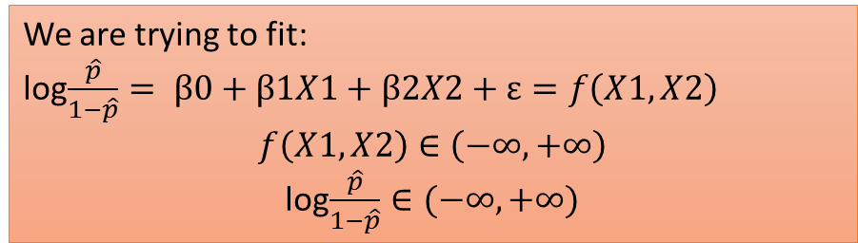
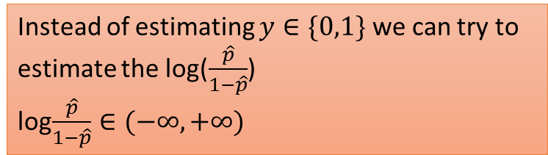
Supervised Learning: Fitting a line
Instead of estimating $y∈\{0,1\}$ we can try to estimate the log($\frac{\hat{p}}{1−\hat{p}}$)
log$\frac{\hat{p}}{1−\hat{p}}∈(−∞,+∞)$
All estimates make sense now
We are trying to fit:
log$\frac{\hat{p}}{1−\hat{p}}= β0+β1X1+β2X2+ε=f\left(X1,X2\right)$
$$f\left(X1,X2\right)∈\left(−∞,+∞\right)$$
log$\frac{\hat{p}}{1−\hat{p}}∈(−∞,+∞)$

Slide 65
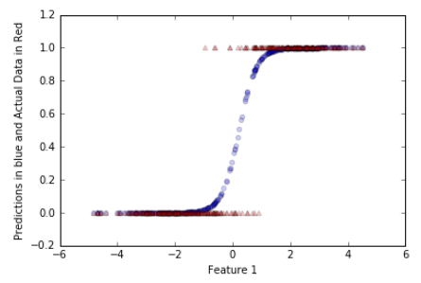
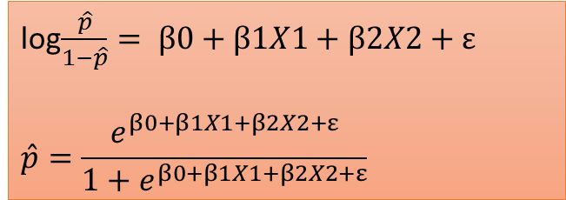
Supervised Learning: Logistic Function
log$\frac{\hat{p}}{1−\hat{p}}= β0+β1X1+β2X2+ε$
$$\hat{p}=\frac{e^{β0+β1X1+β2X2+ε}}{1+e^{β0+β1X1+β2X2+ε}}$$
Logistic function

Slide 66
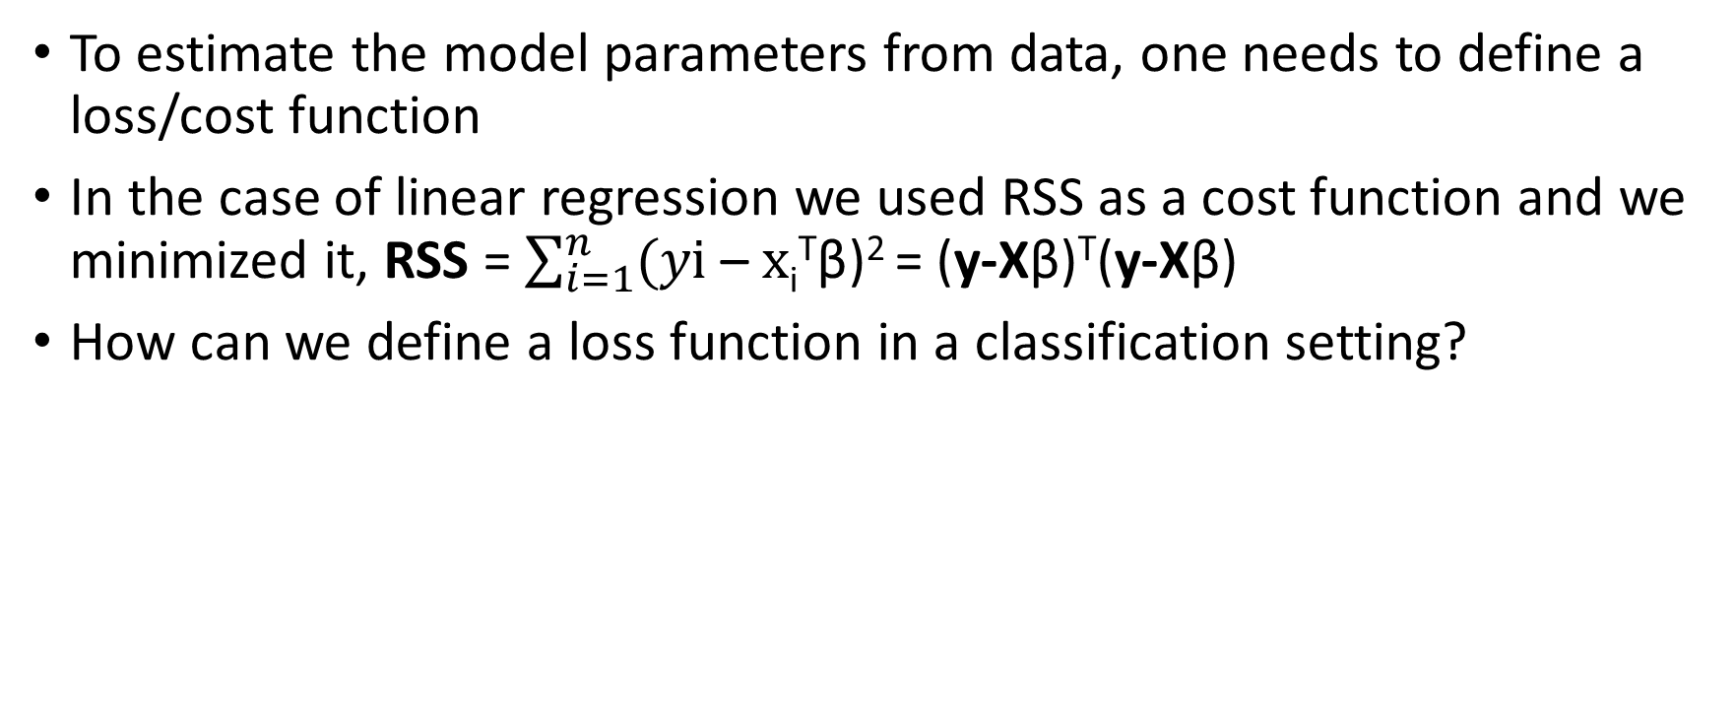
Supervised Learning: Logistic Cost Function
To estimate the model parameters from data, one needs to define a loss/cost function
In the case of linear regression we used RSS as a cost function and we minimized it, RSS = $\sum_{i=1}^{n}{(y\text{i}\text{ – }x\text{i}\text{T}\text{β}}$)² = (y-Xβ)^{T}(y-Xβ)
How can we define a loss function in a classification setting?

Slide 67
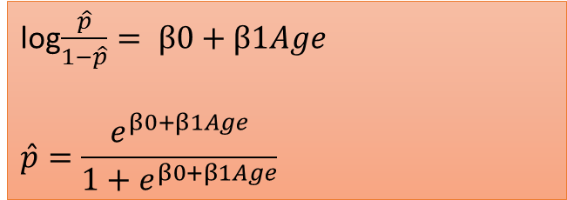
Supervised Learning: Logistic Cost Function
Age | Good_Bad (Good =1) | Prediction
20 | 1
21 | 1
24 | 0
25 | 0
29 | 0
30 | 1
38 | 1
log$\frac{\hat{p}}{1−\hat{p}}= β0+β1Age$
$$\hat{p}=\frac{e^{β0+β1Age}}{1+e^{β0+β1Age}}$$

Slide 68
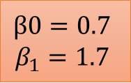
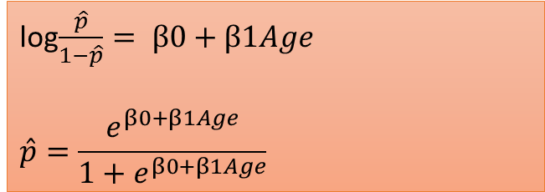
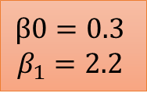
Supervised Learning: Logistic Cost Function
Age | Good_Bad (Good =1) | Prediction
20 | 1 | 0.90
21 | 1 | 0.95
24 | 0 | 0.30
25 | 0 | 0.21
29 | 0 | 0.19
30 | 1 | 0.99
38 | 1 | 0.98
log$\frac{\hat{p}}{1−\hat{p}}= β0+β1Age$
$$\hat{p}=\frac{e^{β0+β1Age}}{1+e^{β0+β1Age}}$$
Age | Good_Bad (Good =1) | Prediction
20 | 1 | 0.70
21 | 1 | 0.60
24 | 0 | 0.50
25 | 0 | 0.45
29 | 0 | 0.70
30 | 1 | 0.62
38 | 1 | 0.40
$$β0=0.3$$
$$β_{1}=2.2$$
$$β0=0.7$$
$$β_{1}=1.7$$
29 | 0 | 0.70

Slide 69
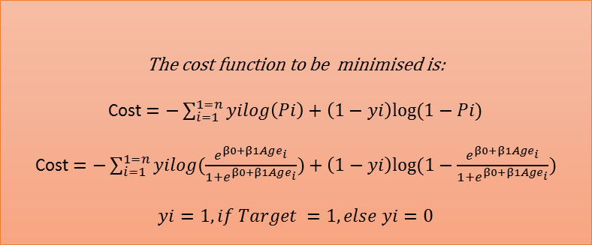
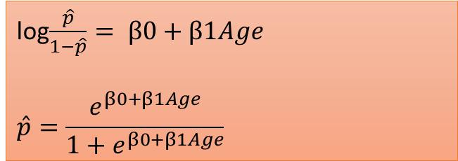
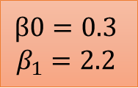
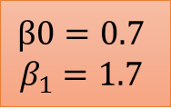
Supervised Learning: Logistic Cost Function
Age | Good_Bad (Good =1) | Prediction
20 | 1 | 0.90
21 | 1 | 0.95
24 | 0 | 0.30
25 | 0 | 0.21
29 | 0 | 0.19
30 | 1 | 0.99
38 | 1 | 0.98
log$\frac{\hat{p}}{1−\hat{p}}= β0+β1Age$
$$\hat{p}=\frac{e^{β0+β1Age}}{1+e^{β0+β1Age}}$$
$$β0=0.7$$
$$β_{1}=1.7$$
Age | Good_Bad (Good =1) | Prediction
20 | 1 | 0.70
21 | 1 | 0.60
24 | 0 | 0.50
25 | 0 | 0.45
29 | 0 | 0.70
30 | 1 | 0.62
38 | 1 | 0.40
$$β0=0.3$$
$$β_{1}=2.2$$
The cost function to be minimised is:
Cost $=−\sum_{i=1}^{1=n}{yilog\left(Pi\right)+\left(1−yi\right)log⁡(1−Pi)}$
Cost $=−\sum_{i=1}^{1=n}{yilog(\frac{e^{β0+β1Age_{i}}}{1+e^{β0+β1Age_{i}}})+\left(1−yi\right)log⁡(1−\frac{e^{β0+β1Age_{i}}}{1+e^{β0+β1Age_{i}}})}$
$$yi=1, if Target =1,else yi=0$$

Slide 70
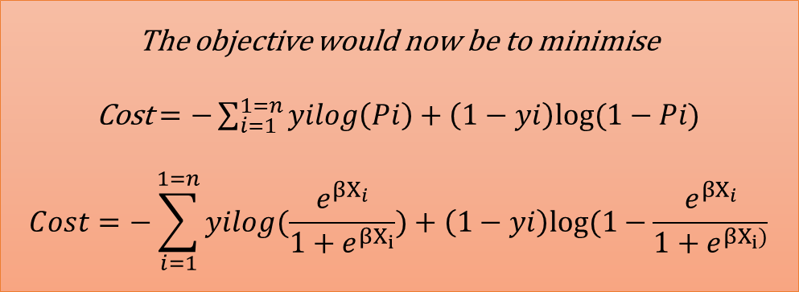
Supervised Learning: Logistic Cost Function
The objective would now be to minimise
Cost $=−\sum_{i=1}^{1=n}{yilog\left(Pi\right)+\left(1−yi\right)log⁡(1−Pi)}$
$$Cost=−\sum_{i=1}^{1=n}{yilog(\frac{e^{βX_{i}}}{1+e^{βX_{i}}})+\left(1−yi\right)log⁡(1−\frac{e^{βX_{i}}}{1+e^{βX_{i})}}}$$
There is no closed form solution to this optimization problem, this is solved using
Numerical optimization procedures such as Newton’s Method etc

Slide 71
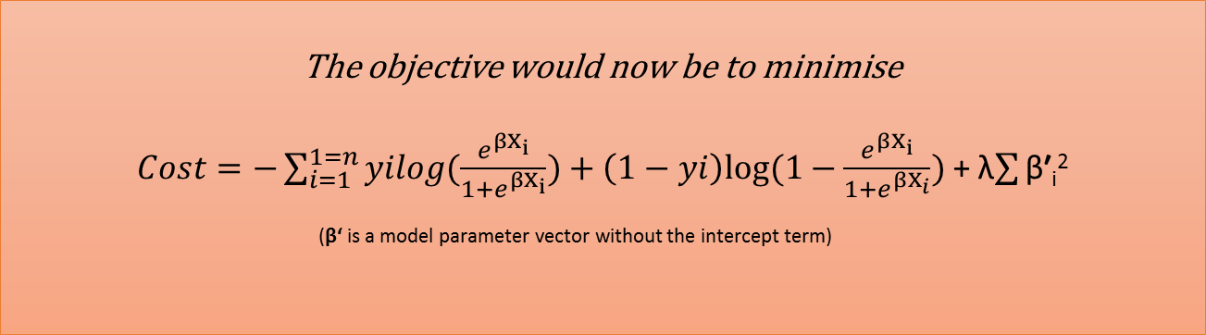
Supervised Learning: L1 and L2 regularization
Just like linear regression, we can introduce regularization in the logistic regression also
The aim of using regularization is to prevent overfit.
The L2 regularization is implemented as:
The objective would now be to minimise
$Cost=−\sum_{i=1}^{1=n}{yilog(\frac{e^{βX_{i}}}{1+e^{βX_{i}}})+\left(1−yi\right)log⁡(1−\frac{e^{βX_{i}}}{1+e^{βX_{i}}})}$ + λ$\sum{\text{β}\text{′}}$_{i}²
(β‘ is a model parameter vector without the intercept term)

Slide 72
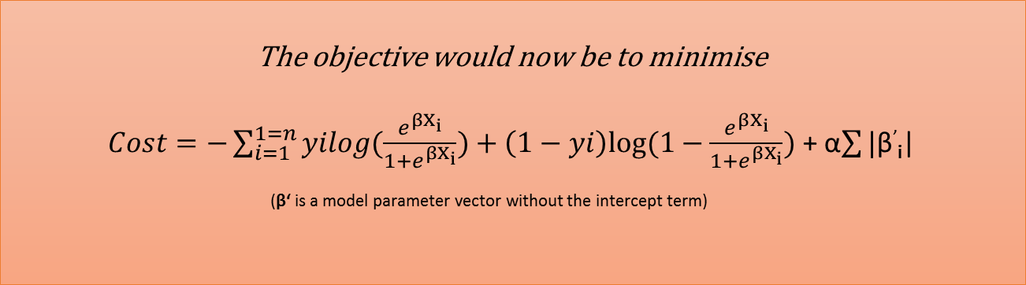
Supervised Learning: L1 and L2 regularization
The L1 regularization is implemented as:
The objective would now be to minimise
$Cost=−\sum_{i=1}^{1=n}{yilog(\frac{e^{βX_{i}}}{1+e^{βX_{i}}})+\left(1−yi\right)log⁡(1−\frac{e^{βX_{i}}}{1+e^{βX_{i}}})}$ + α$\sum{\text{|}\text{β}}$’_{i}|
(β‘ is a model parameter vector without the intercept term)

Slide 73
Supervised Learning: Classification Performance Metrics
Its easy to think about performance metrics for a regression model, the notion of accuracy in a regression setting is fairly straightforward.
How can we talk about the notion of accuracy in a binary classification scenario?
What output will a logistic regression model produce?
How can probability of event be used to classify?

Slide 74
Supervised Learning: Classification Performance Metrics
Age | Good_Bad | Prediction
23 | 1 | 0.90
24 | 1 | 0.75
25 | 1 | 0.60
26 | 0 | 0.45
27 | 0 | 0.40
28 | 0 | 0.30
29 | 1 | 0.82
Age | Good_Bad | Prediction | Pred_Label
23 | 1 | 0.90 | 1
24 | 1 | 0.75 | 1
25 | 1 | 0.60 | 1
26 | 0 | 0.45 | 0
27 | 0 | 0.40 | 0
28 | 0 | 0.30 | 0
29 | 1 | 0.82 | 1
Threshold=0.5
Accuracy = 100%
Accuracy = # of Correctly predicted labels/N

Slide 75
Supervised Learning: Classification Performance Metrics
Age | Good_Bad | Prediction
23 | 1 | 0.90
24 | 1 | 0.75
25 | 1 | 0.48
26 | 0 | 0.52
27 | 0 | 0.53
28 | 0 | 0.30
29 | 1 | 0.82
Age | Good_Bad | Prediction | Pred_Label
23 | 1 | 0.90 | 1
24 | 1 | 0.75 | 1
25 | 1 | 0.48 | 0
26 | 0 | 0.52 | 1
27 | 0 | 0.53 | 1
28 | 0 | 0.30 | 0
29 | 1 | 0.82 | 1
Threshold=0.5
 | Actual_Class 1 | Actual_Class 0
Predicted_Class 1 | 3 | 2
Predicted_Class 0 | 1 | 1

Slide 76
Supervised Learning: Classification Performance Metrics
 | Actual_Class 1 | Actual_Class 0
Predicted_Class 1 | True Positive | False Positive
Predicted_Class 0 | False Negative | True Negative
Precision = tp/(tp+fp)
Recall = tp/(tp+fn)

Slide 77
Supervised Learning: Classification Performance Metrics
What is the peculiarity of the previous approach?
What will happen if p>0.6 is used to make classification?
Will Precision-Recall change?

Slide 78
Supervised Learning: Classification Performance Metrics
Age | Good_Bad | Prediction
23 | 1 | 0.90
24 | 1 | 0.75
25 | 1 | 0.48
26 | 0 | 0.52
27 | 0 | 0.53
28 | 0 | 0.30
29 | 1 | 0.82
Age | Good_Bad | Prediction | Pred_Label
23 | 1 | 0.90 | 1
24 | 1 | 0.75 | 1
25 | 1 | 0.48 | 1
26 | 0 | 0.52 | 1
27 | 0 | 0.53 | 1
28 | 0 | 0.30 | 0
29 | 1 | 0.82 | 1
Threshold=0.4
 | Actual_Class 1 | Actual_Class 0
Predicted_Class 1 | 4 | 2
Predicted_Class 0 | 0 | 1

Slide 79
Supervised Learning: Classification Performance Metrics
 | Actual_Class 1 | Actual_Class 0
Predicted_Class 1 | True Positive | False Positive
Predicted_Class 0 | False Negative | True Negative
Cutoff | TPR=TP/N | FPR=FP/N
P1 | TPR1 | FPR1
P2 | TPR2 | FPR2
.. | .. | ..
Pn | TPRn | FPRn

Slide 80
Supervised Learning: Classification Performance Metrics
 | Actual_Class 1 | Actual_Class 0
Predicted_Class 1 | True Positive | False Positive
Predicted_Class 0 | False Negative | True Negative
Cutoff | TPR=TP/N | FPR=FP/N
P1 | TPR1 | FPR1
P2 | TPR2 | FPR2
.. | .. | ..
Pn | TPRn | FPRn
True Positive Rate
ROC Curve
False Positive Rate

Slide 81
Supervised Learning: Classification Performance Metrics
 | Actual_Class 1 | Actual_Class 0
Predicted_Class 1 | True Positive | False Positive
Predicted_Class 0 | False Negative | True Negative
Cutoff | TPR=TP/N | FPR=FP/N
P1 | TPR1 | FPR1
P2 | TPR2 | FPR2
.. | .. | ..
Pn | TPRn | FPRn
True Positive Rate
AUC is a consolidated measure
False Positive Rate

Slide 82
Supervised Learning: Logistic Regression
Code Demo

Slide 83
Supervised Learning: Classifying multiple classes
The classical binary logistic model can be extended to handle multiple classes
There are two approaches to deal with multiple classes:
One Vs Rest/ One Vs All
Multinomial Logistic

Slide 84

Supervised Learning: Classifying multiple classes
One Vs Rest or One Vs All
Assume, that there are K classes, then for each of the K classes a binary classifier is built predicting:
$$\left\{\begin{aligned}If the sample belongs to Kth class, 1 \\ If the sample doesn^{′}t belong to Kth class, 0\end{aligned}\right.$$

Slide 85
Supervised Learning: Classifying multiple classes
Age | Income | Status
20 | $10 K | Paid
25 | $ 30 K | Paid
32 | $ 18 K | Late Payment
19 | $ 3 K | Not Paid
70 | $ 12 K | Paid
62 | $ 9 K | Late Payment
Model 1 predicting P(Paid) vs P(Not Paid or Late Payment)
Model 2 predicting P(Not Paid) vs P(Paid or Late Payment)
Model 3 predicting P(Late Payment) vs P(Paid or Not Paid)

Slide 86
Supervised Learning: Classifying multiple classes
Model 1 predicting P(Paid) vs P(Not Paid or Late Payment)
Age | Income | Status | Target
20 | $10 K | Paid | 1
25 | $ 30 K | Paid | 1
32 | $ 18 K | Late Payment | 0
19 | $ 3 K | Not Paid | 0
70 | $ 12 K | Paid | 1
62 | $ 9 K | Late Payment | 0

Slide 87
Supervised Learning: Classifying multiple classes
Model 2 predicting P(Not Paid) vs P(Paid or Late Payment)
Age | Income | Status | Target
20 | $10 K | Paid | 0
25 | $ 30 K | Paid | 0
32 | $ 18 K | Late Payment | 0
19 | $ 3 K | Not Paid | 1
70 | $ 12 K | Paid | 0
62 | $ 9 K | Late Payment | 0

Slide 88
Supervised Learning: Classifying multiple classes
Model 3 predicting P(Late Payment) vs P(Paid or Not Paid)
Age | Income | Status | Target
20 | $10 K | Paid | 0
25 | $ 30 K | Paid | 0
32 | $ 18 K | Late Payment | 1
19 | $ 3 K | Not Paid | 0
70 | $ 12 K | Paid | 0
62 | $ 9 K | Late Payment | 1

Slide 89
Supervised Learning: Classifying multiple classes
Age | Income | Status
20 | $10 K | Paid
25 | $ 30 K | Paid
32 | $ 18 K | Late Payment
19 | $ 3 K | Not Paid
70 | $ 12 K | Paid
62 | $ 9 K | Late Payment
23 | $ 12 k
Model 1 predicting P(Paid) vs P(Not Paid or Late Payment) = 0.81
Model 2 predicting P(Not Paid) vs P(Paid or Late Payment) = 0.62
Model 3 predicting P(Late Payment) vs P(Paid or Not Paid) = 0.70
Will pay
?

Slide 90
Supervised Learning: Classifying multiple classes
Multinomial Logistic or Max Ent or Soft Max:
In One Vs All/ One Vs Rest approach, you would have noticed that the sum of the Probabilities of K classes can exceed 1.
For example in the previous illustration we had estimated:
Model 1 predicting P(Paid) vs P(Not Paid or Late Payment) = 0.81
Model 2 predicting P(Not Paid) vs P(Paid or Late Payment) = 0.62
Model 3 predicting P(Late Payment) vs P(Paid or Not Paid) = 0.70

Slide 91

Supervised Learning: Classifying multiple classes
Multinomial Logistic or Max Ent or Soft Max:
Here the following model is fit, for each of the K classes, the Kth class probability is modelled as
All the Probabilities are estimated simultaneously
This method has a nice property that all the K class probabilities sum to 1
P(y=k|X=xi)=$\frac{e^{βiX}i}{\sum{e^{βiXi}}}$
Class A (0.4), Class B(0.30), Class C(0.30)
Predict Class A

Slide 92
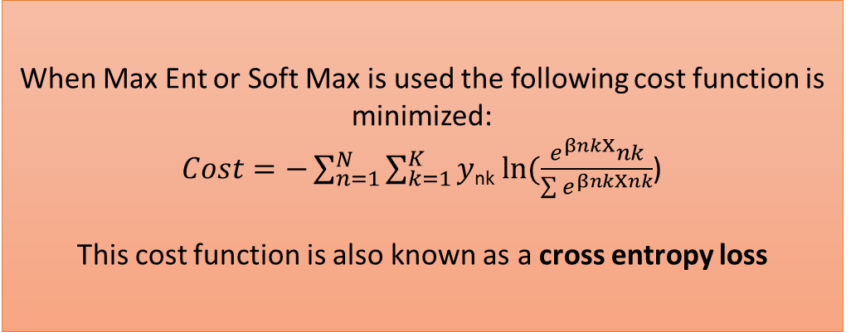
Supervised Learning: Loss Function multiple classes
When Max Ent or Soft Max is used the following cost function is minimized:
$Cost=−\sum_{n=1}^{N}{\sum_{k=1}^{K}{y}}$_{nk} $ln⁡(\frac{e^{βnkX}nk}{\sum{e^{βnkXnk}}}$)
This cost function is also known as a cross entropy loss

Slide 93
Supervised Learning: Loss Function multiple classes
Code demo

Slide 94
Supervised Learning: Logistic Regression Recap
Logit function
Binary classifier: Cost function
Regularization: L1 and L2
Multiclass classification using Soft Max
Multiclass loss function

