Slide 1
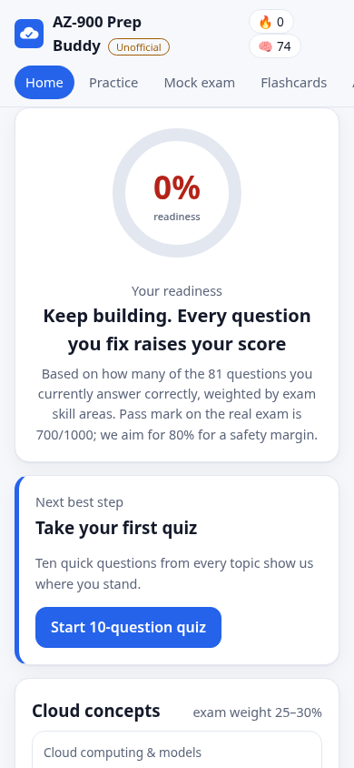
Power Learn Project · #1MillionDevs
AZ-900 Prep Buddy
Quiz it. Understand it. Remember it. Plan it. Prove it.
UNOFFICIAL STUDY TOOL
[Your name] · Vibe Coding Hackathon: AZ-900 Exam Prep Edition
Unofficial · not affiliated with Microsoft
01
Notes:
Open with one sentence on who you are and why AZ-900. Then: 'I built the tool I wished I had while preparing.'

Slide 2
The Problem
Meet Amina
Illustrative persona, not a real person
Amina studies AZ-900 on her phone with limited data. She scores 60% on practice tests but cannot tell why she misses questions, mixes up LRS and GRS, and has no plan for her exam date.
Practice questions show a score, but not WHY an answer is right or wrong.
Similar terms blur together: IaaS/PaaS, LRS/GRS, Policy/RBAC.
Learners do not know when they are ready, or how to split time before the exam date.
Most examples are not from learners' daily lives, and data is expensive.
Unofficial · not affiliated with Microsoft
02
Notes:
Amina is an illustrative persona. Judges score this slide on whether it draws on YOUR own AZ-900 experience, so replace her with two true sentences from your own journey before presenting.

Slide 3
Our Solution
One app covering all five hackathon challenges, in one learning loop.
Quiz Builder: 81 original questions, instant feedback, an African analogy for each.
Flashcard Coach: every missed question brings its card back first.
Study Planner: exam date + hours → a plan weighted to weak skills.
AI Study Buddy: simple explanations in 8 languages via a Python server, with an offline fallback.
Readiness Tracker: score per skill, weighted like the real exam areas.
”
Unofficial · not affiliated with Microsoft
03
Notes:
The loop: miss a question -> read the why and the analogy -> the flashcard returns -> readiness updates -> the study plan adapts.

Slide 4
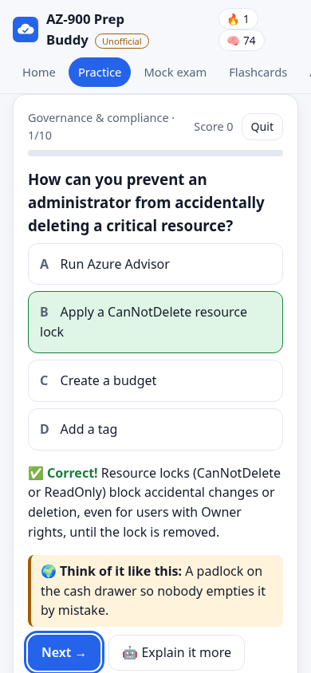
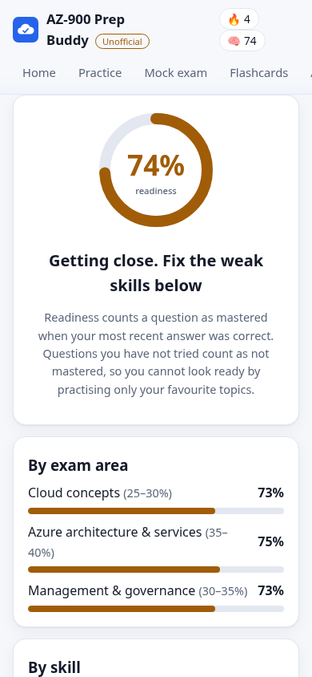
Product
Works on a phone, offline.
Quiz, mock exam (30 questions, 30 minutes), flashcards, study plan, readiness tracker and AI Buddy.
Live demo: [add URL]
Instant feedback + African analogy
Readiness tracker (sample data)
Unofficial · not affiliated with Microsoft
04
Notes:
Demo path (90 sec): home ring -> answer one wrong on purpose -> explanation + analogy -> flashcards -> progress -> plan -> Buddy in Kiswahili. It also works offline if Wi-Fi fails.

Slide 5
Target Market
27%
of people in Sub-Saharan Africa use mobile internet (a 60% usage gap).
GSMA, State of Mobile Internet Connectivity 2024
230 million
jobs in Sub-Saharan Africa are projected to require digital skills by 2030.
IFC, Digital Skills in Sub-Saharan Africa (2019 projection)
650 million
training opportunities created by that demand, including retraining.
IFC, 2019
So we build phone-first, small and offline. Who we serve: beginners across Africa, study groups and cohorts (1M Devs, PLP), and trainers.
Unofficial · not affiliated with Microsoft
05
Notes:
Statistics verified 23 Oct 2026. GSMA: https://www.gsma.com/newsroom/press-release/new-gsma-report-shows-mobile-internet-connectivity-continues-to-grow-globally-but-barriers-for-3-45-billion-unconnected-people-remain/ IFC: https://www.ifc.org/en/pressroom/2019/ifc-report-finds-130-billion-opportunity-in-digital-skills-across-sub-saharan-africa . The IFC numbers are a 2019 projection, say so.

Slide 6
Market Size
IFC estimates a $130 billion opportunity to provide digital skills in Sub-Saharan Africa through 2030 (2019 estimate). We start narrow with AZ-900, then expand: the engine is content-driven, so each new exam is mostly new data.
Today: AZ-900 candidates
Next: other Microsoft fundamentals exams (AI-900, SC-900, PL-900)
We found no public count of AZ-900 candidates, so we do not claim one. Source: IFC, 2019.
Then: any exam with a published skills outline
Unofficial · not affiliated with Microsoft
06

Slide 7
Competitors
Good options exist. Here is how we differ.
Alternative | What it does well | Where we differ
Microsoft Learn practice assessment | Official, accurate, free | Adds spaced repetition, a study planner, readiness by skill and African analogies
Paid practice-test sites | Large question banks | Free and original. Question dumps risk copying real exam items
Video courses and blogs | Good first explanation | Active recall: quizzes, flashcards and mock exam, not passive viewing
Unofficial · not affiliated with Microsoft
07
Notes:
Be respectful of Microsoft's official practice assessment. Recommend learners use it too. We are a companion, not a replacement.

Slide 8
Competitive Advantage
What makes us unique?
Built on the official outline: all 11 sub-skills are covered.
African analogies on every answer, plus an AI Buddy in 8 languages that runs behind a rate-limited server (no key in the browser).
Honest readiness score: uses your latest answers, so it cannot be gamed.
Misses feed the flashcards; weak skills feed the study plan.
Offline-first and about 100 KB, so it fits low-data phones.
Python (FastAPI) + React (TypeScript): 33 unit tests, plus a real-browser e2e check, run in CI.
Unofficial · not affiliated with Microsoft
08

Slide 9
Project Traction
Tasks
Day 1
Day 2
Day 3
Day 4
Next
Study the official AZ-900 outline
Write 81 original questions + 74 cards
FastAPI backend + React app
Planner, mock exam, AI Buddy
Tests (pytest, vitest, e2e) + CI
Docs, PWA, README, prompts
Pitch deck + submission
Cohort pilot, more exams, translations
Unofficial · not affiliated with Microsoft
09
Notes:
EDIT THIS to match your real timeline before presenting. Days and bars are illustrative.

Slide 10
Business Model
Free for learners, always.
Hackathon stage: no revenue. Static hosting costs almost nothing; the AI Buddy is the only variable cost (per-question API usage), capped by a server-side rate limit.
Sustainability options: sponsored seats from communities and employers, a trainer dashboard for cohorts, and pooled API credits for the Buddy.
Unofficial · not affiliated with Microsoft
10

Slide 11
Go To Market
How we reach learners
Launch inside 1M Devs and PLP cohorts: one shareable link, no sign-up.
Study-group channels (WhatsApp, Telegram, Discord): share a link, or install it from the browser.
Trainers adopt it for class revision and mock exams.
Open-source repo: contributors add questions and reviewed translations.
Partner with Microsoft Learn communities: we send learners to the official resources.
Unofficial · not affiliated with Microsoft
11

Slide 12
Social Impact
Sustainable Development Goals we support
SDG 4, Quality Education: free, explained, self-paced exam preparation.
SDG 8, Decent Work and Economic Growth: a recognised cloud credential opens job paths.
SDG 9, Industry, Innovation and Infrastructure: grows cloud skills for local tech ecosystems.
SDG 10, Reduced Inequalities: low-data, offline and local-language support.
Unofficial · not affiliated with Microsoft
12

Slide 13
Our Ask
Feedback from the judges and mentors on content accuracy and the learner experience.
A pilot with one 1M Devs / PLP cohort to measure readiness gains and mock-exam pass rates.
Sponsored API credits to run the AI Buddy (server-side and rate-limited).
Community reviewers for questions and translations (Kiswahili, Hausa, Yorùbá, isiZulu, Amharic).
We are not asking for funding at this stage.
Unofficial · not affiliated with Microsoft
13

Slide 14
Team Members
Python + React build, AI-assisted with Claude
YN
AI
[YOUR NAME]
CLAUDE
Senior software engineer, product owner and reviewer
AI pair-programmer: drafts content, code and tests; powers the Study Buddy
Unofficial · not affiliated with Microsoft
14
Notes:
Add any teammates and swap the initials for photos. Being open about AI assistance fits this hackathon: prompt engineering and smart tool use are judged categories.

Slide 15
Thank you!
Live demo: [add URL]
GitHub: [add repo URL]
[your email / LinkedIn]
Study with the official sources too: aka.ms/AZ900-StudyGuide
Unofficial · not affiliated with Microsoft
15

