Slide 1
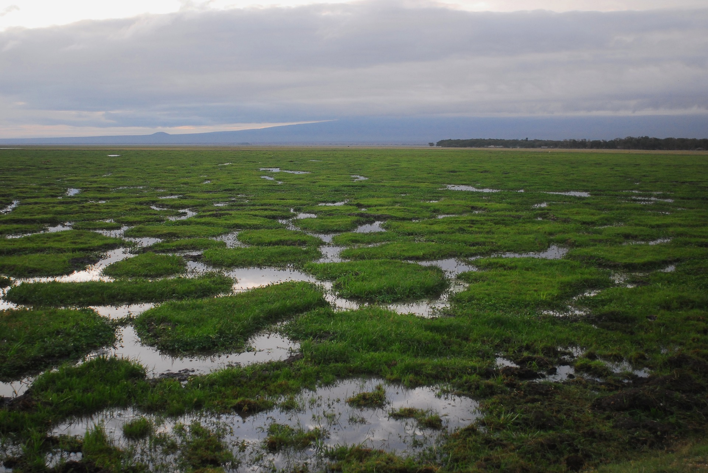
Compound Crisis Cascade - Kenya
Do rainfall deficits precede food price spikes, which in turn precede conflict escalation?
Christine Mutwiri · BI Analyst & Data Scientist · Nairobi, Kenya

Slide 2
THE STAKES
Nineteen years of data. Three crises.
47
19
6
7
counties
analysed
years of data
(2006-2025)
datasets from
HDX HAPI
high-risk counties
identified
Kenya loses an estimated 2-3% of GDP annually to drought-related crises. The 2011 famine, 2017 ASAL drought, and 2022 La Nina event each triggered national emergencies. Each one followed the same sequence.
This project asks whether that sequence is statistically provable, and whether it can be exploited for anticipatory action.
Understanding the Compound Crisis Cascade in Kenya: Analyzing Climate, Prices, and Conflict Dynamics

Slide 3
THE MECHANISM
A directed causal cascade.
🌧
01
📈
02
⚔
03
Rainfall Deficit
Price Spike
Conflict Escalation
RFQ < 80%
2-3 months lag
3-4 months lag
Satellite-derived CHIRPS dekadal anomaly falls below humanitarian early warning threshold. Pasture dries. Livestock values drop.
Real maize prices rise 40-80%. Purchasing power collapses in counties with low market integration and no income buffers.
Intercommunal violence over shrinking pastoral resources. Temporal precedence confirmed in Marsabit; marginal in Turkana. Reverse direction non-significant in all counties.
Conditioned on structural vulnerability (MPI >= 0.30). The cascade is absent in medium and low-vulnerability counties.
›
›
Understanding the Compound Crisis Cascade in Kenya: Analyzing Climate, Prices, and Conflict Dynamics

Slide 4
METHODOLOGY
Every design choice has a reason.
CPI deflation
PEV exclusion (2007-08)
ADF stationarity tests
Nominal prices more than doubled 2006-2025. Without deflation, drought-year spikes conflate real food stress with general inflation.
Post-election violence produced >140 events/month. A political outlier inflates the price-conflict correlation spuriously.
Granger causality requires stationary series. Prices and conflict carry unit roots in levels; differenced before testing.
Vulnerability stratification
Conflict disaggregation
Bootstrap rank uncertainty
Testing nationally averages out the cascade signal. The mechanism is conditional on MPI >= 0.30. It disappears in low-vulnerability counties.
Battles, violence against civilians, and explosions only. Protests and strategic developments excluded since they have different causal mechanisms.
1,000 iterations, 95% CI. VRI county ranks are expressed as ranges not point estimates. Mid-tier counties with overlapping CIs are flagged.
Understanding the Compound Crisis Cascade in Kenya: Analyzing Climate, Prices, and Conflict Dynamics

Slide 5
FINDINGS
What the data shows.
1
Rainfall deficits precede price spikes
2
Price spikes precede conflict
at 2-3 months lag
at 3-4 months lag
Cross-correlation peaks at lag 2-3 months. Temporal precedence confirmed in the deficit-to-price direction. Reverse direction not significant.
Temporal precedence confirmed in Marsabit (p<0.05, lag 1). Marginal in Turkana (p=0.073). Absent in Mandera (cross-border price dynamics suspected). Reverse direction non-significant in all counties.
3
Cascade only in 7 counties
4
Each drought raises the price floor
MPI >= 0.30 threshold
ratchet effect, cumulative stress
The two-link cascade is absent in medium and low-vulnerability counties. High-vulnerability ASAL counties are the only counties where both links hold.
Real maize prices do not return to pre-shock levels after 2011 or 2017. Successive drought cycles compound purchasing power stress permanently.
Understanding the Compound Crisis Cascade in Kenya: Analyzing Climate, Prices, and Conflict Dynamics

Slide 6
STATISTICAL EVIDENCE
Granger precedence results by county and link.
COUNTY GROUP LINK p-VALUE LAG RESULT
Marsabit High-vulnerability (MPI 0.35) Rainfall -> Price p = 0.040 lag 2 Significant (p<0.05)
Marsabit High-vulnerability (MPI 0.35) Price -> Conflict p = 0.021 lag 1 Significant (p<0.05)
Turkana High-vulnerability (MPI 0.50) Rainfall -> Price p = 0.077 lag 3 Marginal
Turkana High-vulnerability (MPI 0.50) Price -> Conflict p = 0.073 lag 1 Marginal
Mandera High-vulnerability (MPI 0.46) Rainfall -> Price p = 0.499 lag 1 Not significant
Mandera High-vulnerability (MPI 0.46) Price -> Conflict p = 0.854 lag 4 Not significant
Kiambu Negative control (MPI 0.07) Both links No data n/a Not testable (no WFP monitoring)
Nairobi Negative control (MPI <0.05) Both links No data n/a Not testable (no WFP monitoring)
Reverse direction tested for all links. Non-significant in all counties. ~90 tests at alpha=0.05 produce 4-5 expected false positives; results interpreted conservatively (consistency across counties required). Absence of WFP price data in Kiambu and Nairobi is itself evidence: WFP monitors food-insecure markets only.
Understanding the Compound Crisis Cascade in Kenya: Analyzing Climate, Prices, and Conflict Dynamics

Slide 7
VULNERABILITY RISK INDEX
The cascade lives in seven counties.
Rank
County
MPI
VRI COMPONENTS
1
Turkana
0.50
Poverty (MPI)
2
Mandera
0.46
Oxford OPHI 2022 survey
Climate exposure
3
Samburu
0.42
Deficit frequency 2009-2020
4
Wajir
0.40
Food price stress
5
Tana River
0.38
Median real maize, imputed for 38 counties
Conflict intensity
6
West Pokot
0.35
Events per 100k, ACLED
Bootstrap rank uncertainty: 1,000 iterations, 95% CI
VRI predicts IPC Phase 3+ outcomes: Pearson r = 0.379 (p = 0.047),
Spearman rho = 0.388 (p = 0.042), n = 28 counties (2019-2025).
7
Marsabit
0.35
Geographically undifferentiated interventions will miss the cascade signal entirely.

Slide 8
IMPLICATIONS
What this means for early warning and for research.
2-3 months early warning window
Target the 7 counties first
A below-normal long-rains season in March should trigger price monitoring by May-June and conflict early warning by July-August in ASAL counties. That window exists. It is not being used.
The cascade is not a national phenomenon. National drought declarations dilute resources across 47 counties when the crisis lives in seven. Geographically undifferentiated responses will always underestimate need.
The ratchet demands a long-cycle lens
MSc research agenda
Single-event analysis understates cumulative stress. Households entering the 2022 La Nina event had a higher real price baseline than at any prior point. Emergency response architecture is not built to see this.
The aggregate cascade is confirmed. The household-level behavioural mechanism is the core empirical question I am proposing to investigate at the MSc level: how do rising prices change conflict participation decisions, and can mobile money transaction data resolve the household-level link?
Understanding the Compound Crisis Cascade in Kenya: Analyzing Climate, Prices, and Conflict Dynamics

Slide 9
LIMITATIONS
What a user of this analysis should know.
Predictive precedence, not structural causation
Granger tests confirm temporal precedence, not structural causation. Unmeasured confounders (governance, aid distribution, road access) may drive both variables. The household-level mechanism is unresolved by aggregate analysis.
Food price data gap from 2021
WFP VAM price coverage ends 2020-2021 for most ASAL counties. The 2022 La Nina window shows rainfall and conflict signals but not price transmission. The primary Granger analysis window is 2006-2020.
MPI and population data are static
MPI is from the 2022 Oxford OPHI survey, which post-dates the 2009-2020 analysis window. County poverty rankings are assumed stable. Population data is from the 2019 census (single year).
Food price imputed for 38 counties
WFP VAM directly monitors 9 counties. The remaining 38 counties use former-province median imputation. Imputed values are flagged throughout and excluded from the primary Granger tests.
Understanding the Compound Crisis Cascade in Kenya: Analyzing Climate, Prices, and Conflict Dynamics

Slide 10
THE ANALYSIS
Five notebooks.
01
Data Coverage Audit
Temporal and geographic overlap across 6 datasets. Vulnerability tier classification. 23-county analysis scope confirmed.
02
Data Cleaning
CPI deflation, conflict disaggregation, PEV exclusion, panel construction. Every decision documented with justification.
03
Exploratory Data Analysis
Drought event deep-dives (2011, 2017, 2022). Tier comparisons. Correlation matrix. 12 figures produced.
04
Lag Correlation Analysis
ADF stationarity tests, cross-correlation functions, Granger causality in both directions. Lag structure confirmed.
05
Vulnerability Risk Index
Composite VRI for all 47 counties. Bootstrap rank uncertainty 1,000 iterations. IPC Phase 3+ validation.
All code and data publicly available, GitHub: compound-crisis-cascade-kenya

Slide 11
Thank You
Christine Mutwiri· BI Analyst and Data Scientist · Nairobi, Kenya
Building at the intersection of humanitarian data,
anticipatory action, and behavioural data science.
GitHub: MutwiriC/compound-crisis-cascade-kenya
LinkedIn: linkedin.com/in/christinekmutwiri
Compound Crisis Cascade: Kenya | 2026

