Slide 1

BHARATH INSTITUTE OF HIGHER EDUCATION AND RESEARCH
VIRTUAL MOUSE OPERATION USING
WEB CAMERA
FINAL REVIEW
PRESENTED BY:
MUTYAM REDDY BEJJANKI [U17IT021]

Slide 2
CONTENTS
Abstract
Introduction
Existing System
Proposed System
Visual Panel
Module Explanation
System Requirements
UML diagrams
Test Cases
Future Enhancement
Conclusion
References

Slide 3
ABSTRACT
Now a days the technology is becoming more powerful and efficient so the importance of the human interaction is rapidly increasing. The interaction between human and computer is evolving since the invention of computer technology becomes flexible. Most devices use touch pads and screen technology which cannot be affordable to all the applications. The mouse is one of the excellent inventions in HCI (HumanComputer Interaction) technology. This project proposes a virtual mouse based on HCI using computer vision and hand gestures. Gestures captured with a camera or webcam and processed with color segmentation & detection technique.. So, the proposed system eliminates device dependency in order to use a mouse. Therefore, it can be proved beneficial in order to develop HCI technology.
INDEX TERMS: Hand Gestures, HCI (Human-Computer Interaction), Color Segmentation, Detection Technique

Slide 4
INTRODUCTION
The most efficient and expressive way of human communication is virtual mouse through hand gesture, which is a universally accepted language. It is pretty much expressive such that the dumb and deaf people could understand it. In this project, real-time hand gesture system is proposed. Experimental setup of the system uses built-in camera or webcam with high definition recording feature mounted on the top of monitor of computer or a fixed camera on a laptop, which captures snapshot using Red Green Blue [RGB] colour space from fixed distance. By this project we are aiming in creating a costfree hand recognition software for laptops and PCs with a web-cam support.The project covers as a hand recognition tool which could be used to move the mouse pointer, perform simple operations like clicking and other hand gesture operations like moving file from computer to computer through delicate socket programming and performing simple but fascinating operations that could be covered with the hand recognition.

Slide 5
EXISTING SYSTEM
Trackball:
The user rolls the ball with the thumb, fingers, or the palm of the hand to move a
cursor. Large tracker balls are common on CAD workstations for easy precision. Before the advent of the touchpad, small trackballs were common on portable computers.
Mechanical Mouse:
A single ball that could rotate in any direction. As part of the hardware package
of the Xerox Alto computer. Detection of the motion of the ball was light based with the help of chopper wheels. This type of is integrated with an internal metal or rubber ball. This ball can spin in all directions. (up, down, right, left). The cursor on the screen moves when the mouse detects the direction.
Optical Mouse:
An optical mouse is a computer pointing device. This type of mouse uses an optical sensor, a digital signal processing, and a light emitting diode. This mouse does not have a mouse ball but its movement is detected by sensing changes in reflected light. Uses a lightemitting diode and photodiodes to detect movement relative to the underlying surface. Digital image correlation, a technology pioneered by the defense industry for tracking military targets. Use image sensors to image naturally occurring texture in materials such as wood, cloth, mouse pads and Image captures in continuous succession and comparison to determine mouse movement.

Slide 6
PROPOSED SYSTEM
The proposed system makes use of the webcam for tracking the user’s hand and to recognize the gestures for the purpose of interaction with the system. The threshold boundary is introduced for faster detection of hand and recognition of gestures. Mouse activities are done by recognizing the gestures. A primary goal of this gesture recognition is to create a system which can identify specific human gestures and use them to convey information to control traffic signals as per traffic controller’s wish and also for controlling the mouse.
Advantages:
• Quick response time and Customized processing.
• Small memory factor, Highly secure and Really helpful for disabled people.
• The main advantage of virtual mouse is that they can help reduce the clutter of
wires around your work area. This can in turn increase your productivity.
• Virtual mouse is becoming more and more popular today. Convenience and flexibility
are two of the most important advantages of device over wired ones.
• Overall, the virtual mouse provides plenty of advantages over wired ones, especially
if you are a heavy laptop user and travel a lot. The additional costs associated with
purchasing a wireless mouse are definitely well worth it.
• Since many wireless mice operate on batteries, you will need to change them every
month. Unlike virtual mouse.
• Without the hassle of wires, virtual mouse can be easily packed along with your
laptop for greater portability.

Slide 7
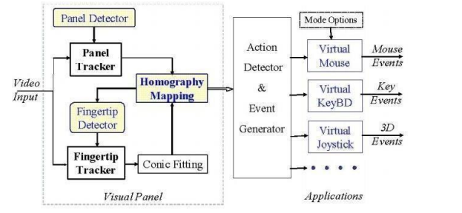
Visual Panel
The interaction movements will be captured, analyzed and implement the positions of the tip-pointer, resulting accurate and robust interaction with the computer. The overall system consists of panel tracker, tip-pointer tracker, holography, calculation and update, and action detector and event generator as it can simulate both mouse and keyboard.

Slide 8
Module Explanation
MODULES :
The modules are the python objects with arbitrarily named attributes that you can bind and reference. Simply a module is a file consisting of python code. A module can define functions, classes and variables. A module can also be include runnable code. In this project the following modules are used they are
Open cv /Cv2
NumPy
Pynput
Controller
WX

Slide 9
SYSTEM REQUIREMENTS Hardware Requirements
Processor - Intel core i3
Speed - 1.5 GHz
RAM - 4GB
Hard Disk - 10GB
Floppy Drive - 500MB
Key Board - Standard Windows Keyboard
Monitor - 15.6’’ display Camera - HD webcam

Slide 10
SYSTEM REQUIREMENTS Software Requirements
Operating System - Windows10/Ubuntu 18.04
Application Software - Anaconda, PyCharm
Modules - cv2, NumPy, PynPut, WX, controller
Script - Python
Drivers - Webcam drivers

Slide 11
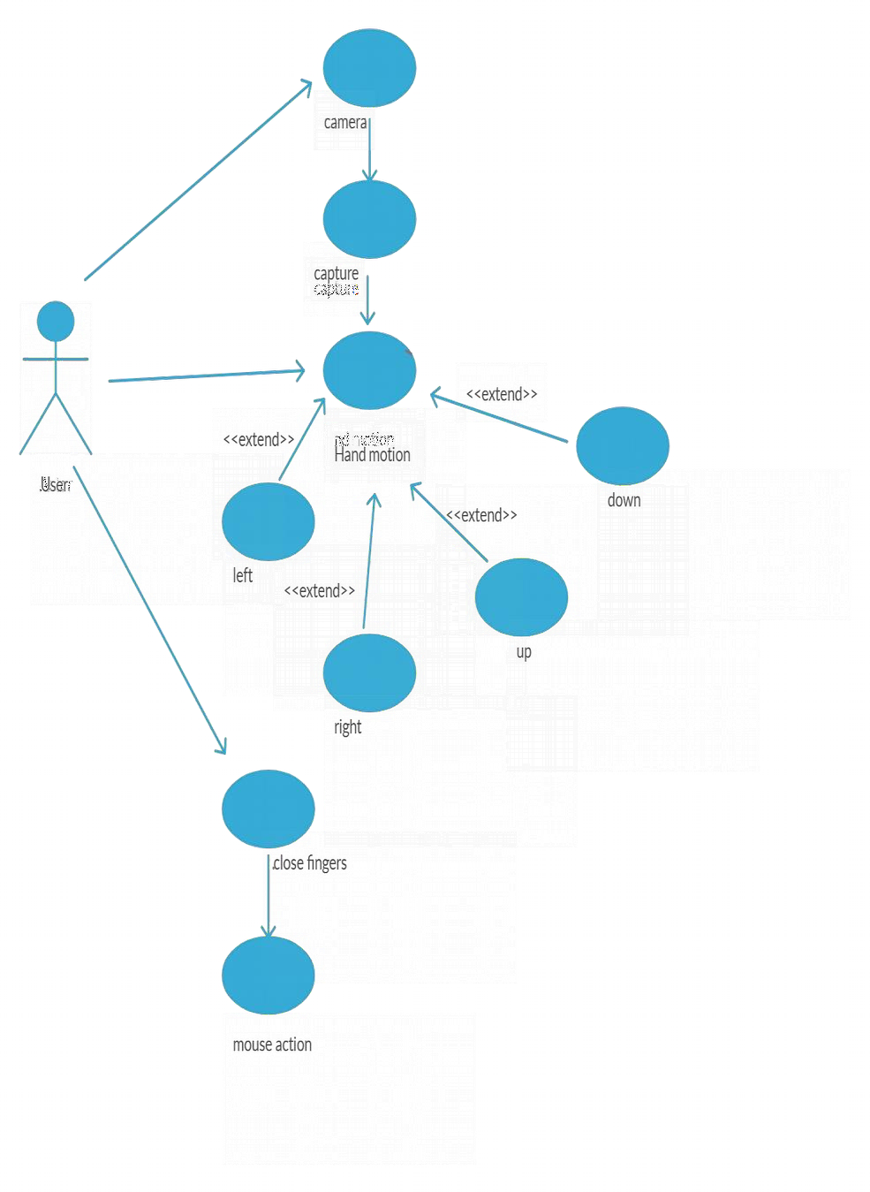
USE CASE DIAGRAM

Slide 12
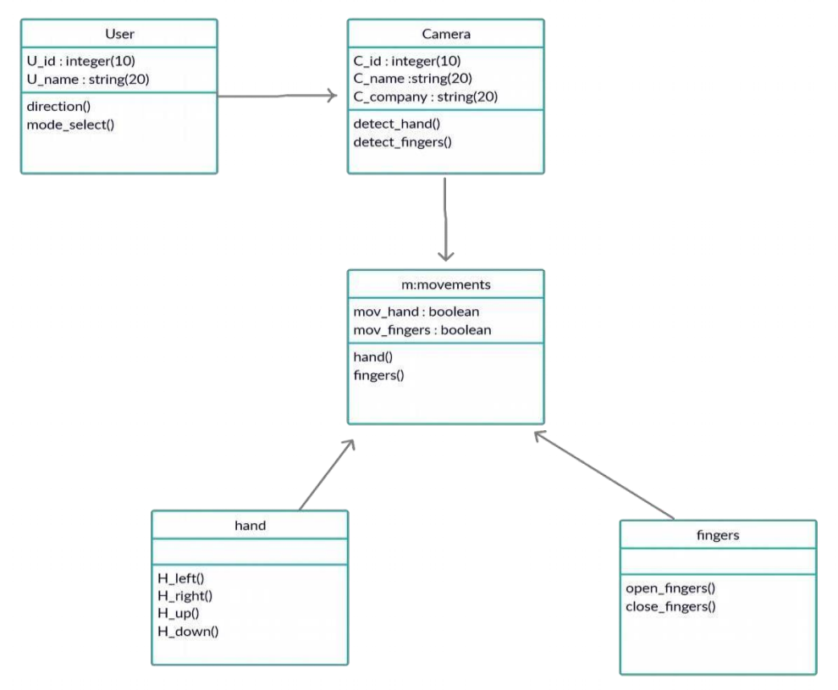
Class Diagram

Slide 13
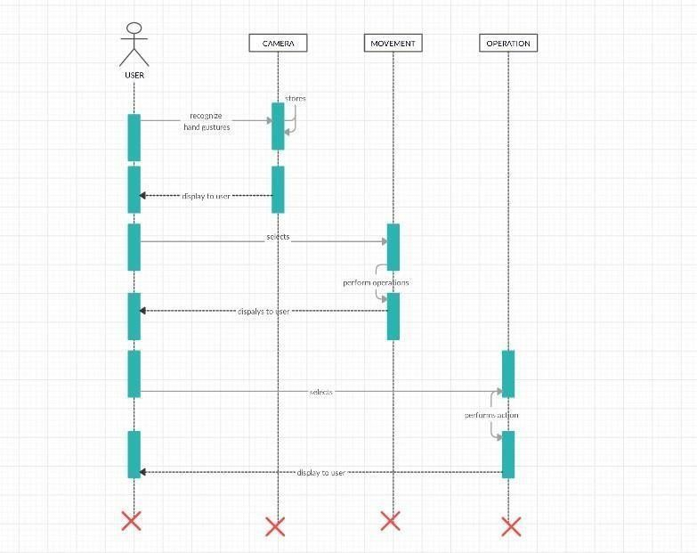
Sequence Diagram

Slide 14
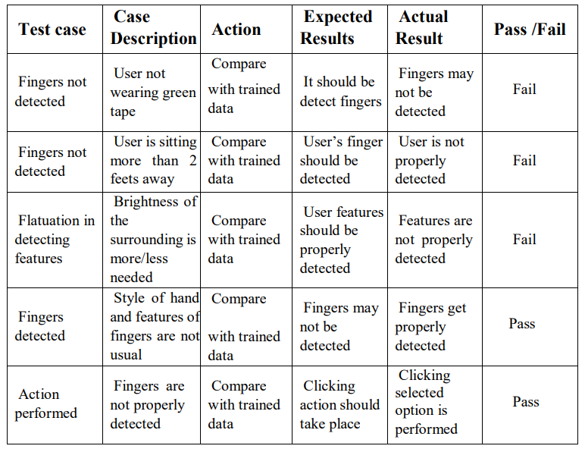
TEST CASES

Slide 15
FUTURE ENHANCEMENT
There are several features and improvements needed in order for the program to be more user friendly, accurate, and flexible in various environments.
The following describes the improvements and the features required:
➢ Smart Recognition Algorithm:
Due to the current recognition process are limited within 25cm radius, an adaptive zoom-in/out functions are required to improve the covered distance, where it can automatically adjust the focus rate based on the distance the users and the webcam.
➢ Better Performance:
The response time are heavily relying on the hardware of the machine, this includes the processing speed of the processor, the size of the available RAM, and the available features of webcam. Therefore, the program may have better performance when it's running on a decent machine with a webcam that performs better in different types of lightings.

Slide 16
CONCLUSION
In conclusion, it’s no surprised that the physical mouse will be replaced by a virtual non- physical mouse in the Human-Computer Interactions (HCI), where every mouse movements can be executed with a swift of your fingers everywhere and anytime without any environmental restrictions. This project had developed a colour recognition program with the purpose of replacing the generic physical mouse without sacrificing the accuracy and efficiency, it is able to recognize colour movements, combinations, and translate them into actual mouse functions. Due to accuracy and efficiency plays an important role in making the program as useful as an actual physical mouse, a few techniques had to be implemented. First and foremost, the coordinates of the colours that are in charge of handling the cursor movements are averaged based on a collection of coordinates, the purpose of this technique is to reduce and stabilize the sensitivity of cursor movements, as slight movement might lead to unwanted cursor movements.

Slide 17
REFERENCES
[1] Banerjee, A., Ghosh, A., Bharadwaj, K., & Saikia, H. (2014). Mouse control using a web camera based on colour detection. arXiv preprint arXiv:1403.4722.
[2] Chu-Feng, L. (2008). Portable Vision-Based HCI. [online] Available at: http://www.csie.ntu.edu.tw/~p93007/projects/vision/vision_hci_p93922007.pdf
[3] Park, H. (2008). A method for controlling mouse movement using a real-time camera. Brown University, Providence, RI, USA, Department of computer science.
[4] Kumar N, M. (2011). Manual Testing: Agile software development. [online] Manojforqa.blogspot.com. Available at: http://manojforqa.blogspot.com/2011/09/agilesoftware-development.html
[5] Niyaz i, K. (2012). Mouse Simulation Using Two Coloured Tapes. IJIST, 2(2), pp.57-63.
[6] Sekeroglu, K. (2010). Virtual Mouse Using a Webcam. [online] Available at: http://www.ece.lsu.edu/ipl/SampleStudentProjects/ProjectKazim/Virtual%20Mouse %20Using%20a%20Webcam_Kazim_Sekeroglu.pdf
[7] Tutorialspoint.com, (n.d.). SDLC - Agile Model. [online] Available at: http://www.tutorialspoint.com/sdlc/sdlc_agile_model.htm.
[8] Tabernae.com, (n.d.). Software Life Cycle | Web Development Outsourcing| IT Offshore Outsourcing. [online] Available at: http://www.tabernae.com/process.aspx.
[9] Zhengyou, Z., Ying, W. and Shafer, S. (2001). Visual Panel: Virtual Mouse, Keyboard and 3D Controller with an Ordinary Piece of Paper. [online]

Slide 18

Thank you

