Slide 1
PCIC 2021 Competition
Causal Discovery Track
Solution Analysis
Team: JayceHaha

Slide 2
Get intuition: check the data
PC algorithm do not work
Estimate DAG by causal effect
Estimate DAG by TTPM method
Failed effort

Slide 3
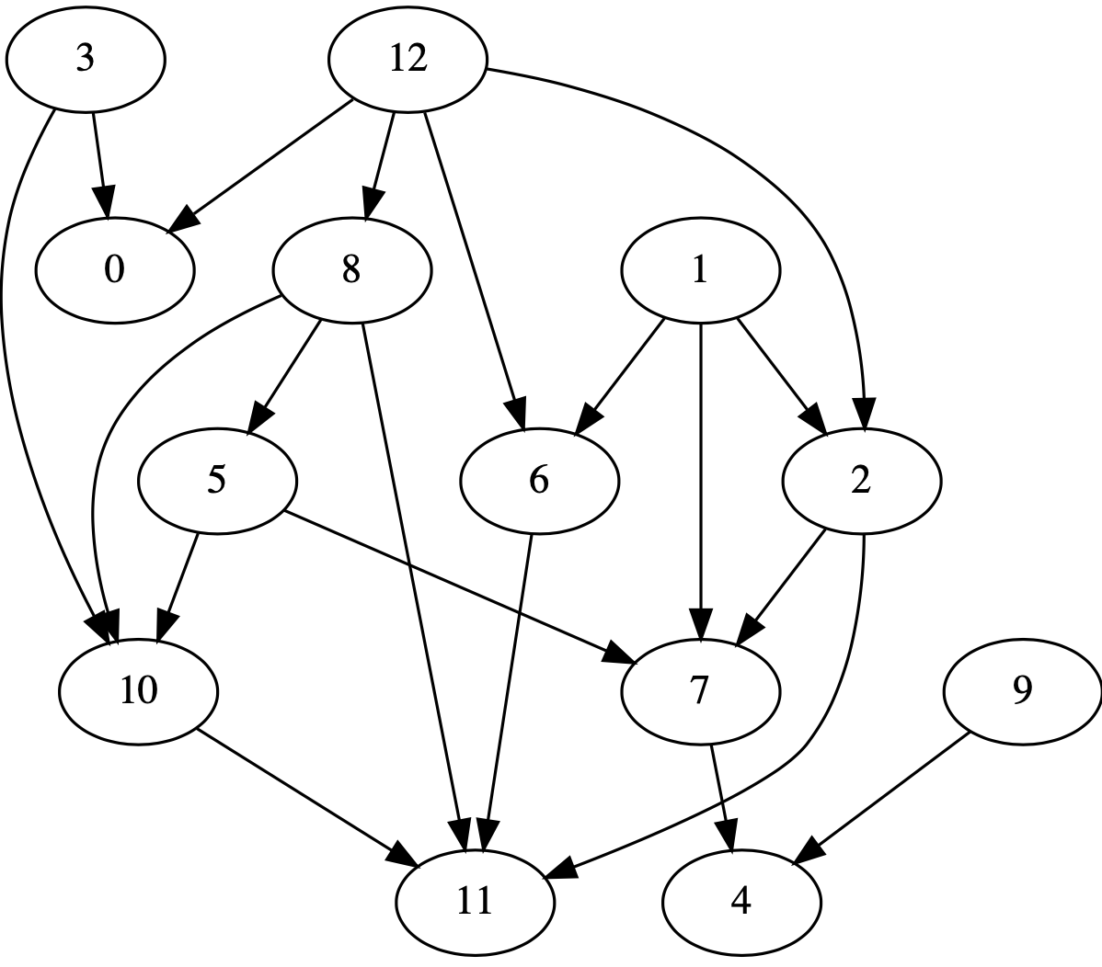
Get intuition
Ground true DAG of data-4:

Slide 4
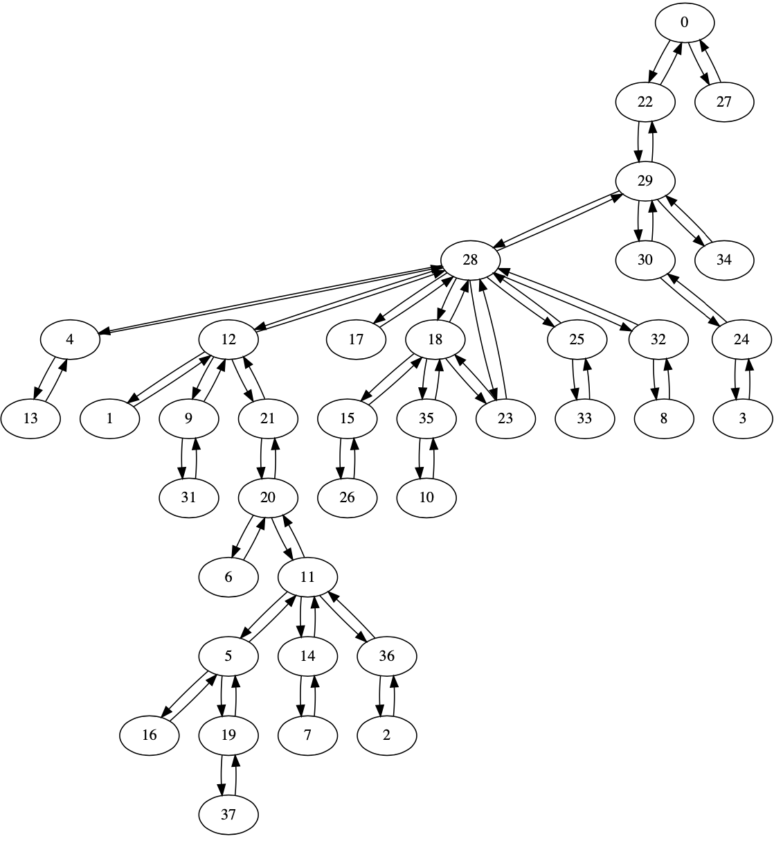
Get intuition
Topology graph of data-4:

Slide 5
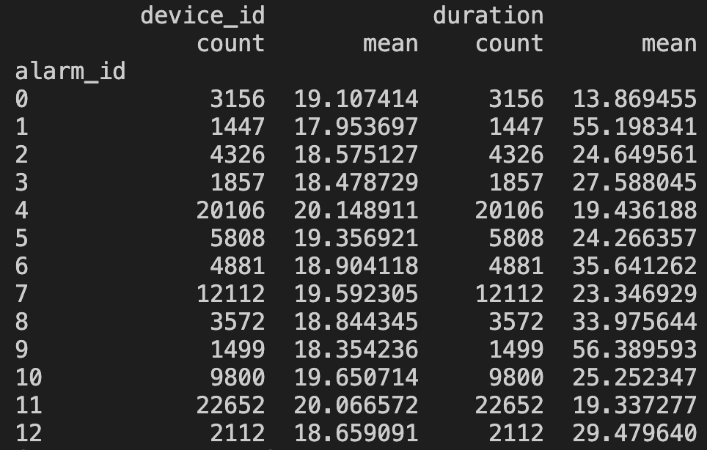
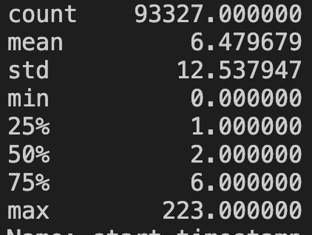
Get intuition
Statistics of data-4:
Time interval between events

Slide 6
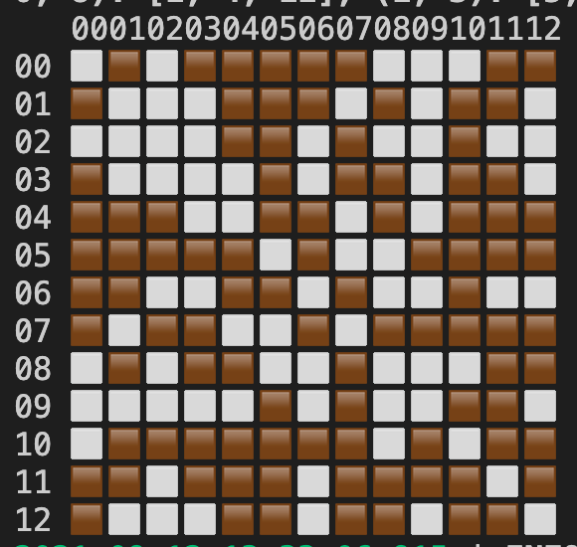
PC-Algorithm do not work
* construct feature by windowing
* should be explored further

Slide 7
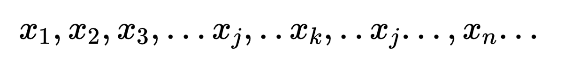
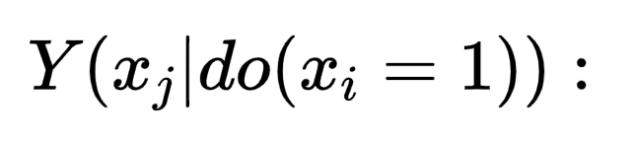
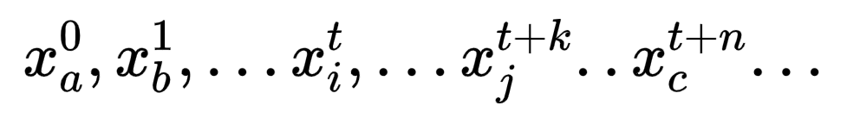
Estimate DAG by causal effect
Calculate the treatment effect of event i on event j
Calculate
NOTE: Actually, we could force to 'do' in the observed data
Select out all windows started by event i
Sum event j (count, time, etc) inside windows
Window size: 12 ~ 16 events

Slide 8
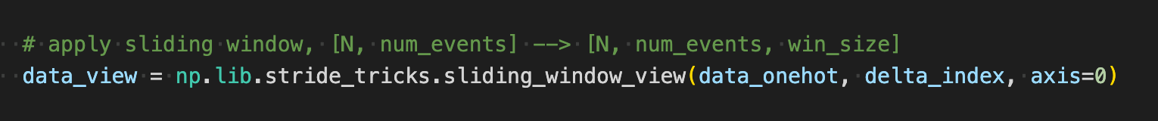
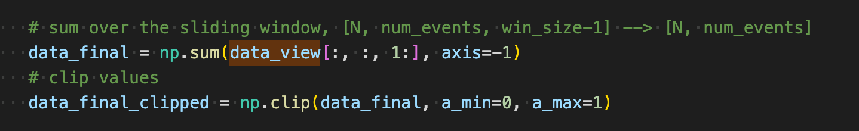
Estimate DAG by causal effect
Windowing
Sum over the window

Slide 9
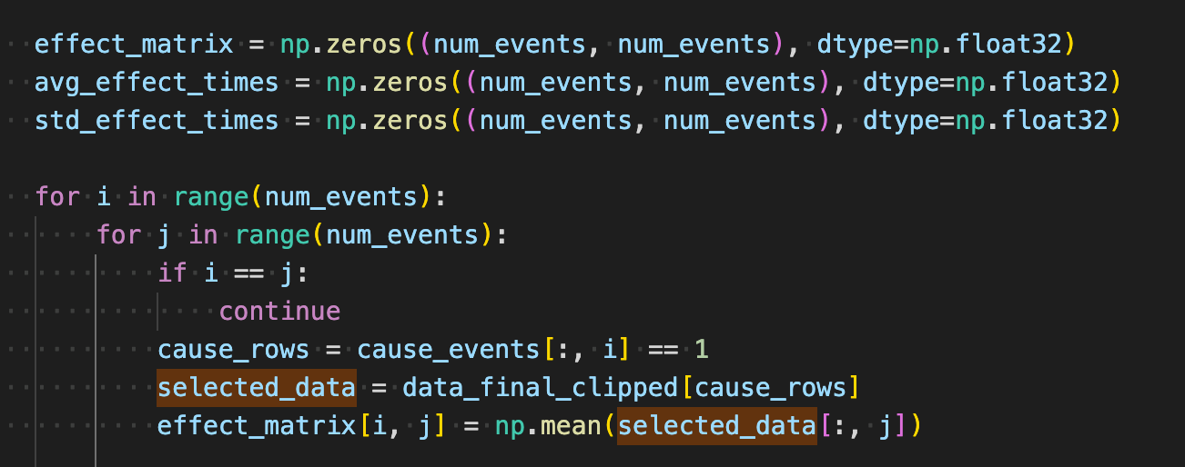
Estimate DAG by causal effect
Apply same procedures to the effect time
effect time: delta of the start time of event j and i
Iterate over all edge pairs

Slide 10
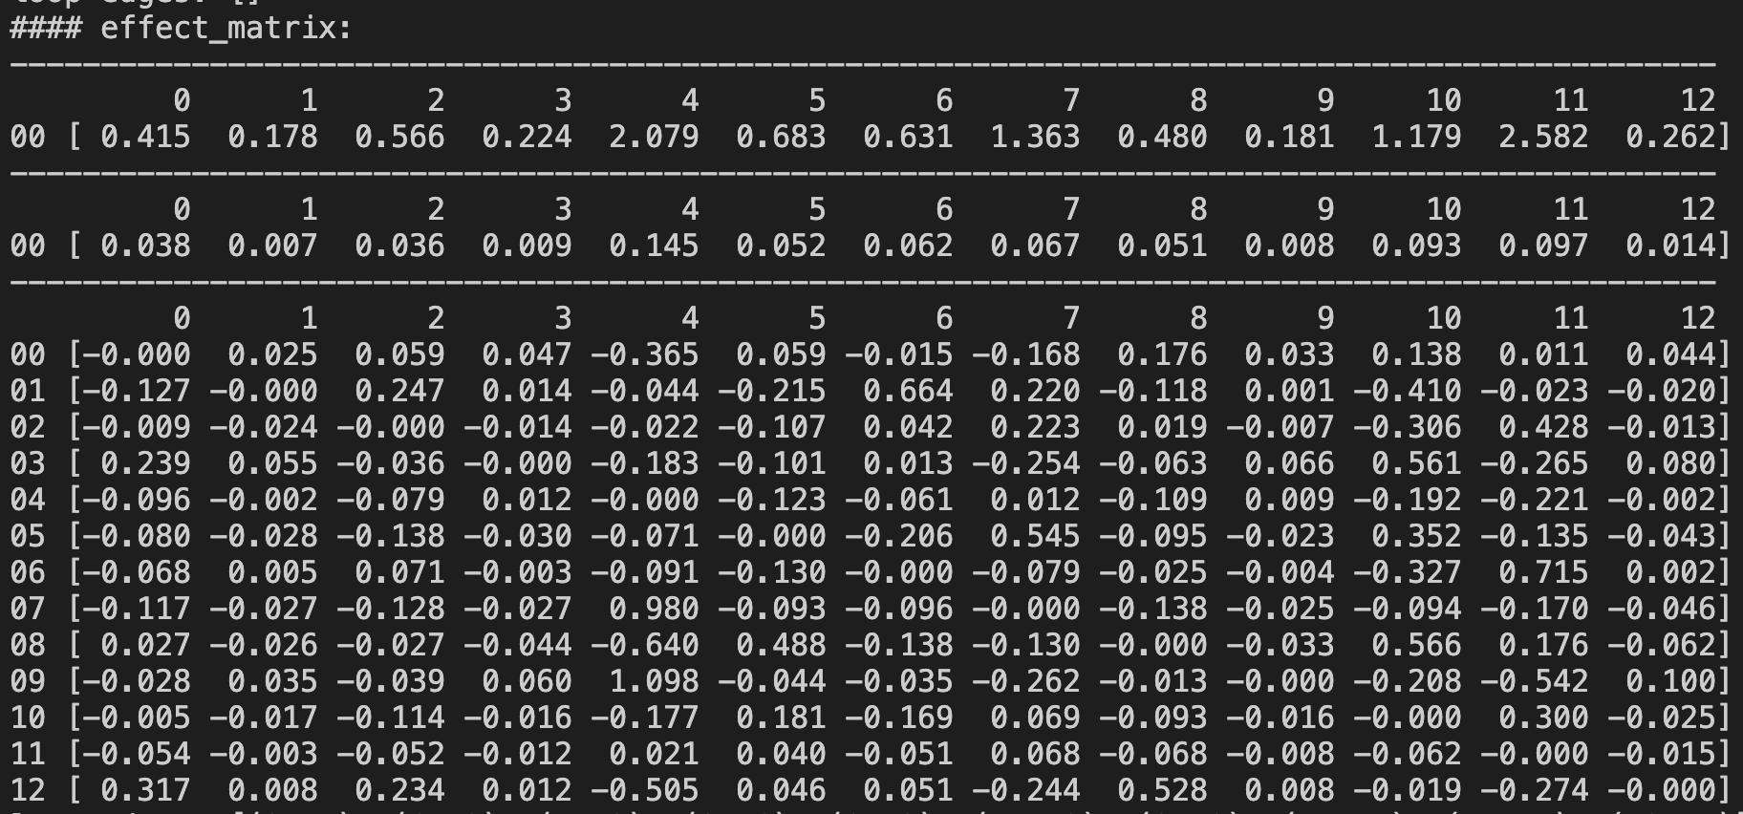
Estimate DAG by causal effect
Treatment effect matrix

Slide 11
Estimate DAG by causal effect
Estimate DAG by deviation detect
mean value along rows:
standard value along rows:
DAG[i, j] = 1 if effect_delta[i, j] > effect_std[j] * scale

Slide 12
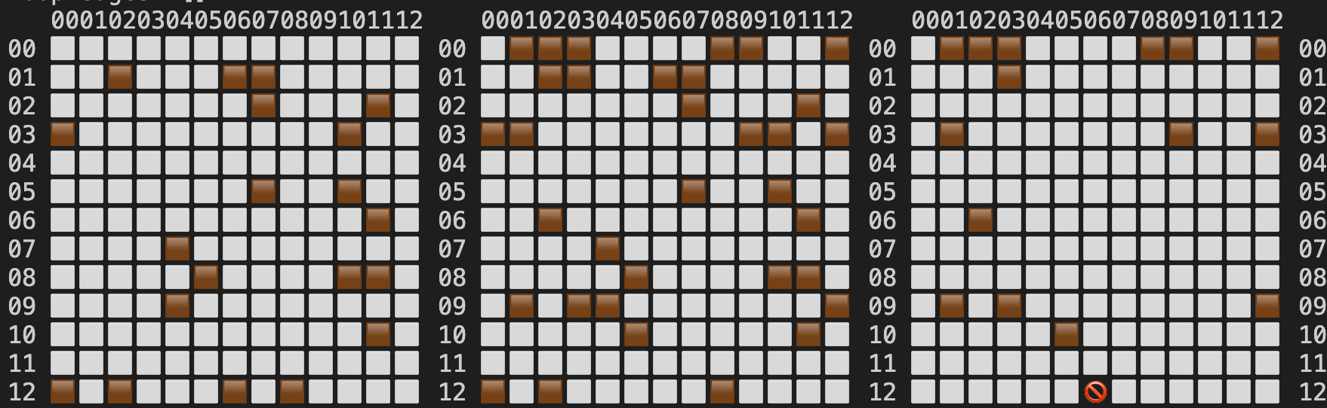
Estimate DAG by causal effect
Estimate DAG by deviation detect
Ground True
Estimated
Estimated - Ground True
Recall most edges
Some false positive edges

Slide 13
Estimate DAG by causal effect
Estimate DAG by sorting
Simply sort all effect value and select the top k edges
Remove bi-directional edges by removing the less significant one

Slide 14
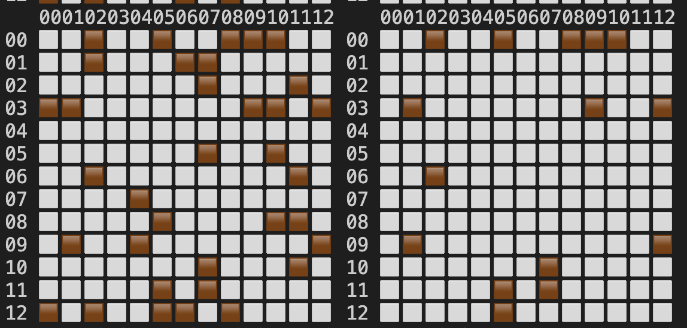
Estimate DAG by causal effect
Estimate DAG by sorting
1. Simply sort all effect value and select the top k edges
2. Remove bi-directional edges by removing the less significant one
Estimated
Estimated - Ground True
Recall all edges
Some false positive edges
(less than checking std value)

Slide 15
Estimate DAG by causal effect
DAG estimated:
Estimated
Estimated - Ground True
Recall all edges
Some false positive edges (less than checking std value)

Slide 16
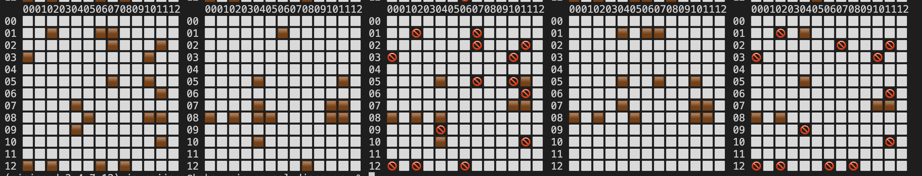
Estimate DAG by causal effect
Apply same process to effect time, Got:
* effect time: delta of the start time of event j and i
Ground True
Estimated by mean effect time
Delta
Estimated by std effect time
Delta

Slide 17
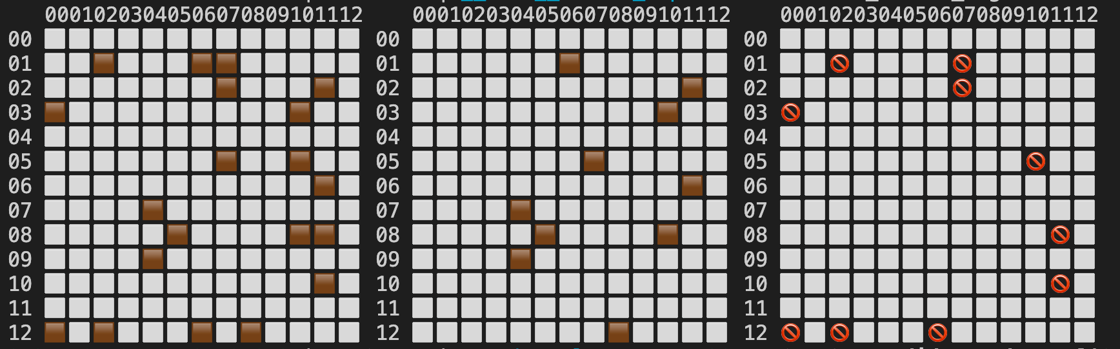
Estimate DAG by causal effect
What these DAG can do?
Give some intuition
Used as initial edge_mat for TTPM
Used as candidate edges for TTPM
Fiter edges with low treatment effect

Slide 18
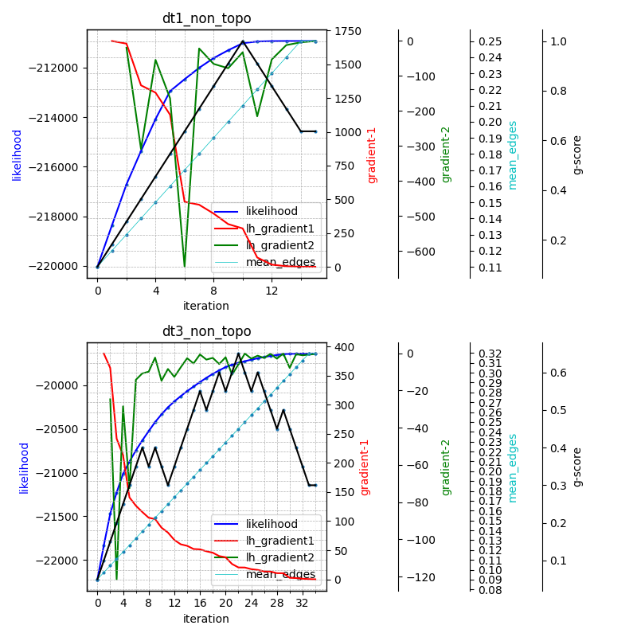
TTPM method
(R. Cai, S.Wu, J.Qiao et al, 2021)
Run the baseline method

Slide 19
TTPM method
Hyper-parameters
max_hop
For data without topo_mat: 0
For data with topo_mat: 2 is better 1 (that's what the paper tell us too)
max_iterations
the larger the better, util the likelihood converges
> 40 for phase1, > 60 for phase 2
delta
roughly around 0.01 ~ 0.04 (default 0.10)
epsilon
2.0 ~ 4.0 (default 1.0)
penalty method:
"BIC" is better than "AIC"

Slide 20
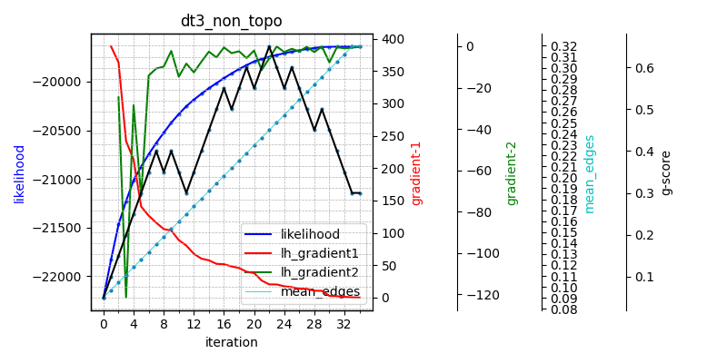
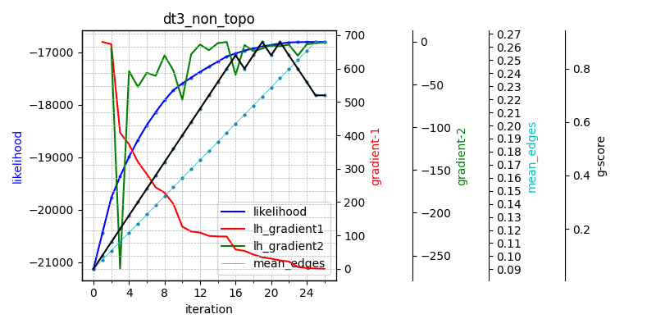
TTPM method
Hyper-parameters: delta
delta: 0.10 (default)
delta: 0.02
higher likelihood
higher g-score

Slide 21
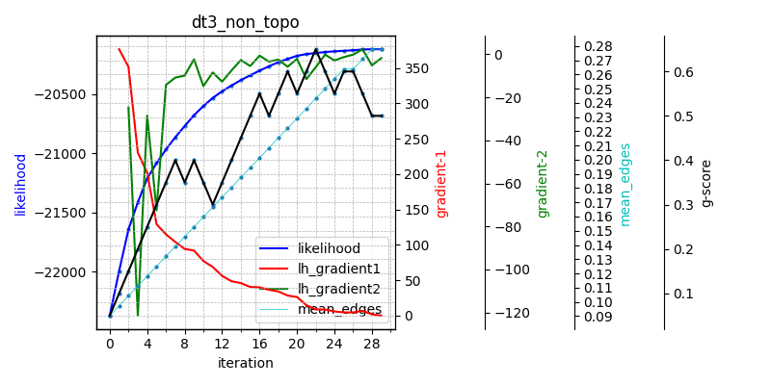
TTPM method
Hyper-parameters: epsilon
epsilon: 1.0 (default)
epsilon: 4.0
Converge more earlier

Slide 22
TTPM method
Hyper-parameters
max_hop
For data without topo_mat: 0
For data with topo_mat: 2 is better 1 (that's what the paper tell us too)
max_iterations
the larger the better, util the likelihood converges
> 40 for phase1, > 60 for phase 2
delta
roughly around 0.01 ~ 0.04 (default 0.10)
epsilon
2.0 ~ 4.0 (default 1.0)
penalty method:
"BIC" is better than "AIC"

Slide 23
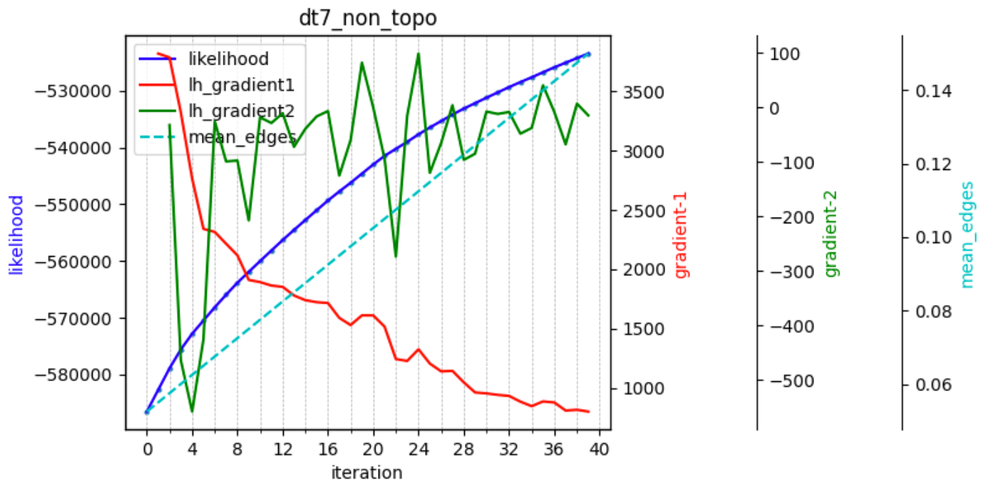
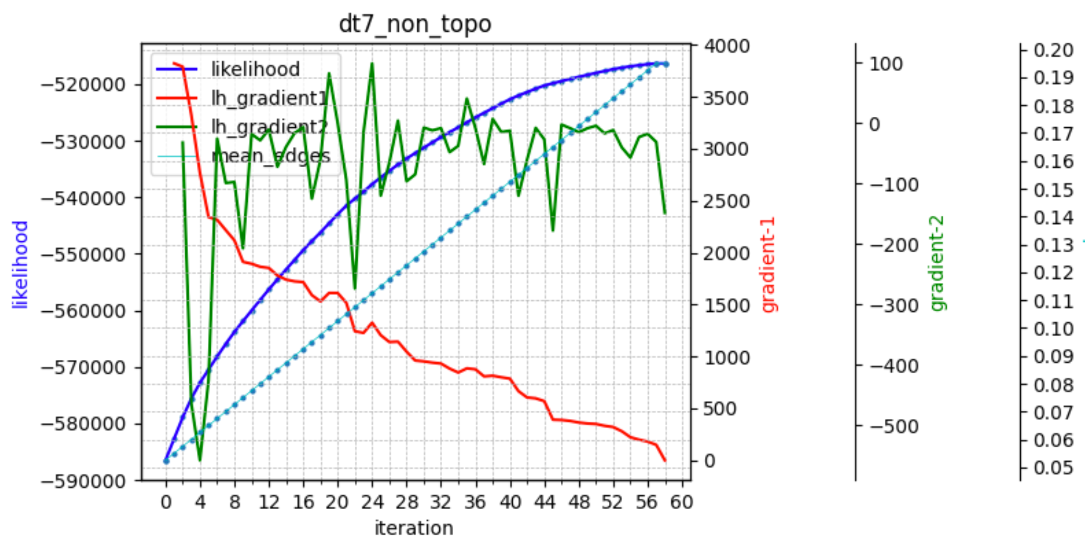
TTPM method
max_iteration
much larger then phase 1
delta
* epsilon
Key details of phase 2

Slide 24
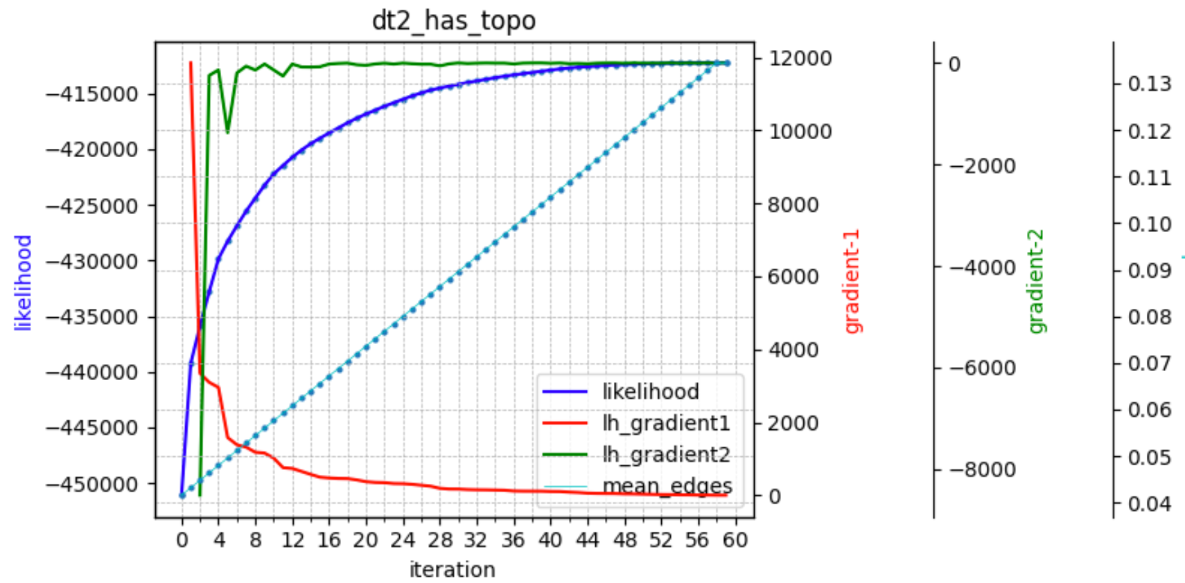
TTPM method
Phase 2: data-1, 2 are hard to learn
max_iteration
much larger then phase 1
likelihood changes too smoothly

Slide 25

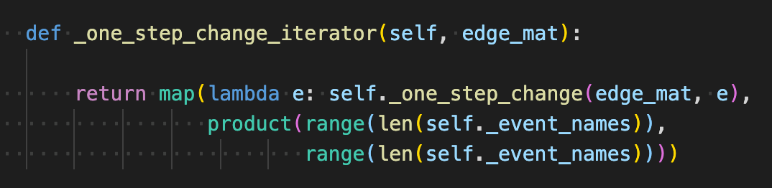
TTPM method
TTPM is time consuming

Slide 26
TTPM method
Improving speed
Use the DAG estimated by treatment effect as initial edge mat
Only keep edges with significant treatment effect (Use the top 6% edges)

Slide 27
TTPM method
Improving speed
Use the DAG estimated by treatment effect as candidate edges
Keep most edges with significant treatment effect (Use the top 25% edges)
Recover to search around all edges when likelihood converges
10x speed up in data [1, 2, 3, 4] in phase 1, not tested for phase2 yet

Slide 28
Failed effort
Try to estimate DAG by gradients but failed
label
Transformer with causal DAG, topo mask
feature-1
feature-2
......
feature-i

Slide 29
Q & A
Thanks!

