Slide 1
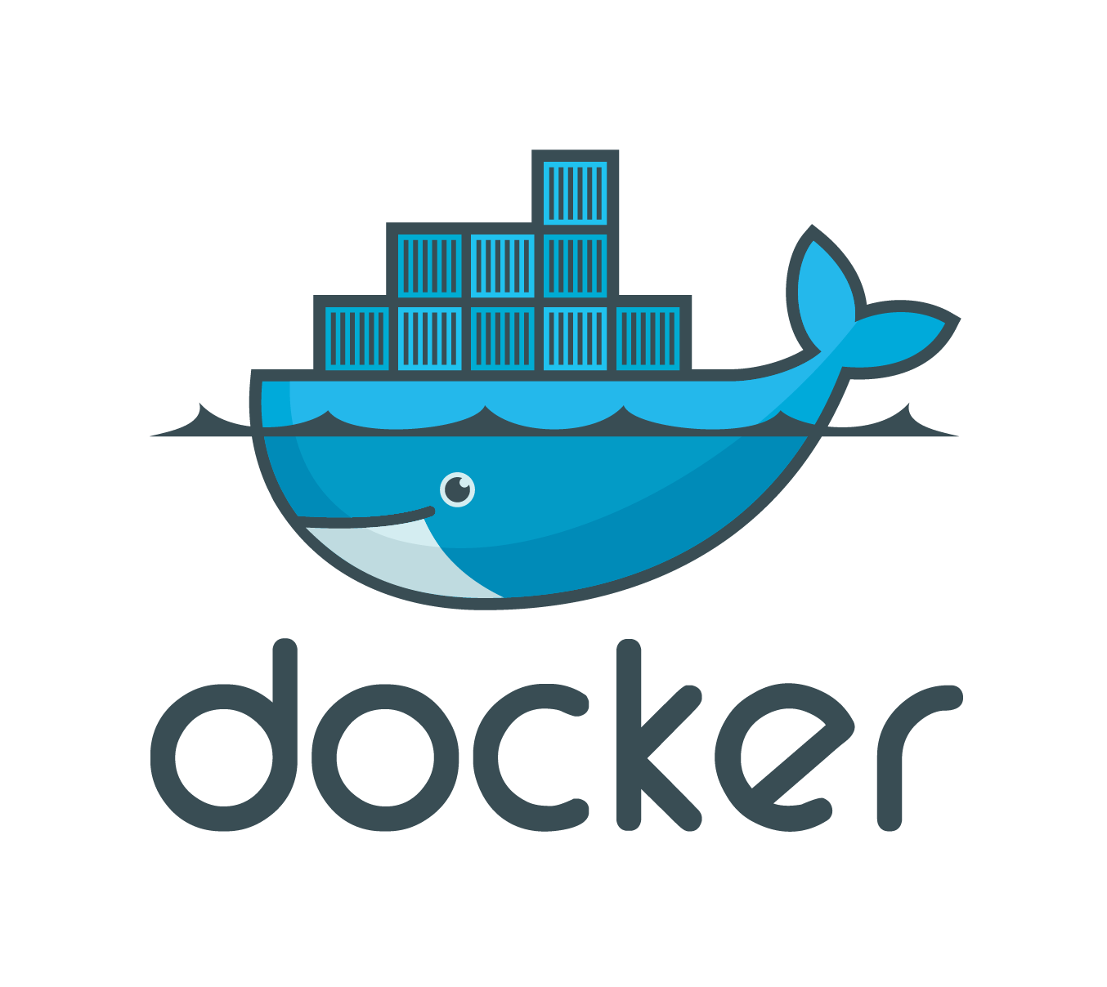
Containerization Technology

Slide 2
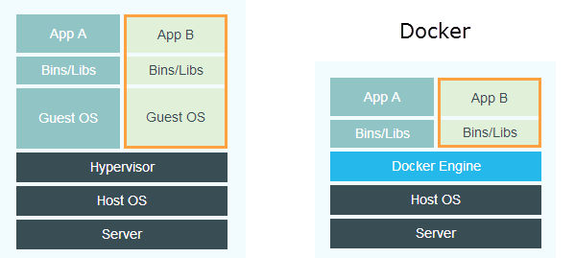
Virtualization and Containerization
The image describes the difference between a VM and Docker. Instead of a hypervisor with Guest OSes on top, Docker uses a Docker engine and containers on top. Does this really tell us anything? What is the difference between a "hypervisor" and the "Docker engine"? A nice way of illustrating this difference is through listing the running processes on the Host.

Slide 3
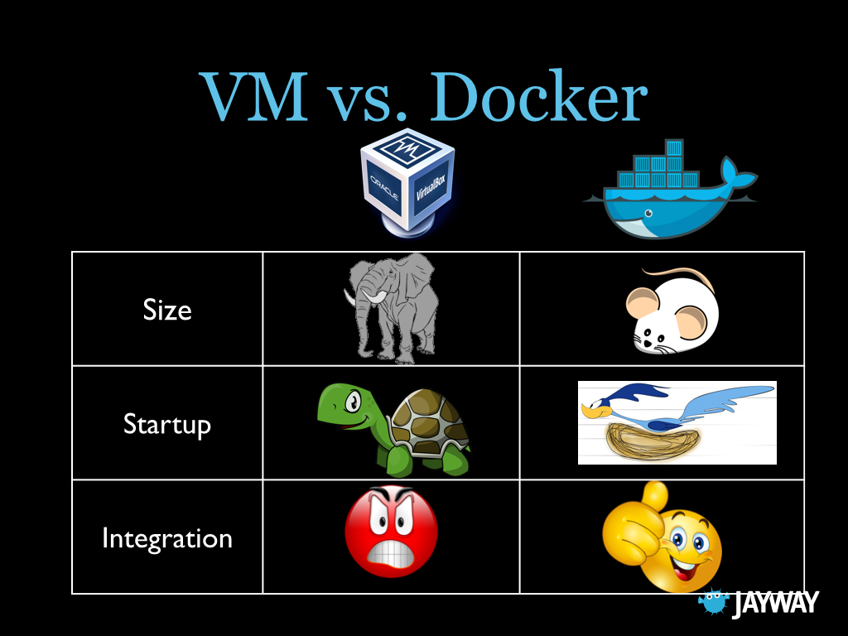
Differences In a Nutshell
Notes:
Difference
Virtualization Containerization
> Mixed OS’s > efficient
More Flexible > Less OS Maintenance
Very Mature > Fast Deployment

Slide 4
How Dockers Works?
Docker file
Nginx
Php
Java
…
…
Dcoker Image
Container
Container
Container
Docker File → Docker Image → Container

Slide 5
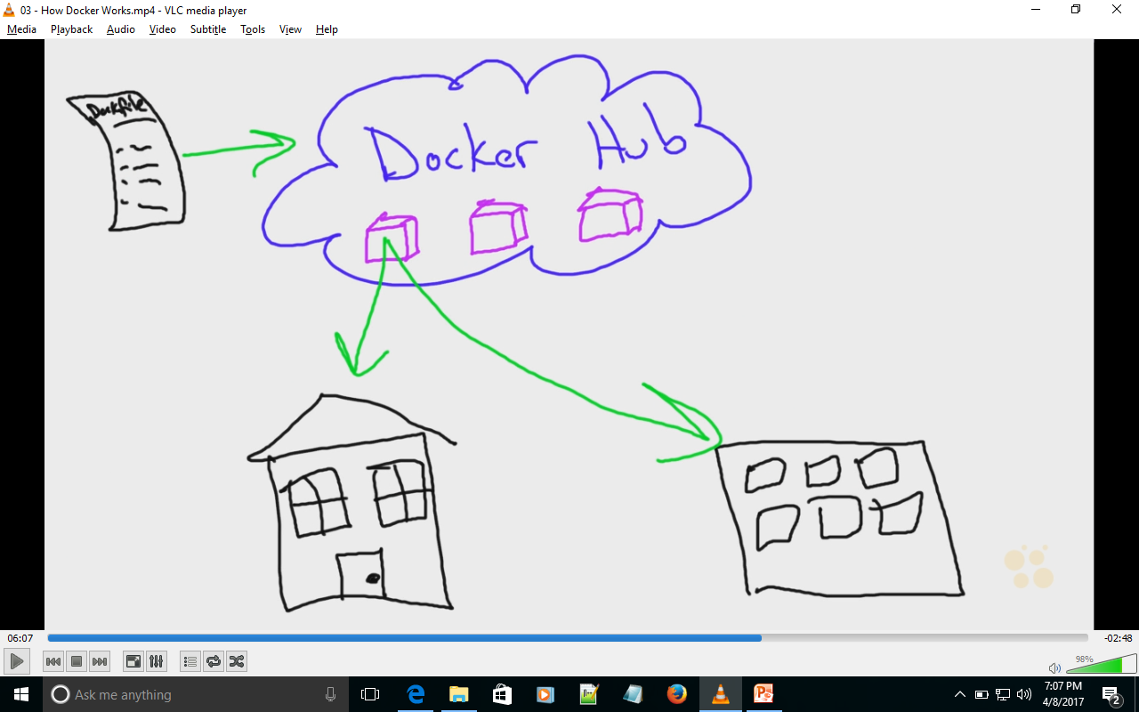
Docker Community
Home Environment
Office Environment

Slide 6
Docker Installation
What not to do?
apt-cache search docker or yum list and do not prefer
docker.io
Or Do not
Yum install docker or
Apt-get install docker
To Install the correct way got use the Docker Installer platform :
STEP 1: got to
https://docs.docker.com/engine/installation/linux/centos/
Follow the steps to install CE (community edition)
Step 2: Check Docker version.
$ docker --version
Step 3: Check for Docker service is running
$ service docker status/start/restart

Slide 7
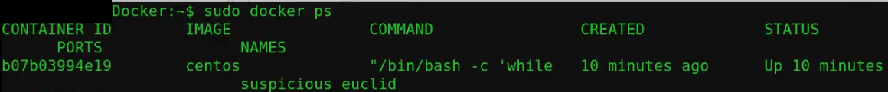
Simple Dockerized App.
What is Docker HUB?
How to download a Docker Image
Run the IMAGE and hence call it a container.
Check the log.
A Docker HUB is a DOCKER IMAGE repository. You can visit www.hub.docker.com
Try the below code in the docker image.
/bin/bash -c 'while true; do X=$[$X+1]; echo $X; sleep 1; done'
$ sudo docker run -d centos /bin….
$ sudo docker ps (docker process running)
$ sudo docker logs <Cont. Name/Cont.ID>
$ sudo docker stop <Cont. Name/Cont.ID>
Check for
$ sudo docker -ps (docker process running)

Slide 8
Download,Update remove
Learn how to
1. Updating and deleting Imaged.
2. Start, Stop and remove containers and Images.
First of all check the Images in your environment.
$ sudo docker images
$ sudo docker search php (“check for the image in Docker HUB”)
$ sudo docker pull php (pull and download the image from Docker hub)
$ sudo docker rmi <image name>
$ sudo docker pull <image name> (to update the existing image or download the latest)
Check for the running or stopped Container
$ sudo docker ps -a (running and stoped container)
$ sudo docker rm –f <Cont.Name or Cont.ID>

Slide 9
NETWORKING IN DOCKER
HOST
Eth0: 192.168.0.X
Docker0:172.16.0.1 (Virtual Interface)
VetnXXX: BridgeNet.
(Vir.ethernetAdapter)
NETWORK
CONTAINER
Eth0:172.16.0.12
Notes:
Adejonge/helloworld – it is a selfcontained webserver which servers onepage on port 8080

Slide 10
NETWORKING IN DOCKER
Hence the Virtual Interface (Docker0:172.16.0.1) is created when you have a docker installed and then a Bridge Networked (Virtual EtherNet Port - VetnXXX) is created for every running container and an IP Address is allocated.
Finding the IP:
Step 1: Check your host with
$ ifconfig
You would find an eht0 and docker0 but not VetnXXX.(Note: without any running container.)
Step 2: Run this container in daemon mode.
$ sudo docker run –d adejonge/helloworld (it is a selfcontained webserver which servers one page on port 8080 but need to know the IP address of this container)
Step 3 : Finding the IP of this contianer.
$ sudo docker inspect <Cont.Name or Cont.ID> (“check for the container information”)
$ sudo docker inspect <Cont.Name or Cont.ID> | grep IP
Exactly here check for
$ ifconfig
You would find an eht0 and docker0 but and VetnXXX. This is the Bridge Networked Virtual EtherNet Port that exposes IP fo the container to rest of the Network.
Step 4:
GOTO BROWSER and type : www.<Container IP Adderss>: 8080

Slide 11
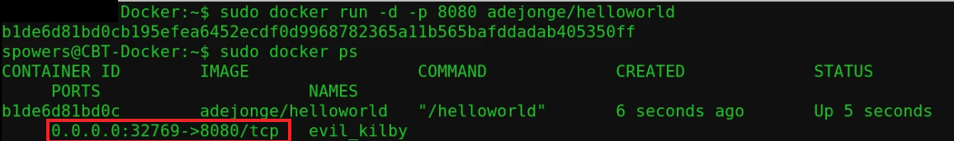
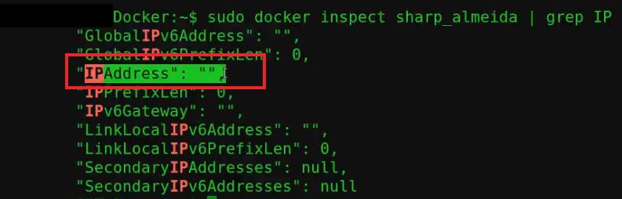
Advanced NETWORKING IN DOCKER
Port Mapping .
Port Redirecting.
Host Networking.
Step 1: Run the container for mapping the port.
$ sudo docker run –d –p 8080 adejonge/helloworld (Note: -p stand for pubish port)
Goto host browser and : www.<locathost IP>:32769
Step 2: Run this container in Redirecting the port.
$ sudo docker run –d –p 9009:8080 adejonge/helloworld (With this command one can assign your prefered port number rather than random number by Docker engine)
Step 3 : Sharing the HOST IP for this contianer.
$ sudo docker –d - -net= host adejonge/helloworld (This would share the host IP and DOES NOT use BRIDGE NETWORKING and Hence no V-etherNET.)
$ sudo docker inspect adejonge/helloworld | grep IP
Exactly here check for
$ ifconfig
You would find an eht0 and docker0 but NOT VetnXXX.

Slide 12
Shared and Persistent Data
External DATA is Ideal – DATA ON HOST
Mapping the External DATA with the Container.
HOST
DK. CONTAINER
External DATA MAPPING
/THE/DIRECTORY/YOU/DESIRE
/HOST/…../DATA
The command is SIMPLE
$ sudo docker run –d –v /HOST/…../DATA:/CONTAINER/LOCATION (Note: -v stand for share volume)
Practice Example:We shall use NGINX image which is a simple webserver
Step 1: First RUN the NGINX conatianer inspect the IP and check the data on host browser.
Step 2: Create an index.html file on HOST MACHINE
Step 3: Using the command above, map the HOST LOCATION to this NGINX container /usr/share/nginx/html
Step 4: Inspect the newly started NGINX container with MAPED DATA and you find the data reflecting in the browser.

Slide 13
Modifying Containers and Hence New Image
1. Attaching to running containers
2. Modifying Image
3.Creating New Image
Step 1: Run the container for mapping the port..
$ sudo docker run –d –name temp_container nginx (Note: --name flag to give your name to container)
Step 2: Now to enter the container. Use the command below.
$ sudo docker exec -i -t <Cont.Name or Cont.ID> bash (Note: -i and –t flags stand for interactive and terminal respectively and bash is the command that we want to run under that terminal)
You would now be INSIDE that container.
root@ <Cont.ID> $
Now here if you can change the content of index.html under /usr/share/nginx/html
root@ <Cont.ID> : /usr/share/nginx/html $ cat > index.html
<h1>CHANGED THE DATA</h1>
(ctrl+d) ---this would save the changed in index.html
Step 3: Now to create a New IMAGE with these changes as permanent.
To do so, exit out of the running container to host. And follow the command below.
$ sudo docker commit temp_container regenerated_nginx
i.e $ sudo docker commit <Running Cont.Name with changes> <Name of the NEW IMAGE>
LISTH DOCKER IMAGES AND YOU WOULD FIND AND NEW IMAGE

Slide 14
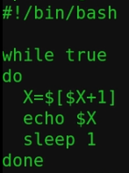
Creating New Image from Scratch
Docker file
Nginx
Php
Java
…
…
Dcoker Image
Container
To create a Docker file follow the procedure below.
Step 1: Under the directory /home/USER/DockerPrac lets us create a small programme called ticker.sh
Which basically does the function of ticking from 1 – infinity.
Now let us create a Docker Image which when run (Docker Container) displays ticker 1-….

Slide 15
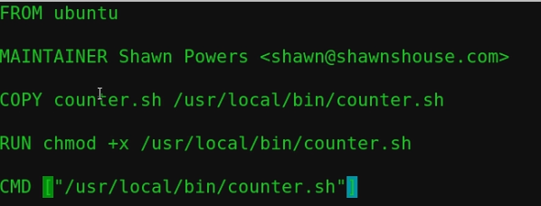
Creating New Image from Scratch cont…
Step 2: Now create a file name Dockerfile (by convention this is the method D capital). Under the same location /home/USER/DockerPrac as below.
Step 2: Now create a Docker image from this as follows.
$ sudo docker build –t ticker_ubuntu . (Note: -t refers to tag a name to new IMAGE and mind the . DOT it sates from the current directory. Very Necessary make sure the ticker.sh file is present in the same directory as the Dcokerfile is present for the example above.
Step 3: The IMAGE is created with the name ticker_ubuntu
$ sudo docker images
$ sudo docker run –d –name check_ticker ticker_ubuntu
$ sudo docker logs check_ticker
MUST GET COUNT GOING EVERY SECOND……

Slide 16
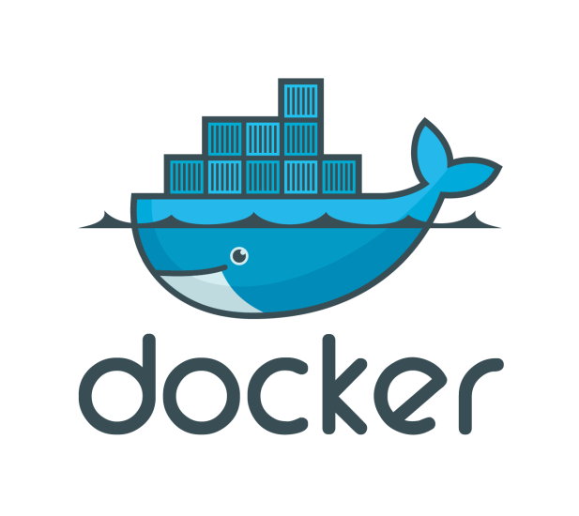
THANK YOU FOR LEARNING

