Slide 1
Resource vectors for AI4Research
What processes use on a GPU, how they interact when sharing it, and what that means for measurement, planning, capsules and scheduling
Measured on a real GPU: 140 runs, 1,760 container starts
Notes:
TIME 0:20
SAY: Main points:
- Each task is a resource vector, and vectors can be combined to simulate a shared GPU

Slide 2

THE IDEA
Store each task as a resource vector, simulate the shared GPU from vectors
Vector = memory read, tensor cores, compute units, GPU busy, kernel size and rate, memory footprint, PCIe copies, startup phases, CPU time. Solo vectors blended by time share reproduce shared-GPU counters with 4.0 pp mean error (sum: 16.0 pp)
Time-split blend: report.md appendix A.5 and table B.6; computed in figs1e.py
2
Notes:
TIME 1:30
SAY: Main points:
- A capsule runs alone in a container and the host profiler records its vector
- The vector is stored with the capsule version
- Vectors of concurrent processes are blended by each process's GPU time share, taken from per-process kernel traces
- The blend gives predicted device counters, a per-process share and a slowdown estimate
- Outputs feed planner pairing, model routing, capacity checks and chip what-ifs

Slide 3
WHAT IT MEANS
Each result maps to measurement, planning, capsules and scheduling
Result (evidence) | Measurement | Planning | Capsules | Scheduling
**Distinct vectors.** Decode 78% memory, 0% tensor; training 30% memory, 13% tensor; speech and NVENC 0 to 3% | Record several dimensions plus kernel size and rate | Classify nodes by dominant resource | Declare resource dimensions | Pair unlike vectors
**Blend works.** Solo vectors by time share: 4.0 pp mean error vs 16.0 pp for the sum, better in 12 of 15 cells | Per-process traces give shares; solo runs give vectors | Simulate a pair before placing it | Simulator capsule: vectors in, usage out | Predicted device load before launch
**Slowdown follows vector shape.** LLM decode x2.08 beside training, x2.27 beside LLM, x1.00 to x1.12 beside speech or NVENC | Measure both directions of every pair | Avoid memory-bound plus long-kernel pairs | Admission stores pair behaviour | Pair heavy with light
**Copies lose to batching.** 4 processes 258 tok/s and 8.9 GiB; batched 614 tok/s and 2.5 GiB | Count memory per copy | Budget model residency | Model serving as a shared service | Route requests to one batching server
**Startup dominates small tasks.** 6.1 s vs 0.05 s model load; 64 s vs 5 s JIT; +216 ms container with GPU | Separate startup, cold and steady phases | Include startup in node cost | Declare warm and cache needs | Keep containers and models warm
**Decode meets the bandwidth wall at 7B.** 737 GB/s of 850; GB10 listed at 273 | Memory bandwidth is the tracked dimension | Size local models to bandwidth | Declare model size | Fewer, smaller resident models
Test machine (RTX 5070 Ti): sources/2026-10-16-shared-gpu/report.md (tables B.1 to B.8); blend error computed from B.6
3
Notes:
TIME 1:45
SAY: Main points:
- Six measured results, each with its effect on how usage is measured, how nodes are planned, how capsules are declared and how work is scheduled
- The blend result is the base of the simulator: solo vectors plus time shares reproduce shared device counters
- Slowdown follows vector shape, so pairing rules come straight from the vectors

Slide 4

TESTS
The tests: 140 runs, 1,760 container starts, 10 experiment sets
X2 decode vs prefill by model size. X3 each task type alone. X4 batching vs separate copies. X5 every task pair. X6 cold start. X7 idle, A, B, A+B sequences under one counter observer. JIT cache. Start: 1,760 container starts. Repeats 2 to 12 per point; raw traces and ledger stay on the test machine
Test machine (RTX 5070 Ti): sources/2026-10-16-shared-gpu/report.md (appendix A.4 experiment table; run ids 171 to 316; Start experiment 1,760 starts)
4
Notes:
TIME 1:15
SAY: Main points:
- Ten experiment sets: idle floor, hardware ceilings, LLM prefill and decode by model size, training, speech and NVENC, batching versus separate copies, every task pair, cold start, A then B then both sequences, and the GPU-code cache
- 140 measured runs plus 1,760 timed container starts
- Host sampling every 100 ms, GPU counters at 10 kHz, kernel traces from Nsight Systems
- Repeats are small, 2 to 12 per point, so treat single numbers as indicative
- Everything here is one Ryzen 7 plus RTX 5070 Ti machine, not the GB10
Supplemental points:
- Run counts come from the report's run id ranges: X0 6, X1 3, X2 21, X3 8, X4 28, X5 32, X6 6, X7 28, JIT 8
- Repeat agreement: X7 within 0.3 points, X2 throughput within 2%, most pair slowdowns within about 0.1x except LLM beside training (x1.7 to x2.4)

Slide 5
AI4RESEARCH
Where the local GPU would be used in AI4Research
Capsule kind | Local GPU work (expected) | Nearest measured task | What a profile tells us
Agent capsules: intent, requirements, planner, search, screening, hypothesis, evaluation, delivery | Local LLM calls: prefill, then decode | LLM prefill and decode | Tokens, context length, concurrency
Verifier, after every node | Many short LLM calls | LLM decode | Whether calls batch well
research.builder | Local model writes code, runs POC experiments | LLM plus unknown experiment code | Experiment GPU use: unmeasured
research.benchmark and experiments | Local compute job (declared exclusive) | CNN training | Peak memory, compute use
Model router | Which local models stay resident | Cold load, batching, memory | Residency and quality trade-off
RSI, parallel nodes | Many child runs and tests, several jobs at once | Pair and four-LLM contention | Which pairs collide
Today the models are remote (M1). This deck assumes the local-model vision. First thing to learn: the real mix of LLM time, experiment time, CPU and I/O in a local run
design-package/1-system.md (research stages), reference/examples/*_capsule.json, capsules/research-benchmark.md:29, side-systems/rsi-workbench.md. Expected, not measured on AI4Research
5
Notes:
TIME 1:15
SAY: Main points:
- In the vision every agent capsule's model calls run on a local model, so most of the GPU work is LLM prefill and decode
- The verifier adds many short calls after every node, which is where batching matters
- The builder and benchmark run experiment code, which have not been measured
- The router decides which local models stay resident, which is a memory and quality trade-off
- Parallel nodes and RSI put several jobs on the GPU at once, which is where the contention data applies
- None of this is measured on AI4Research, it is the expected use
Supplemental points:
- Resource facts for the benchmark and builder come from the example declarations in the design package

Slide 6

CAPSULES
Profiling belongs to every capsule: host-side profiler, simulator capsule
Part | Form | Basis
Resource vector | Section of every capsule: declared dimensions, measured values stored with the version | declaration_sha256 keys a version; admission evidence; library entry; scorecard
Profiling run | Host-side tool at admission | Needs quiet GPU, Nsight, DCGM, SYS_ADMIN; CCs get no Docker socket and no sidecar tools
Simulator | Pure tool capsule: vectors and shares in, usage out | No privileges; output is an assessment consumed through a protected input
design-package/AGENTS.md (sidecar and tool boundaries), reference/declaration.md, side-systems/rsi-workbench.md, checking/README.md
6
Notes:
TIME 1:30
SAY: Main points:
- Resource profile is a section every capsule can carry: declared dimensions up front, measured values at admission
- The profiling run needs host privileges, so it stays a host tool
- The simulator needs none, so it fits a tool capsule that returns an assessment
- Host checks compare declared and observed usage because the verifier capsule sees only declaration and output

Slide 7
CAPSULES
Profiling-aware authoring: one resource-profile section, five steps
Step | What happens | Existing hook
1 Declare | Dimensions and class: memory read, tensor, compute, kernel size and rate, footprint, startup, heavy or light, exclusive or shared | declaration needs.resources (mode, exclusive), budget wall_s
2 Profile | Admission runs the pinned version in a quiet window; host profiler writes the vector | admission self-tests, memory_mb, run-start.json host facts
3 Store | Vector kept with the version; version change starts a new vector; RSI child re-profiles | declaration_sha256, library snapshot, scorecard
4 Check | Observed usage compared with declared dimensions | host check bundle, conformance record
5 Use | Simulator capsule blends vectors; planner and router read the result | execution-profile seam (run-plan.md:645), resource_feasibility
Resource profile joins identity, ports, effects and budget as a declared-first section: declared before the run, measured at admission, checked after
design-package/reference/declaration.md, reference/run-plan.md:645, reference/derived-records.md, side-systems/rsi-workbench.md
7
Notes:
TIME 1:15
SAY: Main points:
- Same declare-first pattern as effects and reversibility
- Every step has an existing hook in the design package

Slide 8

EVIDENCE: VECTORS
Vector contents: tasks use very different resources
• How to read: each row is one task running alone. Each column is a GPU resource. Red means heavily used
• LLM decode is memory-bound: 78% memory, 0% tensor cores, tiny kernels (median 2.5 us, 193k launches/s)
• Prefill and training use compute: tensor cores 13 to 18%, kernels 7 to 77 us
• Speech-to-text and NVENC barely touch the GPU (0 to 3%)
• So what: decode beside training collides on memory and time. Speech or NVENC beside anything is nearly free
Test machine (RTX 5070 Ti): sources/2026-10-16-shared-gpu/report.md (table B.5: each task alone; kernel figures from table B.4)
8
Notes:
TIME 1:15
SAY: Main points:
- This is what a profile record would hold, using real numbers from the test machine, each task run alone
- Decode reads the whole model per token, so memory is busy and tensor cores are not
- Prefill and training lean on compute and tensor cores
- Speech-to-text and NVENC leave the GPU almost idle in the test, so pairing them costs little
- Which pairs collide follows from these fingerprints, and the pair matrix agrees in direction
Supplemental points:
- Kernel median 2.5 us for 3B decode, 77 us for CNN training fp32, from table B.4
- Percentages are device counters during a solo run, so they belong to that task only because nothing else ran

Slide 9

EVIDENCE: VECTORS
Kernel size and launch rate separate tasks that look alike on GPU busy
• Decode: 2.5 us kernels, 192,622 launches/s, GPU busy 91%; 76% of time in gemv
• Prefill: 6.8 us, 32,232/s, 48% busy; 81% gemm
• CNN training fp32: 77.2 us, 4,736/s, 69% busy; gemm 30%, norm 23%, elementwise 23%
• Speech-to-text: 1.7 us, 2,945/s, 3% busy
• NVENC: 4.5 us, 568/s, 0% busy
• Long training kernels hold the GPU while tiny decode kernels wait for a turn
Test machine (RTX 5070 Ti): sources/2026-10-16-shared-gpu/report.md (table B.4; marker size = GPU busy in the task's window)
9
Notes:
TIME 1:00
SAY: Main points:
- Decode launches about 193k tiny kernels per second, training about 5k long ones
- Both keep the GPU busy, which is why a single busy number hides the interaction

Slide 10

EVIDENCE: VECTORS
Decode and prefill load different resources at every model size
Decode: tokens/s 738, 283, 157, 80 for 0.5B, 3B, 7B, 14B; memory read 32, 61, 78, 78%; tensor 0%. Prefill: 31,726, 10,709, 6,590, 3,397 tok/s; tensor 2, 10, 18, 22%; SMs active 13 to 69%
Test machine (RTX 5070 Ti): sources/2026-10-16-shared-gpu/report.md (tables B.3 and B.5)
10
Notes:
TIME 1:00
SAY: Main points:
- Decode is memory-bound at every size and saturates at 7B
- Prefill raises tensor and compute use with model size

Slide 11

EVIDENCE: VECTORS
Decode hits the bandwidth wall at 7B; GB10 has a third
• How to read: each bar is how much memory the GPU reads per second while generating text. Lines are what the card can sustain
• Bandwidth rises with model size and flattens at 7B (737 GB/s; 14B 723), near the ceilings of 770 copy and 850 matrix-vector
• Past that point a bigger model just generates slower (157 tok/s at 7B, 80 at 14B)
• So what: the GB10 is listed at 273 GB/s, about a third, shared with the CPU. Bigger local models would generate more slowly there, and their weights share the pool with experiments
Test machine (RTX 5070 Ti): sources/2026-10-16-shared-gpu/report.md (table B.3 decode GB/s = model file bytes x tok/s; table B.7 ceilings). GB10 273 GB/s from NVIDIA DGX Spark docs
11
Notes:
TIME 1:00
SAY: Main points:
- Each decode token reads every weight once, so bytes per token is about the model file size
- On this card decode bandwidth rises from 294 GB/s for 0.5B to 737 GB/s for 7B and then stops, because it reached the card's ceiling
- The DGX Spark is listed at 273 GB/s, about a third of what this card sustained
- So bigger local models there would decode more slowly, which matters for how many and how large models stay resident
Supplemental points:
- This uses the documented spec, a GB10 measurement may differ

Slide 12
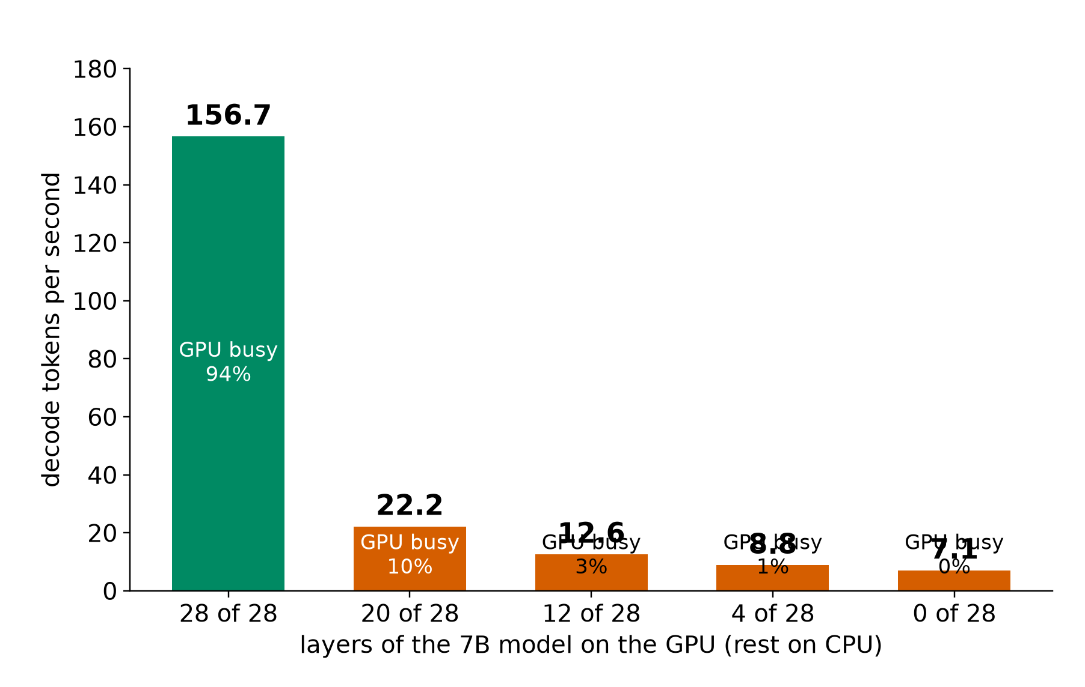
EVIDENCE: VECTORS
Layers left on the CPU drop decode from 156.7 to 22.2 tok/s
• 28 of 28 layers on the GPU: 156.7 tok/s, GPU busy 94%
• 20 of 28: 22.2 tok/s, 10% busy: the PCIe copy dominates
• 12, 4, 0 of 28: 12.6, 8.8, 7.1 tok/s
• A vector dimension for memory placement: GPU-resident vs host-resident
• On a unified-memory GB10 the PCIe step is absent, so this dimension needs a re-measure
Test machine (RTX 5070 Ti): sources/2026-10-16-shared-gpu/report.md (table B.3, partial offload, 7B decode)
12
Notes:
TIME 0:45
SAY: Main points:
- Memory placement changes throughput by 22 times for the same model
- The PCIe cliff is a property of discrete GPUs

Slide 13

EVIDENCE: INTERACTION
Who slows whom: heavy GPU jobs slow LLM decode about 2x
• How to read: each row is a task, each column the task running beside it. x2.08 means the row task took 2.08 times as long as alone
• LLM decode slowed x2.08 beside CNN training and x2.27 beside another LLM
• CNN training slowed only x1.16: its long GPU steps hold the GPU, so decode loses its turn
• Speech-to-text and NVENC barely moved (x0.98 to x1.12): they use almost no GPU
• So what: pair heavy GPU jobs with light ones, not with each other
• Repeats: 2 per pair, 8 for LLM beside LLM; x1.7 to x2.4 for LLM beside training
Test machine (RTX 5070 Ti): sources/2026-10-16-shared-gpu/report.md (Fig. 6, table B.2)
13
Notes:
TIME 1:15
SAY: Main points:
- Four task types, every pairing, each compared with its own solo run
- LLM decode issues very short kernels with pauses between tokens, so it loses its turn to long training kernels
- Speech-to-text and NVENC leave the GPU almost idle, so they cost little beside anything
- The practical rule is to pair heavy GPU jobs with light ones
Supplemental points:
- Spread between runs is large for LLM beside training: x1.7 to x2.4 over two runs

Slide 14

EVIDENCE: INTERACTION
What sharing looks like: four LLMs make 91% of one alone
• How to read: each bar is the share of a 5 ms slice the GPU spent on this process. Top: one LLM alone. Bottom: the same LLM with three others
• Alone: the GPU works for it all the time, 3.5 ms per token
• With three others: short bursts, 15.8 ms per token
• Together the four make 258 tok/s against 284 for one: 91%. Each gets 22 to 26% of solo speed
• Why: the GPU switches between processes and loses time at each switch. It does not split 25% each
• The trace reads 37% because it includes time switched out
Test machine (RTX 5070 Ti): sources/2026-10-16-shared-gpu/report.md (Fig. 7, table B.1; 63.4 of 283.5 tok/s). Discrete card: the cost may differ on unified memory
14
Notes:
TIME 1:00
SAY: Main points:
- One of four identical LLM processes, kernel trace, 600 ms in 5 ms steps
- The trace reads 37% because a kernel's span includes time it was switched out
- Mean stream makes 63.4 of 283.5 tokens per second, which is 22% (range 22 to 26%), and the four total 91% of one alone
- Each token takes 4.5 times longer and the four together make less than one alone
- Discrete RTX 5070 Ti, not evidence about unified memory
Supplemental points:
- Trace span and device busy are different metrics: 100% alone against 91%

Slide 15


EVIDENCE: INTERACTION
Copies lose to batching: 258 vs 614 tok/s, 8.9 vs 2.5 GiB
1 request: 284 tok/s separate, 274 batched. 2: 250 vs 406. 4: 258 vs 614. 8 batched: 1,417 (5.6 ms/token, faster per token than 4). Each separate process holds its own weights; a batch reads weights once for every request
Implication: serve each model from one batching process; model copies multiply memory on the shared pool
Test machine (RTX 5070 Ti): sources/2026-10-16-shared-gpu/report.md (table B.1; qwen2.5 3B, 256 tokens)
15
Notes:
TIME 1:00
SAY: Main points:
- Four separate processes take turns and make less than one process
- One process batching four requests makes 2.4 times the output in less than a third of the memory

Slide 16
EVIDENCE: INTERACTION
Busy GPU: cgroups, memory and kernel traces split per process; counters are whole-GPU
Level | Measures | Isolated to one task while sharing?
Container | CPU time, RAM peak, I/O, out-of-memory events (cgroup v2) | Yes, exactly
Process | GPU memory per process; every kernel and copy (CUPTI) | Yes; kernel duration includes time the GPU spent on others
Device | GPU utilization, power, clocks, SM, tensor, DRAM and PCIe counters | Whole GPU; equals the task when it ran alone
• Per-process kernel traces give each process's time share of the GPU in any busy window
• Solo runs give each process's vector (the device counters of its quiet-window run)
• Shares and vectors together apportion the whole-GPU counters across processes (next slides)
• Measurement stack: cgroups and NVML every 100 ms; Nsight Systems kernel traces and counters at 10 kHz; one counter session at a time; GPU lock held per run; idle floor 17 W unobserved, 27 W profiled
Test machine (RTX 5070 Ti): sources/2026-10-16-shared-gpu/report.md (appendix A.2 and A.3)
16
Notes:
TIME 1:15
SAY: Main points:
- Three measurement levels with different isolation under sharing
- Time share comes from per-process traces and is available in busy windows
- Vectors come from quiet runs, so the two combine into per-process attribution

Slide 17

EVIDENCE: SIMULATION
Time-split blend: device usage = floor + sum of (solo - floor) x share / solo busy
Measured vs blend vs sum for 3 pairs x 5 counters. LLM+LLM at 51% / 49% share: SMs active 72.3 measured, 91.4 blend, 100 sum; DRAM read 52.4, 67.1, 100. LLM+NVENC at 85% / 0%: SMs 75.3, 77.6, 84.2
Test machine (RTX 5070 Ti): sources/2026-10-16-shared-gpu/report.md (table B.6; formula appendix A.5)
17
Notes:
TIME 1:15
SAY: Main points:
- The blend takes each task's solo reading minus the idle floor, weights it by the task's GPU time share divided by its solo busy fraction, and adds the floor back
- Sum adds the solo readings
- The blend sits close to measured in all three pairs

Slide 18

EVIDENCE: SIMULATION
Blend error 4.0 pp mean vs 16.0 pp for the sum; better in 12 of 15 cells
• LLM + CNN training: blend 2.8 pp, sum 21.8 pp
• LLM + LLM: blend 8.4 pp, sum 22.5 pp
• LLM + NVENC: blend 1.0 pp, sum 3.7 pp
• Switching loss (blend minus measured, DRAM read): 9% LLM+training, 2% LLM+NVENC, 22% LLM+LLM
• Time shares come from the co-run trace; predicting shares from vectors is the next test (kernel length and fingerprint position are the candidate predictors)
• MPS removes context switches and would separate switching cost from launch queuing and cache refills
Test machine (RTX 5070 Ti): sources/2026-10-16-shared-gpu/report.md (table B.6; errors computed in figs1e.py over 15 pair-counter cells)
18
Notes:
TIME 1:15
SAY: Main points:
- Mean absolute error across all 15 cells: 4.0 percentage points for the blend, 16.0 for the sum
- The residual between blend and measured is the switching cost, 2 to 22% on DRAM read

Slide 19
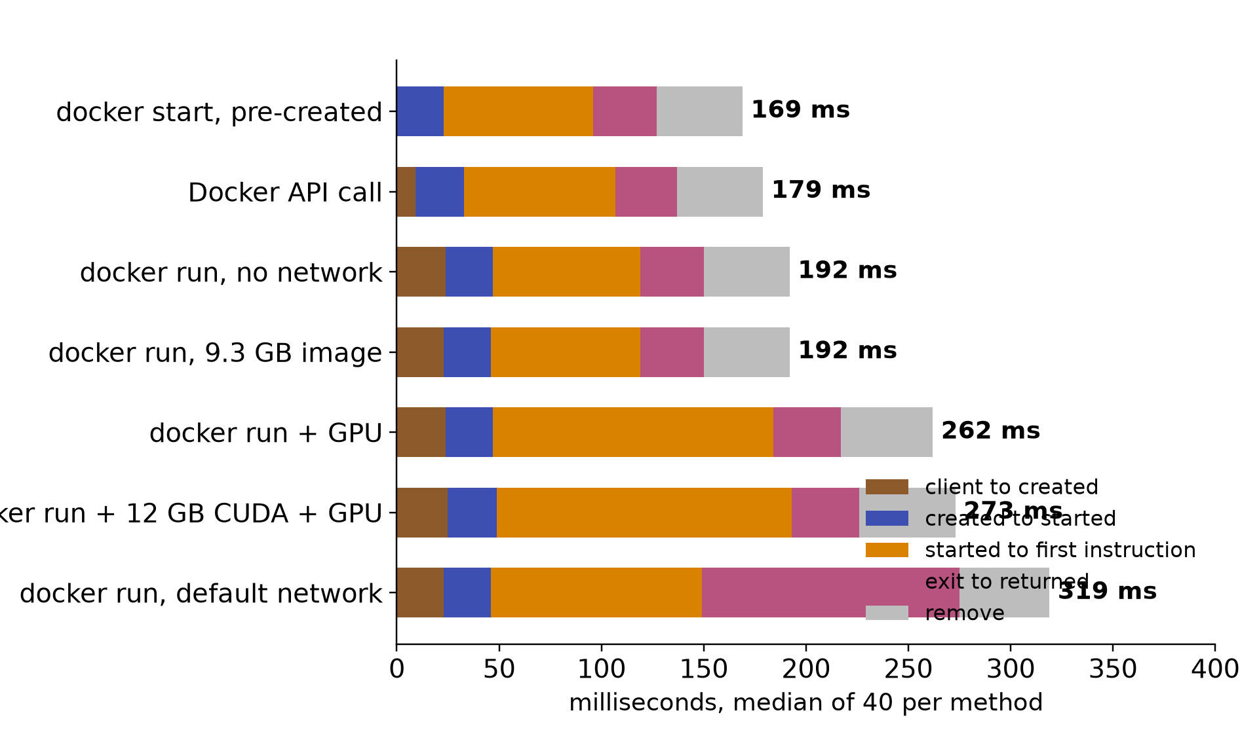
EVIDENCE: RUNTIME
Container start: 3 ms native, 49 ms exec, 219 ms with GPU
• Phases (ms): client to created 24; created to started 23; started to first instruction 72 (no network), 103 (default network), 137 (GPU), 144 (12 GB CUDA image + GPU); exit to returned 31 to 126; remove 42 to 47
• GPU access adds about 65 ms before the first instruction
• Default network adds about 30 ms there and 95 ms on exit
• Image size leaves the median unchanged (9.3 GB: 153 ms)
Test machine (RTX 5070 Ti): sources/2026-10-16-shared-gpu/report.md (table B.8; 40 shuffled starts per method)
19
Notes:
TIME 1:00
SAY: Main points:
- Most start time sits between started and the first instruction
- GPU access and the default network each add a fixed amount

Slide 20

EVIDENCE: RUNTIME
Bursts slow each start; overhead grows with a real task
1 start 152 ms; 4 at once 191; 8 at once 263; 16 at once 423 (2.8x). Overhead with a 340 ms task: exec +48, start +146, API +170, run no network +174, run + GPU +245, run default network +293 ms
Test machine (RTX 5070 Ti): sources/2026-10-16-shared-gpu/report.md (table B.8 and burst measurements; 1,760 starts in total)
20
Notes:
TIME 1:00
SAY: Main points:
- Launching 16 containers together makes each start 2.8 times slower
- Overhead is +216 ms empty and +245 ms with a 340 ms task for GPU containers

Slide 21

EVIDENCE: RUNTIME
Four cheap runtime levers show up in the data
1 Weights stay in GPU memory, so no reload. 2 Compiled GPU code is reused, not rebuilt. 3 One process reads the weights once for many requests. 4 A warm container skips startup. None needs the GB10 to act on; model quality for routing is not measured
Test machine (RTX 5070 Ti): sources/2026-10-16-shared-gpu/report.md (tables B.1 and B.8). Shapes should carry to other machines; milliseconds depend on the CPU
21
Notes:
TIME 1:15
SAY: Main points:
- Keep models loaded: first token takes 6.1 s from disk, 2.7 s from RAM, 0.05 s when resident
- Share the GPU-code cache across containers: a fresh container took 64 s without it and 5 s with it
- Batch requests in one process instead of one process per request: 614 against 258 tokens per second, and 2.5 against 8.9 GiB
- Reuse warm containers for short tasks: 49 ms for docker exec against 219 ms for docker run with the GPU
Supplemental points:
- On the GB10 the memory-related levers may behave differently, see the caveat slide
- Batch 8 gave 1,417 tok/s and is flagged for a recheck

Slide 22
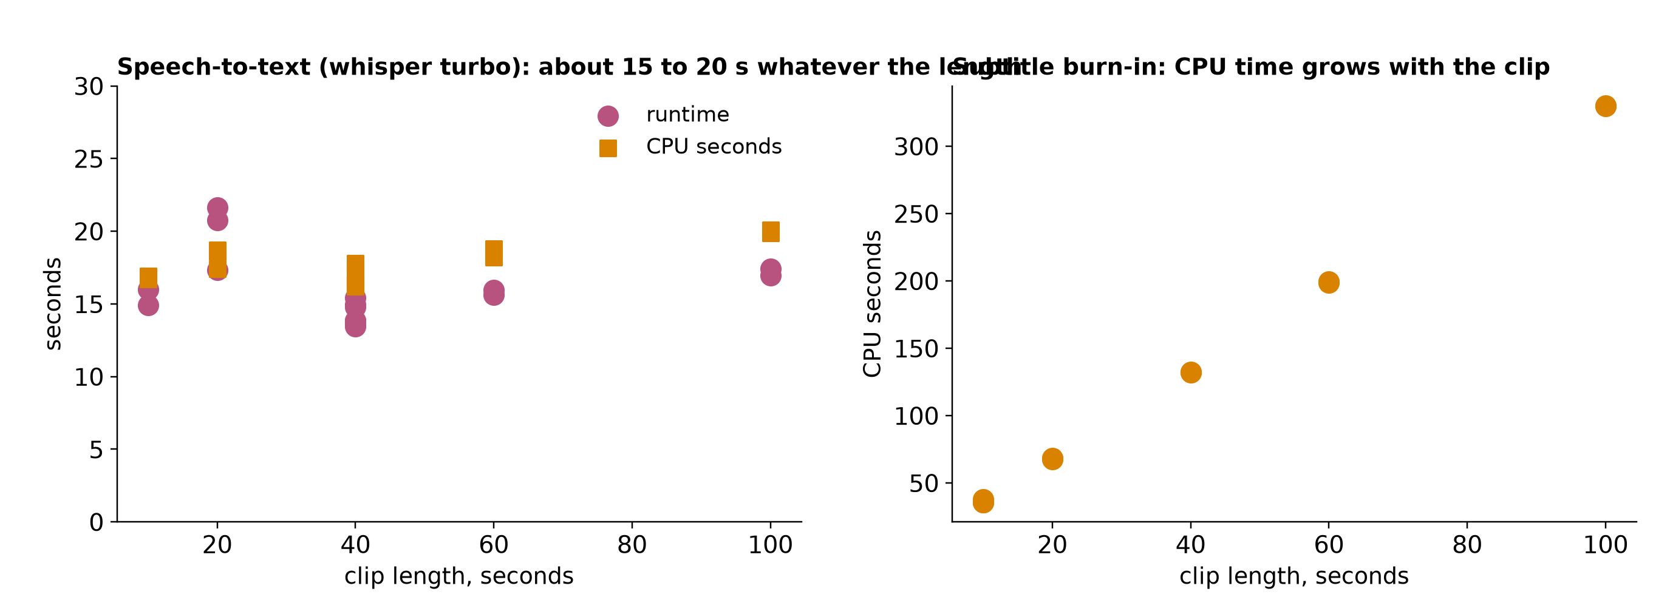
EVIDENCE: RUNTIME
Speech: 14 to 21 s at any clip length; subtitles: 3.3 CPU-s per video second
Whisper turbo at 10, 20, 40, 60, 100 s clips: 13.5 to 21.6 s, GPU busy 3%. Burn-in CPU seconds: 36 (10 s clip), 68 (20 s), 132 (40 s), 199 (60 s), 330 (100 s), all on the CPU encoder. A resident speech worker removes most of the node time; GPU encoding frees the CPU
Test machine (RTX 5070 Ti): sources/2026-10-16-shared-gpu/report.md (video pipeline nodes used as stand-ins for agent work nodes; 1080x1920)
22
Notes:
TIME 1:00
SAY: Main points:
- Speech time is startup-bound and the GPU stays near idle
- Subtitle encoding is CPU-bound and grows linearly with clip length

Slide 23
EVIDENCE: SIMULATOR DATA
Per-run records hold every kernel and copy, solo and shared, aligned kernel for kernel
Record | Fields
node | run_id, workload, params (model, phase, tokens)
hardware | GPU name, driver, VRAM total
isolation | concurrent_with_runs; interference_vs_solo: slowdown 1.72, kernel_stretch 1.65 (run 254, three concurrent)
timing, resources | container_s, gpu_window_s; cpu_time_s, ram_peak, vram_peak, power mean, energy
kernels | name, category, start_us, dur_us, grid, block, stream, regs_per_thread, shared_mem_bytes
copies | kind (h2d, d2h), start_us, dur_us, bytes, stream
• 353,970 kernels in one traced task; identical runs launch identical sequences
• Ledger 6.9 MB (100 ms samples); 11 CSV tables 2.3 MB; per-node traces 45 MB (Perfetto); Nsight reports 20 GB
• Samples: cgroup and NVML at 100 ms; GPU counters at 10 kHz; kernel timeline at 10 ms
• Rebuild with gauge dataset and gauge trace-export
Test machine (RTX 5070 Ti): sources/2026-10-16-shared-gpu/report.md (appendix A.6)
23
Notes:
TIME 1:00
SAY: Main points:
- The trace record carries launch shape, registers and shared memory per kernel
- Solo and shared traces of the same task line up, which makes simulator checks direct

Slide 24
EVIDENCE: SIMULATOR DATA
What a GPU simulator can take from the data, and what extra input it needs
Simulator input | In the data | Source
Kernel sequence with duration and launch shape | Yes: 353,970 kernels for one task | Nsight Systems / CUPTI
Shared-run kernel stretch per kernel | Yes: solo and shared traces for pairs | X5, X7
Device counters over time | Yes: SM, issue, tensor, DRAM read and write at 10 kHz, one session at a time | Nsight counters
Time shares per process | Yes: from each task's own trace | per-process kernel trace
Memory per process, CPU, I/O | Yes: 100 ms samples | NVML, cgroup v2
Instruction dependencies and memory-access pattern | Extra input: separate profiler pass per kernel | Nsight Compute
Hardware what-if (bandwidth, cache, clocks) | Extra input: controlled-change runs | power and clock caps, working-set sweeps
Vectors plus time shares drive the shared-GPU simulation now; a cycle-level GPU simulator adds instruction and memory-access traces
report.md appendix A.6 and Open questions; experiment-agent-brief.md (simulator inputs); Accel-Sim, ISCA 2020; Chakra, 2023
24
Notes:
TIME 1:00
SAY: Main points:
- Kernel timelines, counters and shares cover the blend simulator
- A cycle-level simulator such as Accel-Sim also takes instruction and memory traces

Slide 25

GB10
On GB10 the GPU shares one pool and dashboards go blind
NVIDIA DGX Spark hardware and known-issues pages; NVIDIA developer blog, Maximizing Unified Memory Performance in CUDA; copy speeds: Test machine (RTX 5070 Ti): sources/2026-10-16-shared-gpu/report.md
24a
Notes:
INSERT: optional slide; delete or hide it and the talk flows unchanged
TIME 1:15
SAY: Main points:
- Discrete card: VRAM is a number and PCIe copies are measurable
- Unified Memory on a discrete card migrates pages on demand, its cost was not measured
- GB10: 128 GB LPDDR5x at 273 GB/s shared by CPU, GPU and OS
- NVIDIA documents nvidia-smi Memory-Usage as Not Supported on iGPU, read MemAvailable instead
- The numbers come from the discrete card and do not transfer
Supplemental points:
- Cross-machine differences cannot be credited to unified memory alone

Slide 26
GB10
The GB10 differs: what may change, what is unknown
Finding | Measured on discrete card | On the GB10 | Status
Decode is bandwidth-bound | 7B at 87 to 96% of measured ceilings | Ceiling lower, shared with CPU | Expected to carry over
Batching beats separate processes | 614 vs 258 tok/s | Same weight-reuse argument | Expected to carry over
CPU work takes GPU bandwidth | Not applicable, separate memory | Likely the main new interference | Untested
Process switching cost | 2 to 22% of GPU work lost across 3 pairs (DRAM read) | Needs remeasuring | Unknown
Model load | First token 6.1 s disk, 2.7 s RAM, 0.05 s resident | May converge, no PCIe copy | Unknown
Partial CPU offload | 7B with 20 of 28 layers on the GPU: 157 down to 22 tok/s | PCIe cliff goes away | Unknown
Memory accounting | 16 GB dedicated. File cache charged to the first container that reads it | 128 GB shared. Whether cgroups see GPU allocations is unproven | Unknown
GB10 = one 128 GB LPDDR5x pool, 273 GB/s, shared by CPU, GPU and OS; nvidia-smi shows Memory-Usage Not Supported (NVIDIA DGX Spark docs)
Test machine (RTX 5070 Ti): sources/2026-10-16-shared-gpu/report.md, Limits section; NVIDIA DGX Spark hardware and known-issues pages. Nothing here is measured on a GB10
25
Notes:
TIME 0:45
SAY: Main points:
- Everything measured so far is x86 with a separate GPU over PCIe
- Shapes of bandwidth-bound decode and batching should carry over, absolute numbers will not
- CPU work competing for GPU bandwidth is the main new effect and has no test yet
- Switching cost, load times and offload need a GB10 run before anyone relies on them
Supplemental points:
- Cross-machine differences cannot be credited to unified memory alone

Slide 27
GB10
What the GB10 exposes: tools and what each splits per process
Tool | Split per process while others run? | Limit
nvidia-smi | Memory yes. Utilization only where pmon supports it | GB10: Memory-Usage Not Supported
DCGM (NVIDIA datacenter monitor): profiling, job stats, MIG | Profiling counters no: whole device. Job stats and MIG partly, GB10 unknown | 1 Hz default, conflicts with Nsight
Nsight (timeline and per-kernel profilers) | Yes, but kernel durations include time spent on others | Intrusive, replay perturbs the run
cgroups (Linux per-container accounting) | Yes | Host CPU, memory, I/O only
The SM, tensor and DRAM counters need the GPU alone. Process memory and cgroup data split under sharing. Kernel times split too, but inflated by time spent on others
Terms: SM = streaming multiprocessor (GPU compute block). MIG = GPU partitioning. pmon = nvidia-smi per-process monitor. Quiet window = nothing else uses the GPU
NVIDIA DCGM user guide (feature overview); DGX Spark known issues; gb10-profiling-plan.md:29-31; report.md:285-287
25a
Notes:
INSERT: optional slide; delete or hide it and the talk flows unchanged
TIME 1:15
SAY: Main points:
- DCGM says its profiling counters are device-level and conflict with Nsight
- Per-process memory and kernel timelines survive sharing, but kernel durations include time the GPU spent on others (report.md:286)
- So the quiet window is for SM, tensor and DRAM counters, not for everything
- DCGM job statistics and MIG might give more attribution, the Spark preflight decides
Supplemental points:
- Clouds attach pod labels to DCGM metrics, but the counters stay device-wide

Slide 28
PRECEDENT
Closest precedent: MuxFlow profiles solo, predicts shared speed
Who | How they share | Uses solo profiles? | Lesson
NVIDIA time-slicing | Replicas take turns; no memory or fault isolation | No | Matches the measured turn-taking loss
NVIDIA MIG | Hardware partitions with static profiles | No | Preflight on the GB10
MuxFlow (paper; 'CompanyX', 20,000+ GPUs) | MPS space-sharing of online and offline jobs. xCUDA limits offline memory and kernel launches; SysMonitor evicts offline jobs if online suffers | Yes: offline job profiled for a few iterations; a small MLP per GPU type predicts shared speed; matching picks pairs | The same idea, at scale, for inference on T4 GPUs
Alibaba cGPU | Per-container GPU memory and compute isolation | No | A quota, not a prediction
MuxFlow's 26% to 76% GPU utilization is from sharing plus protection in production. The predictor and matching were tested on 1,000 T4 GPUs (4.0x utilization) and in simulation. Inference, not agents
MuxFlow, arXiv 2303.13803 (read in full); NVIDIA GPU Operator docs (time-slicing, MIG); Alibaba Cloud ACK cGPU docs. Last column is a reading
26
Notes:
TIME 1:15
SAY: Main points:
- MuxFlow has an online class for latency-critical inference and an offline class for best-effort jobs, and shares each GPU between them with NVIDIA MPS
- Protection has two levels: xCUDA caps offline memory and delays offline kernel launches, and SysMonitor evicts offline jobs if the GPU state threatens online ones
- For scheduling it profiles each offline job alone for a few iterations, a small neural network predicts shared speed from solo features, and a matching algorithm picks pairs
- That is the same idea as profiling alone and predicting shared behavior, so it is the closest precedent for the idea explored here
- Production numbers are for sharing plus protection only, the predictor and matching were evaluated on a testbed and in simulation
Supplemental points:
- Testbed: 125 machines, 1,000 T4 GPUs; claims up to 90% of GPU resources oversold to offline work and 4.0x utilization, 4.7x SM activity, 1.5x memory
- Production: more than 20,000 GPUs, four weeks, online latency up by under 10 ms, daily error devices 0.9% against 0.7% for online-only
- 99% of propagated MPS errors came from SIGINT and SIGTERM, handled by a graceful exit
- The paper does not name the company, it says CompanyX

Slide 29
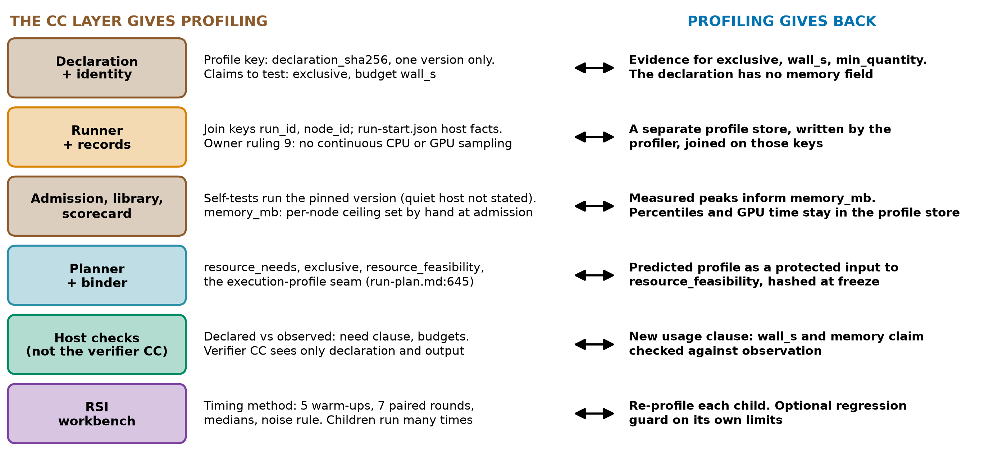
AI4RESEARCH
The CC layer and profiling feed each other
design-package/reference/declaration.md, reference/derived-records.md, reference/run-plan.md:645, checking/README.md:29, side-systems/rsi-workbench.md:174
27
Notes:
TIME 1:30
SAY: Main points:
- The declaration identity, declaration_sha256, would be the profile key, so a profile belongs to one version
- The runner records join keys and host facts, but owner ruling 9 rules out continuous GPU sampling in run capture
- Admission self-tests run the pinned version, and memory_mb is set by hand today
- The planner has an execution-profile seam, a prediction would need a new protected input
- Host checks can compare declared with observed. The verifier capsule cannot, since it sees only declaration and output
Supplemental points:
- The declaration can name gpu_device exclusive and has wall_s, but no memory or GPU quantity field
- RSI timing: 5 warm-ups, 7 paired rounds, medians, more than 3x calibrated noise

Slide 30
NEXT
Next steps: vectors for real capsules, GB10 validation, simulator capsule
Step | Action | Result
1 Vectors for capsules | Run each capsule solo in a quiet window; store the vector with the version | Vector library covering the capsule set
2 GB10 probe | DCGM, Nsight, MIG, cgroups; memory accounting under unified memory; PCIe-free offload | Which dimensions the GB10 can record
3 Blend on GB10 | LLM decode beside a CPU memory-streaming job, beside training, beside LLM; MPS vs time-slicing | Blend error and switching cost on the target
4 Share prediction | Predict time share from vector features (kernel length, fingerprint) on held-out pairs | Prediction before launch
5 Simulator capsule | Vectors and shares in, per-process and device usage out | Planner and router input
6 Schema | Resource-profile section in the declaration; admission profile run; host check | Profiling-aware capsules
7 Local models | Residency, batching and quality per local model on the Spark | Router design
Order follows cost: steps 1 and 2 need no new tooling beyond the existing profiler and probes
report.md Open questions; gb10-profiling-plan.md phases A to D; sidecar/README.md and owner-rulings.md (capture boundaries)
28
Notes:
TIME 1:00
SAY: Main points:
- Vectors for the real capsule set come first, then the GB10 probe
- The blend gets validated on GB10 pairs before it drives any placement

Slide 31
NEXT
Chip questions: what would be needed, much later
Question for a chip team | Controlled change needed | Output
How much does bandwidth matter? | Working-set and context sweeps; memory clock if exposed | Slope with interval
How much does compute matter? | Power cap, GPU clock, MPS thread percentage as an SM proxy | Slope with interval
Does CPU work take GPU bandwidth? | CPU streaming job beside decode | Slowdown curve
What do agent workloads look like? | Replay real capsule traces: bursts, tool waits, model swaps | Duty cycles
Why here: the long-term aim is to inform chips for agentic systems. Known already: decode is bandwidth-bound. New would be the agent mix and the shared pool. Simulator fidelity on unified memory is unverified
gb10-profiling-plan.md:14 (a bottleneck claim needs a controlled change); Accel-Sim ISCA 2020; Chakra 2023
29
Notes:
TIME 0:45
SAY: Main points:
- Solo records on one chip cannot separate bandwidth from compute from capacity
- Each chip question needs a controlled change, and which knobs the GB10 exposes is unknown
- Already known: decode is bandwidth-bound, so the new content is the agent workload mix
- This is far from the first step, it only shows where the work could lead
Supplemental points:
- Chakra is a trace format, Accel-Sim is a simulator, neither has been run here

Slide 32
Appendix
Hardware ceilings, planner toy case, clouds, record schema, sources
Notes:
TIME 0:05
SAY: Main points:
- Backup material

Slide 33
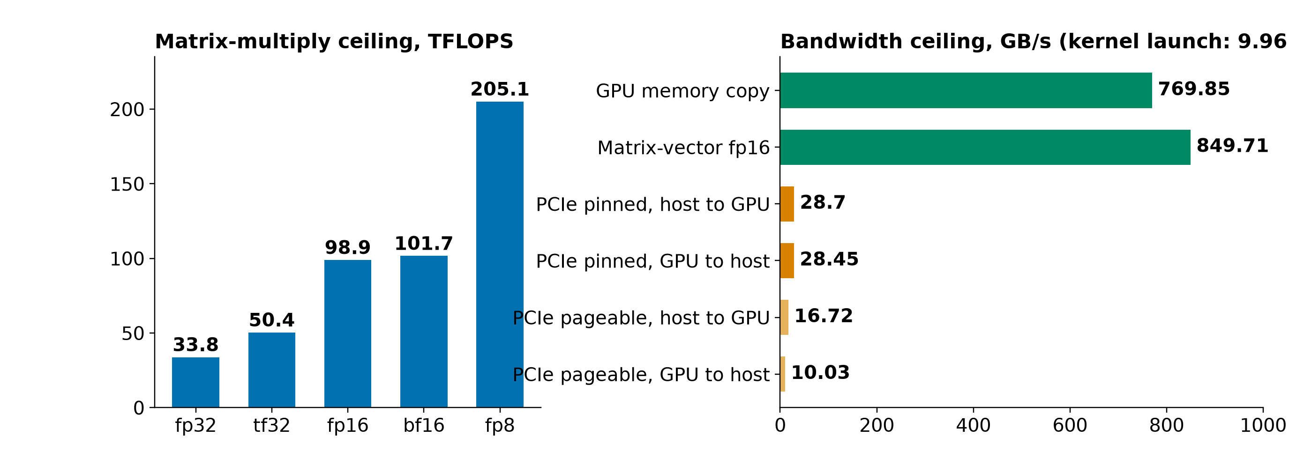
APPENDIX
Machine ceilings: compute by format, memory and PCIe bandwidth
RTX 5070 Ti 16 GB (Blackwell), PCIe Gen4 x16, Ryzen 7 3700X, 46 GiB, driver 595.91.07. Kernel launch 9.96 us. Idle 17 W unobserved, 27 W profiled
Test machine (RTX 5070 Ti): sources/2026-10-16-shared-gpu/report.md (tables A.2 and B.7)
30a
Notes:
INSERT: optional slide; delete or hide it and the talk flows unchanged
TIME 0:30
SAY: Main points:
- Reference ceilings for the test machine

Slide 34
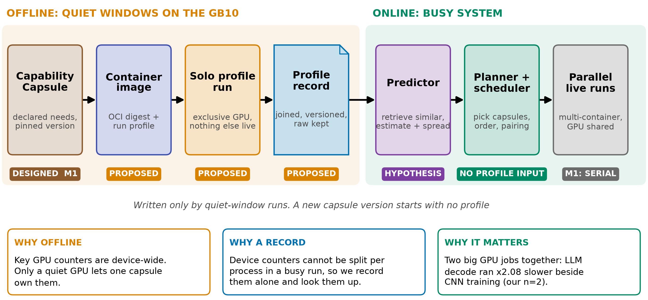
APPENDIX
The idea in one picture
Status: exploratory. Measured so far: one x86 machine (RTX 5070 Ti), imported report, raw traces not yet reviewed. Not done: any GB10 (DGX Spark) run, any predictor
gb10-profiling-plan.md; planner seam: design-package/reference/run-plan.md:645
30b
Notes:
INSERT: optional slide; delete or hide it and the talk flows unchanged
TIME 1:30
SAY: Main points:
- The idea has two halves: record each capsule alone on an idle machine, then use the records when many things run at once
- The reason: key GPU counters cannot be split per process while other jobs run
- The chips on the diagram say what exists: only the capsule declaration exists, the rest is an idea
- Everything measured so far is on a different machine from the DGX Spark
- The point of this talk is to decide what is worth trying first
Supplemental points:
- The sidecar benchmark runner does not cover this profiler (D36, D40)

Slide 35
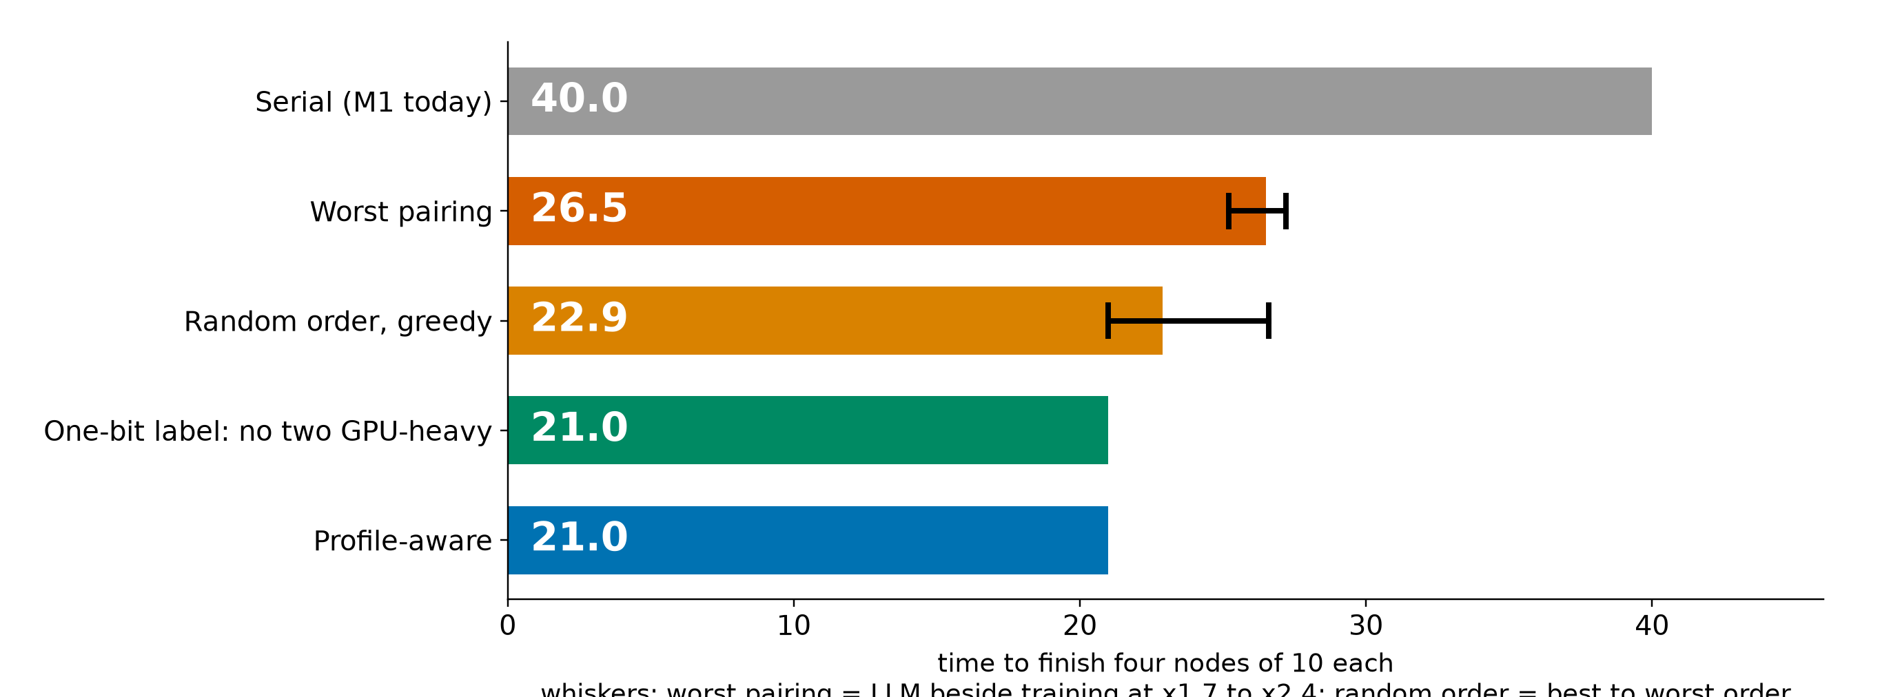
APPENDIX
Toy case: a simple label already finds the best pairing
• A one-bit label (a declared GPU-heavy flag, never two together) already matches profile-aware, if each node's class is known
• Partly by construction: with two GPU classes one flag suffices. Profiles earn their cost with many classes, and for memory and routing
• No benefit in serial M1: this matters only once parallel nodes exist (planner.md:216)
planner_baselines.py: fluid model, two slots, four nodes of 10, n=2 pair slowdowns (RTX 5070 Ti, unaudited)
30c
Notes:
INSERT: optional slide; delete or hide it and the talk flows unchanged
TIME 1:15
SAY: Main points:
- Four nodes of equal length, A LLM, B training, C speech, D NVENC, at most two run at once
- Worst pairing 26.5, random order about 22.9, best 21.0, serial 40
- A one-bit GPU-heavy label picks the best pairing without any profile
- So the planner case for profiles is many classes, memory limits and routing, not this toy. Parallel nodes are outside M1
Supplemental points:
- Whiskers: LLM beside training at x1.7 to x2.4 moves the worst pairing from 25.2 to 27.2
- Orion (EuroSys 2024) co-schedules kernels by complementary resource use

Slide 36
APPENDIX
Routing hypothesis: few models, batched requests
4 separate processes: 258 tok/s and 8.9 GiB. Batched: 614 tok/s and 2.5 GiB. One request alone: 284 separate, 274 batched. Batch 8 is faster per token than 4 (n=2): recheck
First token of a 7B model: 6.1 s from disk, 2.7 s from RAM, 0.05 s resident. On the GB10 the weights come from the shared pool. Model quality is not measured
Test machine (RTX 5070 Ti): sources/2026-10-16-shared-gpu/report.md (B.1, B.8). qwen2.5 3B, 256 tokens. Cold load is for a 7B model
30d
Notes:
INSERT: optional slide; delete or hide it and the talk flows unchanged
TIME 1:15
SAY: Main points:
- Left: separate processes each load their own weights, so memory grows with the number of copies
- Right: one process batching requests makes more tokens per second than several processes
- On the Spark the weights, the experiments and the OS share one pool, so fewer models leave more room
- This suggests the router should prefer a few resident models, and only cost was measured; quality was not
- Routing is behind RouterPort with a fixed route today, so this is an input for later phases
Supplemental points:
- Bandwidth bound for decode is in the appendix
- MPS was not tested

Slide 37

APPENDIX
Where a profile could attach, and where it must not
design-package/reference/run-plan.md:74-80,191,645; reference/declaration.md:41; development-tools/sidecar/README.md:103,107; side-systems/owner-rulings.md:123
30e
Notes:
INSERT: optional slide; delete or hide it and the talk flows unchanged
TIME 1:00
SAY: Main points:
- Five existing places cannot carry a prediction, each for a stated reason in the design
- The landing is a new protected input beside the resource inventory and plan policy, hashed at freeze
- Sidecar README line 107 says no profiling integration or product telemetry, and owner ruling 9 says no continuous CPU or GPU sampling in run capture. So this needs an owner decision
- The execution-profile seam is already named for parallel branches
Supplemental points:
- Sidecar launcher never pauses or preempts a core run

Slide 38
APPENDIX
Checking GPU load: AWS vs DGX Spark
Platform | How you check | What you see | What you cannot isolate
AWS EC2 | CloudWatch agent, nvidia_gpu block | nvidia_smi_utilization_gpu (share of time kernels ran), memory, PCIe, encoder | Which process or model caused the load
AWS EKS | Container Insights, DCGM exporter add-on | node_gpu_utilization, node_gpu_memory_utilization, pod_gpu_utilization | Bandwidth or SM share between pods on one GPU
AWS ECS | Container Insights, Managed Instances | GPU metrics per container, task, instance | Same: time-based, not per kernel
Google GKE | DCGM to Managed Prometheus | 21 metrics incl. tensor, FP, DRAM activity, labelled by pod | Kernel or instruction cause
DGX Spark | nvidia-smi, /proc/meminfo, DCGM if supported, Nsight | Per-process GPU memory. Pool via MemAvailable. Memory-Usage: Not Supported | Per-process bandwidth or SM share, a GPU-only memory number
Example: four LLMs each ran 4.5x slower per token. A time-based utilization number does not show that
AWS CloudWatch GPU, Container Insights EKS and ECS docs; GKE DCGM metrics page; NVIDIA DGX Spark known issues; the report B.1
30f
Notes:
INSERT: optional slide; delete or hide it and the talk flows unchanged
TIME 1:15
SAY: Main points:
- Every cloud path gives device or pod level time-based metrics
- A slowdown from switching does not appear as lower utilization
- On the Spark the pool is read from the OS, GPU memory used and total is not available from nvidia-smi
- Per-process bandwidth and SM share are what cannot be isolated while others run
Supplemental points:
- DCGM profiling on GB10 is a preflight check, not assumed
- EKS enhanced observability needs add-on v6.0.1 or later for the OpenTelemetry path

Slide 39
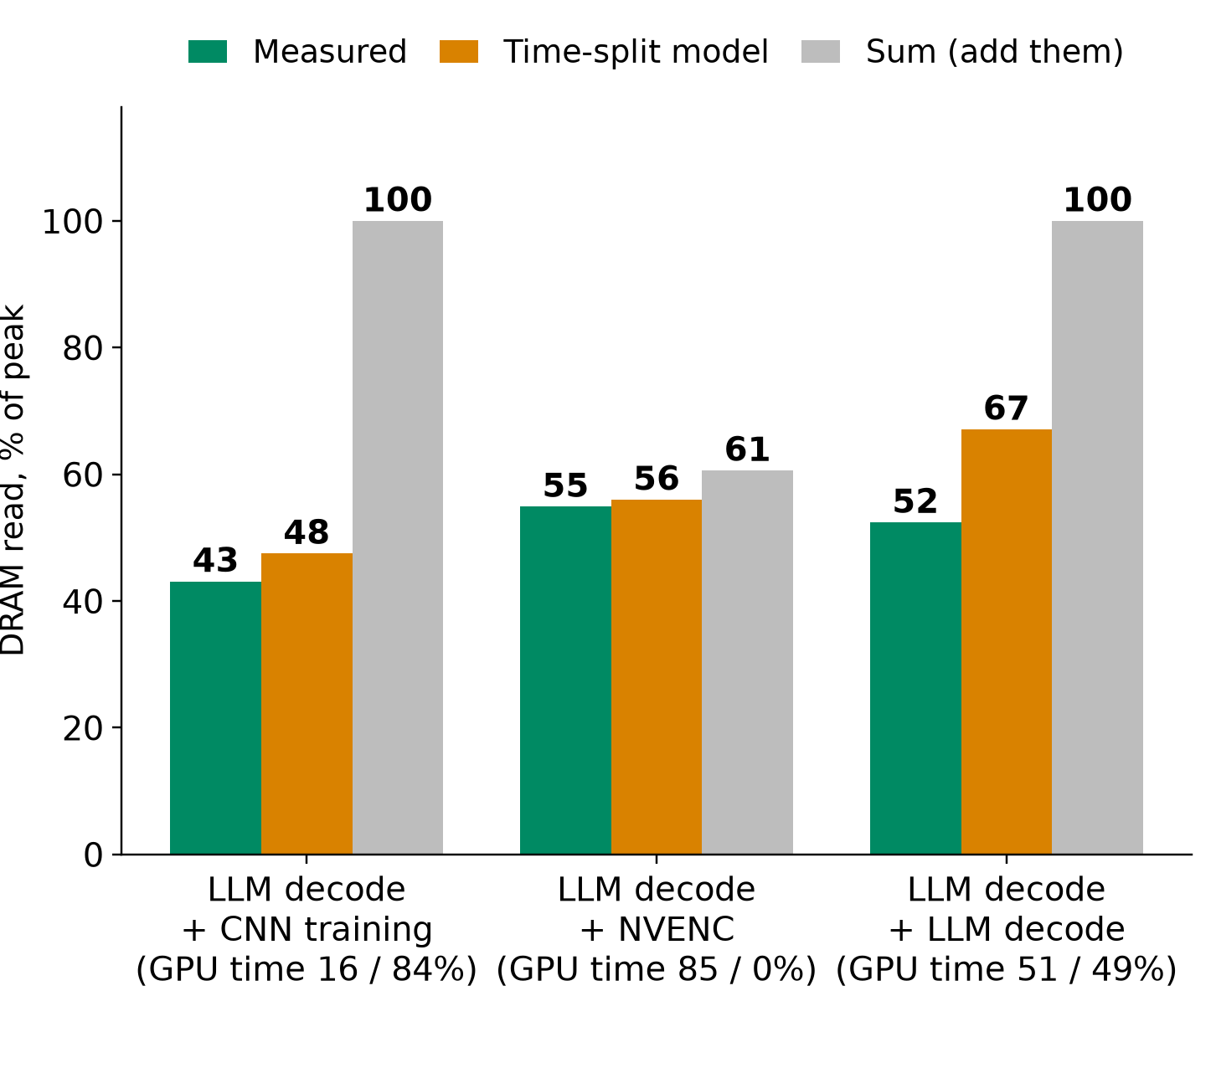
APPENDIX
Time-split model: explains, does not predict
4 separate: 258 tok/s. Batched: 614. Memory 8.9 vs 2.5 GiB. Batch 8 is faster per token than 4 (n=2): recheck
Time-split needs co-run time shares: it explains, not predicts. Share is not slowdown (16% share, x2.08, not x5.7)
Test machine (RTX 5070 Ti): sources/2026-10-16-shared-gpu/report.md (Fig. 2, 3, 4; tables B.1, B.6). DRAM read only. MPS not tested
30g
Notes:
INSERT: optional slide; delete or hide it and the talk flows unchanged
TIME 1:15
SAY: Main points:
- Left: DRAM read bandwidth of A+B measured, from the time-split model, and from summing
- Time-split is close, but its inputs are the time shares, which only exist after the co-run
- The 2 to 22% switching loss is the leftover, computed on DRAM read only
- Right: qwen2.5 3B, 256 tokens, separate processes lose to batching
- NVIDIA MPS exists to cut context switching and GKE offers it, it was not tested
Supplemental points:
- Other counters differ: SMs active for LLM+LLM is 21% off, DRAM write is negative

Slide 40
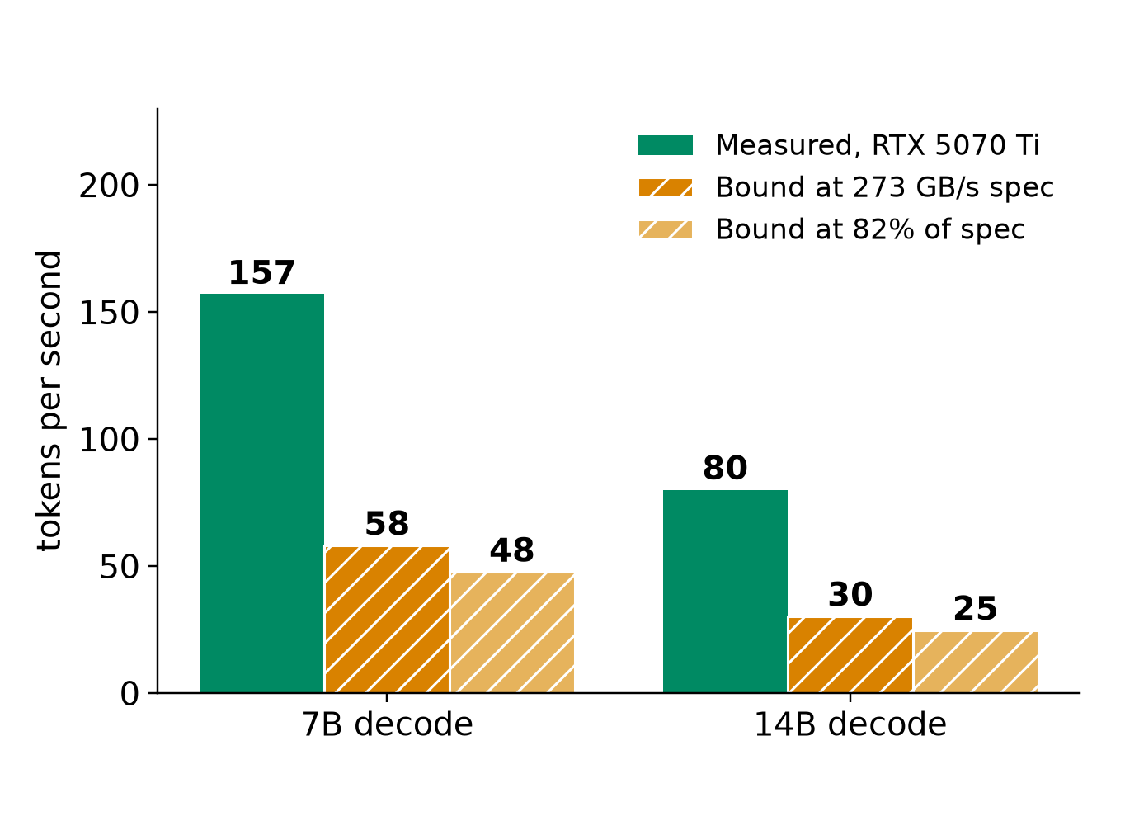
APPENDIX
Decode bandwidth bound at the GB10 spec
• 7B reads about 4.7 GB per token: at most 58 tok/s at 273 GB/s, 48 at the 5070 Ti's 82% efficiency
• 14B reads about 9.0 GB: 30 and 25
• Assumes decode stays bandwidth-bound and CPU traffic is zero
• Batching raises total tokens above this: weights are read once per batch
• An MoE model differs (qwen.code30b: 3.3B active)
Test machine (RTX 5070 Ti): sources/2026-10-16-shared-gpu/report.md (B.3). Bytes per token = model file size = decode GB/s over tok/s. Bound = arithmetic at 273 GB/s, not measured
30h
Notes:
INSERT: optional slide; delete or hide it and the talk flows unchanged
TIME 0:30
SAY: Main points:
- This is arithmetic from the file sizes, not a GB10 measurement

Slide 41

APPENDIX
How a quiet-window run could work (proposed)
The image gives | It lacks | Cost and constraint
Digest as executable identity, repeatable environment | Exclusive GPU, deterministic timing | +216 ms per GPU start (219 total); +245 ms with a 340 ms task
cgroup and PID-tree accounting | Kernel metrics scoped to the container | Window on the single product host (D35). Launcher never preempts
Same packaging unit as the Paper2Agent proposal | Any change to the capsule declaration | Sidecar README:107 excludes profiling integration today
gb10-profiling-plan.md; NVIDIA Container Toolkit; Slurm job arrays; sidecar/README.md:103,107; owner-rulings.md:123; startup: Test machine (RTX 5070 Ti): sources/2026-10-16-shared-gpu/report.md
30i
Notes:
INSERT: optional slide; delete or hide it and the talk flows unchanged
TIME 1:15
SAY: Main points:
- Containers do not make GPU counters per container, the quiet window does
- Prebuild images, run serially, stop on any failed preflight, never preempt a running job
- The GB10 is the only M1 product host, so a window is a scheduling decision
- Keep the Docker socket out of the capsule, the host launcher owns profiler and cleanup
Supplemental points:
- arm64 and amd64 images are different environments and are recorded separately
- AGX Orin study (HiPC 2023) found small container overhead for its setup, so the overhead is measured

Slide 42
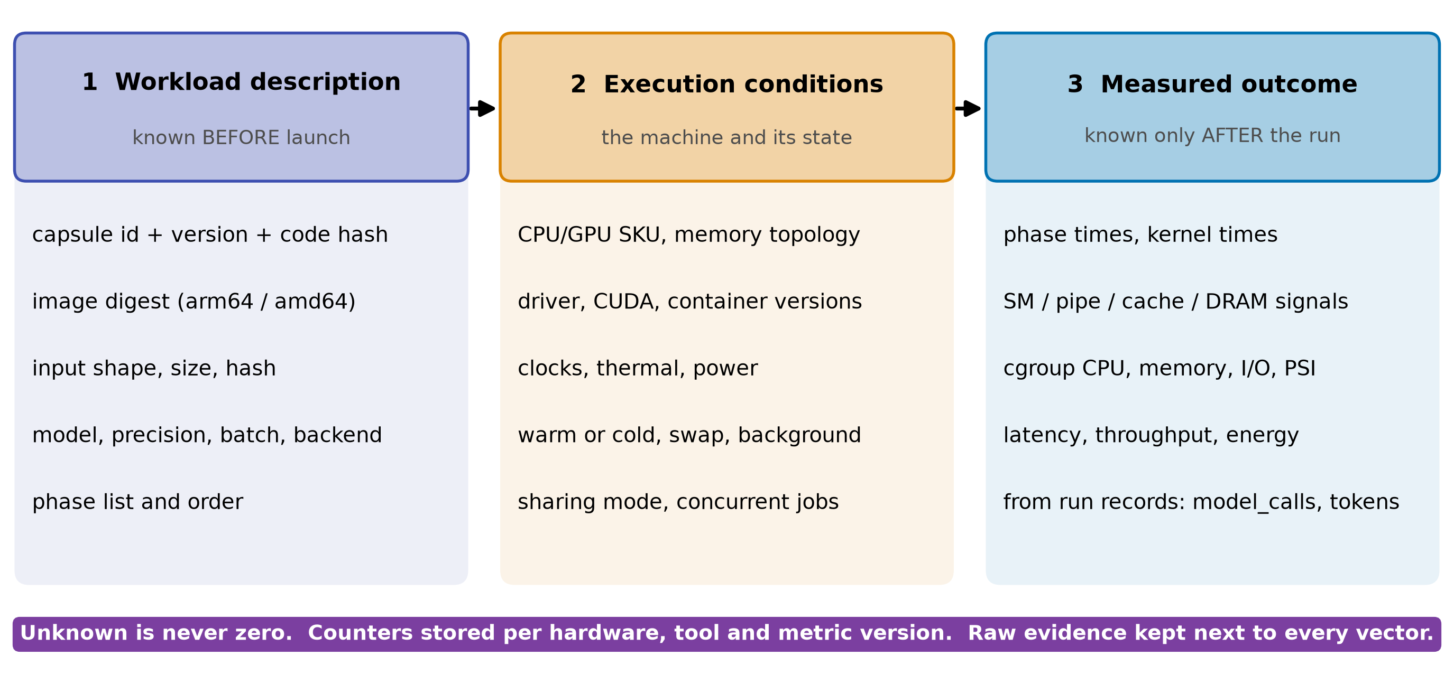
APPENDIX
Three linked records, versioned like the capsule
• Invalidate on: new declaration_sha256, image digest, driver or firmware change
• RSI child: inherits memory_mb, not its profile. Re-profile before use
• Unprofiled capsule: unknown, never zero. Planner falls back to declared exclusive or serial
gb10-profiling-plan.md, future data contract; design-package/reference/declaration.md (declaration_sha256), side-systems/rsi-workbench.md
30j
Notes:
INSERT: optional slide; delete or hide it and the talk flows unchanged
TIME 1:00
SAY: Main points:
- Description is known before launch and is the only input to pre-launch prediction
- Conditions describe the machine, counters are stored per hardware and tool version
- Outcome is after the run and never an input to the same run's prediction
- A new capsule version is a new identity, so its record starts empty
Supplemental points:
- Start with nearest neighbor on understandable features, preserve phase order
- Chakra is a training-trace format, reuse only what maps to capsule phases

Slide 43
APPENDIX
If a predictor is tried later: how it would be tested
Claim | Inputs allowed | Test | Pass if
1 Before launch | Solo features only: kernel median, GPU busy, launch rate, plus DRAM and tensor % if test 1 finds them | Leave one task family out, predict pair slowdown | Beats B0 and B1 on slowdown error and pairing choice, by more than the repeat spread
2 After a short prefix | Plus a bounded profiling run | Same split, report profiling cost | Error falls enough to pay for the prefix
3 Changed hardware | Plus a hardware model | Not tested here | Needs a calibrated simulator
• Baselines: B0 no interference (x1). B1 one-bit GPU-heavy label. B2 nearest neighbor. Time-split with measured shares is an upper bound, not a predictor
• Spread first: LLM beside training varied x1.7 to x2.4 over two runs, so no error target below that is testable. Measure repeat variance, then the planner owner sets the target. Only 4 task families exist today: leave-one-out is a feasibility check, not a statistical test
• Stop rule: if B1 matches on pairing, ship the label and keep profiles for memory and routing
literature/README.md (NeuSight ASPLOS 2025, Orion EuroSys 2024, SoCC 2025); plan Phase D; Test machine (RTX 5070 Ti): sources/2026-10-16-shared-gpu/report.md
30k
Notes:
INSERT: optional slide; delete or hide it and the talk flows unchanged
TIME 1:15
SAY: Main points:
- Three separate claims, never mix a finished run's counters into a pre-launch prediction
- Hold out whole task families and hardware, not repeats of the same run
- Baselines include a one-bit label because the planner example showed it can be enough
- The program has a stop rule, so the funding ask has an exit
Supplemental points:
- The error target is not set: it must exceed the repeat spread
- SoCC 2025 (Elvinger et al.) gives resource-specific sensitivity methods to reuse

Slide 44
APPENDIX
Vendor practices and the data, tagged
Do | Backed by | Avoid | Because
Profile solo in exclusive windows | DCGM profiling conflicts with Nsight (NVIDIA) | Per-container GPU shares from device counters | Counters are device-wide
Key records by declaration hash, image digest, machine | NVIDIA Container Toolkit, OCI; CC identity | Comparing percentages across chips | Utilization is not headroom
Keep phases: startup, cold, steady | Ours, 5070 Ti, GB10 pending: 64 s vs 5 s | One averaged vector per task | Averages hide peaks
Pair by resource class, test against a label | Orion; ours, 5070 Ti, GB10 pending: x2.08 vs x1.02 | Summing utilization | Time-split fits 3 pairs
Batch, do not clone, model servers | Ours, 5070 Ti, GB10 pending: 614 vs 258 tok/s; GKE offers MPS | Treating GB10 memory as VRAM | One pool, no VRAM counter
NVIDIA DCGM, MPS, Container Toolkit docs; Orion EuroSys 2024; GKE MPS guide; Test machine (RTX 5070 Ti): sources/2026-10-16-shared-gpu/report.md
30l
Notes:
INSERT: optional slide; delete or hide it and the talk flows unchanged
TIME 1:00
SAY: Main points:
- Every row names where it is used or measured, and which rows still wait on the GB10
- The avoid column is the failure modes from the literature and from the numbers
Supplemental points:
- Also avoid exhaustive combination sweeps and collecting every counter

Slide 45
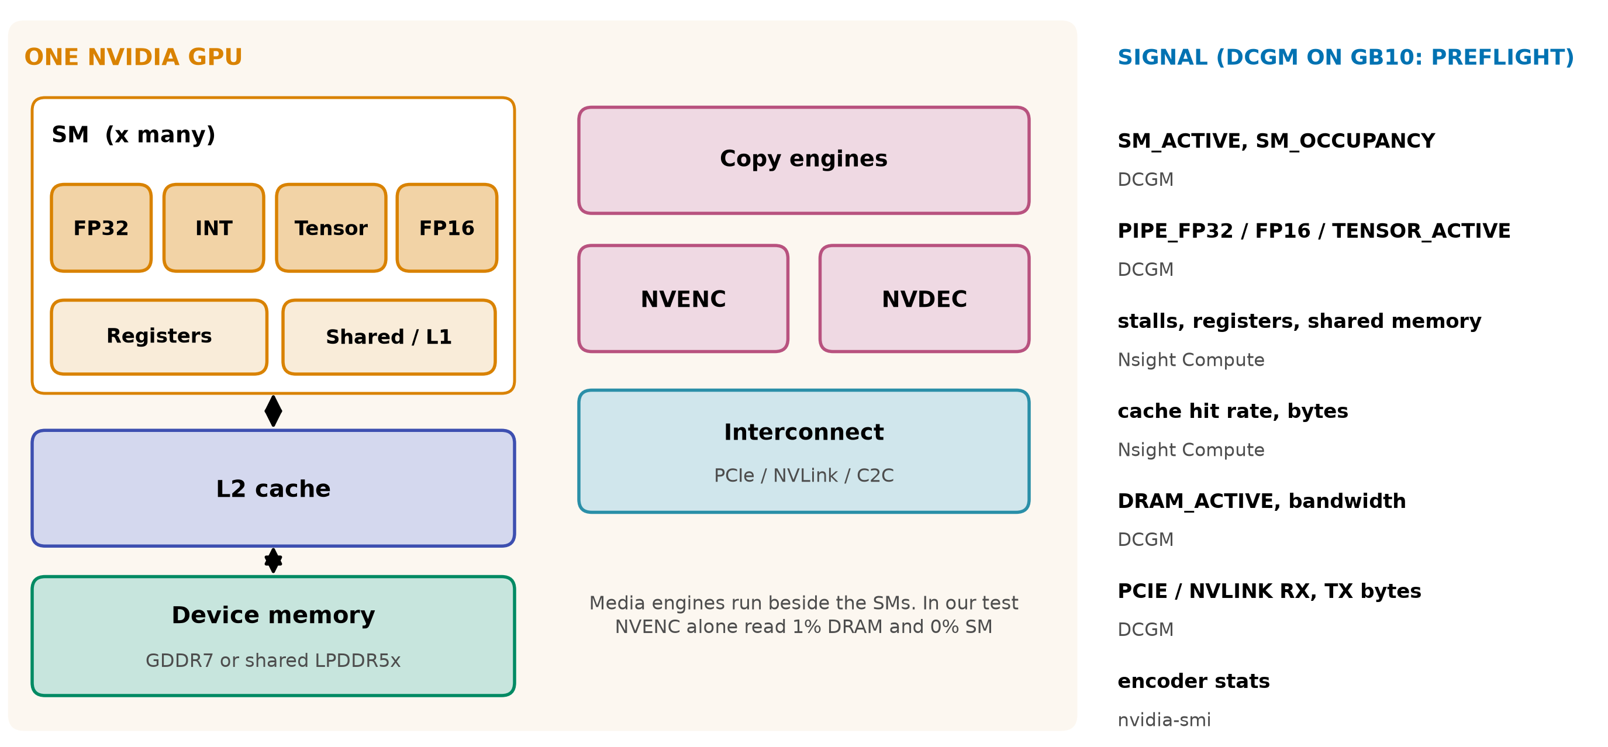
APPENDIX
Six GPU resources, six different signals
NVIDIA DCGM profiling fields; AWS CloudWatch encoder stats; NVENC read 1% DRAM, 0% SM: Test machine (RTX 5070 Ti): sources/2026-10-16-shared-gpu/report.md (B.5)
30m
Notes:
INSERT: optional slide; delete or hide it and the talk flows unchanged
TIME 0:30
SAY: Main points:
- Media engines run beside the SMs, in the test NVENC alone read 1% DRAM and 0% SM

Slide 46
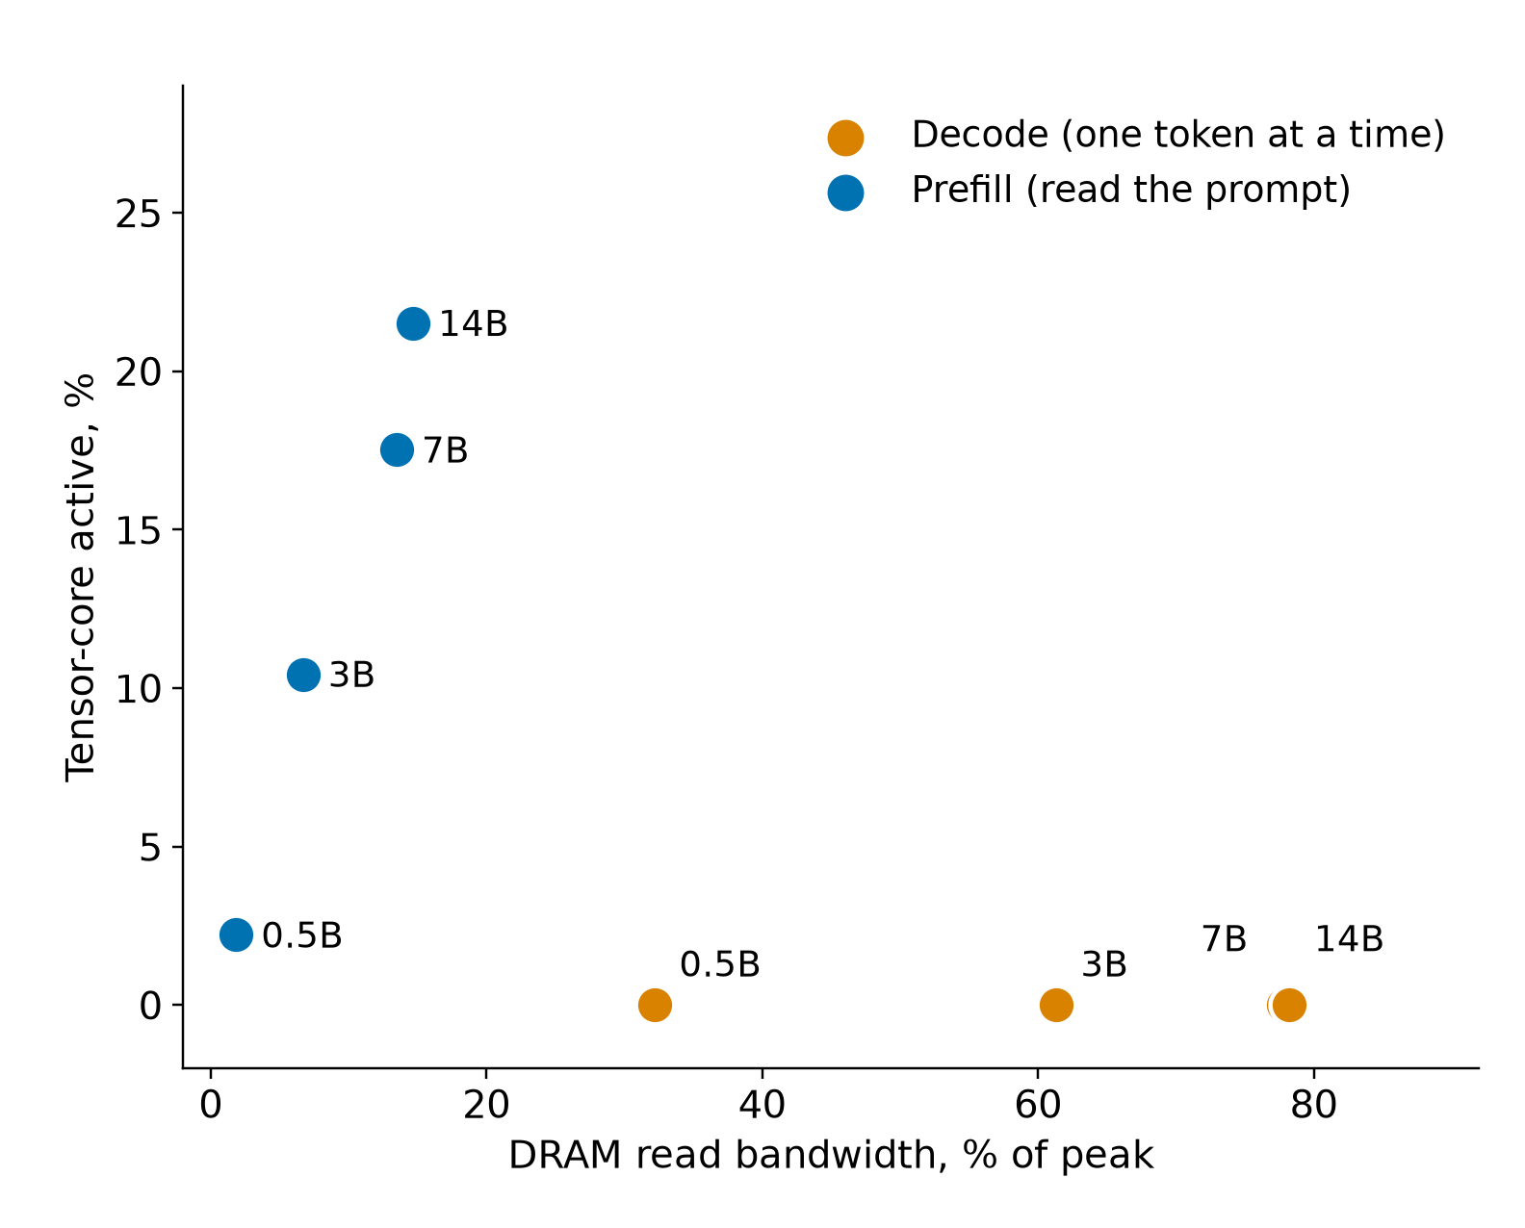
APPENDIX
Decode is memory-bound: 7B reaches 87 to 96% of ceilings
Model | Decode tok/s | Decode DRAM | Prefill tok/s | Prefill tensor
0.5B | 738 | 32% | 31,726 | 2%
3B | 283 | 61% | 10,709 | 10%
7B | 157 | 78% | 6,590 | 18%
14B | 80 | 78% | 3,397 | 22%
• Speech-to-text and NVENC: 0 to 3% on every counter
• 7B partial offload: 157 tok/s all-GPU, 22 at 20 of 28 layers
Test machine (RTX 5070 Ti): sources/2026-10-16-shared-gpu/report.md (Fig. 8, tables B.3 and B.5). Decode GB/s = model file bytes x tok/s; ceilings: 850 GB/s matrix-vector, 770 GB/s copy (B.7)
30n
Notes:
INSERT: optional slide; delete or hide it and the talk flows unchanged
TIME 0:30
SAY: Main points:
- Records need both memory and compute dimensions

Slide 47
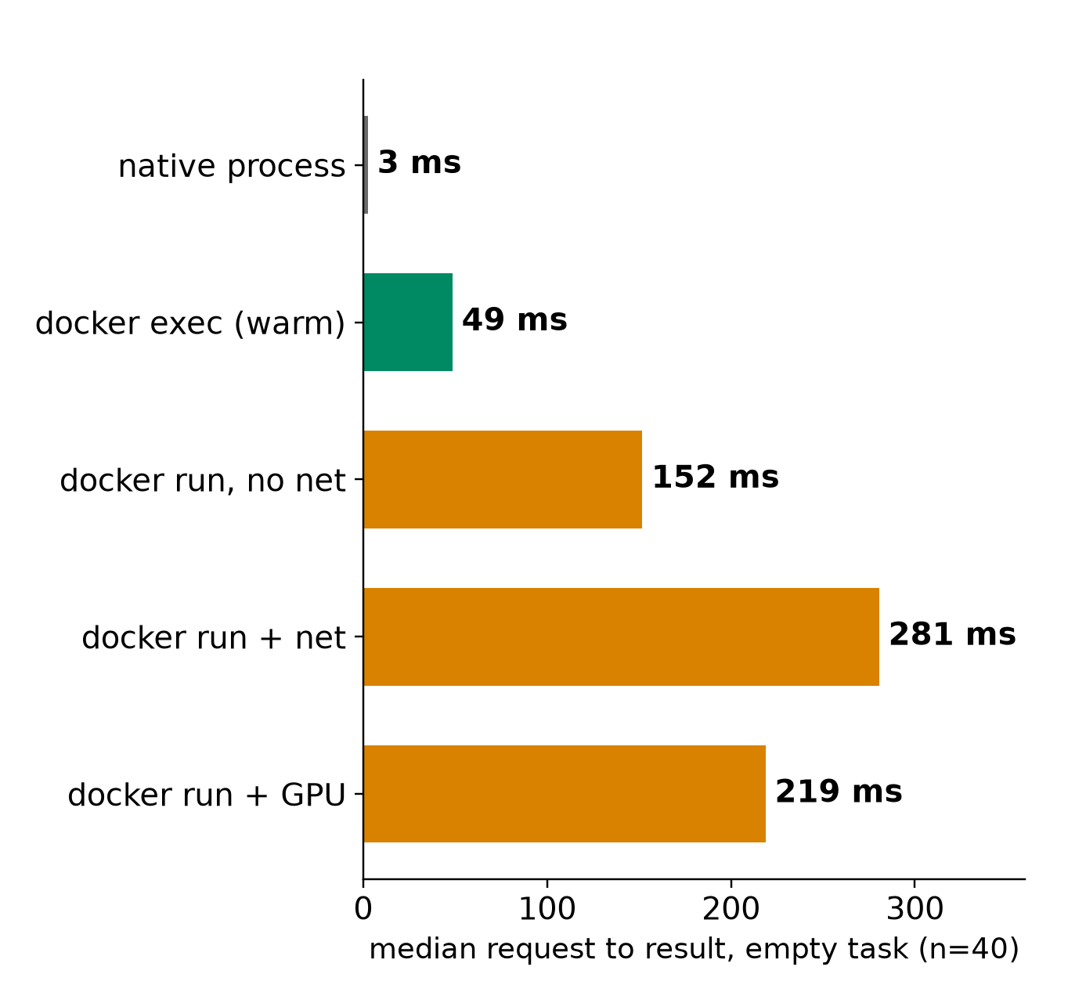
APPENDIX
Startup is its own phase: +216 ms, 64 s vs 5 s
• Overhead per GPU start: +216 ms empty, +245 ms with a 340 ms task
• 16 containers at once: about 2.8x slower each
• Fresh Ollama container: 64.4 s vs 5.3 s with a shared GPU-code cache
• 7B first token: 0.049 s loaded, 2.7 s in RAM, 6.1 s from disk
Test machine (RTX 5070 Ti): sources/2026-10-16-shared-gpu/report.md (Fig. 9 to 13, table B.8)
30o
Notes:
INSERT: optional slide; delete or hide it and the talk flows unchanged
TIME 0:30
SAY: Main points:
- Profile cold and warm separately and label which one a record is

Slide 48
APPENDIX
Clouds collect device metrics; labels need Kubernetes
Provider | Path | What it collects | Attribution
AWS | CloudWatch agent, nvidia_gpu block | nvidia_smi_* utilization, memory, temperature, PCIe, encoder stats | Instance level, needs driver and nvidia-smi
Google GKE | Managed DCGM to Managed Prometheus | 21 metrics: GPU util, SM, FP16/32/64 and tensor pipes, DRAM, PCIe, NVLink, power | container, pod and namespace labels on every metric
Microsoft AKS | DCGM exporter to Managed Prometheus and Grafana | Utilization, memory, temperature, power | Per scrape of GPU node pools
AWS CloudWatch agent NVIDIA GPU page; GKE DCGM metrics page; AKS monitor-gpu-metrics page
30p
Notes:
INSERT: optional slide; delete or hide it and the talk flows unchanged
TIME 0:30
SAY: Main points:
- Same device metrics everywhere
- Only Kubernetes labels give workload attribution

Slide 49
APPENDIX
Prior work: what to reuse, what is still open
Prior work | Reuse | Still open here
Utilization prediction, HotCloud 2020 | Graph features, no per-job profiling | Coarse busy, not per component
NeuSight, ASPLOS 2025 | Tile-level latency across GPUs | Not stress for arbitrary tasks
Orion, EuroSys 2024 | Kernel profiles for sharing | Predicted, not measured, profiles
GPU Resource Interference One Level Deeper, SoCC 2025 | Resource sensitivity methods | Unseen tasks, agent mix
Accel-Sim, ISCA 2020; Chakra 2023 | Simulator; trace format | Calibration on the target
literature/README.md. Links on the source map
30q
Notes:
INSERT: optional slide; delete or hide it and the talk flows unchanged
TIME 0:30
SAY: Main points:
- Reuse code, datasets and trace formats before running new experiments

Slide 50
APPENDIX
What this evidence shows and what it does not
Shows | Does not show
Pairing, batching and cold start effects on one x86 plus RTX 5070 Ti machine | Anything about the GB10 or unified memory
Time-split fits DRAM read on three pairs | That it predicts, or that MPS removes the switching cost (not tested)
Decode is bandwidth-bound across 0.5B to 14B | Prediction accuracy: no predictor built or held out
Container start +216 ms with GPU | Chip-design conclusions: no sensitivity runs
Repeats are small (2 to 12), raw traces and ledger stay on the other machine | NVDEC, NVENC subtitle path, real agent traffic, how much of a real run is local GPU
Test machine (RTX 5070 Ti): sources/2026-10-16-shared-gpu/report.md
30r
Notes:
INSERT: optional slide; delete or hide it and the talk flows unchanged
TIME 0:30
SAY: Main points:
- Everything here was imported from the measuring machine and not independently audited

Slide 51
APPENDIX
Source map
Claim | Source
DCGM device-level profiling, 1 Hz, conflicts with Nsight; job stats | docs.nvidia.com/datacenter/dcgm/latest/user-guide/feature-overview.html
Memory-Usage Not Supported on DGX Spark; GB10 hardware | docs.nvidia.com/dgx/dgx-spark/known-issues.html and hardware.html
GKE DCGM metrics with pod labels; MPS on GKE | docs.cloud.google.com/kubernetes-engine/docs/how-to/dcgm-metrics and nvidia-mps-gpus
AWS CloudWatch NVIDIA GPU; Container Insights EKS and ECS | docs.aws.amazon.com/AmazonCloudWatch/latest/monitoring/CloudWatch-Agent-NVIDIA-GPU.html
AKS DCGM exporter; NVIDIA MPS | learn.microsoft.com/en-us/azure/aks/monitor-gpu-metrics; docs.nvidia.com/deploy/mps/latest/index.html
Orion; SoCC 2025 interference; HotCloud 2020 | anakli.inf.ethz.ch/papers/orion_eurosys24.pdf, gpu_interference_socc25.pdf; usenix.org hotcloud20_paper_yeung.pdf
NeuSight; Accel-Sim; Chakra; HiPC 2023 Orin | doi.org/10.1145/3669940.3707265; doi.org/10.1109/ISCA45697.2020.00047; arxiv.org/abs/2305.14516, 2312.07220
CUDA Unified Memory behavior | developer.nvidia.com/blog/maximizing-unified-memory-performance-in-cuda/
Declaration, records, planner, checks, RSI, sidecar, owner rulings | design-package/reference/*.md, checking/README.md, side-systems/rsi-workbench.md, side-systems/owner-rulings.md, development-tools/sidecar/README.md
Paper2Agent container proposal (packaging unit) | arxiv.org/abs/2509.06917; AI4Research_private_planning/ai4r_muk/paper2agent-reference/06-paper2agent-cc-container-proposal.md
Accessed October 2026. design-package paths are under jiuwenswarm/docs/architecture/
30s
Notes:
INSERT: optional slide; delete or hide it and the talk flows unchanged
TIME 0:10
SAY: Main points:
- Source list

