Slide 1
Exploration notes: tasks sharing one GPU
Informal preliminary results from hands-on testing, to get a feel for the profiling problem and what it implies for scheduling, the planner and capsules
Prelim work: 140 runs, 1,760 container starts, one RTX 5070 Ti machine
Notes:
TIME 0:20
SAY: Main points:
- Informal notes from exploration, not a formal test report
- Purpose: a feel for the problem and what it implies for the program

Slide 2
FRAMING
What this is: exploration to get a feel for the problem
 | Detail
Purpose | Preliminary hands-on testing to see what kind of problem profiling is when LLMs, training, video encode and speech share one GPU
Output | A feel for which effects are large, which are small, and what they imply for the scheduler, planner and capsules
Strength of the numbers | Directional: one machine, 2 to 12 repeats per point, imported report not yet audited
Use | Shapes the design questions; the numbers need a re-measure on the target hardware (GB10)
Companion markdown file keeps the same content as context for later work
Test machine (RTX 5070 Ti): sources/2026-10-16-shared-gpu/report.md
2
Notes:
TIME 0:45
SAY: Main points:
- This is a set of exploration notes
- The aim is to understand the shape of the problem
- Numbers are directional and need a re-measure on the target hardware

Slide 3

TESTS
Tests: 140 runs, 1,760 container starts, one machine
X2 decode vs prefill by model size. X3 each task type alone. X4 batching vs separate copies. X5 every task pair. X6 cold start. X7 idle, A, B, A+B sequences under one counter observer. JIT cache. Start: 1,760 container starts. Repeats 2 to 12 per point; raw traces and ledger stay on the test machine
Test machine (RTX 5070 Ti): sources/2026-10-16-shared-gpu/report.md (appendix A.4 experiment table; run ids 171 to 316; Start experiment 1,760 starts)
3
Notes:
TIME 1:15
SAY: Main points:
- Ten experiment sets: idle floor, hardware ceilings, LLM prefill and decode by model size, training, speech and NVENC, batching versus separate copies, every task pair, cold start, A then B then both sequences, and the GPU-code cache
- 140 measured runs plus 1,760 timed container starts
- Host sampling every 100 ms, GPU counters at 10 kHz, kernel traces from Nsight Systems
- Repeats are small, 2 to 12 per point, so treat single numbers as indicative
- Everything here is one Ryzen 7 plus RTX 5070 Ti machine, not the GB10
Supplemental points:
- Run counts come from the report's run id ranges: X0 6, X1 3, X2 21, X3 8, X4 28, X5 32, X6 6, X7 28, JIT 8
- Repeat agreement: X7 within 0.3 points, X2 throughput within 2%, most pair slowdowns within about 0.1x except LLM beside training (x1.7 to x2.4)

Slide 4
WHAT IT MEANS
Six results and what each means for planning and capsules
Result (evidence) | Measurement | Planning | Capsules | Scheduling
Distinct vectors. Decode 78% memory, 0% tensor; training 30% memory, 13% tensor; speech and NVENC 0 to 3% | Record several dimensions plus kernel size and rate | Classify nodes by dominant resource | Declare resource dimensions | Pair unlike vectors
Blend works. Solo vectors by time share: 4.0 pp mean error vs 16.0 pp for the sum, better in 12 of 15 cells | Per-process traces give shares; solo runs give vectors | Simulate a pair before placing it | Simulator capsule: vectors in, usage out | Predicted device load before launch
Slowdown follows vector shape. LLM decode x2.08 beside training, x2.27 beside LLM, x1.00 to x1.12 beside speech or NVENC | Measure both directions of every pair | Avoid memory-bound plus long-kernel pairs | Admission stores pair behaviour | Pair heavy with light
Copies lose to batching. 4 processes 258 tok/s and 8.9 GiB; batched 614 tok/s and 2.5 GiB | Count memory per copy | Budget model residency | Model serving as a shared service | Route requests to one batching server
Startup dominates small tasks. 6.1 s vs 0.05 s model load; 64 s vs 5 s JIT; +216 ms container with GPU | Separate startup, cold and steady phases | Include startup in node cost | Declare warm and cache needs | Keep containers and models warm
Decode meets the bandwidth wall at 7B. 737 GB/s of 850; GB10 listed at 273 | Memory bandwidth is the tracked dimension | Size local models to bandwidth | Declare model size | Fewer, smaller resident models
Test machine (RTX 5070 Ti): sources/2026-10-16-shared-gpu/report.md (tables B.1 to B.8); blend error computed from B.6
4
Notes:
TIME 1:45
SAY: Main points:
- Six measured results, each with its effect on how usage is measured, how nodes are planned, how capsules are declared and how work is scheduled
- The blend result is the base of the simulator: solo vectors plus time shares reproduce shared device counters
- Slowdown follows vector shape, so pairing rules come straight from the vectors

Slide 5

EVIDENCE: VECTORS
Vector contents: tasks use very different resources
• How to read: each row is one task running alone. Each column is a GPU resource. Red means heavily used
• LLM decode is memory-bound: 78% memory, 0% tensor cores, tiny kernels (median 2.5 us, 193k launches/s)
• Prefill and training use compute: tensor cores 13 to 18%, kernels 7 to 77 us
• Speech-to-text and NVENC barely touch the GPU (0 to 3%)
• So what: decode beside training collides on memory and time. Speech or NVENC beside anything is nearly free
Test machine (RTX 5070 Ti): sources/2026-10-16-shared-gpu/report.md (table B.5: each task alone; kernel figures from table B.4)
5
Notes:
TIME 1:15
SAY: Main points:
- This is what a profile record would hold, using real numbers from the test machine, each task run alone
- Decode reads the whole model per token, so memory is busy and tensor cores are not
- Prefill and training lean on compute and tensor cores
- Speech-to-text and NVENC leave the GPU almost idle in the test, so pairing them costs little
- Which pairs collide follows from these fingerprints, and the pair matrix agrees in direction
Supplemental points:
- Kernel median 2.5 us for 3B decode, 77 us for CNN training fp32, from table B.4
- Percentages are device counters during a solo run, so they belong to that task only because nothing else ran

Slide 6

EVIDENCE: VECTORS
Decode hits the bandwidth wall at 7B; GB10 has a third
• How to read: each bar is how much memory the GPU reads per second while generating text. Lines are what the card can sustain
• Bandwidth rises with model size and flattens at 7B (737 GB/s; 14B 723), near the ceilings of 770 copy and 850 matrix-vector
• Past that point a bigger model just generates slower (157 tok/s at 7B, 80 at 14B)
• So what: the GB10 is listed at 273 GB/s, about a third, shared with the CPU. Bigger local models would generate more slowly there, and their weights share the pool with experiments
Test machine (RTX 5070 Ti): sources/2026-10-16-shared-gpu/report.md (table B.3 decode GB/s = model file bytes x tok/s; table B.7 ceilings). GB10 273 GB/s from NVIDIA DGX Spark docs
6
Notes:
TIME 1:00
SAY: Main points:
- Each decode token reads every weight once, so bytes per token is about the model file size
- On this card decode bandwidth rises from 294 GB/s for 0.5B to 737 GB/s for 7B and then stops, because it reached the card's ceiling
- The DGX Spark is listed at 273 GB/s, about a third of what this card sustained
- So bigger local models there would decode more slowly, which matters for how many and how large models stay resident
Supplemental points:
- This uses the documented spec, a GB10 measurement may differ

Slide 7

EVIDENCE: INTERACTION
Heavy GPU jobs slow LLM decode about 2x
• How to read: each row is a task, each column the task running beside it. x2.08 means the row task took 2.08 times as long as alone
• LLM decode slowed x2.08 beside CNN training and x2.27 beside another LLM
• CNN training slowed only x1.16: its long GPU steps hold the GPU, so decode loses its turn
• Speech-to-text and NVENC barely moved (x0.98 to x1.12): they use almost no GPU
• So what: pair heavy GPU jobs with light ones, not with each other
• Repeats: 2 per pair, 8 for LLM beside LLM; x1.7 to x2.4 for LLM beside training
Test machine (RTX 5070 Ti): sources/2026-10-16-shared-gpu/report.md (Fig. 6, table B.2)
7
Notes:
TIME 1:15
SAY: Main points:
- Four task types, every pairing, each compared with its own solo run
- LLM decode issues very short kernels with pauses between tokens, so it loses its turn to long training kernels
- Speech-to-text and NVENC leave the GPU almost idle, so they cost little beside anything
- The practical rule is to pair heavy GPU jobs with light ones
Supplemental points:
- Spread between runs is large for LLM beside training: x1.7 to x2.4 over two runs

Slide 8
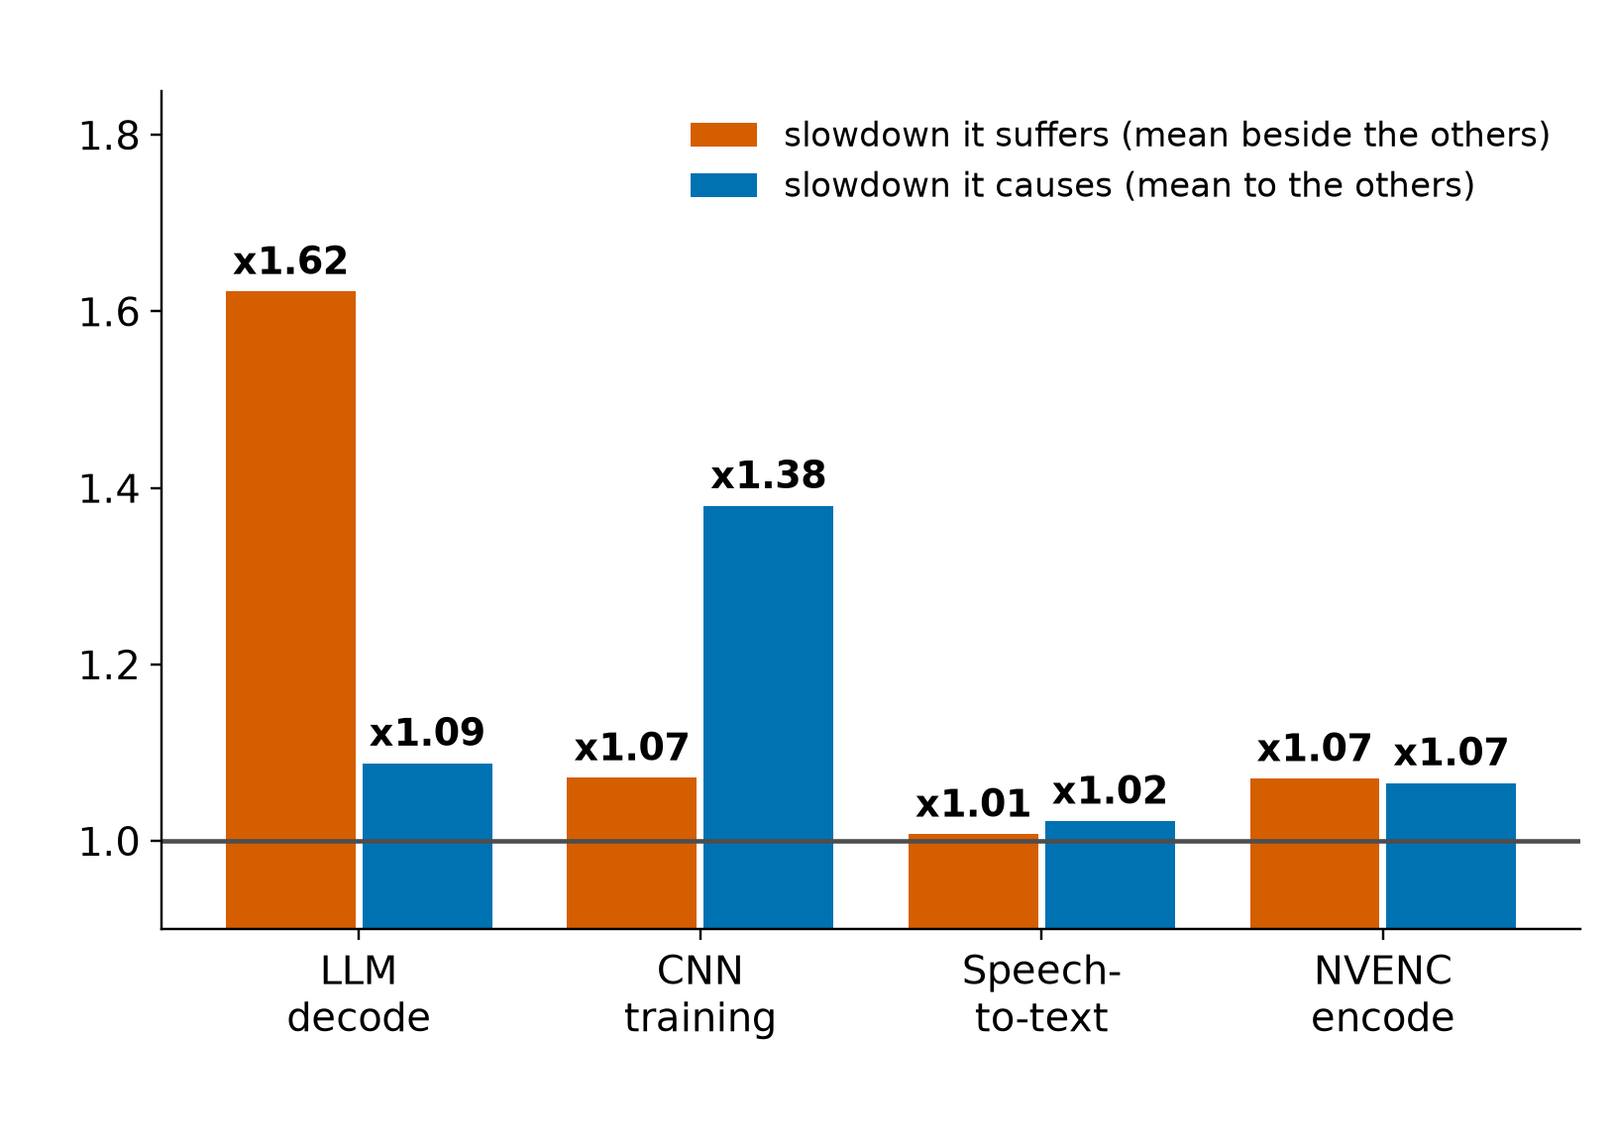
EVIDENCE: INTERACTION
GPU task types and how they interact
Task type | Uses | Suffers | Causes
LLM decode | memory bandwidth, tiny kernels | x1.62 mean, x2.27 beside LLM | x1.09
Training | compute, tensor, long kernels | x1.07 | x1.38, x2.08 on decode
Speech-to-text | almost nothing (3% busy) | x1.01 | x1.02
Video encode (NVENC) | media engine, 0% SMs | x1.07 | x1.07
Rules from the matrix: memory-bound LLM decode is the victim, long-kernel training the aggressor, speech and NVENC are near-free neighbours. Video decode (NVDEC), prefill beside other tasks and multi-GPU jobs were not tested
Test machine (RTX 5070 Ti): sources/2026-10-16-shared-gpu/report.md (table B.2: 13 pair cells, 2 repeats each, 8 for LLM+LLM)
8
Notes:
TIME 1:15
SAY: Main points:
- Suffered is the mean slowdown a task takes beside the other three types, caused is the mean slowdown it inflicts on them
- LLM decode suffers most and causes little, training causes most
- Speech-to-text and NVENC are near-free neighbours because they use almost none of the GPU
- NVDEC video decode was not tested

Slide 9

EVIDENCE: INTERACTION
Four LLMs together make 91% of one alone
• How to read: each bar is the share of a 5 ms slice the GPU spent on this process. Top: one LLM alone. Bottom: the same LLM with three others
• Alone: the GPU works for it all the time, 3.5 ms per token
• With three others: short bursts, 15.8 ms per token
• Together the four make 258 tok/s against 284 for one: 91%. Each gets 22 to 26% of solo speed
• Why: the GPU switches between processes and loses time at each switch. It does not split 25% each
• The trace reads 37% because it includes time switched out
Test machine (RTX 5070 Ti): sources/2026-10-16-shared-gpu/report.md (Fig. 7, table B.1; 63.4 of 283.5 tok/s). Discrete card: the cost may differ on unified memory
9
Notes:
TIME 1:00
SAY: Main points:
- One of four identical LLM processes, kernel trace, 600 ms in 5 ms steps
- The trace reads 37% because a kernel's span includes time it was switched out
- Mean stream makes 63.4 of 283.5 tokens per second, which is 22% (range 22 to 26%), and the four total 91% of one alone
- Each token takes 4.5 times longer and the four together make less than one alone
- Discrete RTX 5070 Ti, not evidence about unified memory
Supplemental points:
- Trace span and device busy are different metrics: 100% alone against 91%

Slide 10


EVIDENCE: INTERACTION
Copies lose to batching: 258 vs 614 tok/s, 8.9 vs 2.5 GiB
1 request: 284 tok/s separate, 274 batched. 2: 250 vs 406. 4: 258 vs 614. 8 batched: 1,417 (5.6 ms/token, faster per token than 4). Each separate process holds its own weights; a batch reads weights once for every request
Implication: serve each model from one batching process; model copies multiply memory on the shared pool
Test machine (RTX 5070 Ti): sources/2026-10-16-shared-gpu/report.md (table B.1; qwen2.5 3B, 256 tokens)
10
Notes:
TIME 1:00
SAY: Main points:
- Four separate processes take turns and make less than one process
- One process batching four requests makes 2.4 times the output in less than a third of the memory

Slide 11

EVIDENCE: SIMULATION
Blend error 4.0 pp vs 16.0 pp for the sum (12 of 15 cells)
• LLM + CNN training: blend 2.8 pp, sum 21.8 pp
• LLM + LLM: blend 8.4 pp, sum 22.5 pp
• LLM + NVENC: blend 1.0 pp, sum 3.7 pp
• Switching loss (blend minus measured, DRAM read): 9% LLM+training, 2% LLM+NVENC, 22% LLM+LLM
• Time shares come from the co-run trace; predicting shares from vectors is the next test (kernel length and fingerprint position are the candidate predictors)
• MPS removes context switches and would separate switching cost from launch queuing and cache refills
Test machine (RTX 5070 Ti): sources/2026-10-16-shared-gpu/report.md (table B.6; errors computed in figs1e.py over 15 pair-counter cells)
11
Notes:
TIME 1:15
SAY: Main points:
- Mean absolute error across all 15 cells: 4.0 percentage points for the blend, 16.0 for the sum
- The residual between blend and measured is the switching cost, 2 to 22% on DRAM read

Slide 12
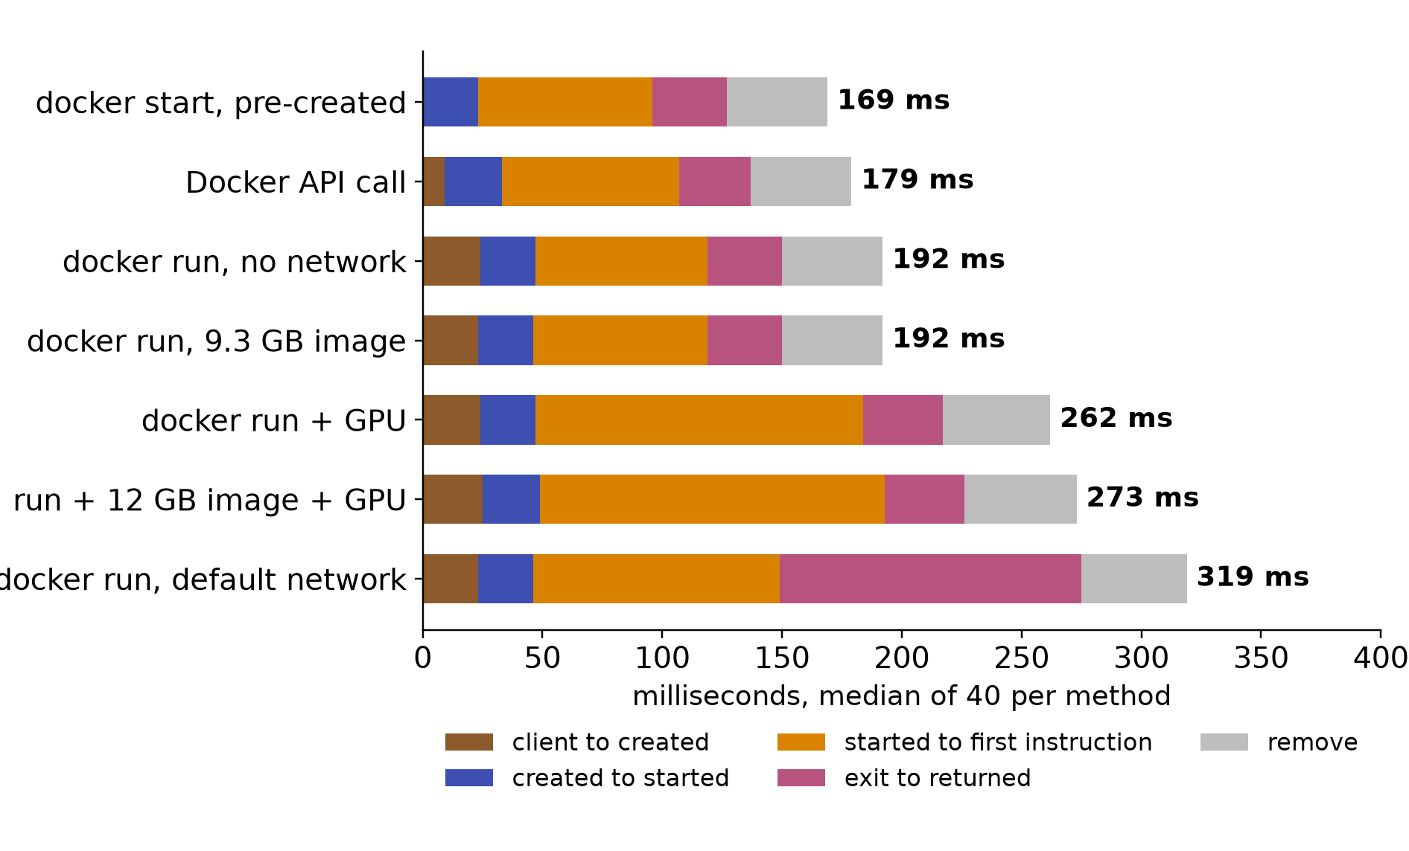
EVIDENCE: RUNTIME
Container start: 3 ms native, 49 ms exec, 219 ms with GPU
• Phases (ms): client to created 24; created to started 23; started to first instruction 72 (no network), 103 (default network), 137 (GPU), 144 (12 GB CUDA image + GPU); exit to returned 31 to 126; remove 42 to 47
• GPU access adds about 65 ms before the first instruction
• Default network adds about 30 ms there and 95 ms on exit
• Image size leaves the median unchanged (9.3 GB: 153 ms)
Test machine (RTX 5070 Ti): sources/2026-10-16-shared-gpu/report.md (table B.8; 40 shuffled starts per method)
12
Notes:
TIME 1:00
SAY: Main points:
- Most start time sits between started and the first instruction
- GPU access and the default network each add a fixed amount

Slide 13
WHAT IT MEANS
DAG scheduling: some branches parallelise, some only look parallel
Parallel branch | Measured behaviour | Effect on the schedule
LLM call beside another LLM on a different model | Each ran x2.27 slower; four together made 258 tok/s vs 284 for one, each stream at 22 to 26% of solo | No wall-time gain: parallel costs about the same as serial, with four copies of weights in memory
LLM calls to the same model | Batched: 614 tok/s at 2.5 GiB vs 258 tok/s at 8.9 GiB for 4 processes | Parallelises well when routed to one batching server
LLM call beside training or an experiment | LLM decode x2.08 slower, training x1.16 | A critical-path LLM node can double in duration; the experiment node barely moves
LLM call beside speech-to-text or video encode | x1.00 to x1.12 for both sides | Close to free parallelism
Many container starts at once | 16 at once: 423 ms each vs 152 ms for one (2.8x); GPU start 219 ms vs 49 ms warm | Fan-out startup is not free; warm containers cut it
Planner inputs this suggests: a resource class per node, duration under sharing (solo x pair factor), and a memory budget. Parallel width is a resource decision, not just a graph property
Test machine (RTX 5070 Ti): sources/2026-10-16-shared-gpu/report.md (B.1, B.2, B.5, B.8); planner.md:216 (parallel nodes outside M1); D33 (Cluster Mode in M1)
13
Notes:
TIME 1:30
SAY: Main points:
- A DAG fan-out of k nodes only gives a k-fold speedup if the nodes use different resources
- Two heavy GPU jobs, or two LLMs on different models, share the GPU by turns and lose time at each switch
- Same-model LLM calls batch, which turns parallelism into a gain
- Pairing a GPU-heavy node with a light one such as speech or encode costs almost nothing
- Node durations in a plan would need a sharing factor from the pair matrix, and a memory budget for model copies

Slide 14
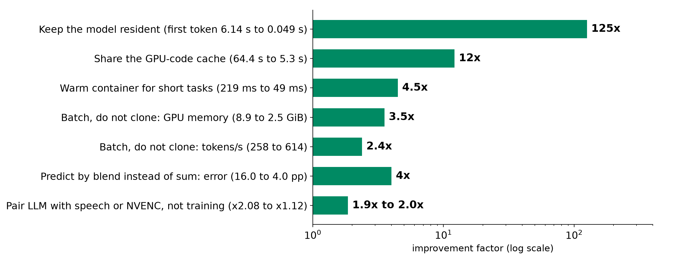
POTENTIAL IMPROVEMENTS
Potential improvements: each one measured on the test machine
Each factor is a measured before and after on the test machine. Precedent at scale: MuxFlow raised production GPU utilization from 26% to 76% by sharing GPUs with protection. GB10 values need a re-measure
Test machine (RTX 5070 Ti): sources/2026-10-16-shared-gpu/report.md (tables B.1, B.2, B.6, B.8; JIT experiment); MuxFlow, arXiv 2303.13803
14
Notes:
TIME 1:00
SAY: Main points:
- Keeping a model resident cuts the first token from 6.14 s to 0.049 s
- Sharing the GPU-code cache cuts a fresh container from 64.4 s to 5.3 s
- A warm container starts a short task in 49 ms instead of 219 ms
- Batching four requests uses 2.5 GiB instead of 8.9 GiB and gives 614 instead of 258 tokens per second
- The blend predicts shared counters with 4.0 pp error against 16.0 pp for the sum
- Pairing LLM decode with speech or video encode instead of training avoids about a 2x slowdown

Slide 15
LIMITS
What the exploration covers and what stays open
Area | Covered | Open
Tasks | LLM decode and prefill (4 model sizes), CNN training, NVENC video encode, speech-to-text | Video decode (NVDEC), prefill beside other tasks
Sharing | All task pairs (2 to 8 repeats), four LLMs at once, batching vs copies, counter timelines (X7) | More than four tasks, multi-GPU, MPS and MIG
Runtime | 1,760 container starts, bursts of 16, JIT cache, cold and warm model load | Behaviour of real AI4Research capsules
Prediction | Blend over 3 pairs, 15 counter cells; shares taken from co-run traces | Predicting shares before launch
Hardware | One RTX 5070 Ti machine; 2 to 12 repeats per point; imported report, unaudited | Any GB10 (DGX Spark) run
Every value is from one test machine as prelim work; the method (solo vectors, time-share blend) carries to other hardware, the numbers do not
Test machine (RTX 5070 Ti): sources/2026-10-16-shared-gpu/report.md
15
Notes:
TIME 1:00
SAY: Main points:
- The table lists what each test set covered and what remains
- All numbers come from one machine and need a re-measure on the target hardware

Slide 16
Appendix
Visibility per process, runtime levers, kernels, offload, counter timelines, bursts, speech nodes, trace data, ceilings, sources
Notes:
TIME 0:05
SAY: Main points:
- Backup material

Slide 17
EVIDENCE: INTERACTION
What stays visible per process on a busy GPU
Level | Measures | Isolated to one task while sharing?
Container | CPU time, RAM peak, I/O, out-of-memory events (cgroup v2) | Yes, exactly
Process | GPU memory per process; every kernel and copy (CUPTI) | Yes; kernel duration includes time the GPU spent on others
Device | GPU utilization, power, clocks, SM, tensor, DRAM and PCIe counters | Whole GPU; equals the task when it ran alone
• Per-process kernel traces give each process's time share of the GPU in any busy window
• Solo runs give each process's vector (the device counters of its quiet-window run)
• Shares and vectors together apportion the whole-GPU counters across processes (next slides)
• Measurement stack: cgroups and NVML every 100 ms; Nsight Systems kernel traces and counters at 10 kHz; one counter session at a time; GPU lock held per run; idle floor 17 W unobserved, 27 W profiled
Test machine (RTX 5070 Ti): sources/2026-10-16-shared-gpu/report.md (appendix A.2 and A.3)
17
Notes:
TIME 1:15
SAY: Main points:
- Three measurement levels with different isolation under sharing
- Time share comes from per-process traces and is available in busy windows
- Vectors come from quiet runs, so the two combine into per-process attribution

Slide 18

EVIDENCE: RUNTIME
Four runtime levers, all measured
1 Weights stay in GPU memory, so no reload. 2 Compiled GPU code is reused, not rebuilt. 3 One process reads the weights once for many requests. 4 A warm container skips startup. None needs the GB10 to act on; model quality for routing is not measured
Test machine (RTX 5070 Ti): sources/2026-10-16-shared-gpu/report.md (tables B.1 and B.8). Shapes should carry to other machines; milliseconds depend on the CPU
18
Notes:
TIME 1:15
SAY: Main points:
- Keep models loaded: first token takes 6.1 s from disk, 2.7 s from RAM, 0.05 s when resident
- Share the GPU-code cache across containers: a fresh container took 64 s without it and 5 s with it
- Batch requests in one process instead of one process per request: 614 against 258 tokens per second, and 2.5 against 8.9 GiB
- Reuse warm containers for short tasks: 49 ms for docker exec against 219 ms for docker run with the GPU
Supplemental points:
- On the GB10 the memory-related levers may behave differently, see the caveat slide
- Batch 8 gave 1,417 tok/s and is flagged for a recheck

Slide 19

EVIDENCE: VECTORS
Kernel size and launch rate separate tasks with equal busy
• Decode: 2.5 us kernels, 192,622 launches/s, GPU busy 91%; 76% of time in gemv
• Prefill: 6.8 us, 32,232/s, 48% busy; 81% gemm
• CNN training fp32: 77.2 us, 4,736/s, 69% busy; gemm 30%, norm 23%, elementwise 23%
• Speech-to-text: 1.7 us, 2,945/s, 3% busy
• NVENC: 4.5 us, 568/s, 0% busy
• Long training kernels hold the GPU while tiny decode kernels wait for a turn
Test machine (RTX 5070 Ti): sources/2026-10-16-shared-gpu/report.md (table B.4; marker size = GPU busy in the task's window)
19
Notes:
TIME 1:00
SAY: Main points:
- Decode launches about 193k tiny kernels per second, training about 5k long ones
- Both keep the GPU busy, which is why a single busy number hides the interaction

Slide 20

EVIDENCE: VECTORS
Decode and prefill load different resources
Decode: tokens/s 738, 283, 157, 80 for 0.5B, 3B, 7B, 14B; memory read 32, 61, 78, 78%; tensor 0%. Prefill: 31,726, 10,709, 6,590, 3,397 tok/s; tensor 2, 10, 18, 22%; SMs active 13 to 69%
Test machine (RTX 5070 Ti): sources/2026-10-16-shared-gpu/report.md (tables B.3 and B.5)
20
Notes:
TIME 1:00
SAY: Main points:
- Decode is memory-bound at every size and saturates at 7B
- Prefill raises tensor and compute use with model size

Slide 21
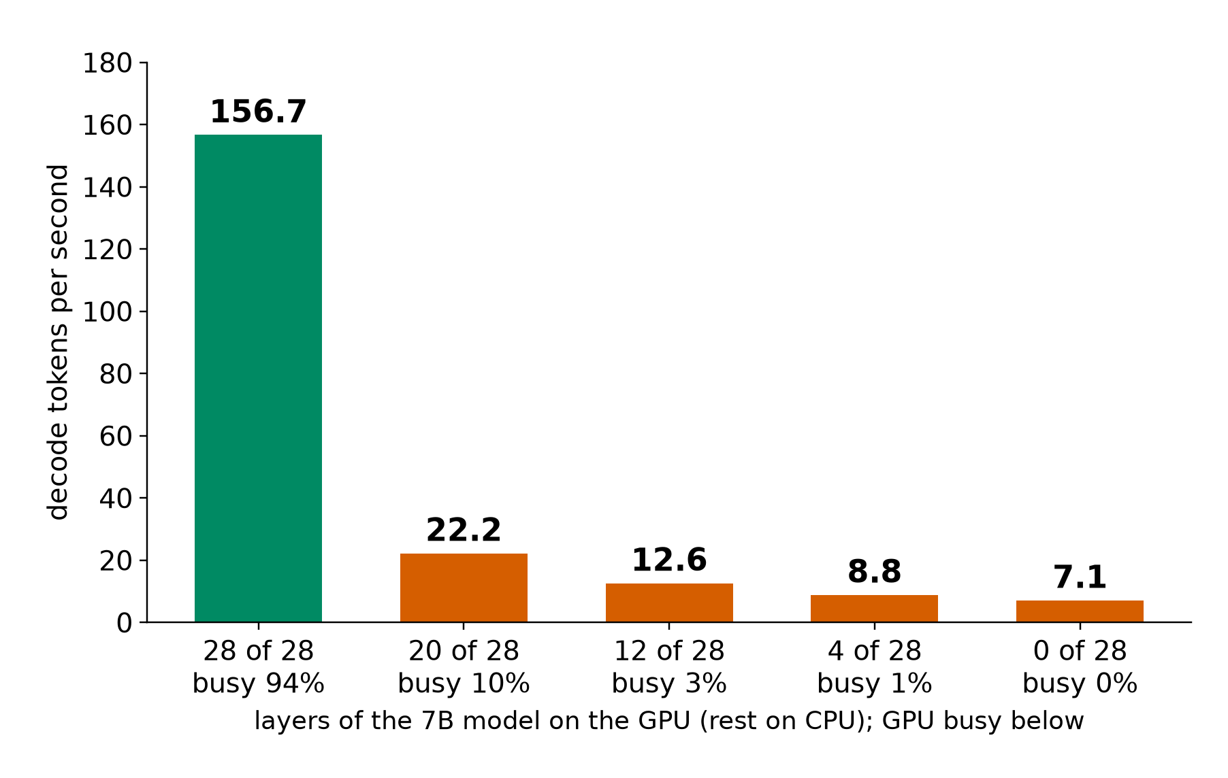
EVIDENCE: VECTORS
Layers on the CPU cut decode from 156.7 to 22.2 tok/s
• 28 of 28 layers on the GPU: 156.7 tok/s, GPU busy 94%
• 20 of 28: 22.2 tok/s, 10% busy: the PCIe copy dominates
• 12, 4, 0 of 28: 12.6, 8.8, 7.1 tok/s
• A vector dimension for memory placement: GPU-resident vs host-resident
• On a unified-memory GB10 the PCIe step is absent, so this dimension needs a re-measure
Test machine (RTX 5070 Ti): sources/2026-10-16-shared-gpu/report.md (table B.3, partial offload, 7B decode)
21
Notes:
TIME 0:45
SAY: Main points:
- Memory placement changes throughput by 22 times for the same model
- The PCIe cliff is a property of discrete GPUs

Slide 22
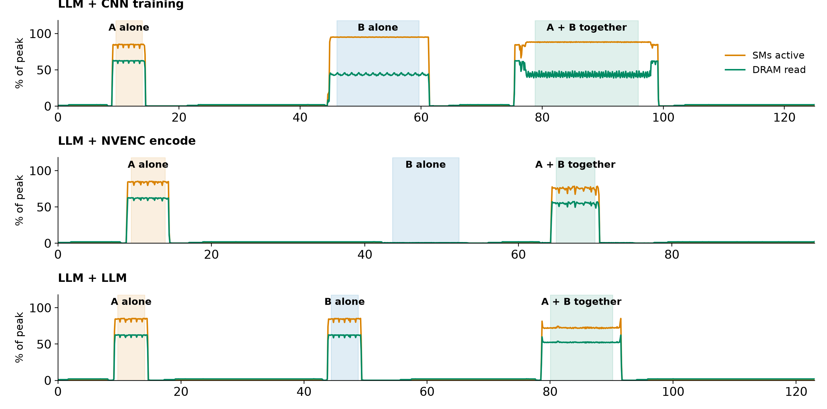
EVIDENCE: INTERACTION
Counters over time: A alone, B alone, then both together
Each pair ran as idle, A, idle, B, idle, A+B under one counter observer. Together the counters sit between the two solo levels, not at their sum: LLM+training SMs 88.2, DRAM read 43.1; LLM+LLM SMs 72.3, DRAM read 52.4; LLM+NVENC SMs 75.3, DRAM read 54.9
Test machine (RTX 5070 Ti): sources/2026-10-16-shared-gpu/report.md (experiment X7, figure 1; table B.6)
22
Notes:
TIME 1:15
SAY: Main points:
- The three panels are the three pairs, each as idle, A alone, B alone, then both together
- The GPU alternates between the two tasks, so the combined counters land between the solo readings
- LLM+NVENC stays close to LLM alone because the encoder barely touches the GPU

Slide 23

EVIDENCE: RUNTIME
Bursts slow each start; overhead grows with a real task
1 start 152 ms; 4 at once 191; 8 at once 263; 16 at once 423 (2.8x). Overhead with a 340 ms task: exec +48, start +146, API +170, run no network +174, run + GPU +245, run default network +293 ms
Test machine (RTX 5070 Ti): sources/2026-10-16-shared-gpu/report.md (table B.8 and burst measurements; 1,760 starts in total)
23
Notes:
TIME 1:00
SAY: Main points:
- Launching 16 containers together makes each start 2.8 times slower
- Overhead is +216 ms empty and +245 ms with a 340 ms task for GPU containers

Slide 24
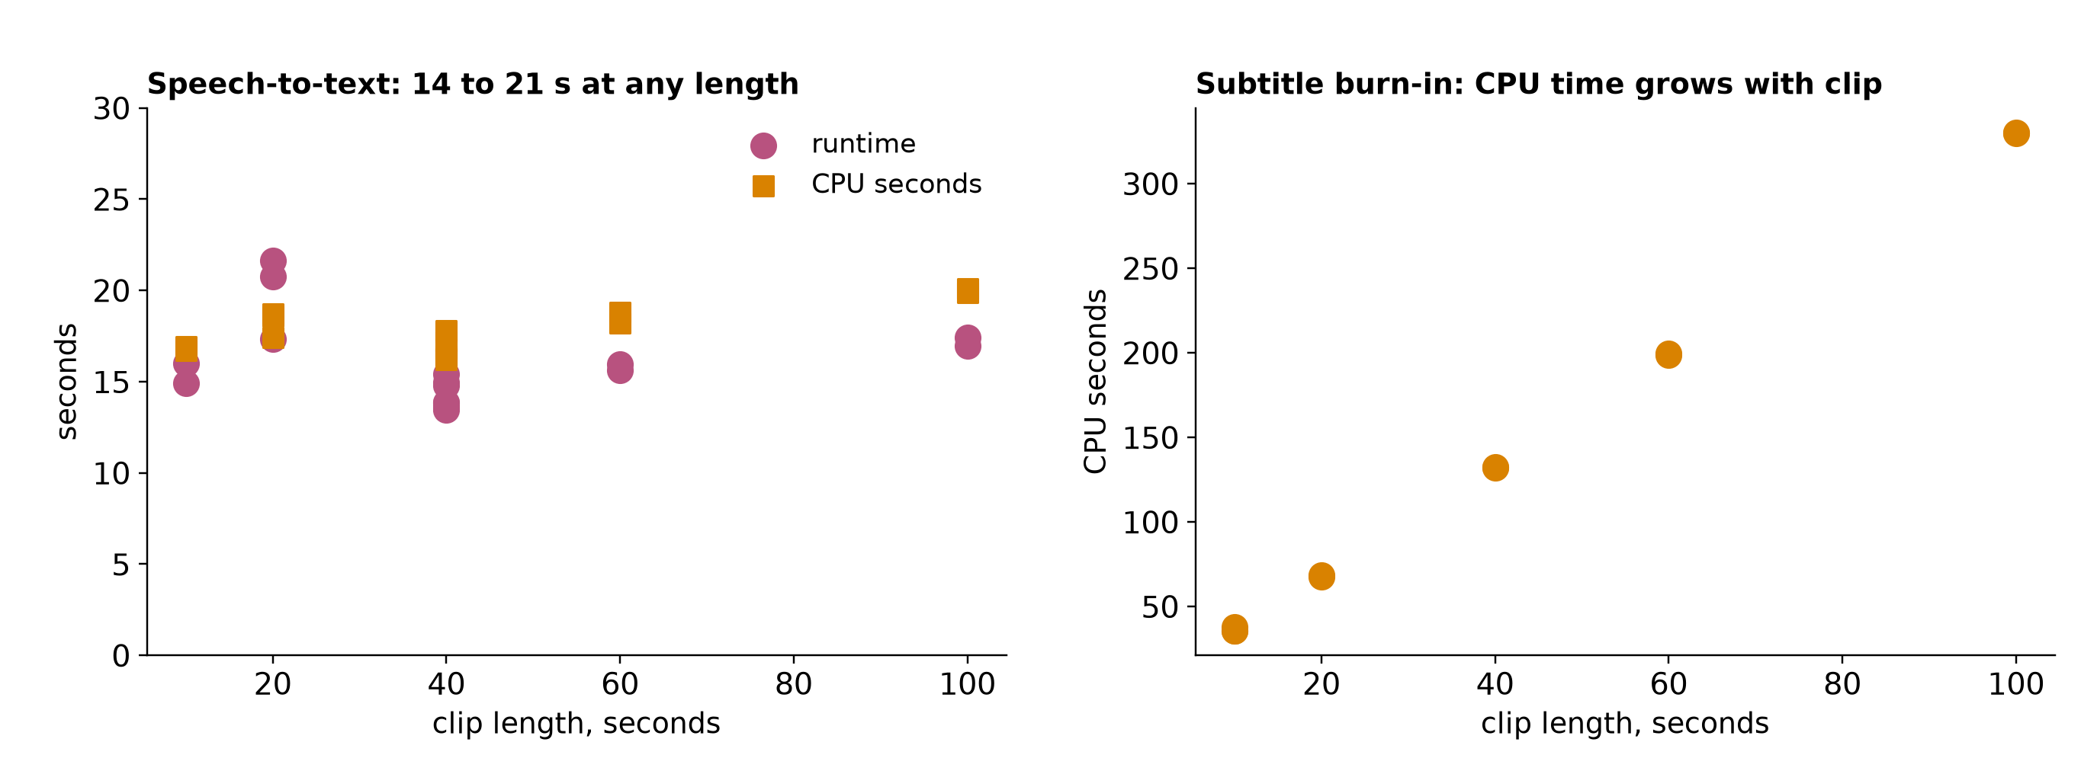
EVIDENCE: RUNTIME
Speech and subtitle nodes
Whisper turbo at 10, 20, 40, 60, 100 s clips: 13.5 to 21.6 s, GPU busy 3%. Burn-in CPU seconds: 36 (10 s clip), 68 (20 s), 132 (40 s), 199 (60 s), 330 (100 s), all on the CPU encoder. A resident speech worker removes most of the node time; GPU encoding frees the CPU
Test machine (RTX 5070 Ti): sources/2026-10-16-shared-gpu/report.md (video pipeline nodes used as stand-ins for agent work nodes; 1080x1920)
24
Notes:
TIME 1:00
SAY: Main points:
- Speech time is startup-bound and the GPU stays near idle
- Subtitle encoding is CPU-bound and grows linearly with clip length

Slide 25
EVIDENCE: SIMULATOR DATA
Trace records for simulator checks
Record | Fields
node | run_id, workload, params (model, phase, tokens)
hardware | GPU name, driver, VRAM total
isolation | concurrent_with_runs; interference_vs_solo: slowdown 1.72, kernel_stretch 1.65 (run 254, three concurrent)
timing, resources | container_s, gpu_window_s; cpu_time_s, ram_peak, vram_peak, power mean, energy
kernels | name, category, start_us, dur_us, grid, block, stream, regs_per_thread, shared_mem_bytes
copies | kind (h2d, d2h), start_us, dur_us, bytes, stream
• 353,970 kernels in one traced task; identical runs launch identical sequences
• Ledger 6.9 MB (100 ms samples); 11 CSV tables 2.3 MB; per-node traces 45 MB (Perfetto); Nsight reports 20 GB
• Samples: cgroup and NVML at 100 ms; GPU counters at 10 kHz; kernel timeline at 10 ms
• Rebuild with gauge dataset and gauge trace-export
Test machine (RTX 5070 Ti): sources/2026-10-16-shared-gpu/report.md (appendix A.6)
25
Notes:
TIME 1:00
SAY: Main points:
- The trace record carries launch shape, registers and shared memory per kernel
- Solo and shared traces of the same task line up, which makes simulator checks direct

Slide 26
EVIDENCE: SIMULATOR DATA
Simulator inputs: what exists, what is missing
Simulator input | In the data | Source
Kernel sequence with duration and launch shape | Yes: 353,970 kernels for one task | Nsight Systems / CUPTI
Shared-run kernel stretch per kernel | Yes: solo and shared traces for pairs | X5, X7
Device counters over time | Yes: SM, issue, tensor, DRAM read and write at 10 kHz, one session at a time | Nsight counters
Time shares per process | Yes: from each task's own trace | per-process kernel trace
Memory per process, CPU, I/O | Yes: 100 ms samples | NVML, cgroup v2
Instruction dependencies and memory-access pattern | Extra input: separate profiler pass per kernel | Nsight Compute
Hardware what-if (bandwidth, cache, clocks) | Extra input: controlled-change runs | power and clock caps, working-set sweeps
Vectors plus time shares drive the shared-GPU simulation now; a cycle-level GPU simulator adds instruction and memory-access traces
report.md appendix A.6 and Open questions; experiment-agent-brief.md (simulator inputs); Accel-Sim, ISCA 2020; Chakra, 2023
26
Notes:
TIME 1:00
SAY: Main points:
- Kernel timelines, counters and shares cover the blend simulator
- A cycle-level simulator such as Accel-Sim also takes instruction and memory traces

Slide 27
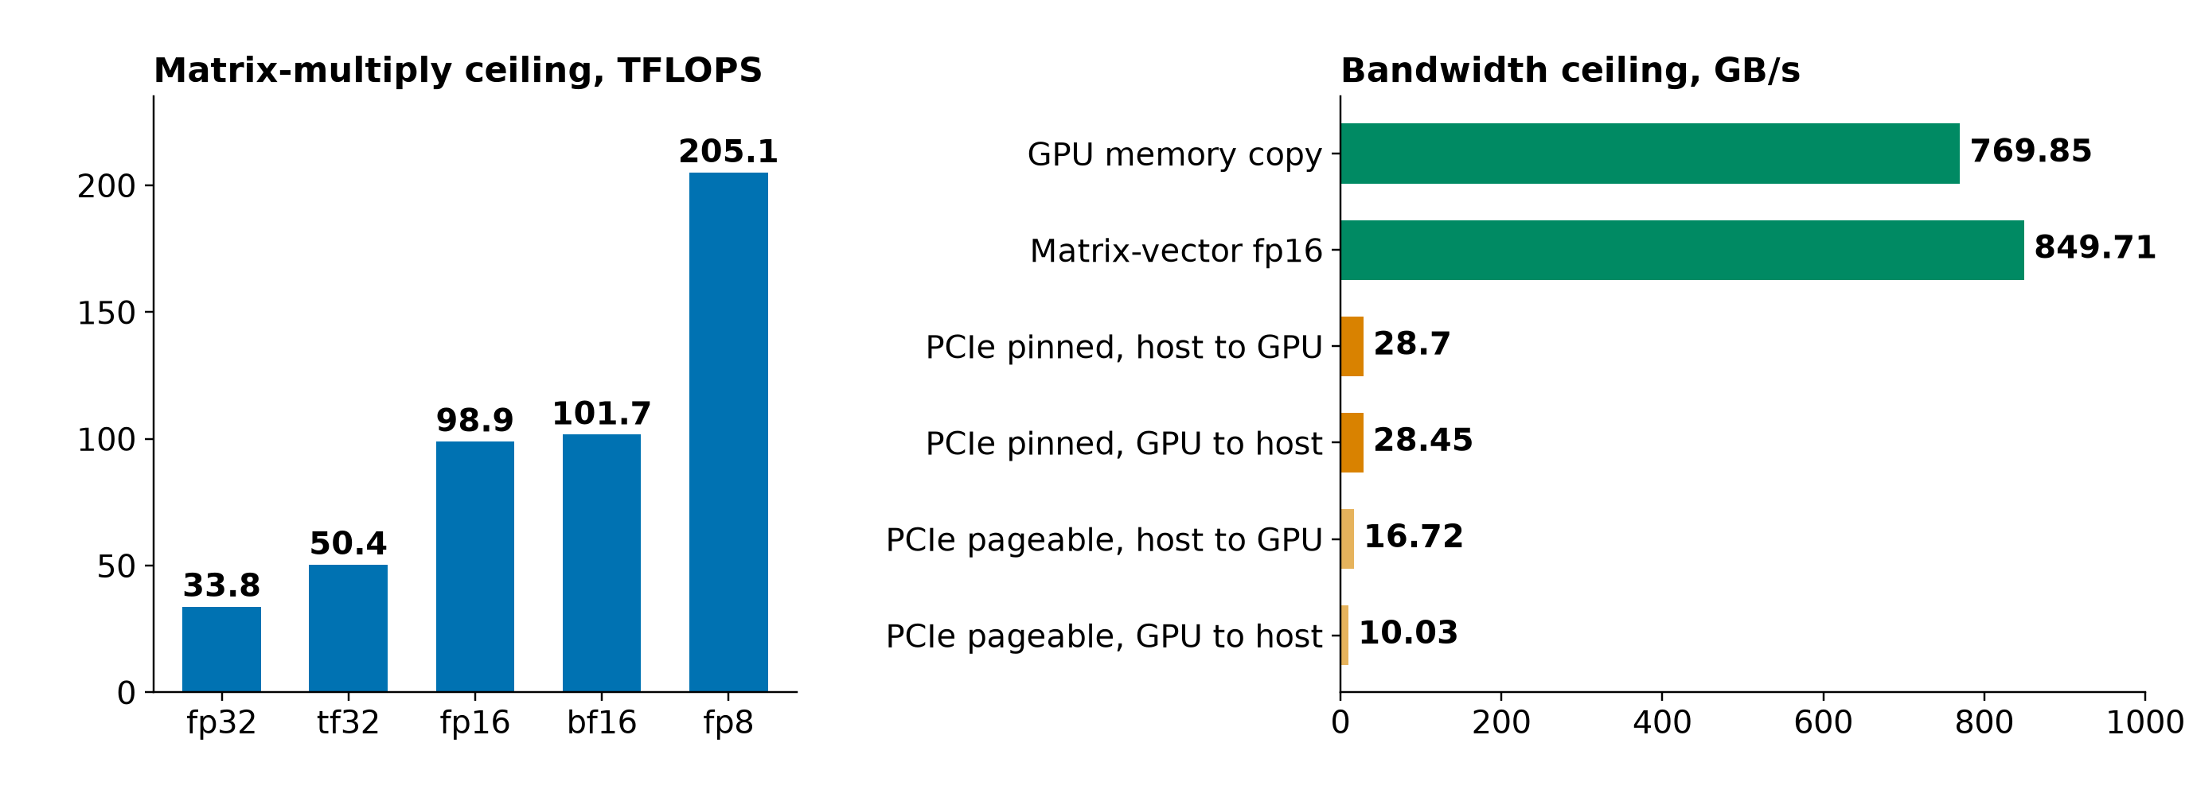
APPENDIX
Machine ceilings: compute, memory, PCIe
RTX 5070 Ti 16 GB (Blackwell), PCIe Gen4 x16, Ryzen 7 3700X, 46 GiB, driver 595.91.07. Kernel launch 9.96 us. Idle 17 W unobserved, 27 W profiled
Test machine (RTX 5070 Ti): sources/2026-10-16-shared-gpu/report.md (tables A.2 and B.7)
26a
Notes:
INSERT: optional slide; delete or hide it and the talk flows unchanged
TIME 0:30
SAY: Main points:
- Reference ceilings for the test machine

Slide 28
APPENDIX
Source map
Claim | Source
DCGM device-level profiling, 1 Hz, conflicts with Nsight; job stats | docs.nvidia.com/datacenter/dcgm/latest/user-guide/feature-overview.html
Memory-Usage Not Supported on DGX Spark; GB10 hardware | docs.nvidia.com/dgx/dgx-spark/known-issues.html and hardware.html
GKE DCGM metrics with pod labels; MPS on GKE | docs.cloud.google.com/kubernetes-engine/docs/how-to/dcgm-metrics and nvidia-mps-gpus
AWS CloudWatch NVIDIA GPU; Container Insights EKS and ECS | docs.aws.amazon.com/AmazonCloudWatch/latest/monitoring/CloudWatch-Agent-NVIDIA-GPU.html
AKS DCGM exporter; NVIDIA MPS | learn.microsoft.com/en-us/azure/aks/monitor-gpu-metrics; docs.nvidia.com/deploy/mps/latest/index.html
Orion; SoCC 2025 interference; HotCloud 2020 | anakli.inf.ethz.ch/papers/orion_eurosys24.pdf, gpu_interference_socc25.pdf; usenix.org hotcloud20_paper_yeung.pdf
NeuSight; Accel-Sim; Chakra; HiPC 2023 Orin | doi.org/10.1145/3669940.3707265; doi.org/10.1109/ISCA45697.2020.00047; arxiv.org/abs/2305.14516, 2312.07220
CUDA Unified Memory behavior | developer.nvidia.com/blog/maximizing-unified-memory-performance-in-cuda/
Declaration, records, planner, checks, RSI, sidecar, owner rulings | design-package/reference/*.md, checking/README.md, side-systems/rsi-workbench.md, side-systems/owner-rulings.md, development-tools/sidecar/README.md
Paper2Agent container proposal (packaging unit) | arxiv.org/abs/2509.06917; AI4Research_private_planning/ai4r_muk/paper2agent-reference/06-paper2agent-cc-container-proposal.md
Accessed October 2026. design-package paths are under jiuwenswarm/docs/architecture/
26b
Notes:
INSERT: optional slide; delete or hide it and the talk flows unchanged
TIME 0:10
SAY: Main points:
- Source list

