Slide 1

Neural Network Hyperparameter Optimization with Sparse Grids
Maximilian Michallik
Technical University Munich
Chair of Scientific Computing
Dr. Felix Dietrich, Dr. Michael Obersteiner
Department Computer Science
TUM School of Computation, Information
and Technology
Garching, 02. August 2023

Slide 2
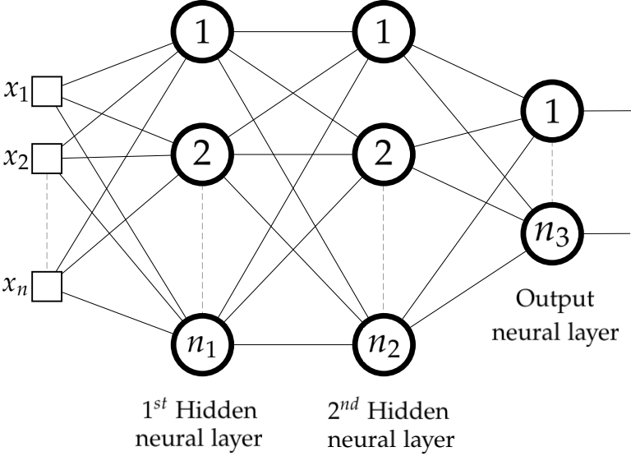
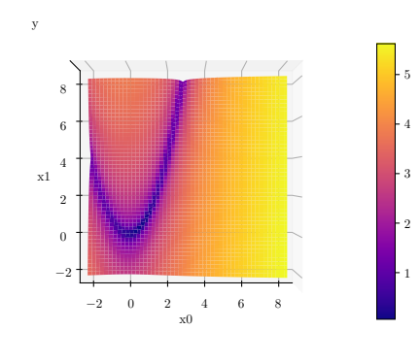
Hyperparameter Optimization
Hyperparameters: Paramaters of a ML model that are fixed before training
Number of layers/ neurons, epochs,
learning rate, ...
Optimization: finding the optimum of a function
Rosenbrock: Optimum at (1, 1)

Slide 3
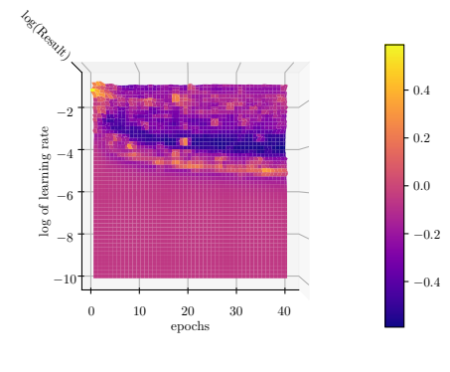
Hyperparameter Optimization
Regression with 2-layer neural network:

Slide 4
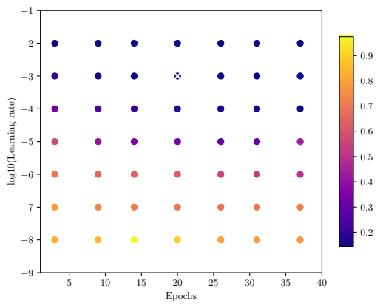
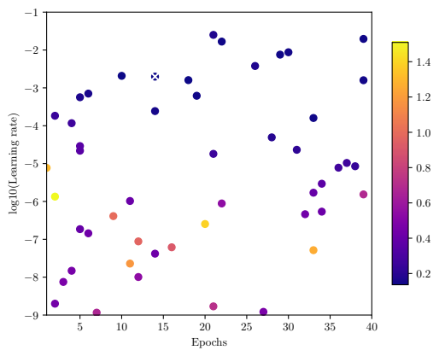
Hyperparameter Optimization – State of the Art
      Grid search:
    Random search:

Slide 5
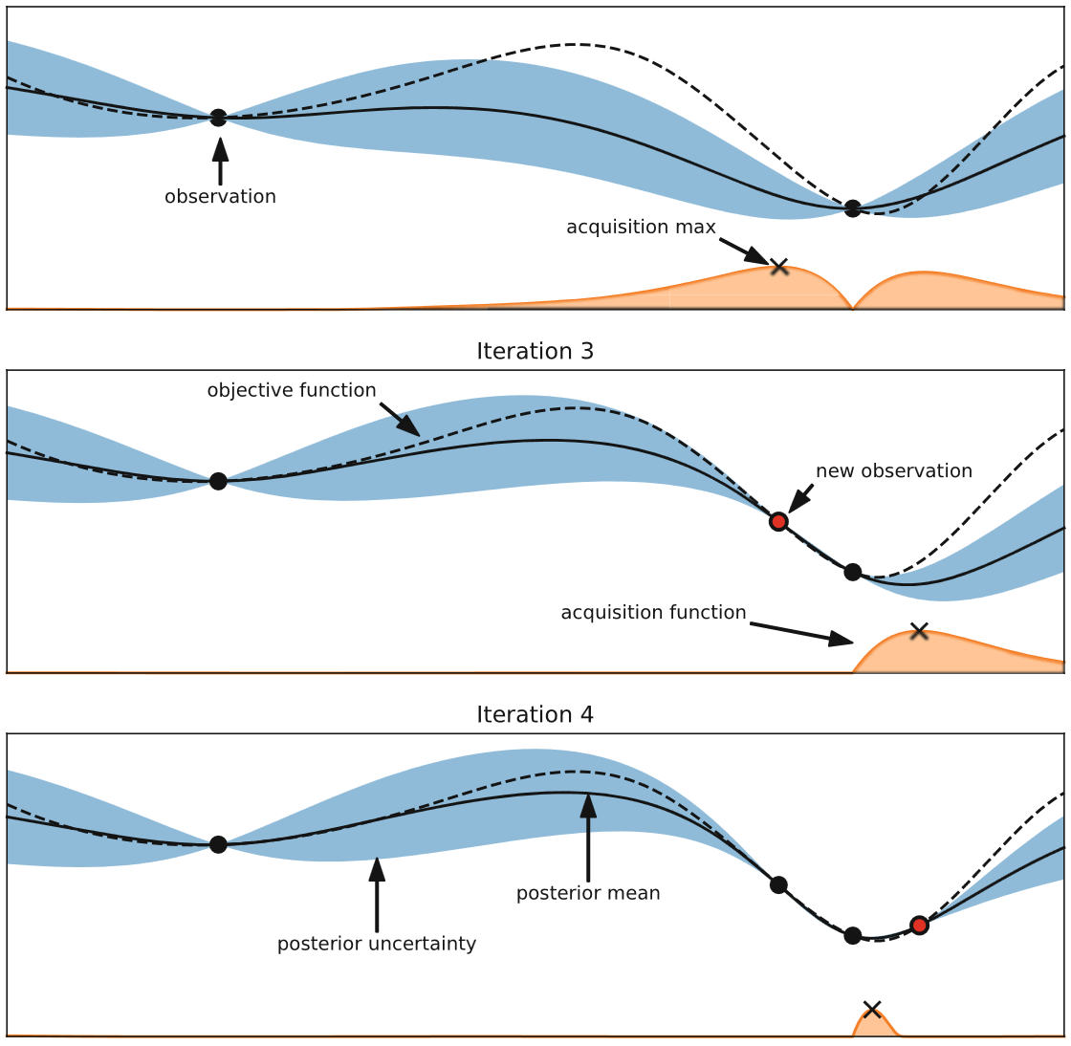
Hyperparameter Optimization – State of the Art
Bayesian optimization:
Surrogate model: approximates the function,
e.g. gaussian process, random forest, …
Acquisition function: finds new candidates for the optimum, e.g. expected improvement:
λ: configuration
fmin: best value so far
y: model prediction

Slide 6
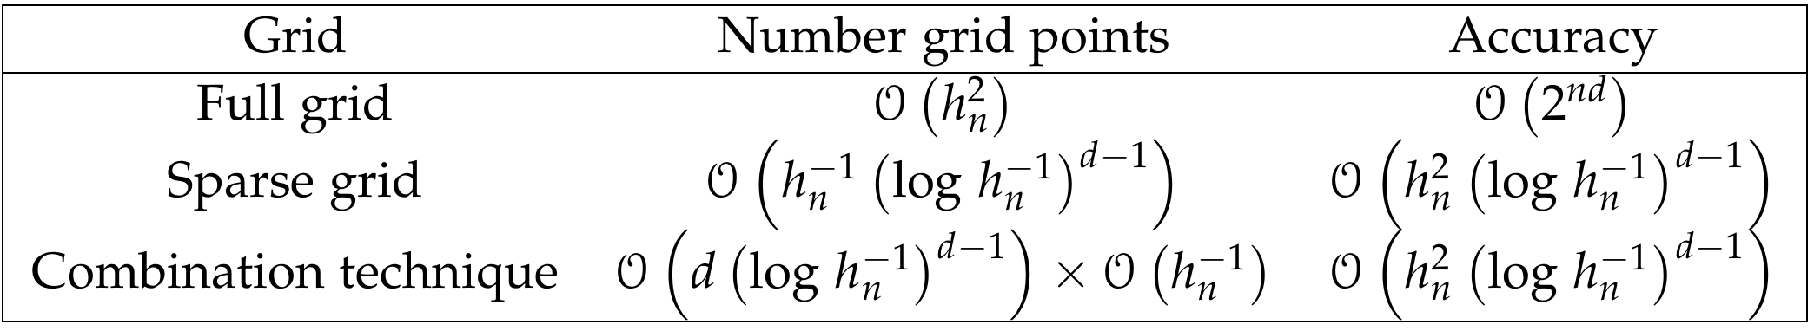
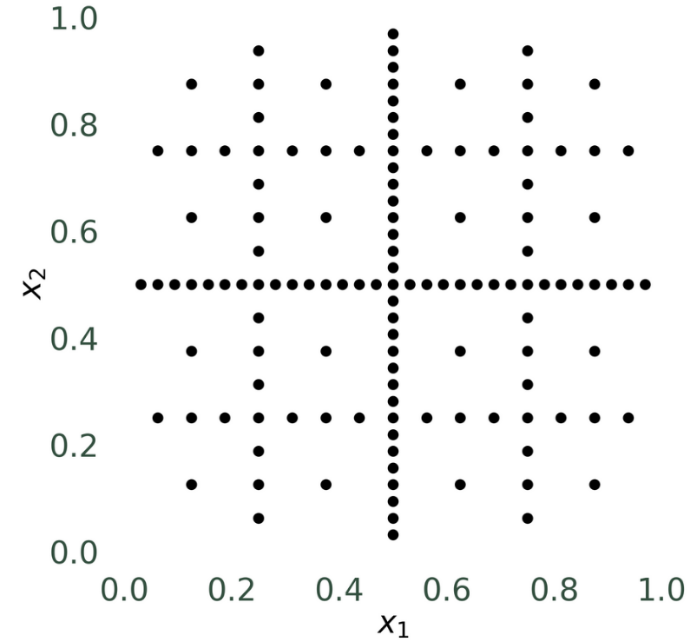
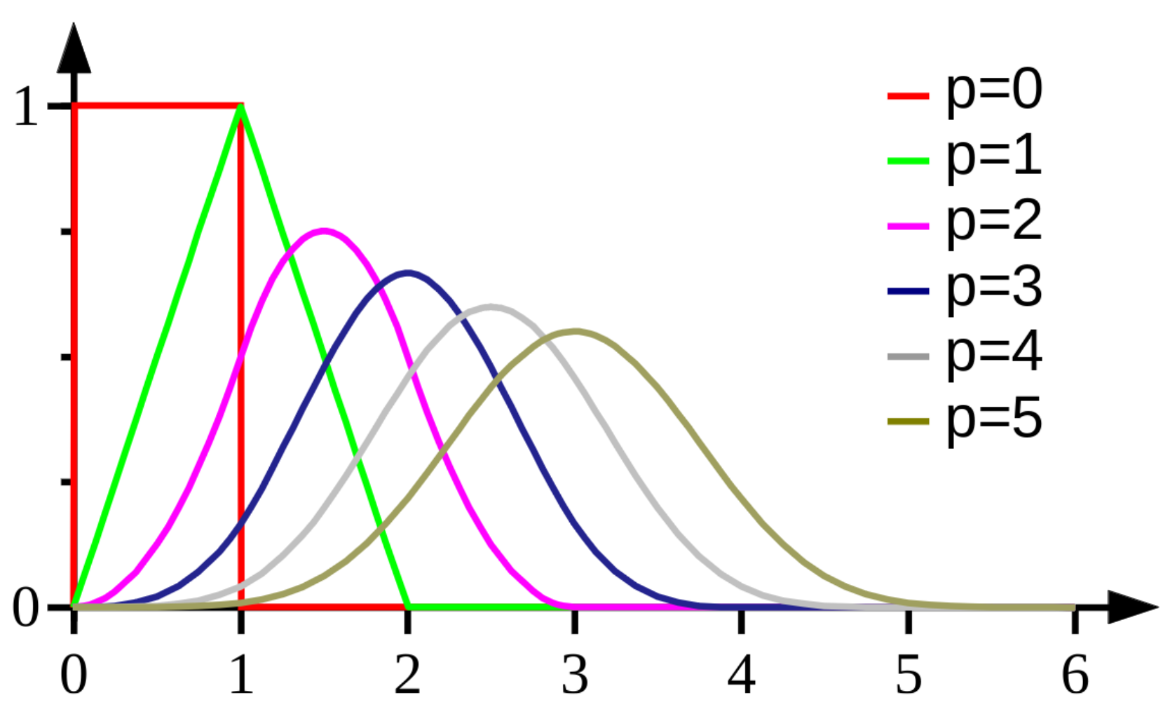
Hyperparameter Optimization with Sparse Grids
Background:
Efficient way for representing functions:
Interpolation with B-splines as basis function:

Slide 7
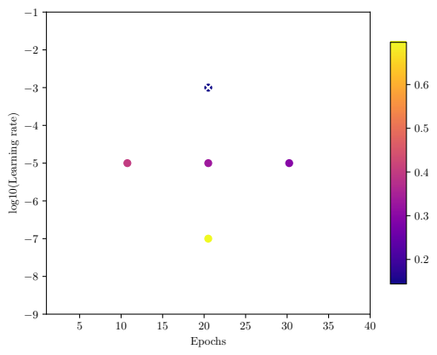
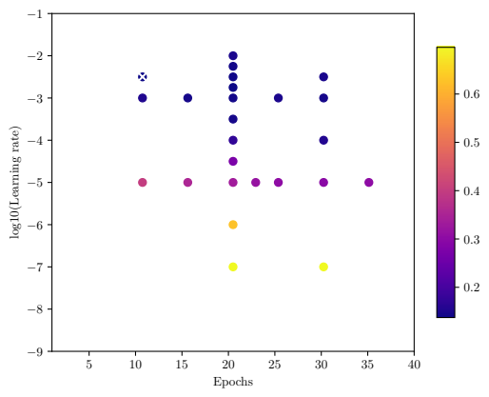
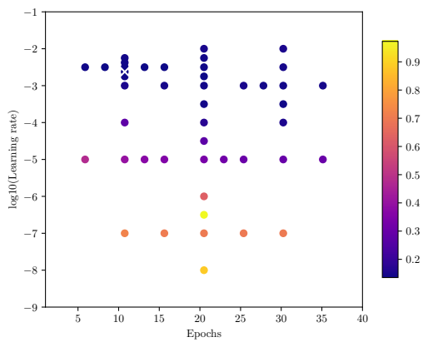
Sparse Grid Hyperparameter Optimization
With Novak-Ritter refinement criterion:
Iterative adaptive grid generation:

Slide 8
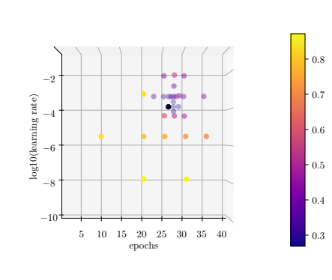
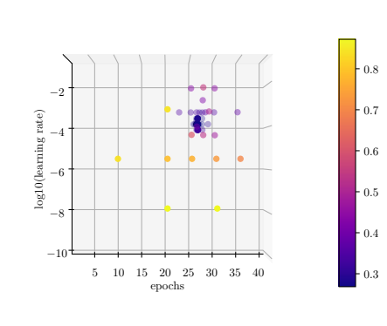
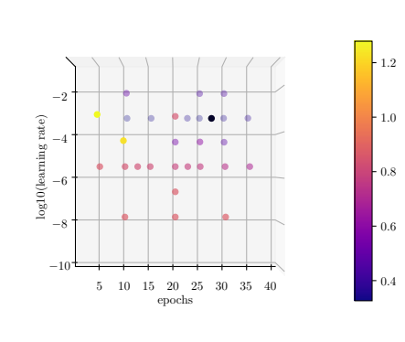
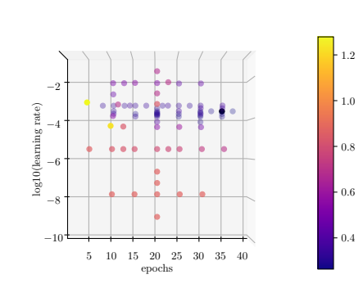
Adaptivity Parameter γ
Budget = 30
Budget = 50
γ = 0.5
γ = 0.85

Slide 9
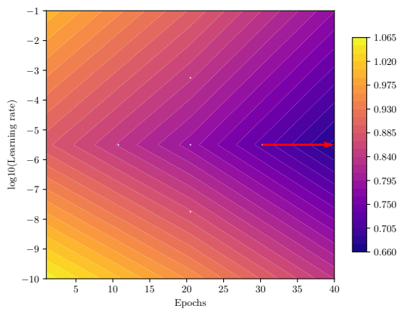
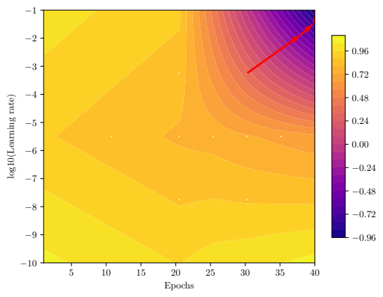
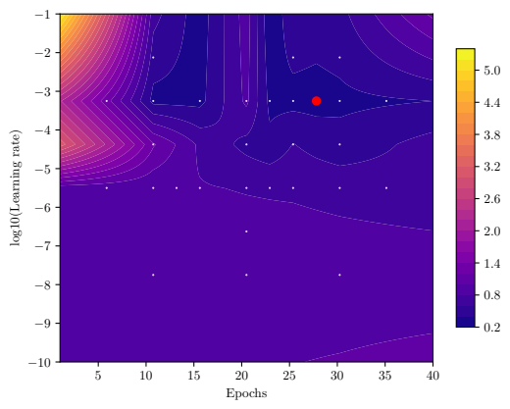
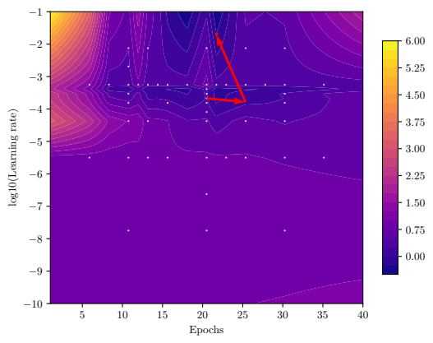
Sparse Grid Hyperparameter Optimization
Gradient-free optimizers:
Nelder Mead, differential evolution, CMA-ES
Gradient-based optimizers:
Gradient descent, NLCG, Newton, Rprop

Slide 10
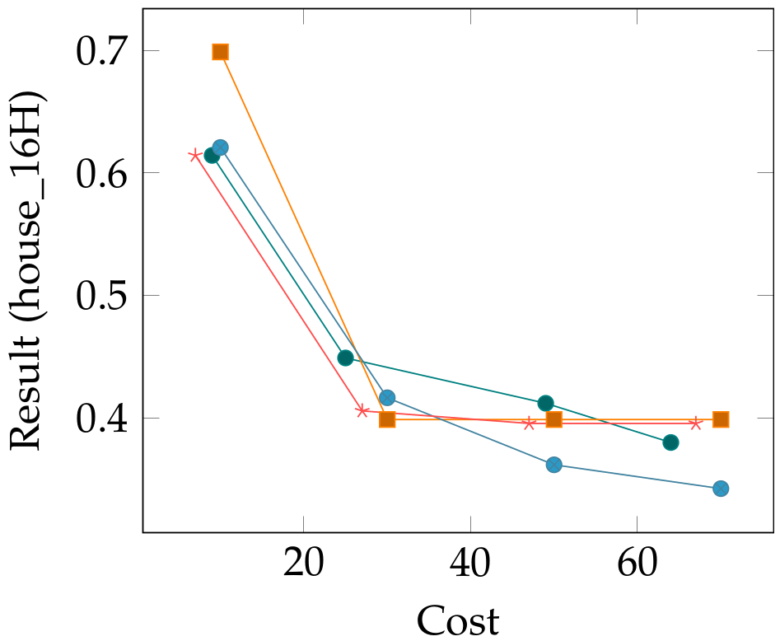
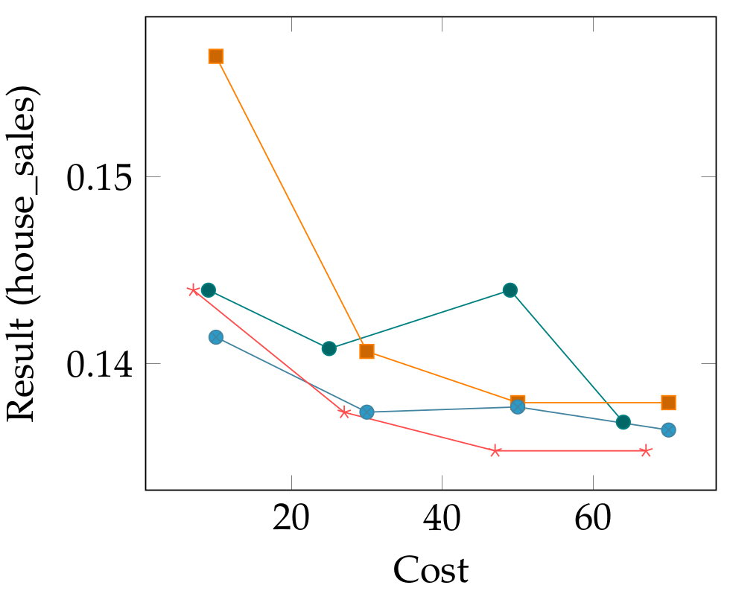
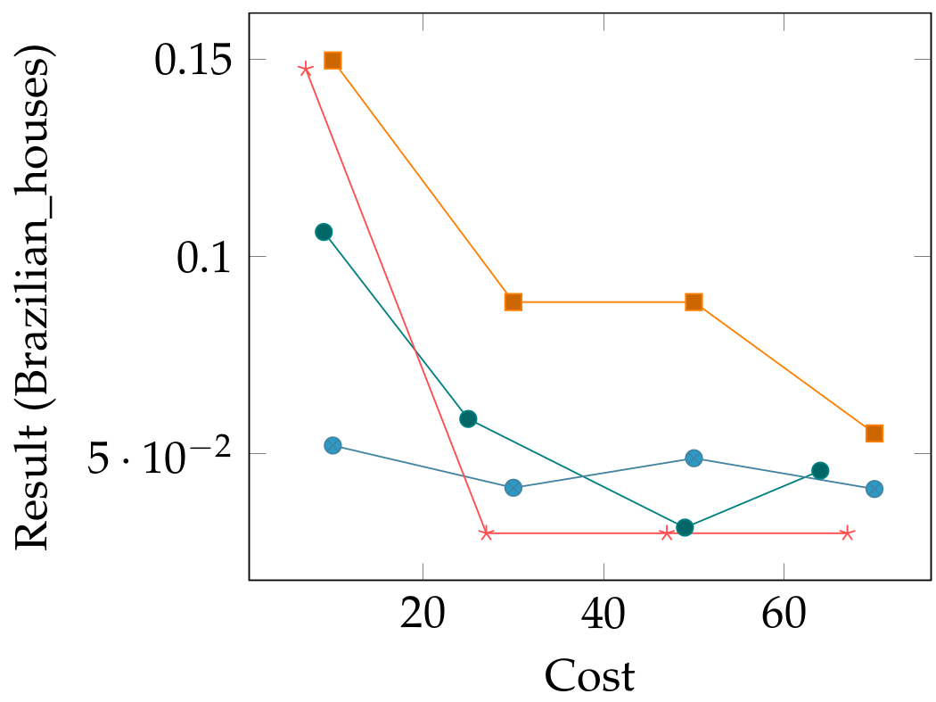
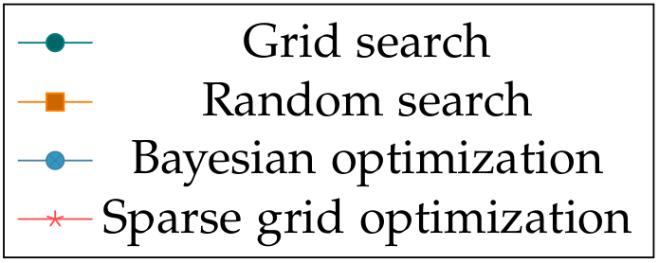
Numerical Results
2D Optimization: Epochs, Learning rate

Slide 11
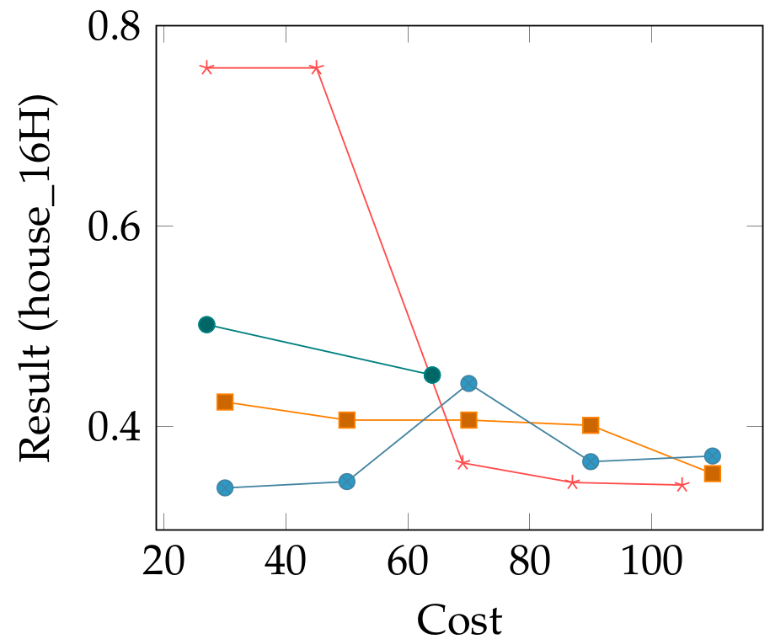
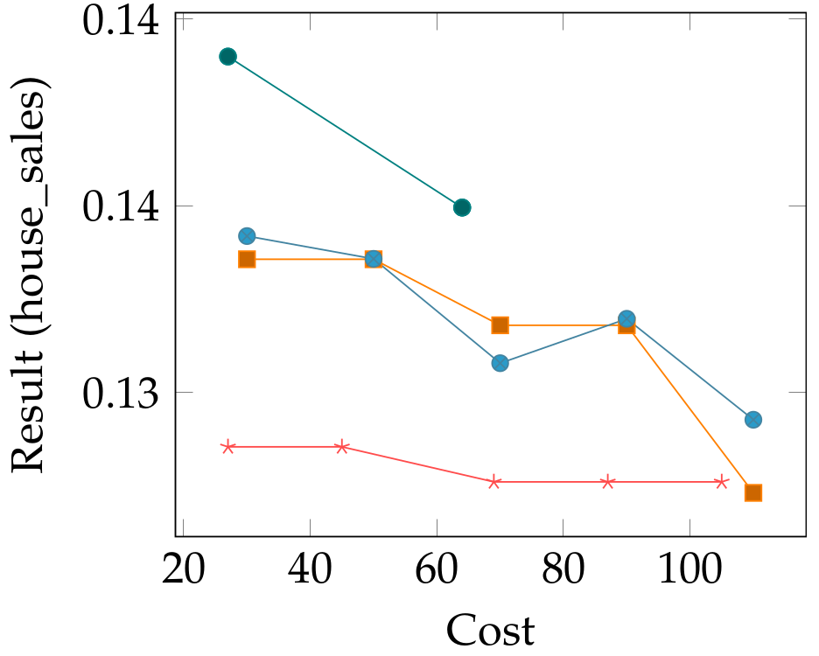
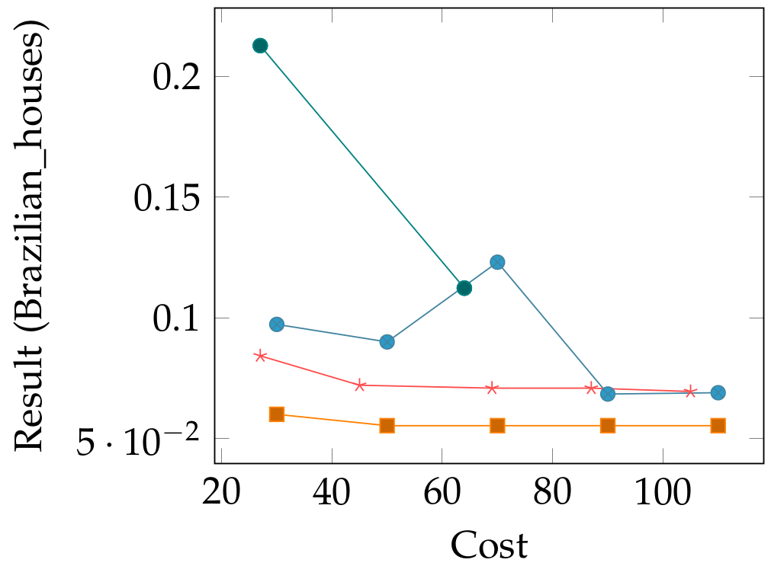
Numerical Results
3D Optimization: Epochs, Learning rate, Batch size

Slide 12
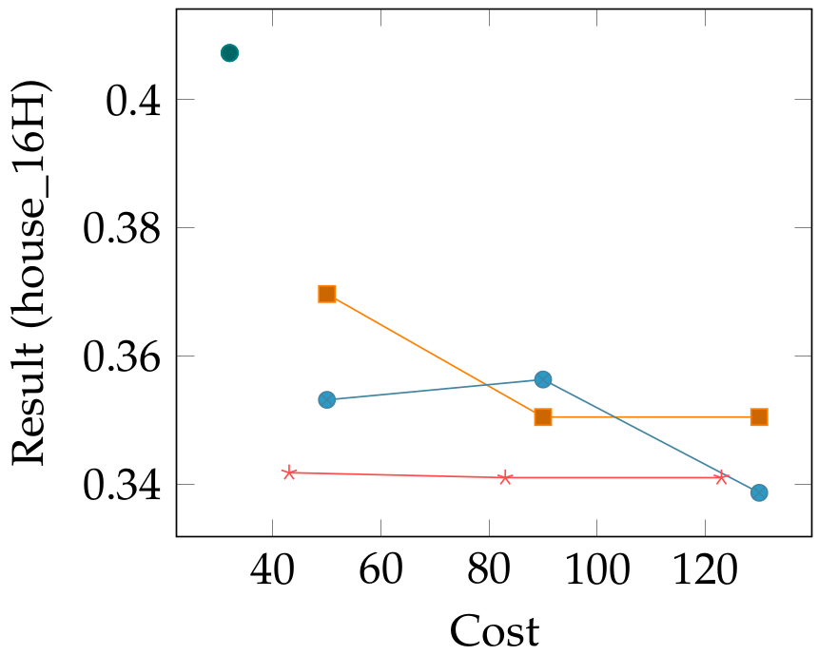
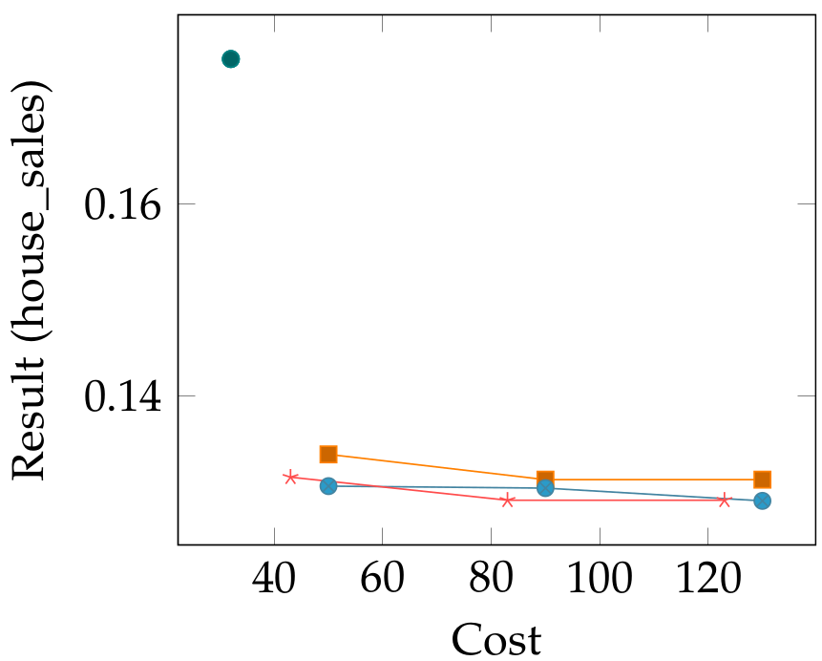
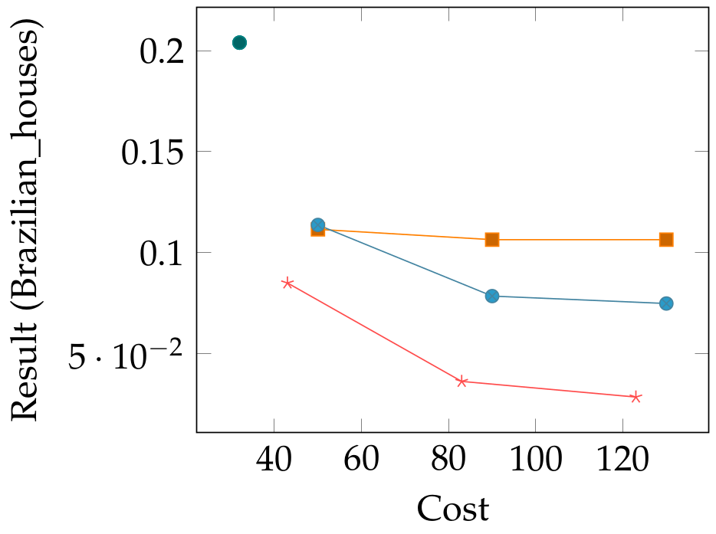
Numerical Results
5D Optimization: Epochs, Learning rate, Batch size, Number of layers & neurons per layer

Slide 13
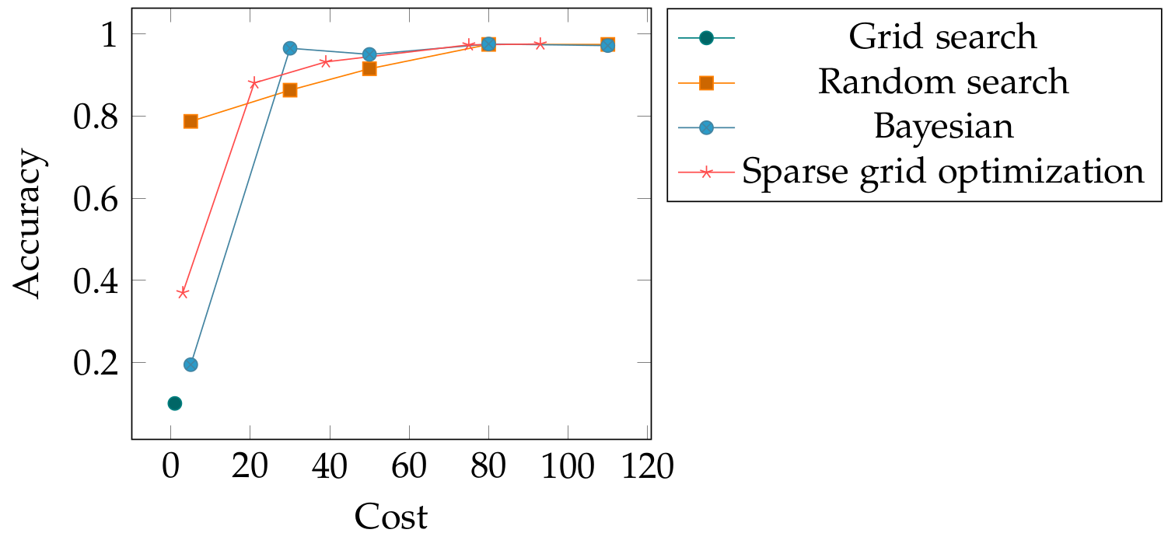
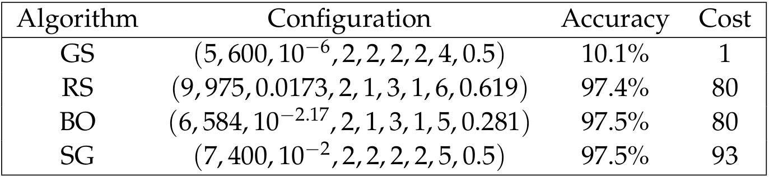
Application: MNIST
9D Optimization:
Epochs
Batch size
Learning rate
Number of convolutional Layers
Number of fully connected layers
Kernel size
Pool size
Neurons per fully connected
Dropout probability

Slide 14
Iterative Adaptive Random Search
Sample initial points uniformly
in search space
Algorithm:
Will budget
be exhausted?
Sort array of points with
ascending function values
Sort array of points with
ascending function values
Return array of points
Select point to be
refined
Sample new points according
to refinement strategy

Slide 15
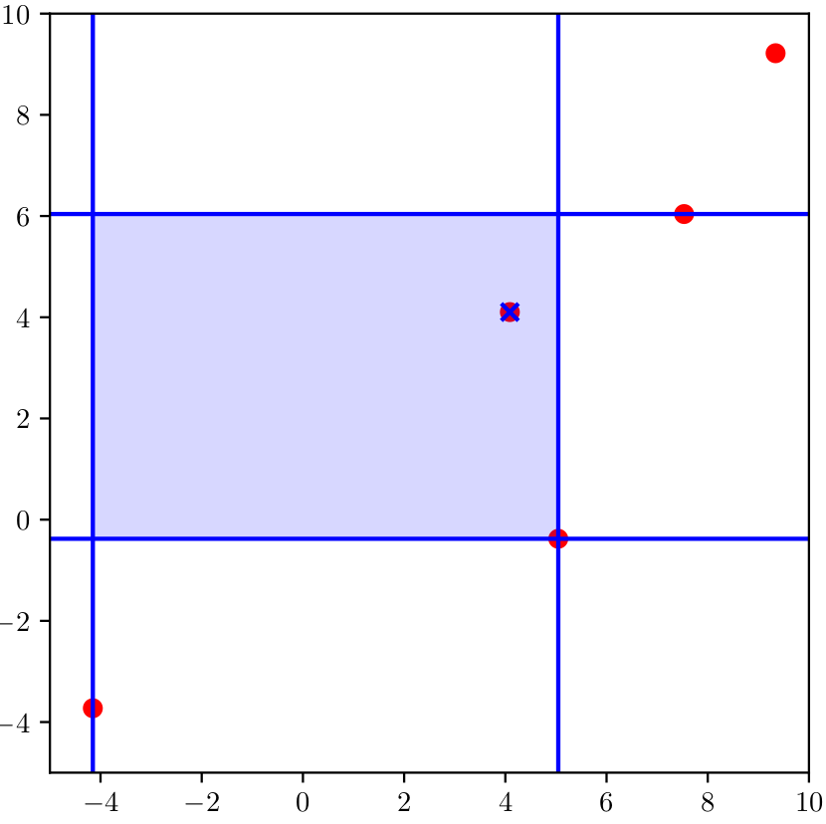
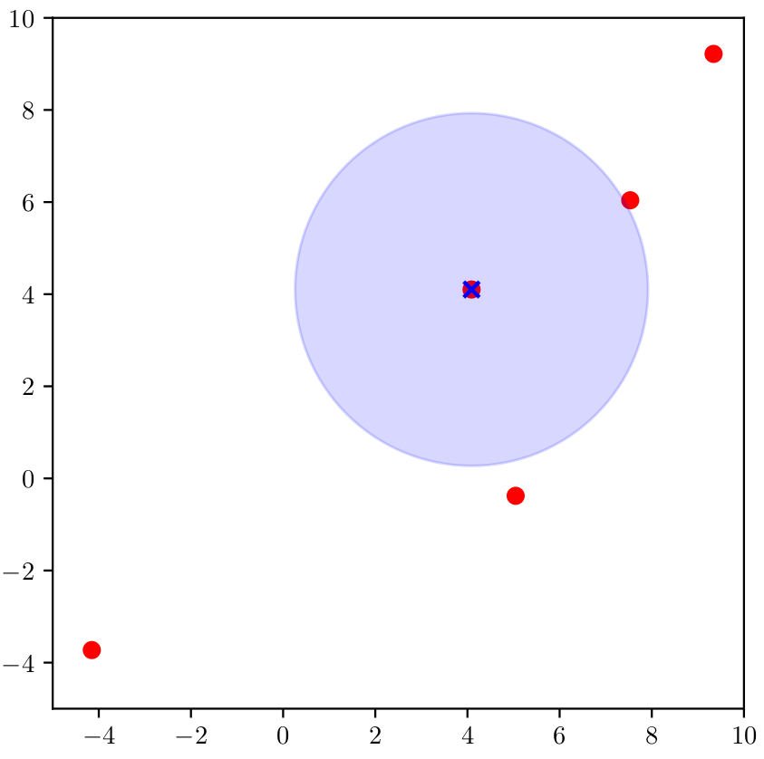
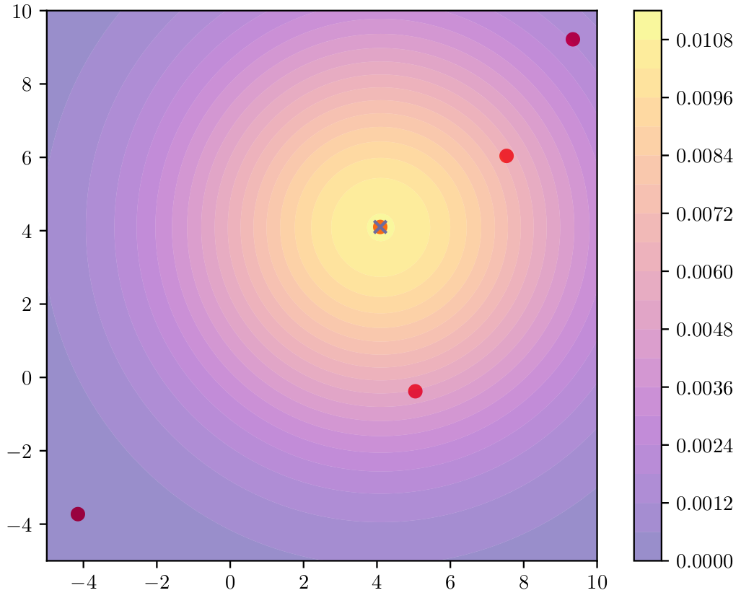
Refinement Strategies
Interval based refinement
Uniform d-ball sampling
Normal distribution sampling
Refinement criterion:

Slide 16
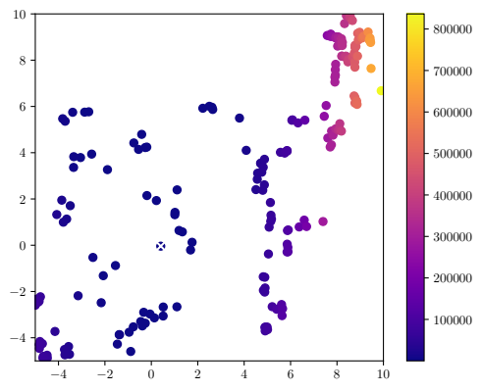
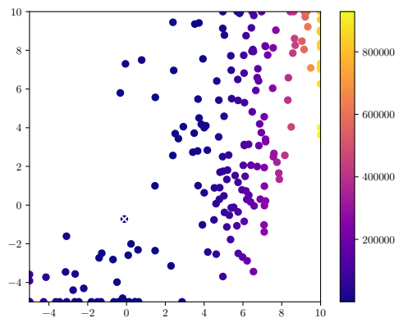
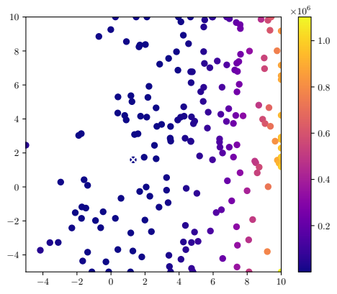
Adaptivity parameter γ = 1.0
Interval based refinement
Uniform d-ball sampling
Normal distribution sampling
Refinement criterion:
1

Slide 17
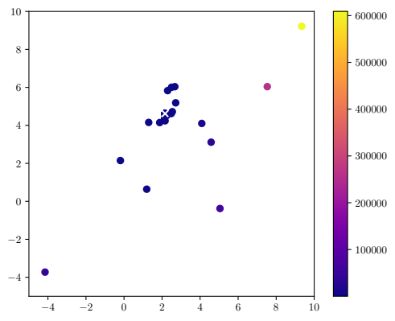
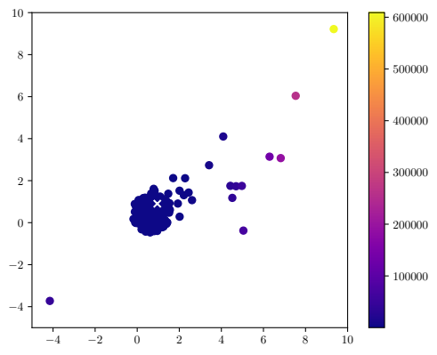
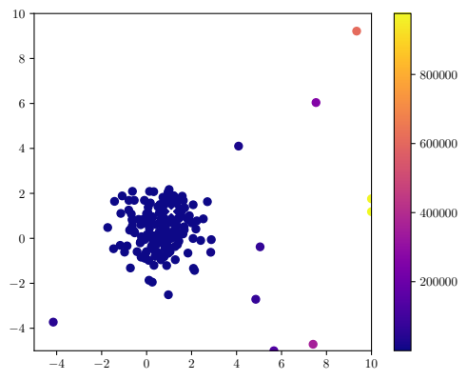
Adaptivity parameter γ = 0.0
Interval based refinement
Uniform d-ball sampling
Normal distribution sampling
Refinement criterion:
1

Slide 18
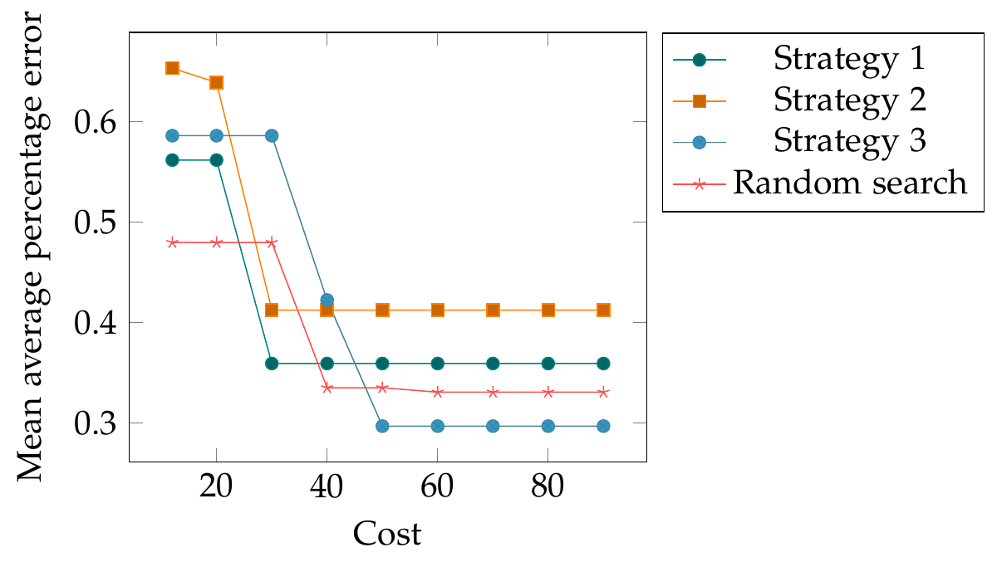
Comparison of Optimization Algorithms
2D Optimization: Epochs & Learning rate

Slide 19
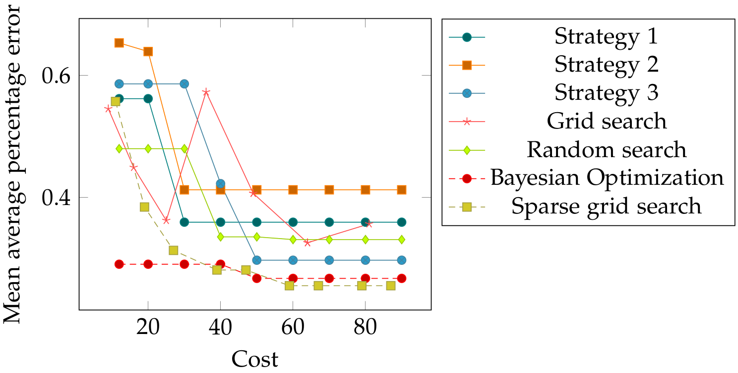
Comparison of Optimization Algorithms
2D Optimization: Epochs & Learning rate

Slide 20
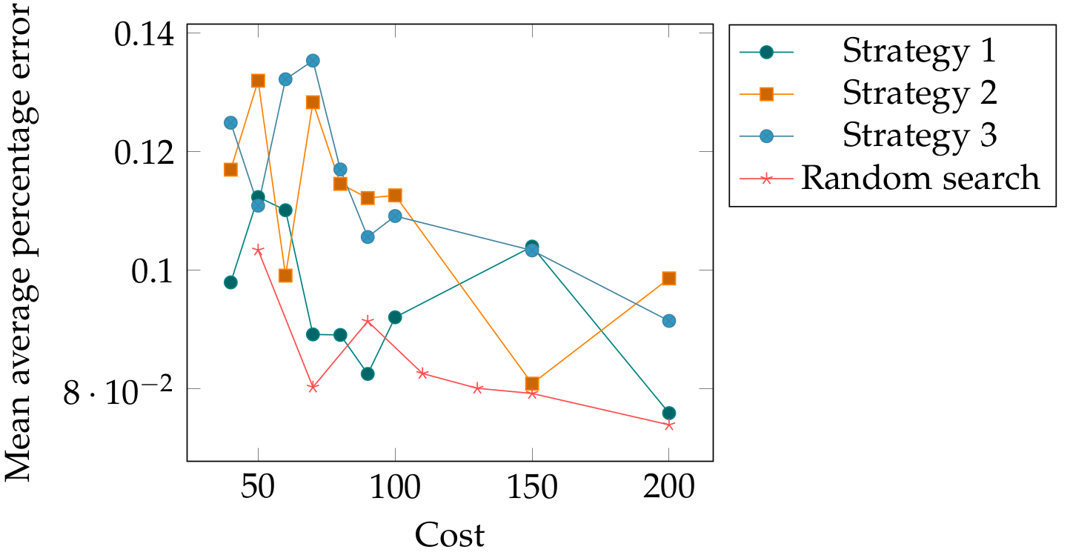
Comparison of Optimization Algorithms
6D Optimization:
Epochs
Batch size
Learning rate
Number of layers
Neurons per layer
Dropout probability

Slide 21
Discussion – Sparse Grid Hyperparameter Optimization
Often not enough grid points for optimizer
→ apply global and local optimizer and compare with the best grid point
Problem if optimum at the boundary
→ optimizer can sometimes help or use sparse grid with boundary points
BUT: time to solution most important
Performs well especially in higher dimensions

Slide 22
Discussion – Iterative Adaptive Random Search
Promising results in small dimension
Problem: Volume of d-ball compared to d-hypercube decreases rapidly for increasing d
→ worse performance than conventional random search for higher dimensions
More analysis:
  Convergence?
  Adapt algorithm?
  Other search radius?
  Change refinement criterion (e.g. include function value)?
  Other refinement strategy?

Slide 23
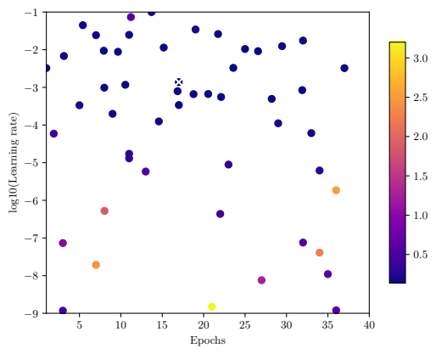
Conclusion
      Grid search:
      Bayesian optimization:
      Random search:
      Sparse grid optimization:

Slide 24
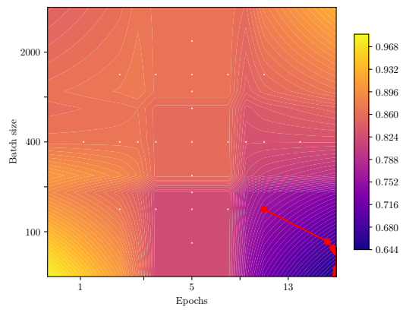
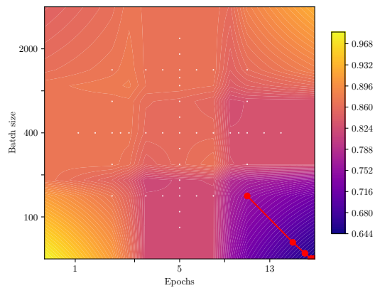
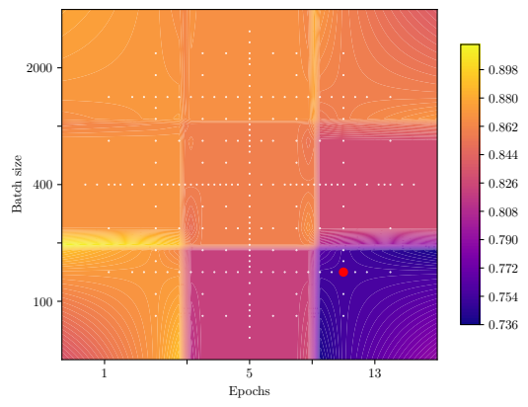
Optimization – Categorical Hyperparameters
Examples: choice of optimizer as hyperparameter, rounding to integers

