Slide 1

Neural Network Hyperparameter Optimization with Sparse Grids
Maximilian Michallik
Technichal University Munich
Chair of Scientific Computing
Department Computer Science
TUM School of Computation, Information
and Technology
Garching, 02. August 2023

Slide 2
Outline
Introduction
  Def. Hyperparameters
  Overview over techniques from literature
  Overview over new techniques
Sparse Grid Search
  Implementation
  Analysis
  Numerical results (and comparison with other techniques)
Iterative adaptive random search
  Implementation
  Analysis
  Numerical results
Discussion & Conclusion
Outlook

Slide 3
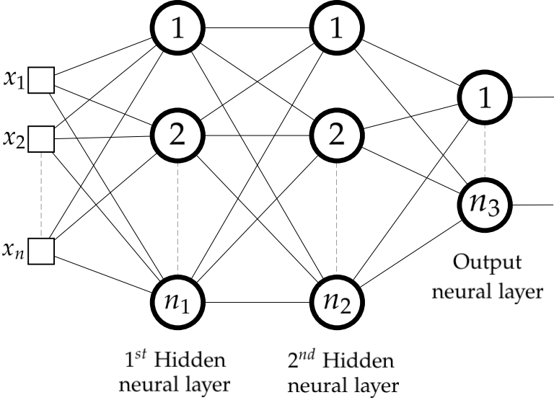
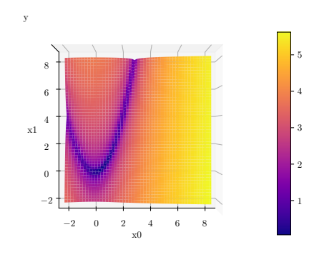
Hyperparameter Optimization
Hyperparameters: Paramaters of a ML model that are fixed before training
Number of layers/ neurons, epochs,
learning rate, ...
Optimization: finding the optimum of a function
Rosenbrock: Optimum at (1, 1)

Slide 4
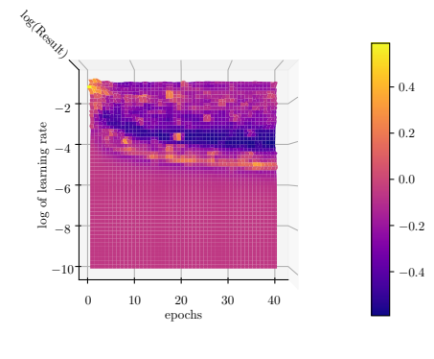
Hyperparameter Optimization
Regression of 2-layer neural network:

Slide 5
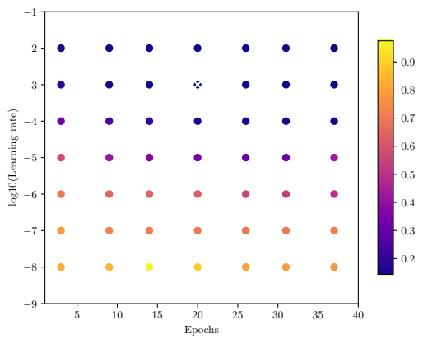
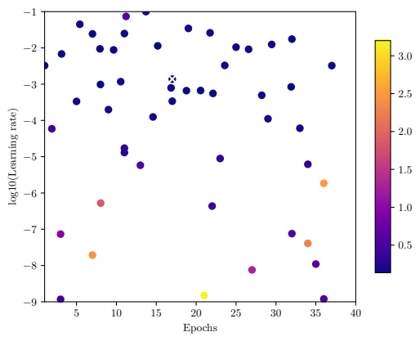
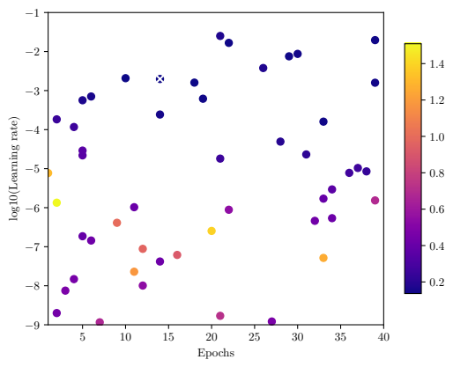
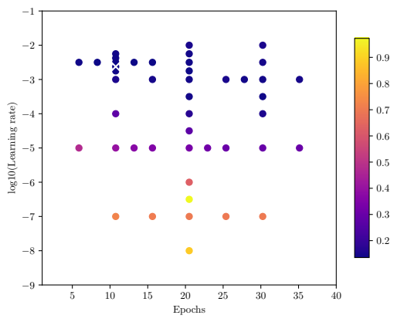
Hyperparameter Optimization
  Grid search:
  Random search:
Bayesian optimization:
Sparse grid search:

Slide 6
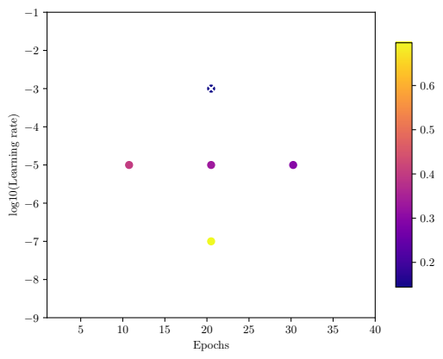
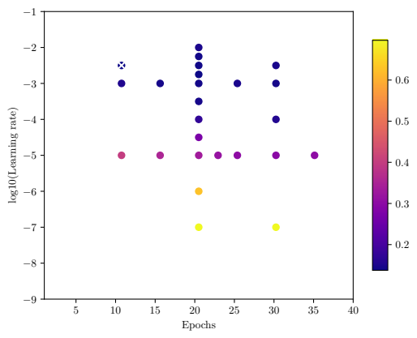
Sparse Grid Hyperparameter Optimization
With Novak-Ritter refinement criterion:

Slide 7
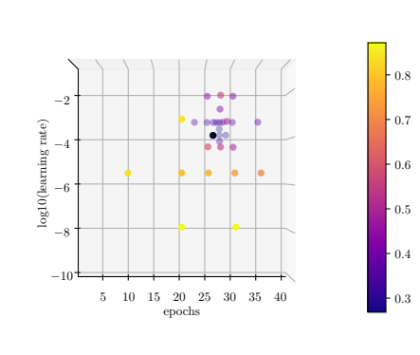
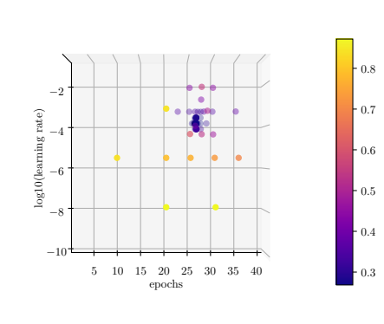
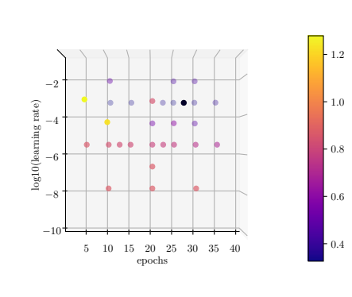
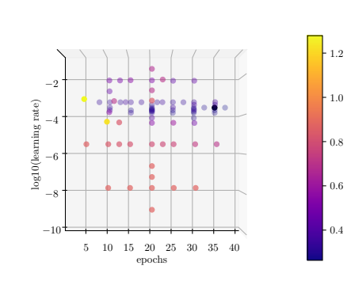
Adaptivity Parameter γ
Budget = 30
Budget = 50
γ = 0.5
γ = 0.85

Slide 8
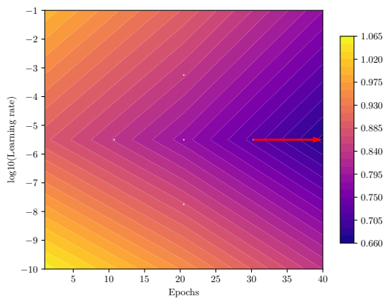
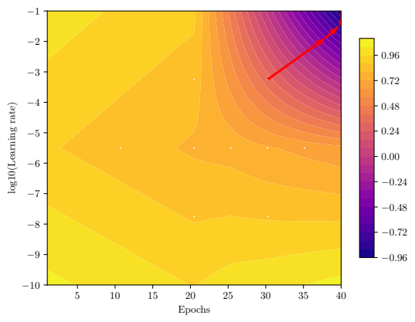
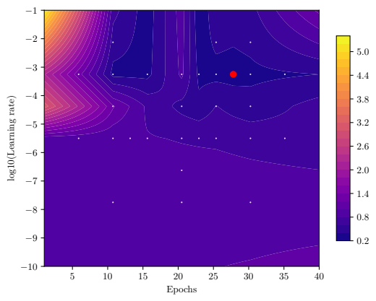
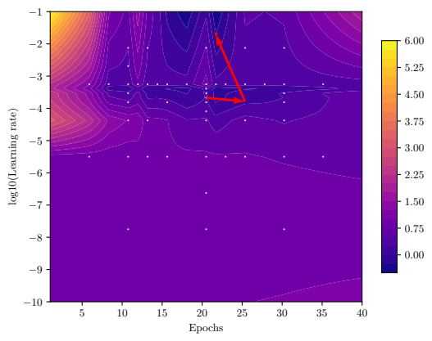
Sparse Grid Hyperparameter Optimization
Gradient-free optimizers:
Nelder Mead, differential evolution, CMA-ES
Gradient-based optimizers:
Gradient descent, NLCG, Newton, Rprop

Slide 9
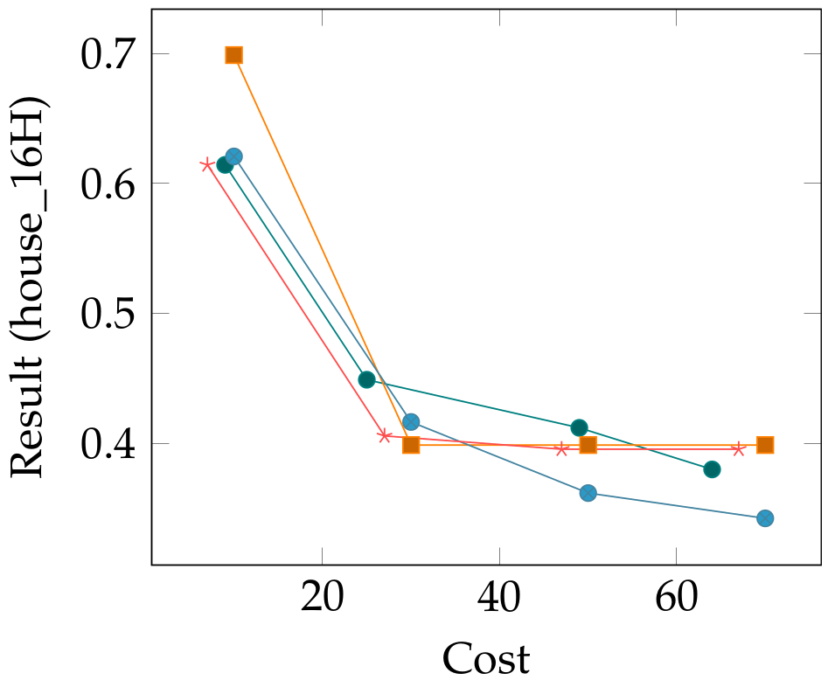
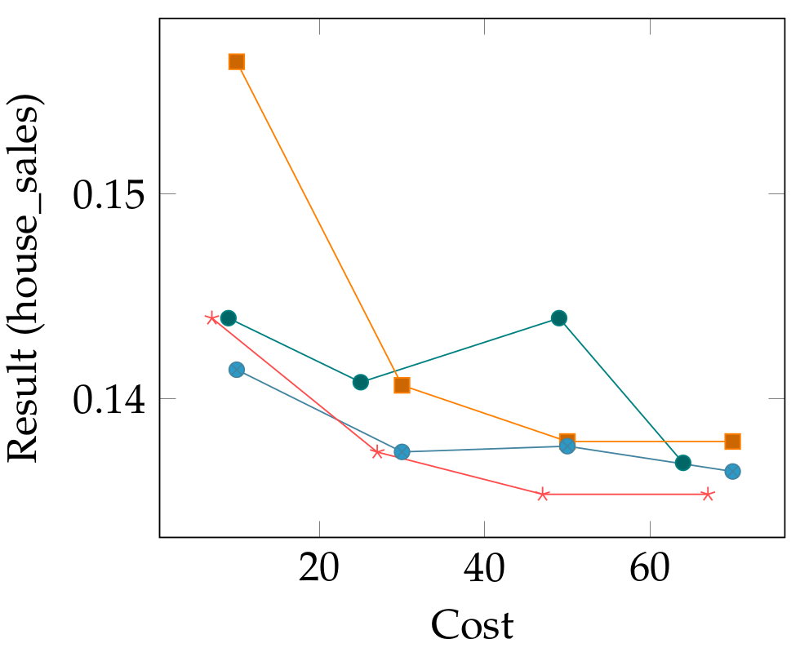
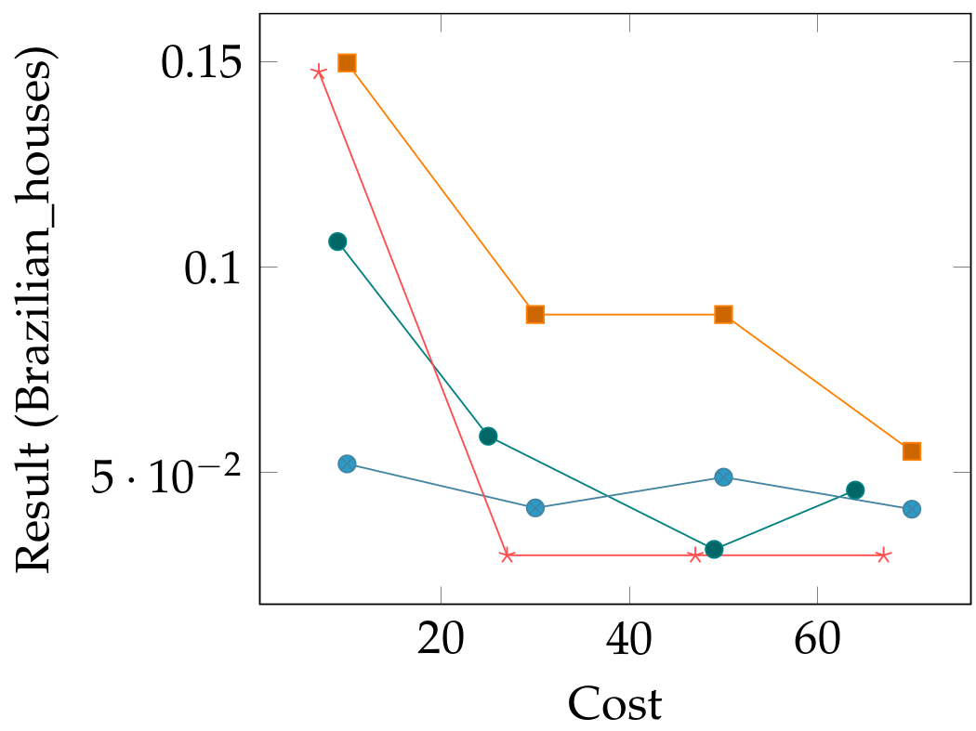
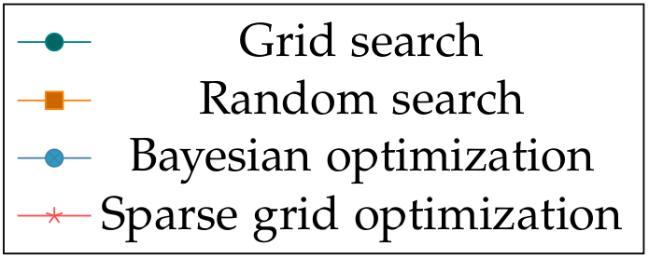
Numerical Results
2D Optimization: Epochs, Learning rate

Slide 10
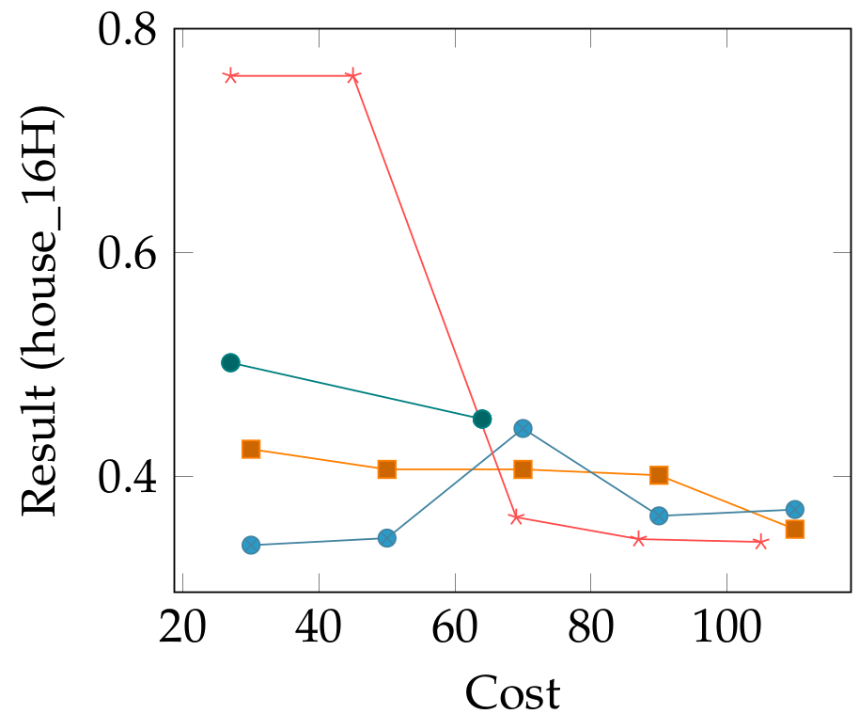
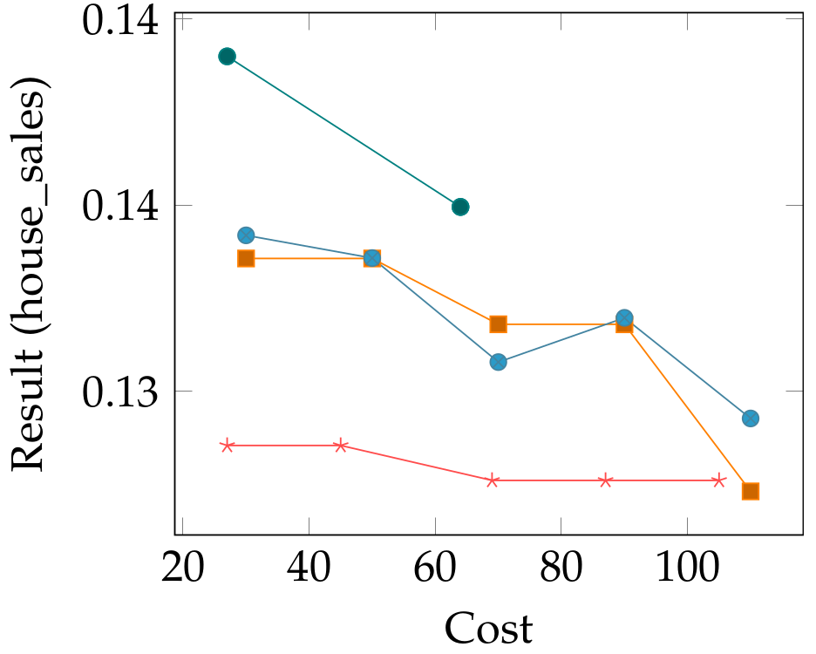
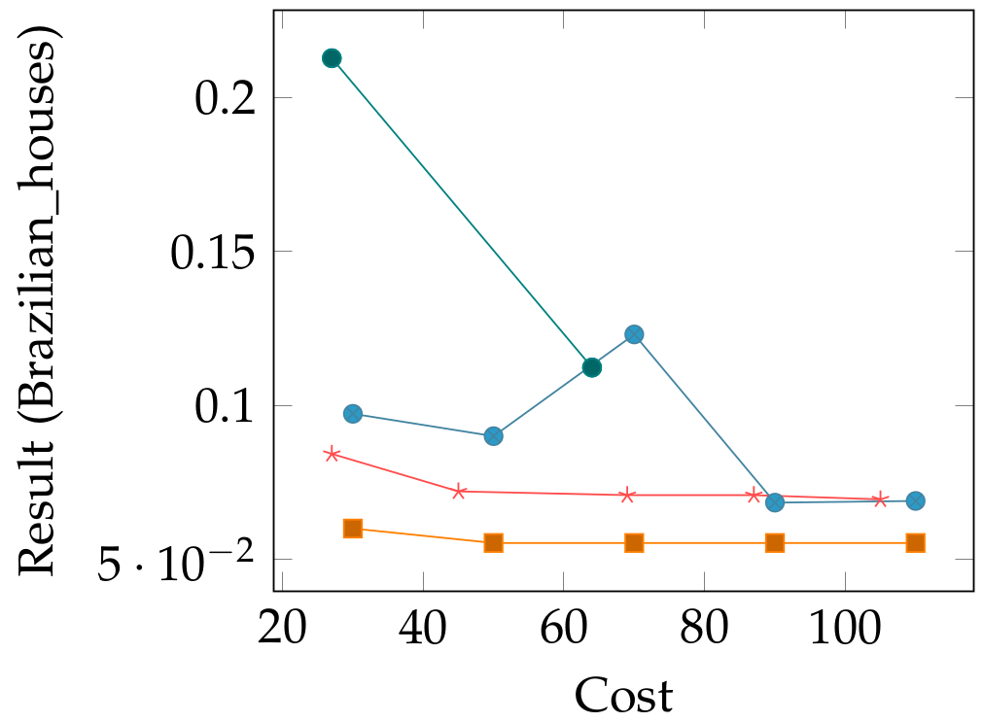
Numerical Results
3D Optimization: Epochs, Learning rate, Batch size

Slide 11
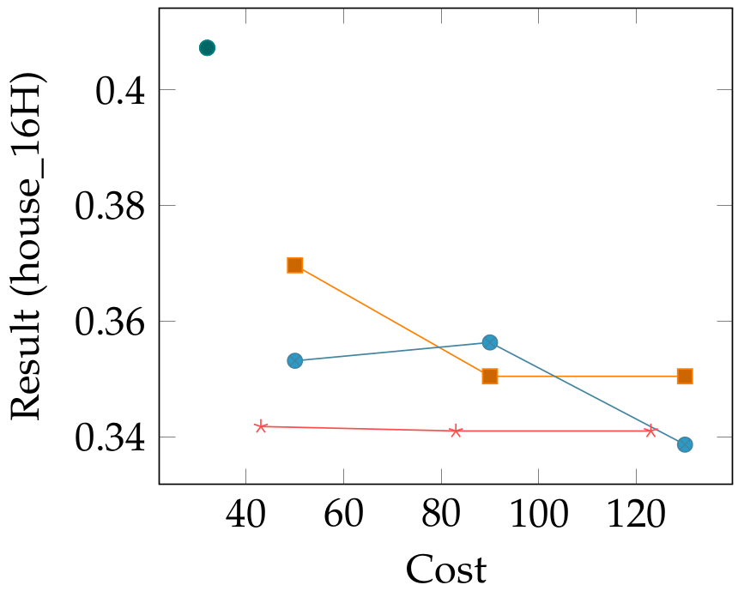
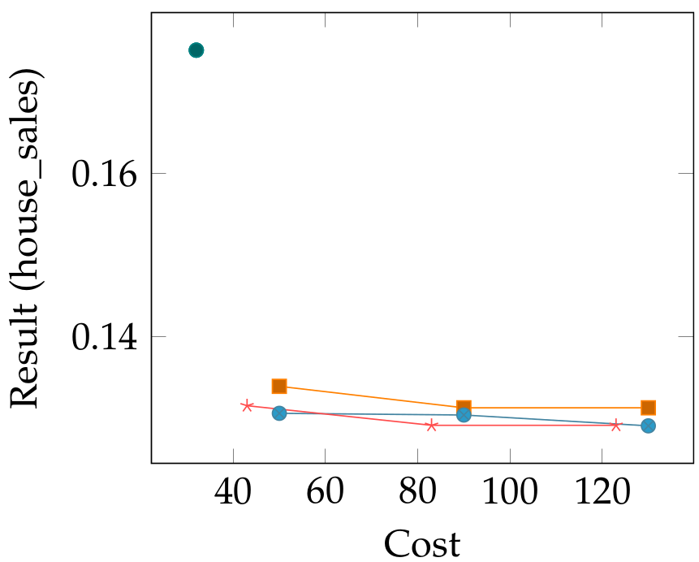
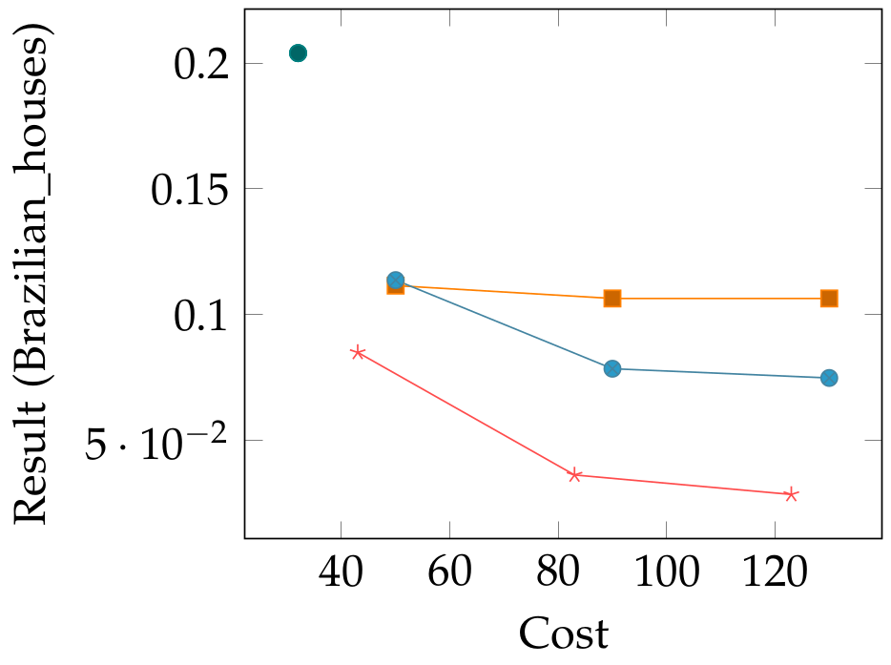
Numerical Results
5D Optimization: Epochs, Learning rate, Batch size, Number of layers & neurons per layer

Slide 12
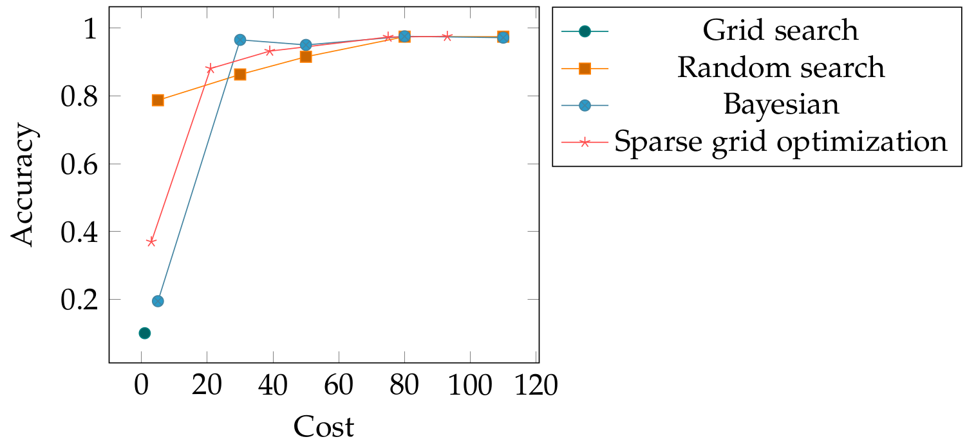
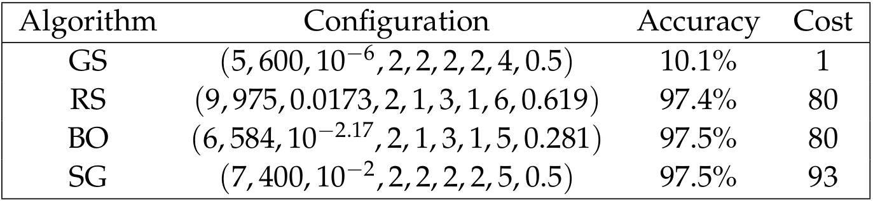
Application: MNIST
9D Optimization:
Epochs
Batch size
Learning rate
Number of convolutional Layers
Number of fully connected layers
Kernel size
Pool size
Neurons per fully connected
Dropout probability

Slide 13
Improvement of Random Search
Idea: Combine advantages of random search and iterative optimization algorithm
Algorithm:
Sample initial points uniformly
in search space
Will budget
be exhausted?
Sort array of points with
ascending function values
Sort array of points with
ascending function values
Return array of points
Select point to be
refined
Sample new points according
to refinement strategy

Slide 14
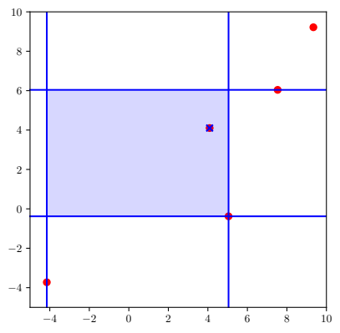
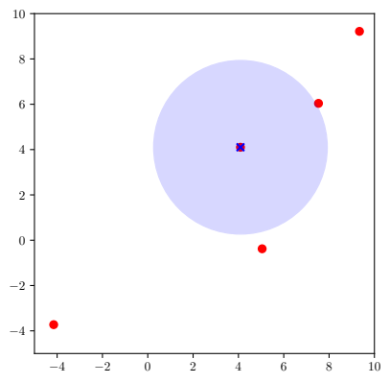
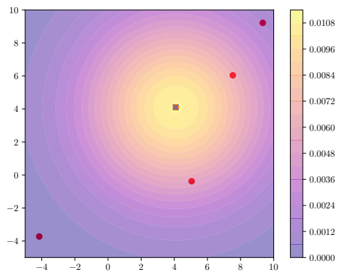
Refinement Strategies
Interval based refinement
Uniform d-ball sampling
Normal distribution sampling
Refinement criterion:

Slide 15
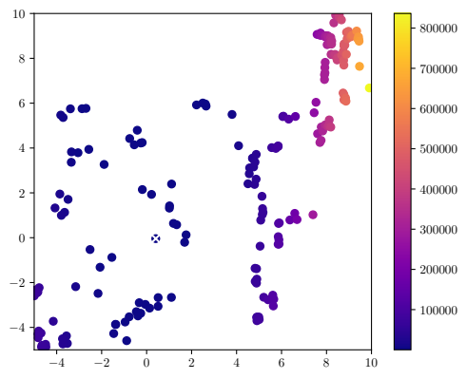
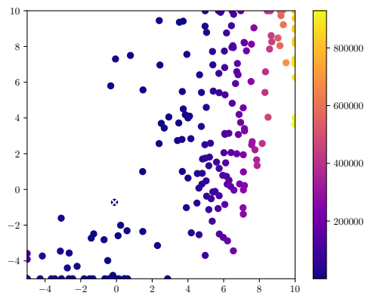
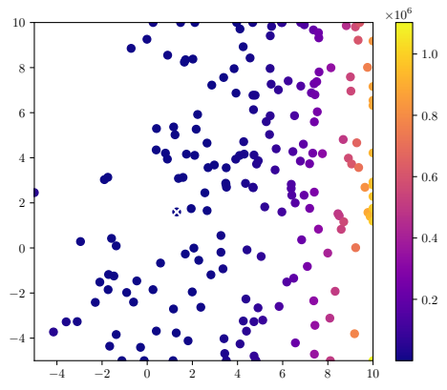
Adaptivity parameter γ = 1.0
Interval based refinement
Uniform d-ball sampling
Normal distribution sampling
Refinement criterion:
1

Slide 16
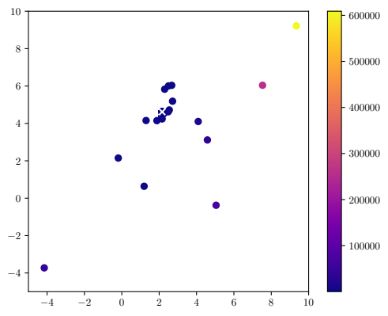
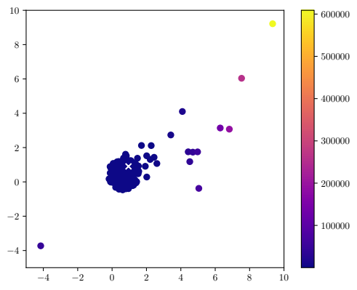
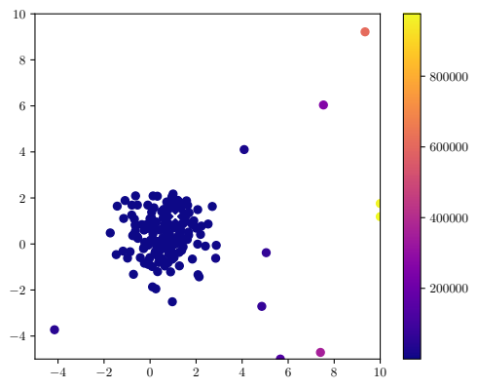
Adaptivity parameter γ = 0.0
Interval based refinement
Uniform d-ball sampling
Normal distribution sampling
Refinement criterion:
1

