Slide 1
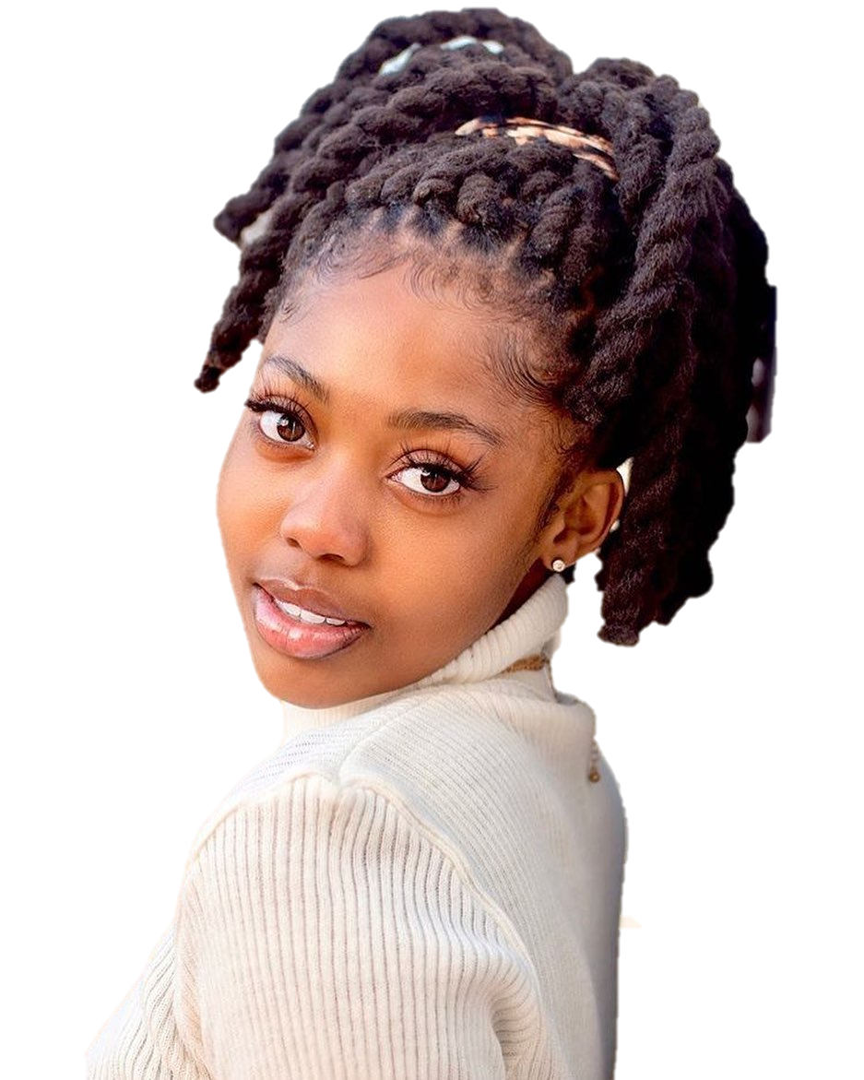
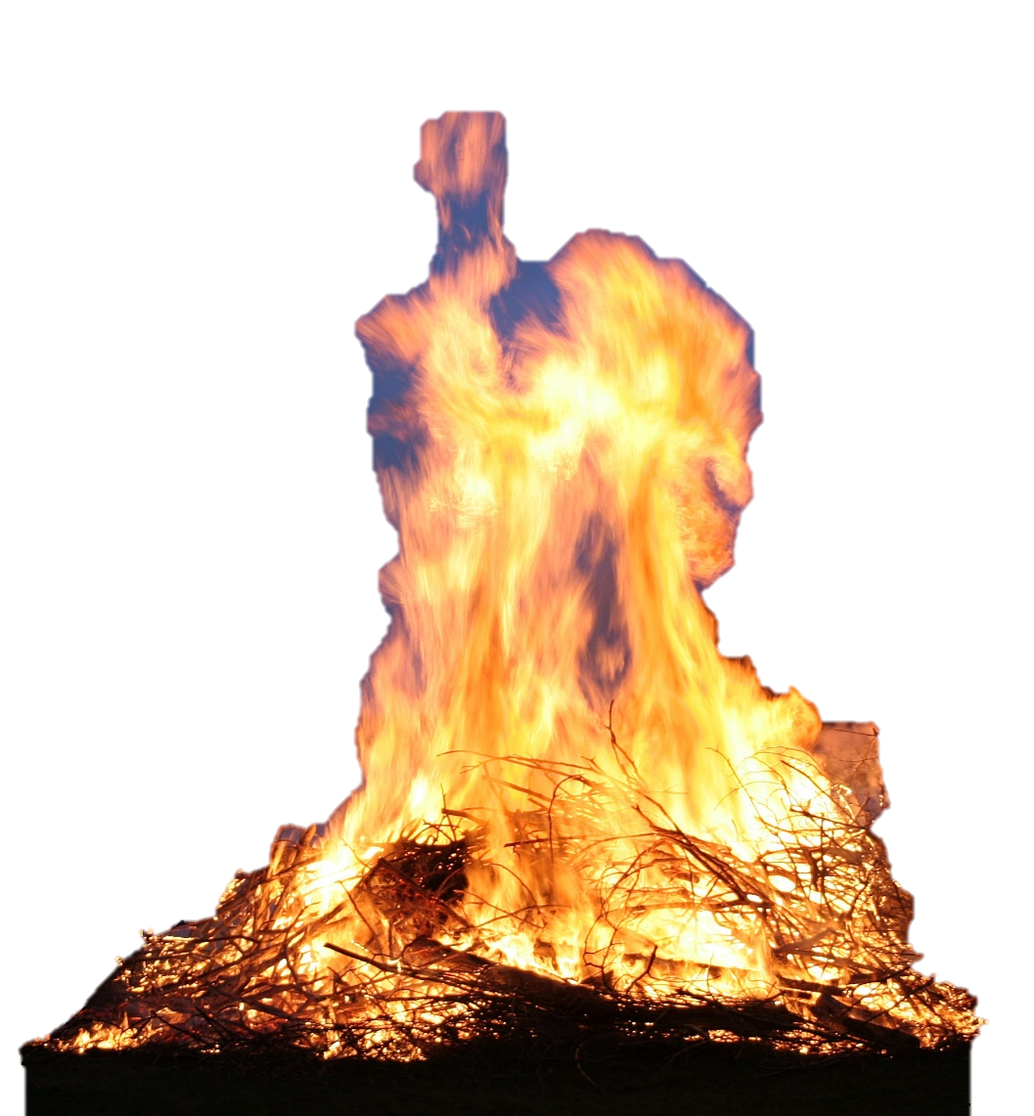
Miracle hands
+263 771 386 613
CLUB
PARTY
DEC 25TH
PARADISE CLUB ,ENTRY $12,00
Party starts 10:00pm
Dj WHISK|DJ BANTANNA |DJ ORy2X |ABUJAR 55X 55x

