Slide 1
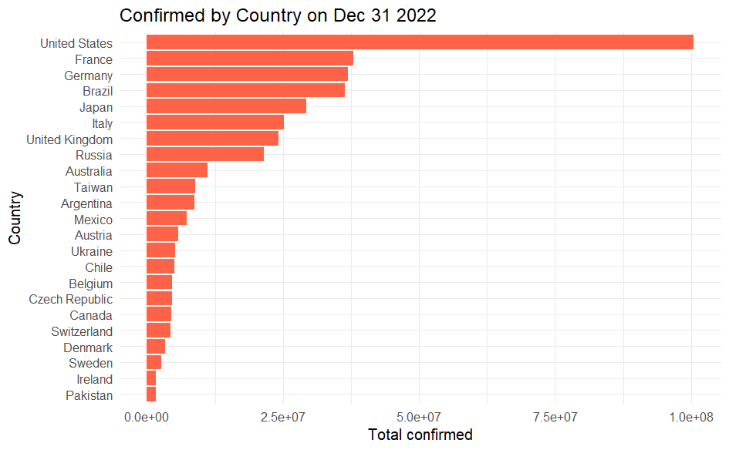
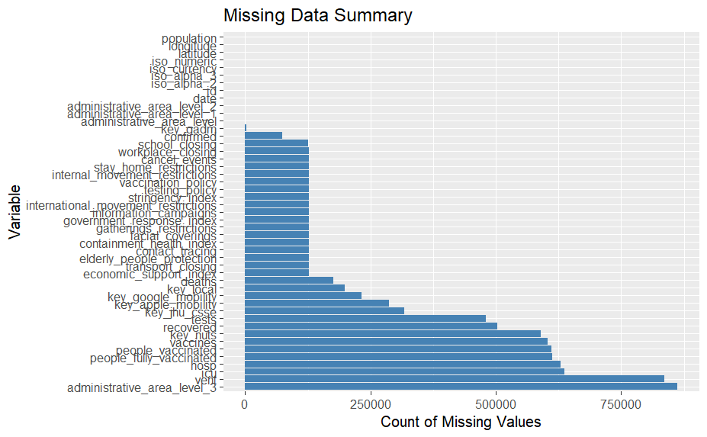
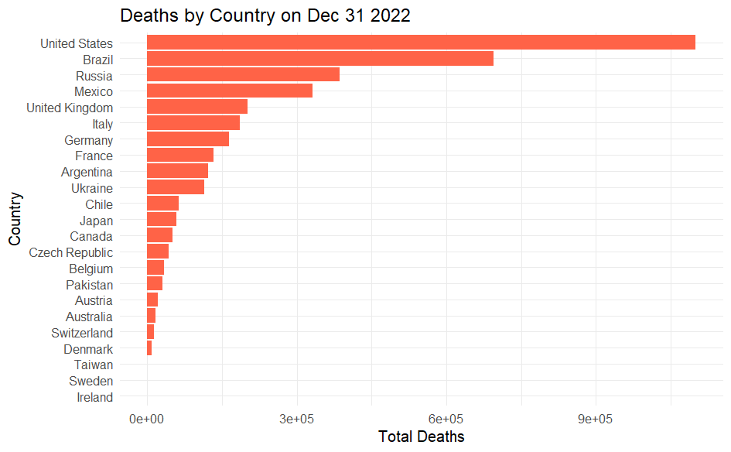
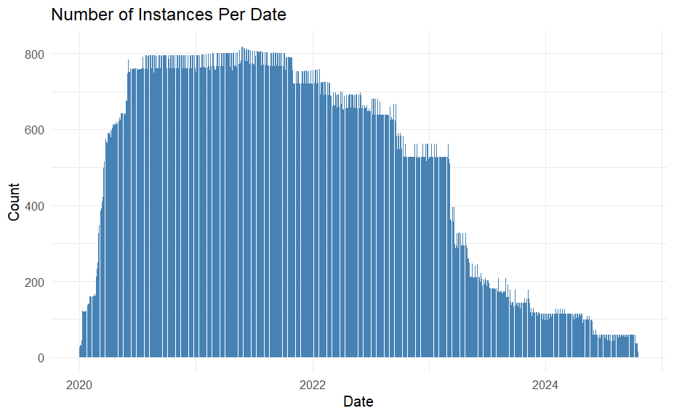
Data Preprocessing
Based on Figures 3 and 4, the U.S. ranks first in the world in terms of the number of confirmed cases and the number of deaths, so we will choose the U.S as a focus of analysis.
Based on Figure 1, we can confirm that there are no missing values for the variable of date.
Thus, we can create Figure 2 which is the change in the amount of data based on the change of the date.
As the daily data volume decreases after the end of 2022, we can choose Dec 31, 2022, as the time node.
And we can create Figures 3 and 4 depending on this date.

Slide 2
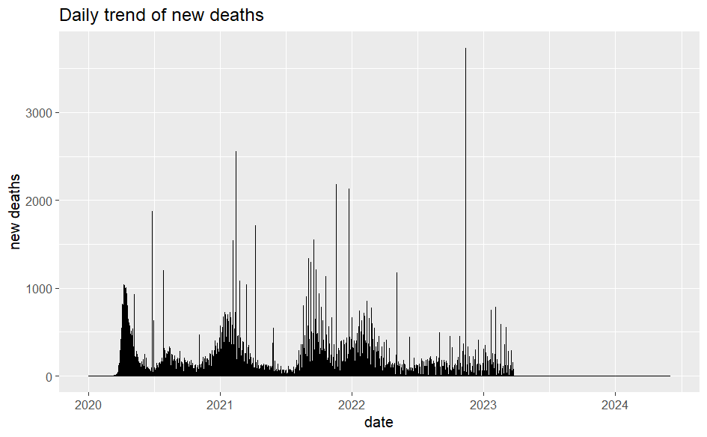
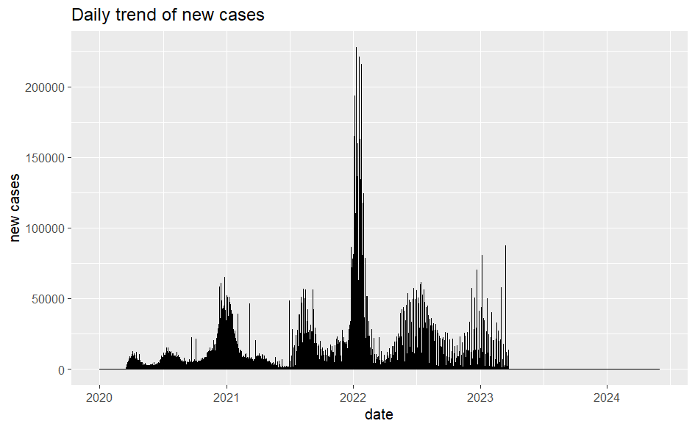
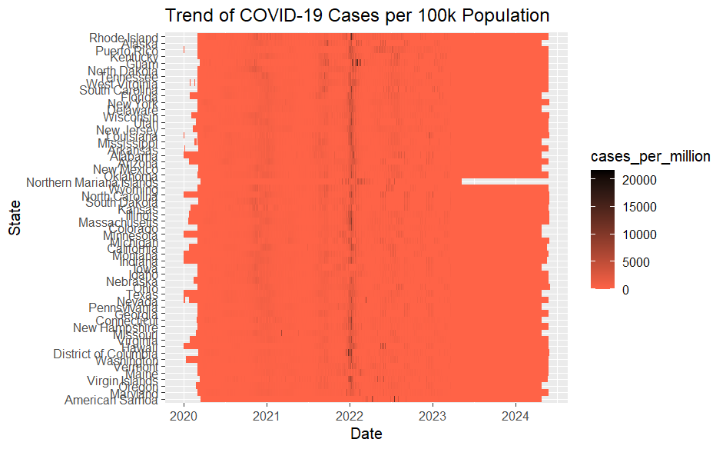
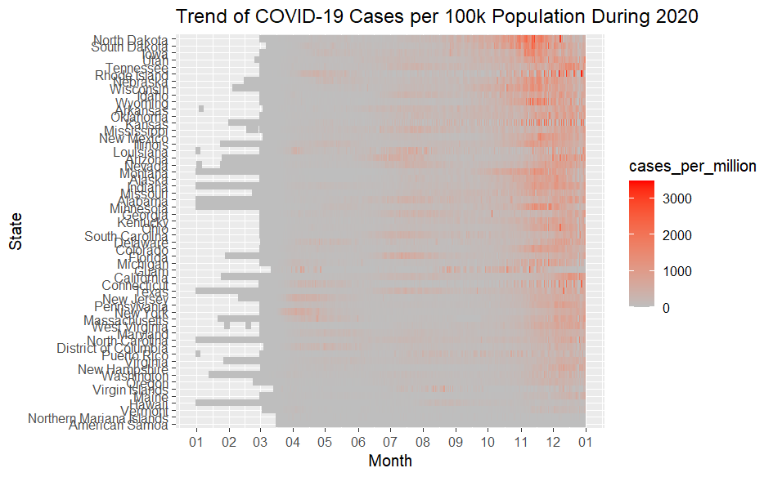
United States epidemic data analysis
Here’re the daily changes in the number of new confirmed and new deaths as shown in Figure 5 and 6.
If we restrict the time period within 2020, we can see the difference in new confirmed from state to state.
Next, I analyzed the variation in new confirmed across states. Considering that the total population of each state is different, I compare new confirmed per million people across states.

Slide 3
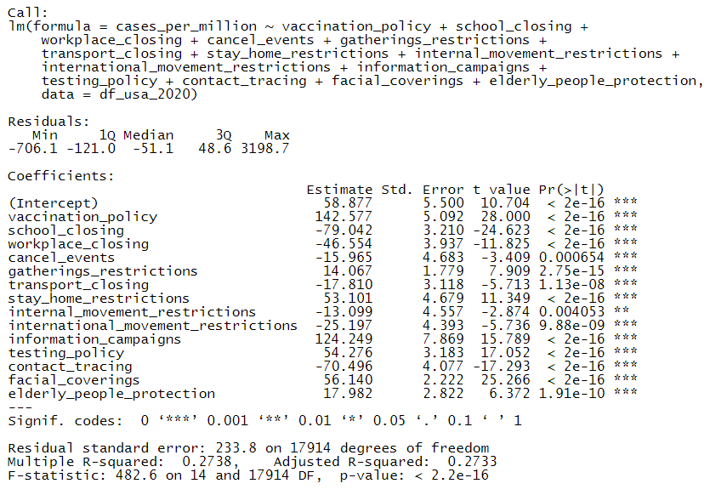
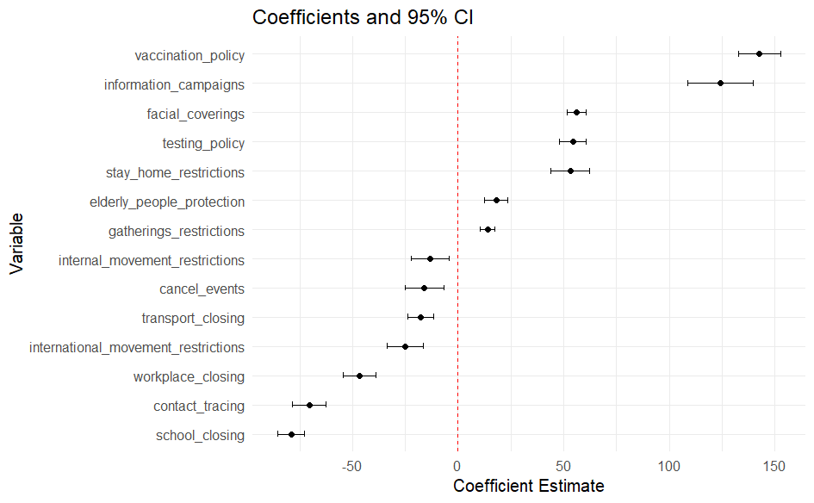
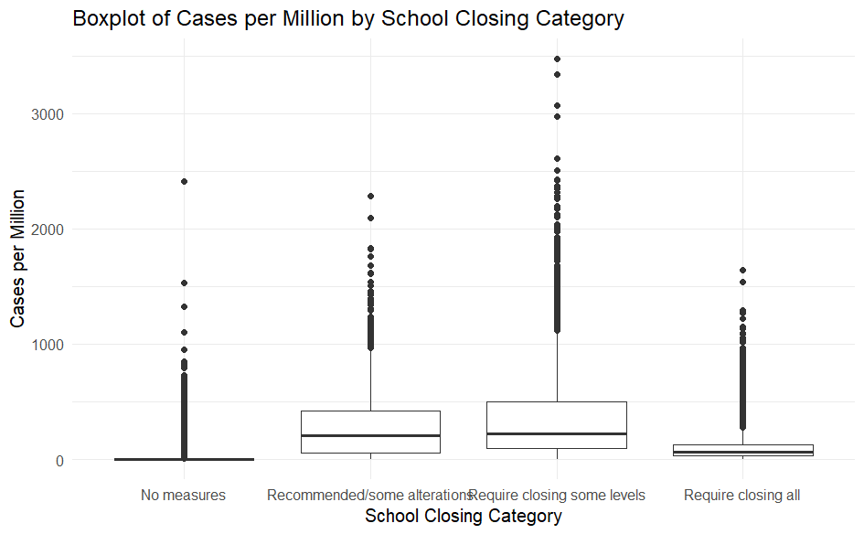
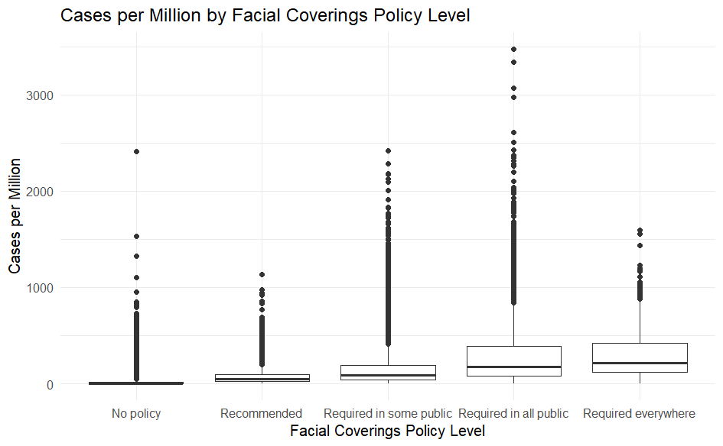
The effect of Policy on the epidemic
Here’s the coefficient estimates and their confidence intervals for each variable. As confidence intervals have the same sign and neither crosses 0. This means that the effect of policy variables on the new confirmed per million people is statistically significant.
I conduct a regression analysis using new confirmed per million people as the dependent variable and the other policy measure variables as independent variables.
As policy measure variables are all categorical, I use box plots to analyze the effect of school closures and mask-wearing policies on new confirmed per million people.

