Slide 1
Control-guided condensate classification diagnostics
H2B-bound vs MCM2-bound separability and target-track interpretation
2,169
178
9,930
H2B_Bound tracks
MCM2_Bound tracks
TDP43/NONO target tracks
Cautious readout: motion patterns consistent with confinement/trapping, not definitive condensate localization.
Control-guided diagnostics and separability
01

Slide 2
FRAMING
Why this diagnostic was needed
H2B-bound and MCM2-bound are both chromatin-associated controls, but they may not represent the same motion pattern.
The target question is whether TDP43/NONO tracks differ from free-like nuclear motion and both bound-control patterns.
The stricter label is target-specific trapping-like dynamics; tracking alone does not prove physical condensates or paraspeckles.
Control-guided diagnostics and separability
02

Slide 3
INPUTS
Data inventory
2,169
178
9,930
13
H2B_Bound tracks
MCM2_Bound tracks
TDP43/NONO tracks
TDP43 folders parsed
Files used: single-behaviour-track-H2b-bound.csv, single-behaviour-track-MCM2-bound.csv, final_control_guided_track_classification.csv, and 48 old condensate_evaluation CSVs.
TDP43 folder names were parsed as genotype-date-treatment, with unknown fields kept rather than crashing.
Control-guided diagnostics and separability
03

Slide 4
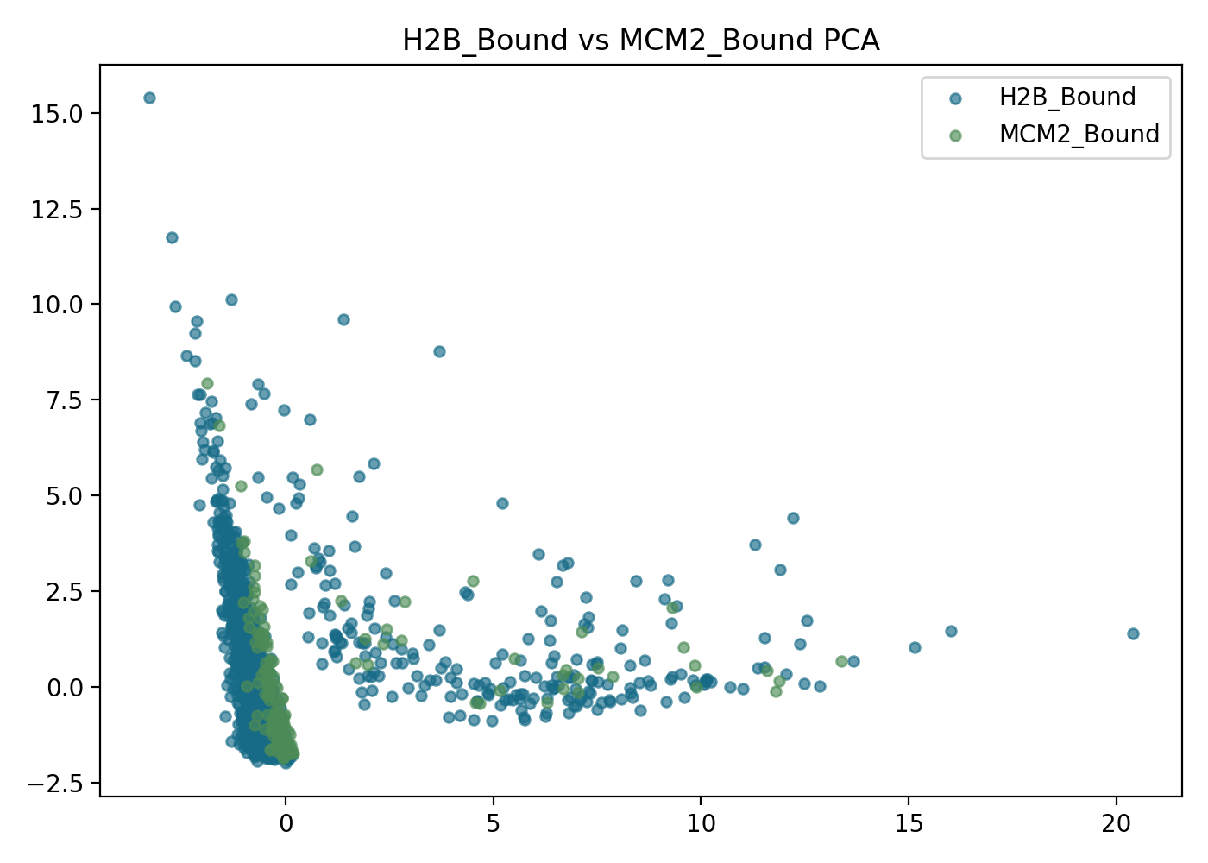
BOUND-CONTROL TEST
H2B_Bound vs MCM2_Bound: partly separable
0.623
balanced accuracy
0.902
ROC-AUC
0.665
macro F1
Interpretation: the controls carry separable signal, but overlap remains substantial. Treat them as related-but-not-identical reference states.
Control-guided diagnostics and separability
04

Slide 5
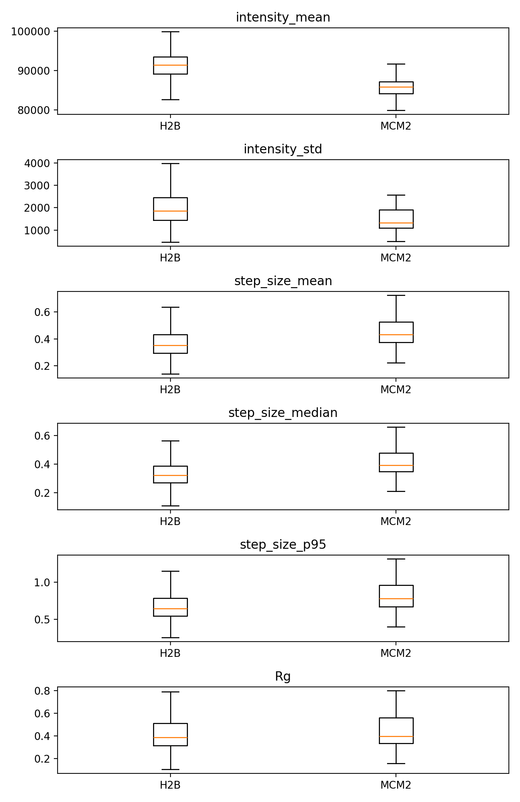
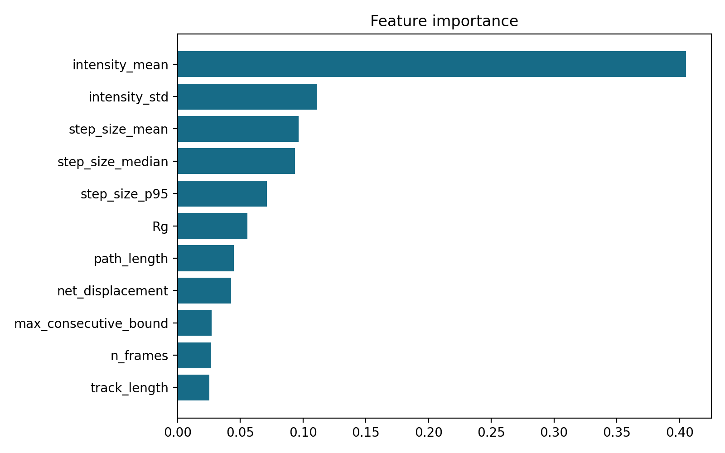
DRIVERS
Features separating H2B_Bound and MCM2_Bound
Top drivers included median step size, intensity variability, track duration, spatial spread, and mean intensity.
Biological read: the classifier is detecting motion and signal-pattern differences, not direct localization.
Control-guided diagnostics and separability
05

Slide 6
CLASS IMBALANCE CHECK
Separation remains after balancing, but is not clean
178
30x
50x
minority-class tracks
repeated downsampling
label permutations
The main conclusion is based on balanced/repeated-downsampled models rather than the much larger H2B count.
Above-chance ROC-AUC supports real separation; modest balanced accuracy shows many tracks remain control-overlap cases.
Practical implication: keeping H2B_Bound and MCM2_Bound separate is justified, while reporting ambiguous overlap is essential.
Control-guided diagnostics and separability
06

Slide 7
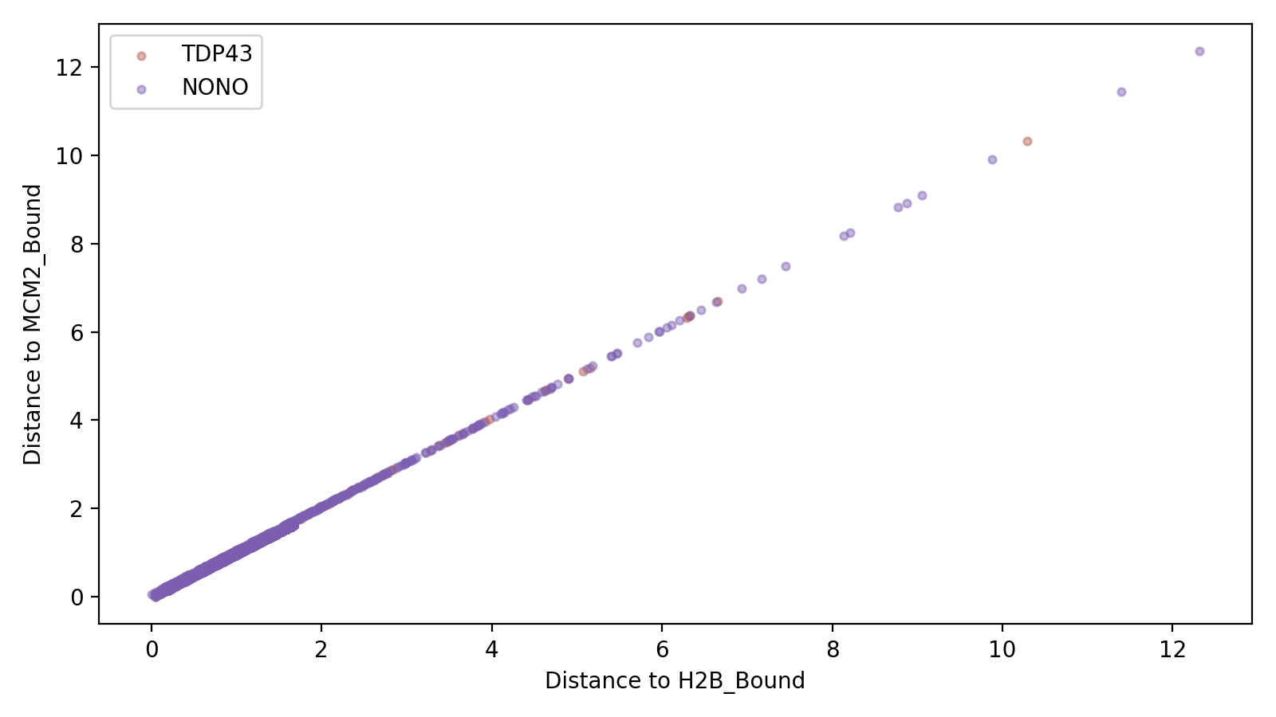
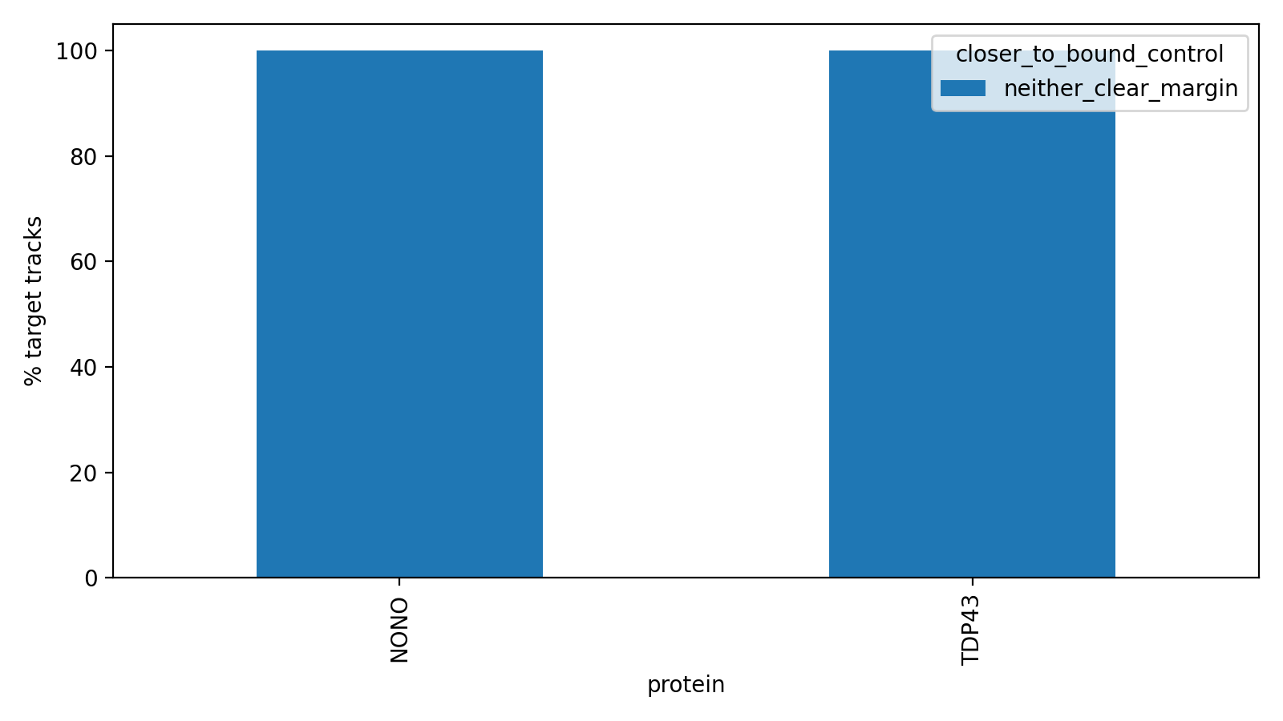
TARGET PROJECTION
Where TDP43 and NONO fall
Protein-level averages sit nearly halfway between H2B_Bound and MCM2_Bound, with a small tilt toward MCM2_Bound-like probability.
Control-guided diagnostics and separability
07

Slide 8
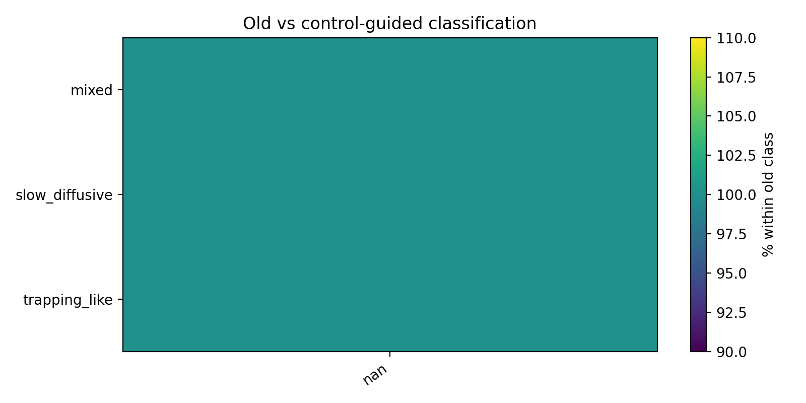
HISTORICAL COMPARISON
Old versus new classification
The old condensate_evaluation labels were compared against final_control_guided_class where track identity allowed.
The stricter model asks a different question: is the target track distinct from NLS, H2B-bound, and MCM2-bound controls?
Old trapping-like should be read as a broad historical label, not the same as target-specific trapping-like.
Control-guided diagnostics and separability
08

Slide 9
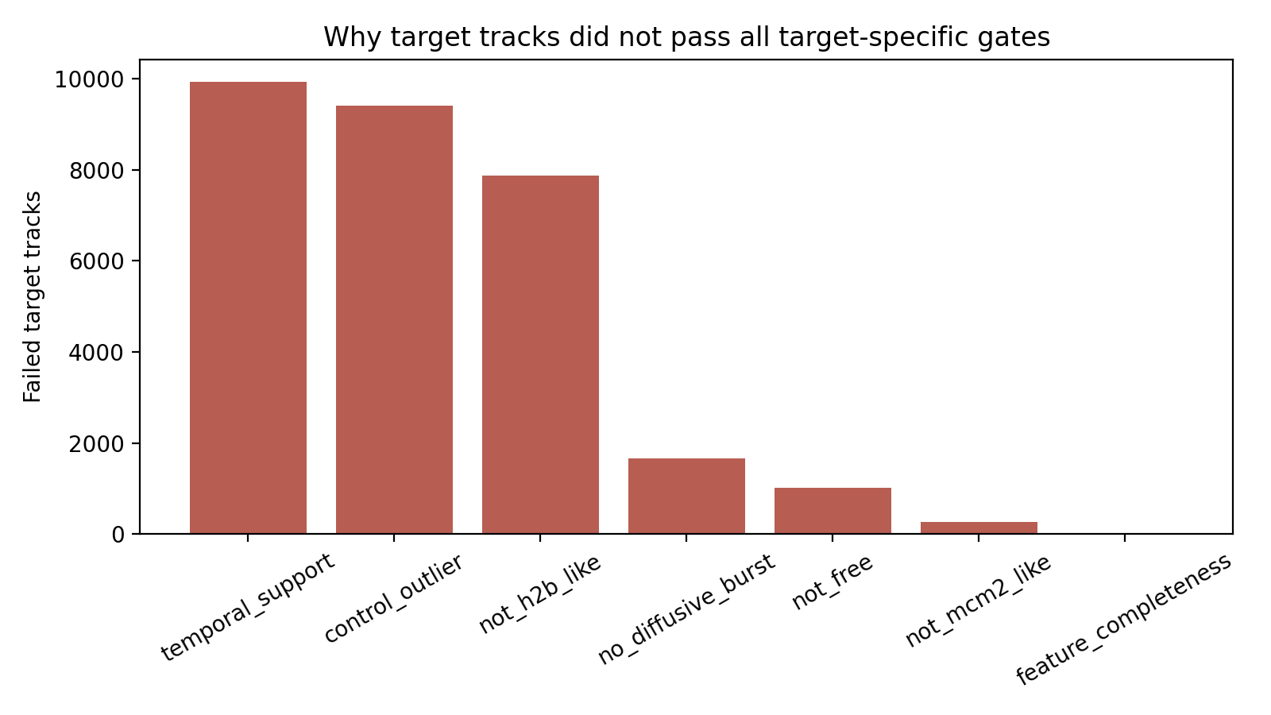
GATE FAILURES
Why no target-specific trapping-like tracks?
Temporal support
100.0%
Control outlier
94.7%
Not H2B-like
79.2%
Diffusive burst
16.7%
Not free-like
10.2%
Not MCM2-like
2.6%
Top bottleneck: temporal support failed for 100.0% of target tracks, followed by control-outlier and not-H2B-like gates.
Control-guided diagnostics and separability
09

Slide 10
NEAR MISSES
Ambiguous tracks are the manual-review pool
1,214
Top 100
ambiguous TDP43/NONO tracks
ranked review table
Ambiguous means the track does not confidently fit a control-like class, but also did not pass every target-specific gate.
The ranked table prioritizes high trapping/temporal/control-outlier scores and sufficient track length.
These are candidate trapping-like behavior records for visual inspection, not validated condensate-localized tracks.
Control-guided diagnostics and separability
10

Slide 11
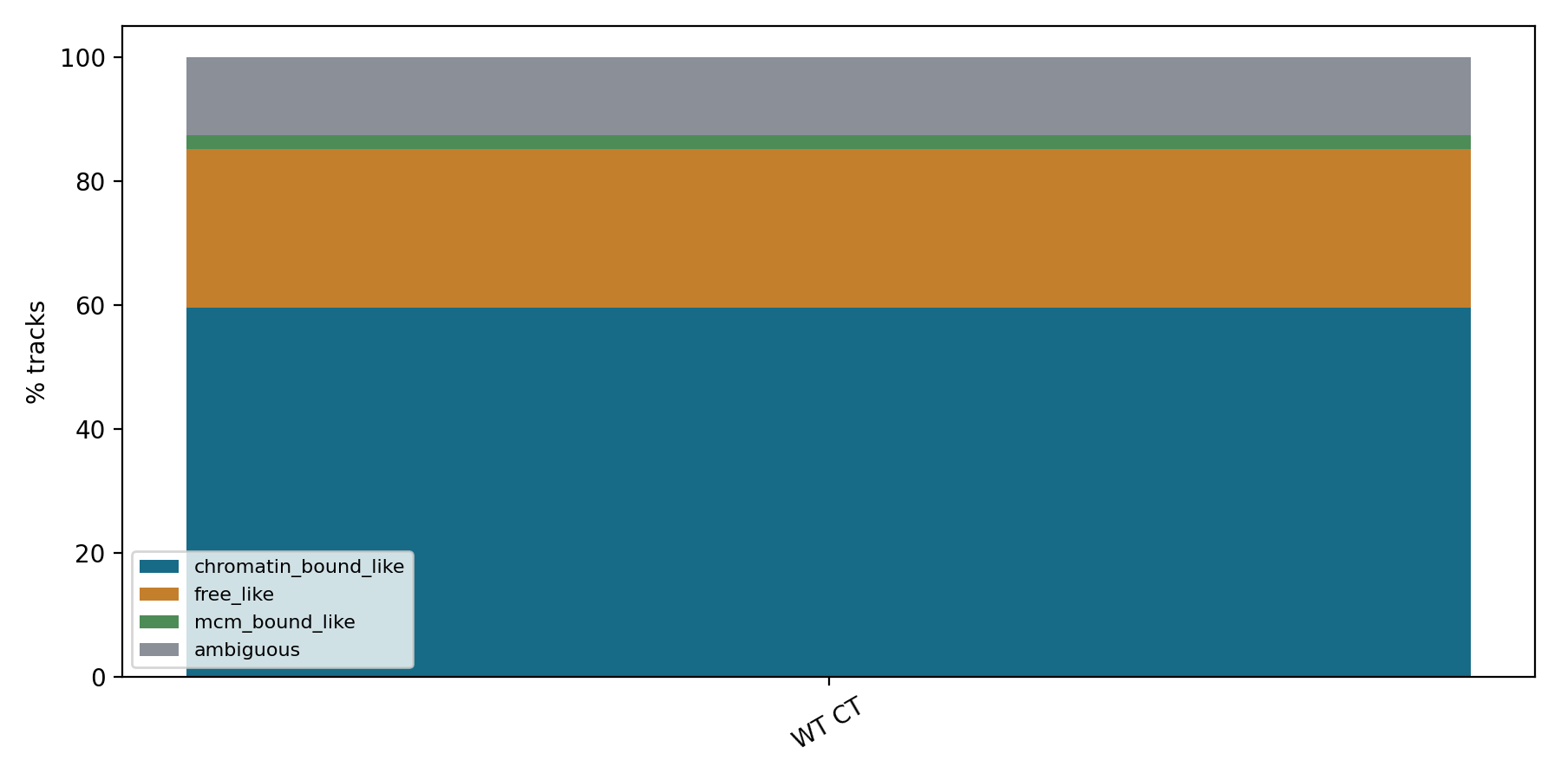
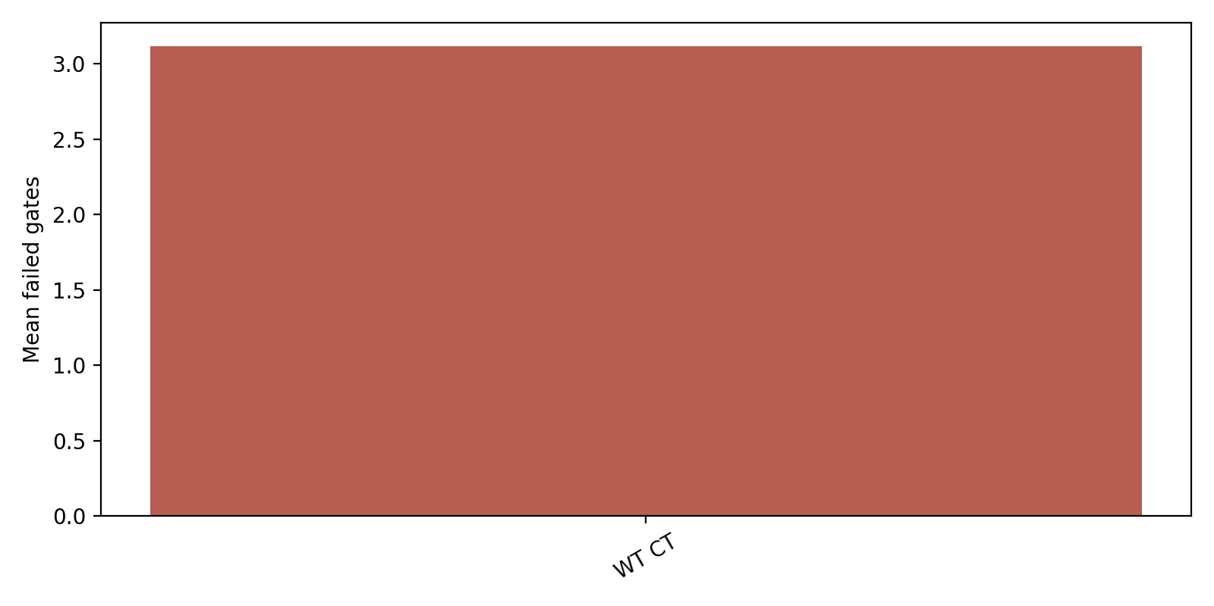
GENOTYPE AND TREATMENT
Expanded TDP43 condition analysis
Current final-classification table contains WT control TDP43 tracks; expanded folders were inventoried for future batch outputs.
Replicate-level interpretation is cautious because some expected folders currently have no generated classification rows.
Control-guided diagnostics and separability
11

Slide 12
WHAT IS SUPPORTED
Biological interpretation
Supported: H2B_Bound and MCM2_Bound are partly distinct motion references.
Supported: target tracks often overlap control-like dynamics and failed temporal support in this gate set.
Not proven: physical condensate localization, paraspeckle localization, or pure negative-control behavior.
Best wording: candidate target-specific trapping-like dynamics, motion pattern consistent with confinement/trapping, or not explained by current controls.
Control-guided diagnostics and separability
12

Slide 13
ACTION PLAN
Recommended next steps
Inspect the top ambiguous near-miss tracks against raw movies and localization quality.
Validate candidate trapping-like behavior with condensate or paraspeckle markers rather than tracking alone.
Keep H2B_Bound and MCM2_Bound separate for now, but report overlap explicitly.
Review temporal-support thresholds because that gate is the dominant bottleneck in the current output.
Rerun final classification after expanded TDP43 condition folders have complete analysis outputs.
Control-guided diagnostics and separability
13

Slide 14
DELIVERABLES
File locations
Results folder
D:/Tianzi/condensate_classification_pj/control_guided_classification/diagnostics_and_separability
Core report
control_separability_report.md, target_gate_failure_report.md, easy_interpretation_diagnostics.md
Review tables
ambiguous_target_tracks_for_review.csv, ambiguous_target_tracks_ranked_top100.csv, target_gate_failure_table.csv
Presentation
presentation/control_guided_diagnostics_and_separability.pptx
Control-guided diagnostics and separability
14

