Slide 1
Bi-Weekly Meeting
April 27, 2026
Ing Muyleang
PhD Student — Quantum Computing Lab
Pukyong National University
muyleanging@gmail.com

Slide 2
Index
Quantum Federated Learning (QFL)
1. Research Topic & Motivation
2. QFL vs QE-SAC — Method Comparison
3. VQC Circuit & SPSA Training
4. Implementation & Architecture
5. Early Experiment Results
6. Next Action Plan

Slide 3
Quantum Federated Learning (QFL)

Slide 4
Executive Summary
Problem: Lin et al. (2025) QE-SAC controls Volt-VAR for ONE utility — no federation.
This Work (QFL): Extends QE-SAC to 3 utilities federated via FedAvg.
• Replaces SAC (RL) with SPSA — gradient-free VQC optimization, no critic, no replay buffer
• Federates only the QuantumEncoder (280 params = 1.1 KB) — private topology encoders stay local
• 383× communication reduction vs classical Federated SAC-FL
Implementation: Complete. QFLAgent + QFLTrainer across 13-bus / 34-bus / 123-bus topologies.
Experiment: Running (3 seeds × 2 conditions). Early results confirm stable training.

Slide 5
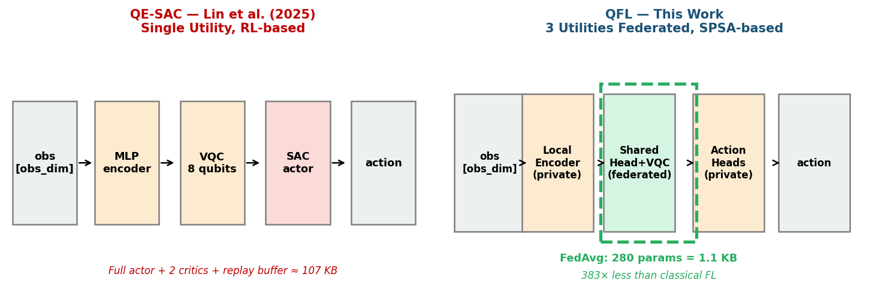
New Progress
QFL vs QE-SAC (Lin et al. 2025) — key differences:
Training: QE-SAC uses SAC (RL) | QFL uses SPSA (no RL, no critic)
Scope: QE-SAC = 1 utility | QFL = 3 utilities federated
Federated: QE-SAC = No | QFL = Yes (FedAvg on QuantumEncoder)
Comm cost: QE-SAC = N/A | QFL = 280 params = 1.1 KB/round
vs classical FL: — | 383× smaller than SAC-FL actor
VQC role: QE-SAC = actor policy | QFL = shared quantum encoder
Figure 1: QFL vs QE-SAC architecture (federated region = green dashed box)

Slide 6
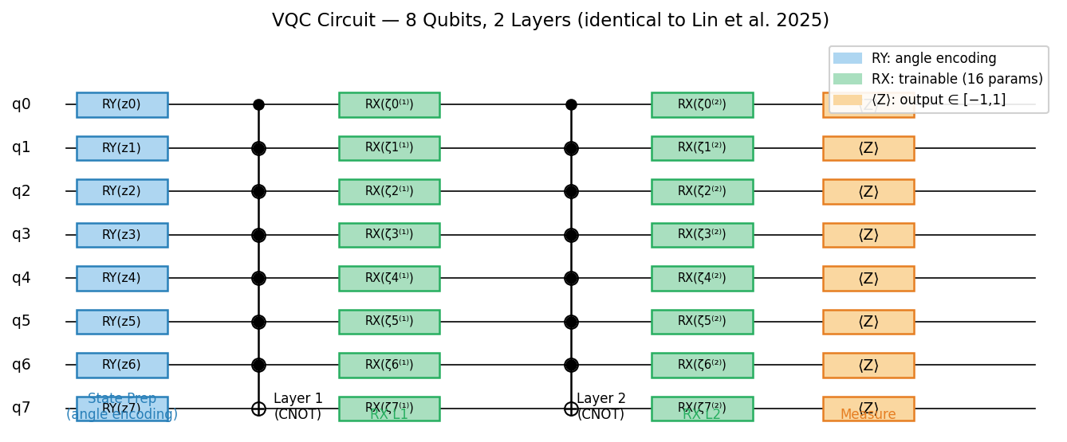
New Progress (cont)
VQC Circuit — identical to Lin et al. 2025 (fair comparison):
• 8 qubits, 2 layers, 16 trainable RX params
• State prep: RY(zᵢ), z = Tanh(SharedHead(obs)) × π ∈ (−π, π)
• Entanglement: CNOT(i, i+1) nearest-neighbour per layer
• Output: ⟨Zᵢ⟩ expectation per qubit → 8-dim feature
SPSA Optimizer (replaces SAC backprop through VQC):
• δ ~ Rademacher(±1), perturb θ ± c·δ, evaluate reward twice
• ∂L/∂θ ≈ (L₊ − L₋) / (2c·δ) — no quantum gradient needed
• Update: θ ← θ − α·∂L/∂θ (c=0.1, α=0.01)
• Avoids barren plateau — SPSA never backprops through the circuit
Figure 2: QFL VQC circuit — RY angle encoding, CNOT entanglement, RX trainable, ⟨Z⟩ measurement

Slide 7
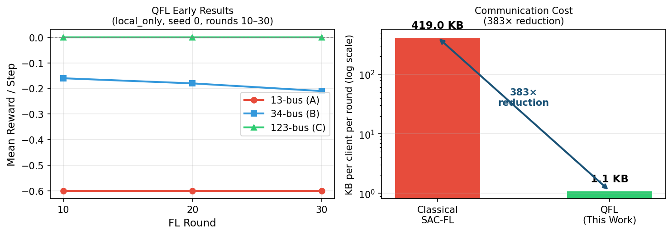
New Progress (cont 2)
Experiment: 3 seeds × 2 conditions (local_only vs qfl) — 🔄 Ongoing
Topologies: 13-bus (A, obs=43) | 34-bus (B, obs=113) | 123-bus (C, obs=349)
Rounds: 50 | Steps/round: 1,000/client | Seeds: 0, 1, 2
Early results — seed 0, local_only, mean reward/step:
Round 10: A = −0.60 | B = −0.16 | C = −0.00
Round 20: A = −0.60 | B = −0.18 | C = −0.00
Round 30: A = −0.60 | B = −0.21 | C = −0.00
Interpretation: C (123-bus) converges immediately — fewer critical buses per observation.
B still learning. A stable but negative — voltage violations present, SPSA exploring.
QFL (federated) condition starts after local_only completes per seed.
Figure 3 (left): QFL learning curves — Figure 3 (right): Communication cost (383× reduction vs classical FL)

Slide 8
Discussion
Items for advisor discussion:
1. Comparison baseline — QFL vs QE-SAC (Lin et al. 2025)
QE-SAC = single-utility RL. QFL = multi-utility, no RL, federated.
Metrics to compare: mean reward, violation rate, convergence speed.
2. Method name — 'QFL' (Quantum Federated Learning)
No RL, no SAC. Focus is on the FL + quantum representation.
Approval needed before paper title is finalized.
3. SPSA justification
SPSA avoids backprop through VQC → no barren plateau risk.
Tradeoff: 2 env evaluations per step (vs 1 for RL policy gradient).
Is this framing acceptable for IEEE TSG reviewers?

Slide 9
Next Action
2-Week Plan:
Week 1 (Apr 27 – May 3):
• Collect full QFL results (3 seeds × 2 conditions) once run finishes
• Statistical analysis: local_only vs qfl — effect size d, t-test
• Add QE-SAC (Lin et al.) numbers as single-utility comparison baseline
• Generate final communication cost figure (383× bar chart)
Week 2 (May 4 – May 10):
• Write paper Section 3: QFL Methodology (SPSA + VQC + FedAvg)
• Write paper Section 4: Experiments (QFL vs QE-SAC vs local_only)
• Prepare VQC circuit diagram for paper (Figure 2 in paper)
• Internal draft → send to advisor for review

Slide 10
Q & A

