Slide 1
Project C On Generating Cluster Hierarchies Based on Mol2Vec Embeddings of Compounds
Rahima Akter - Sana Ghaffar - Muhammed Muzamil – Ece Özdemir
Supervisor: Daniyal Kazempour

Slide 2

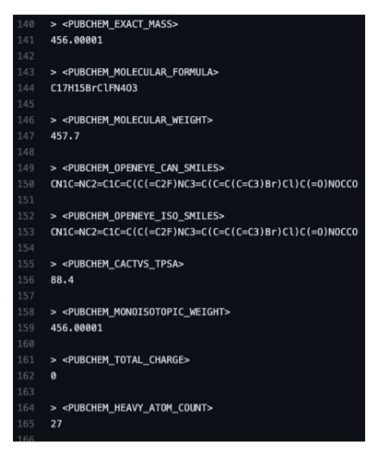

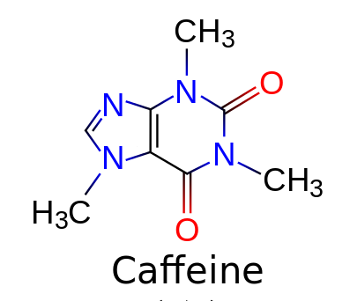
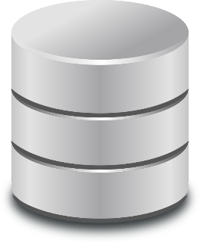
Goal
Embedding and clustering of the entire 111 Mio compounds of PubChem with mol2vec
Studying the applicability for compound search acceleration with computing dendrogram, medoid and variance.
Notes:
2

Slide 3


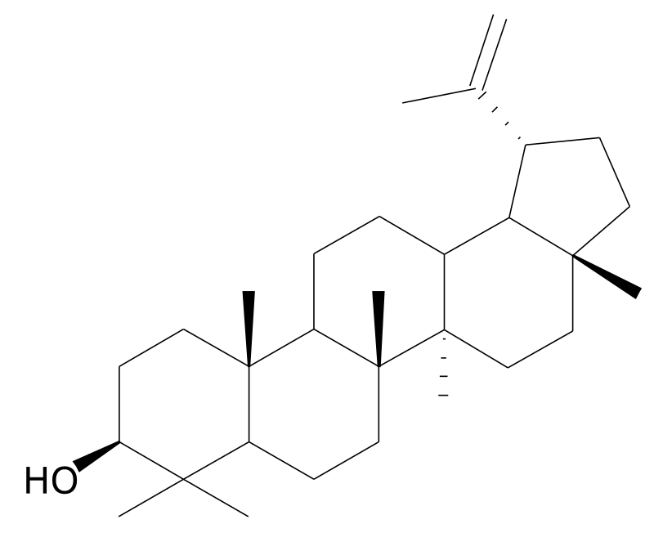
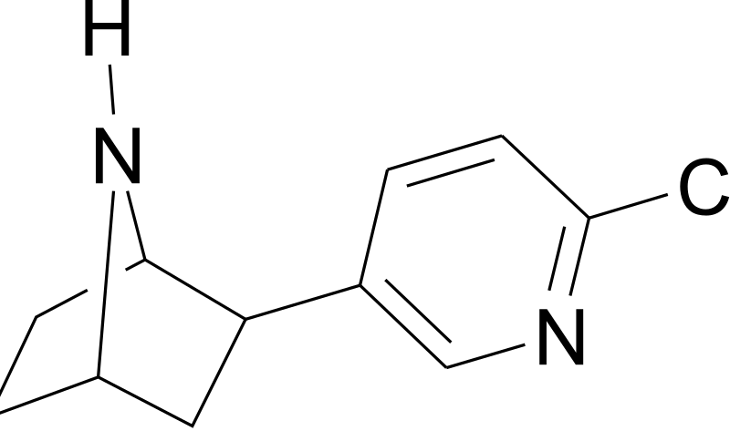
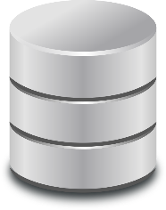
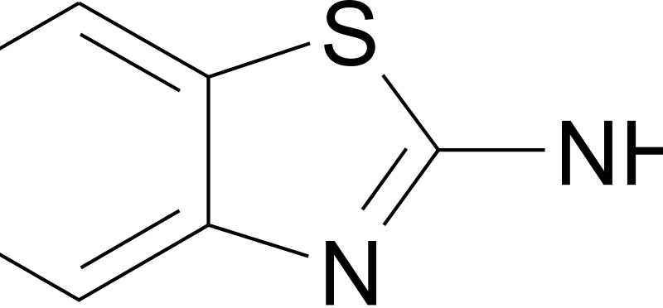
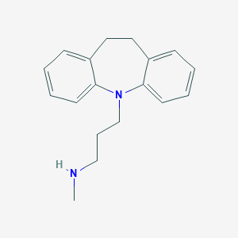
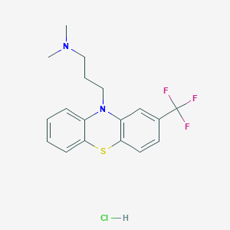


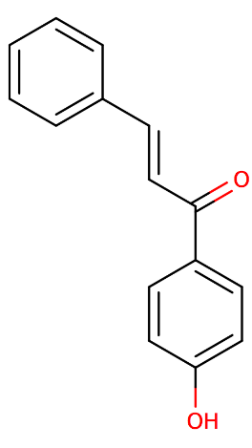
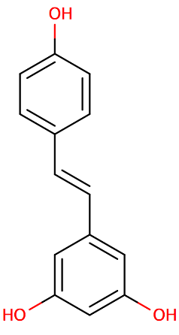
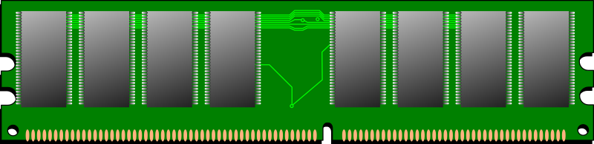
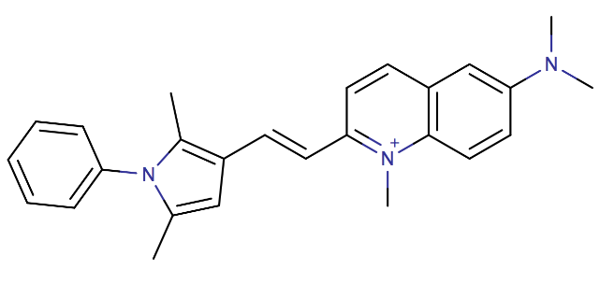
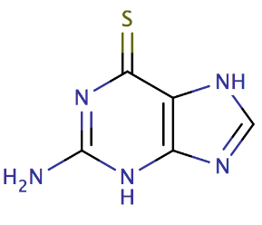
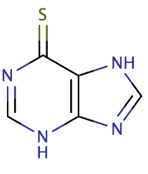






Implementations for goal
$$(i)$$
vectorize (Mol2Vec)
SDF
$$\left({x_{0} \atop \begin{aligned}x_{1} \\ x_{2} \\ ⋮ \\ x_{d}\end{aligned}}\right)$$
SDF
Download SDF
(PubChemPy)
SDF
$$\left(vi\right)$$
Experiments
$$\left(ii\right)$$
Clustering via hierarchical methods
$$(iv)$$
$$(iii)$$
variance
Medoid

Slide 4
Task Distribution
Task 1: All group members
Task 2: Sana
Task 3: Ece and Rahima
Task 4: Muzamil
Task 5: All group memebers
Embedding compound
Dendrogram from hierarchical clustering
Medoid compound, tree representation
Computation of variance of each sub cluster and bounding box
Experiments
Communication
Every Friday at 18.00 zoom meeting
Whatsapp group
Discord channel
Notes:
4

Slide 5
Timeline
Task 1: Done
Task 2: Done
Task 3: Done.
Task 4: Done.
Task 5: Done.
Half time project presentation: 25th of May
Final project presentation: 30th of June
Final project submission: 5th of July
Embedding compounds
Dendrogram from hierarchical clustering
Computation of medoids
Computation of variance
Experiments and Benchmarking
Notes:
5

Slide 6
Challenges
Technical level
Organizational level
Memory Problem
Library dependencies with python version
Library dependencies with platform
Algorithm level
Linkage Matrix
Construct a tree as dendrogram
Variance and bounding box
Distribution of the task
Notes:
Since the source is really big file. Our computers were not able to run the code. So first we splitted 1 sdf file to 12 csv. And then did mol2vec embedding. Also another difficulty was that when we creating the csv file, the code was running successfully done. But we could not see the csv file. Then with this comment on cmd
‘mol2vec featurize -i C:\\Users\\Ece\\Desktop\\MPML\\Compound_000000001_000500000.sdf -o C:\\Users\\Ece\\Desktop\\MPML\\mysdf2vec.csv -m C:\\Users\\Ece\\Desktop\\MPML\\model_300dim.pkl -r 1 --uncommon UNK’
We were able to see the error in the back.
Library dependencies with python version
The Mol2Vec library have problem in recent Python/Numpy Setups (Python 3.8)
Solution : pip install -Iv gensim==3.8.2
Library dependencies with platform
Mol2Vec library has some problem with linux , work fine with windows
Algorithm level: To understand dendrogram, K medoid algotihms
Misunderstandings within the group: another challenge for us as a group, commınication with eachothers
6

Slide 7
Task 1 - Embedding compounds
Download the source
Dividing sub files
Run the model_300dim.pkl
Obtain csv file with vectors
Notes:
7

Slide 8
Task 2 - Dendrogram from hierarchical clustering
Task 2 - Dendrogram from hierarchical clustering
Cluster the dataset
Dendrogram represent Hierarchical Clustering
Notes:
From task 1 , we obtain cvs files, each csv file contain 300 dimention vector and some other information. We use that 300dimention vector as a dataset. Now we need to cluster the dataset.
Agglomerative clustering , this uses a bottom-up approach, where at first each data point consider as a cluster. Two most similar cluster merge together at each step.
To represent Hierarchical Clustering here used Dendrogram.
8

Slide 9
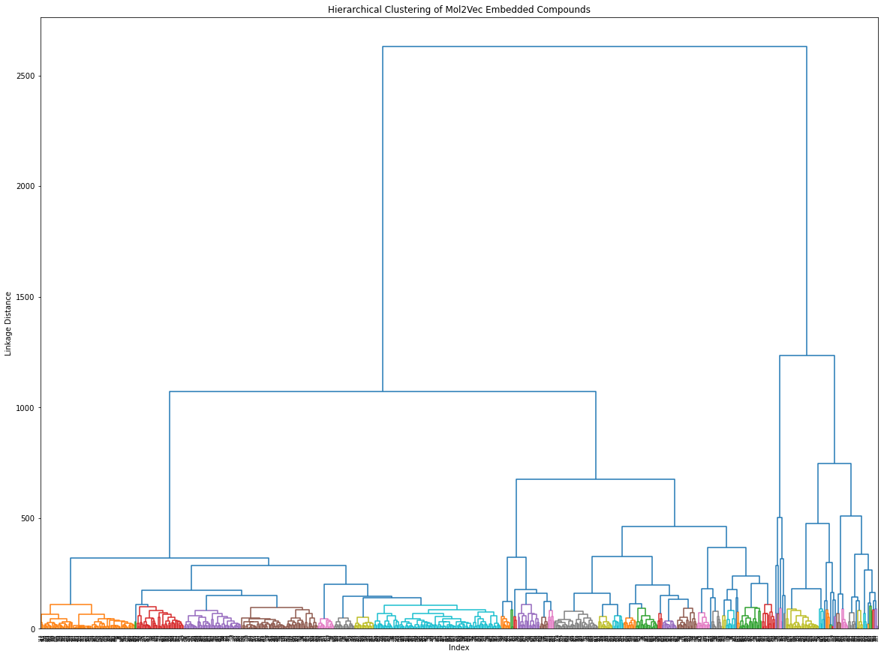
Output of task 2
Output of Task 2
Notes:
This is the output from task 2, Here 5000 compounds use
9

Slide 10
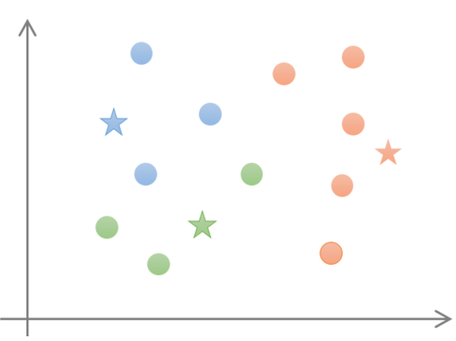
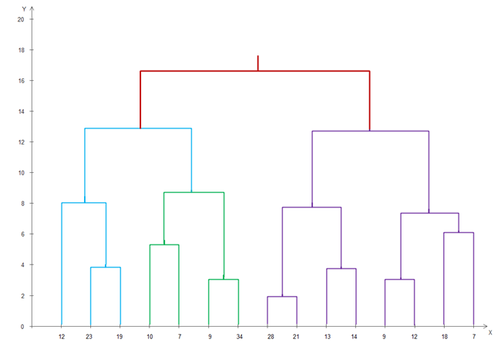
Task 3 - Computation of medoid
c2
c1
c2
c3
c5
c4
c6
c7
c9
c14
c8
Obtain cluster
Cut the dendrogram
Find medoid
Tree representation
c12
c10
c13
c11
Notes:
Now we have dendrogram, we have to find medoid for faster search. First we thought that will be very easy, when we get cluster item, using distance matrix we will find medoid. But reality is not like that. This task has 4 subtask.
Now to having a tree, are we done yet? We need not compare with all. We will compare with representative. That is medoid.
Cut the dendrogram at some distance level,
- visually we can cut the dendrogram, challenge was how to implement it
- - then found linkage matrix is our input
- linkage matrix – which contain information of children node used for cluster, at which distance point and how many compound available in this cluster
- we decide to cut it at joining point
Retrieve clusters from each cut
- We cut the dendrogram from bottom to top, so same cluster found in many cut. We calculate medoid for one cluster one time.
- when we have only two compound, we skip medoid calculation for that cluster also
Find the medoid of the cluster
Now what is medoid? – In a cluster we have multiple points. it has the smallest average dissimilarity to all other points in that cluster .
We used euclidean distance.
Construct a Tree as dendrogram Hierarchy, where node value is medoid

Slide 11
Task 3 - Computation of medoid cont.
cC0A2
c1
cluster | medoid | Cluster members | parent | direction
C13 | none | 9,12 | C7 | left
C14 | none | 7,18 | C7 | right
C7 | 12 | 7,9,12,18 | C3 | right
c2
c3
c4
c5
c6
c7
c14
c9
c12
c8
c13
c10
c11
Notes:
11

Slide 12
Search
Q – new compound
cC0A2
c1
c2
c3
c4
c5
c6
c7
c14
c9
c12
c8
c13
c10
c11
Notes:
12

Slide 13
Task 4
Computation of the variance
Help domain experts in decision making.
Selecting the best clusters
Bounding Box
Detection of the object.
Problems
Variance and bounding box for each cluster having multidimensional vectors
Notes:
13

Slide 14
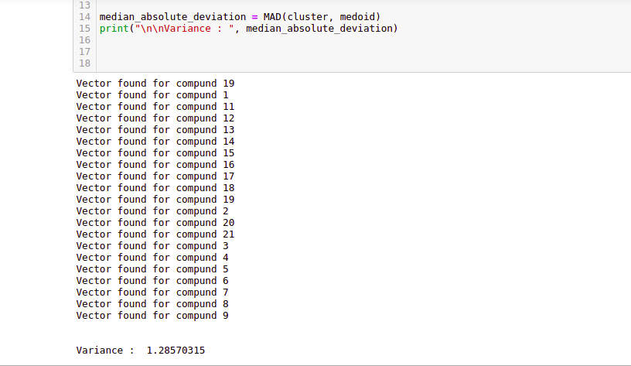
Median absolute deviation
Notes:
Why MAD? – people don’t want to go at the end. They may stop at earlier result. Later development
MAD - Median absolute deviation

Slide 15
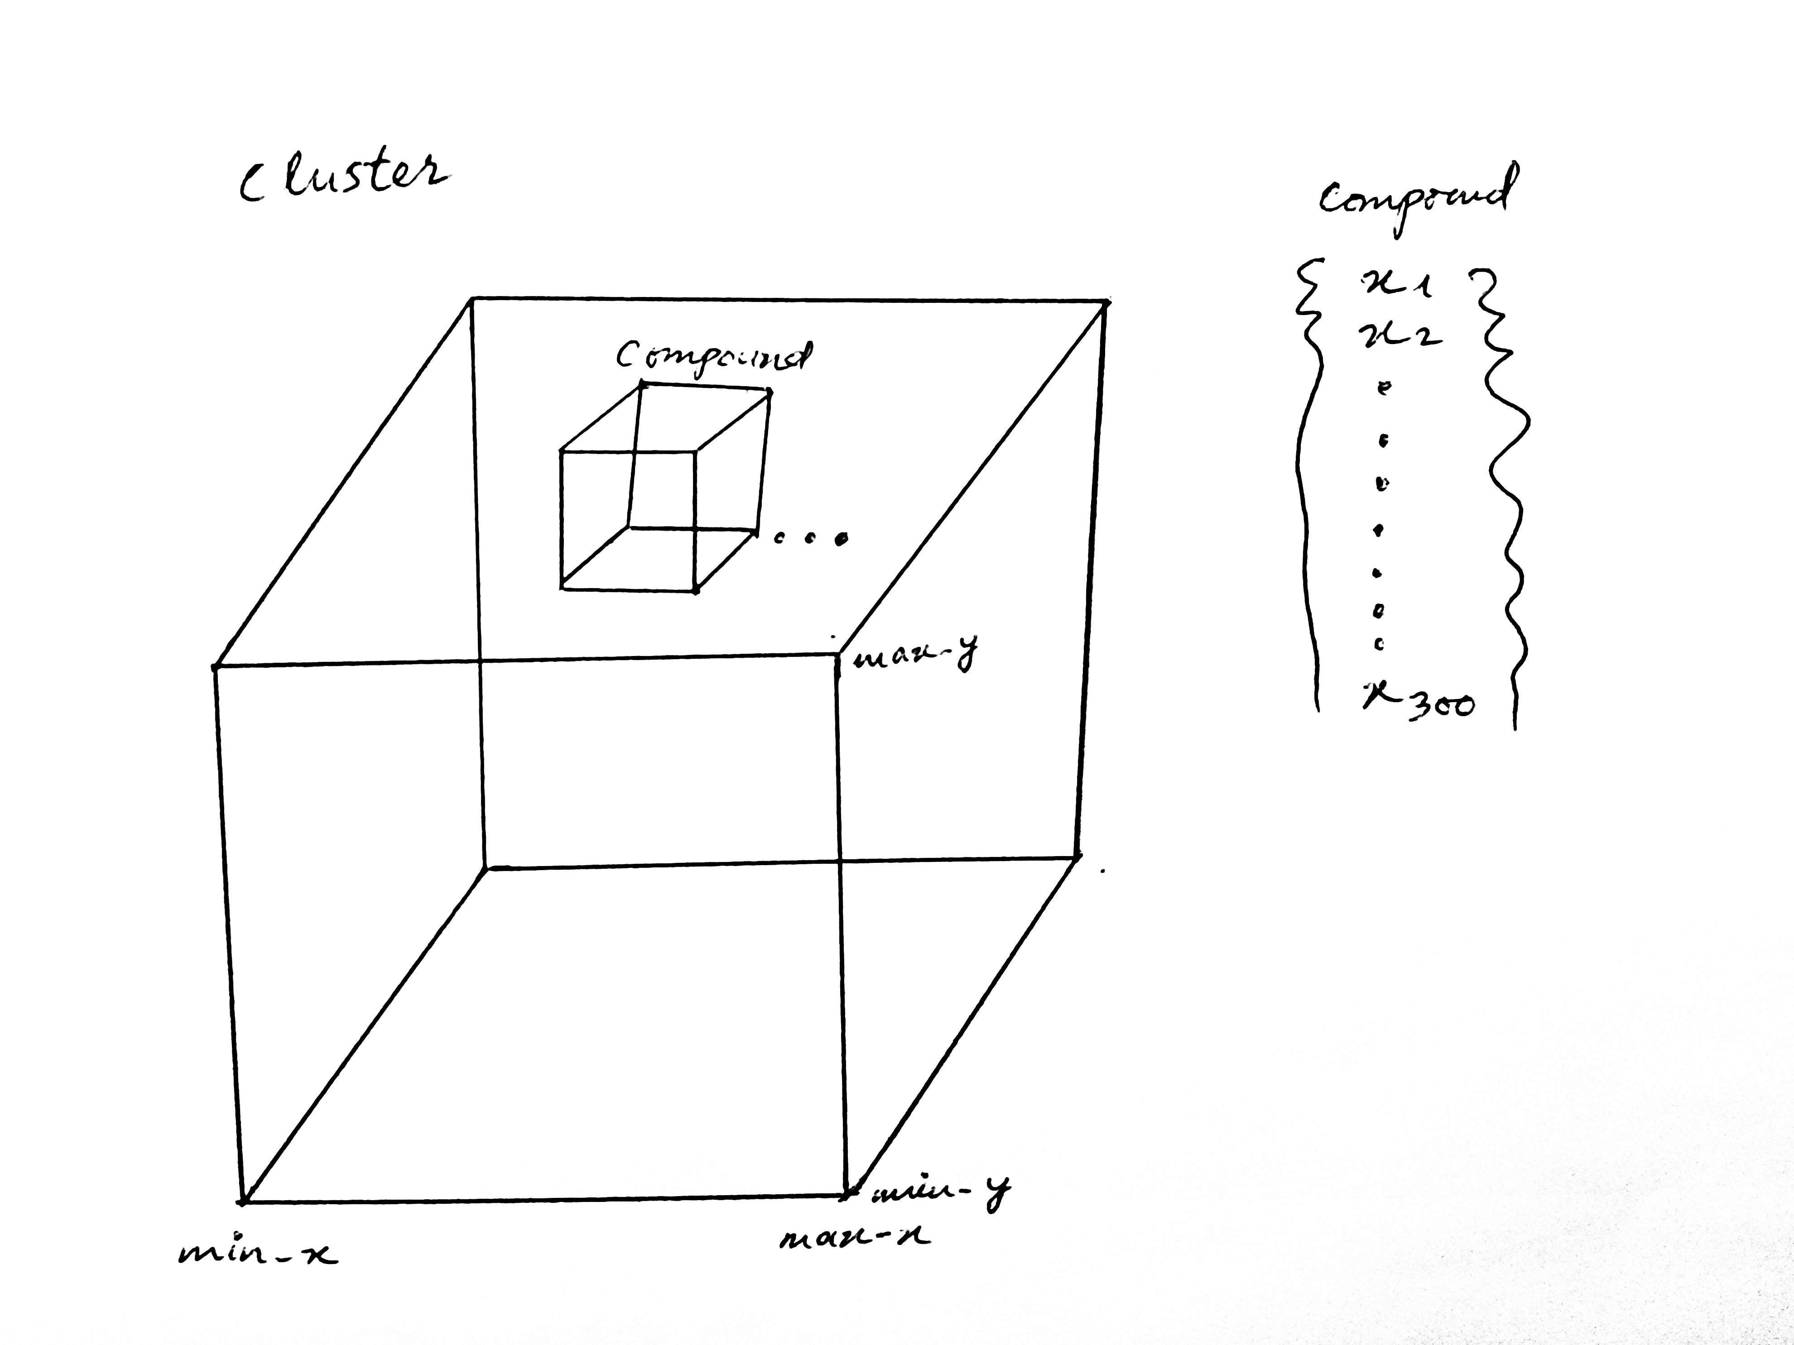
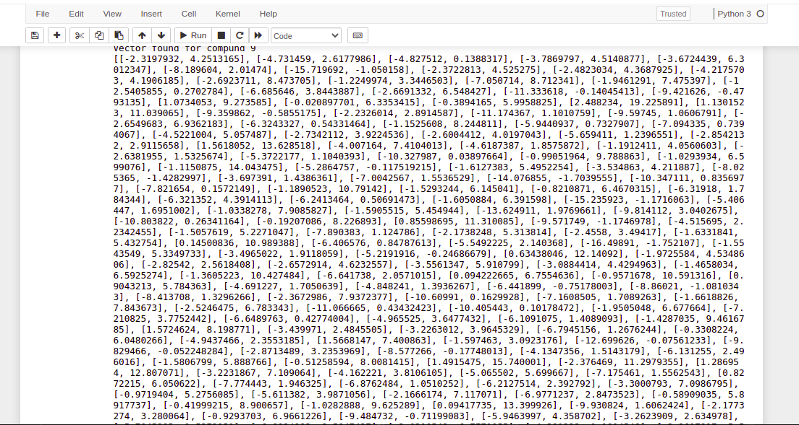
Bounding Box
Notes:
What is this use for? We compute distance with medoid. In future we can use this to compute distance corner of the bounding box.
Are bounding box cascading or overlap ? - disjoint set
What early stopping?

Slide 16

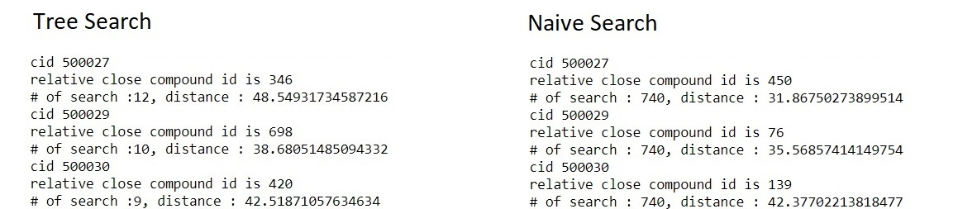


Task 5 – Run time Experiment
Notes:
16

Slide 17
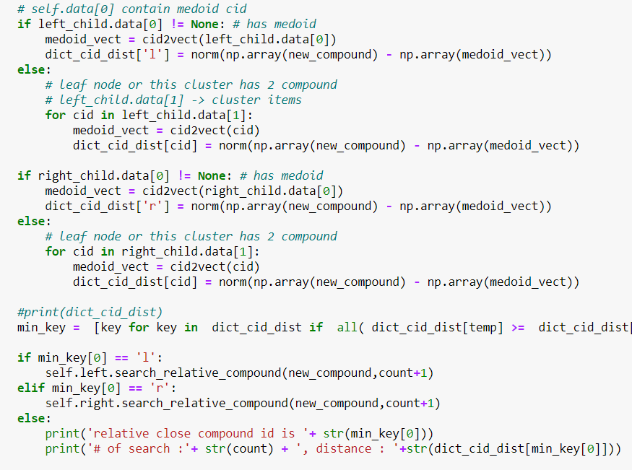

cProfile
0.05680964469909668
0.002995271682739258

Slide 18
Experiment Result
.
Notes:
we got the tree, is this yield close enough results compare to naiv search or deviation too high?
18

Slide 19
Lesson Learned
Need to know different operating system
Dealing changing Libraries
Use Command Prompt to find bug
Experiment with small dataset first
Expectation and reality totally different thing
Notes:
19

Slide 20
What we got and future work
Tree to accelerate compound search
Bounding box to stop early
Deploying on large scale
Improve search result
Investigate more bounding box
Apply bounding box in batches

Slide 21
Q/A
Notes:
1.

