Slide 1

Seasonal Agriculture Performance Analysis
Mohammad Ahmed Muzakkir
AICTE STU ID:STU6a63ab74d42471784916852

Slide 2

PROBLEM STATEMENT
(Agricultural activities are influenced by seasonal variations in environmental conditions, farming practices, resource availability and market conditions. As a result, agricultural performance may differ from one season to another. However, raw agricultural data does not clearly explain how agricultural performance changes across seasons or what patterns can be observed in different seasonal conditions. The problem is to analyze the given agricultural dataset and investigate seasonal differences in agricultural performance by identifying meaningful patterns, trends, relationships and variations within the available data.

Slide 3
Project Description
This project analyzes 3,880 farm records spanning 8 Indian states, 8 major crops, and 3 growing seasons (Kharif, Rabi and Zaid) to uncover how profitability, yield, water usage, input consumption, and pest/disease risk vary across seasons. Using Python with Pandas, Matplotlib and Seaborn, the study covers seasonal profitability, resource intensity, crop-specific performance, environmental risk correlations, input-usage patterns, water efficiency, feature correlations, state-wise comparisons, and yield-gap analysis — delivering data-driven insights for farmers, agribusinesses, and policymakers.

Slide 4

WHO ARE THE END USERS?
Farmers & Agronomists – choose the right crop and season for maximum yield and profit
Agricultural Policymakers & Government Bodies – plan irrigation, subsidies, and resource allocation
Agribusinesses & Agri-fintech Companies – assess crop and seasonal risk for insurance and lending
Researchers & Agri-Tech Students – use as a reference for further data-driven farming studies

Slide 5

Technology Used
Python 3
Pandas & NumPy – data cleaning and aggregation
Matplotlib & Seaborn – data visualization
Jupyter Notebook / Google Colab – development environment
Structured CSV dataset – 3,880 records, 28 features

Slide 6
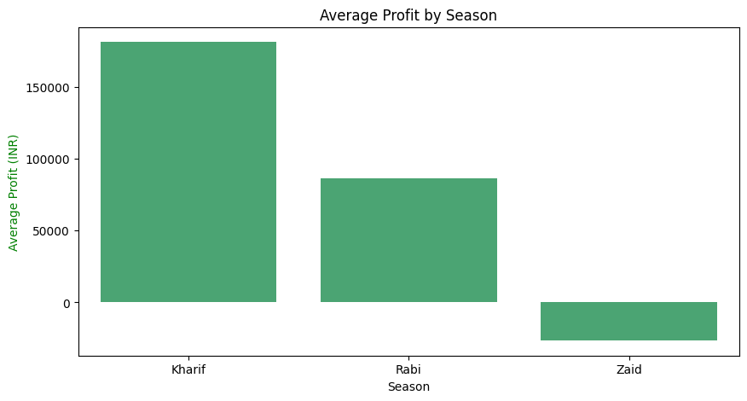
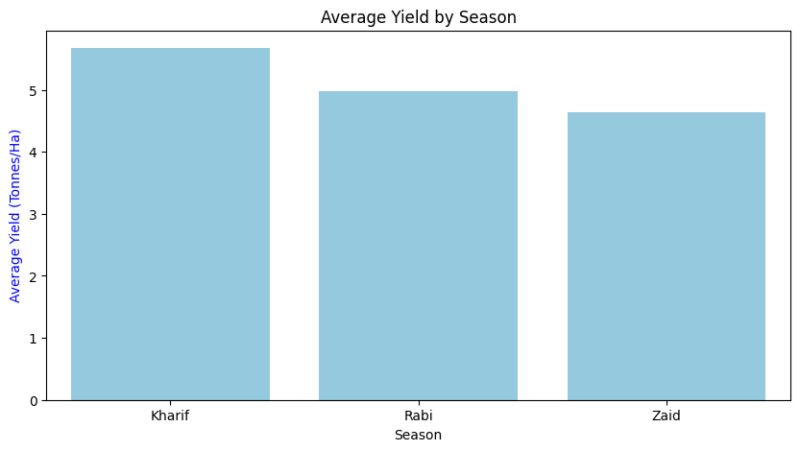
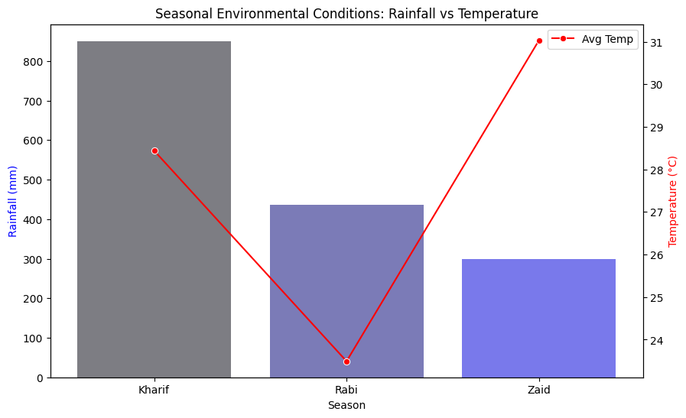
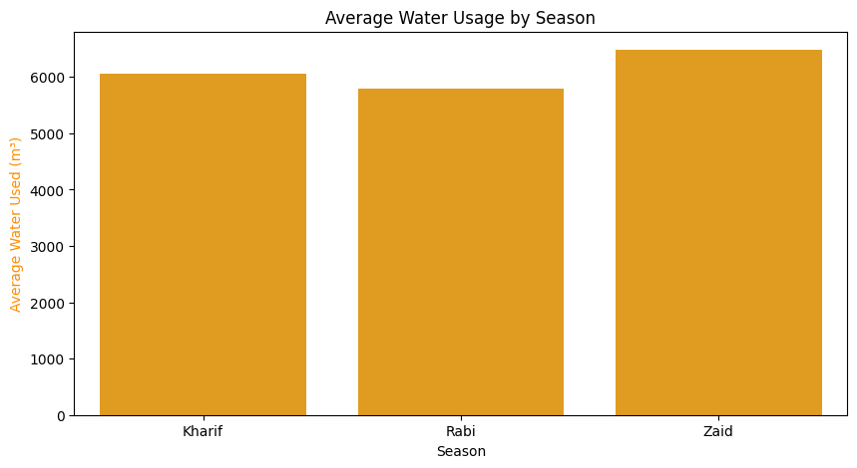
RESULTS

Slide 7
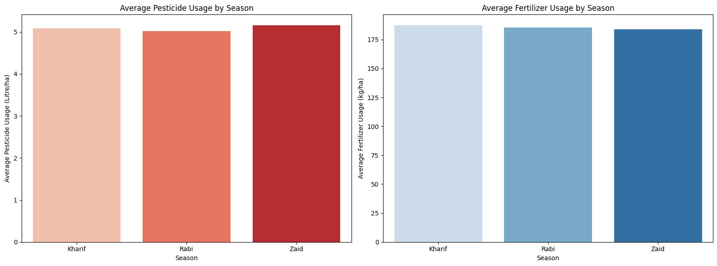
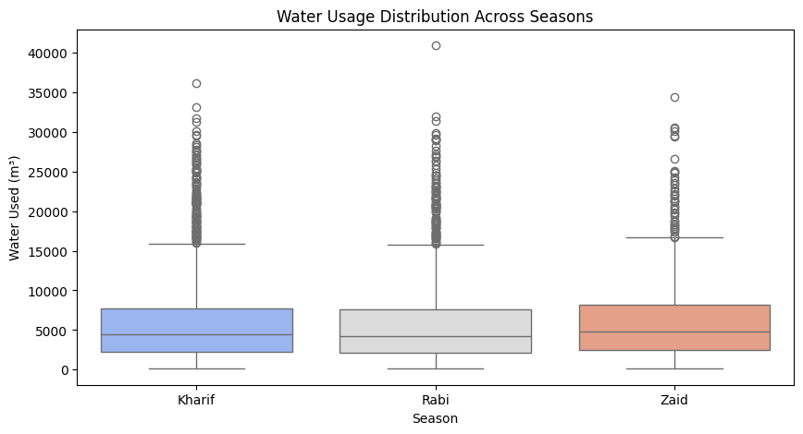
RESULTS
Resource & Input Usage

Slide 8
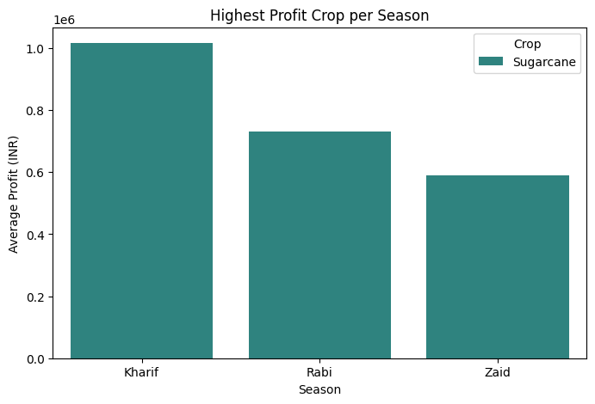
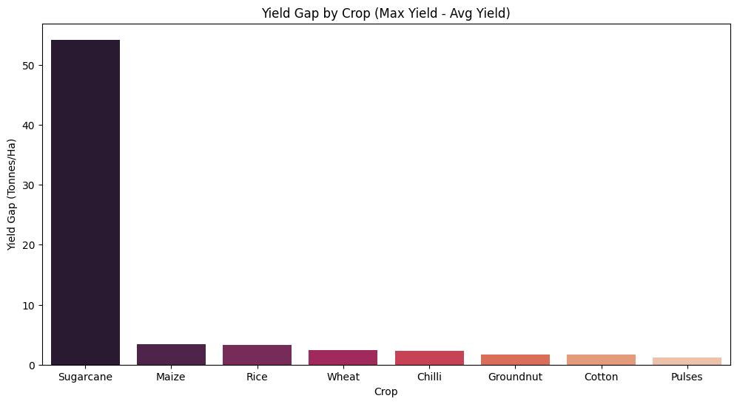
RESULTS
Crop-Specific Performance

Slide 9
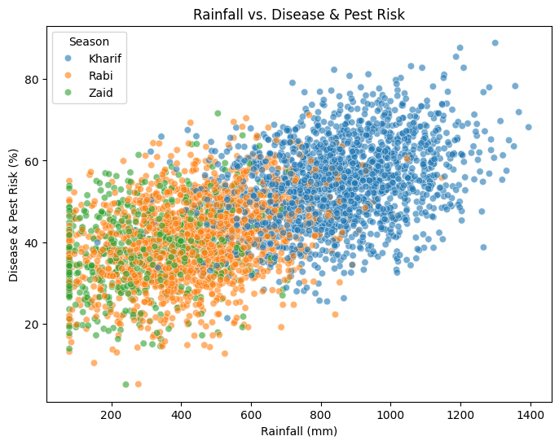
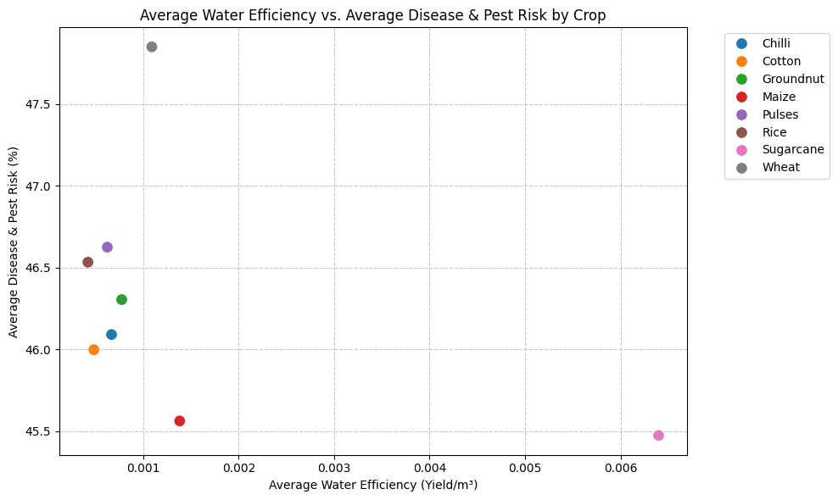
RESULTS
Environmental & Disease Risk

Slide 10
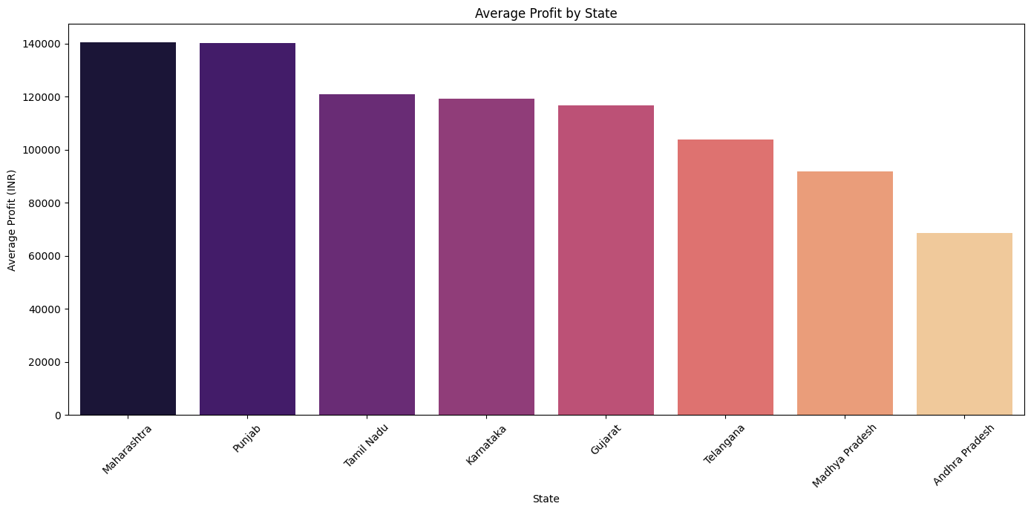
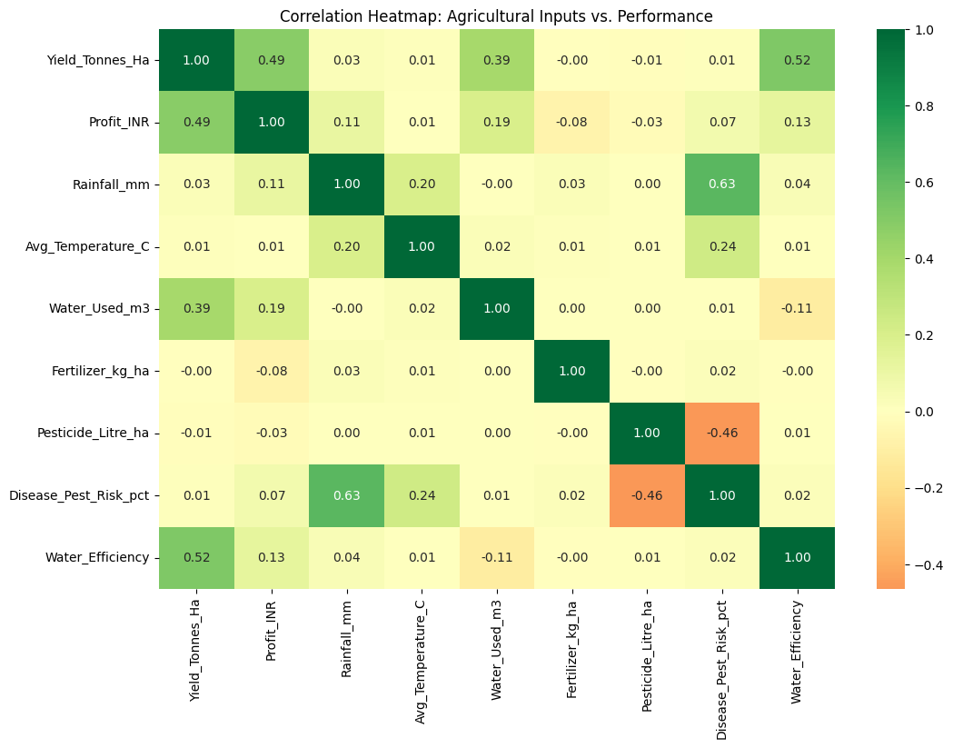
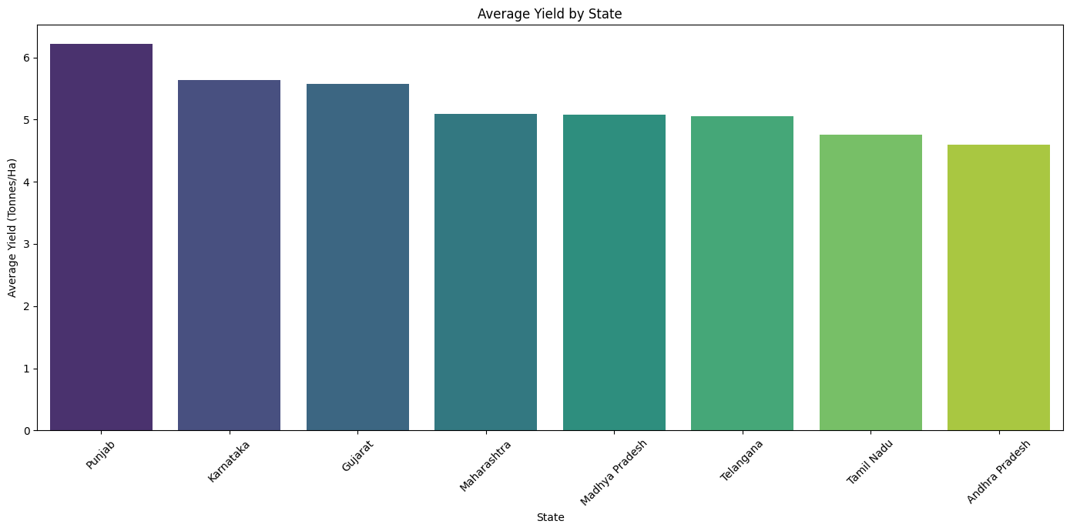
RESULTS
Correlation & State Analysis

Slide 11
Future scope
• Integrate real-time weather and market-price APIs for live seasonal forecasting
• Build a machine-learning model to recommend the optimal crop and season for a given farm
• Extend the analysis to additional states and multi-year data for long-term trend forecasting
• Develop an interactive dashboard (Power BI / Streamlit) for farmers and policymakers
• Incorporate soil-health and satellite-imagery data for deeper environmental insight

Slide 12
GitHub Link
https://github.com/Muzakkir-278617/Seasonal-Agriculture-Performance-Analysis

Slide 13
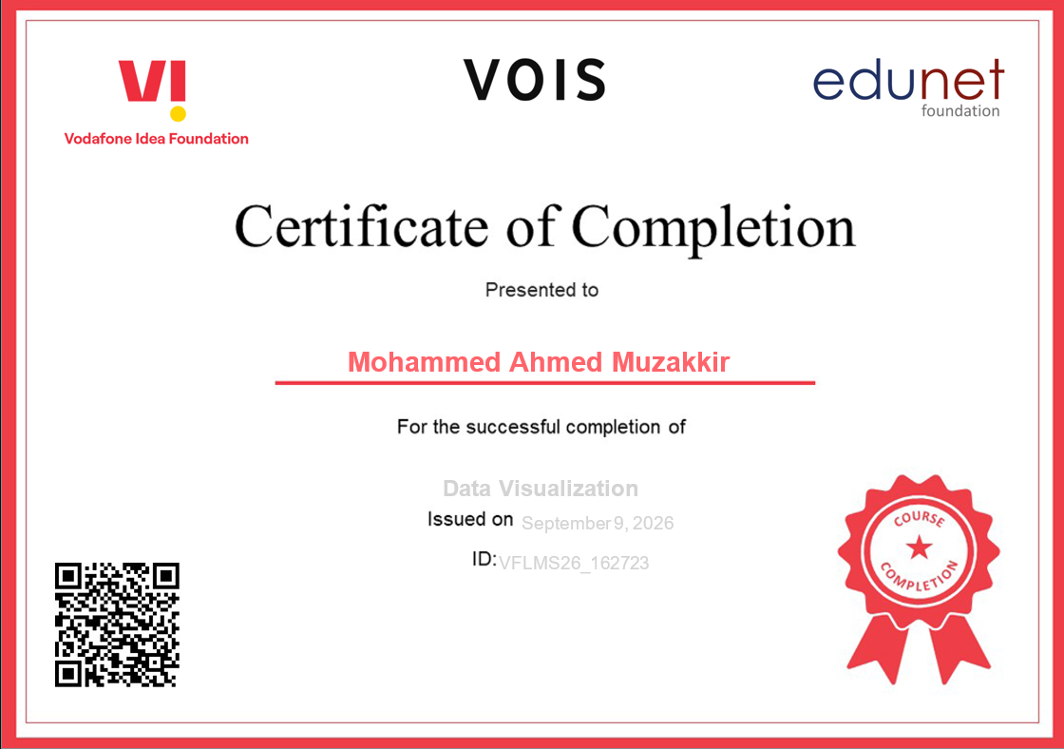
VOIS Course completion certificate - Course name- Data Visualization

Slide 14
Thank you
I'm happy to answer any questions you have about the project.
.
.

