Slide 1
Project Overview
Objective:
To develop an AI model for plant identification and diagnosis and integrate it into a Flutter-based frontend application.
Key Features:
Plant Identification
Disease Diagnosis
Possible Steps
User Interface

Slide 2

1: Model Building
Dataset
Selection
Data
Visualization
Data
Preprocessing
Data
Splitting
Model
Training
Model
Testing

Slide 3
Frontend Development with Flutter
Mobile Application:
To create a user-friendly mobile application using Flutter that allows users to interact with the AI model seamlessly.
Key Components:
1) User Interface (UI): Design a clean, intuitive interface where users can upload images and view results
2) Cross-Platform Support: Leverage Flutter’s ability to create apps for both Android and iOS with a single codebase.
3) Real-Time Feedback: Ensure the app provides instant feedback once the model processes the image.

Slide 4
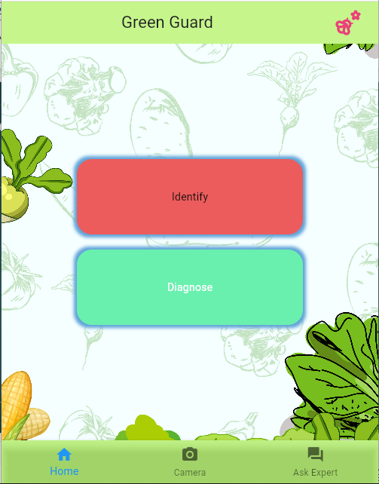
Home Page
Application Name “Green Guard”
Features
Identification
Diagnose
Ask Experts

Slide 5
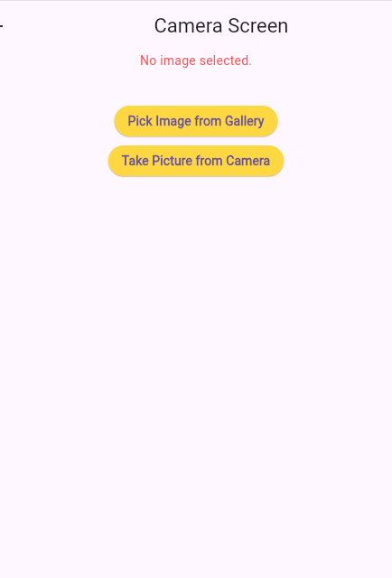
Selection Image
Select image from Mobile Gallery
Capture image from Camera

Slide 6
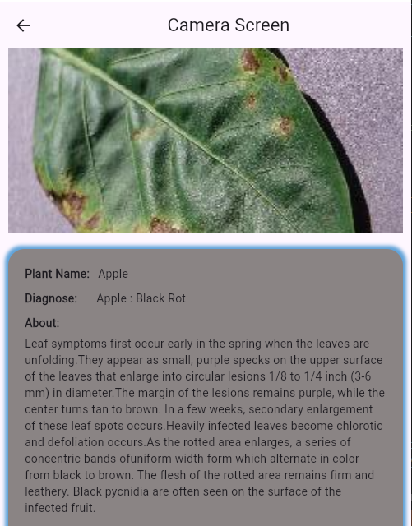
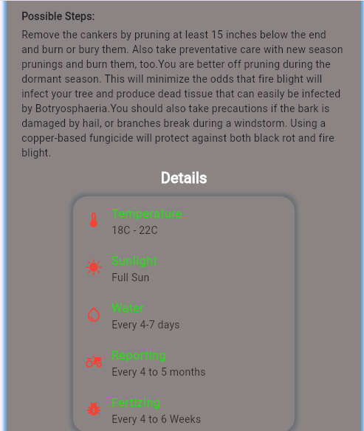

Slide 7
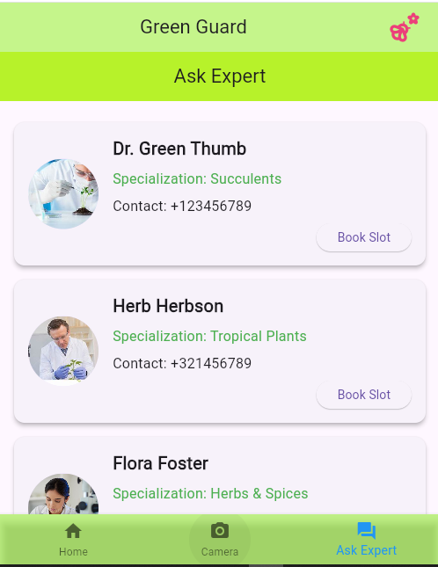
ASK EXPERTS

