Slide 1


MSC. Cloud Computing
NCI
2026
PROJECT REVIEW
FOG AND EDGE COMPUTING
Presented By:
Muzammil Sarwar x24212857

Slide 2
01
OBJECTIVES
SMART CAMPUS ENVIRONMENTAL MONITORING
Sensor types: Temperature, Humidity, CO2, Light
Simulates campus sensors in the edge layer
Processes telemetry in a virtual fog layer
Publishes and stores aggregates for dashboard analytics
A user facing dashboard consuming data from REST API

Slide 3
02
HIGH-LEVEL ARCHITECTURE
Flow
EventBridge (Triggers) → 4x Edge Lambdas → SQS (With DLQ) → Fog Lambda → IoT Core + S3-hosted dashboard → API Gateway → API Lambda → DynamoDB
Queue decouples edge and fog
Lambda provides elastic scaling
DynamoDB to store both fog state and aggregations
Fog Layer: validate → filter → smooth → window aggregate → emit
Publish aggregate payloads to IoT Core
Persist data to DynamoDB
Backend REST Server
FastAPI (python) on Lambda via Mangum
Dashboard application
Frontend (React + Vite + Tailwind): SPA hosted on S3

Slide 4
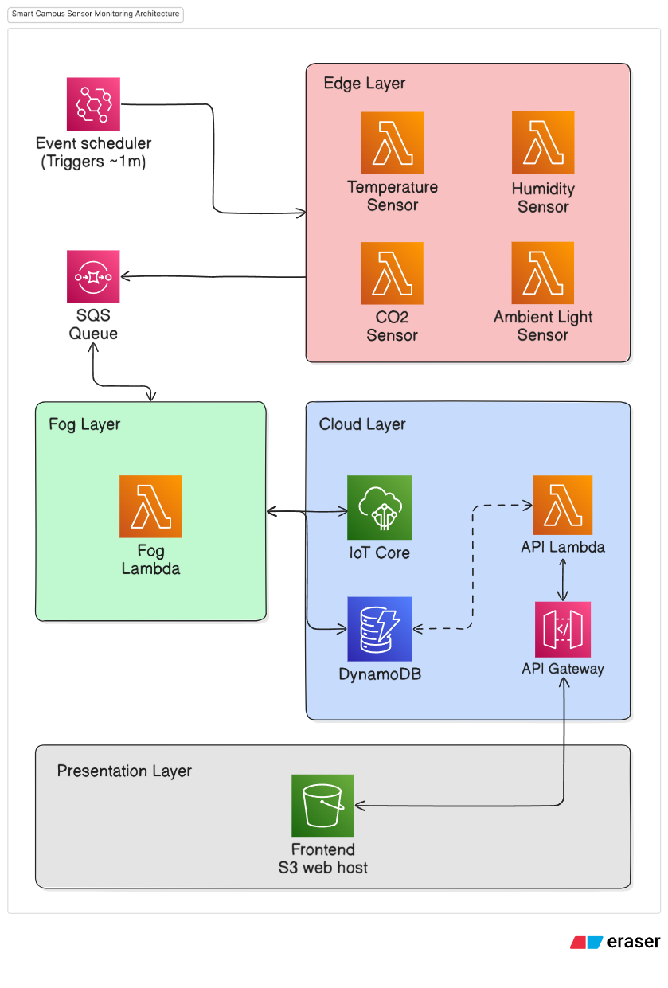
03

Slide 5
DEMO
Fog and Edge Computing
Muzammil Sarwar
x24282157
NCI - MSC Cloud Computing

