Slide 1
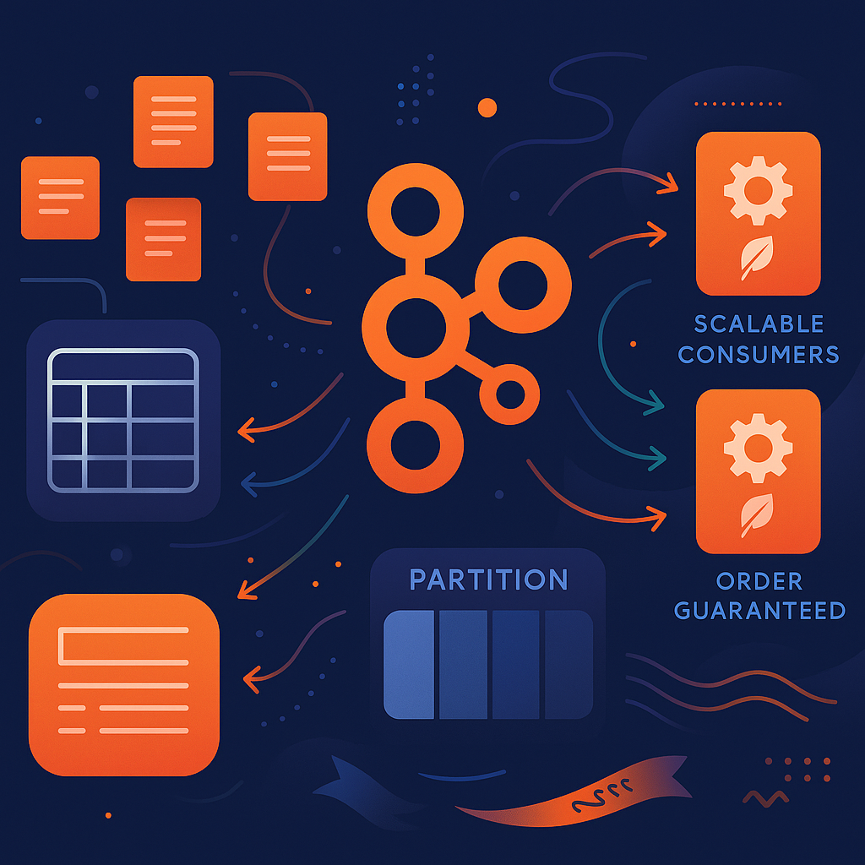
Kafka Event Partitioning & Order Maintenance

Slide 2
Problem Statement
We receive events with fields like SECURITY_ITEM_NUMBER(SIN).
Need to ensure:
All events for a SIN go to the same partition.
The order of events for each SIN is preserved.
Handle consumers deployed in multiple instances.

Slide 3
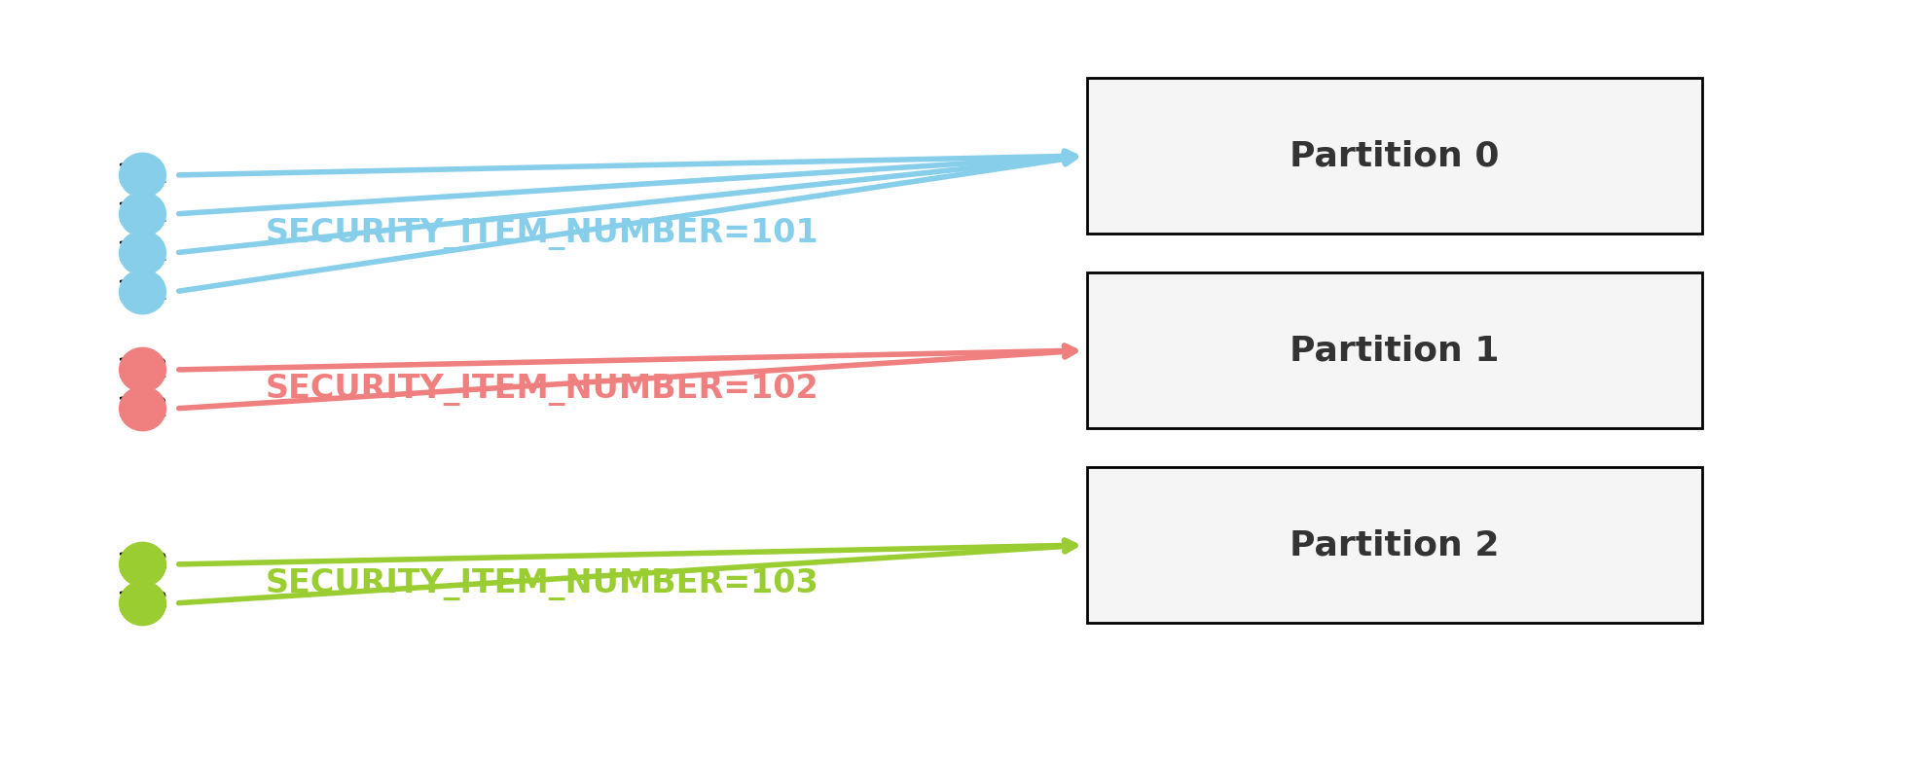
Kafka Partitions & Key-Based Partitioning
How Partitioning Works:
- Kafka topics are split into partitions.
- Producer or Kafka Connect sets message key: e.g., SIN
- Kafka hashes the key to choose a partition.
Result:
- All messages with the same key always go to the same partition.

Slide 4
Maintaining Order
Kafka Guarantees:
- Order of events is preserved within a partition.
- By ensuring all events for a key go to the same partition, we maintain order per SIN.

Slide 5
Kafka Connect SMTs for Key-Based Partitioning
- Use Single Message Transforms (SMTs) to set the message key in Kafka Connect.
- Typical config:
transforms: copyFieldToKey,extractKeyFromStruct
transforms.copyFieldToKey.type: org.apache.kafka.connect.transforms.ValueToKey
transforms.copyFieldToKey.fields: SIN
transforms.extractKeyFromStruct.type: org.apache.kafka.connect.transforms.ExtractField$Key
transforms.extractKeyFromStruct.field: SIN _ID

Slide 6
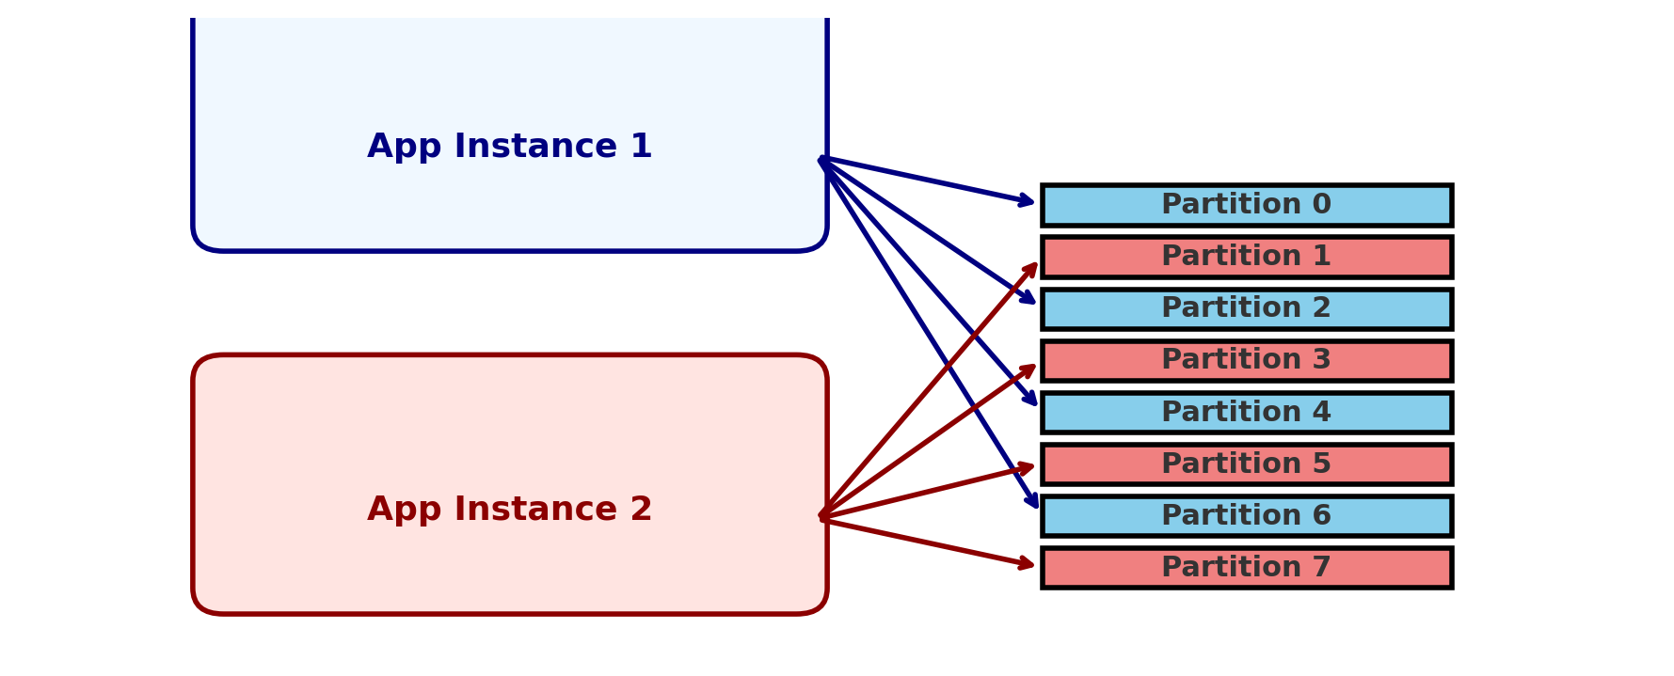
Scaling Consumers (Spring Boot Instances)
How Kafka Distributes Work:
Consumers are part of a consumer group.
Kafka assigns each partition to only one consumer instance at a time.
All events for a SIN (one key) are always processed by the same instance at any moment.

Slide 7
Partition Assignment with 2 App Instances
Scenario:
8 Kafka partitions
2 Spring Boot app instances (same group.id) How it works:
Kafka assigns 4 partitions to each app instance.
Each instance processes messages from its assigned partitions in parallel.
If we set concurrency=4, each instance can process all 4 partitions in parallel threads.

Slide 8
Q&A
Questions?

