Slide 1


Smart Asset Tracking and Predictive Maintenance System for Flight Catering
Project ID : 20
Internal Advisor ~ Dr Shahab Tehzeeb

Slide 2
GROUP MEMBERS
WAHAJ
RAZA
CS – 21055
CGPA : 3.97
FARRUKH NIAZ
CS – 21064
CGPA : 3.2
HUZAIFA NASEER
CS – 21067
CGPA : 3.39
MUZAMMIL RIZVI
CS – 21089
CGPA : 3.43

Slide 3
PROJECT BACKGROUND
Flight Catering struggles with efficiently managing its catering vehicle fleet, which is critical for delivering food.
The current manual tracking of vehicle usage and maintenance scheduling is prone to errors and inefficiencies.
Ineffective maintenance planning leads to unplanned vehicle downtime, reducing fleet availability.

Slide 4
PROJECT INTRODUCTION
We got connected with Ephlux and they provided us with their platform ‘Swift’ to build an IOT based solution to this problem.
“
The scope of our project is to build Smart Asset Tracking and Predictive Maintenance System which uses IOT sensors and AI to predict vehicle maintenance needs and automate work orders, streamlining operations.
”

Slide 5
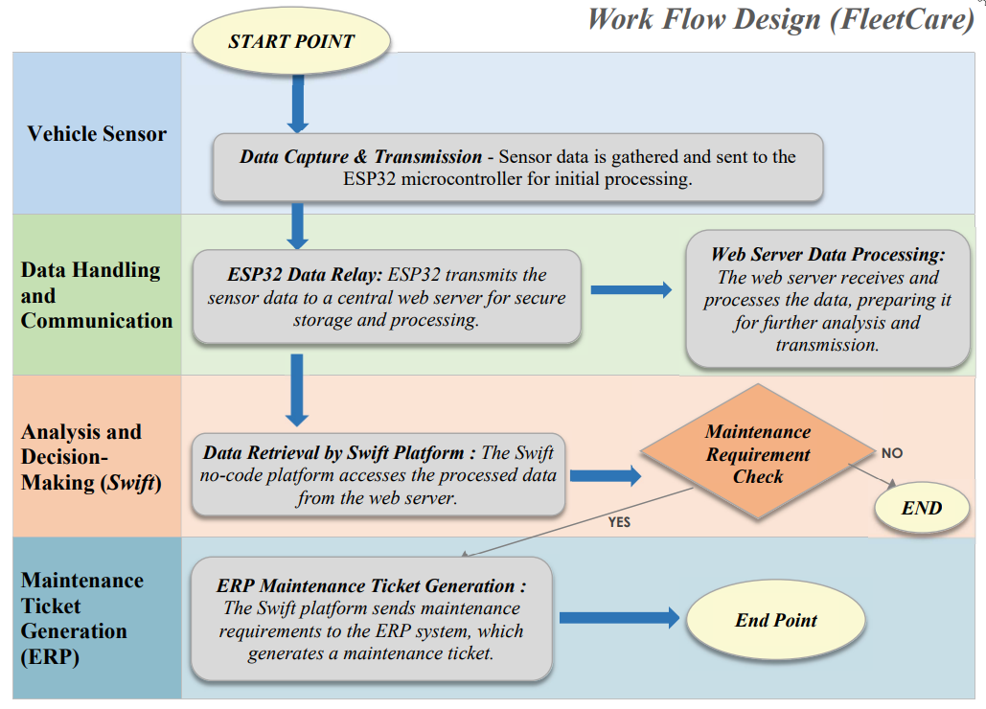
FLOW OF THE PROJECT

Slide 6
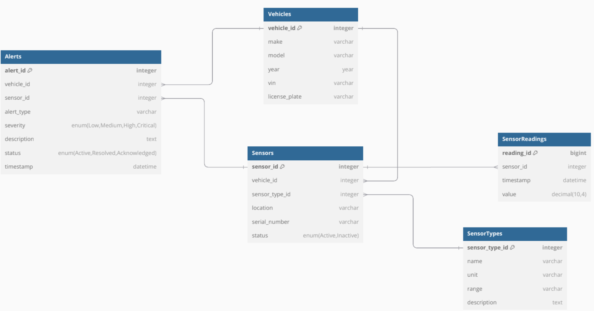
ER DIAGRAM

Slide 7
PROJECT FLOW DIAGRAM

Slide 8
PHASE 1
PHASE 2
PHASE 3
Overall
Architecture
Design
Solution Integration
UI / UX
Prototype
Sensor Data Simulation
Device Connectivity
Testing
Interface Creation of Swift
ML Predictive
Model
Demo
Launch
Real Time Dashboard Dataflow &
Alerts Generation

Slide 9
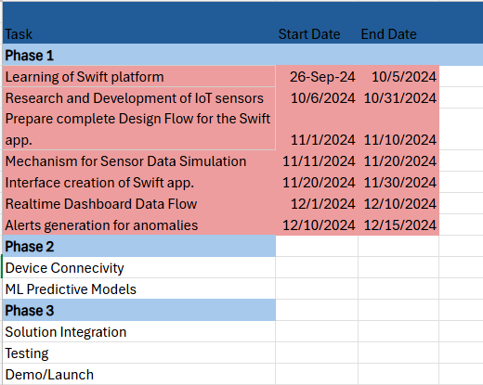
MILESTONES ACHEIVED

Slide 10
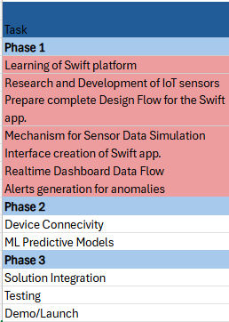
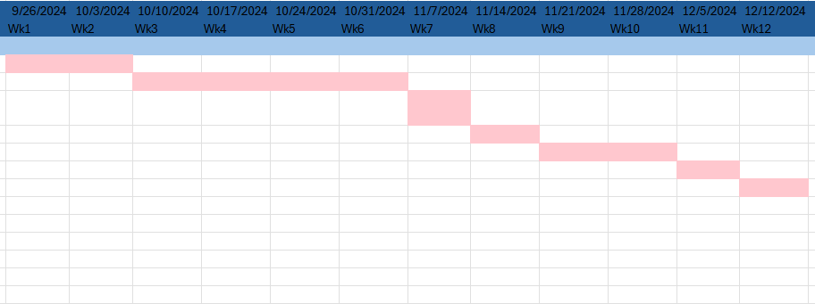
GANTT CHART

Slide 11
Milestones Achieved Summary
Learning Swift Platform
R&D of IoT Sensors for Vehicles
Complete Design Flow
Sensor Data Simulation
Dashboard and UI on Swift App
Interfaces Created on Swift App
Alerts Generation

Slide 12
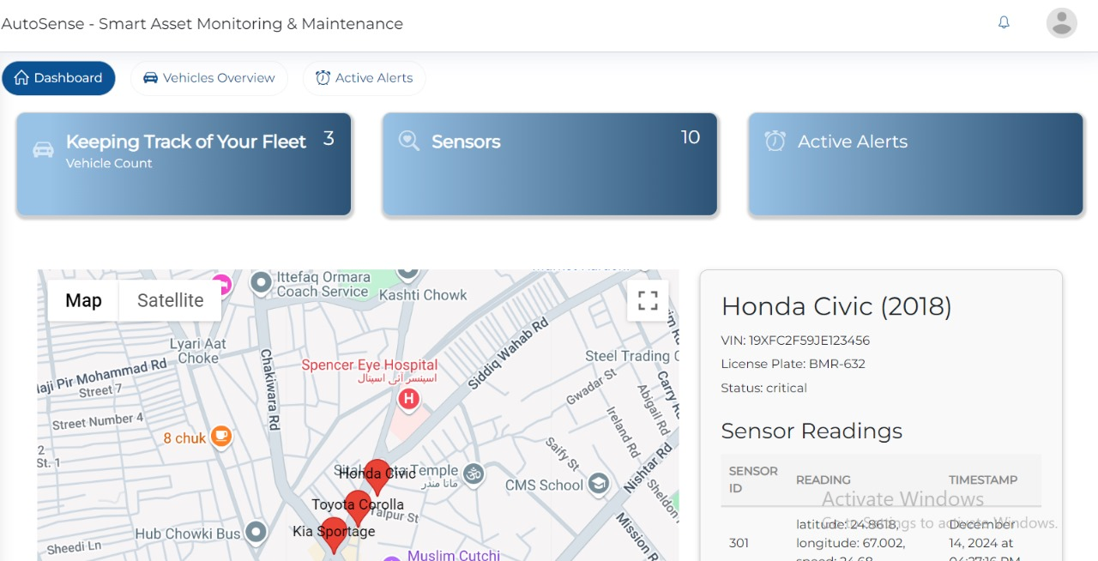

Slide 13
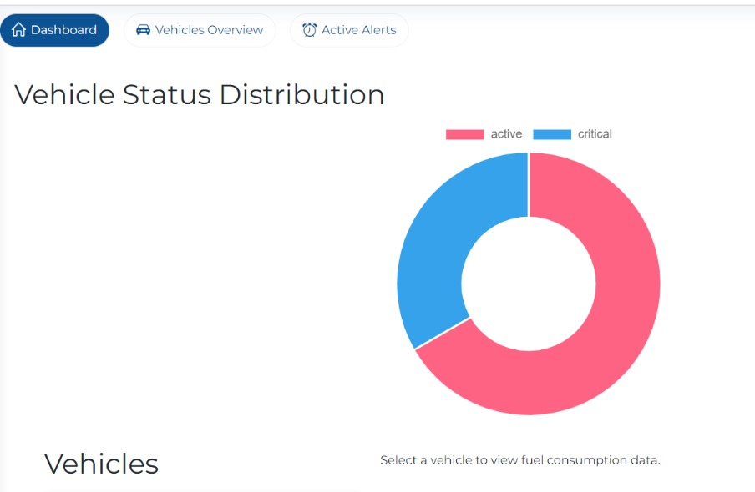

Slide 14
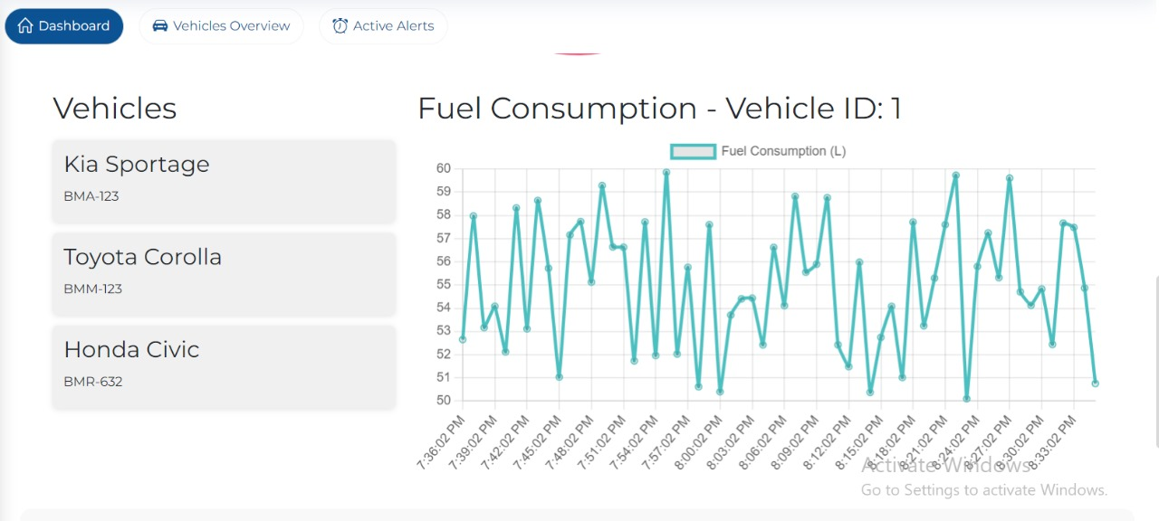

Slide 15
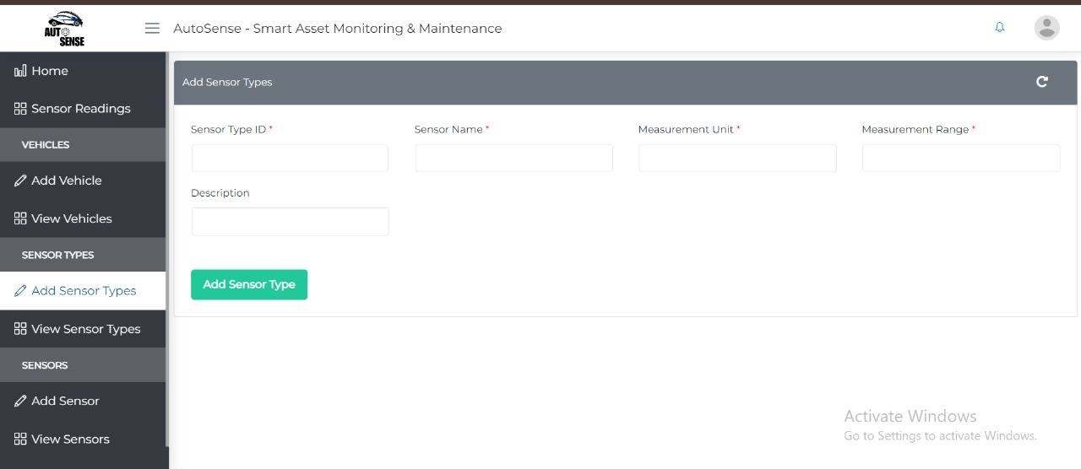

Slide 16
FUTURE PLANS
Predictive Analytics for Maintenance
Use historical data and sensor readings to predict potential vehicle issues.
AI Powered Anomaly Detection
Detect abnormal vehicle behavior (e.g., temperature spikes, efficiency drops).
Alert users in real-time to prevent further damage and ensure safety.
Automatic ERP Ticket Creation
Automatically generate ERP tickets when maintenance issues are detected.
Include detailed diagnostics and prioritize tickets based on issue severity.
End-to-End Solution Demonstration
Demonstrate the entire process from sensor data collection to ERP ticket generation.
Show seamless integration between vehicle monitoring, AI predictions, and maintenance.
Application Demo & Launch 🚀

Slide 17
INDIVIDUAL’S CONTRIBUTION IN ACHIEVING MILESTONES
HUZAIFA NASEER KHAN
CS – 21067
API integration (Google Maps)
Map view for vehicle locations
Mock sensor data simulation
Status simulation (e.g., overheating)
Coordination with IA and supervisor
MUZAMMIL RIZVI
CS – 21089
Sensor data integration into DB
Webhooks for real-time updates
Dynamic view forms & filtering
Dropdowns for predefined values
Action forms for status updates
Reassign sensors to vehicles

Slide 18
INDIVIDUAL’S CONTRIBUTION IN ACHIEVING MILESTONES
WAHAJ RAZA
CS – 21055
Define object structures in DB
ER & Architecture Diagrams
Swift workflows (create/update/delete/read)
Webhooks for alerts & notifications
Real-time graph for status data
Middleware-DB-frontend integration
FARRUKH NIAZ
CS – 21064
Widget for alerts/notifications
Middleware for preprocessing
Ensure accurate data forwarding
Project flow/timeline diagrams
View & Entry forms
Input validation mechanisms

Slide 19
THANK YOU!
Any questions?

