Slide 1
Final Exam
1月7日 10:30-12:30 建议提前20分钟进场
客观题全部在指定的答题框/空格内作答
有限开卷，自带3张有内容（可正反面写/打印）的A4纸入场
40道选择题，4道填空题，3道问答题
Notes:
30分问答题、填空题10分、选择60分 （写到答题卷里，和试卷分开交） 课本为主，实验的指导书也要进行一些理解（lab已经做好了）

Slide 2
OS Concepts Main Textbook

Slide 3
Chapter 1
OS definition, kernel
Interrupt
Synchronous vs. Asynchronous I/O
Hardware generated
Caused by error
Software generated
System call

Slide 4
Device status table
Storage hierarchy
Cache and coherency
OS structure: multi-programming for CPU utilization; and multi-tasking (time sharing) for interactivity
OS operation: user-mode and kernel (monitor) mode

Slide 5
Process mgmt: Multi-threaded process has one program counter per thread
Memory mgmt: determines what is in memory
Storage mgmt: file system
I/O subsystem: hide peculiarities

Slide 6
Chapter 2
Read the main textbook
OS services
System call
OS design and implementation
Separation of mechanism and policy
OS structures
Layered structure
Monolithic kernel
Microkernel

Slide 7
System Call Implementation
Typically, a number associated with each system call
System-call interface maintains a table indexed according to these numbers
The system call interface invokes intended system call in OS kernel and returns status of the system call and any return values
The caller needs to know nothing about how the system call is implemented
Just needs to obey API and understand what OS will do as a result call
Most details of OS interface hidden from programmer by API
Managed by run-time support library (set of functions built into libraries included with compiler)

Slide 8
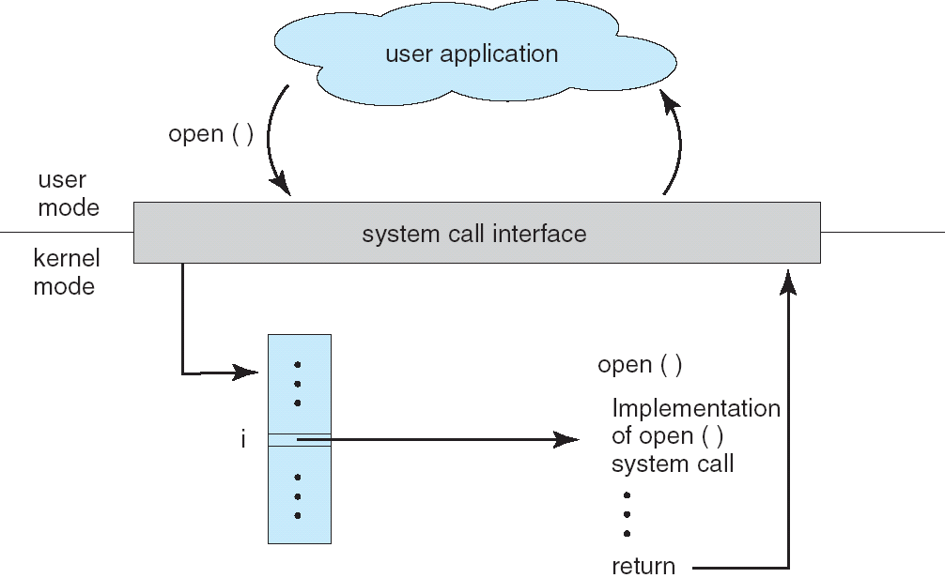
API – System Call – OS Relationship

Slide 9
Microkernel System Structure
Moves as much from the kernel into “user” space
Communication takes place between user modules using message passing
Benefits:
Easier to extend a microkernel
Easier to port the operating system to new architectures
More reliable (less code is running in kernel mode)
More secure
Detriments:
Performance overhead of user space to kernel space communication

Slide 10
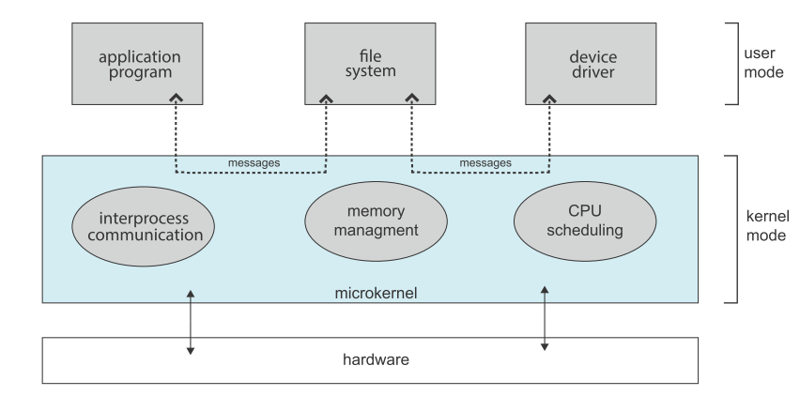
Architecture of A Typical Microkernel

Slide 11
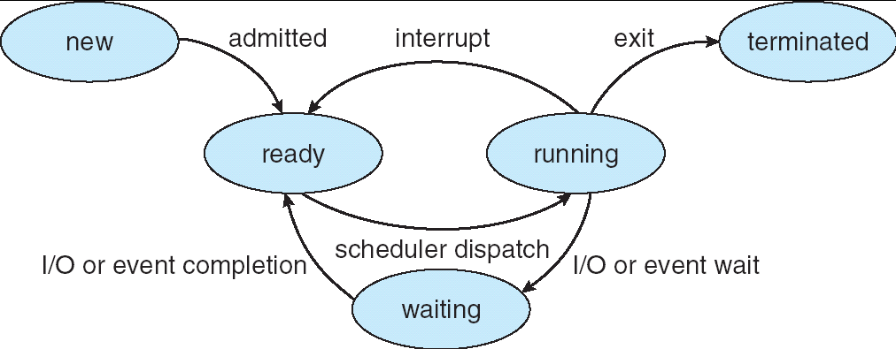
Chapter 3
Process states: the state transition diagram.

Slide 12
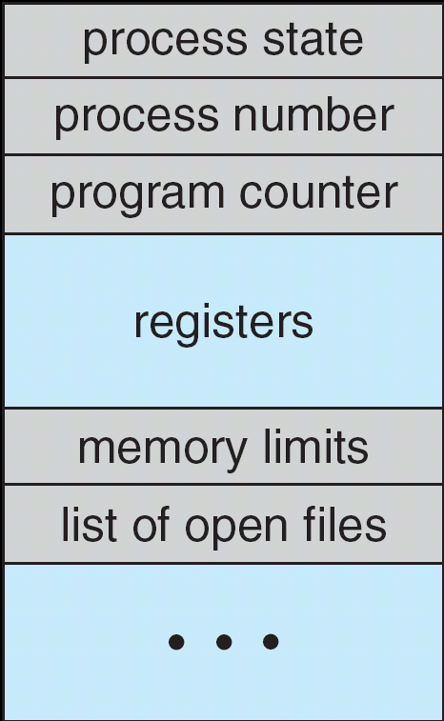
Process Control Block (PCB)

Slide 13
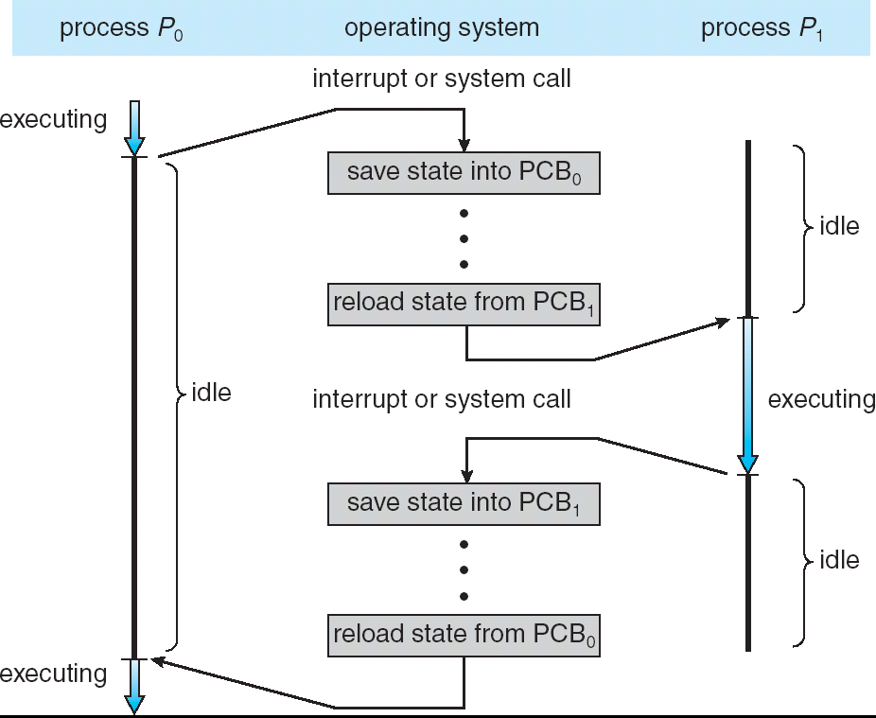
Context Switch

Slide 14
Process Scheduling Queues
Job queue – set of all processes in the system
Ready queue – set of all processes residing in main memory, ready and waiting to execute
Device queues – set of processes waiting for an I/O device
Processes migrate among the various queues

Slide 15
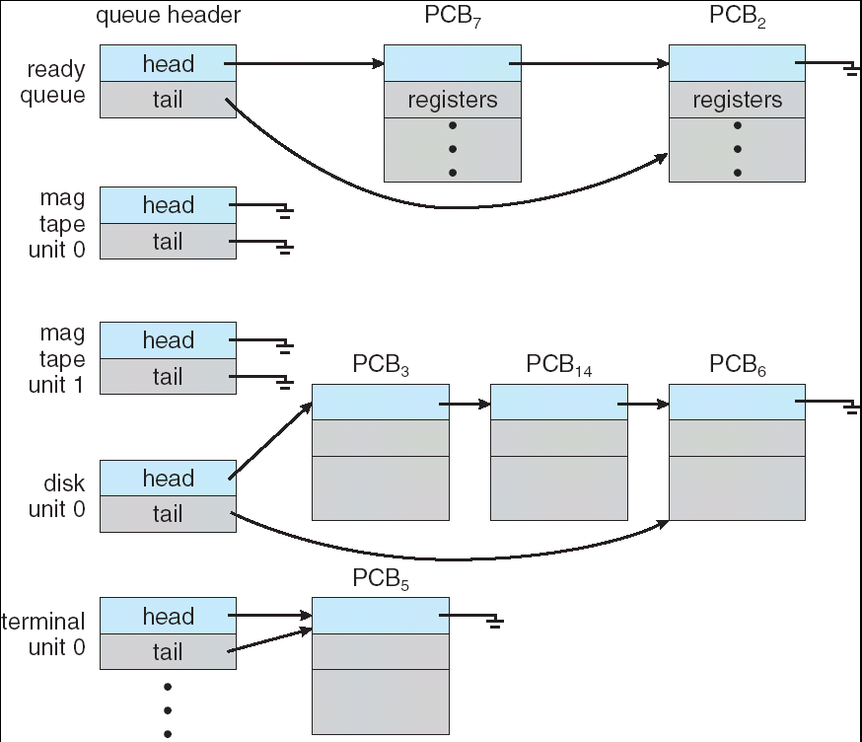
Ready Queue And Various I/O Device Queues

Slide 16
Producer-Consumer Problem
Paradigm for cooperating processes, producer process produces information that is consumed by a consumer process
unbounded-buffer places no practical limit on the size of the buffer. Consumer has to wait if no new item.
bounded-buffer assumes that there is a fixed buffer size. Producer must wait if buffer full.

Slide 17
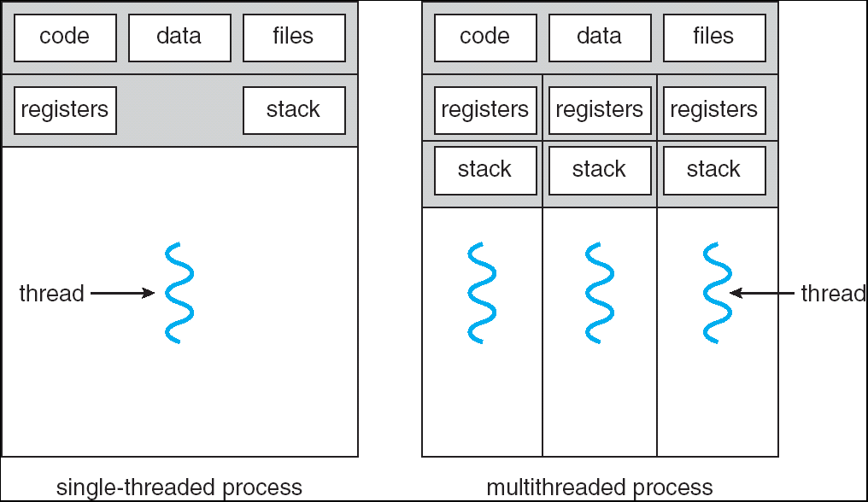
Chapter 4
Thread concept
Thread resources
User/kernel mode threads

Slide 18
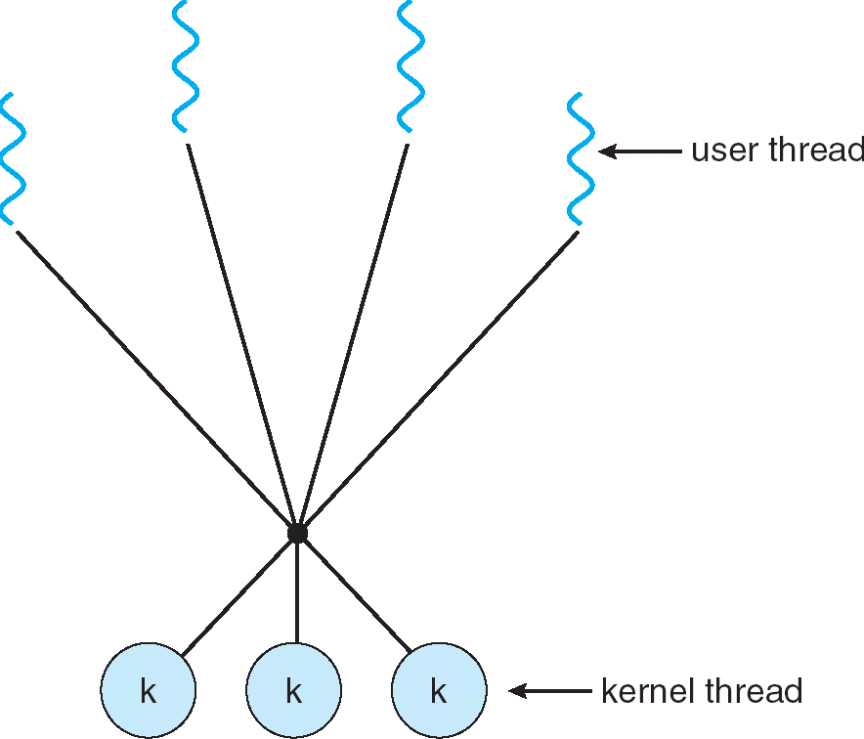
Multi-threading models: many-to-one, one-to-one, many-to-many
补充slides: multithreading models

Slide 19

班级比赛（多线程）
班级：Process
号码簿/班级号：Process ID
跑道：CPU core
每条跑道只能有一个运动员
运动场可以有一条/多条跑道
班级成员：Threads
规则
每班发一个号码簿
成员能跑的戴号码簿上场
全班跑完为止
Many-to-one
一班
二班
三班
四班
班级内部选一个成员佩戴号码簿，kernel根据号码簿调度场上运动员

Slide 20
班级比赛（多线程）
班级：Process
号码簿：Thread ID
班级号：Process ID
跑道：CPU core
每条跑道只能有一个运动员
运动场可以有一条/多条跑道
班级成员：Threads
规则
每人可申请一个号码簿
成员戴号码簿上场
全班跑完为止
One-to-one
101
103
102
209
kernel根据号码簿调度场上运动员，一个班可以有多个运动员在跑

Slide 21
班级比赛（多线程）
班级：Process
号码簿(1班x号）：LWP ID
班级号：Process ID
跑道：CPU core
每条跑道只能有一个运动员
运动场可以有一条/多条跑道
班级成员：Threads
规则
每班限发若干个号码簿
成员能跑的戴号码簿上场
全班跑完为止
Many-to-many
一班01
一班02
三班01
三班02
每班限上场2人
班级内部指定号码簿给谁戴，kernel根据号码簿调度场上运动员

Slide 22
Chapter 5
CPU scheduling criteria:
utilization,
throughput,
turnaround-time,
waiting time,
response time
Gantt chart

Slide 23
CPU Scheduler
Selects from among the processes in memory that are ready to execute, and allocates the CPU to one of them
CPU scheduling decisions may take place when a process:
When a process switches from the running state to the waiting state (e.g. I/O request or an invocation of wait())
When a process switches from the running state to the ready state (e.g., when an interrupt occurs)
When a process switches from the waiting state to the ready state (e.g., at completion of I/O)
When a process terminates
Scheduling under 1 and 4 is nonpreemptive
All other scheduling is preemptive

Slide 24
Scheduling algorithms (Preemptive and non-preemptive)
FCFS
SJF
Priority
Round Robin
Multilevel queue
Multilevel Feedback Queue

Slide 25
Chapter 6
Three requirements to solve critical section problem: mutual exclusion(互斥)、progress (空闲让进)、bounded waiting (有限等待)
Preemptive/non-preemptive kernels
Synchronization hardware
Semaphore
Counting semaphore
Producer-consumer (bounded-buffer) problem
Readers-writers problem

Slide 26
Chapter 7
Four conditions to form a deadlock
Mutual exclusion
Hold & wait
No preemption
Circular wait
Deadlock prevention
Avoidance
RAG
Suppose that process P_{i} requests a resource R_{j}
The request can be granted only if converting the request edge to an assignment edge does not result in the formation of a cycle in the resource allocation graph

Slide 27
Banker’s algorithm
Safety Algorithm: attempts to find a sequence in which all processes can finish
Resource-Request Algorithm:
If Request_{i} ≤ Need_{i} go to step 2. Otherwise raise error.
If Request_{i} ≤ Available, go to step 3. Otherwise P_{i} must wait.
Pretend to allocate requested resources to P_{i}
If safe ⇒ the resources are allocated to Pi.
If unsafe ⇒ Pi must wait, and the old resource-allocation state is restored

Slide 28
Chapter 8
Binding time
Logical/physical addresses
Swapping
Variable-partition scheme
Dynamic partition allocation: first/best/worst fit
External/internal fragmentation
Paging: Page table, TLB, hierarchical page table, inverted page table
Effective access time
Segmentation: segment table

Slide 29
Multistep Processing of a User Program
Hello.c
#include<stdio>
int main() {
printf("hello, world\n");
return 0;
}
A compiler is a computer program (or set of programs) that transforms source code written in a computer language (the source language) into another computer language (the target language, often having a binary form known as object code).
Hello.o
Relocatable binary object
Printf.o
Other object
A linker or linkage editor is a program that takes one or more objects generated by a compiler and combines them into a single executable program.
A loader loads the .exe file into memory for execution.
Hello.exe

Slide 30
Binding of Instructions and Data to Memory
Address binding of instructions and data to memory addresses can happen at three different stages
Compile time（编译时刻）: If memory location known a priori, absolute code can be generated; must recompile code if starting location changes
Load time（装入时刻）: Must generate relocatable code if memory location is not known at compile time
Execution time（执行时刻）: Binding delayed until run time if the process can be moved during its execution from one memory segment to another. Need hardware support for address maps (e.g., base and limit registers)

Slide 31
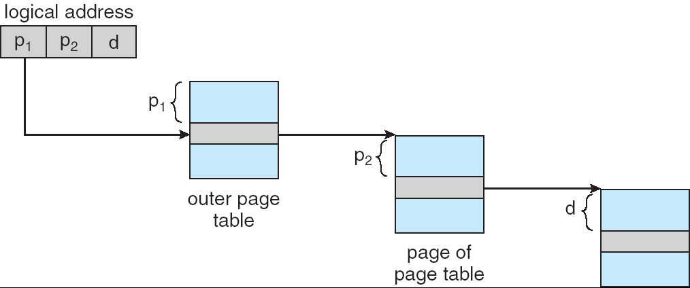
Address-Translation Scheme

Slide 32
Chapter 8
Binding time
Logical/physical addresses
Swapping
Variable-partition scheme
Dynamic partition allocation: first/best/worst fit
External/internal fragmentation
Paging: Page table, TLB, hierarchical page table, inverted page table
Effective access time
Segmentation: segment table

Slide 33
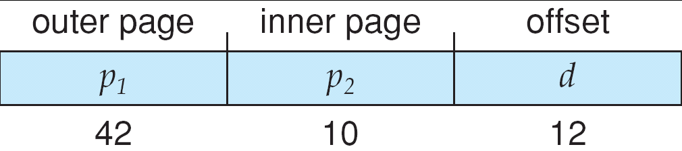
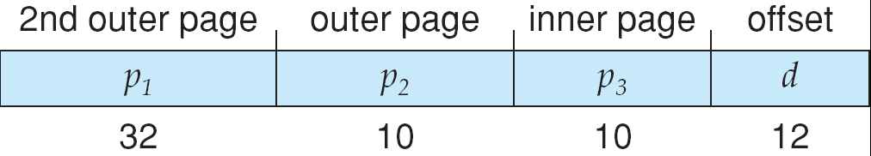
Three-level Paging Scheme

Slide 34
Chapter 9
Concept of virtual memory
Demand paging
Page fault, Effective Access Time (EAT)
EAT = (1 – p) x memory access
+ p (page fault overhead
+ swap page out
+ swap page in
+ restart overhead)
Page replacement algorithms – algorithms FIFO, LRU, Optimal, CLOCK, MFU etc.

Slide 35
Virtual Memory
Virtual memory – separation of user logical memory from physical memory.
Only part of the program needs to be in memory for execution
Logical address space can therefore be much larger than physical address space
Allows address spaces to be shared by several processes
Allows for more efficient process creation
Xv6 book: virtual memory isn’t a physical object, but refers to the collection of abstractions and mechanisms the kernel provides to manage physical memory and virtual addresses.
Virtual memory can be implemented via:
Demand paging
Demand segmentation

Slide 36
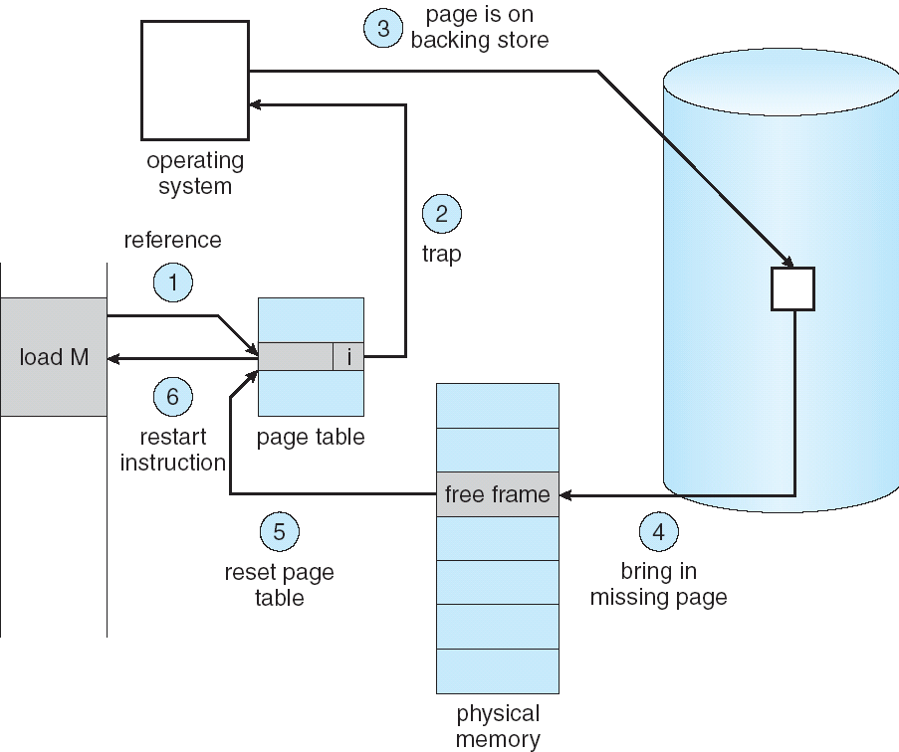
Steps in Handling a Page Fault

Slide 37
A Page Fault Causes The Following
Trap to the operating system.
Save the registers and process state.
Determine that the interrupt was a page fault.
Check that the page reference was legal, and determine the location of the page in secondary storage.
Issue a read from the storage to a free frame:
Wait in a queue until the read request is serviced.
Wait for the device seek and/or latency time.
Begin the transfer of the page to a free frame.
While waiting, allocate the CPU core to some other process.
Receive an interrupt from the storage I/O subsystem (I/O completed).
Save the registers and process state for the other process.
Determine that the interrupt was from the secondary storage device.
Correct the page table and other tables to show that the desired page is now in memory.
Wait for the CPU core to be allocated to this process again.
Restore the registers, process state, and new page table, and then resume the interrupted instruction.
Notes:
详细的描述

Slide 38
First-In-First-Out (FIFO) Algorithm
Reference string: 1, 2, 3, 4, 1, 2, 5, 1, 2, 3, 4, 5
3 frames (3 pages can be in memory at a time per process)
4 frames
Belady’s Anomaly: more frames ⇒ more page faults
1
1
4
5
2
2
1
3
9 page faults
3
3
2
4
1
1
5
4
2
2
1
5
10 page faults
3
3
2
4
4
3

Slide 39
Optimal Algorithm
Replace page that will not be used for longest period of time
4 frames example
1, 2, 3, 4, 1, 2, 5, 1, 2, 3, 4, 5
How do you know this?
Used for measuring how well your algorithm performs
1
4
2
6 page faults
3
4
5

Slide 40
Least Recently Used (LRU) Algorithm
Reference string: 1, 2, 3, 4, 1, 2, 5, 1, 2, 3, 4, 5
Counter implementation
Every page entry has a counter; every time page is referenced through this entry, copy the clock into the counter
When a page needs to be changed, look at the counters to determine which are to change
1
1
1
1
5
2
2
2
2
2
3
5
5
4
4
4
4
3
3
3

Slide 41
LRU Approximation Algorithms
Reference bit
With each page associate a bit, initially = 0
When page is referenced bit set to 1
Replace the one which is 0 (if one exists)
We do not know the order, however
Second chance
Need reference bit
Clock replacement
If page to be replaced (in clock order) has reference bit = 1 then:
set reference bit 0
leave page in memory
replace next page (in clock order), subject to same rules

Slide 42
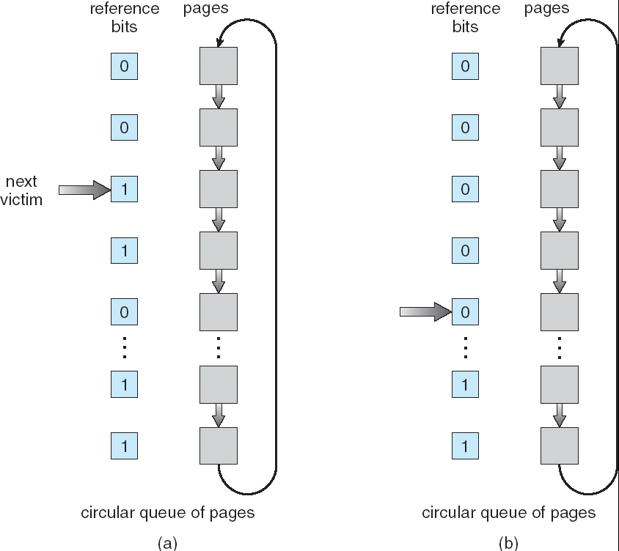
Second-Chance (clock) Page-Replacement Algorithm

Slide 43
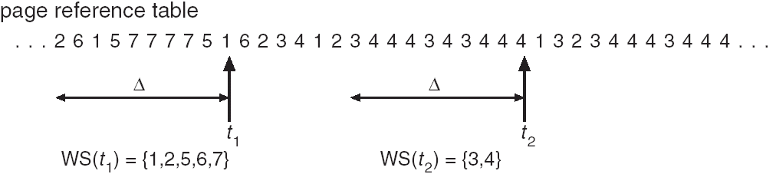
Thrashing
Why does demand paging work? Locality model
Why does thrashing occur? Σ size of locality 大于物理内存
How to prevent thrashing? Reduce the demand for memory
Working set

Slide 44
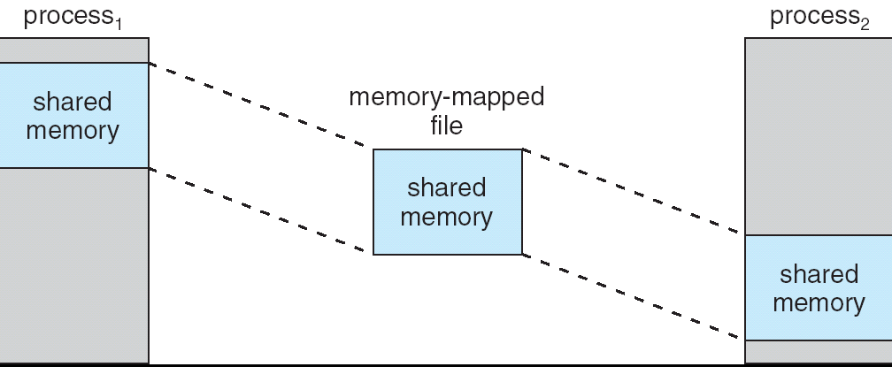
Memory mapped file

Slide 45
Chapter 10
File system
provides the mechanism for on-line storage of and access to both data and programs.
File system consists of two parts: a collection of files, a directory structure.
Most file systems live on storage devices.

Slide 46
File Attributes
Name – only information kept in human-readable form
Identifier – unique tag (number) identifies file within file system
Type – needed for systems that support different types
Location – pointer to file location on device
Size – current file size
Protection – controls who can do reading, writing, executing
Time, date, and user identification – data for protection, security, and usage monitoring
Information about files are kept in the directory structure, which is maintained on the disk

Slide 47
File Operations
File is an abstract data type
Create
Write – define a pointer
Read – use the same pointer
Per-process current file-position pointer
Seek
Delete
Truncate
Open(F_{i}) – search the directory structure on disk for entry F_{i}, and move the content of entry to memory
Close (F_{i}) – move the content of entry F_{i} in memory to directory structure on disk

Slide 48
Open file tables
Access methods: sequential, direct
Directory structure:
Efficiency – locating a file quickly
Naming – convenient to users
Two users can have same name for different files
The same file can have several different names
Grouping – logical grouping of files by properties, (e.g., all Java programs, all games, …)

Slide 49
Chapter 11
Data structures for FS
FCB
Virtual File Systems
Directory implementation
File allocation methods: contiguous/linked/FAT/indexed allocation, extents, Unix file allocation
Free space mgmt

Slide 50
Data Structures Used to Implement FS
Disk structures
Boot control block (per volume)
Volume control block per volume (superblock in Unix)
Directory structure per file system
Per-file FCB (inode in Unix)
In-memory structures (see fig)
In-memory mount table about each mounted volume
Directory cache for recently accessed directories
System-wide open-file table
Per-process open-file table

Slide 51
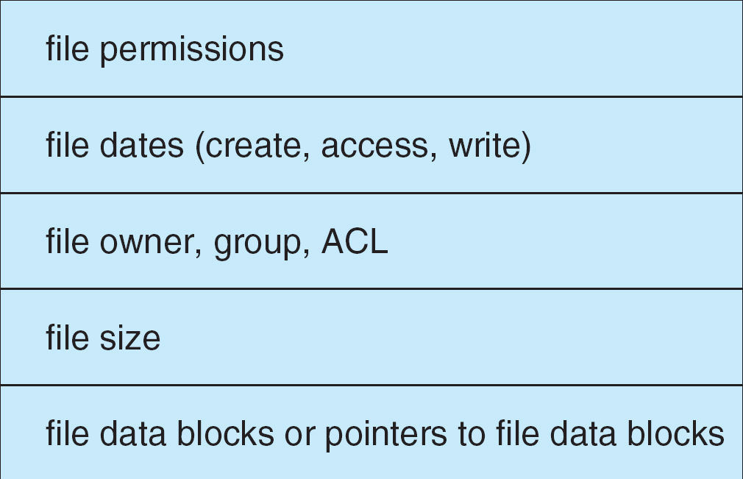
File Control Block
File control block – storage structure consisting of information about a file

Slide 52
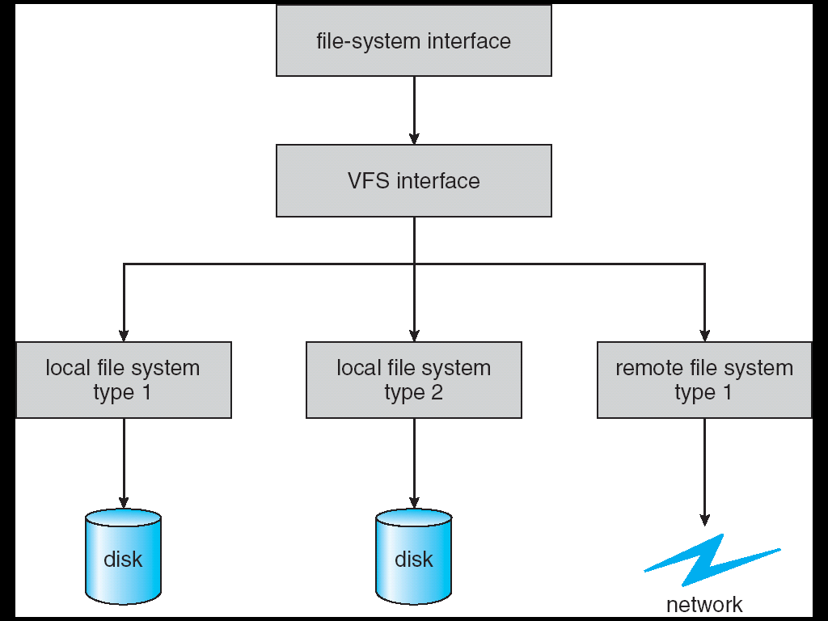
Schematic View of Virtual File System
write()
sys_write()
vfs_write()
Calls the write() methods of specific filesystems

Slide 53
Directory Implementation
Linear list of file names with pointer to the data blocks.
simple to program
time-consuming to execute
Hash Table – linear list with hash data structure.
decreases directory search time
collisions – situations where two file names hash to the same location
fixed size – can use chained-overflow hash table
Or rehashing to another larger hash table
In Unix, a directory is implemented as a file of dentries.

Slide 54
Chapter 12
Time to access a disk block
Seek time, rotational delay, transfer time
Disk scheduling algorithms
Cost model: seek distance
FCFS, SSTF, SCAN, C-SCAN, LOOK etc.
RAID concept

Slide 55
Chapter 13
Devices accessed by special i/o instruction, or memory mapped i/o
Interrupts, DMA
Blocking/non-blocking i/o
Device status table
Caching, buffering, spooling

Slide 56
OS Lab

Slide 57
Overview of Linux
Basic commands in Linux like ls, cp, ln, mv, echo, gcc, find, grep,…
Basic BASH/shell scripting
Lab 实验指导
Lectures (and slides)

Slide 58
Trap 与系统调用
课件：Trap与系统调用
System call processing
Invoking system_call()
Return from system call

Slide 59
Process Address Space Kernel Memory Management
课件：LKD12 Kernel Memory, LKD15 Process Address Space
Address spaces in linux
Memory management data structures in linux: e.g. MM, VMA
Hierarchical paging in linux
Physical memory management in linux: buddy algorithm, slab allocation

Slide 60
The Linux File System
课件：Linux 文件系统
Linux FCB information, inode structure
VFS structures
Symbolic (soft) links
open()、read() implementation

Slide 61
预祝各位同学取得佳绩！

