Slide 1

Google Play Store Apps

Slide 2

Introduction
The goal of this project is to deliver insights to understand customer demands and helping developers to popularize the product. The dataset is chosen from Kaggle. It is of 10k Play Store apps for analyzing the Android market.

Slide 3

The Dataset contain 10841 rows × 13 columns consists of :
App:
Application name
Category:
Category the app belongs to
Rating:
Overall user rating of the app (as when scraped)
Reviews:
Number of user reviews for the app (as when scraped)
Size:
Size of the app(as when scraped)
Installs:
Number of user downloads/installs for the app (as when scraped)
Type :
Paid or Free
Price:
Price of the app (as when scraped)
Content Rating:
Age group the app is targeted at - Children / Mature 21+ / Adult
Genres :
An app can belong to multiple genres (apart from its main category). For eg, a musical family game will belong to
Last update:
Date of the last update
Current Ver :
Current Version of the app Android Ver Which Android Ver its compatible with the app

Slide 4
Tools
The tools that I used for the MTA project are:
• Python programming language
• Jupyter lab as programming environment
• Numpy and Pandas for data manipulation
• Matplotlib and Seaborn for plotting

Slide 5
Preprocessing
Check missing /null values
Check Duplicate
Drop unnecessary column
Strip column names
changing column names

Slide 6

Questions to answer
Highest apps category?
Which Apps type is the highest?
The highest installed app categories is it free or paid?
What is Highest Content Rating?

Slide 7

Findings

Slide 8
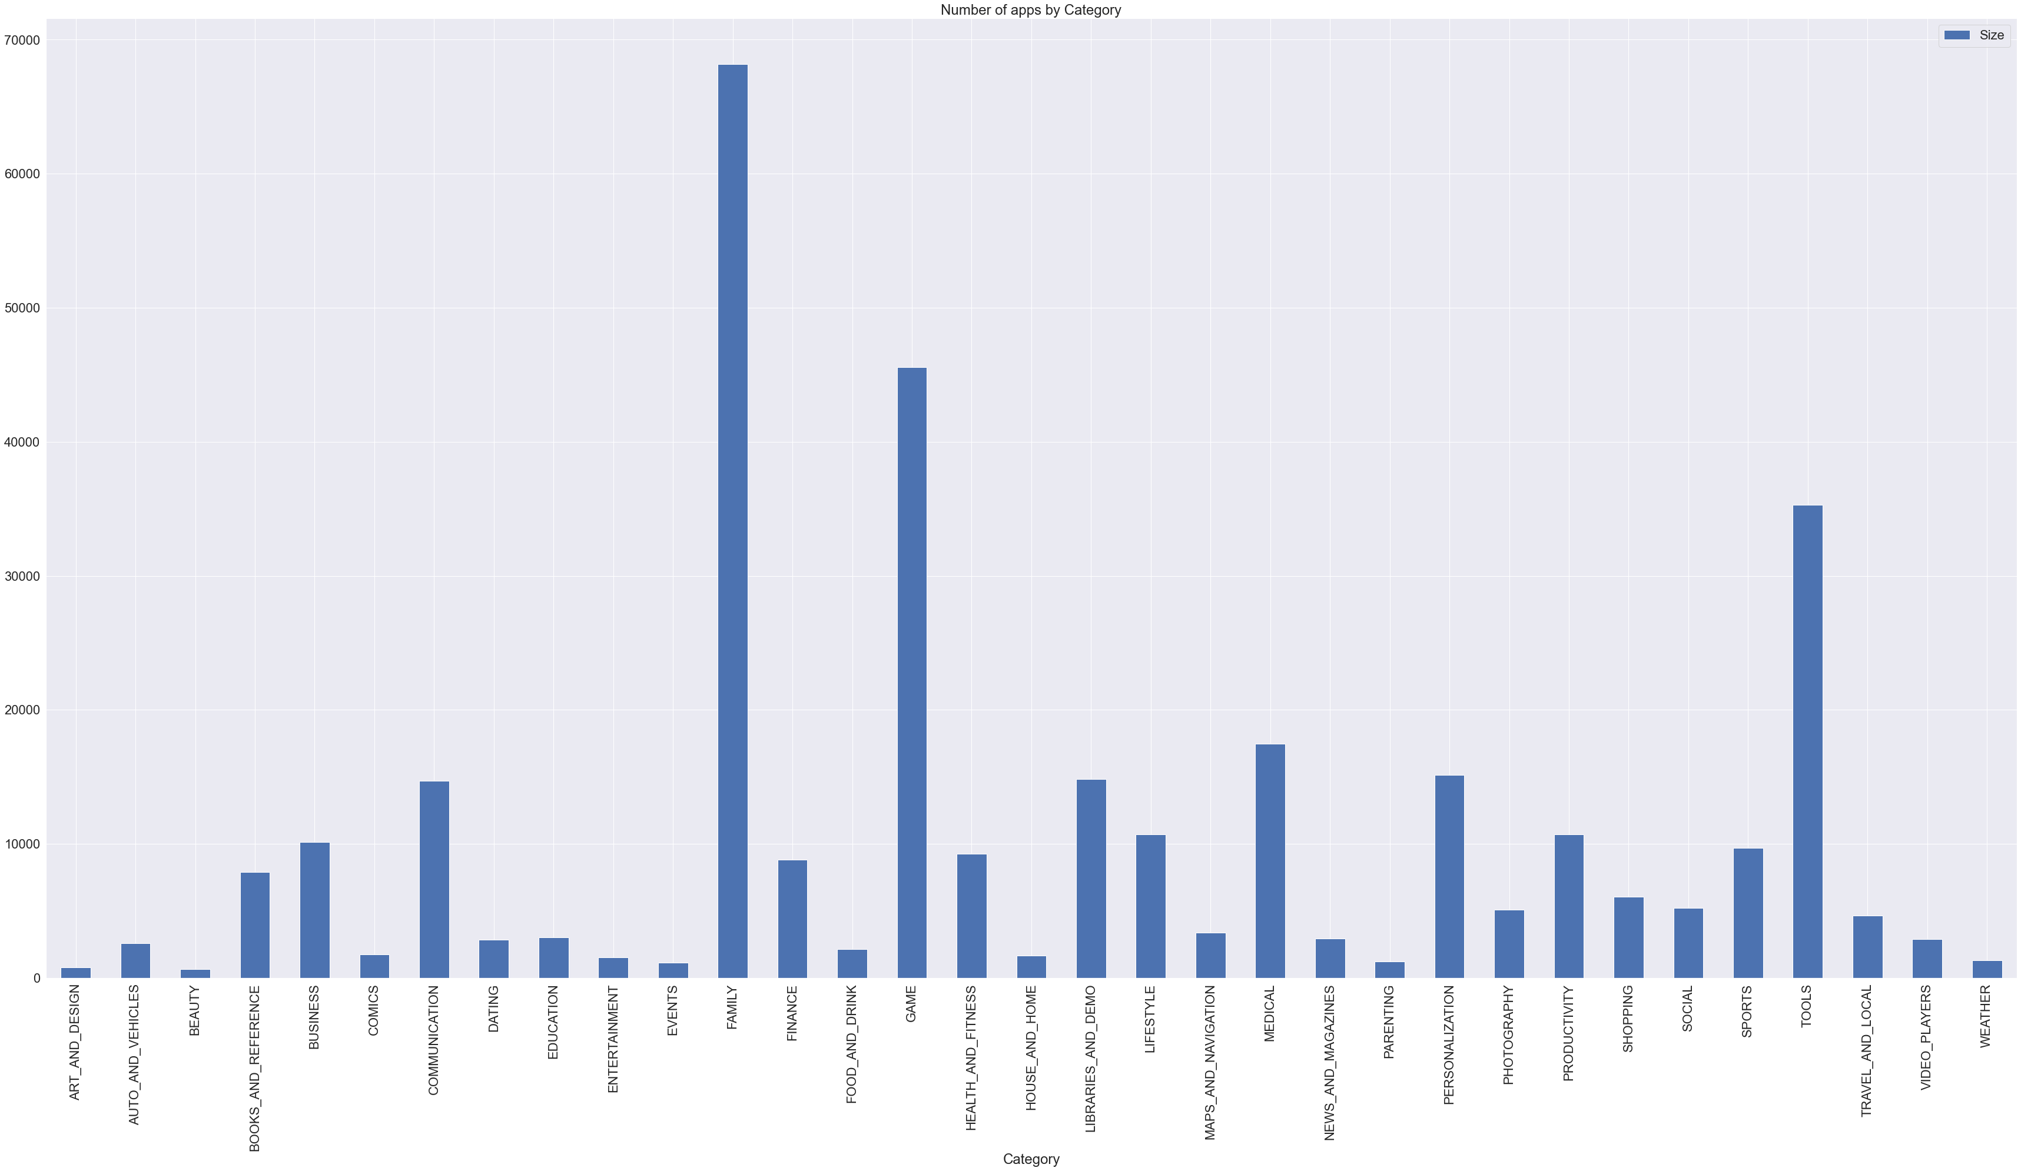
The Highest App Category

Slide 9

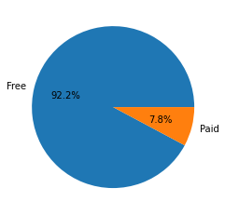
Free App or Paid App

Slide 10
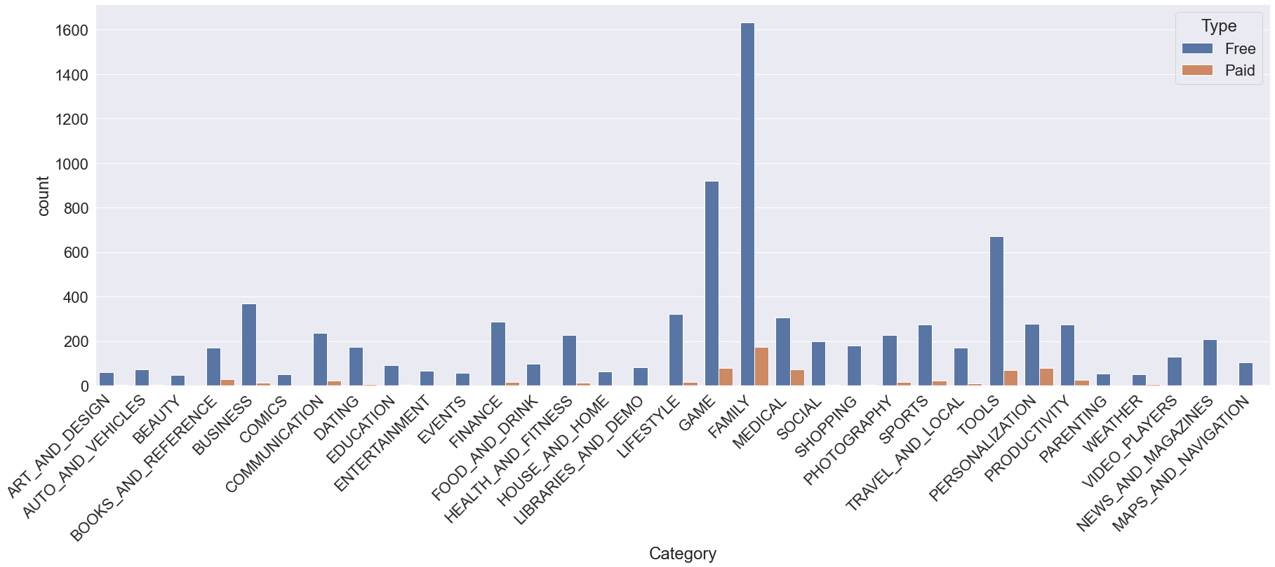
Highest installed app categories is it free or paid?

Slide 11
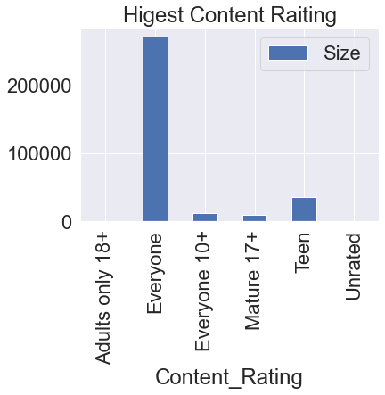
What is Highest Content Rating

Slide 12
Conclusion
▸ Family Category got the people interest more than the other categories .
▸Free Apps in the google play store apps more than the paid one.
▸the Content ‘Everyone’ is more than the others.

Slide 13

Thank you

