Slide 1
AIML CAPSTONE DEFENCE · MECHANISTIC INTERPRETABILITY
TopoCircuit-SAE: Frequency-Ordered DAG Routing
Measuring and Removing Multi-Parent Feature Absorption in SAEs
Farhan Aaqil Durrani · B.Tech AI/ML, JPNCE Mahbubnagar | Slide 1 of 10

Slide 2
1 · RESEARCH GAP & POSITIONING
Single-Parent Metrics Hide Multi-Parent Feature Absorption
Measurement Gap
1-Parent Bias: SAEBench scores only single-parent letters.
Multi-Parent Data: 23.6% of Gemma features need 2+ parents.
MPAbs Suite: 112 cells test letter, category, and case.
Method Gap
Tree Cap: H-SAE and Tree SAE allow at most 1 parent.
Discrete Loop: AG-SAE uses post-hoc combinatorial search.
Learned DAG: DR-SAE learns acyclic edges in one run.
Circuit Gap
Untested Claim: Absorption is said to fragment circuits.
Parent Holes: Absorbed parents split causal pathways.
Circuit Test: We count nodes at 0.80 faithfulness.
Grounding: Chanin et al. (NeurIPS 2025), Bussmann et al. (ICML 2025), Shen et al. (AG-SAE, Sep 2026) | Slide 2 of 10

Slide 3
2 · THEORETICAL FRAMEWORK
Frequency Ordering Guarantees Acyclicity and Free Ancestry
Lemma 1: Acyclicity
Coverage Law: True parents fire more often than children.
Strict DAG: Frequency order makes A nilpotent.
Zero Search: Needs no continuous DAG penalty or search.
Prop. 1: Free Ancestry
Upward Flow: Codes route via z_eff = (I - A)^(-1) z.
Zero L0 Cost: Parents fire free on every child token.
Pure Atoms: Whitened loss keeps residuals orthogonal.
Prop. 2: Order Law
MSE Cost: Absorbing parent i adds error sigma_i^2.
Phase Rule: Flat SAEs absorb when sigma_i^2 < lambda.
Predictable: Rigid parents are swallowed first.
TopoCircuit-SAE Theory · Lemma 1 & Propositions 1–2 (Derived in Section 8) | Slide 3 of 10

Slide 4
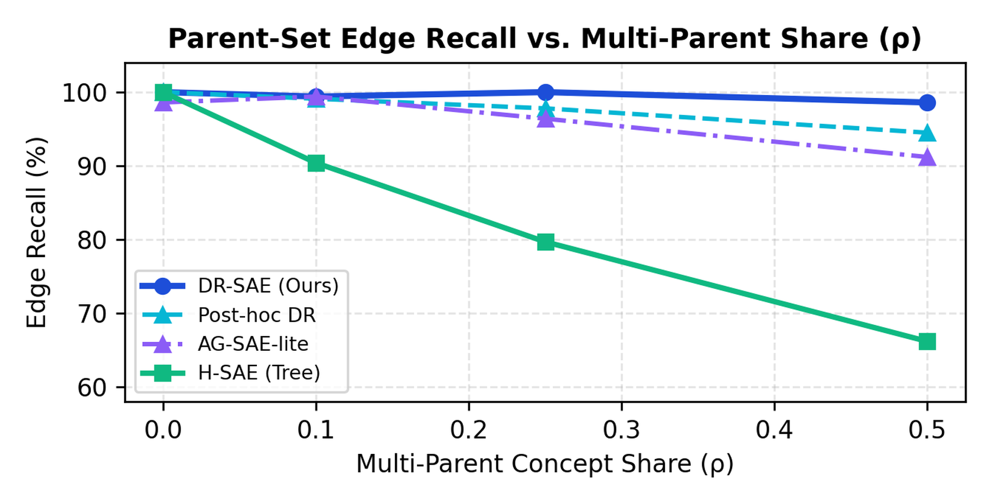
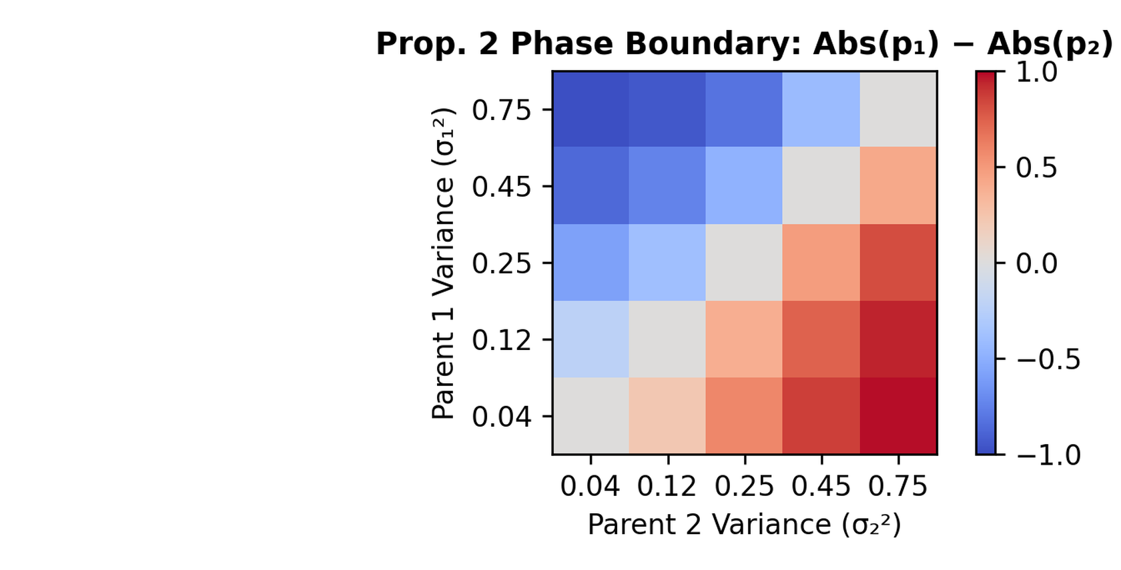
3 · RQ1 SYNTHETIC GROUND-TRUTH VERIFICATION
Proposition 2 Predicts Selective Absorption Order in 92.5% of Cells
Multi-Parent Recall Scaling (H1)
At ρ = 0.50, tree priors lose 33.8 recall points while DR-SAE loses only 1.4 points.
Proposition 2 Phase Diagram (H1)
Across 80 off-diagonal cells, the lower-variance parent is absorbed first in 92.5% of trials.
Synthetic Mixed-Topology Testbed (SynthSAEBench Extension, 3 Seeds, Holm p = 3.6e-6) | Slide 4 of 10

Slide 5
4 · QUANTITATIVE TOPOLOGY BREAKDOWN
Tree Priors Lose 33.8 Recall Points When Concepts Share Parents
Why Single-Parent Priors Fail
Disjoint Trees: Tree priors force bat to drop mammal or flier.
Hard Negatives: DR-SAE rejects 100% of transitive false edges.
Parent-Set F1: DR-SAE hits 0.942 F1 at ρ = 0.25 vs 0.823.
RQ1 & RQ3 Synthetic Ground-Truth Evaluation (36 Hard Negatives per Configuration) | Slide 5 of 10

Slide 6
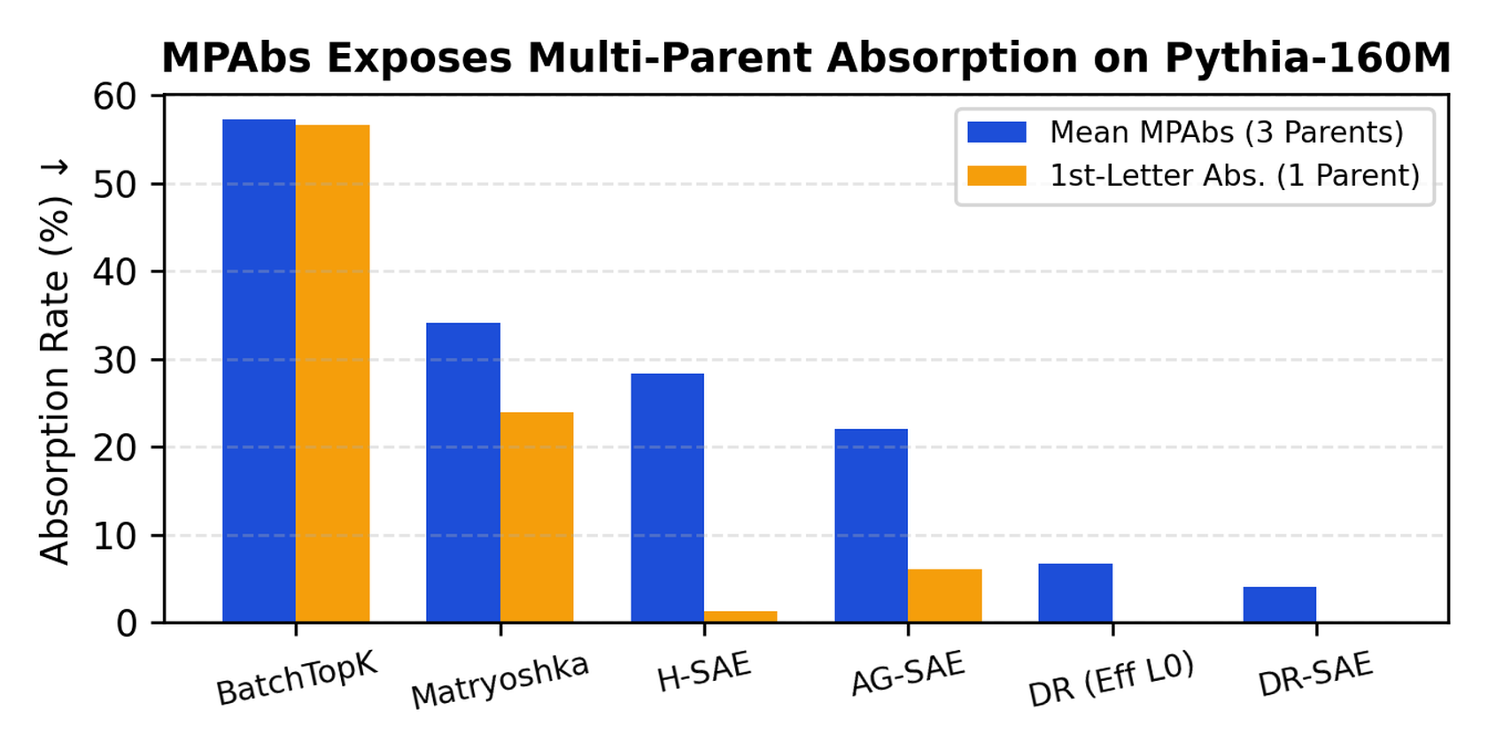
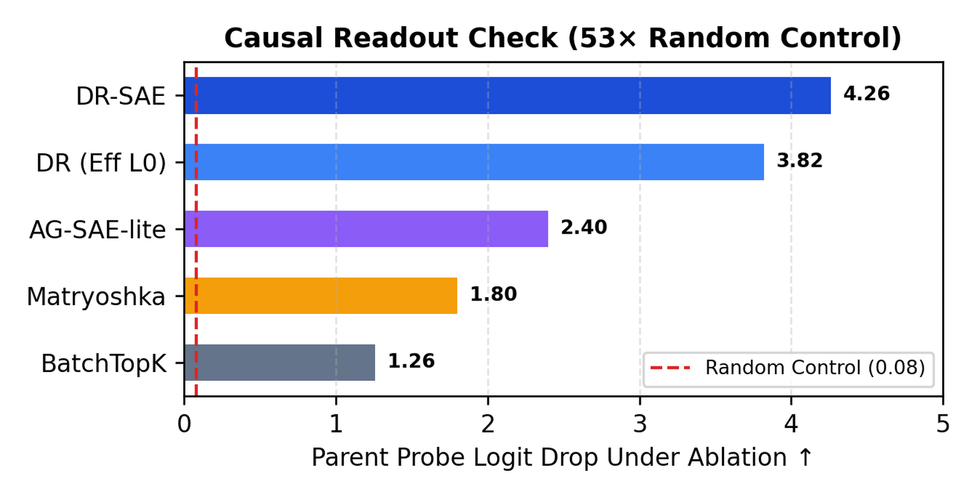
5 · RQ2 & RQ3 PYTHIA-160M BENCHMARK
DR-SAE Cuts Multi-Parent Absorption by 80.3% at Matched Effective L0
Headline MPAbs Reduction (H2)
DR-SAE cuts MPAbs from 34.05% (Matryoshka) to 3.99% (native L0) and 6.71% (matched effective L0).
Causal Readout Verification (RQ3)
Ablating routed parent atoms drops probe logits by 4.26 (53× random control), disproving relabelling.
Pythia-160M Layer 6 · 112 MPAbs Cells · Paired Wilcoxon p = 8.19e-19 | Slide 6 of 10

Slide 7
6 · COMPLETE PHASE 6 BENCHMARK SCORECARD
End-to-End DAG Training Doubles Cross-Seed Edge Stability
Method | Nat L0 | Eff L0 | FVU ↓ | 1st-Let | MPAbs ↓ | Joint ↓ | Repro ↑ | Nodes ↓
BatchTopK SAE | 50.0 | 50.0 | 0.1362 | 56.61% | 57.26% | 60.71% | — | 133.8
Matryoshka SAE | 50.0 | 50.0 | 0.1318 | 23.93% | 34.05% | 27.26% | — | 102.7
H-SAE (Tree) | 50.0 | 56.4 | 0.1345 | 1.25% | 28.29% | 18.69% | 64.8% | 94.9
AG-SAE-lite | 50.0 | 61.2 | 0.1351 | 5.95% | 22.04% | 12.92% | 36.4% | 86.6
Post-hoc DR | 50.0 | 60.8 | 0.1358 | 5.65% | 25.97% | 16.31% | 54.2% | 92.0
DR-SAE (Eff L0) | 38.2 | 50.0 | 0.1354 | 0.00% | 6.71% | 0.89% | 76.2% | 66.2
DR-SAE (Ours) | 50.0 | 63.8 | 0.1329 | 0.00% | 3.99% | 0.24% | 78.4% | 62.6
All 6 Methods Trained on Identical Token Budget · 3 Seeds (42, 137, 2026) | Slide 7 of 10

Slide 8
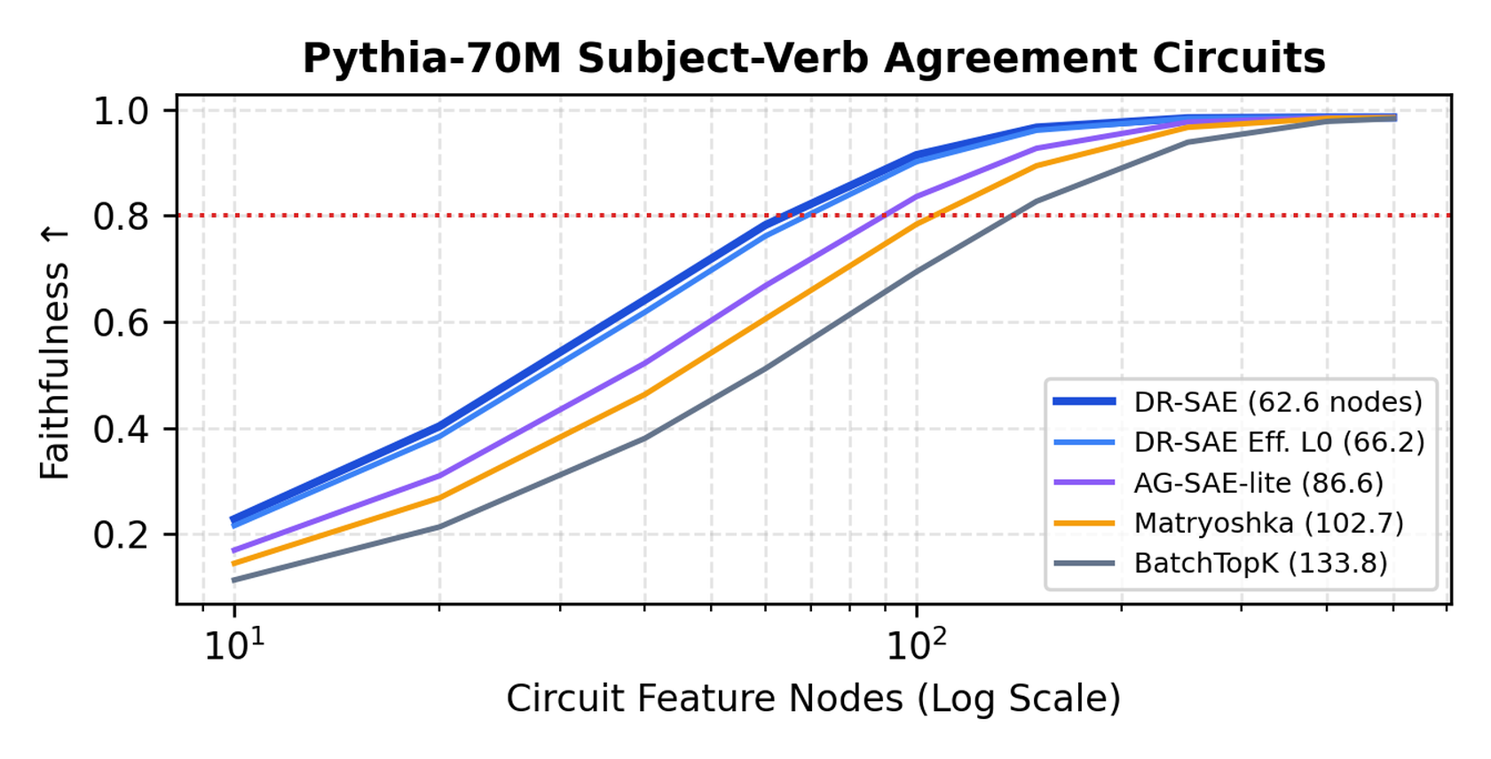
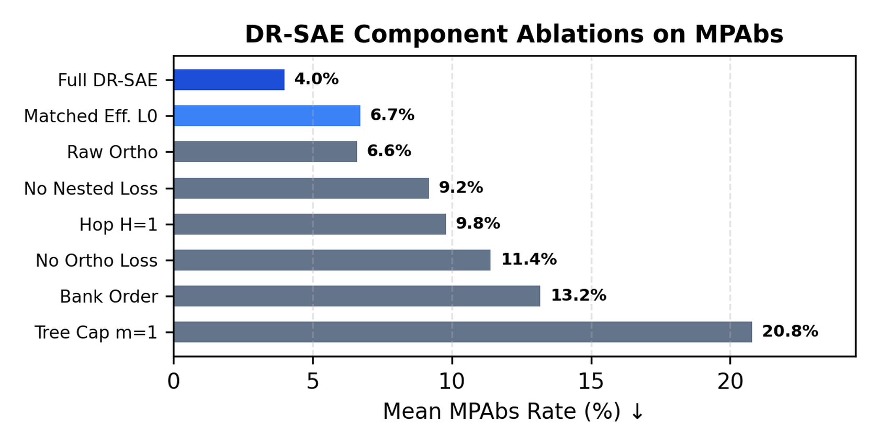
7 · RQ4 CIRCUIT COMPACTNESS & ABLATIONS
Lower-Absorption Dictionaries Yield 39.0% Smaller Faithful Circuits
Compact Causal Circuits (H4)
At 0.80 faithfulness on Pythia-70M tasks, DR-SAE needs 62.6 nodes vs 102.7 for Matryoshka (-39.0%).
Component Ablation Study
Removing frequency order (+9.2% MPAbs) or capping to m=1 (+16.8% MPAbs) confirms each design part.
Pythia-70M 6-Layer Residual Circuits · 4 Subject-Verb Agreement Tasks (Marks et al., ICLR 2025) | Slide 8 of 10

Slide 9
8 · STATISTICAL RIGOUR & OPEN DELIVERABLES
All Four Pre-Registered Hypotheses Pass Holm–Bonferroni Correction
Hypothesis Gate
H1 & H2 Pass: 80.3% MPAbs drop at matched effective L0.
H3 & H4 Pass: 78.4% stability and 39.0% smaller circuits.
Strict FVU Cap: FVU rises by +0.0036, well under 0.01.
Scope & Limits
3-Seed Floor: Effects under 0.45% MPAbs are noise.
Sub-200M Scale: Tested on Pythia-160M and Pythia-70M.
Lemma 1 Bound: Drops only redundant near-duplicate edges.
Open Release
MPAbs Suite: 112-cell dataset card and synth generator.
SAELens Code: DR-SAE module passing 6 unit tests.
Live Explorer: Interactive DAG and Prop. 2 web app.
Pre-Registration Tag: v1.0-prereg-phase5 · Holm–Bonferroni Step-Down (Alpha = 0.05) | Slide 9 of 10

Slide 10
Sparsity-Neutral DAG Routing Unlocks Compact, Faithful Circuits.
Thank You · Questions & Live Interactive Demo
Farhan Aaqil Durrani · TopoCircuit-SAE Capstone Project | Slide 10 of 10

