Slide 1

Resource Management and Orchestration in 5G
Zhifei Mao
Thesis Supervisor: Yuming Jiang

Slide 2
Outline
5G vision
Network slicing
Concept
NFV & SDN
Resource management and orchestration (MANO)
MANO frameworks
VNF placement and traffic routing
Spectrum resource allocation

Slide 3
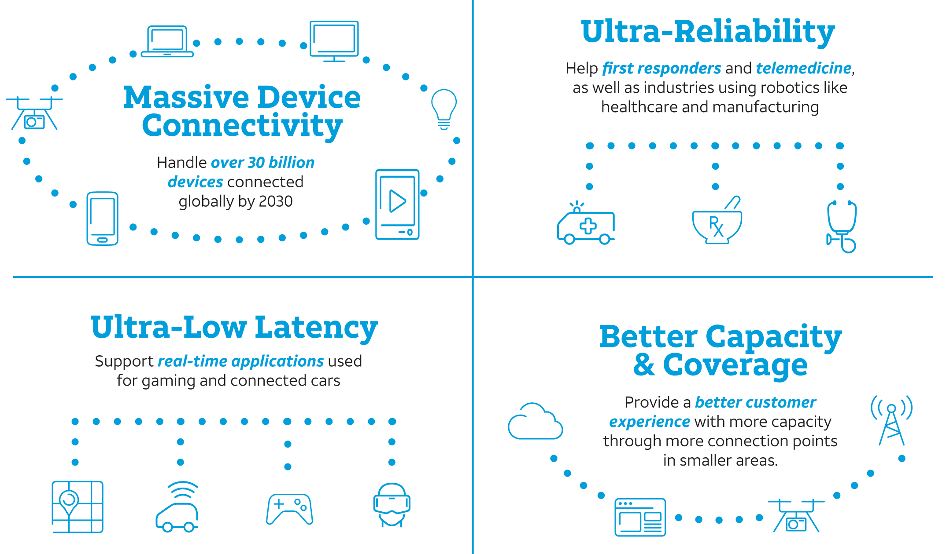
5G vision
Picture source: The 5G Future for Business, AT&T Policy Forum
Notes:
the question is how 5G is going to support so many use cases with so diversified requirements?

Slide 4
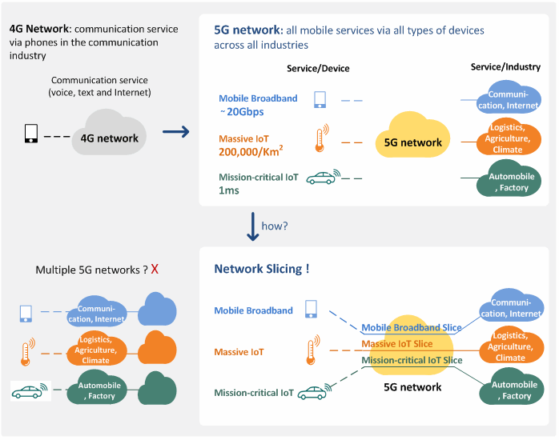
How can 5G achieve this vision?
Picture source: www.netmanias.com
Notes:
building and operating multiple 5G networks really cost a lot.
A much more efficient approach is to operate multiple dedicated networks on a common infrastructure, and this is effectively what “network slicing” allows.

Slide 5
How can 5G achieve this vision?
Picture source: www.netmanias.com
Notes:
With network slicing, network operators can open their physical network to concurrent deployment of multiple logical networks.

Slide 6
Network slices for different use cases ^{[1]}
Notes:
We can see that the network slices above can span across multiple parts of the 5G network.
logically isolated and self-contained.
they use different network functions
network operator deletes this slice, and release the underlying physical resources for other tenants to use.
So how can the provisioning of network slices so flexible?

Slide 7
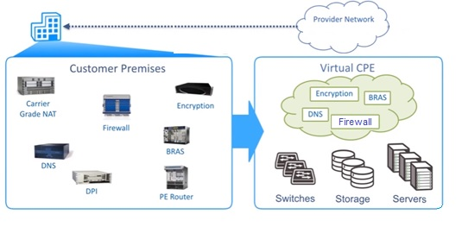
NFV for network slicing
Network function virtualization (NFV)
Network slice based on NFV
Service
VNF 1
VNF 2
VNF 3
VNF …
A network slice
Resources
Upper picture source: https://www.ciena.com/insights/videos/video-intro-to-NFV-prx.html
Notes:
answer is NFV
decouples network functions from dedicated hardware, implement in the form of software called VNFs
operator create a set of virtualized network functions (VNFs) that are needed to carry out the tenant’s service.
No new hardware is required, just software installation of network functions.

Slide 8
Example of VNF chaining
Virtual Reality ^{[2]}
Notes:
a service has its own logic, data traffic of each service has to go through the VNFs in a correct order
virtual reality. have to first then process the request
cannot process the video first and do the authentication later on
how are the VNFs for a service is chained together?

Slide 9
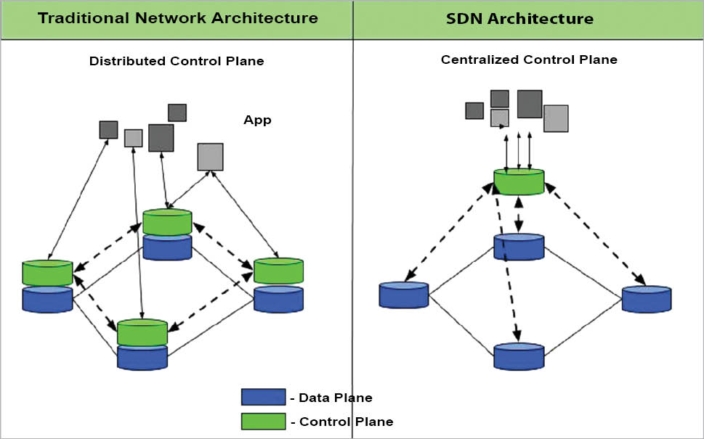
SDN for network slicing
Software defined networking (SDN)
Applications
Applications
Picture source: https://opensourceforu.com/2017/10/primer-software-defined-networking-sdn-openflow-standard/
Notes:
SDN come into play
decouples control plane and data plane
overview of the mapping between the installed VNFs and underlying hardware
connections between VNFs within a network slice can be set up very fast

Slide 10
A layered view of network slicing ^{[3]}
A service can use a bundle of network slices
Slices can be shared by different services
VNFs can be shared among network slices
Notes:
a service can be using several network slices
car system may require a ultra-low-latency slice for auto driving, a mobile broad band slice for entertainment, an IoT slice since there are many sensors inside
a VNF can be shared by many network slices

Slide 11
Outline
5G vision
Network slicing
Concept
NFV & SDN
Resource management and orchestration (MANO)
MANO frameworks
VNF placement and traffic routing
Spectrum resource allocation
Notes:
requests from end users very dynamic
need a very efficient management and orchestration entity to make sure the requirements for all the services can be satisfied

Slide 12
Management and orchestration (MANO)
Overall functionality of MANO
Translate service models into network slices (mgmt)
Map them to infrastructure resources optimally (orchestration)
Configure and monitor each slice during its life cycle (mgmt)
Service 1
Service 2
Service …
Service layer
Translate
VNF 2
VNF …
VNF 1
VNF 3
Slice layer
Map
VNF 4
Node 1
Node 2
Node …
Infrastructure layer
Notes:
should be able to translate the business services to network slices
and be able to map the VNFs for the slices into the physical resources in an optimal way
means that the VNFs should be allocated to a proper location with a proper amount of resources

Slide 13
NFV MANO framework – ETSI ^{[4]}
NFV orchestrator (NFVO): combine NFs to create end-to-end services
VNF manager (VNFM): manage the life cycle of VNFs
Virtualized infrastructure manager (VIM): manage NFVI physical & virtual resources
Notes:
a reference framework for NFV management and orchestration
orchestrator in charge of allocating resources to the VNFs and chain them together in order to from a network slice
only focuses on VNF management and orchestration, does not specify the role of SDN in the network

Slide 14
NFV & SDN MANO ^{[1]}
Notes:
including two SDN controller functions.
Infrastructure SDN controller, it setup and configure the SDN switches that connect the servers
The tenant controller controls the VNFs used by a specific tenant
infrastructure controller manages the SDN switches of the whole network, and it is not aware of which tenant is using which slice

Slide 15
Fundamental MANO problems
VNF placement and traffic routing
Infrastructural resource domain
Spectrum resource allocation
Non-infrastructural resource domain
Notes:
there are a lot specific resource management and orchestration problems

Slide 16
VNF placement and traffic routing
Basic question:
which VNF is installed on which resource node, taking how much resources, for which service instance
Service 1
VNF 2
VNF …
Service 2
VNF 1
VNF 3
VNF 4
Service …
Node 1
Node …
Node 2
Node …
Edge cloud
Core cloud
Notes:
a lot of resource nodes
many requesting network slices
the question is where are we going to place those VNFs?

Slide 17
VNF placement and traffic routing – Optimization approach
General Objective
Optimize cost and performance while guarantee QoS
Costs
Resource consumption (minimize)
Energy consumption (minimize)
Performances
Overall path length (minimize)
Overall latency (minimize)
Number of service instances (maximize)
Fairness among service instances (maximize)
Notes:
big branch using mathematical optimization
overall objective

Slide 18
VNF placement and traffic routing – Optimization approach (cont’d)
Constraints
C5: order of
VNFs in the chain
C4: VNF capacity
Service 1
VNF 2
VNF …
Service 2
VNF 1
VNF 3
VNF 4
Service …
Node 1
Node …
Node 2
Node …
C3: node capacity
Edge cloud
Core cloud
C1: Bandwidth
C2: Delay
Notes:
a number of constraints to consider
would be more constraints, but those general constraints already make the problem hard to solve

Slide 19
VNF placement and traffic routing – Optimization approach (cont’d)
Optimization models
Integer linear programming (ILP)
Single objective or multiple objectives ^{[5]}
Optimal solutions
NP-hard
Approximation for near optimal solutions
Connected: 1
?
Not connected: 0
VNF
Resource Node
Notes:
In general based on Integer linear programming

Slide 20
VNF placement and traffic routing – Game-theoretic approach ^{[6]}
Market structure
Telco operator (TO)
Telco
operator
U – VNF user (tenant)
S – server provider
TO owns all servers
Market of VNF server providers
Notes:
another study using game theory, consider different market structure
Traditionally, telecom network operator owns physical resources
a market of VNF servers can be some commercial cloud providers

Slide 21
VNF placement and traffic routing – Game-theoretic approach (cont’d)
Publish
Download
Decide which VNFs to serve
Register
Broadcast
Decide which servers to use
Register
Configure
Management process flow
Notes:
management system works
network manager is a broker
the server providers register their capability
tenants can choose which servers in the market to run the required VNFs

Slide 22
VNF placement and traffic routing – Game-theoretic approach (cont’d)
Two-stage Stackelberg game
Unique equilibrium
Operator
Stage
1
1. Decide
bandwidth prices
2. Decide the amount of bandwidth to buy
Commission fee
Bandwidth fee
Server providers
2. Decide VNF prices
3. Decide which servers to choose
Stage
2
VNF fee
Tenants
Notes:
The servers are not free, and the broker also wants to make money

Slide 23
Spectrum resource allocation
End-user level
Cognitive radio networking
Device to device communication
Network-operator level
Spectrum pooling
Network-slice level (trending)
Notes:
a lot of works trying to address this problem at different levels
user level, cognitive radio networking and device to device communication allow reuse in an opportunistic way
network level, network operators pool their licensed spectrum and allocate the whole spectrum more dynamically
5G is going to be supported by network slicing

Slide 24
Slice-level spectrum resource allocation
Call for slice-level spectrum resource allocation
Traffic isolation and radio-electrical isolation ^{[7]}
Diversity of the QoS requirements of different network slices (or use cases)
Notes:
radio-electrical isolation means that there should be no interferences among the transmissions of different tenants

Slide 25
Slice-level spectrum resource allocation (cont’d)
RAN slicing at spectrum level ^{[7]}
Notes:
each slice gets a dedicated sub-carrier or sub channel at each cell

Slide 26
Slice-level spectrum resource allocation (cont’d)
RAN slicing at ICIC (Inter-Cell Interference Coordination) level ^{[7]}
Notes:
dedicated resource blocks are allocated to each slice in each cell

Slide 27
Slice-level spectrum resource allocation (cont’d)
Radio tiling for 5G radio with network slicing ^{[8]}
Notes:
give different transmission time intervals to resource blocks

Slide 28


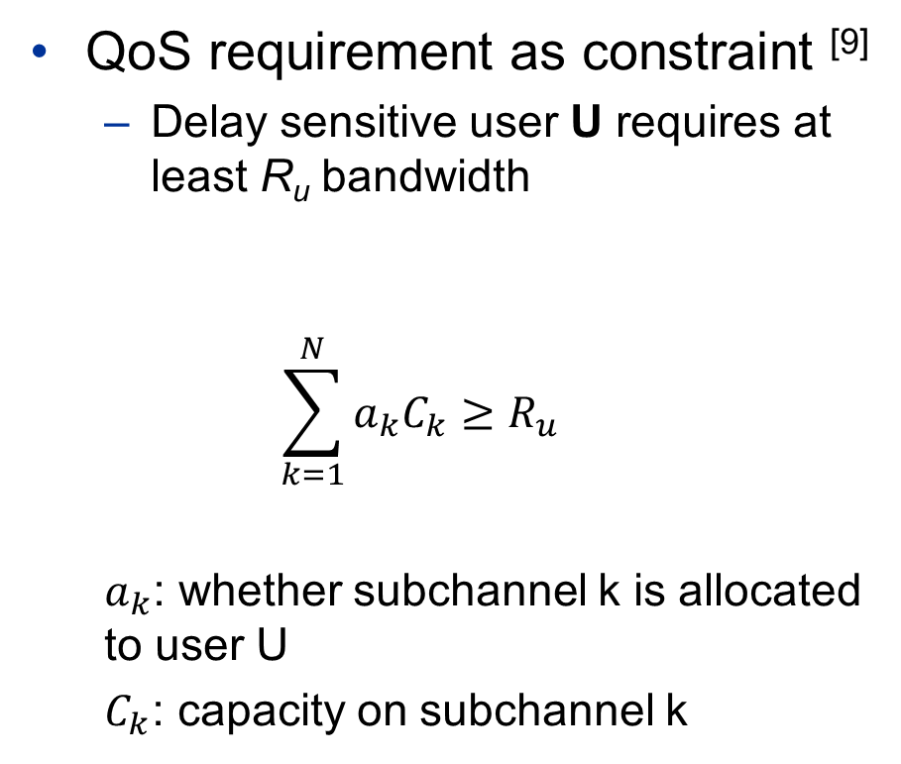
Slice-level spectrum resource allocation (cont’d)
QoS requirement as constraint ^{[9]}
Delay sensitive user U requires at least R_{u} bandwidth
$$\sum_{k=1}^{N}{a_{k}C_{k}}≥R_{u}$$
$a_{k}$: whether subchannel k is allocated to user U
$C_{k}$: capacity on subchannel k
U
Notes:
have to allocate the spectrum resource in an optimal manner

Slide 29
Challenges
End-to-end slice orchestration and management ^{[10]}
…
Network Slicing in 5G: Survey and Challenges
Notes:
so far, the VNF placement and spectrum allocation are treated separately
have to provide a holistic orchestration approach

Slide 30
References
[1] Ordonez-Lucena, Jose, et al. "Network Slicing for 5G with SDN/NFV: Concepts, Architectures, and Challenges." IEEE Communications Magazine 55.5 (2017): 80-87.
[2] Akhtar, Nabeel, et al. "Virtual Function Placement and Traffic Steering over 5G Multi-Technology Networks." IEEE NetSoft (2018).
[3] Yousaf, Faqir Zarrar, et al. "NFV and SDN-Key Technology Enablers for 5G Networks." IEEE Journal on Selected Areas in Communications 35.11 (2017): 2468-2478.
[4] Mijumbi, Rashid, et al. "Management and orchestration challenges in network functions virtualization." IEEE Communications Magazine 54.1 (2016): 98-105.
[5] Y. T. Woldeyohannes, A. Mohammadkhan, K. K. Ramakrishnan and Y. Jiang, "ClusPR: Balancing Multiple Objectives at Scale for NFV Resource Allocation," in IEEE Transactions on Network and Service Management
[6] D’Oro, Salvatore, et al. "A game theoretic approach for distributed resource allocation and orchestration of softwarized networks." IEEE Journal on Selected Areas in Communications 35.3 (2017): 721-735.
[7] Sallent, Oriol, et al. "On radio access network slicing from a radio resource management perspective." IEEE Wireless Communications 24.5 (2017): 166-174.
[8] Rost, Peter, et al. "Network slicing to enable scalability and flexibility in 5G mobile networks." IEEE Communications magazine 55.5 (2017): 72-79.
[9] Zhang, Haijun, et al. "Resource allocation in spectrum-sharing OFDMA femtocells with heterogeneous services." IEEE Trans. Communications 62.7 (2014): 2366-2377.
[10] Foukas, Xenofon, et al. "Network slicing in 5G: Survey and challenges." IEEE Communications Magazine 55.5 (2017): 94-100.

Slide 31
Related papers on end-to-end MANO
Orchestration of RAN and Transport Networks for 5G: An SDN Approach
Multi-domain Orchestration and Management of Software Defined Infrastructures: a Bottom-Up Approach
Orchestration of Network Services Across Multiple Operators: The 5G Exchange Prototype

