Slide 1

CSE207 — Digital Logic Design
Class 1: Introduction to Digital Logic
Masnoon Muztahid
Lecturer
Department of Computer Science and Engineering
Presidency University
Class 1 of 8

Slide 2
INTRODUCTION
What Will We Learn Today?
Digital Systems
By the end of this class, you will be able to:
Analog vs Digital
1
Explain what a digital system is
2
Tell analog and digital signals apart
0 and 1
3
Explain why computers use 0 and 1
Switching Circuits
4
Show how switches can make decisions
Logic Gates
5
Recognise the basic logic gates
Truth Tables
6
Read and build a truth table
CSE207 · Digital Logic Design · Class 1
2 / 24

Slide 3





WHAT IS DIGITAL LOGIC?
What Is a Digital System?
NEW TERM
NEW TERM
Digital system — a system that stores and processes information using a limited set of separate values.
Discrete — separate, countable values with nothing in between — like the steps of a staircase, not a ramp.
Computers
Smartphones
Digital watches
Calculators
Microcontrollers
Key idea: digital systems represent information using a limited set of distinct states.
CSE207 · Digital Logic Design · Class 1
3 / 24

Slide 4
WHAT IS DIGITAL LOGIC?
Why Do Computers Use Digital Logic?
Voltage
A circuit only has to answer one simple question:
HIGH range
“Is the voltage HIGH or LOW?”
1
Easy to tell apart — two ranges that are far from each other
Reliable — a small wobble in voltage does not change the meaning
Simple — every part only needs to handle two states
uncertain
(avoided)
LOW range
NEW TERM
NEW TERM
0
Voltage — the electrical “push” in a circuit, measured in volts (V).
Noise — small, unwanted changes in a signal (for example from nearby wires).
CSE207 · Digital Logic Design · Class 1
4 / 24

Slide 5
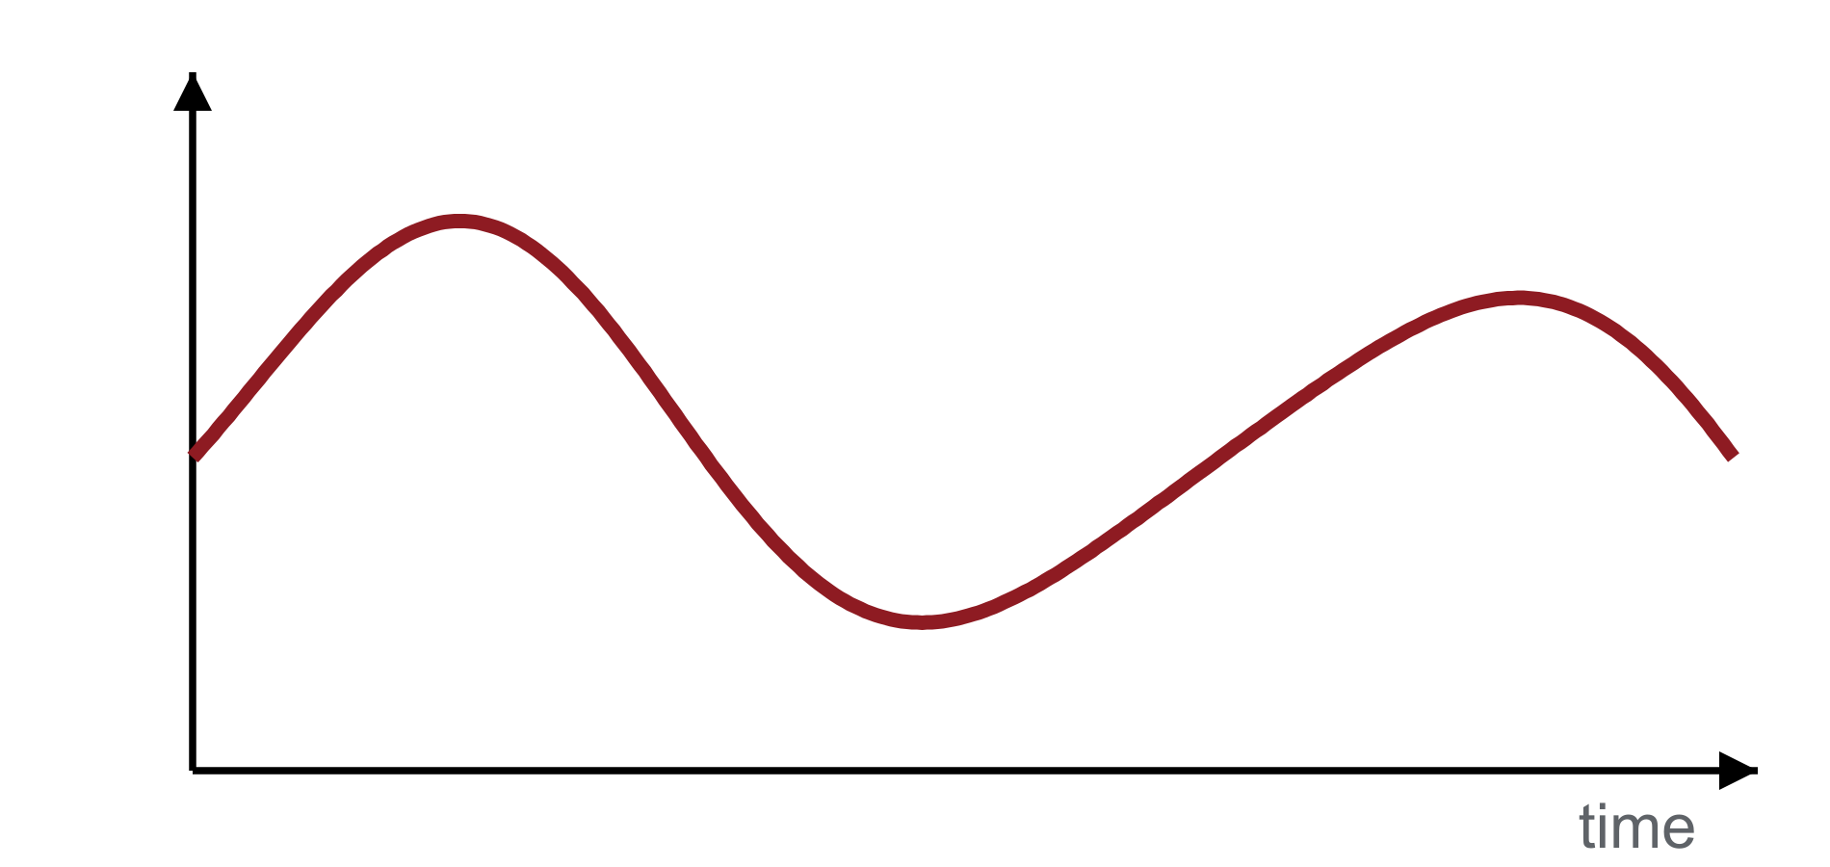
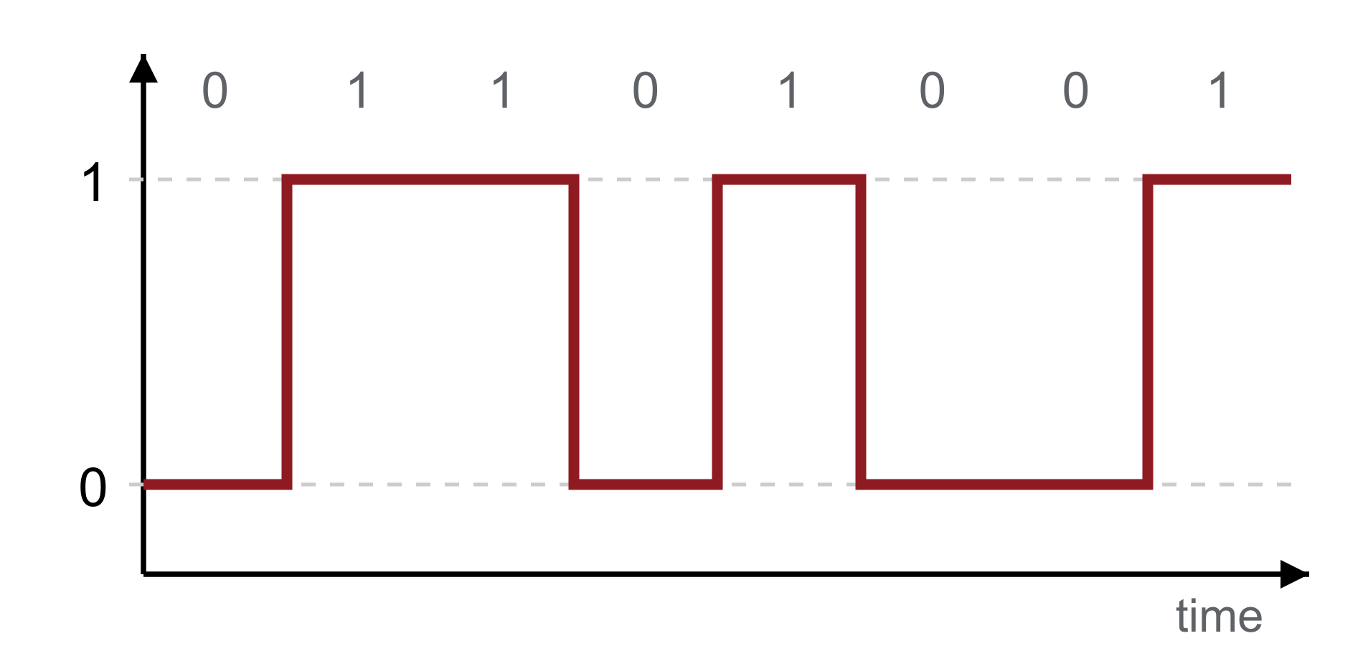
ANALOG VS DIGITAL
Analog vs Digital
Analog: changes smoothly, can take any value
Digital: jumps between two distinct levels
Analog | Digital
Continuous values — any value in a range | Discrete values — only certain values
Can vary smoothly | Uses distinct states (here: 0 and 1)
Example: microphone signal | Example: computer data
CSE207 · Digital Logic Design · Class 1
5 / 24

Slide 6




ANALOG VS DIGITAL
A Simple Real-World Example: The Light Switch
↔
Switch OFF → light OFF
Switch ON → light ON
0
1
OFF ↔ ON is like 0 ↔ 1
This is an analogy: a light switch has exactly two states, just like one digital signal.
CSE207 · Digital Logic Design · Class 1
6 / 24

Slide 7
BINARY AND LOGIC LEVELS
The Two Basic Logic States
Logic value | Voltage level | Switch | Meaning
0 | LOW | OFF | FALSE / no
1 | HIGH | ON | TRUE / yes
NEW TERM
IMPORTANT
Logic level — a range of voltages that the circuit treats as the same logical value (0 or 1).
0 and 1 are logical states, not exact voltages. “1” means “somewhere in the HIGH range”, not “exactly 5 V”.
CSE207 · Digital Logic Design · Class 1
7 / 24

Slide 8
BINARY AND LOGIC LEVELS
What Is a Bit?
Bit = Binary digit
A sequence of bits carries information
More bits → more patterns:
NEW TERM
1 bit
0
1
2 patterns
Binary — having exactly two possible values. A bit is always 0 or 1.
2 bits
0
0
0
1
1
0
1
1
Examples
4 patterns
0
1
1
0
1
0
3 bits
000, 001, 010, … 111 → 8 patterns
1 bit
1 bit
4 bits
1
1
0
0
1
Letters, numbers, images and sound are all stored as bits.
5 bits
CSE207 · Digital Logic Design · Class 1
8 / 24

Slide 9
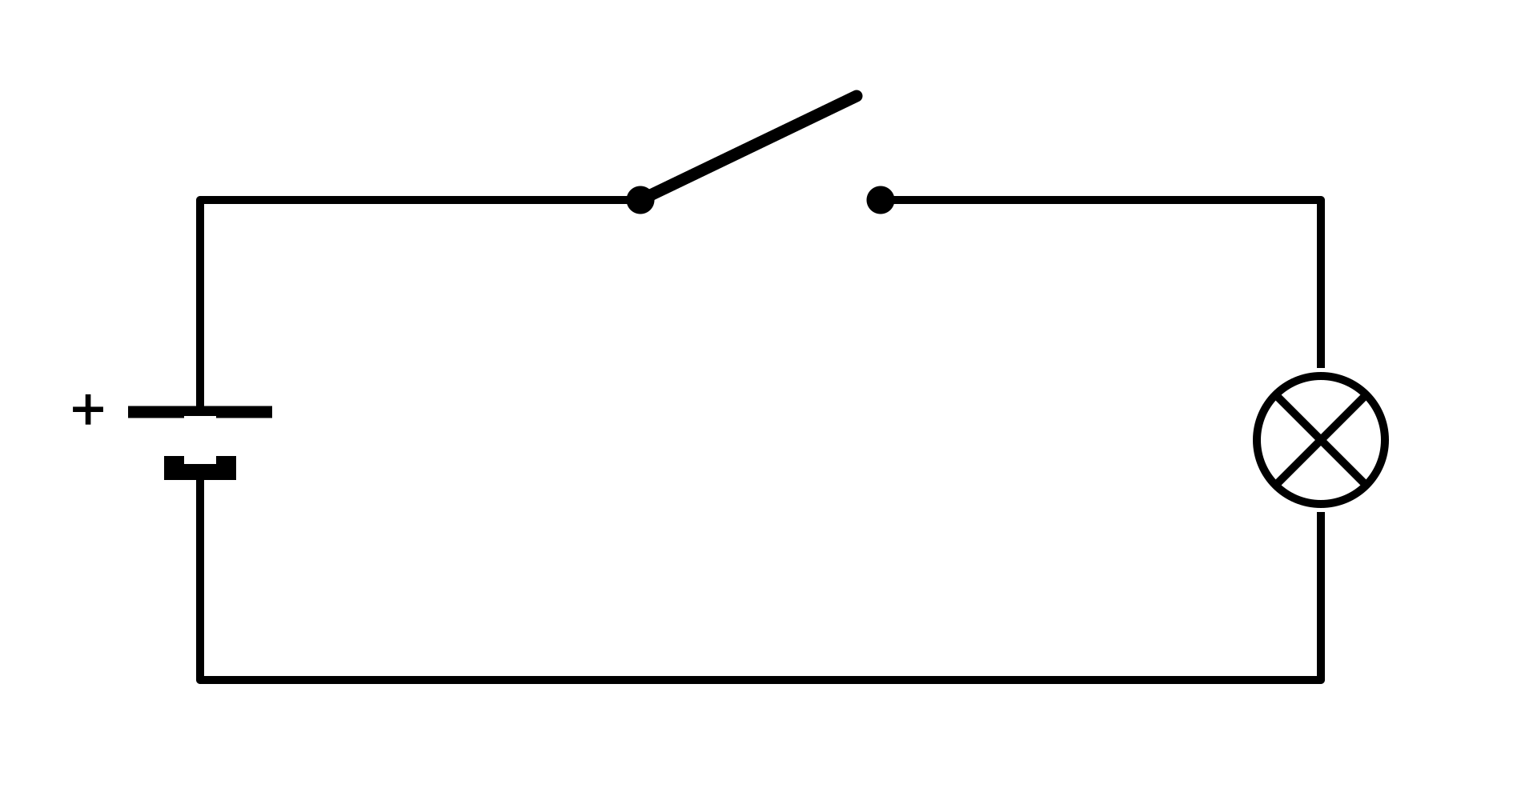
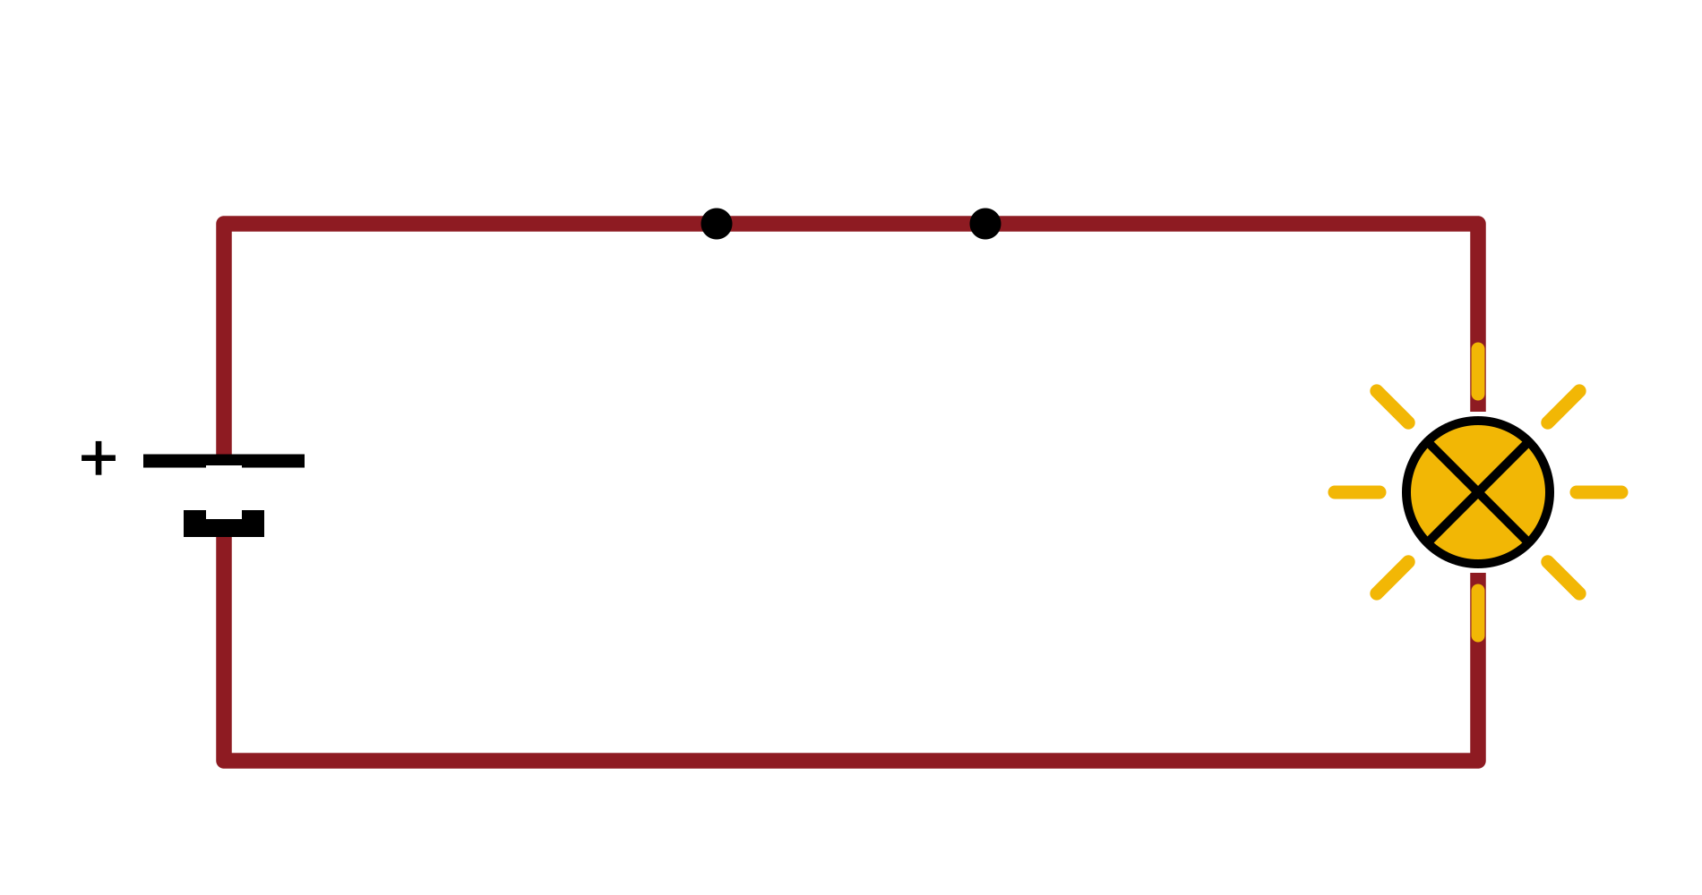
SWITCHING CIRCUITS
What Is a Switch?
A switch controls whether a path is open or closed.
Open → current cannot flow → OFF → 0
Closed → current can flow → ON → 1
NEW TERM
NEW TERM
Circuit — a closed loop that electricity can flow around.
Current — the flow of electricity through the circuit (shown in red).
CSE207 · Digital Logic Design · Class 1
9 / 24

Slide 10

SWITCHING CIRCUITS
What Is a Switching Circuit?
NEW TERM
Switching circuit — a circuit whose components operate between distinct states, such as ON and OFF, to represent logical values.
Switching state → Logic state
Mechanical switch
OFF
0
Turned ON/OFF by a hand. Easy to see, but big and slow.
ON
1
Transistor
An electronic switch turned ON/OFF by a voltage. A modern processor contains billions.
CSE207 · Digital Logic Design · Class 1
10 / 24

Slide 11
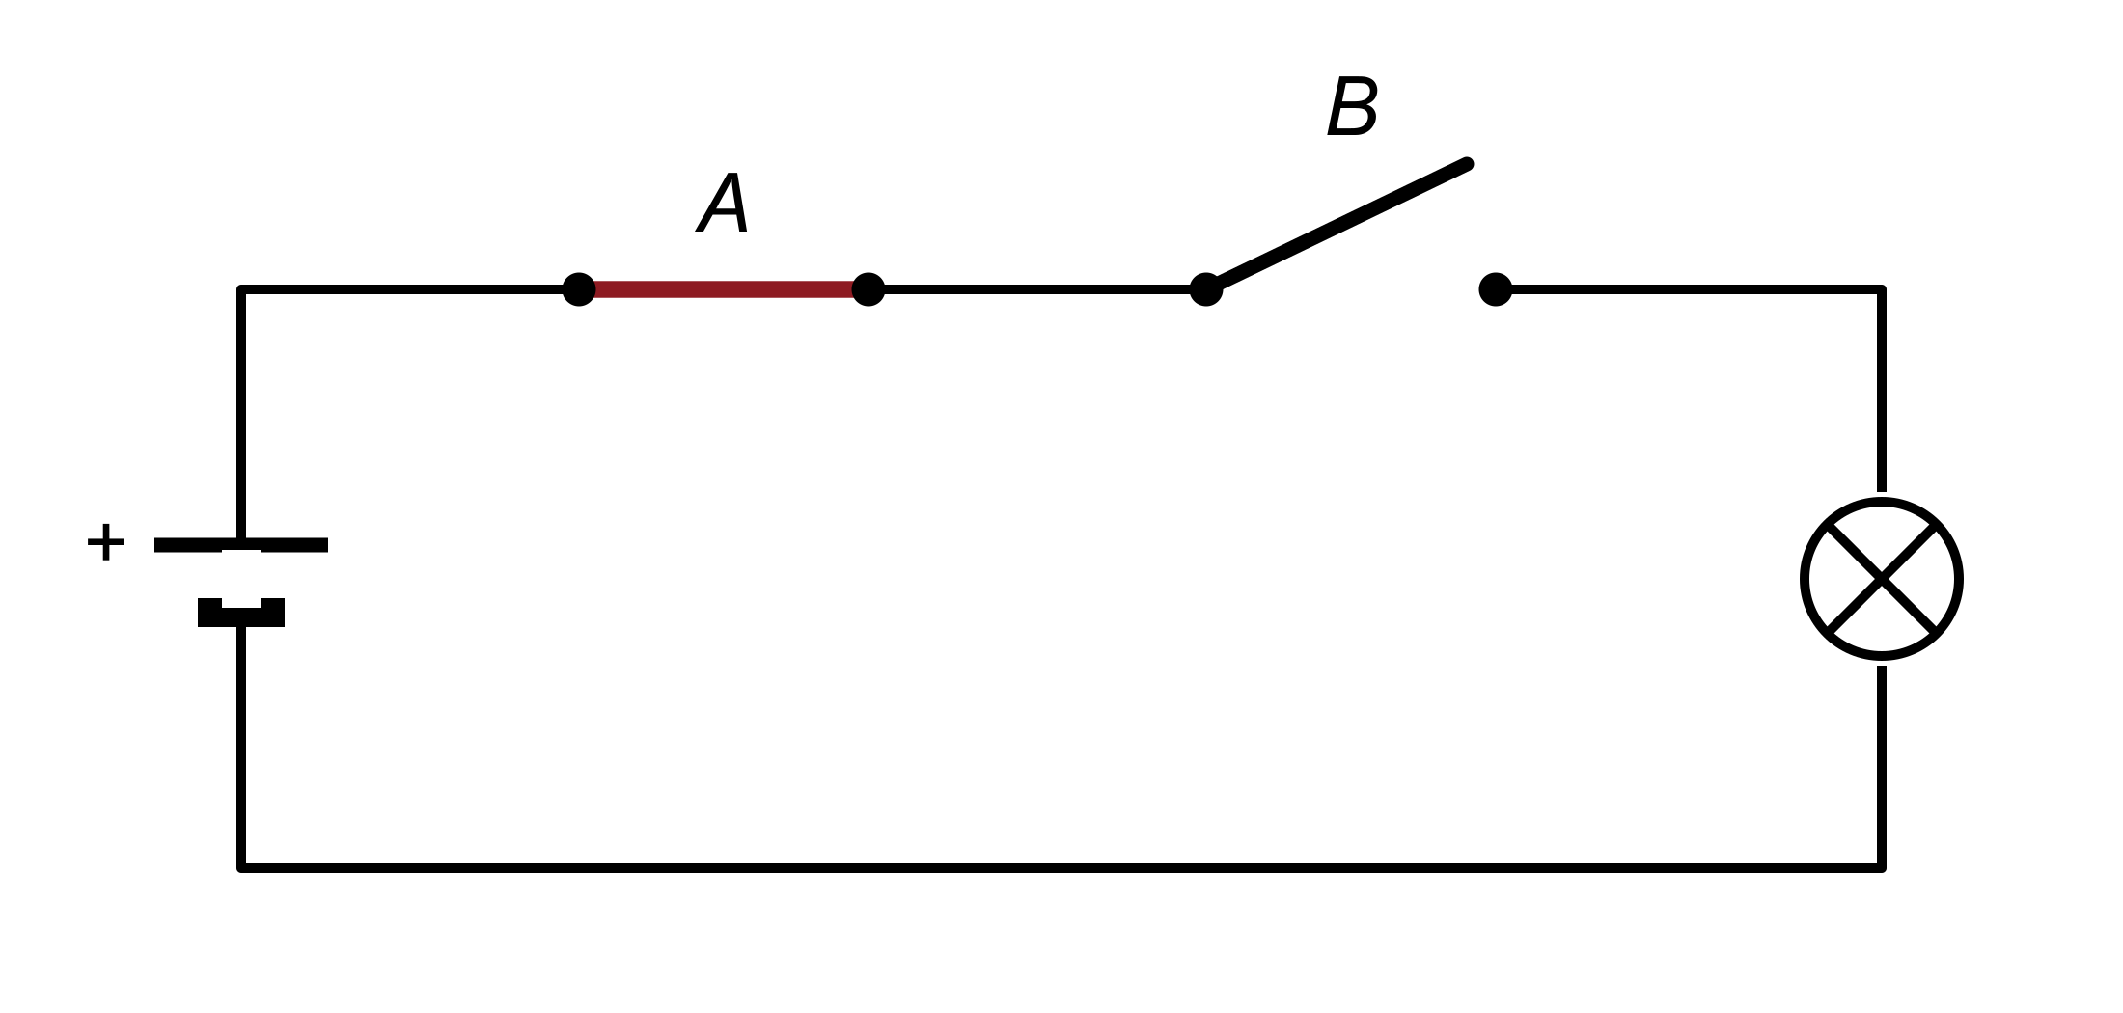
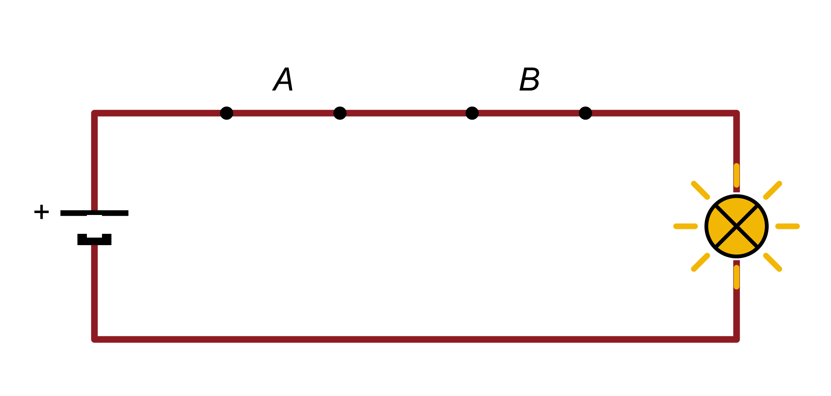
SWITCHING CIRCUITS
Series Switches — AND Behavior
Series = one after another, on a single path.
The lamp is ON only when both A and B are closed.
A | B | Lamp
0 | 0 | 0
0 | 1 | 0
1 | 0 | 0
1 | 1 | 1
ANALOGY
A locker with two locks opens only if key A AND key B are both turned.
A = 1, B = 0 → lamp OFF (0)
Series switching → AND behavior
Switch closed = 1, open = 0. Lamp ON = 1, OFF = 0.
A = 1, B = 1 → lamp ON (1)
CSE207 · Digital Logic Design · Class 1
11 / 24

Slide 12
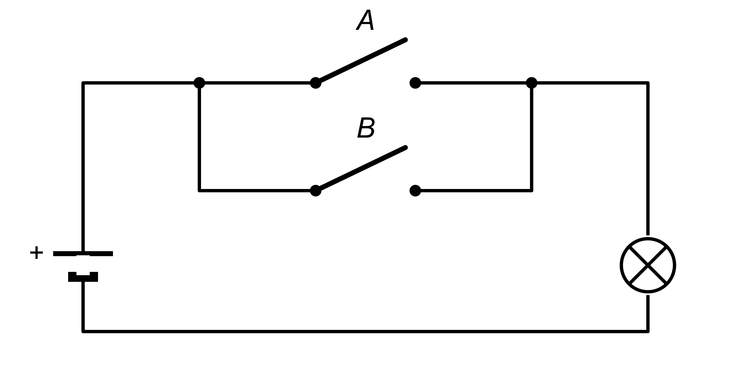
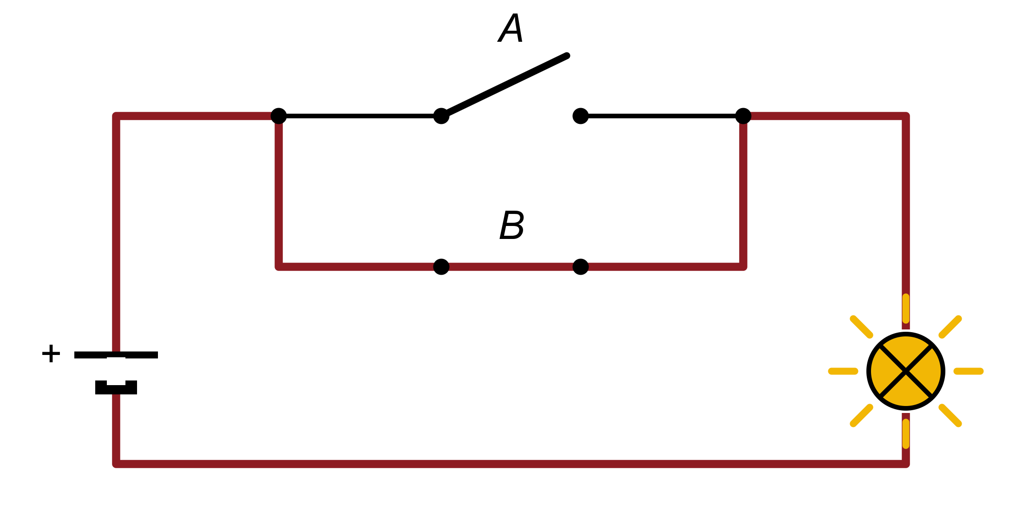
SWITCHING CIRCUITS
Parallel Switches — OR Behavior
Parallel = side by side, on separate paths.
The lamp is ON if at least one switch is closed.
A | B | Lamp
0 | 0 | 0
0 | 1 | 1
1 | 0 | 1
1 | 1 | 1
ANALOGY
A doorbell with a front button and a back button: either one rings it.
A = 0, B = 0 → lamp OFF (0)
Parallel switching → OR behavior
Current only needs ONE complete path to reach the lamp.
A = 0, B = 1 → lamp ON (1)
CSE207 · Digital Logic Design · Class 1
12 / 24

Slide 13
SWITCHING CIRCUITS
From Switches to Logic Gates
Switches
Switching Circuits
Logical Operations
Logic Gates
Digital Circuits
devices with two states: ON / OFF
switches wired in series or parallel
AND, OR, NOT …
standard blocks that do one operation
adders, memory, processors
WHY DO LOGIC GATES EXIST?
REMEMBER
A gate packages one logical operation into a reusable block. Designers can then think “AND” or “OR” instead of drawing switches and wires every time.
Hand-operated switches are only a model to build intuition. Real gates are made of transistors, so they are tiny, fast and controlled by electricity.
CSE207 · Digital Logic Design · Class 1
13 / 24

Slide 14
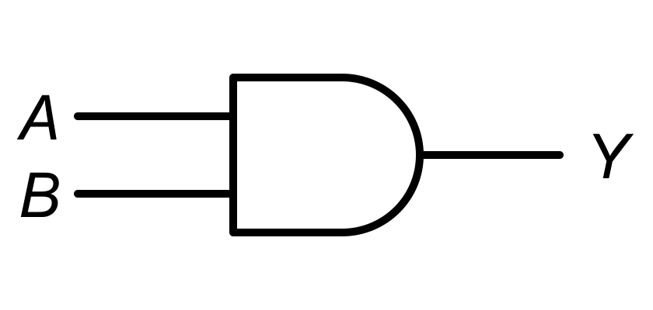
LOGIC GATES
What Is a Logic Gate?
NEW TERM
Logic gate — a digital circuit that performs a logical operation on one or more inputs and produces an output.
Inputs
Output
NEW TERM
NEW TERM
Logic
Gate
Input — a 0/1 signal going INTO the gate.
Output — the 0/1 signal the gate PRODUCES.
A
Y
B
EXAMPLE
An AND gate with inputs A = 1 and B = 1 gives output Y = 1.
A, B → AND → Y
CSE207 · Digital Logic Design · Class 1
14 / 24

Slide 15
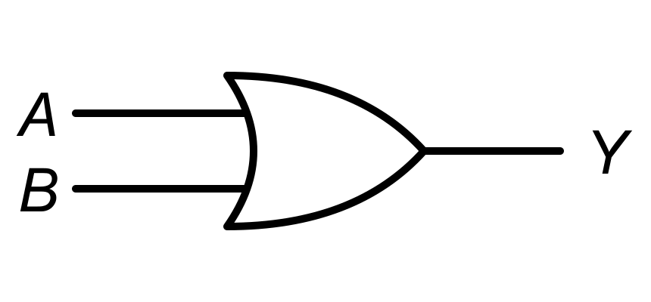
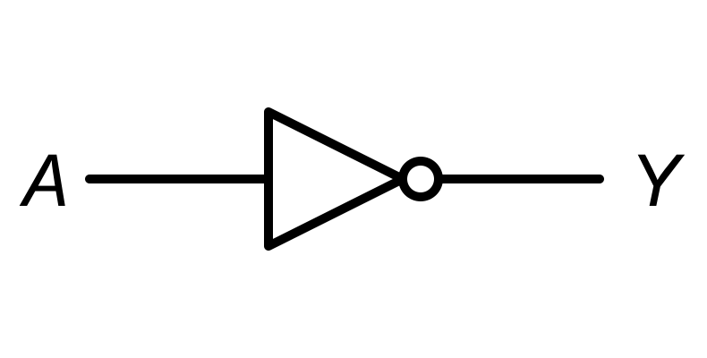
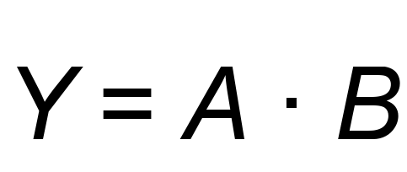
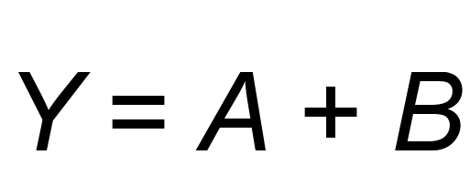
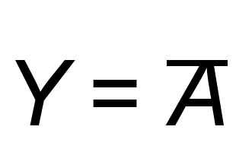
LOGIC GATES
The Three Basic Gates: AND, OR, NOT
AND
OR
NOT
1 only if ALL inputs are 1
1 if AT LEAST ONE input is 1
flips the input
“ · ” is read “AND”
“ + ” is read “OR” — not addition!
the bar is read “NOT A”
A | B | Y
0 | 0 | 0
0 | 1 | 0
1 | 0 | 0
1 | 1 | 1
A | B | Y
0 | 0 | 0
0 | 1 | 1
1 | 0 | 1
1 | 1 | 1
A | Y
0 | 1
1 | 0
CSE207 · Digital Logic Design · Class 1
15 / 24

Slide 16

LOGIC GATES
AND Gate
WHAT IS IT?
A | B | Y
0 | 0 | 0
0 | 1 | 0
1 | 0 | 0
1 | 1 | 1
Output is 1 only when ALL inputs are 1.
WHY DO WE NEED IT?
To represent “all conditions must be true”.
HOW DOES IT WORK?
Example: security alarm
The alarm sounds (Y = 1) only when sensor A detects something AND sensor B detects something.
CSE207 · Digital Logic Design · Class 1
16 / 24

Slide 17
LOGIC GATES
OR Gate
WHAT IS IT?
A | B | Y
0 | 0 | 0
0 | 1 | 1
1 | 0 | 1
1 | 1 | 1
Output is 1 when AT LEAST ONE input is 1.
WHY DO WE NEED IT?
To represent “any one condition is enough”.
HOW DOES IT WORK?
Example: call button
A buzzer rings (Y = 1) if button A is pressed OR button B is pressed — or both.
CSE207 · Digital Logic Design · Class 1
17 / 24

Slide 18

LOGIC GATES
NOT Gate
WHAT IS IT?
A | Y
0 | 1
1 | 0
NOT reverses (inverts) the input.
WHY DO WE NEED IT?
To express the opposite of a condition.
0
NOT
1
HOW DOES IT WORK?
1
NOT
0
Example: night lamp
Lamp = NOT(daylight). Daylight = 1 → lamp 0. Daylight = 0 → lamp 1.
CSE207 · Digital Logic Design · Class 1
18 / 24

Slide 19
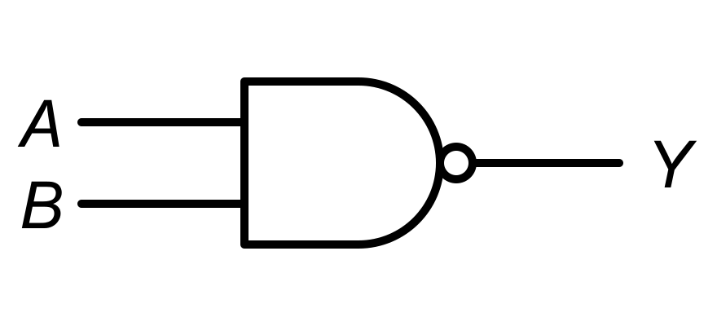
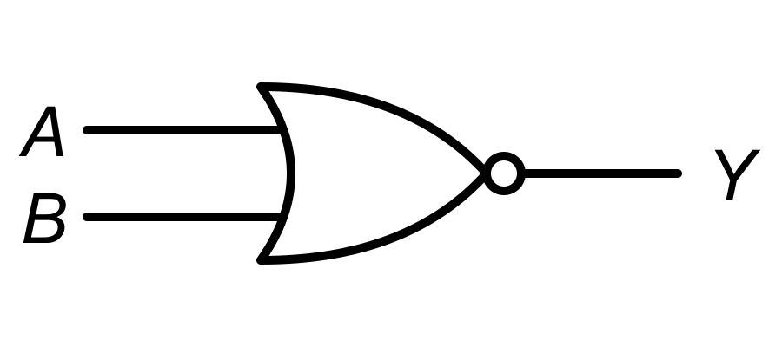


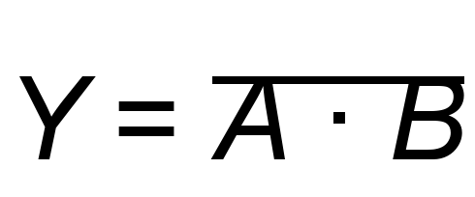
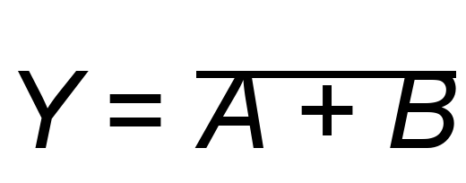
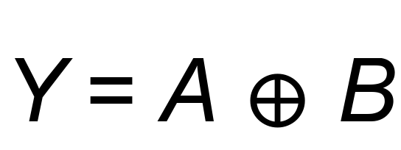
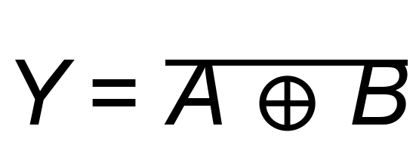
LOGIC GATES
More Gates: NAND, NOR, XOR, XNOR
NAND
NOR
XOR
XNOR
NOT(AND)
NOT(OR)
1 when inputs are DIFFERENT
1 when inputs are the SAME
A | B | NAND | NOR | XOR | XNOR
0 | 0 | 1 | 1 | 0 | 1
0 | 1 | 1 | 0 | 1 | 0
1 | 0 | 1 | 0 | 1 | 0
1 | 1 | 0 | 0 | 0 | 1
EASY WAY TO REMEMBER
NAND / NOR: do AND / OR, then flip.
XOR: a “difference detector”.
XNOR: a “sameness detector”.
CSE207 · Digital Logic Design · Class 1
19 / 24

Slide 20
TRUTH TABLES
What Is a Truth Table?
NEW TERM
Truth table — a table that lists every possible combination of inputs and shows the output for each one.
WHY DO WE NEED IT?
inputs
output
It completely describes the logical behavior of a circuit — nothing is left out.
A | B | Y
0 | 0 | 0
0 | 1 | 0
1 | 0 | 0
1 | 1 | 1
If two circuits have the same truth table, they do the same job.
each row = one situation
Example: AND gate. Row 3 says “if A = 1 and B = 0, then Y = 0”.
CSE207 · Digital Logic Design · Class 1
20 / 24

Slide 21
TRUTH TABLES
How to Build a Truth Table
1
Count the inputs: n
Step 3: list combinations
Step 4: fill output (AND)
A | B
0 | 0
0 | 1
1 | 0
1 | 1
A | B | Y
0 | 0 | 0
0 | 1 | 0
1 | 0 | 0
1 | 1 | 1
2
Number of rows = 2ⁿ
3
List every combination (count in binary)
4
Fill the output column row by row
Inputs (n) | Rows (2ⁿ)
1 | 2¹ = 2
2 | 2² = 4
3 | 2³ = 8
4 | 2⁴ = 16
TIP
Count 00, 01, 10, 11 — like counting in binary. This way you never miss or repeat a row.
CSE207 · Digital Logic Design · Class 1
21 / 24

Slide 22
PRACTICE
Quick Practice
1
What is the output of AND when A = 1 and B = 0?
2
What is the output of XOR when A = 1 and B = 0?
Hint: AND needs ALL inputs to be 1.
Hint: XOR checks if inputs are different.
3
How many rows are needed in a truth table with 3 inputs?
4
What is the difference between a switching circuit and a logic gate?
Hint: use 2ⁿ.
Hint: think “model” vs “building block”.
CSE207 · Digital Logic Design · Class 1
22 / 24

Slide 23
PRACTICE
Answers & Recap
Q1
Q2
Q3
0
AND gives 1 only when ALL inputs are 1.
1
The inputs (1 and 0) are different.
8
2³ = 8 rows.
Q4
Switching circuit: switches (ON/OFF) wired together so that their states represent logic.
Logic gate: a standard electronic block (made of transistor switches) that performs one logical operation.
RECAP
Digital
0 / 1
Switching
Gates
Truth Tables
CSE207 · Digital Logic Design · Class 1
23 / 24

Slide 24
BIG PICTURE
The Big Picture
Digital Systems
information as distinct states
0 and 1
two logic levels: LOW and HIGH
Switching Circuits
ON/OFF switches represent logic
Logic Gates
AND, OR, NOT, NAND, NOR, XOR, XNOR
Truth Tables
describe every input combination
More Complex Digital Circuits
adders, memory, processors …
Next class: Boolean Algebra and Boolean Expressions
CSE207 · Digital Logic Design · Class 1
24 / 24

