Slide 1

CSE207 · Digital Logic Design
Class 2: Boolean Algebra and Boolean Expressions
Masnoon Muztahid
Lecturer
Department of Computer Science and Engineering
Presidency University
Notes:
Welcome back. Class 1 ended by naming today's topic: Boolean algebra and Boolean expressions.

Slide 2
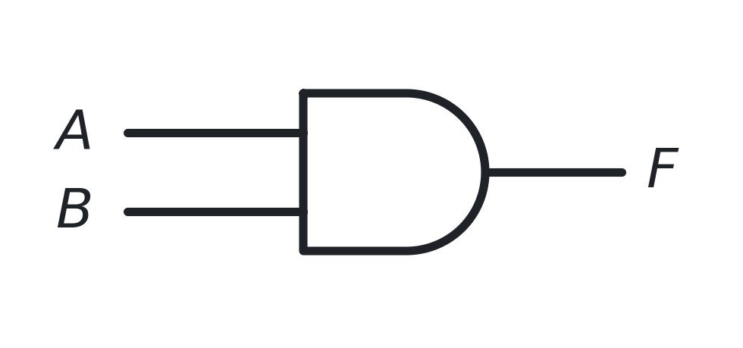
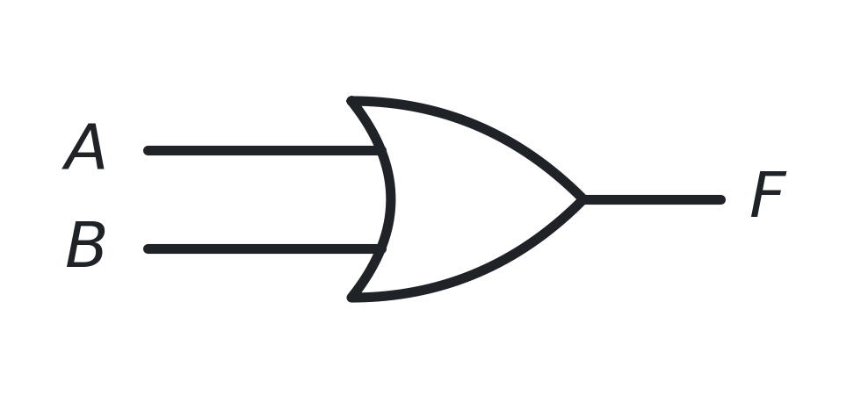
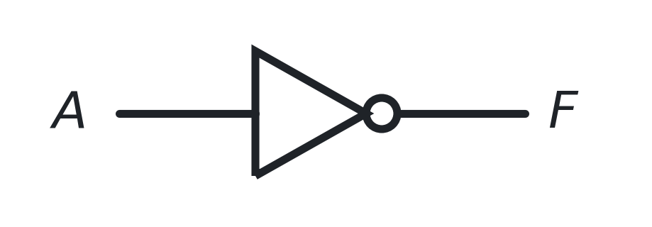
RECAP
Where We Left Off in Class 1
FROM CLASS 1
Digital logic uses only two values: 0 and 1. A logic gate takes binary inputs and produces a binary output. A truth table lists every input combination together with the output.
AND
OR
NOT
1 only if BOTH inputs are 1
1 if AT LEAST ONE input is 1
flips the input value
COMING BACK LATER
NAND, NOR, XOR and XNOR were introduced in Class 1. We will revisit them when we need them.
CSE207 · Digital Logic Design · Class 2
2 / 26
Notes:
Keep this short - three minutes. The only goal is to bring back 0/1, gates and truth tables.

Slide 3
INTRODUCTION
What Will We Learn Today?
Boolean Values
By the end of this class, you will be able to:
Boolean Operations
1
Use 0 and 1 as Boolean values
2
Apply the AND, OR and NOT operations
Boolean Expressions
3
Read and write Boolean expressions
Expression → Circuit
4
Turn an expression into a logic circuit
Expression → Truth Table
5
Build a truth table for a whole expression
Simplification
6
Simplify expressions using Boolean laws
CSE207 · Digital Logic Design · Class 2
3 / 26
Notes:
Show the road map on the left; read the six objectives on the right.

Slide 4
BOOLEAN VALUES
Boolean Values: Only 0 and 1
NEW TERM
Boolean algebra — the mathematics of values that can only be 0 or 1. It is the language we use to describe what a digital circuit does.
0
FALSE
1
TRUE
also read as: no · OFF · LOW
also read as: yes · ON · HIGH
IMPORTANT
A Boolean variable (A, B, C …) is simply a name for a value that is either 0 or 1 — there is nothing in between.
In Class 1, 0 and 1 were voltage levels. From now on they are values we can calculate with.
CSE207 · Digital Logic Design · Class 2
4 / 26
Notes:
Class 1 treated 0 and 1 as voltage levels. Today they become values we can calculate with.

Slide 5



BOOLEAN OPERATIONS
The Three Boolean Operations
AND
OR
NOT
read as “A AND B”
read as “A OR B”
read as “NOT A”
1 only if BOTH inputs are 1
1 if AT LEAST ONE input is 1
flips the value it is given
A | B | F
0 | 0 | 0
0 | 1 | 0
1 | 0 | 0
1 | 1 | 1
A | B | F
0 | 0 | 0
0 | 1 | 1
1 | 0 | 1
1 | 1 | 1
A | F
0 | 1
1 | 0
THE LINK BACK TO CLASS 1
Each Boolean operation is exactly what one of the gates already does: AND → AND gate, OR → OR gate, NOT → NOT gate.
CSE207 · Digital Logic Design · Class 2
5 / 26
Notes:
Same three operations as the three basic gates in Class 1 - now written as mathematics.

Slide 6

BOOLEAN OPERATIONS
Careful: “+” Means OR, Not Addition
IMPORTANT
In Boolean algebra “+” means OR and “ · ” means AND. They are logic operations, not arithmetic.
COMPARE
Arithmetic: 1 + 1 = 2
Boolean: 1 + 1 = 1
because 1 OR 1 = 1
ORDER OF OPERATIONS
NOT is applied first, then AND ( · ), then OR ( + ) — exactly as × comes before + in ordinary arithmetic. Use brackets whenever you want a different order.
A Boolean result is always 0 or 1 — never 2.
CSE207 · Digital Logic Design · Class 2
6 / 26
Notes:
This is the single most common beginner mistake. Spend a minute on 1 + 1 = 1.

Slide 7




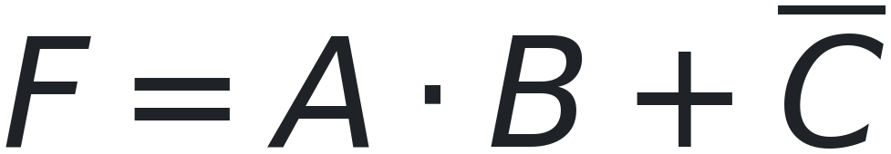
BOOLEAN EXPRESSIONS
What Is a Boolean Expression?
NEW TERM
Boolean expression — a combination of Boolean variables and Boolean operations that produces a Boolean result (0 or 1).
EXAMPLES
HOW TO READ ONE
1
First do A AND B
2
Then OR that result with C
“ · ” is done before “ + ”, just like × before +.
An expression says exactly how the output is built from the inputs.
CSE207 · Digital Logic Design · Class 2
7 / 26
Notes:
Read each example aloud in words before moving on.

Slide 8
EXPRESSION → CIRCUIT
From an Expression to a Circuit
Every operation in the expression becomes one gate in the circuit.
one AND gate
one OR gate
one NOT gate
RULE OF THUMB
Find the operations in the expression, draw one gate for each of them, then connect the gates in the order the expression is evaluated.
CSE207 · Digital Logic Design · Class 2
8 / 26
Notes:
One operation = one gate. Start from the smallest possible examples.

Slide 9
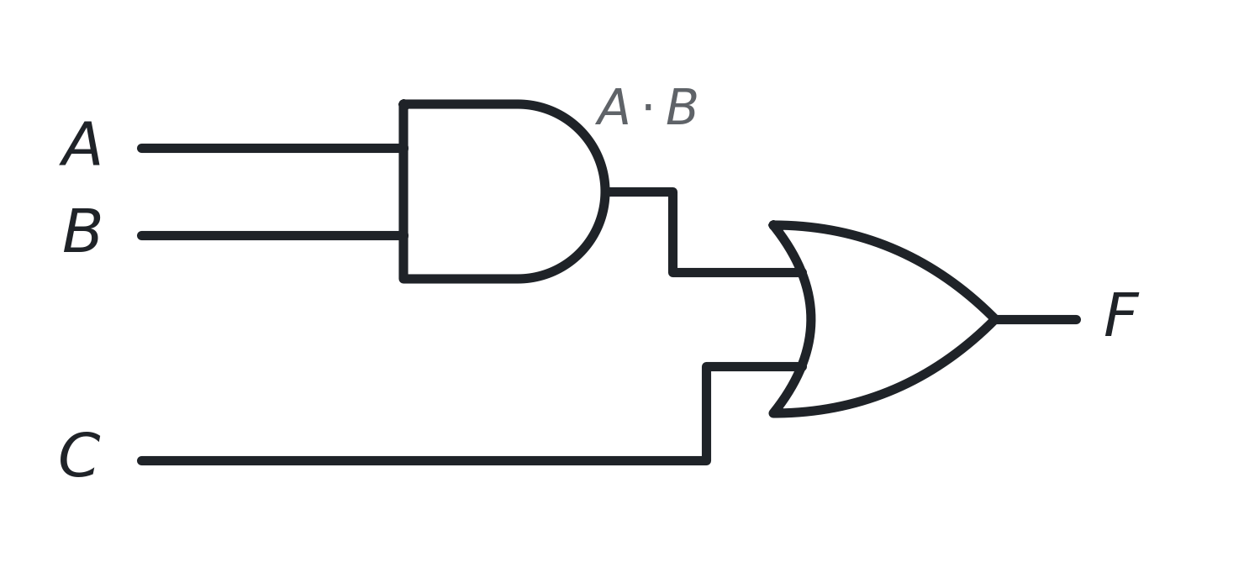
EXPRESSION → CIRCUIT
Building a Circuit Step by Step
STEP 1
AND A with B — that gives A · B.
STEP 2
OR that result with C. That gives the whole expression.
The AND is evaluated first, so the AND gate comes first in the circuit.
Circuit for F = A · B + C
Two operations → two gates. The AND gate's output becomes an input of the OR gate.
CSE207 · Digital Logic Design · Class 2
9 / 26
Notes:
Draw this on the board at the same time as the slide.

Slide 10
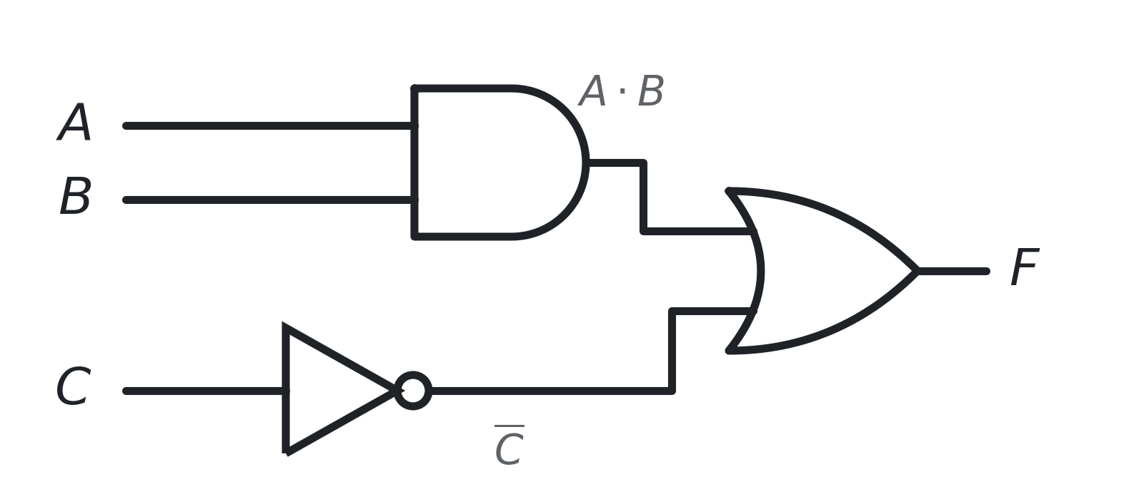
EXPRESSION → CIRCUIT
Adding a NOT Gate
WHAT CHANGED?
C now has a bar over it. The bar means NOT C, so a NOT gate is placed on the C line before the OR gate.
READ IT AS
NOT C first, then A AND B, then OR the two results together.
One AND gate, one NOT gate and one OR gate.
A bar over a variable always becomes a NOT gate in the circuit.
CSE207 · Digital Logic Design · Class 2
10 / 26
Notes:
Point at the bar over C, then at the NOT gate on the C line.

Slide 11
EXPRESSION → TRUTH TABLE
A Truth Table for a Whole Expression
In Class 1 we built truth tables for single gates. Now we build one for a complete expression.
A | B | F = A + B
0 | 0 | 0
0 | 1 | 1
1 | 0 | 1
1 | 1 | 1
HOW MANY ROWS?
For n input variables the table has 2ⁿ rows — one row for every possible combination of inputs.
Inputs (n) | Rows (2ⁿ)
1 | 2¹ = 2
2 | 2² = 4
3 | 2³ = 8
Count 00, 01, 10, 11 … like counting in binary, so no row is missed or repeated.
The OR gate and the expression A + B give exactly the same table.
CSE207 · Digital Logic Design · Class 2
11 / 26
Notes:
Class 1 built truth tables for single gates. Now we do it for a complete expression.

Slide 12
EXPRESSION → TRUTH TABLE
Using Intermediate Columns
A | B | C | A · B | F = A · B + C
0 | 0 | 0 | 0 | 0
0 | 0 | 1 | 0 | 1
0 | 1 | 0 | 0 | 0
0 | 1 | 1 | 0 | 1
1 | 0 | 0 | 0 | 0
1 | 0 | 1 | 0 | 1
1 | 1 | 0 | 1 | 1
1 | 1 | 1 | 1 | 1
WHY AN EXTRA COLUMN?
Do not try to work out F in one jump. First find A · B, then OR it with C.
1
Fill in A, B and C — all 8 combinations
2
Work out A · B in each row
3
Then F = (A · B) + C
3 variables → 2³ = 8 rows.
Highlighted row: A · B is 1, so F is 1 even though C = 0.
The extra column turns one hard step into two easy ones.
CSE207 · Digital Logic Design · Class 2
12 / 26
Notes:
Stress this: never try to get F in one jump. Add a column for each inner term.

Slide 13

BIG IDEA
Three Representations of the Same Logic Function
BOOLEAN EXPRESSION
LOGIC CIRCUIT
TRUTH TABLE
A | B | C | F
0 | 0 | 0 | 0
0 | 0 | 1 | 1
0 | 1 | 0 | 0
0 | 1 | 1 | 1
1 | 0 | 0 | 0
1 | 0 | 1 | 1
1 | 1 | 0 | 1
1 | 1 | 1 | 1
↔
↔
the mathematics
the hardware
the behaviour
Three different views — one and the same logic function. You can move between them in any direction.
CSE207 · Digital Logic Design · Class 2
13 / 26
Notes:
This is the central idea of Class 2. Make sure everyone sees that all three describe one function.

Slide 14


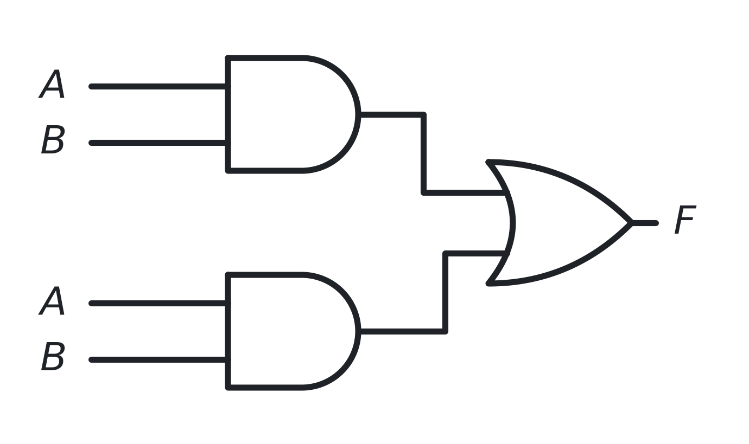
WHY SIMPLIFY?
Why Do We Simplify Boolean Expressions?
Look at this expression — the same term is written twice.
BEFORE
AFTER
1 AND gate
Idempotent Law: A + A = A
2 AND gates + 1 OR gate
Fewer gates can mean less hardware, less area and less delay.
Different expressions can describe the same logic function — but one of them may need a simpler circuit.
CSE207 · Digital Logic Design · Class 2
14 / 26
Notes:
Ask the class what they notice before revealing the right-hand card.

Slide 15








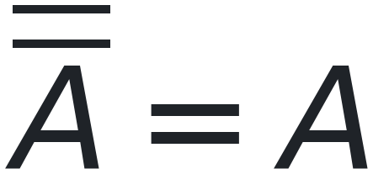
BOOLEAN LAWS
Boolean Algebra Laws — Part 1
These laws are tools. We use them to rewrite an expression into a simpler one.
IDENTITY LAW
NULL LAW
0 in an OR and 1 in an AND change nothing.
1 in an OR and 0 in an AND decide the result on their own.
IDEMPOTENT LAW
COMPLEMENT LAW
Repeating a term adds nothing new.
A variable and its opposite cover everything, or nothing.
INVOLUTION LAW
HOW TO USE THEM
Two NOTs cancel each other out.
You do not have to memorise these. Learn to recognise the pattern, then look the law up while you simplify.
CSE207 · Digital Logic Design · Class 2
15 / 26
Notes:
Do not ask anyone to memorise these today. They are tools to recognise, not facts to recite.

Slide 16





BOOLEAN LAWS
Boolean Algebra Laws — Part 2
These laws let us re-order, re-group and factor an expression.
COMMUTATIVE LAW
ASSOCIATIVE LAW
The order of the terms does not matter.
The grouping of the terms does not matter.
DISTRIBUTIVE LAW
ABSORPTION LAW
Multiply out, or factor back in. Note the second form — it has no arithmetic twin.
The bigger term already covers the smaller one.
MOST USED TODAY
REMEMBER
Absorption, Complement, Identity and Distributive are the four laws that do most of the work when we simplify.
A law is only a rewrite. The expression looks different afterwards, but the output for every input stays the same.
CSE207 · Digital Logic Design · Class 2
16 / 26
Notes:
Absorption and Distributive are the two we will actually use in today's examples.

Slide 17
BOOLEAN LAWS
Checking a Law with a Truth Table
You never have to trust a law. If both sides give the same output in every row, the law is correct.
IDENTITY LAW
IDENTITY LAW
A | 0 | A + 0
0 | 0 | 0
1 | 0 | 1
A | 1 | A · 1
0 | 1 | 0
1 | 1 | 1
The last column is identical to the A column, so A + 0 = A.
Again the last column matches A, so A · 1 = A.
Same output in every row means the same logic function. That is the whole proof.
CSE207 · Digital Logic Design · Class 2
17 / 26
Notes:
Show them they never have to take a law on trust.

Slide 18






DE MORGAN'S LAWS
De Morgan's Laws
LAW 1
LAW 2
ONE TRUTH TABLE PROVES BOTH LAWS
A | B | A + B |  |  | A · B
0 | 0 | 0 | 1 | 1 | 0 | 1 | 1
0 | 1 | 1 | 0 | 0 | 0 | 1 | 1
1 | 0 | 1 | 0 | 0 | 0 | 1 | 1
1 | 1 | 1 | 0 | 0 | 1 | 0 | 0
LAW 1 — these two match
LAW 2 — these two match
EASY WAY TO REMEMBER
NEXT CLASS
Break the bar, change the operation — and every variable gets its own bar.
These laws become especially useful when we build circuits out of NAND and NOR gates.
CSE207 · Digital Logic Design · Class 2
18 / 26
Notes:
Say the memory rule out loud twice: break the bar, change the operation. Then walk the class along one row of the table at a time - the A+B and A.B columns are the intermediate columns, and the two bracketed pairs are what actually prove the laws.

Slide 19

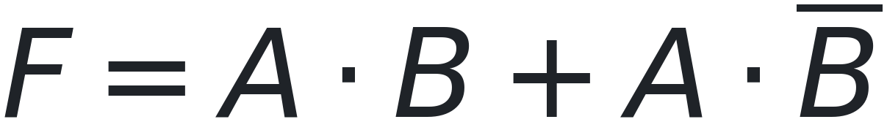
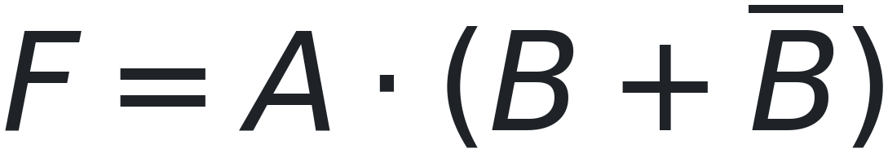


SIMPLIFICATION
Simplifying Step by Step
EXAMPLE 1
EXAMPLE 2
given
given
The term A already covers A · B, so A · B adds nothing new.
factor out A
Absorption Law
Complement Law
Whenever you see A + A · B, the answer is simply A.
Identity Law
THE LAW USED
Every step is allowed because a Boolean law says so.
The expression changes at every step — the logic function does not.
CSE207 · Digital Logic Design · Class 2
19 / 26
Notes:
Name the law out loud at every single step. That is the habit we want.

Slide 20
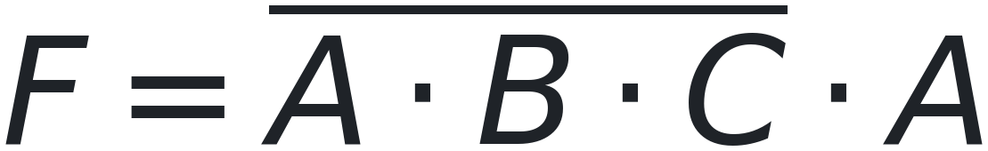


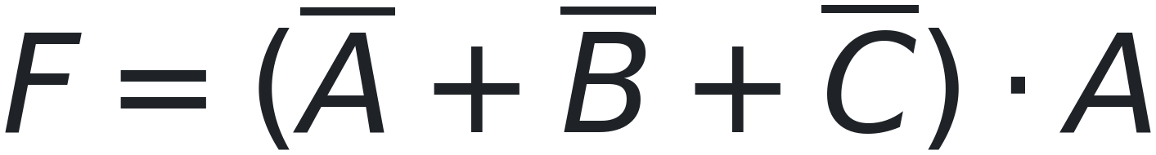

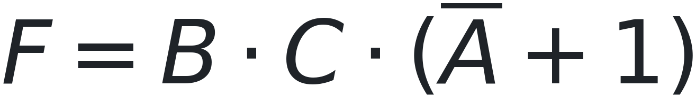


DE MORGAN'S LAWS
Simplifying with De Morgan's Laws
EXAMPLE 1
EXAMPLE 2
EXAMPLE 3
given
given
given
De Morgan's Law
De Morgan's Law
De Morgan's Law
Distributive Law
Distributive Law
Absorption Law
Complement + Identity
Null + Identity
Every De Morgan simplification starts the same way: break the bar, then apply the ordinary laws.
CSE207 · Digital Logic Design · Class 2
20 / 26
Notes:
Three-variable examples. In every one the FIRST move is De Morgan - break the bar - and only then do the ordinary laws apply. Point that out each time. Ex 1 ends on Complement, Ex 2 on Null (A-bar + 1 = 1), Ex 3 on Absorption.

Slide 21
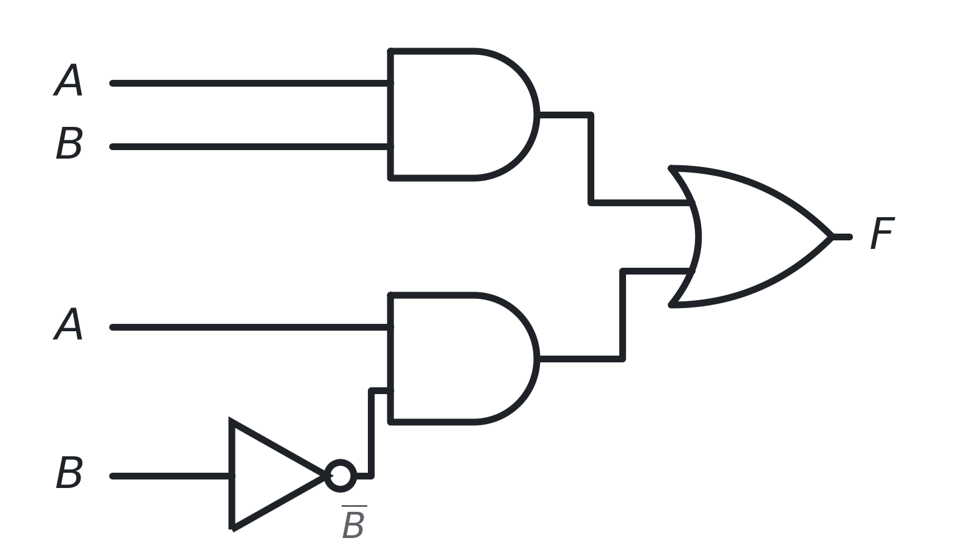

SIMPLIFICATION
Same Logic Function, Simpler Circuit
BEFORE SIMPLIFICATION
AFTER SIMPLIFICATION
No gates at all — the output simply follows A.
Factor out A, then B + NOT B = 1, then A · 1 = A.
2 AND gates, 1 OR gate, 1 NOT gate
4 gates
0 gates
Both circuits have exactly the same truth table. Boolean algebra changes the hardware, not the logic.
CSE207 · Digital Logic Design · Class 2
21 / 26
Notes:
This is where Boolean algebra stops being maths and becomes hardware.

Slide 22

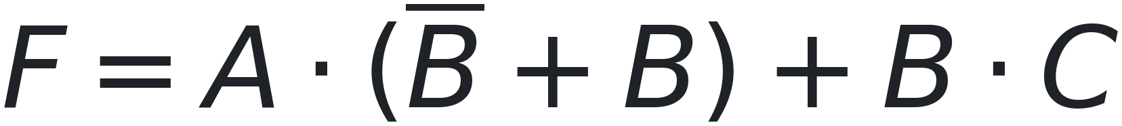


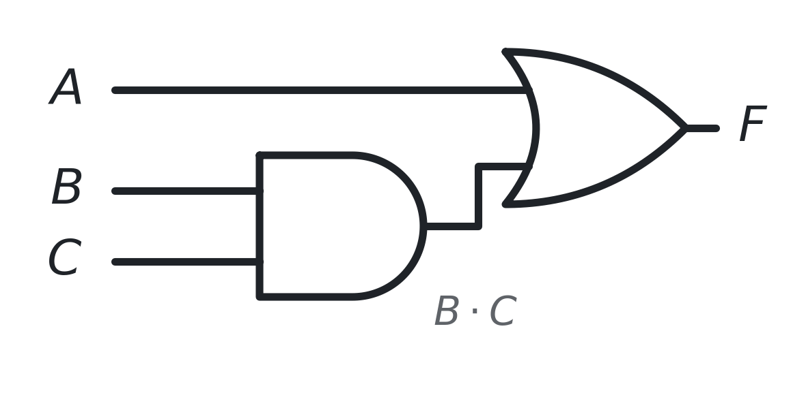
SIMPLIFICATION
A Harder Example: Three Variables
STEP BY STEP
TRUTH TABLE — 8 ROWS FOR 3 VARIABLES
given
A | B | C |  | A · B | B · C | F | A + B · C
0 | 0 | 0 | 0 | 0 | 0 | 0 | 0
0 | 0 | 1 | 0 | 0 | 0 | 0 | 0
0 | 1 | 0 | 0 | 0 | 0 | 0 | 0
0 | 1 | 1 | 0 | 0 | 1 | 1 | 1
1 | 0 | 0 | 1 | 0 | 0 | 1 | 1
1 | 0 | 1 | 1 | 0 | 0 | 1 | 1
1 | 1 | 0 | 0 | 1 | 0 | 1 | 1
1 | 1 | 1 | 0 | 1 | 1 | 1 | 1
factor out A
Complement Law
Identity Law
CIRCUIT FOR THE SIMPLIFIED EXPRESSION
The F column and the A + B · C column match in every row — the simplification is correct.
Same logic function — 6 gates or 2. Boolean algebra decides which.
2 gates instead of 6 (1 NOT, 3 AND, 2 OR).
CSE207 · Digital Logic Design · Class 2
22 / 26
Notes:
Everything from today in one problem. Work the three parts on the board in this order: simplify, draw the simplified circuit, then check with the truth table. The key move is spotting that the first two terms share A.

Slide 23

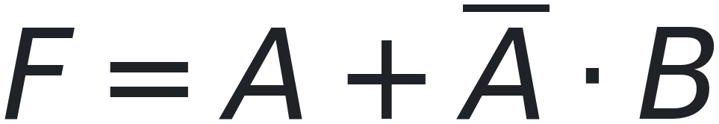
PRACTICE
Your Turn
1
Simplify
2
Simplify
3
Simplify
Hint: Idempotent Law.
Hint: Absorption Law.
Hint: factor out A first.
MINI CHALLENGE
Try this one yourself before looking at the next slide.
Hint: use the Distributive Law in the form A + B · C = (A + B) · (A + C).
Take two or three minutes. The answers are on the next slide.
CSE207 · Digital Logic Design · Class 2
23 / 26
Notes:
Give them two or three minutes. Walk around; do not reveal the answers early.

Slide 24
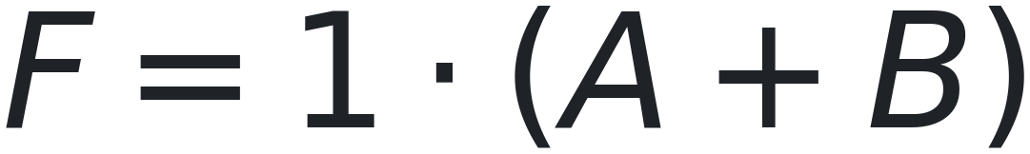
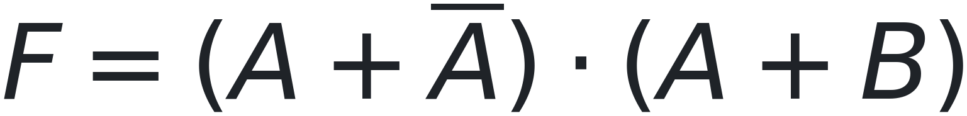

PRACTICE
Answers
Q1
Q2
Q3
Idempotent Law A + A = A
Absorption Law A + A · B = A
Complement + Identity Laws
MINI CHALLENGE — SOLUTION
1
given
3
Complement Law
2
Distributive Law
4
Identity Law
Notice that every single step is justified by a named Boolean law.
CSE207 · Digital Logic Design · Class 2
24 / 26
Notes:
Make the law name the point of each answer, not the letter A.

Slide 25


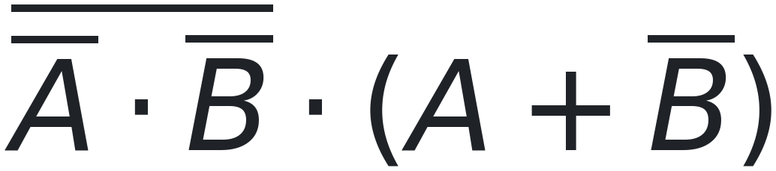


HOMEWORK
Homework
FOR EACH EXPRESSION BELOW, DO ALL THREE
1
Simplify the expression
2
Draw the simplified circuit
3
Build the truth table
EXPRESSIONS
1
5
2
6
3
7
4
8
Name the law you used at every step. Warm-up (no circuit needed): simplify A + 0 and A · 1.
Hints — for 6 start with De Morgan; for 8, two factors that differ only in C collapse into one.
Simplification is a skill — it only comes with practice.
CSE207 · Digital Logic Design · Class 2
25 / 26
Notes:
Answers. 1) A Absorption. 2) A factor A, Complement, Identity. 3) A + B Distributive, Complement, Identity. 4) A.B factor A.B, then C + NOT C = 1, Identity. 5) A.(B + C) Absorption removes A.B.C, then factor A. 6) A De Morgan and Involution turn the first factor into A + B, then (A+B)(A+NOT B) = A + B.NOT B = A. 7) C.(A + B) factor A.C from the first two terms, then A.C + NOT A.B.C = C.(A + NOT A.B) = C.(A + B). 8) A the first two factors give (A+B) + C.NOT C = A + B, then (A+B)(A+NOT B) = A. Truth-table sizes: 1, 2, 3 and 6 are two-variable, so 4 rows; 4, 5, 7 and 8 are three-variable, so 8 rows. Problems 6 to 8 are the hard ones - warn the class that they need more than one law each.

Slide 26
BIG PICTURE
The Big Picture
Boolean Values · 0 and 1
KEY TAKEAWAYS
1
Boolean variables have only two values: 0 and 1.
Boolean Operations
2
A Boolean expression describes a logic function.
Boolean Expressions
3
The same function can be shown as an expression, a circuit or a truth table.
Circuit + Truth Table
4
Boolean laws let us rewrite an expression into a simpler one.
Boolean Laws · De Morgan
5
A simpler expression can mean a simpler circuit — with the same output.
Simpler Circuit
Next question: can we build any circuit using only ONE type of gate?
Next class: Universal Gates — NAND and NOR
CSE207 · Digital Logic Design · Class 2
26 / 26
Notes:
Close the loop back to Class 1, then open the door to Class 3.

