Slide 1
Sentiment-Based Product
Recommendation System
E-Commerce Intelligence for Ebuss
Developed by Shaik Muzubur Rahaman

Slide 2
Problem Statement
The Context
The Objective
Ebuss is an e-commerce company such as Amazon, Flipkart, Myntra, and Snapdeal.
Products span household essentials, books, beauty, health, cosmetics, kitchen, and personal care.
To stay competitive, Ebuss must deliver smarter, personalized product recommendations.
Build a Sentiment-Based Product Recommendation System that:
✔ Analyzes customer reviews via NLP
✔ Filters and ranks top recommendations
✔ Combines collaborative filtering with sentiment scoring
✔ Deploys as a live web application

Slide 3
Project Objectives
01
Analyze & Preprocess Data
04
Improve via Sentiment
EDA, text cleaning, handle missing values & class imbalance
Filter Top 20 → apply sentiment model → rank to Top 5 products
02
Sentiment Analysis Model
05
Deploy End-to-End
TF-IDF features + Logistic Regression, Random Forest, XGBoost
Flask web app deployed on Heroku / Render with personalized UI
03
Recommendation Engine
User-Based & Item-Based Collaborative Filtering; Top 20 per user

Slide 4
Data Preprocessing & EDA
30,000
96.44%
2.55
Product Reviews
Final Model Accuracy
Best CF RMSE
Key Preprocessing Steps:
Drop Nulls
Text Cleaning
Removed reviews_didPurchase, reviews_userCity, reviews_userProvince (high null %)
Lowercase, remove punctuation, stopwords, and apply lemmatization
Feature Engineering
Sentiment Fix
Merged reviews_text + reviews_title → reviews_combined for analysis
Corrected misclassified user_sentiment values based on reviews_rating

Slide 5
Sentiment Analysis Model
Models Trained & Evaluated
Logistic Regression
★ Best Model Selected
Acc: 96.44% F1: 98.09%
Random Forest
Good but overfit
Acc: 96.57% F1: 98.19%
XGBoost
Competitive results
Acc: 96.27% F1: 98.04%
Tuning: RandomizedSearchCV + StratifiedKFold + f1_macro scoring

Slide 6
Model Performance & Evaluation
Model | Type | Train Acc | Test Acc | Train F1 | Test F1 | Train ROC | Test ROC
Log. Reg. | Base | 96.57 | 94.50 | 98.13 | 97.00 | 99.65 | 96.39
Log. Reg. | Tuned ★ | 99.59 | 96.44 | 99.78 | 98.09 | 99.99 | 96.07
Rnd Forest | Base | 99.99 | 96.57 | 99.99 | 98.19 | 100.0 | 95.39
Rnd Forest | Tuned | 96.76 | 94.58 | 98.25 | 97.07 | 97.95 | 93.82
XGBoost | Base | 96.23 | 95.72 | 98.02 | 97.75 | 97.36 | 94.62
XGBoost | Tuned | 97.34 | 96.27 | 98.59 | 98.04 | 99.03 | 95.52
★ Best Model: Logistic Regression (Tuned) — Test Accuracy: 96.44% | Test F1: 98.09% | Selected for deployment

Slide 7
Collaborative Filtering Recommendation
User-User Collaborative Filtering
Item-Item Collaborative Filtering
Identifies similar users by their rating history
Recommends products liked by similar users
Generates Top 20 personalized recommendations
Groups similar products by user rating patterns
Recommends items similar to what user rated highly
Higher RMSE — less suitable for this dataset
RMSE: 2.55
Selected Model ✓
RMSE: 3.55
Not Selected ✗
Pearson correlation-based user similarity
Cosine similarity-based item matching
The User-User model outperformed Item-Item by 28% in RMSE — producing more relevant and personalized recommendations.

Slide 8
Hybrid Recommendation System — How It Works
1
2
3
4
5
User Input
Top 20 Recs
Sentiment Score
Re-Rank
Top 5 Output
Enter existing username
User-User CF generates 20 candidates
Logistic Regression rates each product
Sort by % positive sentiment
Best products displayed to user
Why This Approach Works
Assumption & Scope
Combining personalization (CF) with quality filtering (sentiment) ensures users receive products that are both relevant to their profile AND well-received by other buyers.
System operates on a fixed product and user base. No new users or products are introduced during prediction — ensuring model stability and consistent output quality.

Slide 9
System Architecture & Deployment
Frontend
Flask Backend
ML Models
Cloud Deploy
HTML / CSS / JavaScript
User enters username
Displays Top 5 products
REST API routes
Model inference
Recommendation logic
TF-IDF Vectorizer
Logistic Regression
User-User CF Matrix
Heroku / Render
End-to-end pipeline
Scalable hosting
→
→
→
Pipeline: User Input → TF-IDF Transform → Logistic Regression → CF Recommendation → Top 5 UI Display

Slide 10
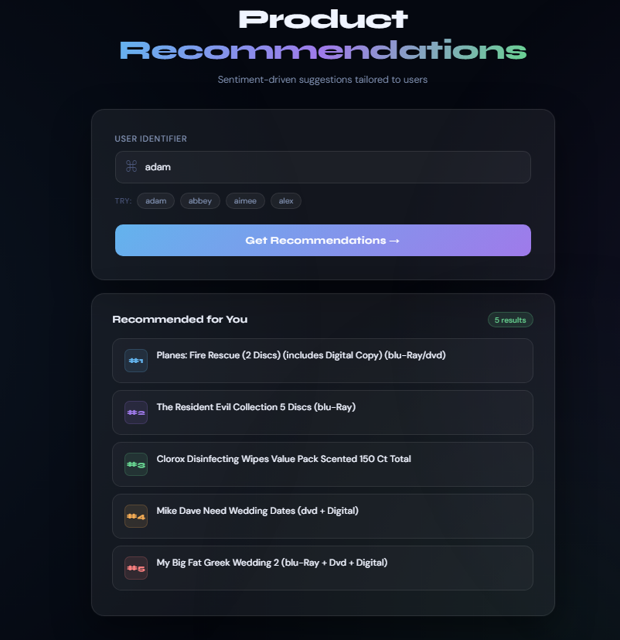
Demo — Valid User Case
User exists in the system → Top 5 recommended products are retrieved and displayed.
]
✔ User Found → Top 5 Products Returned Successfully

Slide 11
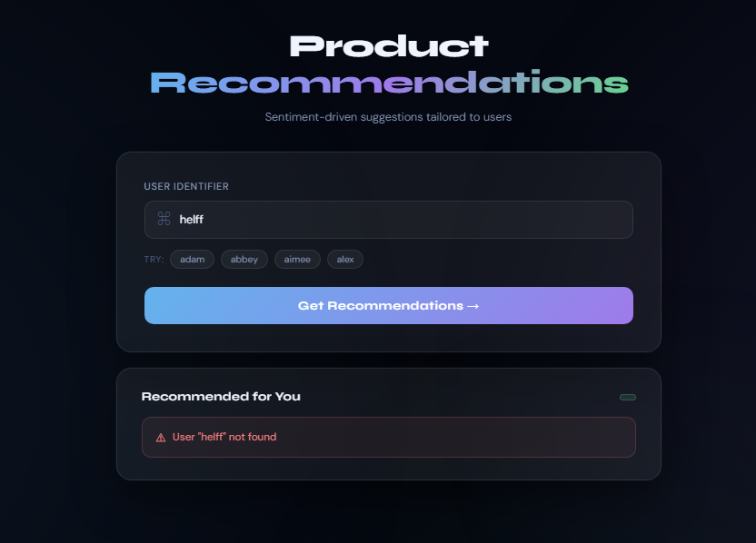
Demo — Invalid User Case
User does not exist in the system → "User is not found" error message is returned.
✗ User Not Found → "User is not found" Message Displayed

Slide 12
Conclusion & Key Takeaways
📊
Data at Scale
🤖
Best-in-Class Sentiment
30,000 reviews cleaned, preprocessed, and converted to ML-ready features using TF-IDF
Tuned Logistic Regression achieved 96.44% accuracy & 98.09% F1-score — robust and generalizable
👥
Personalized Recommendations
🔗
Hybrid Intelligence
User-User CF (RMSE: 2.55) outperformed Item-Item CF by 28% — selected for the final system
Combining CF with sentiment scoring delivers Top 5 products that are both relevant AND highly rated
🚀
End-to-End Deployment
🏆
Business Impact
Full Flask web app deployed on cloud — live, interactive, and production-ready
Positions Ebuss to compete with Amazon/Flipkart using data-driven, user-centric recommendations
Sentiment-Based Product Recommendation System | Ebuss E-Commerce | ML Capstone Project

Slide 13
Thank You
Sentiment-Based Product Recommendation System
Developed by Shaik Muzubur Rahaman

