Slide 1
SETU Approval Note
Company: SETU
Reviewer: Parvez Ashraf
Department: Procurement

Slide 2
Executive Summary
Total Findings: 5

Slide 3
Recommendations
• Perform quaterly inspection

Slide 4
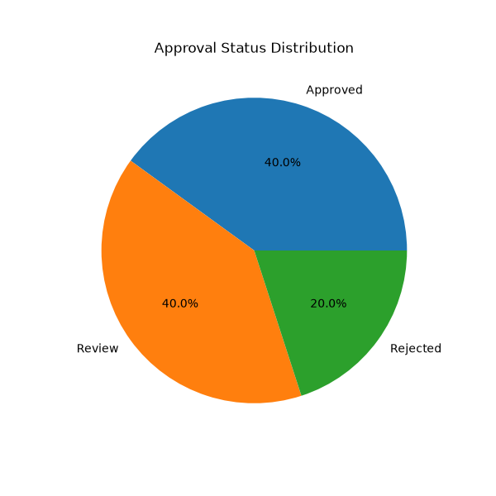
Status Chart

