Slide 1
Software Testing Life Cycle (STLC)
Software Testing

Slide 2
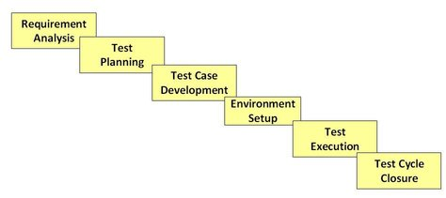
STLC

Slide 3
Requirement Analysis
During this phase of STLC, analyze and study the requirements. Have brainstorming sessions with other teams and try to find out whether the requirements are testable or not.
This phase helps to identify the scope of the testing.
If any feature is not testable, communicate it during this phase so that the mitigation strategy can be planned.

Slide 4
Test Planning
This phase is also called as Test Strategy phase.
In this phase, the Test Manager is involved to determine the effort and cost estimates for the entire project.
It defines the objective & scope of the project.

Slide 5
Test Case Development
The Test case development begins once the test planning phase is completed.
This is the phase of STLC where testing team notes the detailed test cases.
Along with test cases, testing team also prepares the test data for testing.
Once the test cases are ready then these test cases are reviewed by peer members or QA lead.

Slide 6
Test Environment Setup
Setting up the test environment is vital part of the Software Testing Life Cycle.
A testing environment is a setup of software and hardware for the testing teams to execute test cases.
It supports test execution with hardware, software and network configured
he test environment involves setting up of distinct areas like :
Setup of Test Server – Every test may not be executed on a local machine. It may need establishing a test server, which can support applications.
Network – We need to set up the network as per requirements.
Test PC Setup – We need to set up different browsers for different testers.
Bug Reporting – Bug reporting tools should be provided to testers.
Creating Test Data for the Test Environment – Many companies use a separate test environment to test the software product. The common approach used is to copy production data to test.

Slide 7
Test Execution
The next phase in Software Testing Life Cycle is Test Execution.
Test execution is the process of executing the code and comparing the expected and actual results.
When test execution begins, the test analysts start executing the test scripts based on test strategy allowed in the project

Slide 8
Test Cycle Closure
The final phase of the Software Testing Life Cycle is Test Cycle Closure. It involves calling out the testing team member meeting & evaluating cycle completion criteria based on Test coverage, Quality, Cost, Time, Critical Business Objectives, and Software.
A test closure report by the test lead is published after accomplishing the exit criteria and finishing the testing phase.

