Slide 1
Savings Opportunities Analysis
Project
By Mukesh Manral, Butan Mangu, Rafal Pikula

Slide 2
Purpose, Main Assumption and Main Findings
The purpose of this report is to identify some scope for cost efficiency and better strategic planning in order to generate savings.
We concentrate our efforts on the data from the most recent year provided, i.e., the year 2019, and we try to identify the high-value and high-moving products to look for saving opportunities among them.
We isolate a group of 11 such products and observe that their prices are the lowest just at the beginning of the year and then they increase, sometimes substantially, and do not come back to the former level. We can take advantage of this generally upward price trend and under some extra assumptions we are able to propose savings in the ballpark of 3.25% of total spending for 2019.

Slide 3
Data Selection Part I
The data originally contains 75349 rows and 65 columns and has no duplicates. There are some columns with missing values whose number sometimes exceeds 90%. Many columns contain just a single value or are almost constant. Several columns contain information not needed for the purpose of our analysis, e.g., units of measurement or names of people involved in the ordering process. We drop all such columns and we keep the following columns:
'CoCd', 'Material', 'Short Text', 'Plnt', 'SLoc', 'Matl Group', 'PO Quantity’,
'Net Price', 'Net Value', 'Gross value', 'Price Date’
Moreover, we restrict our attention to the data from 2019 only as this is the most recent year available and we retain almost 90% of all the records and over 93% of total spending.

Slide 4
Data Selection Part II
We begin our search for saving opportunities by considering cumulative spending (gross value) in order to find products that generate a lot of spending (high-value products). We are going to group the data by the company code, material and short text columns, where the first two are mostly for the referential purposes.
Moreover, we restrict the data after the aforementioned aggregation in such a way so as to retain exactly 93% of total spending. This way we are left with 1126 products (and ignore low-value items) that we will use as a basis for further explorations.
Next, we are going to use clustering to help us select the high-value high-moving products.

Slide 5
Clustering Part I
To take advantage of the clustering techniques we prepare a new data set that contains the Total Gross Value % column taken from the aggregated data as well as two newly computed columns: Spending Frequency (indicating the number of purchases in the given period) and Spending Days (indicating the number of days on which purchases occurred in the given period, used for reference only).
Despite the elevated correlation between the Total Gross Value % and Spending Frequency columns (at the level of 0.75) we select these two columns as the only columns to be fed into the clustering algorithms. We consider the following algorithms: KMeans, Affinity Propagation, Mean Shift, Spectral Clustering, Agglomerative Clustering, and DBSCAN. Moreover, in each case we always preprocess the data using standard scaler with the default settings.

Slide 6
Clustering Part II
We have found that the KMeans, Affinity Propagation, Mean Shift, Spectral Clustering, and Agglomerative Clustering algorithms perform less than ideal and often the produced clusters are too detailed for our purpose and require manual merging.
On the other hand, the DBSCAN algorithm appears to be best suited for our data. After applying it, we can see on the chart that is on the next slide that the main cluster (composed of red points) consists of low frequency products while those loosely scattered green points mostly represent the products exhibiting both relatively high value and high frequency.
Exactly those green points form our list of potential saving opportunities (that are in line with our business intuition that we should look for such opportunities primarily among the high-value and high-moving products) which we will analyze presently.

Slide 7
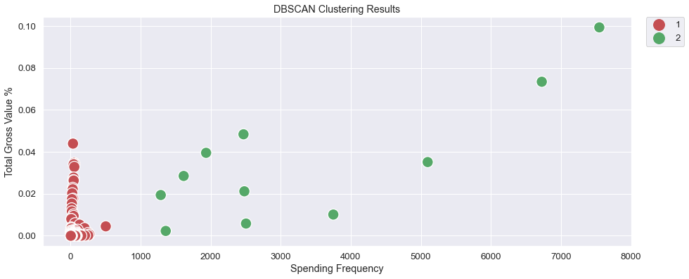
Clustering Part III

Slide 8
Saving Opportunities Part I
Below, we present the selected 11 potential saving opportunities:
 |  |  | Total Gross Value % | Spending Frequency | Spending Days | Cluster
CoCd | Material | Short Text
7860 | 7101320.0 | IB Ross Broiler Finisher Feed | 0.099324 | 7547 | 89 | 2
 |  | IB Ross Broiler Starter Feed | 0.073418 | 6726 | 89 | 2
9000 | 910970.0 | Soya Bean - (MP) | 0.048367 | 2468 | 88 | 2
 | 910070.0 | Soya Bean - (A) | 0.039531 | 1934 | 87 | 2
7860 | 7101320.0 | IB Ross Broiler Pre-Starter Feed | 0.035124 | 5097 | 89 | 2
9000 | 910010.0 | Maize | 0.028506 | 1614 | 79 | 2
 | 910000.0 | Soya Bean | 0.021192 | 2480 | 88 | 2
 | 910860.0 | Khandha | 0.019418 | 1287 | 86 | 2
 | 910420.0 | Rice Bran Boiled | 0.010110 | 3750 | 87 | 2
 |  | Rice Bran Raw | 0.005824 | 2504 | 86 | 2
 | 940730.0 | Rice Husk (New) | 0.002309 | 1358 | 84 | 2

Slide 9
Saving Opportunities Part II
Now, we are going to employ the following strategy: Given the upward price trend, replace the net prices of a given product paid during the period with the daily median price of the first purchase day of that period in order to generate savings. Evidently, this strategy requires some form of verification (which we do by checking that actual savings are generated) and is based on the following assumptions:
The products are easy to store in large quantities for an extended period of time
There is enough storage capacity for a bulk purchase (optionally, several deliveries for one bulk order can be scheduled)
On the next two slides we provide a visual explanation (consisting of two charts) illustrating the validity of our approach and potential savings for the first product on our list, i.e, the IB Ross Broiler Finisher Feed.

Slide 10
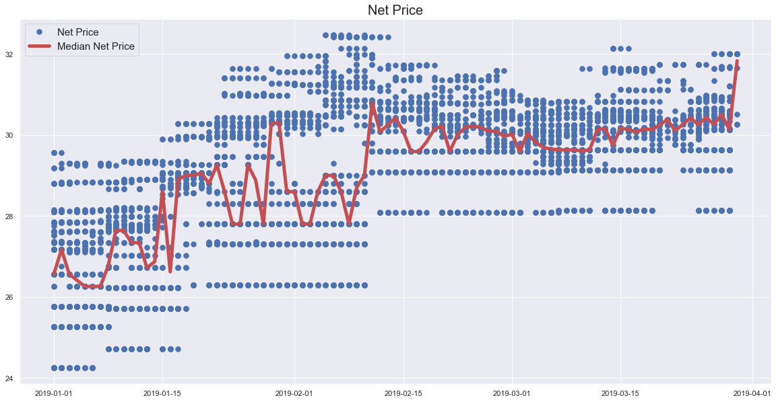
Saving Opportunities Part III

Slide 11
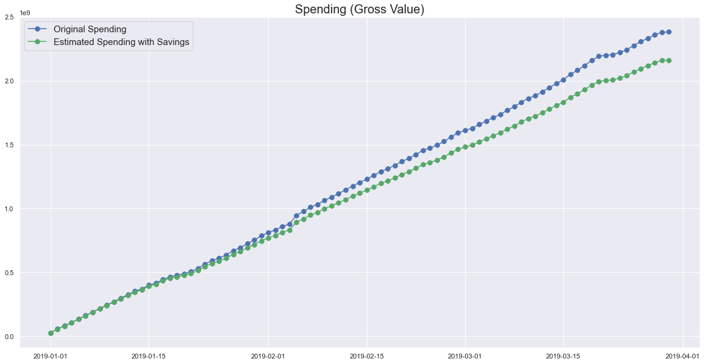
Saving Opportunities Part IV

Slide 12
Saving Opportunities Conclusion
Finally, we compute the combined amount of savings corresponding to those 11 selected products :
Amount of savings: 729763363.47
Savings as the percentage of total spending: 3.041%
Savings as the percentage of spending in 2019: 3.255%
which is in the ballpark of 3% of total spending (in the entire original data set) and 3.25% of spending in 2019.

Slide 13
Recommendation
Given the aforementioned assumptions and the fact that the data in 2019 span the first quarter only, we recommend that, in order to generate substantial savings, the following 11 products be bought at the beginning of the first quarter (as early as possible) for the entire quarter:
IB Ross Broiler Finisher Feed, IB Ross Broiler Starter Feed,
IB Ross Broiler Pre-Starter Feed, Khandha, Maize,
Rice Bran Boiled, Rice Bran Raw, and Rice Husk (New)
Soya Bean, Soya Bean – (MP), Soya Bean – (A)

