Slide 1
Sales and Profit Analysis for Leadership Team
This analysis is on Regional Sales and Profit
Sales and Profit are shown by Category, Subcategory and Segment wise

Slide 2
Initial-Hypothesis for store)
Customer id => for customer name and every next information
Customer Type => bulk buyer, frequent buyer, only offer driven and so on
Country => City => State => Code
Region => East, West, North, South
Year => Month => reference of time
Product => Category => Sub-Category => Particular Product
Sales => Profit => Loss => Discount
H 1. Year => Month => Region => Product => Category => Subcategory => Particular Product => Sales (Product sale year/month wise considering region as a factor and vice versa)
H 1.1. Year => Month => Region => Product => Category => Subcategory => Particular Product => Sales => Profit / Loss => Discount (Product sale year/month wise after providing discount)
H 2. Customer type => Customer id => Region (Type of customer region wise)
H 2.1. City => Profit /Loss(City providing best/worst business)

Slide 3
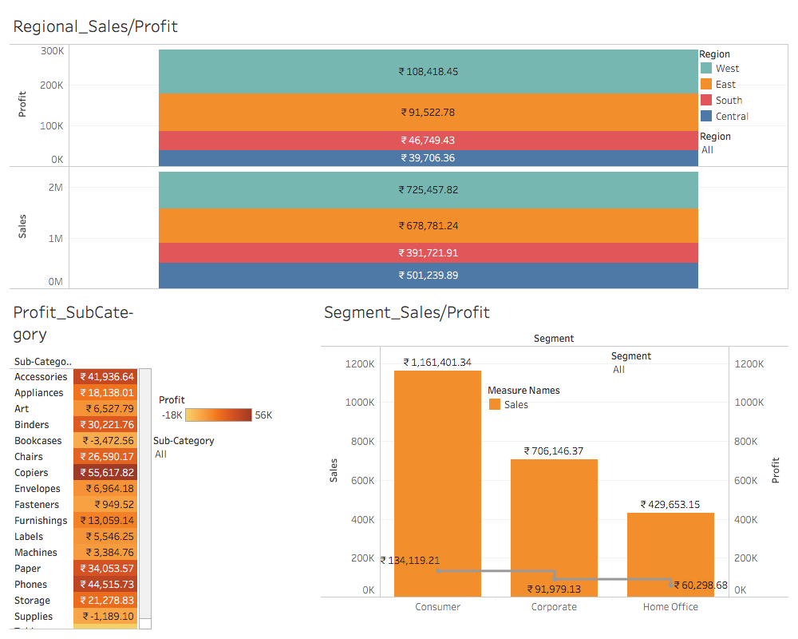

Slide 4
