Slide 1

Exploratory Data Analysis on AMCAT
by
Manandi Venkata Trilokesh
MANANa

Slide 2
Objective :
Description of Data:
The main goal of this dataset is to investigate the connections between various personal, educational, and professional characteristics and their potential impact on outcomes like salary. Specifically, the analysis will focus on:
Identifying the key factors that affect salary, such as education, skills, location, and personality traits.
Discovering patterns or correlations between educational background elements (like college GPA, graduation year, and board scores) and professional success.
Assessing how skills (such as English proficiency, logical reasoning, quantitative ability, and computer programming) influence job-related outcomes like salary or job title.
Analyzing differences in salary or job roles based on gender or location.
Exploring how personality traits such as conscientiousness, agreeableness, and openness may affect professional outcomes, including salary or job designation.
Conducting predictive modeling to estimate salaries based on a combination of skills, education, and personality traits.
Ultimately, this exploratory data analysis (EDA) will provide valuable insights into the dataset, reveal trends, and prepare the data for future predictive modeling tasks.

Slide 3
Summary :
The summary of data format mention in a tabular format.
Column Name | Data Type | Description
ID | int64 | A unique identifier assigned to each individual.
CollegeID | int64 | A unique identifier for the college attended by the individual.
CollegeCityID | int64 | A unique identifier for the city where the college is located.
Gender | object | The gender of the individual.
DOB | object | The date of birth of the individual; should be converted to datetime format.
10percentage | float64 | Percentage marks obtained in 10th grade (secondary school).
10board | object | The educational board under which the 10th-grade exams were taken (e.g., CBSE, State Board).
12graduation | int64 | The year the individual completed their 12th-grade education (senior secondary school).
12percentage | float64 | Percentage marks obtained in 12th grade.
12board | object | The educational board for the 12th-grade exams.

Slide 4
Column Name | Data Type | Description
Degree | object | The academic degree pursued by the individual (e.g., B.Tech, B.Sc.).
Specialization | object | The specific area of study or major within the degree (e.g., Computer Science, Mechanical Engineering).
collegeGPA | float64 | The Grade Point Average earned during college studies.
CollegeState | object | The state in which the individual’s college is located.
GraduationYear | int64 | The year the individual completed their college degree.
English | int64 | A score or assessment of the individual’s proficiency in English.
Salary | float64 | The annual salary of the individual, expressed in a monetary unit (e.g., dollars, rupees).
DOJ | object | The individual's date of joining in their job role; needs conversion to datetime format.
DOL | object | The date the individual left their job; also requires conversion to datetime format.
Designation | object | The job title or role of the individual in the organization.
JobCity | object | The city where the individual is employed.
CollegeTier | int64 | Classification of the college’s rank or quality (1 for top-tier, 2 for mid-tier, etc.).
CollegeCityTier | int64 | Classification of the city’s tier (1 for metropolitan areas, 2 for smaller cities, etc.).

Slide 5
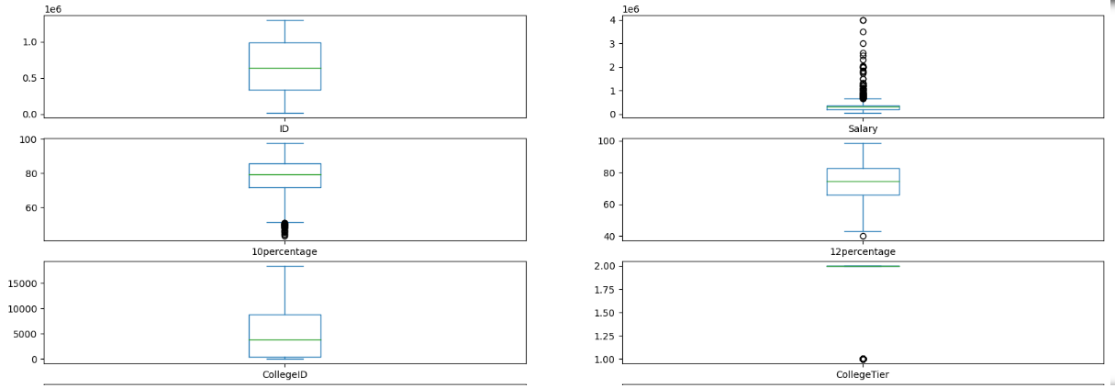
Univariate Analysis
Salary Distribution
Range and Variation: Salaries range from 35,000 to 4,000,000, indicating substantial variability among individuals.
Mean and Median: The average salary is approximately 307,700, with a median of 300,000, suggesting balanced earnings around this point.
Standard Deviation: A standard deviation of about 212,700 reflects a wide dispersion of salaries, highlighting significant differences among individuals.
Potential Influences: Factors such as specialization, location, and company size significantly impact salary levels, indicating areas for deeper analysis.
Educational Performance
10th and 12th Grade Averages: Mean percentages are 77.9 for the 10th grade and 74.5 for the 12th grade, showing relatively high academic performance.
Variability in Scores: Standard deviations of 9.9 and 11.0 suggest considerable variation in educational outcomes among individuals.
Outliers: There are outliers in both the 10th (below 60%) and 12th grades (below 40%), indicating some individuals faced significant academic challenges.
Correlation with Earnings: Exploring the relationship between educational performance and salary could reveal insights into how academic success influences earning potential.

Slide 6
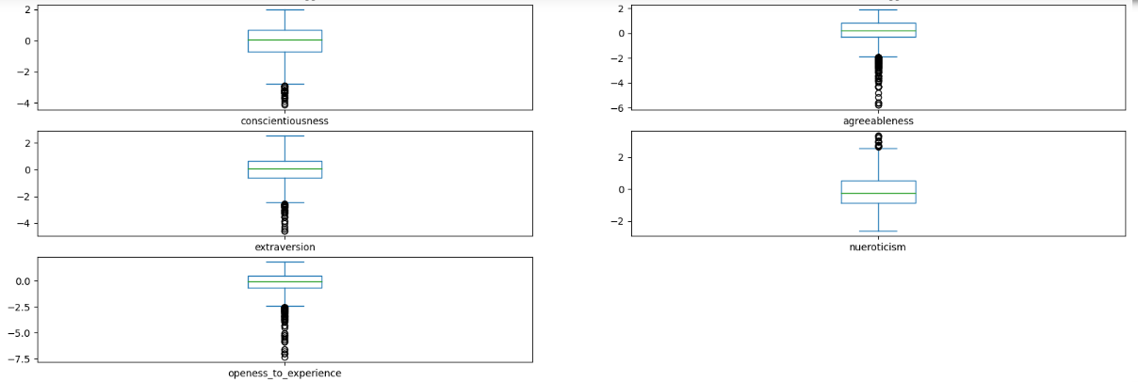
Univariate Analysis
Personality Traits Observations
Trait Diversity: Assesses various traits like conscientiousness, agreeableness, and openness.
Conscientiousness Range: Scores vary from -4.13 to 1.99, indicating different levels of reliability.
Mean and Standard Deviation: Mean close to 0; standard deviation of 1.03 shows variability.
Agreeableness Variation: High standard deviation suggests significant differences in social harmony.
Impact on Career Outcomes: Traits influence job performance, teamwork, and leadership potential.
Correlation with Earnings: Traits can affect salary and career advancement opportunities.
Recruitment Applications: Insights help employers choose candidates aligned with company culture.

Slide 7
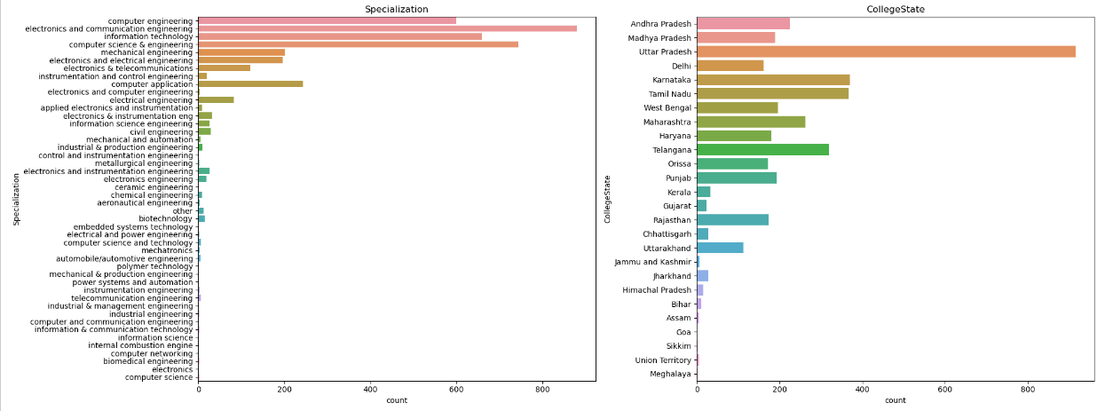
Univariate Analysis
Gender Distribution
Gender Categories: The dataset features two unique gender categories: 'm' (male) and 'f' (female).
Majority Representation: Approximately 76.1% of individuals are male ('m'), indicating a significant male majority in the dataset.
Female Representation: Around 23.9% of the individuals are female ('f'), highlighting a notable but smaller proportion of female participants.
Implications: This gender distribution may reflect broader trends in the fields represented or the demographics of graduates in specific programs.
Degree Distribution
Types of Degrees: There are four distinct degree categories: 'B.Tech/B.E.', 'MCA', 'M.Tech./M.E.', and 'M.Sc. (Tech.)'.
Dominant Degree: 'B.Tech/B.E.' is the most prevalent degree, accounting for approximately 92.5% of the dataset, suggesting a strong focus on engineering disciplines.
Other Degrees: The 'MCA' (Master of Computer Applications) follows, comprising about 6.1% of the dataset. This indicates a secondary interest in computer applications.
Less Common Degrees: 'M.Tech./M.E.' and 'M.Sc. (Tech.)' are less frequent, together making up only about 1.4% of the dataset, indicating limited representation of these advanced degrees.

Slide 8
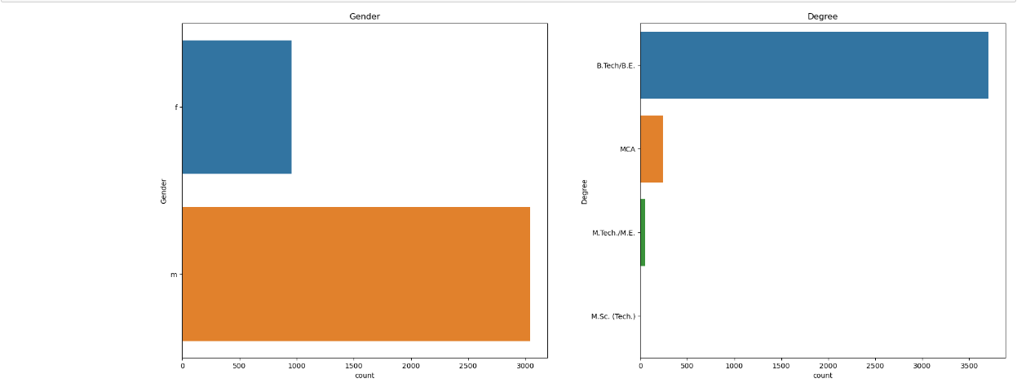
Univariate Analysis
Specialization Distribution
Variety of Specializations: The dataset includes 46 unique specializations, reflecting a diverse range of academic focuses.
Most Common Specializations: The leading specializations are 'electronics and communication engineering', 'computer science & engineering', 'information technology', and 'computer engineering'.
Prevalent Specializations: 'Electronics and communication engineering' is the most common, indicating a strong interest in this field, followed closely by 'computer science & engineering' and 'information technology'.
Educational Trends: This distribution may suggest trends in job market demand and student preferences within engineering and technology sectors.
College State Distribution
Geographical Representation: The dataset comprises colleges from 26 unique states across the country.
Top States: The most represented states include Uttar Pradesh, Karnataka, Tamil Nadu, Telangana, and Maharashtra.
Highest Representation: Uttar Pradesh has the highest number of colleges represented, followed by Karnataka and Tamil Nadu, indicating regional concentrations of educational institutions.
Regional Implications: This state distribution may impact career opportunities and networking for graduates, as certain regions may have more robust job markets or industry connections.

Slide 9
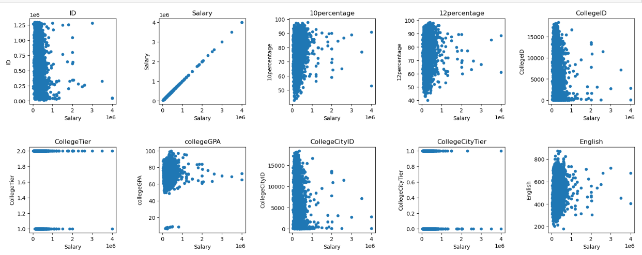
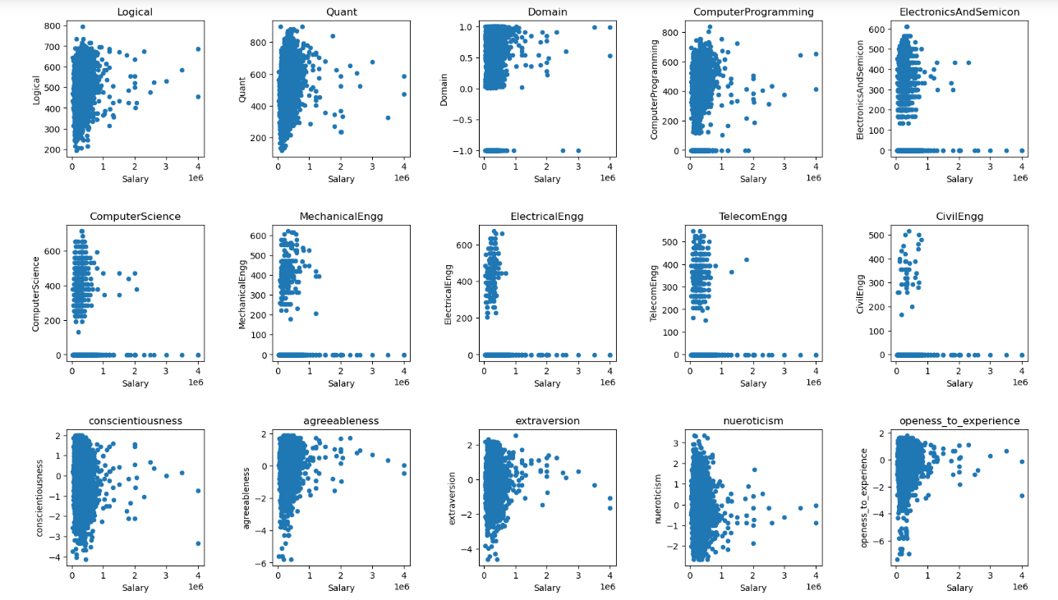
Bivariate Analysis
Observations:
The scatter plots show the relationship between various academic and professional factors and an individual's salary. Some of the factors include college tier, college GPA, city tier, English score, domain of study, conscientiousness, and agreeableness.
There appears to be a positive correlation between college tier and salary. This means that people who went to colleges in higher tiers tend to earn more money than people who went to colleges in lower tiers.
There also appears to be a positive correlation between college GPA and salary. This means that people with higher GPAs tend to earn more money than people with lower GPAs.
The relationship between city tier and salary is less clear. There seems to be a positive correlation for some data points, but there are also many outliers.
There is no clear correlation between English score and salary. The data points are scattered evenly across the plot.
There appears to be a positive correlation between domain of study and salary. People who studied computer programming and electronics seem to earn more money than people who studied other domains.
There is no clear correlation between conscientiousness and salary or agreeableness and salary. The data points are scattered evenly across the plots.

Slide 10
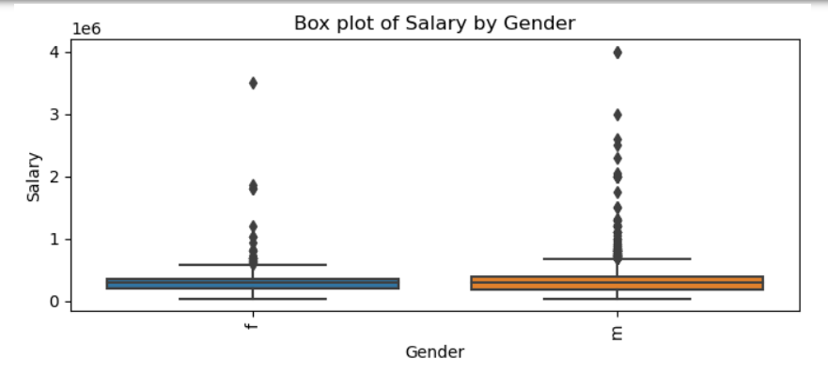
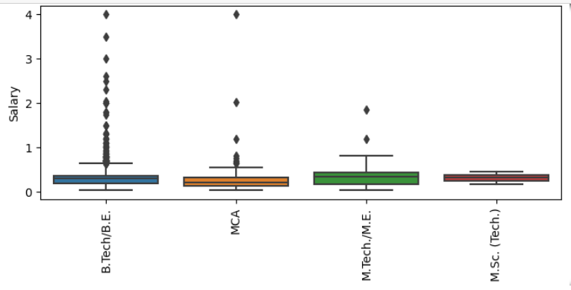
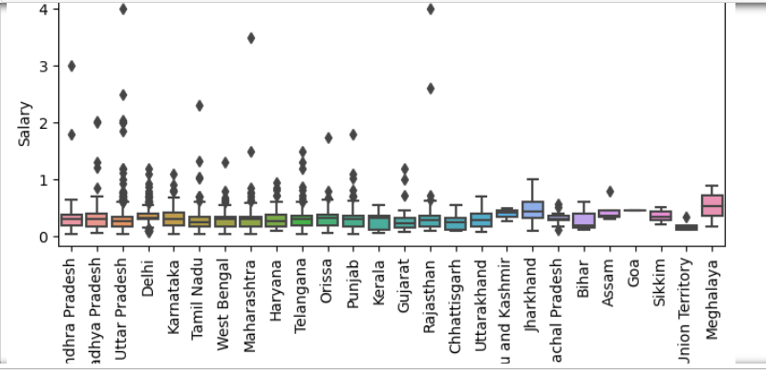
Bivariate Analysis
Observations:
From the above graphs, we can observe the relationship between salary and gender, degree, specialization, and college state of the individual.
Most of the individuals identified as 'Male' have the highest salary of 4000000, compared to females who have the highest salary range between 3000000 and 4000000.
There are many outliers indicating extreme salaries for certain male and female individuals.
Individuals with a B.Tech/B.E. degree have the highest salaries, followed by MCA and M.Tech./M.E. graduates. M.Sc. graduates * tend to have the lowest salaries.
Within the engineering field, individuals with a B.Tech/BE in computer engineering, followed by computer application graduates, have the highest salaries.
Individuals who pursued their degrees in colleges in Uttar Pradesh have the highest salaries, followed by those in Rajasthan and Andhra Pradesh.

Slide 11
Conclusion
This analysis has shed light on the factors that impact earnings for fresh graduates in specific job roles. We highlighted important findings, discussed their implications, and identified areas for future research
.Disparities in Earnings :Our study revealed considerable disparities in earnings among fresh graduates, with crucial factors like specialization, location, and company size significantly influencing salary levels.
Influence of Specialization :The choice of specialization has a notable effect on earning potential. Graduates in high-demand fields, such as Computer Science and Engineering, tend to receive higher salaries than those in other disciplines.
Role of Location Geographical factors emerged as a key determinant of earnings. Graduates based in certain cities or regions often earn higher salaries on average, indicating that economic conditions and variations in the cost of living play a significant role in salary differences.

Slide 12


