Slide 1
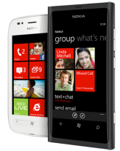


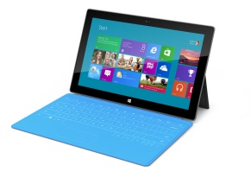
C#
Your App!
C#
Shared Architecture – MonoCross, MvvmCross, ReactiveUI, …
C#
Windows Phone SDK
(WP7)
Monotouch
(iOS)
MonoDroid
(Android)
Windows Store SDK
(Win8)
C#
C#
C#
C#

Slide 2
C#
Your App!
C#
WinPhone Adaption
MonoTouch Adaption
MonoDroid Adaption
Windows Store Adaption
C#
Windows Phone SDK
(WP7)
Monotouch
(iOS)
MonoDroid
(Android)
Windows Store SDK
(Win8)
C#
C#
C#
C#

