Slide 1
Schedule
9:15 Getting started
10:30 Break
10:45 Portable code
11:00 Mvvm and Cross Platform
12:15 Lunch
12:45 Mvvm and Cross Platform
14:15 Break
14:30 Real Apps
15:45 Break
16:00 “Advanced”

Slide 2
Please Tweet
#mvvmcross
#wpdev
#xamarin
#win8dev
@modernjago
@nokiadeveloper

Slide 3
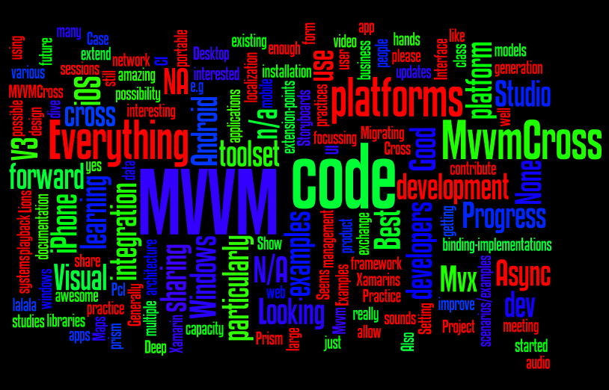

Slide 4
Schedule
9:15 Getting started
10:30 Break
10:45 Portable code
11:00 Mvvm and Cross Platform
12:15 Lunch
12:45 Mvvm and Cross Platform
14:15 Break
14:30 Real Apps
15:45 Break
16:00 “Advanced”

Slide 5
Please Tweet
#mvvmcross
#wpdev
#xamarin
#win8dev
@modernjago
@nokiadeveloper

Slide 6
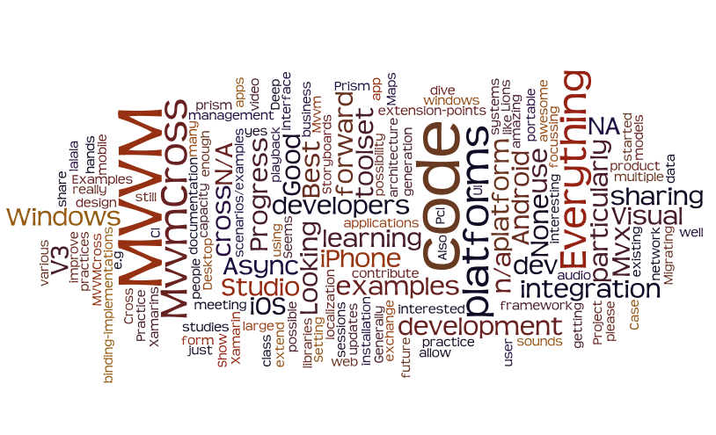

Slide 7
Schedule
9:15 Getting started
10:30 Break
10:45 Portable code
11:00 Mvvm and Cross Platform
12:15 Lunch
12:45 Mvvm and Cross Platform
14:15 Break
14:30 Real Apps
15:45 Break
16:00 “Advanced”

Slide 8
Please Tweet
#mvvmcross
#wpdev
#xamarin
#win8dev
@modernjago
@nokiadeveloper

Slide 9
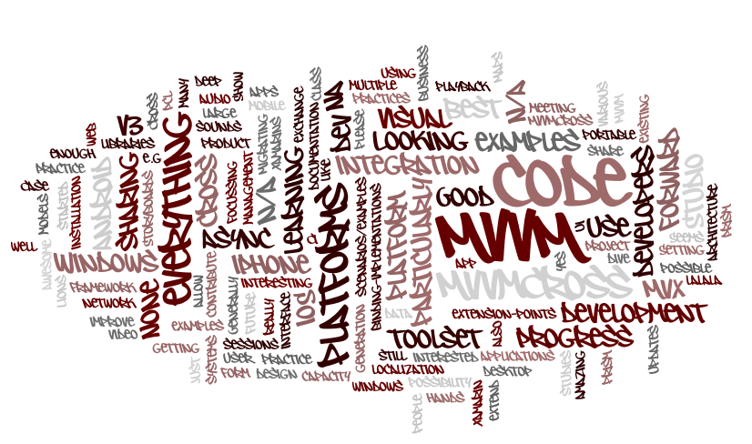

Slide 10
Schedule
9:15 Getting started
10:30 Break
10:45 Portable code
11:00 Mvvm and Cross Platform
12:15 Lunch
12:45 Mvvm and Cross Platform
14:15 Break
14:30 Real Apps
15:45 Break
16:00 “Advanced”

Slide 11
Please Tweet
#mvvmcross
#wpdev
#xamarin
#win8dev
@modernjago
@nokiadeveloper

Slide 12
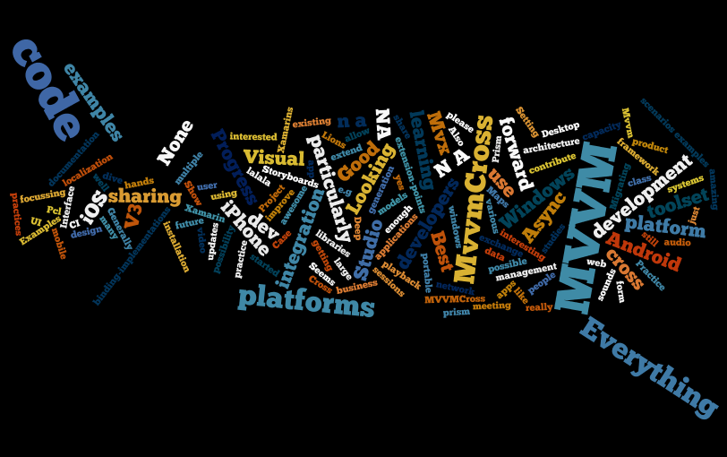

Slide 13
Schedule
9:15 Getting started
10:30 Break
10:45 Portable code
11:00 Mvvm and Cross Platform
12:15 Lunch
12:45 Mvvm and Cross Platform
14:15 Break
14:30 Real Apps
15:45 Break
16:00 “Advanced”

Slide 14
Please Tweet
#mvvmcross
#wpdev
#xamarin
#win8dev
@modernjago
@nokiadeveloper

Slide 15
