Slide 1

App Start

Slide 2
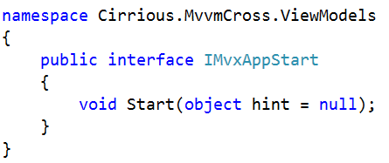
IMvxAppStart

Slide 3
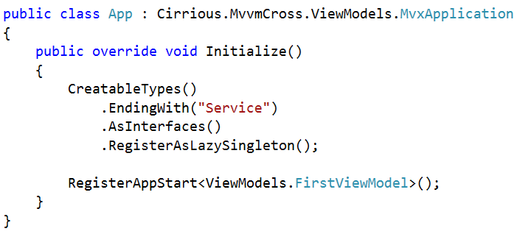
Simple Starts

Slide 4
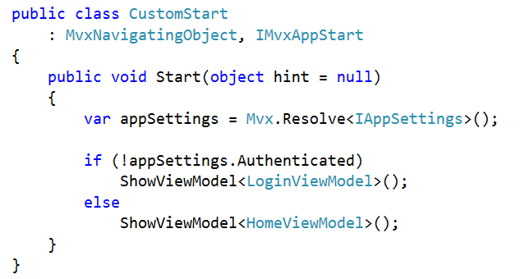
Conditional Starts

Slide 5

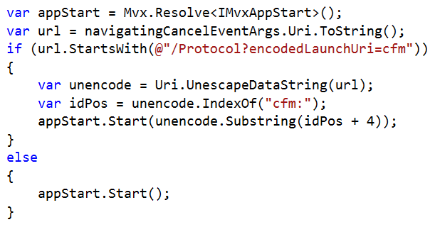
Protocol Starts (Deep Links)
Parse the protocol hint… e.g.

Slide 6
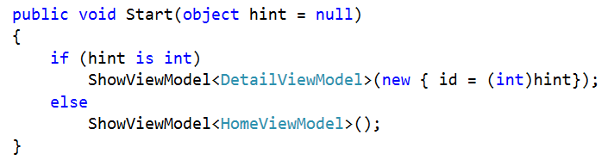
Protocol Starts (Deep Links)
Use the parsed protocol hint:

